Slide 1
Victron Energy Battery System for
R/V Paragon
Chad Kecy
Jan. 10, 2023

Slide 2
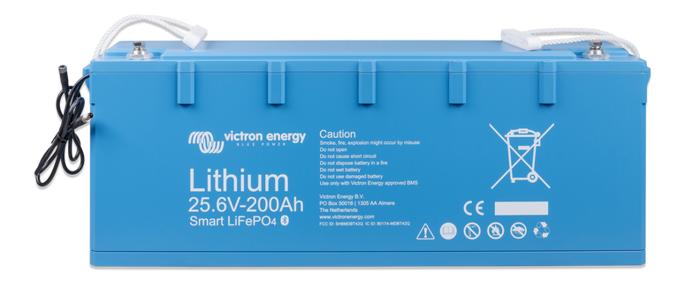
LFP-Smart 25.6V/200aH Battery
Chemistry: Lithium Iron Phosphate
Dimensions: H=237mm (9.3”), W=650mm (25.6”), D=163mm (6.4”)
Weight: 39kg (86 lbs)
Two in series for 48V nominal bus

Slide 3
LFP-Smart 25.6V/200aH Battery
Voltage: 25.6Vdc
Capacity: 200 Amp-Hours
Energy: 5120 Watt-Hours
Discharge Current: 200A (max-rec), 400A (abs-max)
Charge Current: 100A (max-rec), 400A (abs-max)
Internal BMS
  Pre-alarm when cell voltages reach user defined voltage (signal can feed a visual or audible alarm device)
  Disconnect the load when cell voltages reach user defined voltage
  Disconnect the charger when cell voltages reach 3.75V (or temp is too high)
Integrated cell monitoring and balancing
  Attached data cables allow batteries to be daisy chained and info fed to an external Battery Monitor Unit
Bluetooth enabled
  Cell voltages, temperatures, and alarm status can be monitored
  VictronConnect App for phones and smart-devices

Slide 4
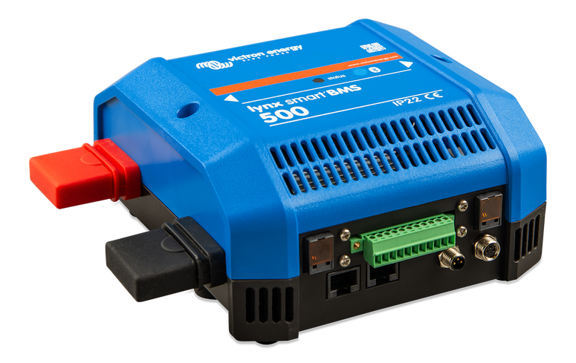
Lynx Smart BMS
Dedicated Battery Management System
Contains
  Positive & Negative bus bars
  Battery Management circuitry
  Contactor
  Battery Monitor

Slide 5
Lynx Smart BMS
Battery Management System
  Monitors State of Charge (SoC) and user-defined Discharge Floor determines when to cutoff discharge to prevent damage to batteries
  ATC/ATD (Allow to Charge/Allow to Discharge) outputs control Smart Battery Protect modules to control charge and discharge paths
  Programmable pre-alarm outputs for visual/audio indicators
Contactor
  Secondary safety contacts in the event ATC/ATD outputs fail
System Communication
  Via Bluetooth and VE.Can to GX devices
Battery Monitor
  Built in shunt is used to monitor input/output current to/from batteries

Slide 6
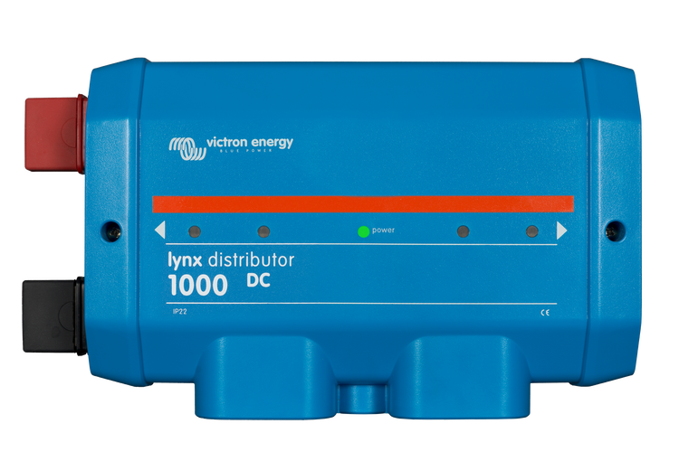
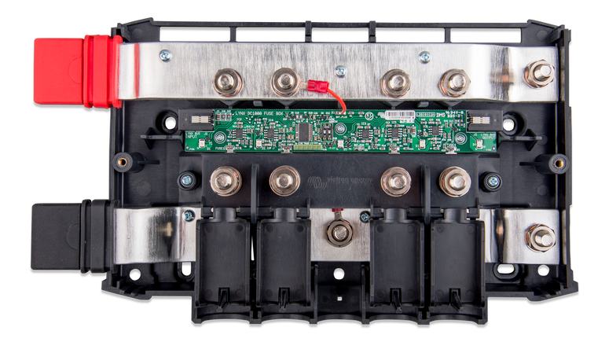
Lynx Distributor
Plugs into Lynx Smart BMS
Has 4 fused connections to loads or batteries
Daisy chained RJ10 cables provide fuse status feedback

Slide 7
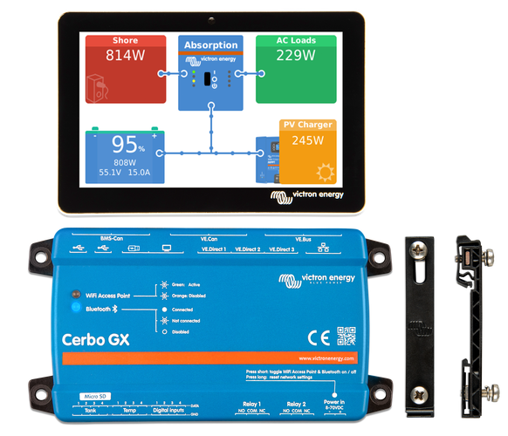
Cerbo GX & Touchscreen
All system components attach to Cerbo GX
Acts as a Communications Center
  Victron Remote Management (VRM) via the internet over LAN or WiFi
  VictronConnect App over Bluetooth
  Cellular networks (3G & 4G)
  Direct access via GX Touch (touchscreen)
Two SPDT relays available for external devices
Can accept auxiliary inputs
  Temperature sensors
  Tank level inputs
  User defined digital inputs
NMEA 2000 GPS compatible

Slide 8
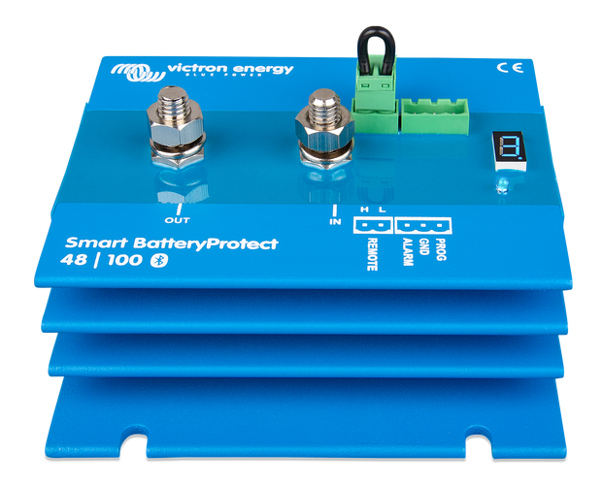
Smart Battery Protect 48V/100A
Primary contactor for loads & chargers
  Used with SmartBMS ATD & ATC signals
Uses MOSFETs not electro-mech relays
Alarm output
  LED
  Buzzer
  External relay
Bluetooth enabled

Slide 9
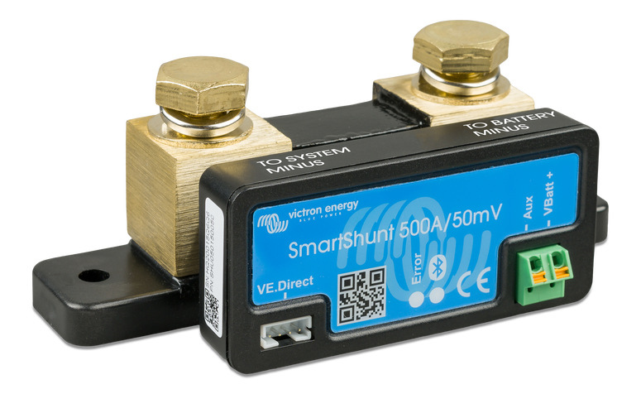
Smart Shunt IP65
Current monitor for individual outputs
  500A, 1000A, and 2000A versions
Communications
  VE.Direct for GX devices
  Bluetooth for Victron App on phone
Aux input
  2nd battery
  Mid-point connection on battery bank
  Temperature

Slide 10
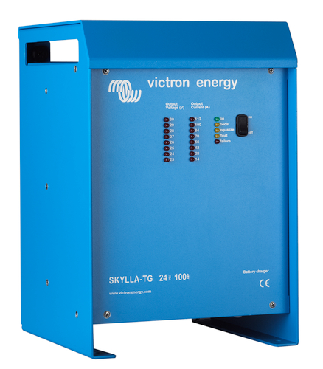
Skylla 48/25 TG Charger
Fully automated charger
  Microprocessor controlled with 3-step charging (Boost, Equalize, Float)
  Continually monitors battery voltage/current
  Voltage sense compensates for i2r losses
Powered from single phase 220 Vac (45-65Hz)
Temperature compensation
  Will automatically decrease charging voltage with increased battery temperature
Mechanical Info
  H=365mm (14.4”), W=250mm (9.8”), D=257mm (10.1”)
  Weight = 10kg (22 lbs)

Slide 11
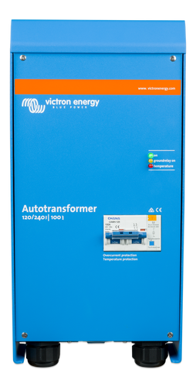
Autotransformer 120V:240V
Configurable
  Step-Up
  Step-Down
  Phase Balancing
32A and 100A versions
Temperature Protection
Mechanical Info
  H=424mm (16.7”), W=214mm (8.4”), D=110mm (4.3”)
  Weight = 12.5kg (28 lbs)

Slide 12
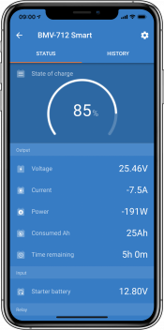
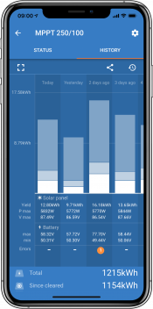
VictronConnect App
Operating Systems
  Android
  iOS
  Windows
  macOS X
Communcation
  Bluetooth
  USB
  Internet/LAN/WiFi
Features

Slide 13
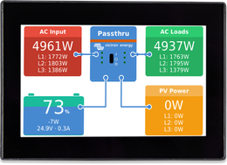
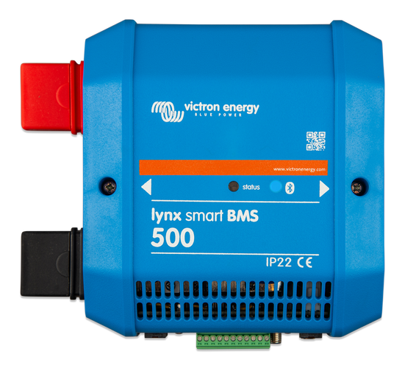
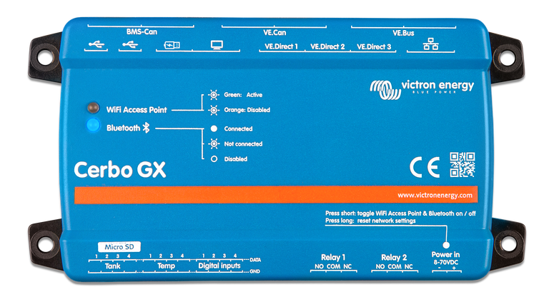
Lynx Interconnected System

Slide 14
Alternator Addition Option
Victron parts do not support charging 48V batteries
Would need a 12V:48V DC-DC Converter (Lots of electric noise)

Slide 15
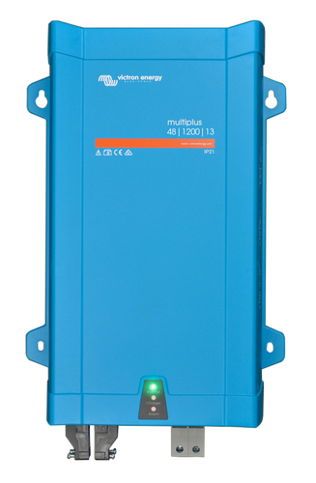
Alternator Addition Option
MultiPlus 48V/1600VA Inverter/Charger
Charger Only Mode
  Generates 230VAC from Paragon Alternator (12Vdc)
  Has both an AC input and output
  The generated AC can feed it’s own Charger (48Vdc output)
Temperature compensation
  Will automatically decrease charging voltage with increased battery temperature
Mechanical Info
  H=470mm (18.5”), W=265mm (10.4”), D=120mm (4.7”)
  Weight = 10kg (22 lbs)

Slide 16
Estimated Victron System Cost (Q1 2023)
 |  |  | (Euros) | (Euros)
Description | Victron PN# | Quan | Unit Price | Item Price
Skylla-TG 48/25 Charger | SDTG4800251 | 1 | 1041 | 1041
Autotransformer 120/240VAC-32A | ITR000100001 | 1 | 674 | 674
MultiPlus 48/1600/20-16 | PMP482160000 | 1 | 959 | 959
Lynx Smart BMS 500 | LYN034160200 | 1 | 1070 | 1070
Lynx Distributor | LYN060102000 | 3 | 250 | 750
Busbar 150A 2P with 10 Screws + Cover | VBB115021020 | 2 | 44 | 88
Battery Switch 275A | VBS127010010 | 3 | 39 | 117
MIDI Single Fuse Holder | CIP000050001 | 1 | 10 | 10
MIDI 30A, 40A, 50A 48V Rated Fuse | TBD | 10 | 12 | 120
MIDI 60A, 80A, 100A 48V Rated Fuse | TBD ? | 10 | 14 | 140
MEGA Single Fuse Holder | CIP000100001 | 1 | 13 | 13
MEGA 125A 48V Rated Fuse | CIP137125010 | 15 | 33 | 495
MEGA 200A 48V Rated Fuse | CIP137200010 | 15 | 33 | 495
Cerbo GX | BPP900450100 | 1 | 382 | 382
GX Touch 70 | BPP900455070 | 1 | 382 | 382
GX Touch 70 Wall Mount | BPP900465070 | 1 | 35 | 35
Smartshunt 500A/50mV | SHU050150050 | 2 | 146 | 292
Smart Battery Protect 48V-100A | BPR110048000 | 3 | 171 | 513
Smart Battery LiFePO4 25.6V/200Ah | BAT524120610 | 2 | 4400 | 8800
Cable: Batt BMS M-F Extender 5m (quan 2) | ASS030560500 | 1 | 50 | 50
Cable: VE.Direct 5m (other lengths avail) | ASS030530250 | 2 | 18 | 36
Cable: ShorePower for Charger | TBD | 1 | 500 | 500
 |  |  |  | 0
 |  |  | Euros | 16962
Euro : US Dollar | 1.05 |  | US Dollars | $17,810
 |  |  | Est Tax | $1,736
 |  |  | Shipping | $500
 |  |  | Total | $20,047

Slide 17
Solar Panel Addition Option
SmartSolar Charge Controller (MPPT 150/100-Tr VE.Can)
  48V, upto 100A 5800W
  Up to 98% Efficiency
  Wired comms: VE.Can and VE.Direct
  Bluetooth comms
  Cost: $950
BlueSolar Monocrystalline Solar Panels
  Multiple sizes/wattages available
    Smallest: 17” x 13”, Largest: 78” x 39”
  Cost: $42-$370 per panel

