Slide 1

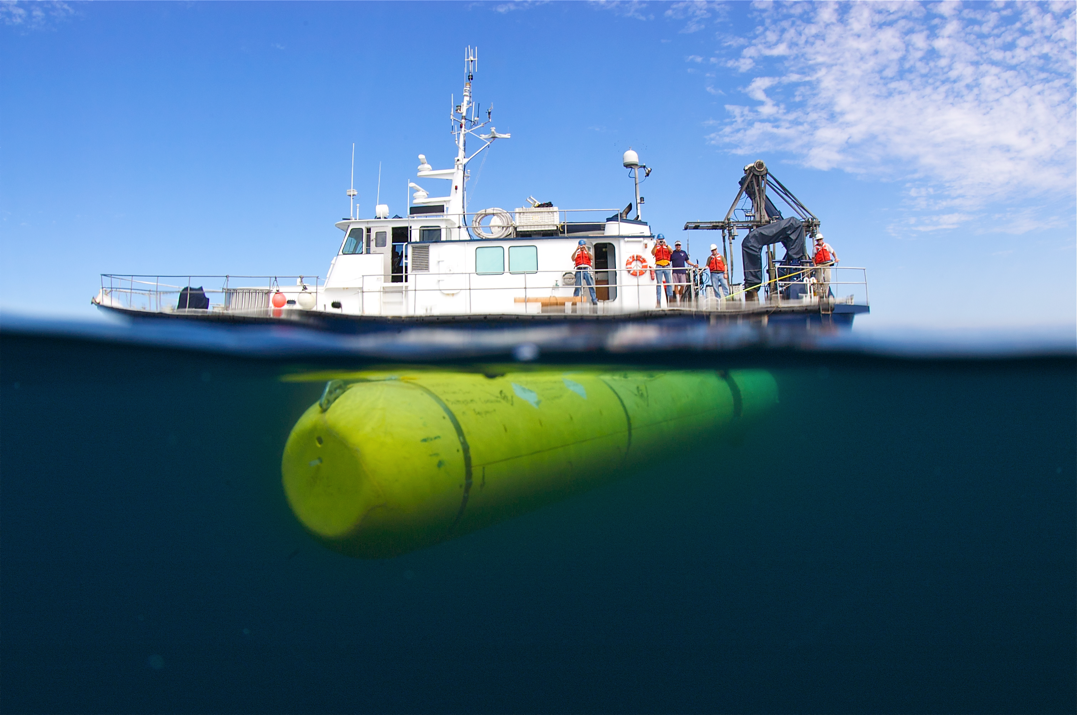
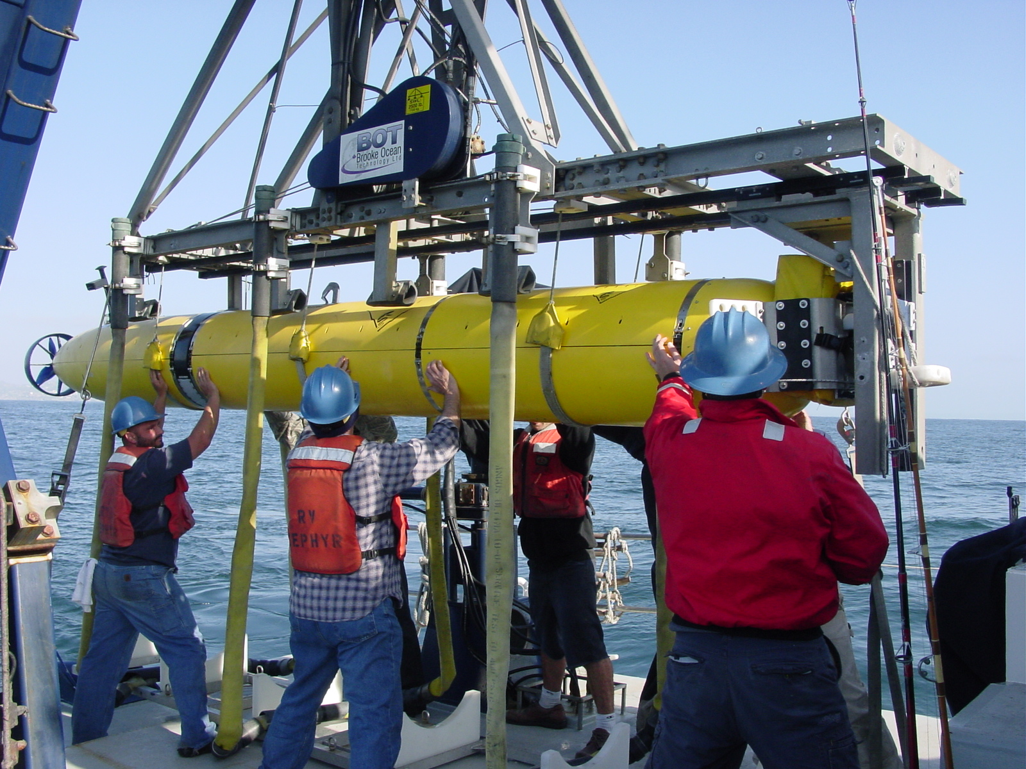
2011 MBARI Mapping AUV Surveys of Slumps, Scours, Gas Seeps, and Spreading Centers
Monterey Bay
  Tubeworm Slump
  San Gregorio Fault (2)
Northern Expedition – Eel River
  Eel Canyon
  Eel Canyon gas seep (2)
  Eel Slump gas seep (2)
  Giant Scours (2)
Northern Expedition – Juan de Fuca Ridge
  Endeavour Ridge (3)
  Axial Pond
  Axial Seamount resurvey (2)

Slide 2
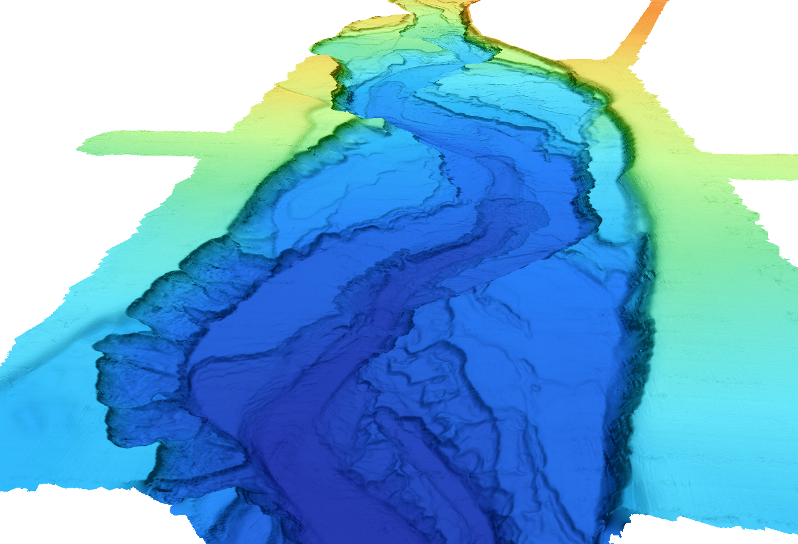
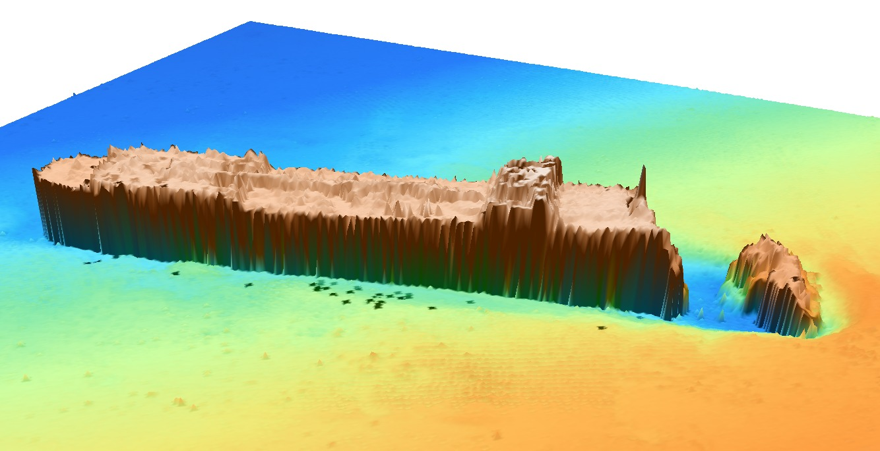
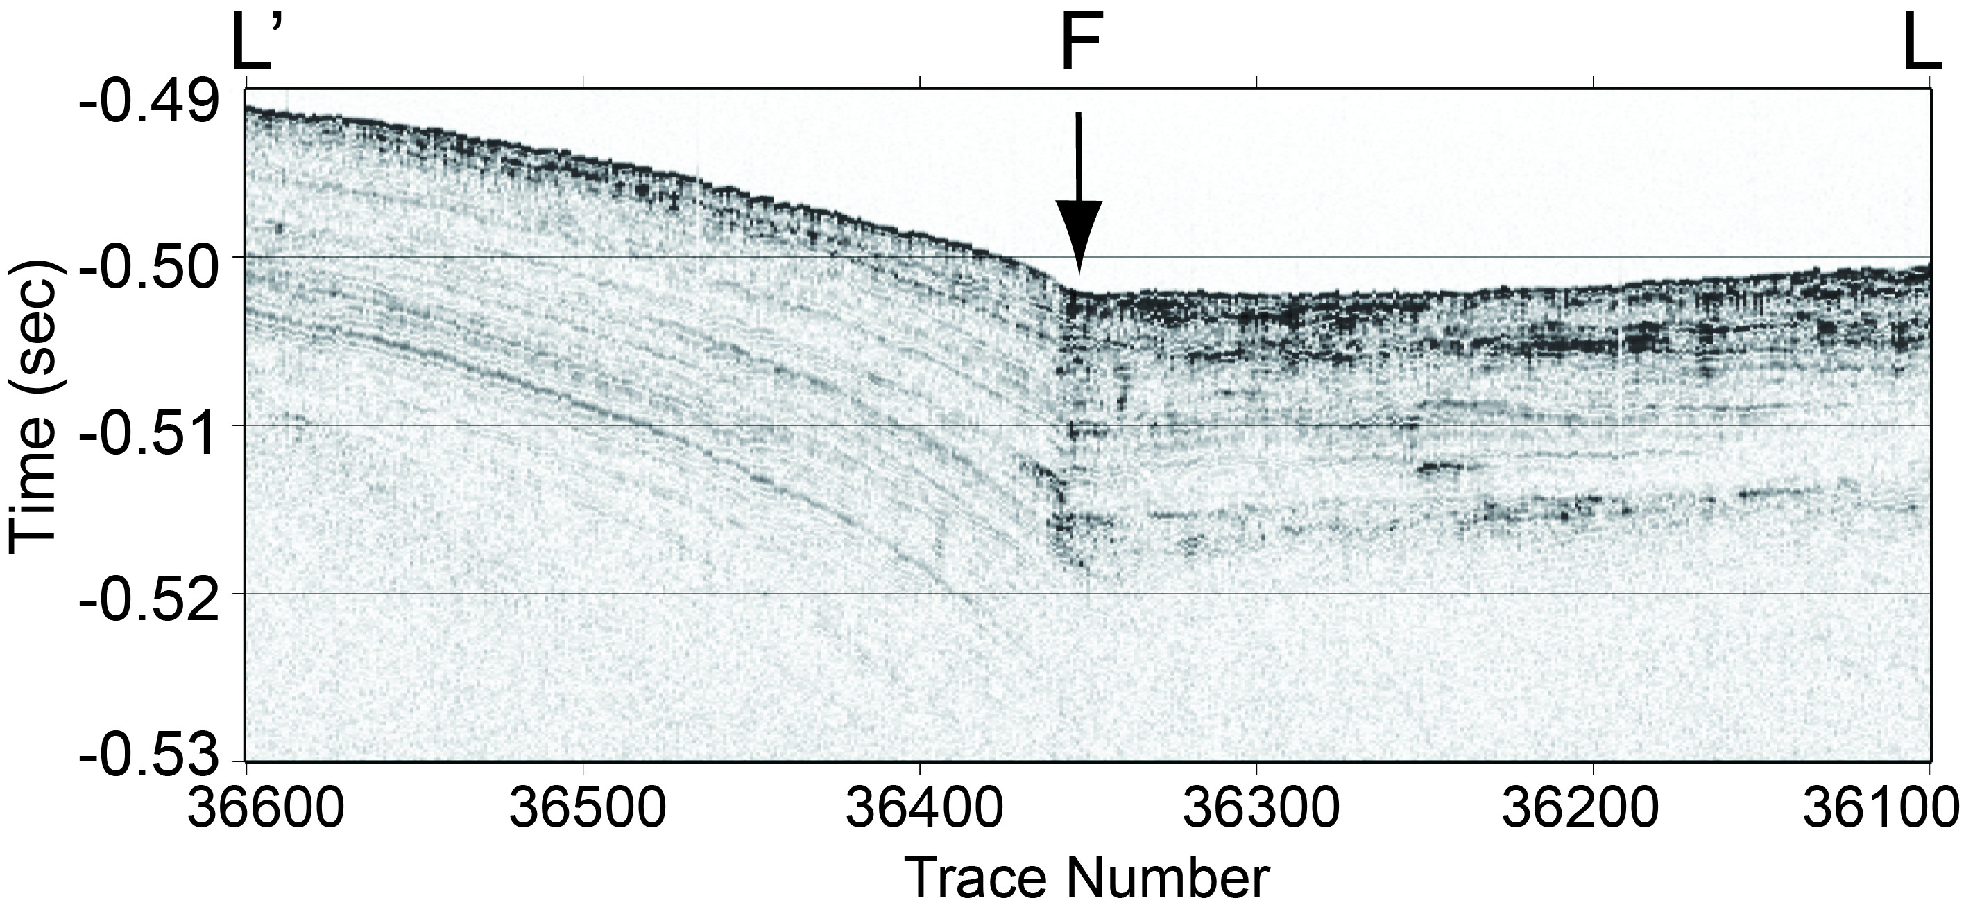
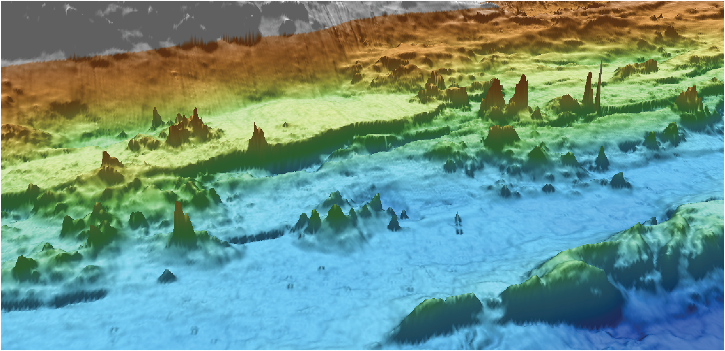
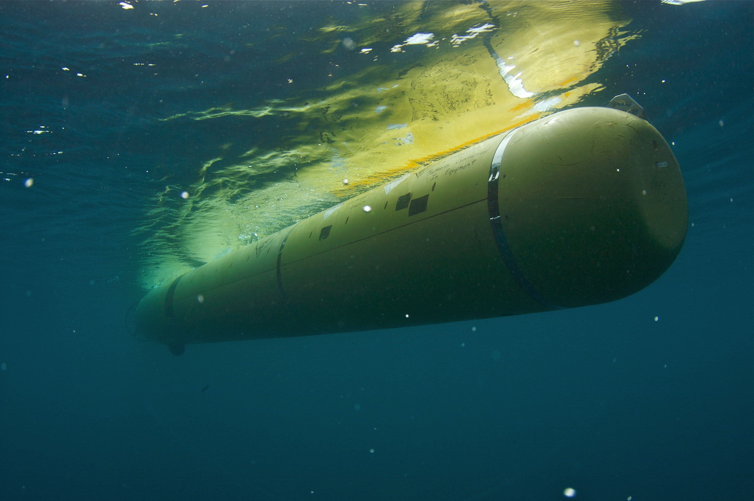
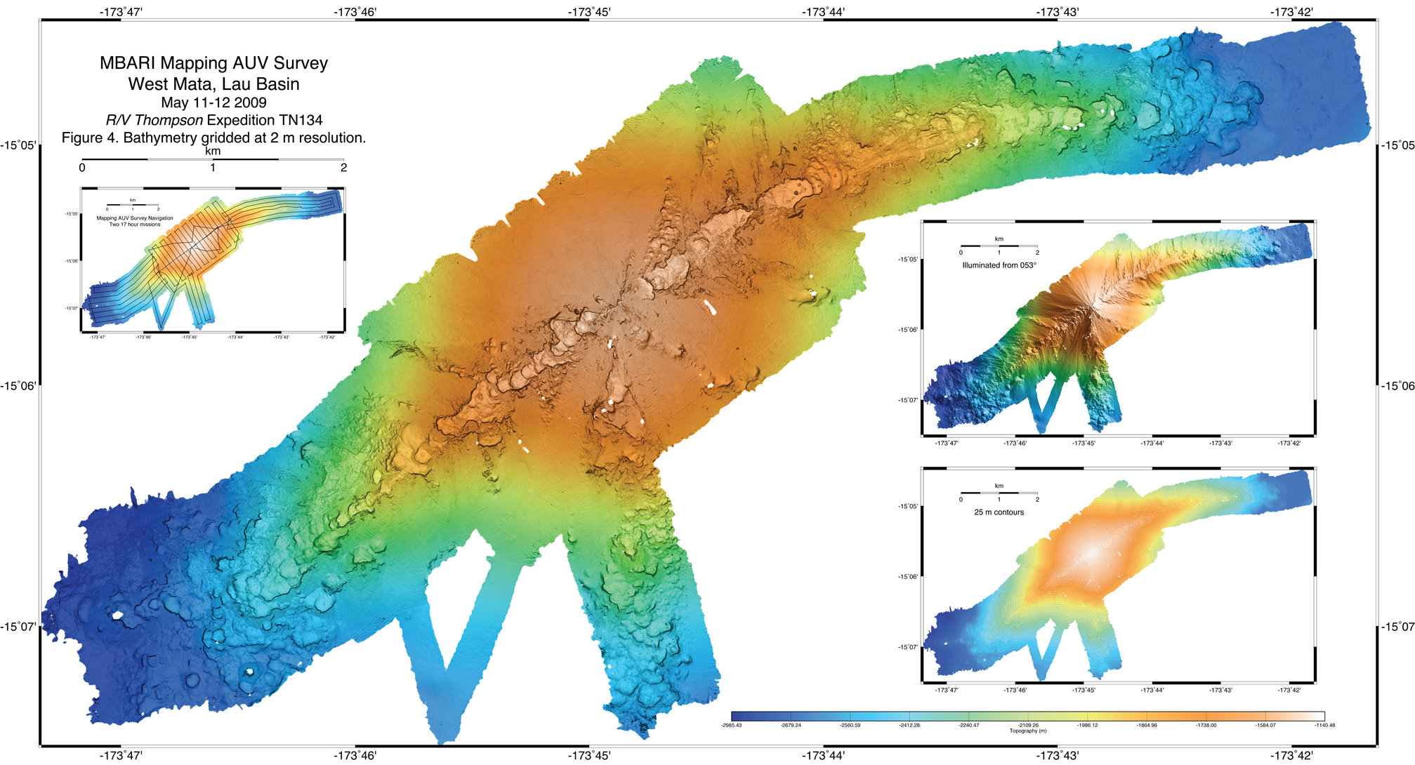
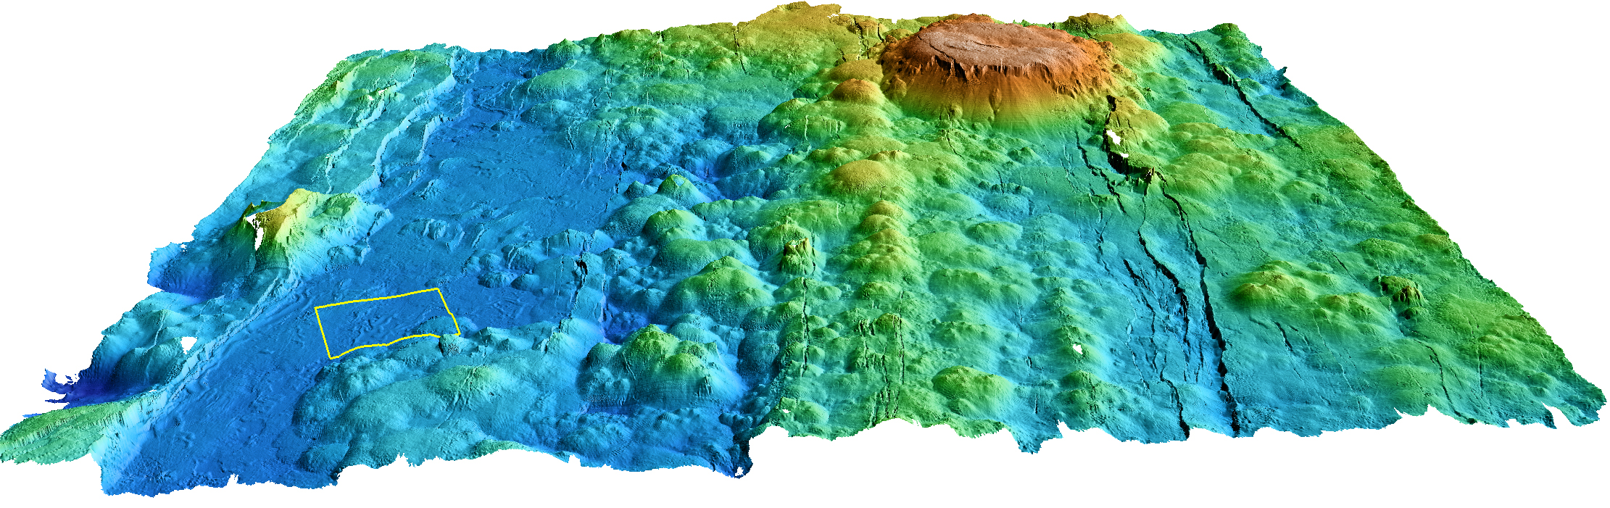
132 Successful Mapping AUV Survey Missions Since 2006…..
  Submarine Canyons: 44 missions
  Seamounts: 11 missions
  Hydrates: 14 missions
  Spreading Centers: 28 missions
  Lau Basin: 3 missions
  Offshore fault zones: 8 missions
  Fan systems: 14 missions
  Slumps: 2 missions
  Shipwrecks: 3 missions
  Cable routes: 3 missions

Slide 3
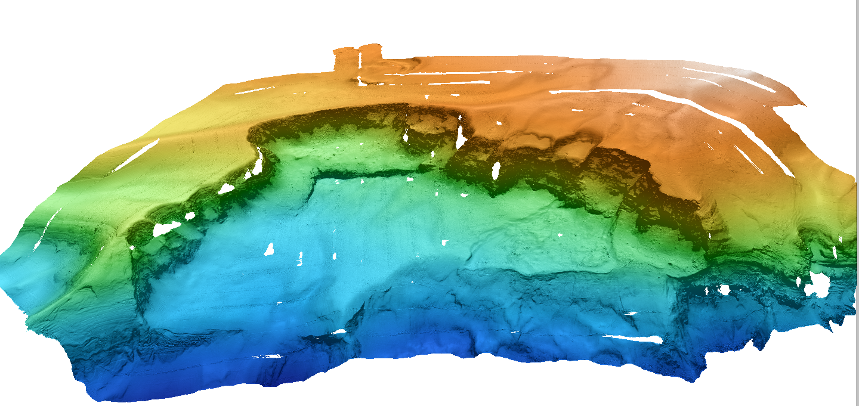
Tubeworm Slump
Previously known chemosynthetic communities
Challenging surveys due to extreme topography
’

Slide 4
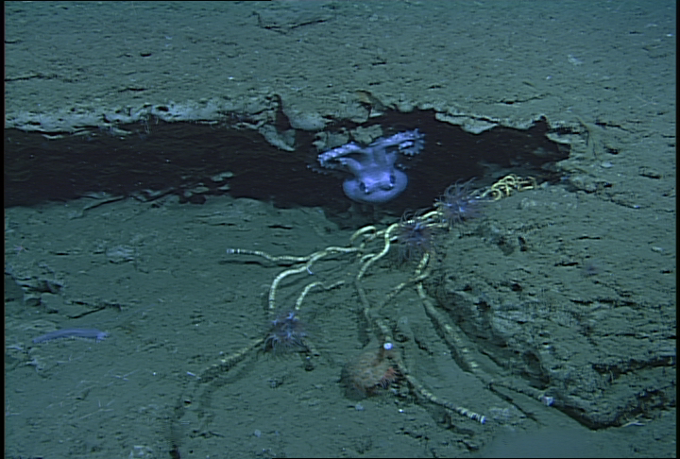
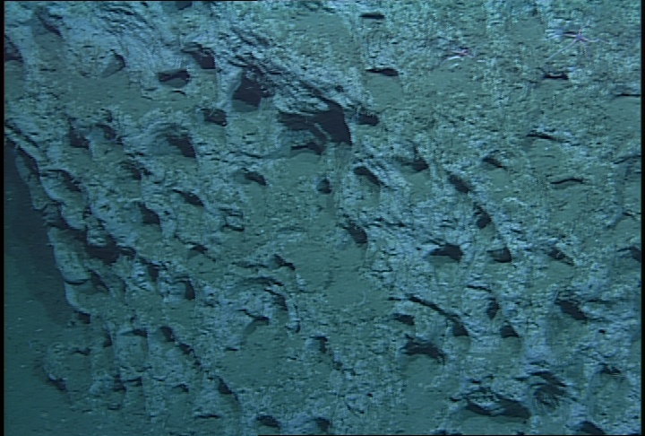
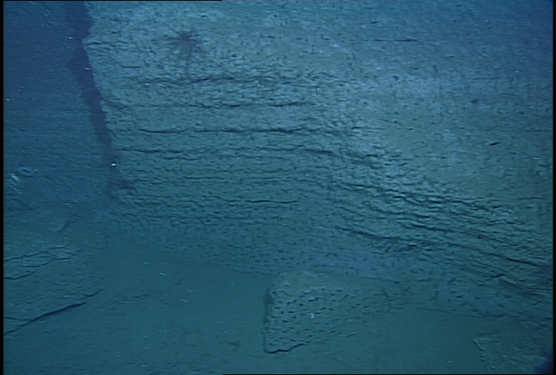
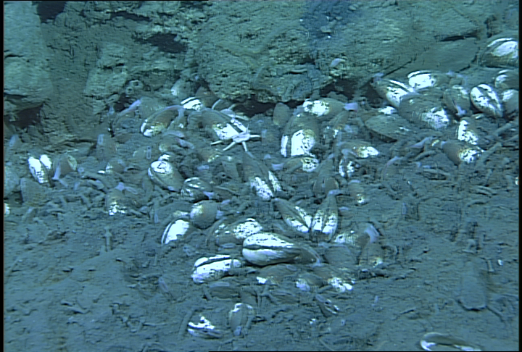
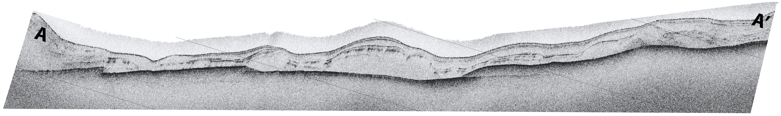
A’
A

Slide 5
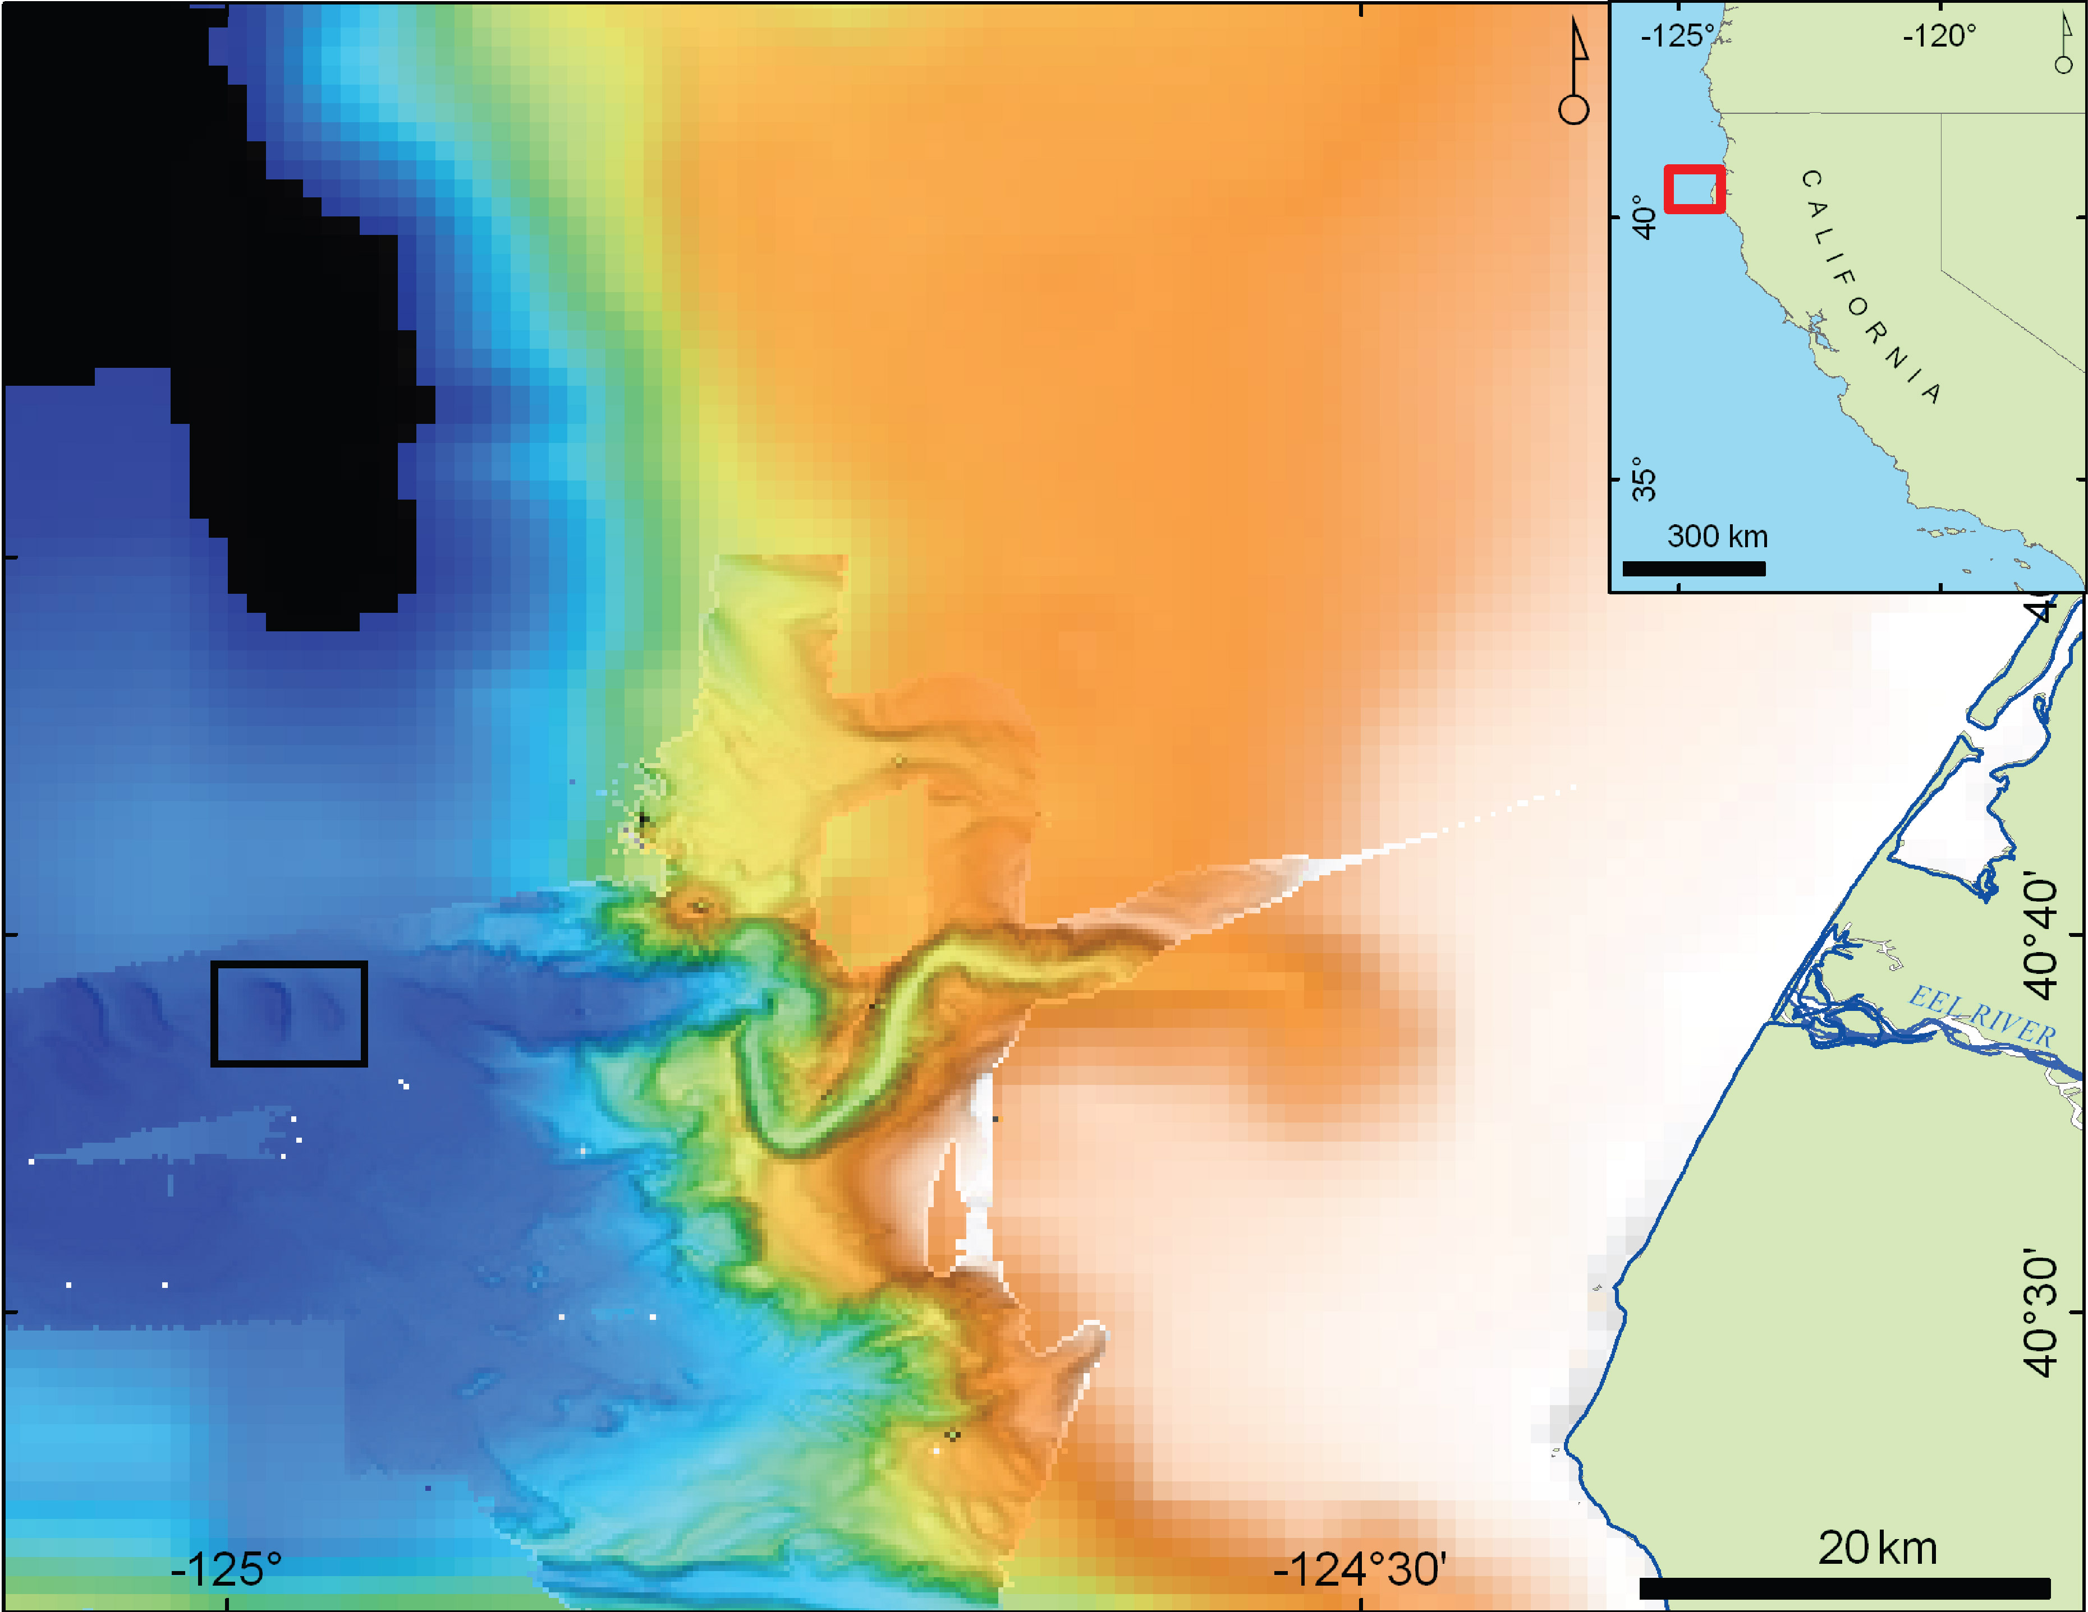
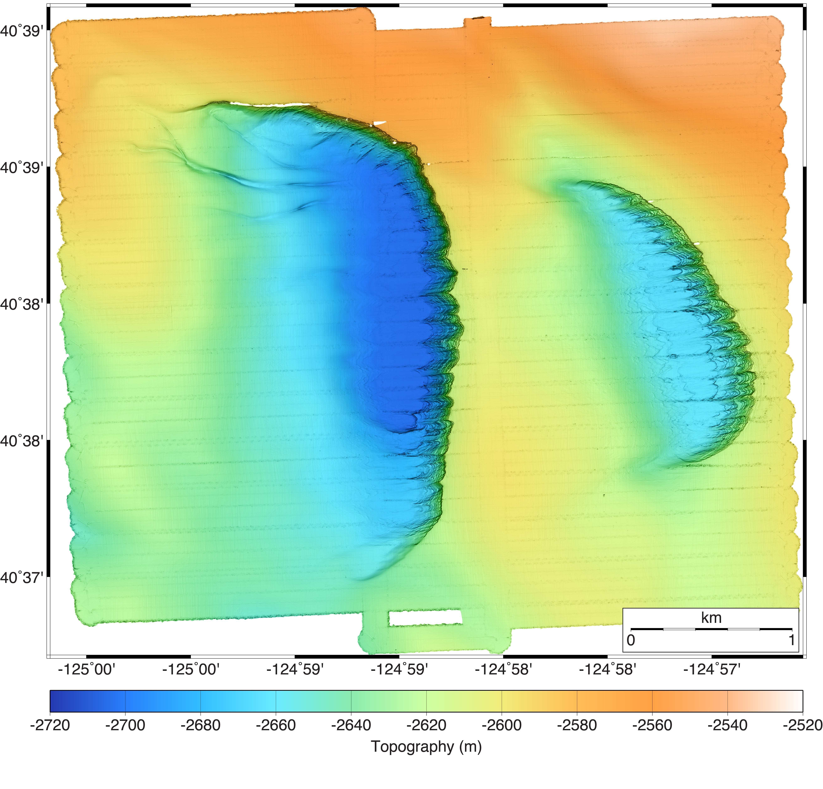
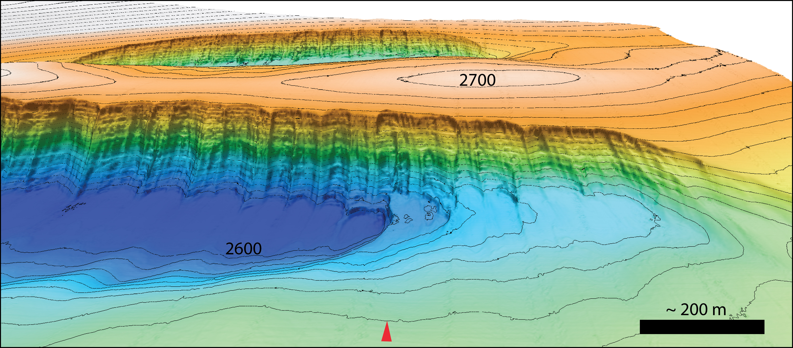
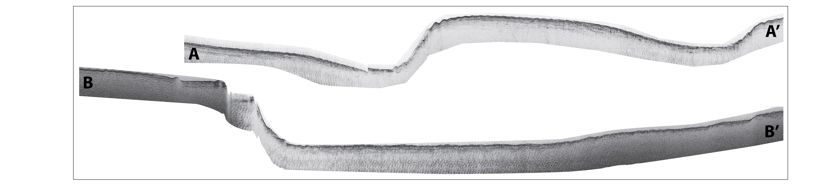
B
Eel River Canyon Scours
A
A’
’
B’

Slide 6
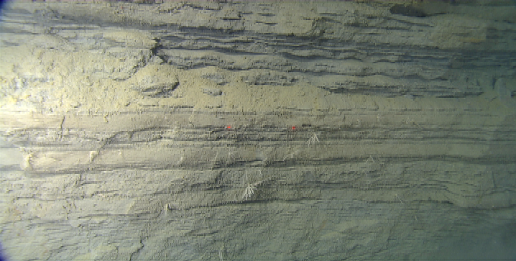
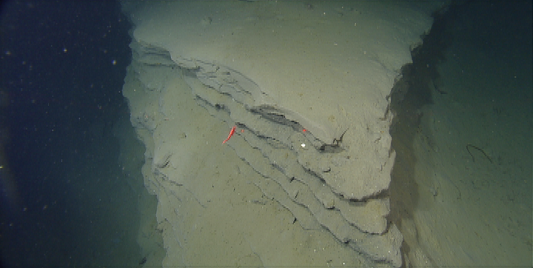
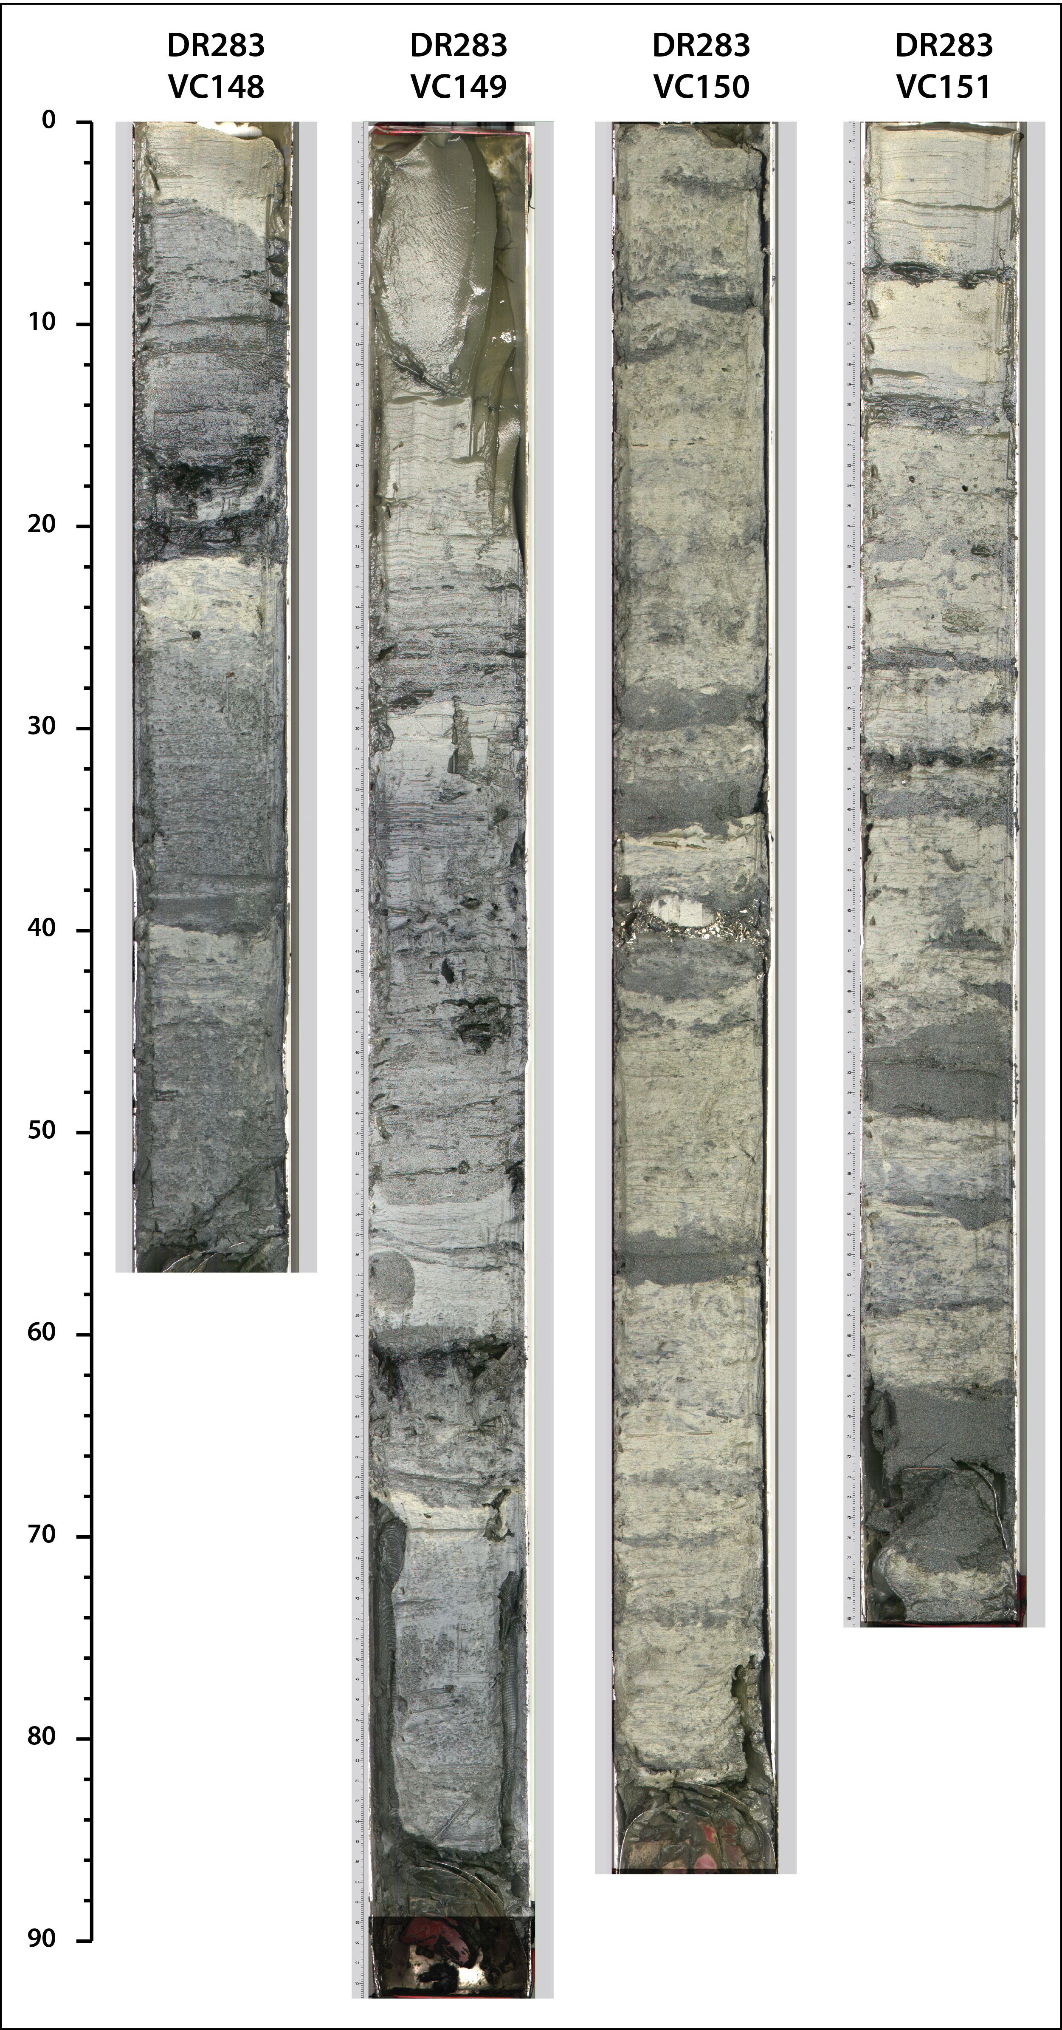
’

Slide 7
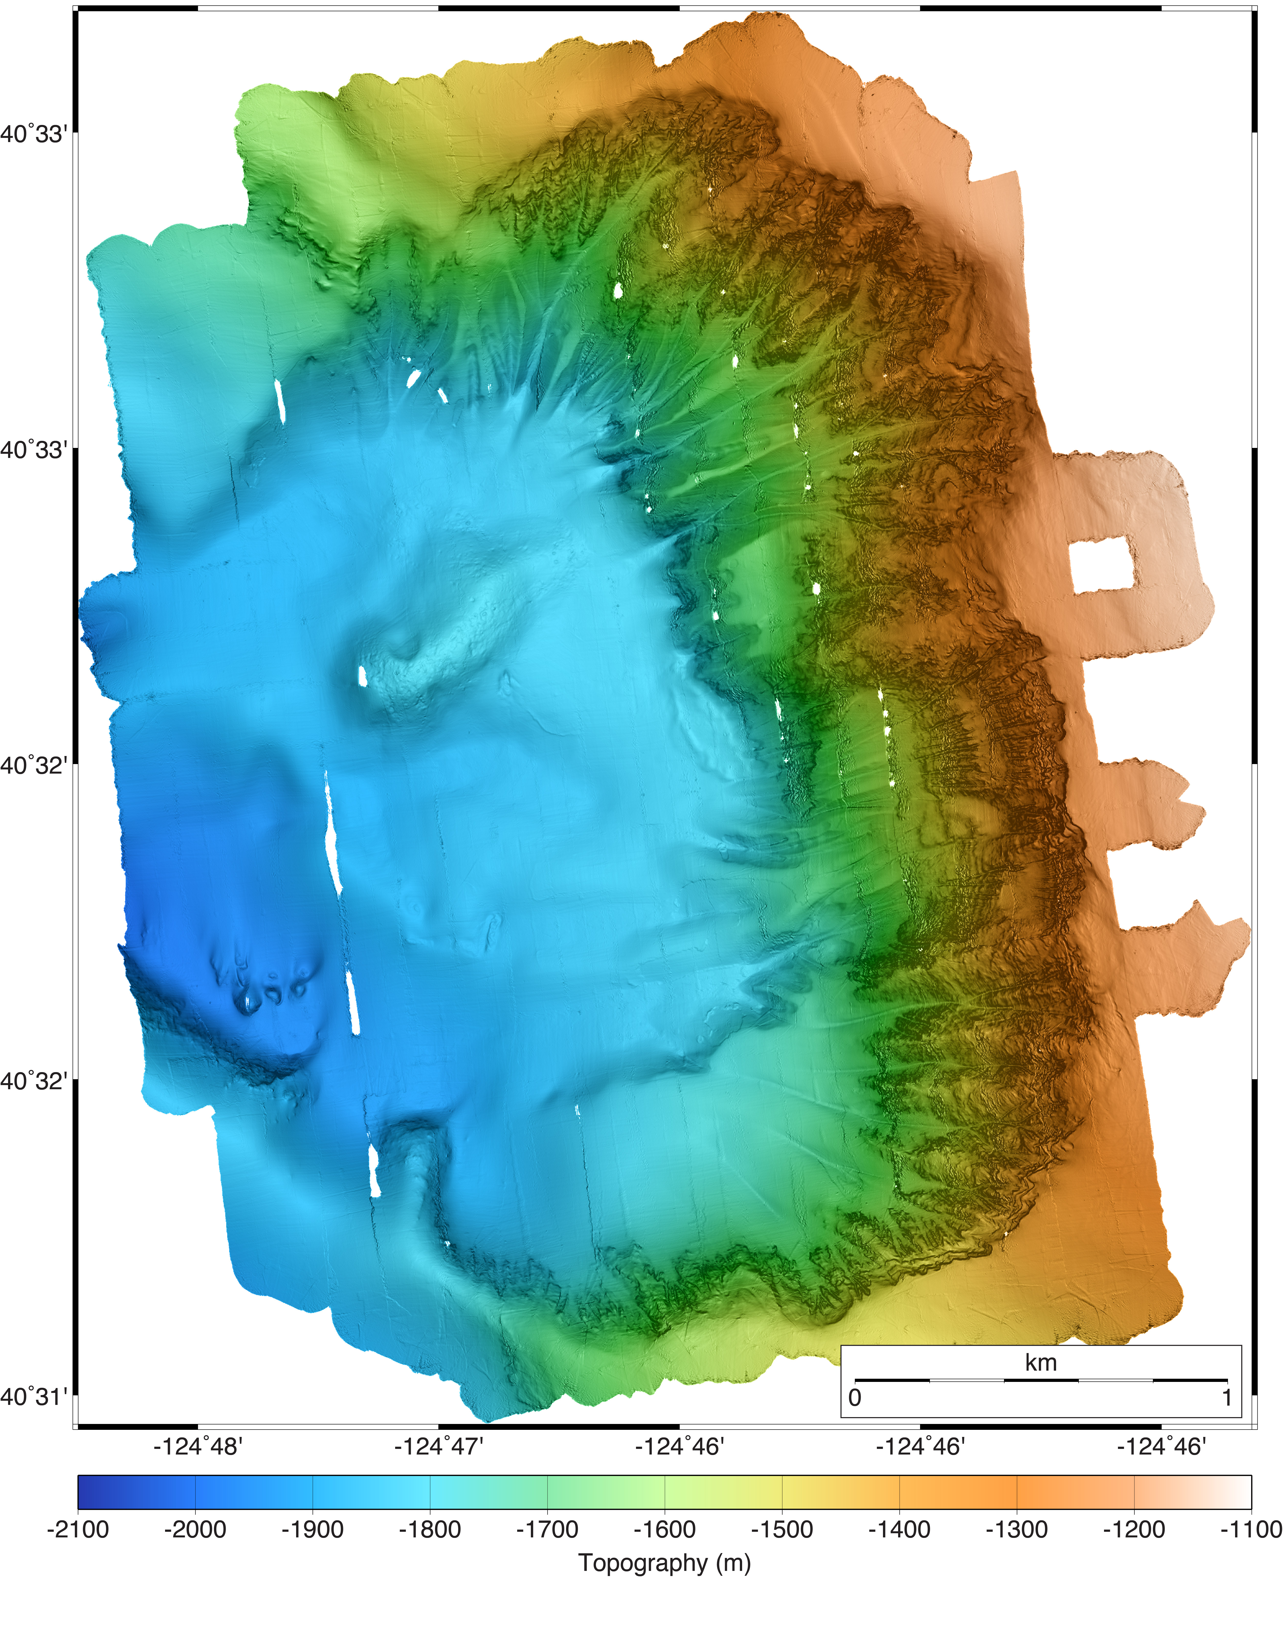
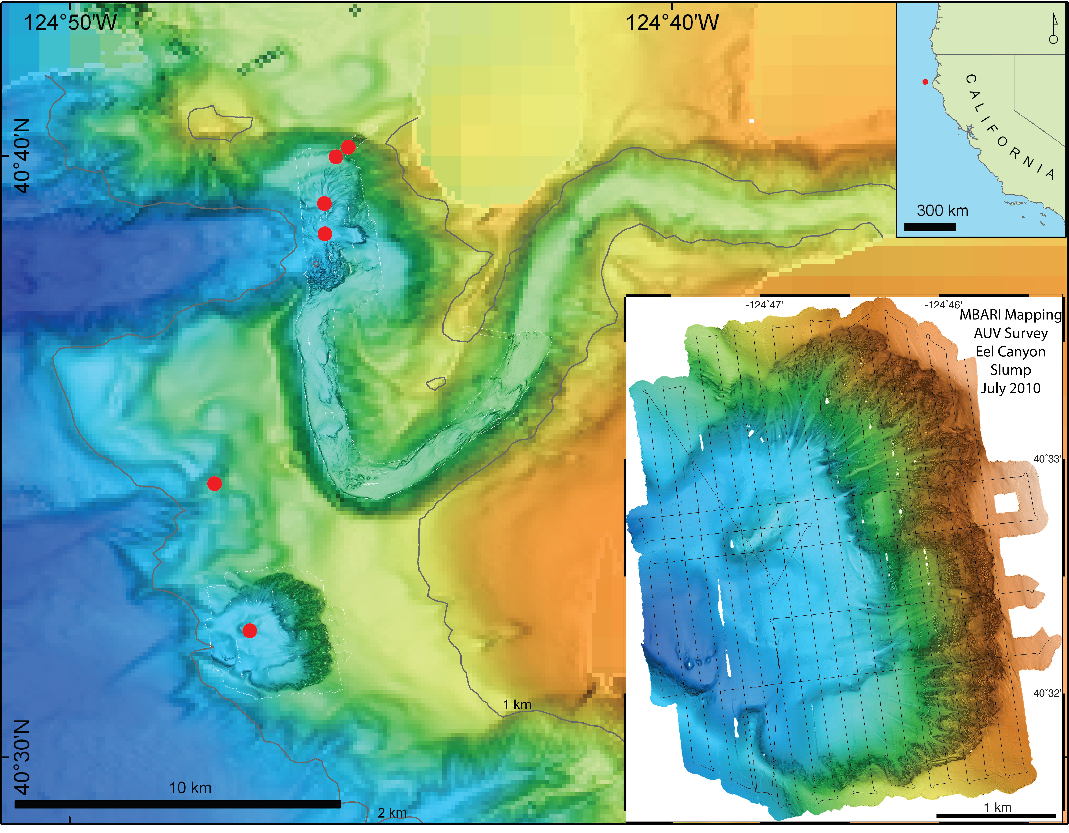
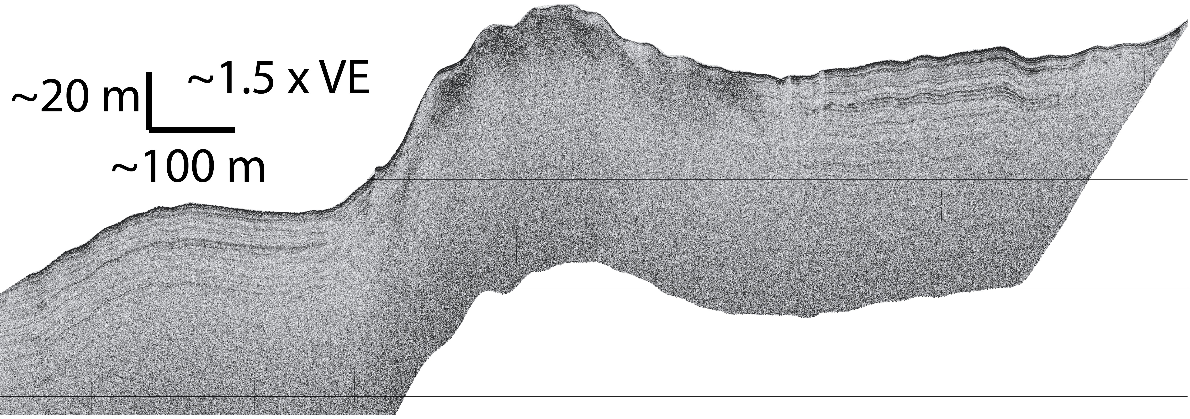
Eel River Slump gas seep site
Gas seeps discovered by NOAA in 2009, presumed associated with subsurface hydrates
Morphology and subsurface structure similar to MBARI AUV and ROV observations in Santa Monica Basin, Hydrate Ridge, Bullseye Vents, Barkeley Canyon
A’
A
A
A’
Notes:
Axial Seamount Repeat Mapping
Following reports of a recent eruption on Axial Seamount (discovered by NOAA/WHOI ROV dives), Leg 4 of R/V Zephyr’s Northern Expedition was repurposed in a matter of hours to achieve the first high resolution measurements of lava flow thickness on the seafloor.
The Axial Seamount summit was previously surveyed by the Mapping AUV during 2006-2009 expeditions.
The new surveys were planned by David Caress (in airports and in San Diego) and David Clague (on R/V Western Flyer) using new data from Bill Chadwick (on R/V Thompson) and transmitted to Hans Thomas on R/V Zephyr for execution.
The first reports came on July 31. The surveys were conducted on August 2 and 4.
Initial data were processed and transferred to the Western Flyer on August 3 to guide an August 4 ROV Ricketts dive on the new flows.

Slide 8
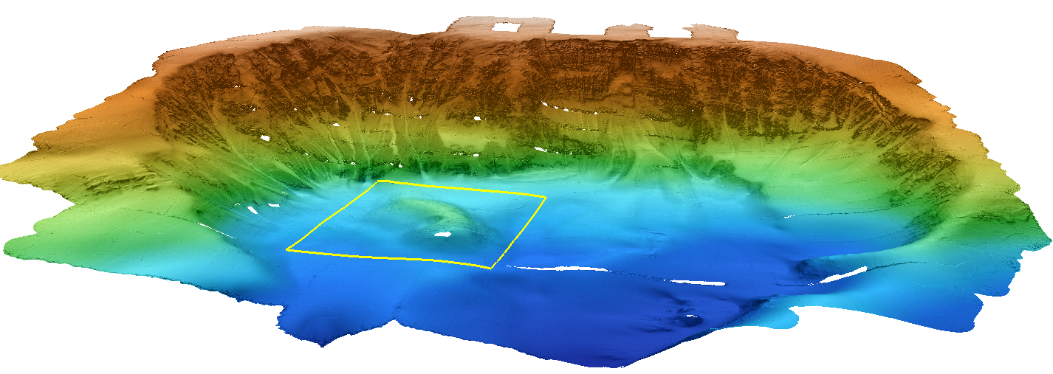
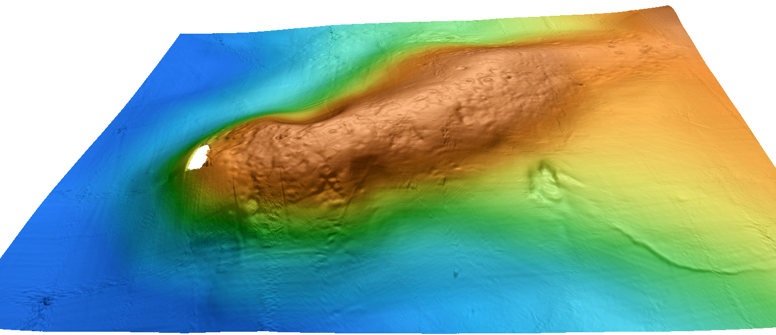
Notes:
Axial Seamount Repeat Mapping
Following reports of a recent eruption on Axial Seamount (discovered by NOAA/WHOI ROV dives), Leg 4 of R/V Zephyr’s Northern Expedition was repurposed in a matter of hours to achieve the first high resolution measurements of lava flow thickness on the seafloor.
The Axial Seamount summit was previously surveyed by the Mapping AUV during 2006-2009 expeditions.
The new surveys were planned by David Caress (in airports and in San Diego) and David Clague (on R/V Western Flyer) using new data from Bill Chadwick (on R/V Thompson) and transmitted to Hans Thomas on R/V Zephyr for execution.
The first reports came on July 31. The surveys were conducted on August 2 and 4.
Initial data were processed and transferred to the Western Flyer on August 3 to guide an August 4 ROV Ricketts dive on the new flows.

Slide 9
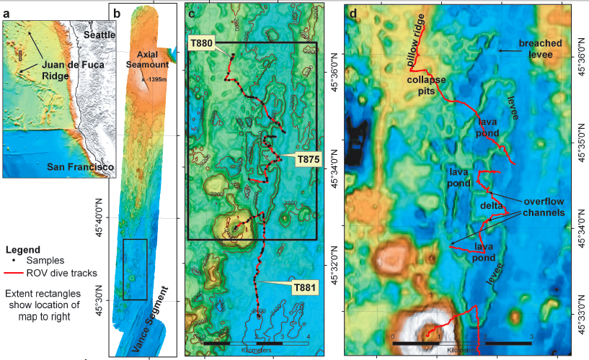
Axial Pond Area:
80 m high drained lava ponds along the south rift of Axial Seamount
Mapped in 1998 with EM300
Notes:
Axial Seamount Repeat Mapping
Following reports of a recent eruption on Axial Seamount (discovered by NOAA/WHOI ROV dives), Leg 4 of R/V Zephyr’s Northern Expedition was repurposed in a matter of hours to achieve the first high resolution measurements of lava flow thickness on the seafloor.
The Axial Seamount summit was previously surveyed by the Mapping AUV during 2006-2009 expeditions.
The new surveys were planned by David Caress (in airports and in San Diego) and David Clague (on R/V Western Flyer) using new data from Bill Chadwick (on R/V Thompson) and transmitted to Hans Thomas on R/V Zephyr for execution.
The first reports came on July 31. The surveys were conducted on August 2 and 4.
Initial data were processed and transferred to the Western Flyer on August 3 to guide an August 4 ROV Ricketts dive on the new flows.

Slide 10
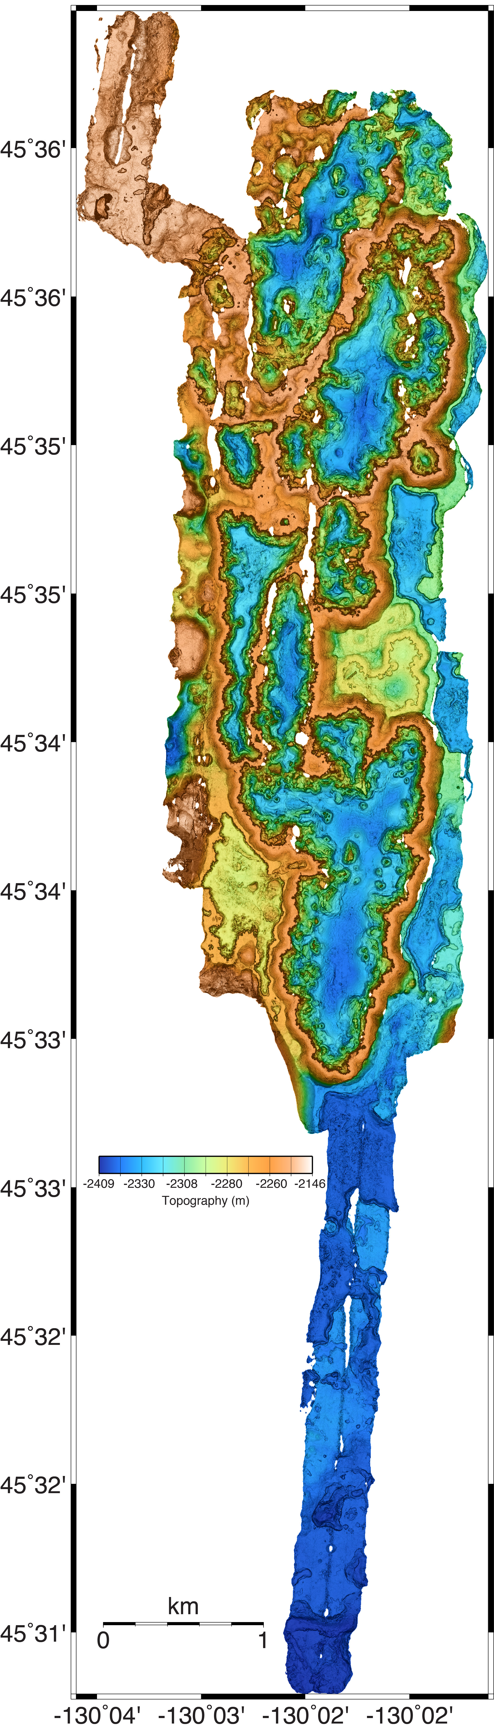
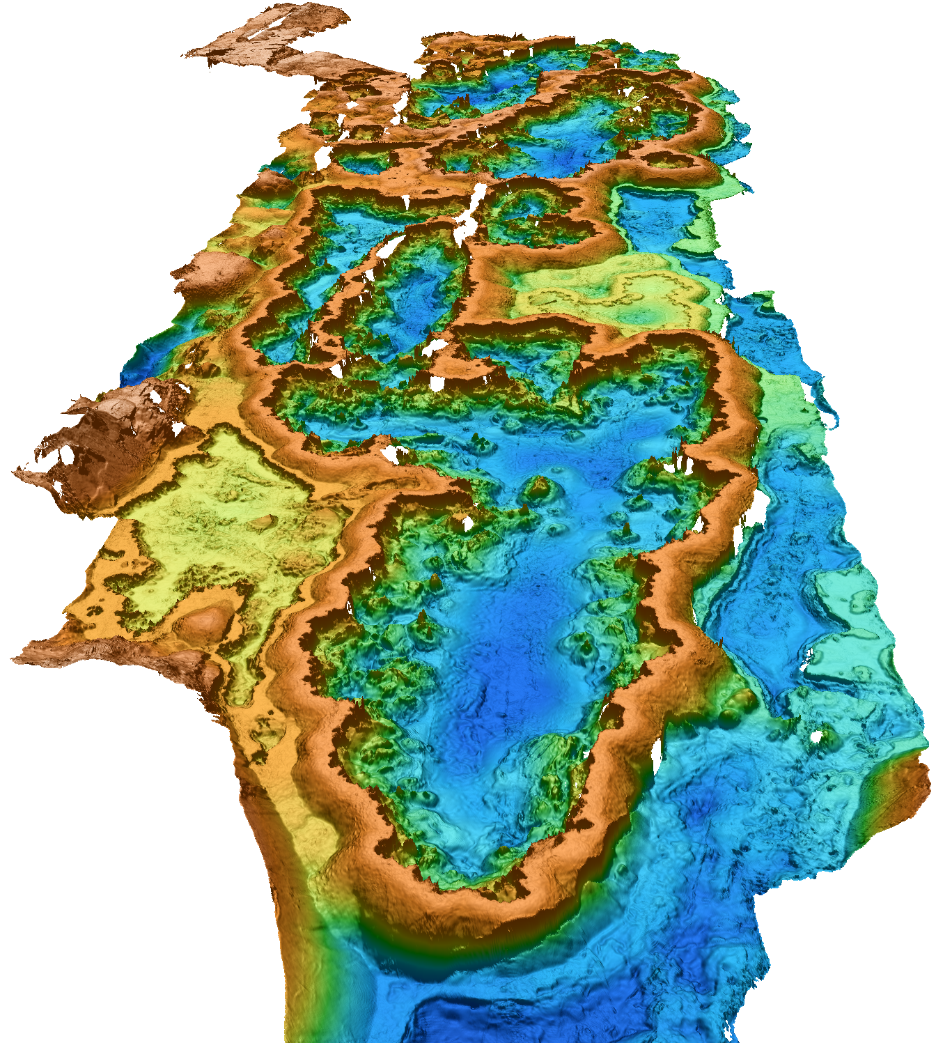
Mapping AUV Survey of 80 m high drained lava ponds along the south rift of Axial Seamount
Notes:
Axial Seamount Repeat Mapping
Following reports of a recent eruption on Axial Seamount (discovered by NOAA/WHOI ROV dives), Leg 4 of R/V Zephyr’s Northern Expedition was repurposed in a matter of hours to achieve the first high resolution measurements of lava flow thickness on the seafloor.
The Axial Seamount summit was previously surveyed by the Mapping AUV during 2006-2009 expeditions.
The new surveys were planned by David Caress (in airports and in San Diego) and David Clague (on R/V Western Flyer) using new data from Bill Chadwick (on R/V Thompson) and transmitted to Hans Thomas on R/V Zephyr for execution.
The first reports came on July 31. The surveys were conducted on August 2 and 4.
Initial data were processed and transferred to the Western Flyer on August 3 to guide an August 4 ROV Ricketts dive on the new flows.

Slide 11
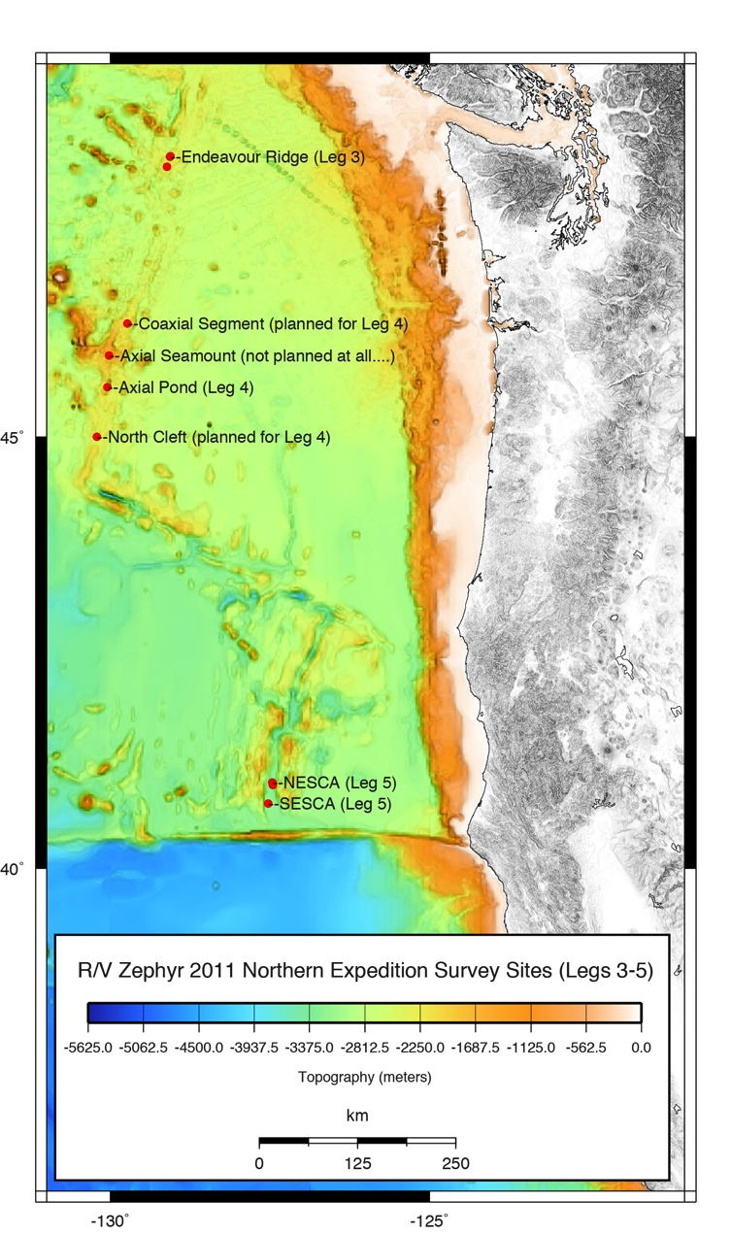
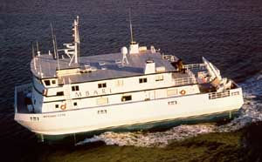
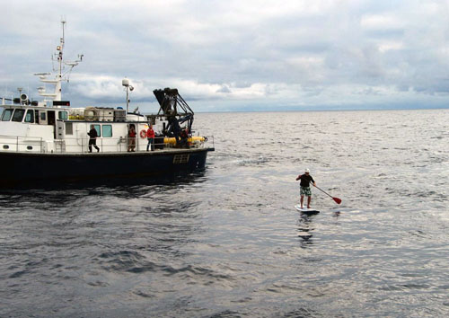
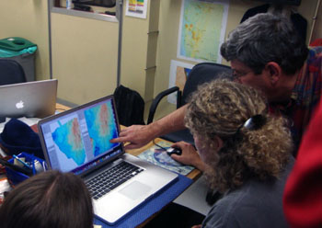
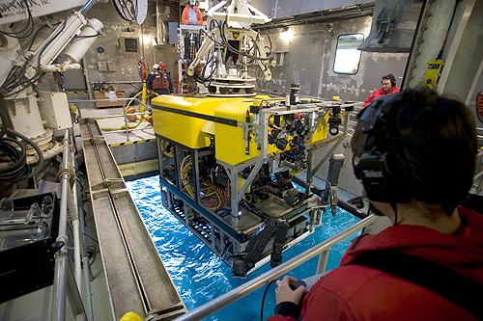
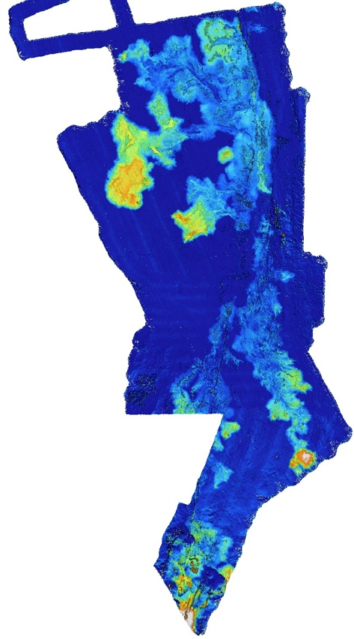
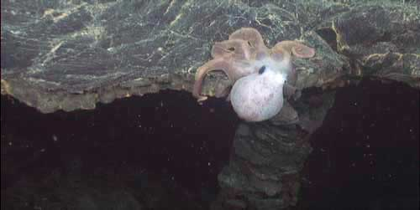
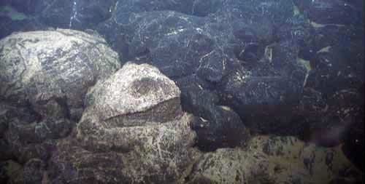
Axial Seamount Repeat Mapping
Discovery of a recent (April) eruption on Axial Seamount by NOAA led to a rapid recasting of R/V Zephyr’s Northern Expedition Leg 4 to resurvey the eruption site.
The Mapping AUV team achieved the first high resolution measurements of new lava flow thickness on the deep ocean seafloor.
Notes:
Axial Seamount Repeat Mapping
Following reports of a recent eruption on Axial Seamount (discovered by NOAA/WHOI ROV dives), Leg 4 of R/V Zephyr’s Northern Expedition was repurposed in a matter of hours to achieve the first high resolution measurements of lava flow thickness on the seafloor.
The Axial Seamount summit was previously surveyed by the Mapping AUV during 2006-2009 expeditions.
The new surveys were planned by David Caress (in airports and in San Diego) and David Clague (on R/V Western Flyer) using new data from Bill Chadwick (on R/V Thompson) and transmitted to Hans Thomas on R/V Zephyr for execution.
The first reports came on July 31. The surveys were conducted on August 2 and 4.
Initial data were processed and transferred to the Western Flyer on August 3 to guide an August 4 ROV Ricketts dive on the new flows.

Slide 12
Axial
Seamount
’

