Slide 1
FWD + AFT and Total Battery currents

Slide 2
Context
On dive 2020.226.00 (Aug 13, 2020), a short occurred in the tail cone electronics housing of Mapper 2 at t = 50,840s (~14h 7m), at 2,355 m depth.
The resulting over current event destroyed the tailcone electronics, and melted the bus aft wiring in the AFT battery (134.89.32.145, SN: C-12).
The vehicle floated to the surface and was recovered.
The newBatt driver samples at 0.1 Hz (10s period).

Slide 3
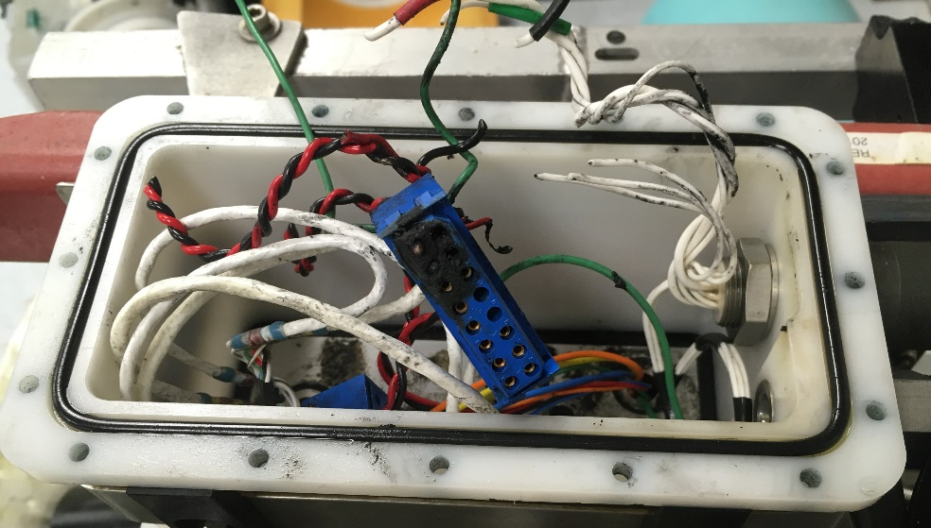
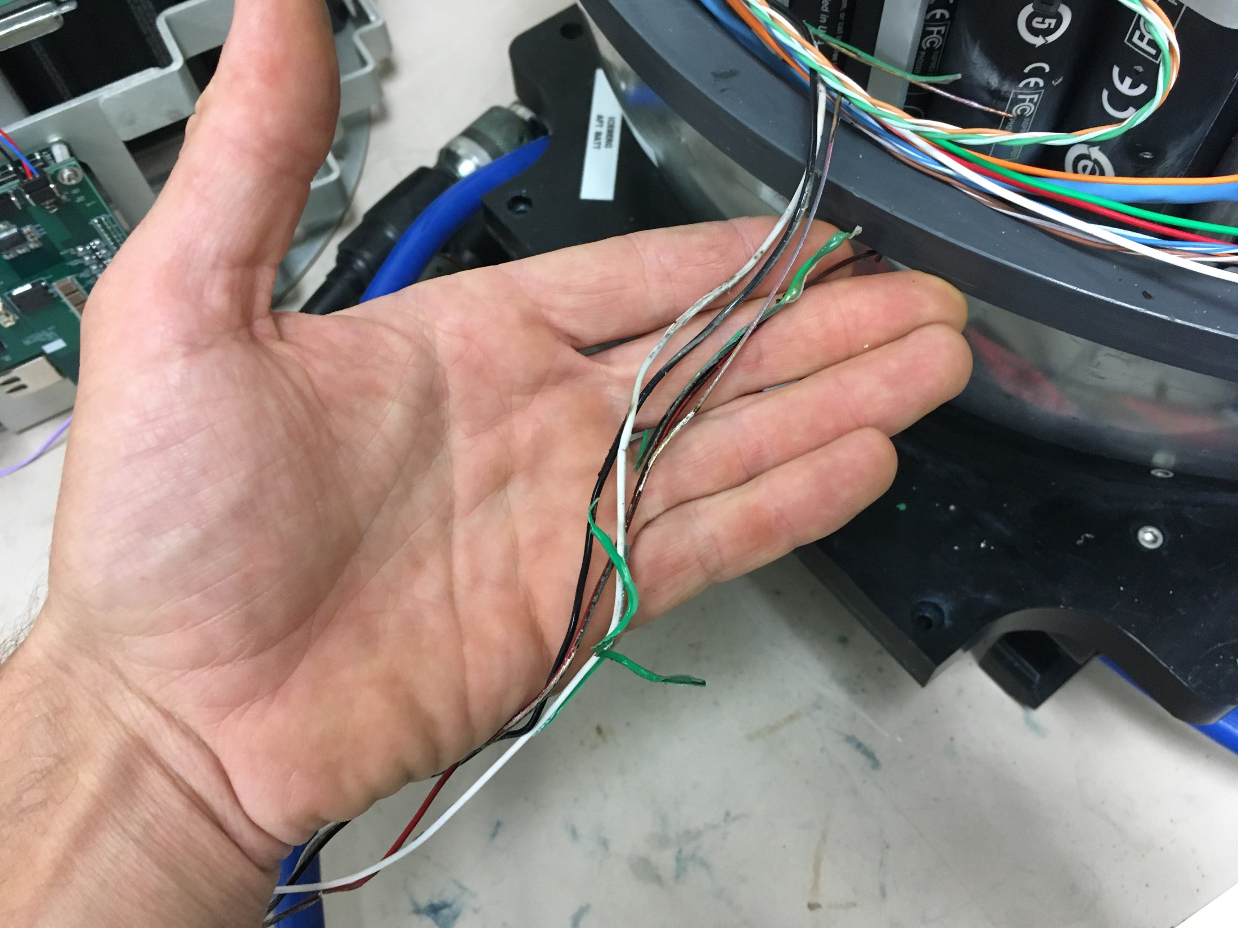
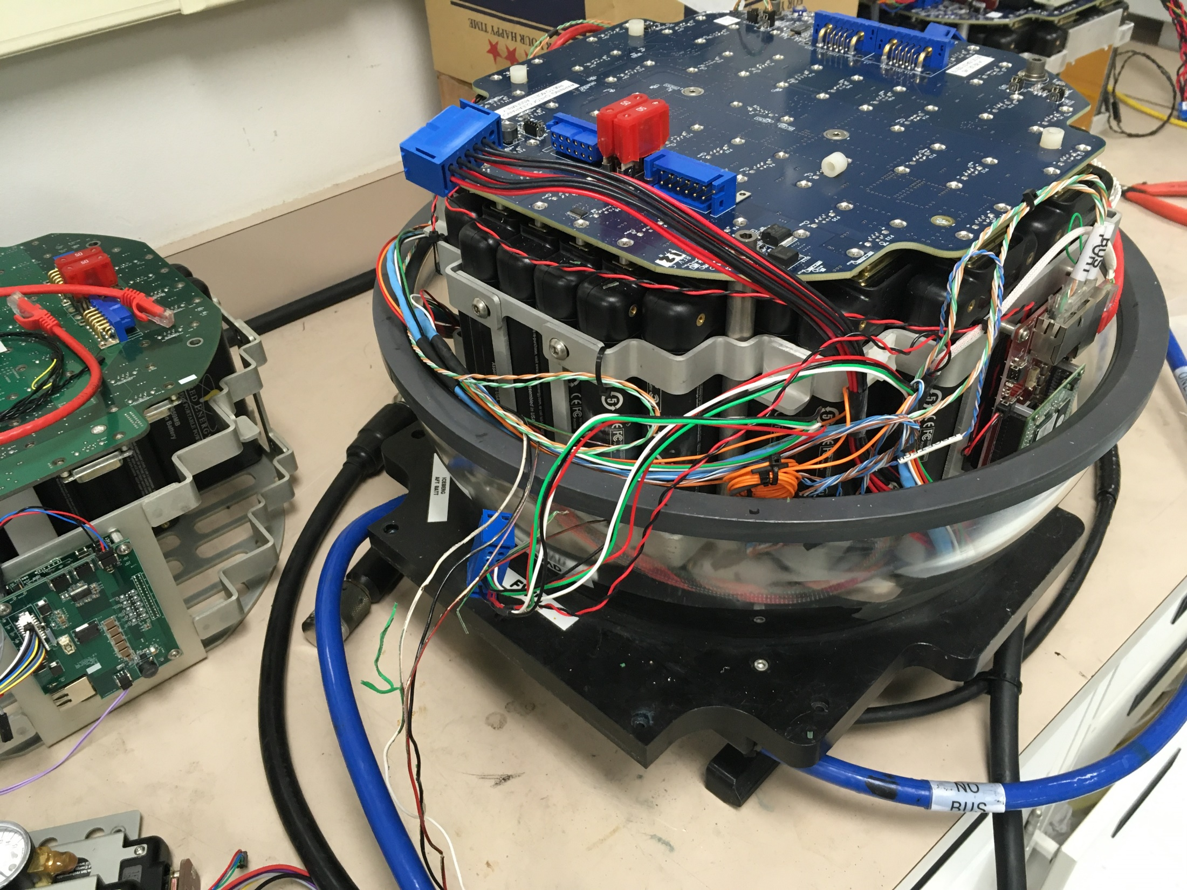
Tailcone & Ball photos

Slide 4
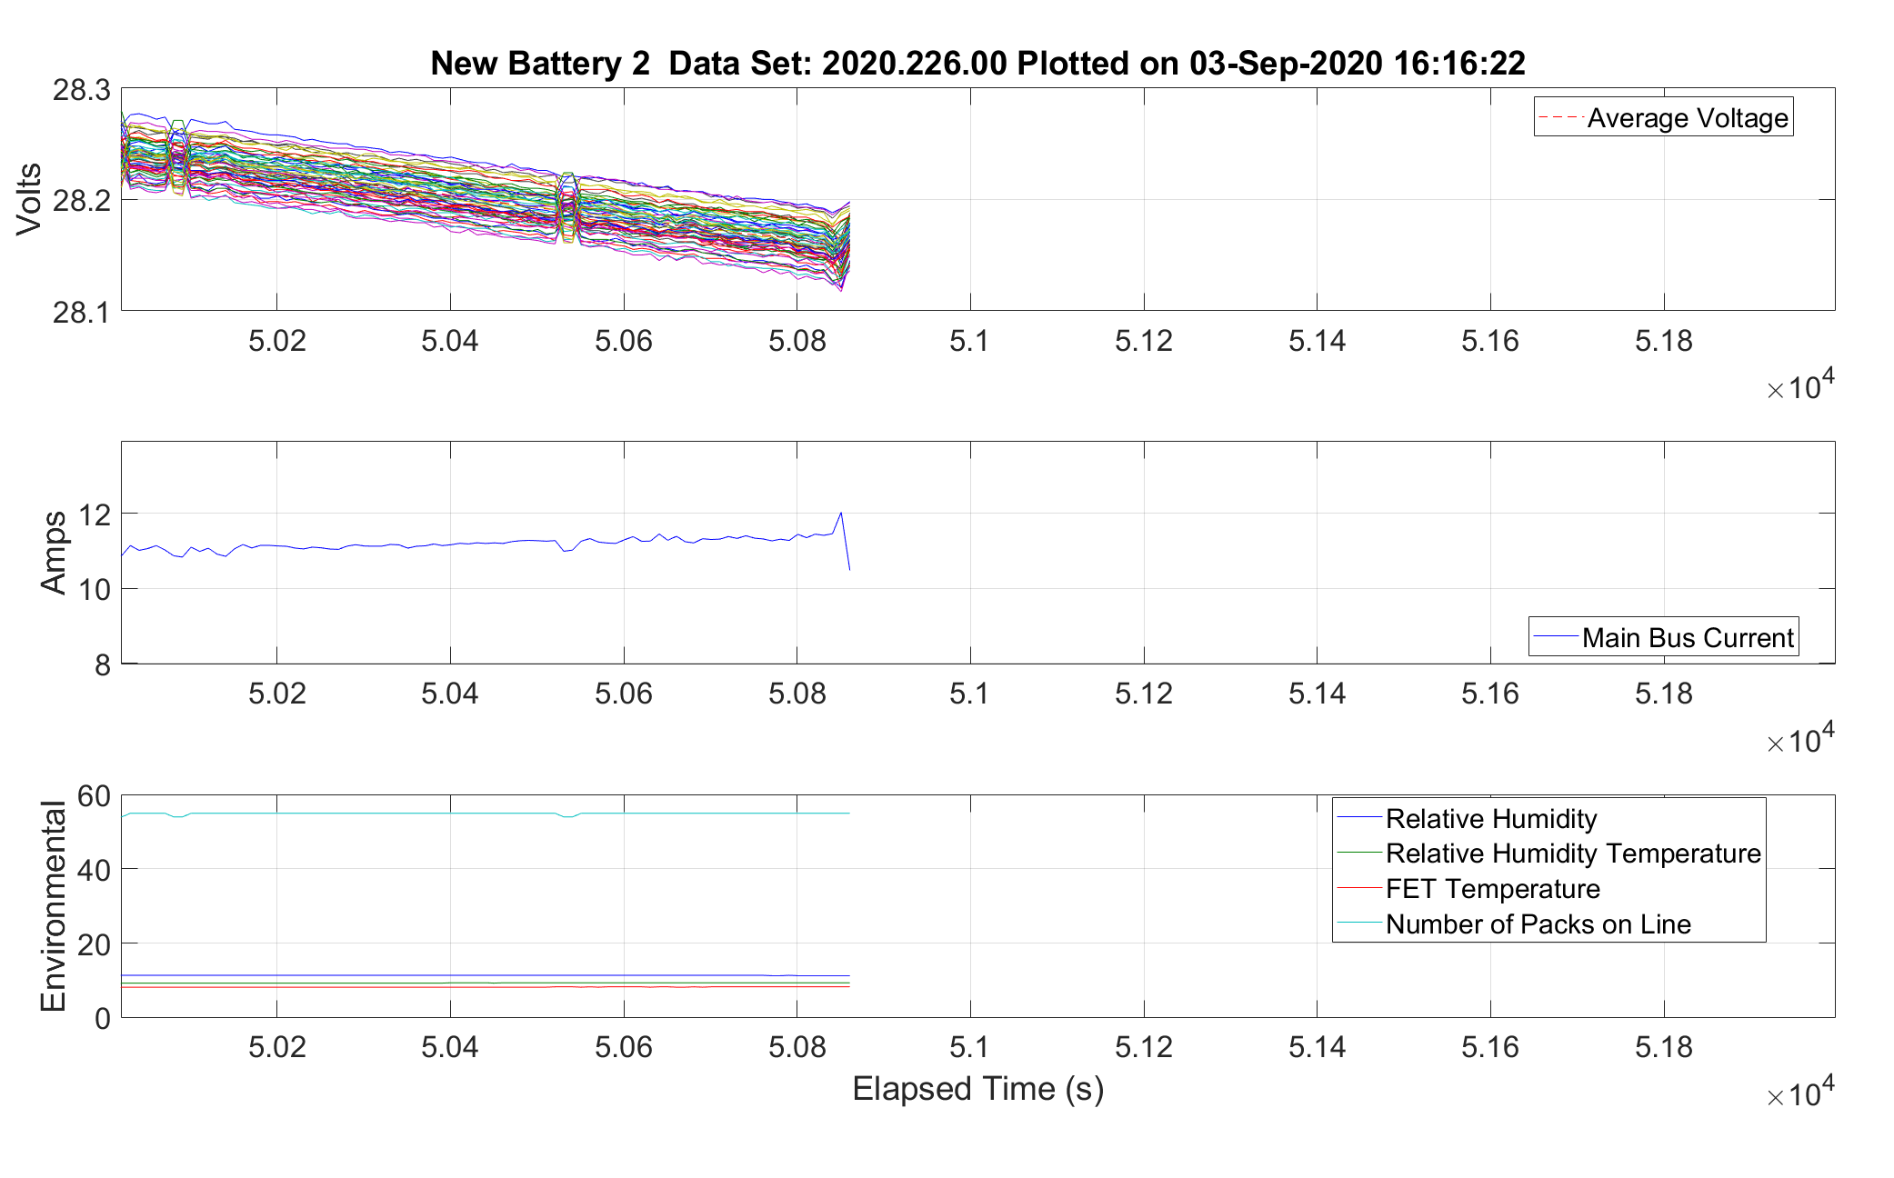
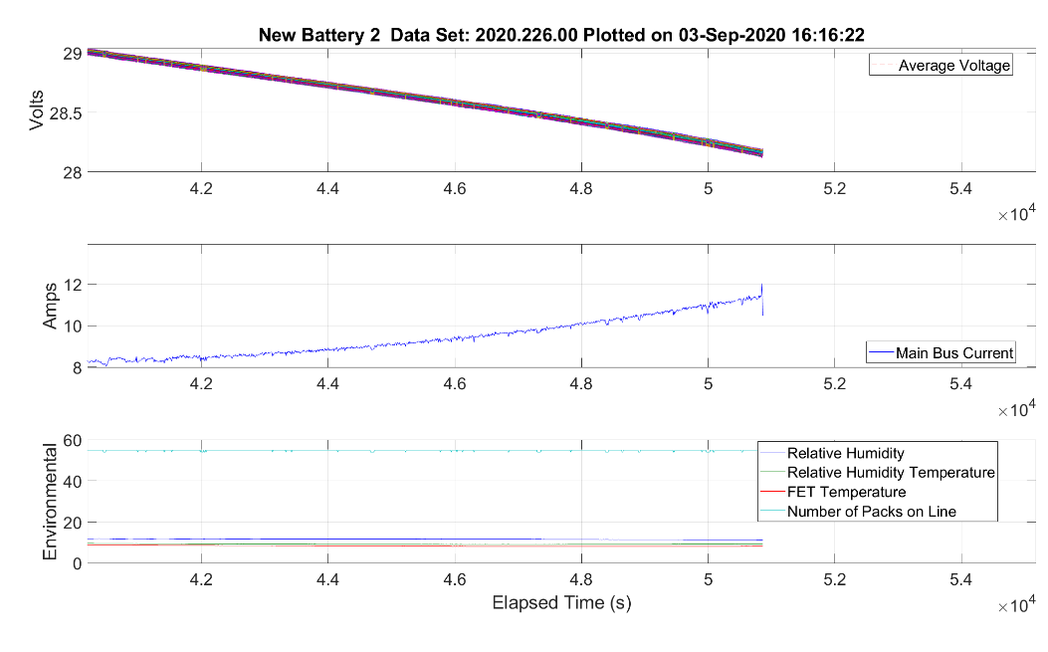
FWD Batt plots

Slide 5
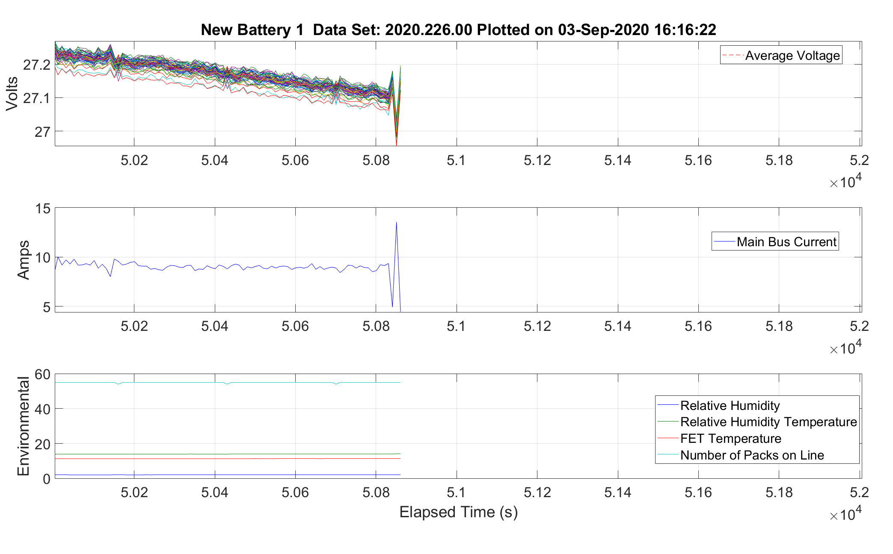
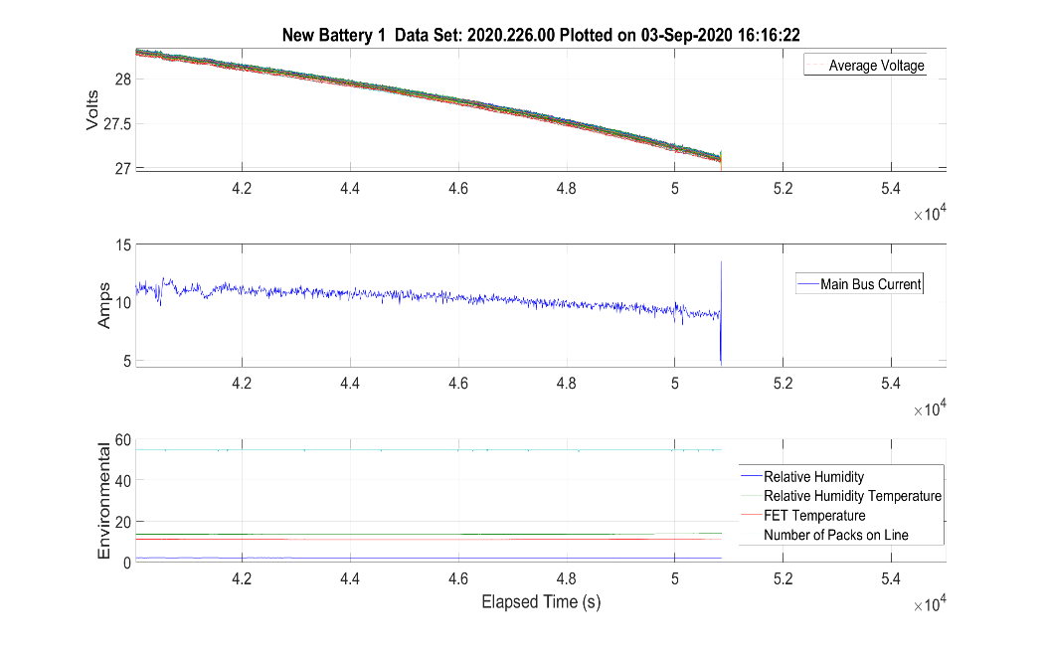
AFT Batt plots

Slide 6
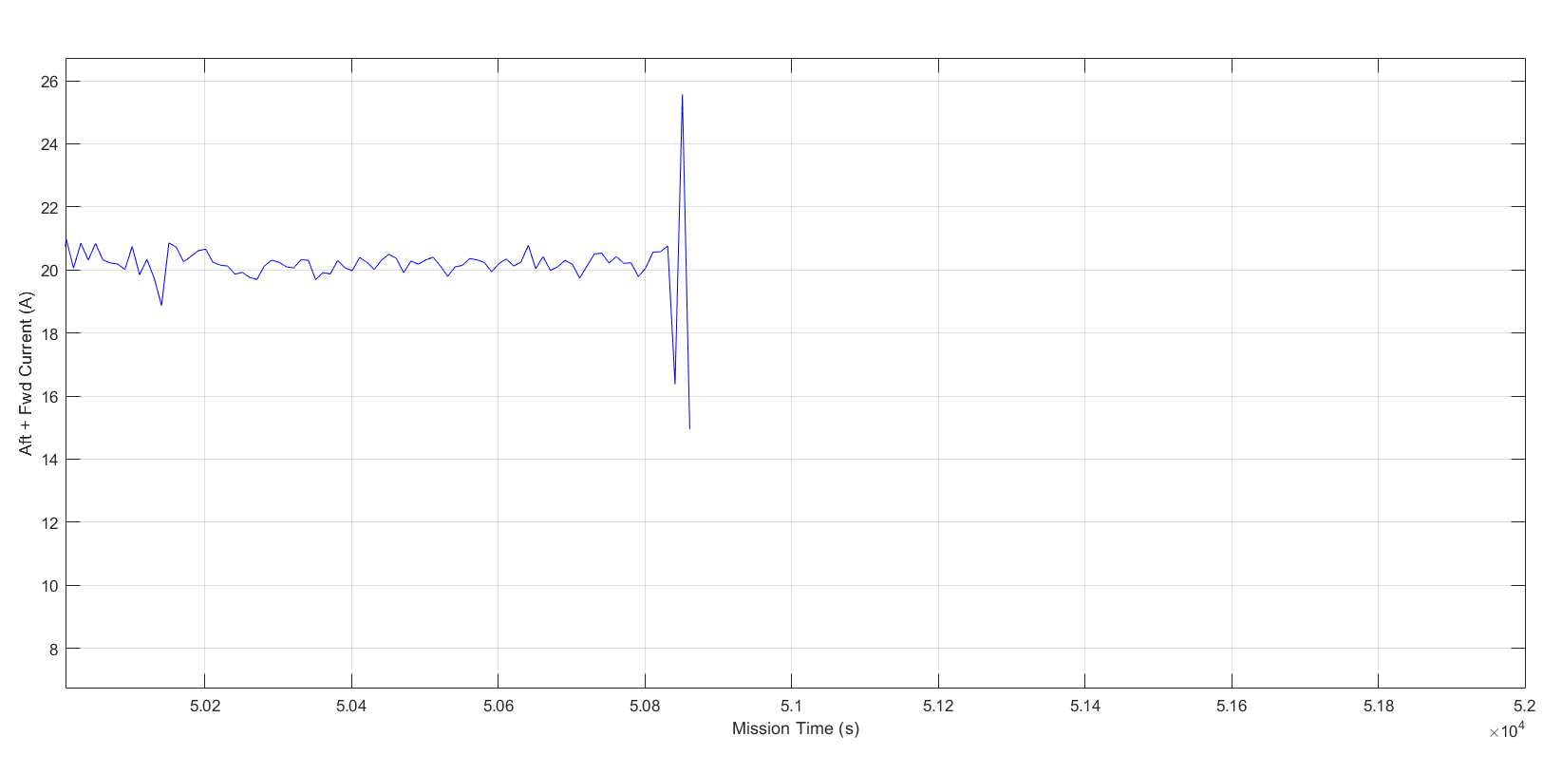
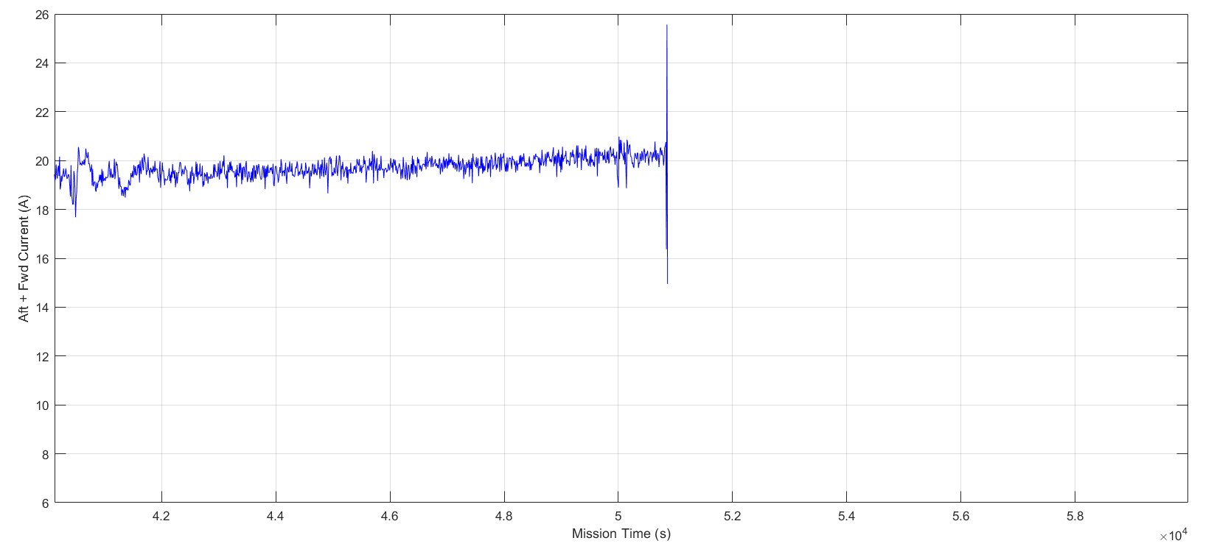
Total current (AFT + FWD)
Max observed current anomaly ~5A.
True anomaly much higher given melting of 22AWG copper bus aft wiring.

Slide 7
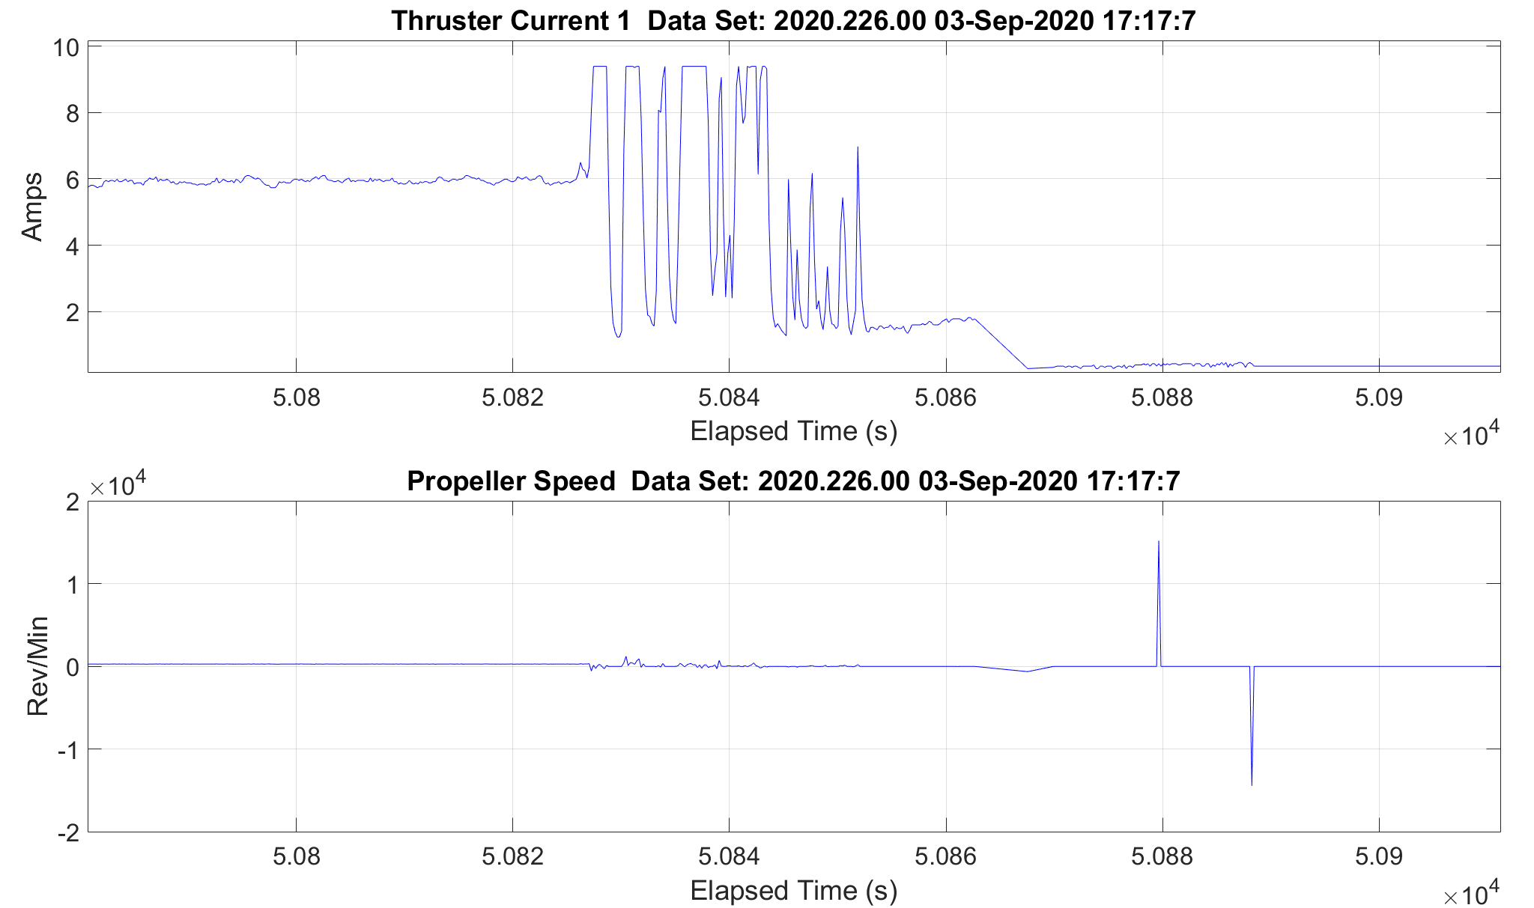
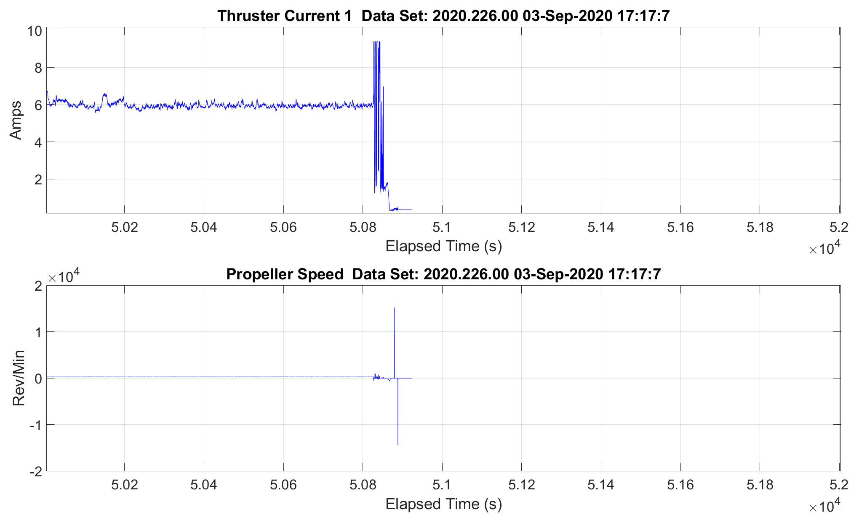
Thruster current measurements
Thruster current ADC saturated at ~9A (3A anomaly).
Actual current draw likely much higher.

Slide 8
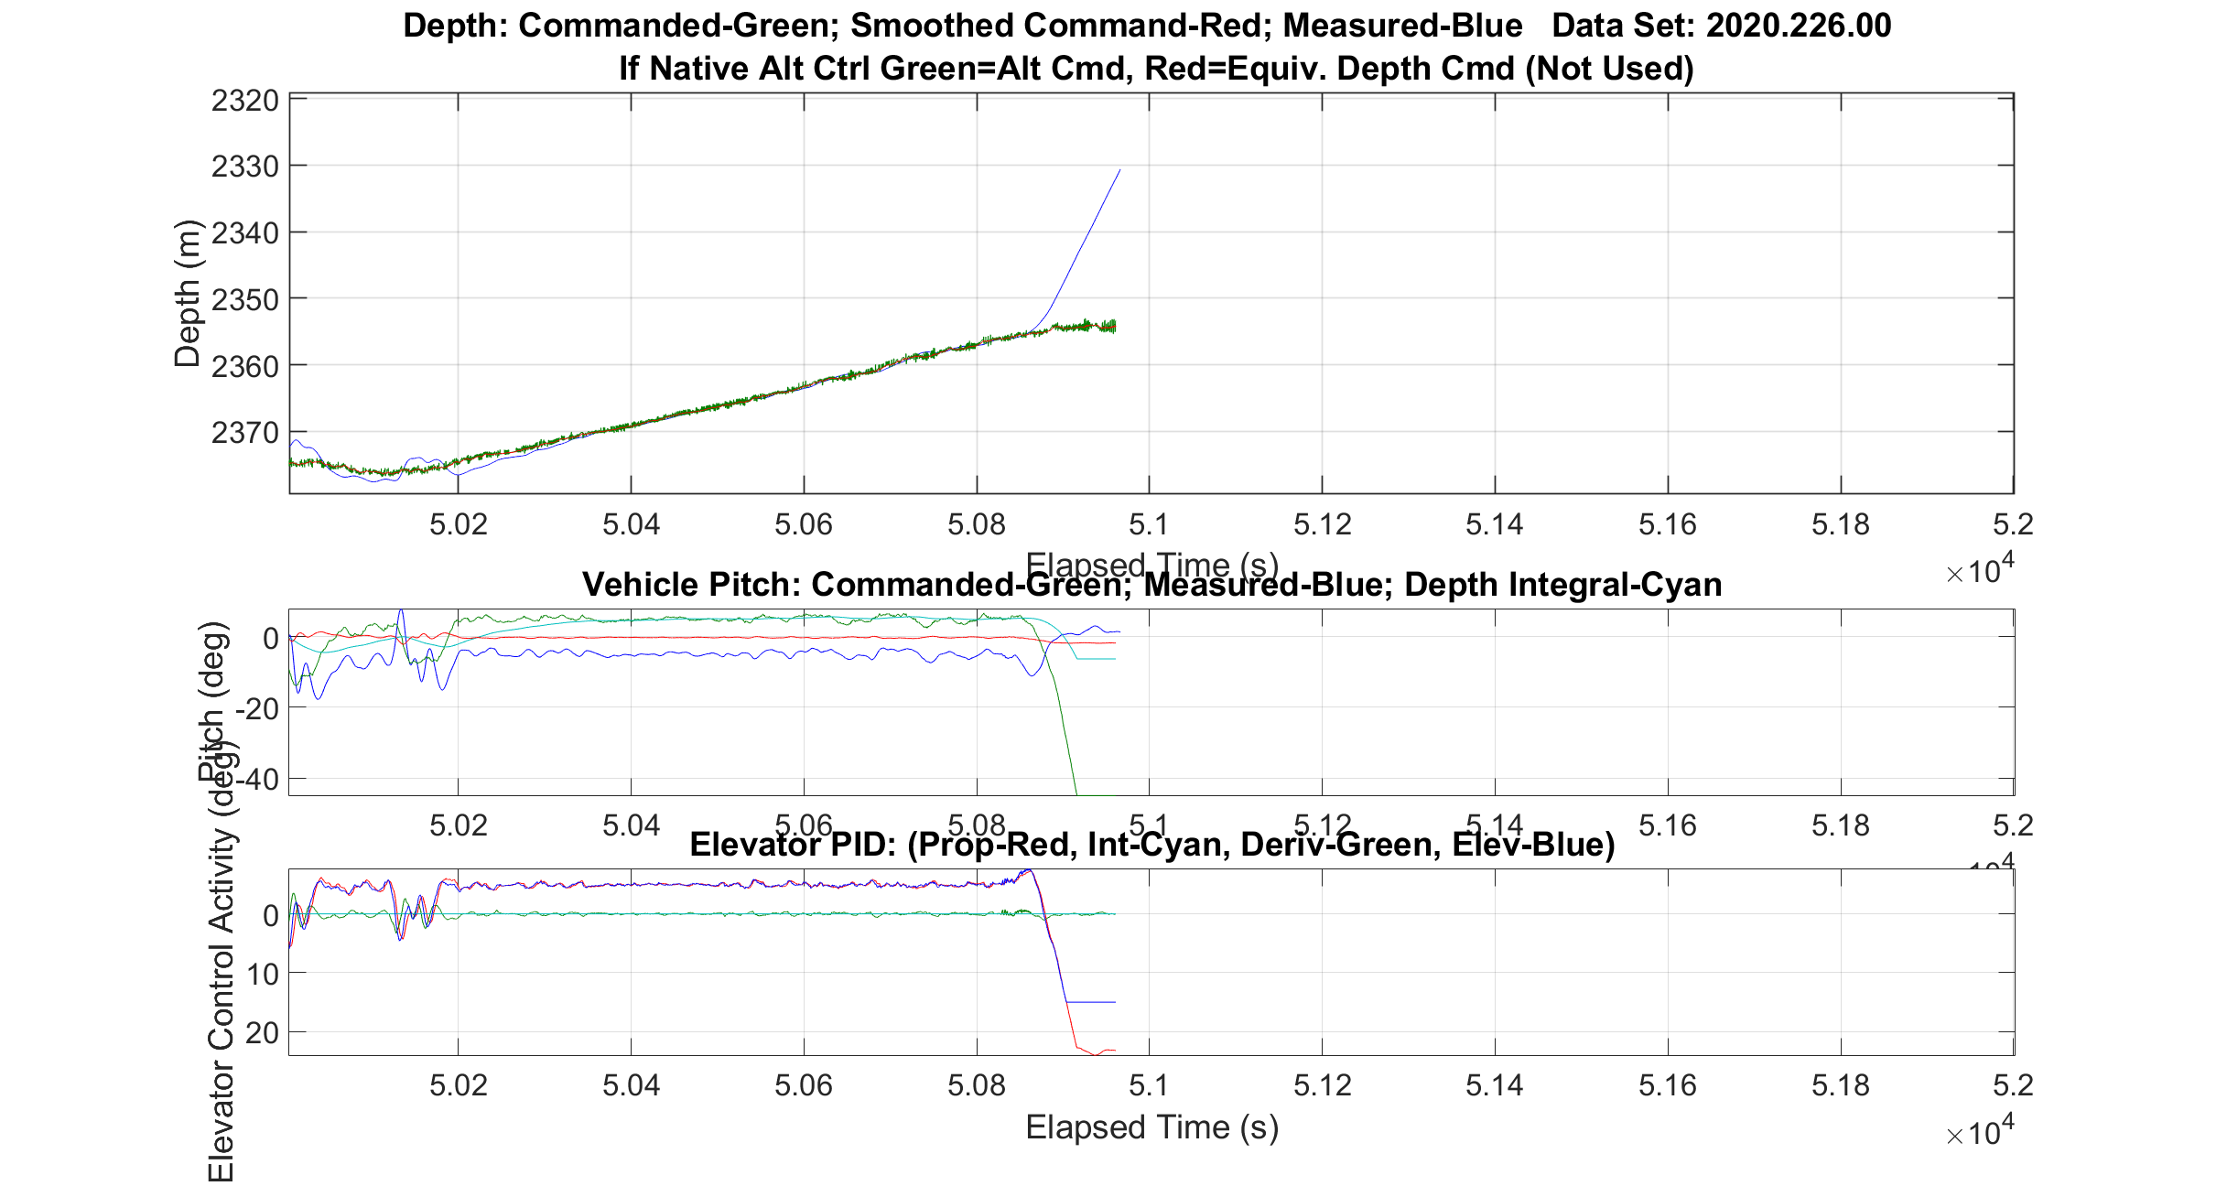
Observed Loss of Control

Slide 9
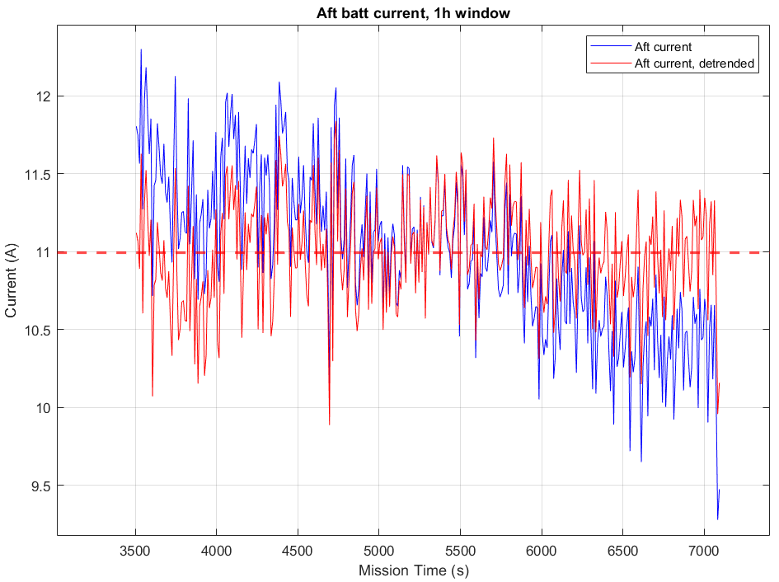
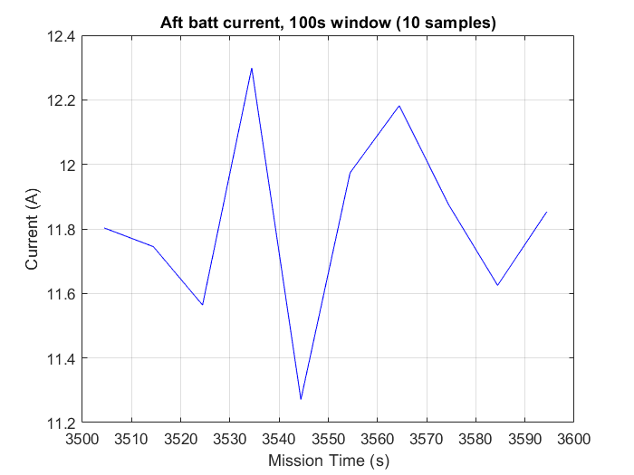
Could a simple statistical model work?
Original Current trace:
STD: 0.52
max – min: 3.02A
MATLAB de-trended trace:
STD: 0.34A
max-min: 1.95A
STD: 0.29A
max-min: 1.03A
→ Seems plausible

Slide 10
Thoughts
Visually, fault is clear, even with under-sampled battery observations
Low memory statistical model running on battery balls seems possible
  Can run at higher frequency
  On fault, could increase UDP broadcast frequency
  Must guard against known current jumps (e.g. prop turn on after receiving acoustic ‘startSurvey’)
  Must guard against other battery shutting off unexpectedly

