Slide 1
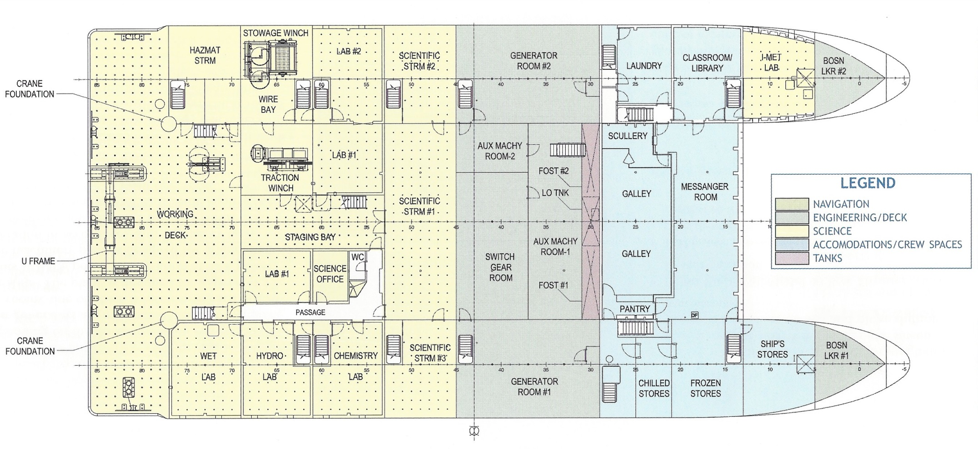
Deck Layout – No AUV LARS Crane
Chadwick Mooring
Gear
MBARI AUV
Weight Stacks
4 Total
Tether Deck
Run
MEDEA
MBARI AUV Charging/OPS
JASON
LARS
JASON Van
LARS HPU

Slide 2
Deck Layout – AUV LARS Crane
Chadwick Mooring
Gear
AUV LARS
MBARI AUV
Weight Stacks
4 Total
Tether Deck
Run
MEDEA
MBARI AUV Charging/OPS
JASON
LARS
JASON Van
LARS HPU

