Slide 1
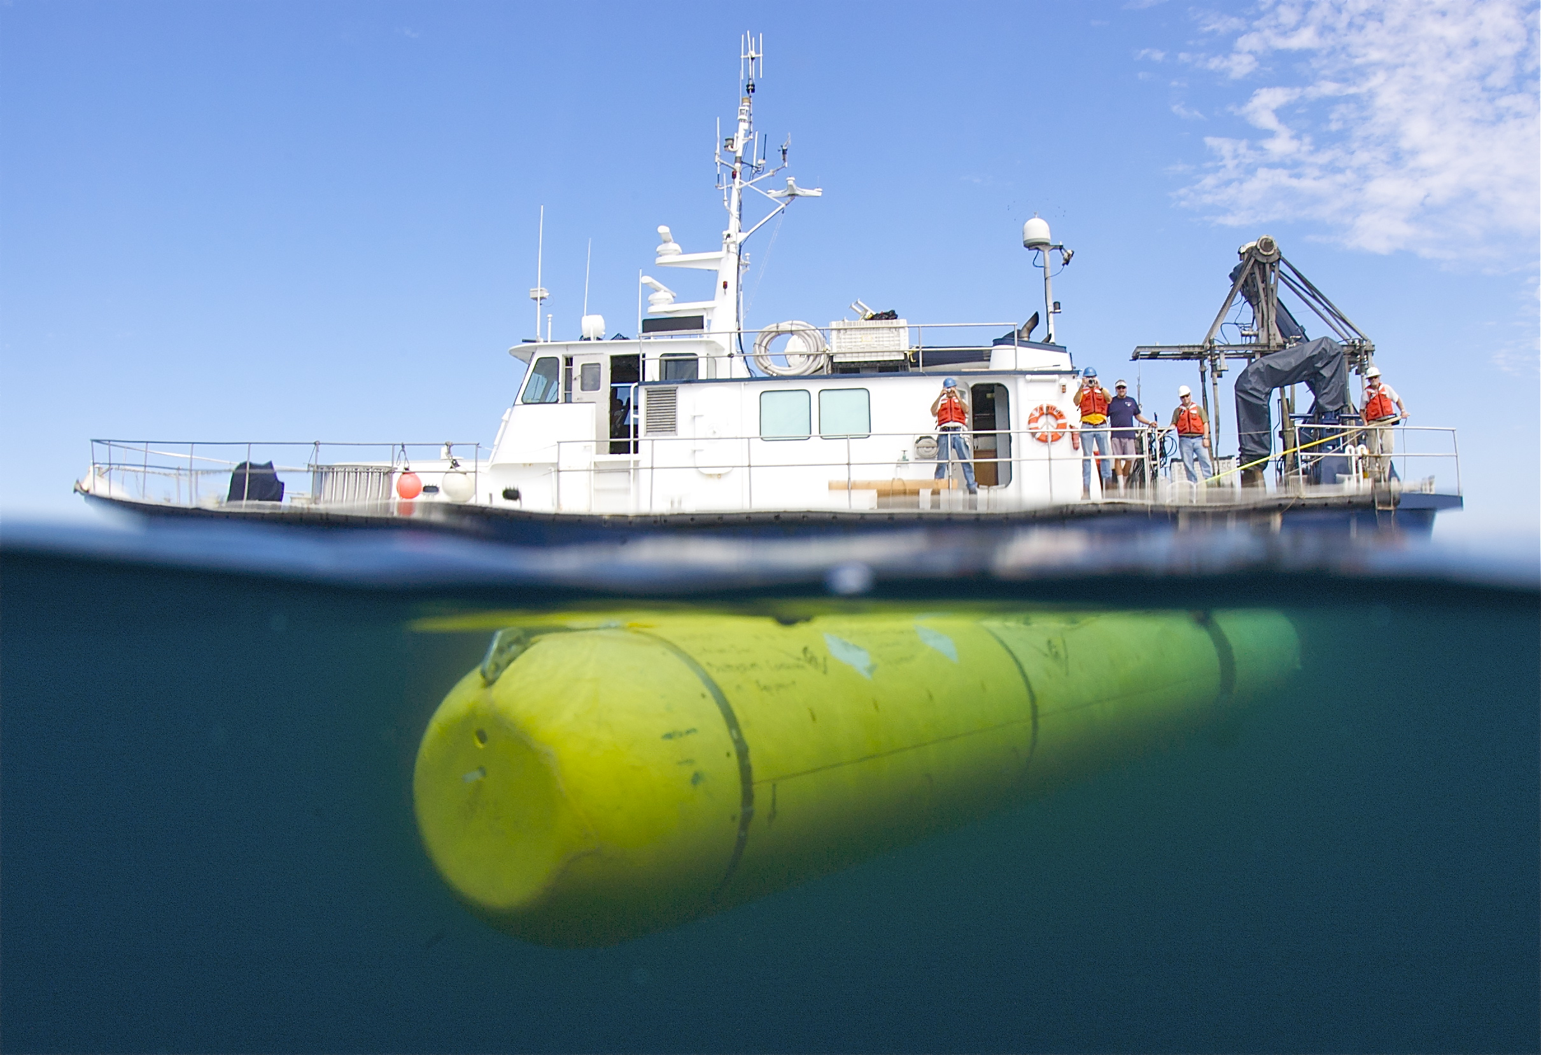

Dorado AUVs
Modular Vehicles for Diverse Science Customers
Hans Thomas
AUV Supervisor
Division of Marine Operations
Monterey Bay Aquarium Research Institute

Slide 2
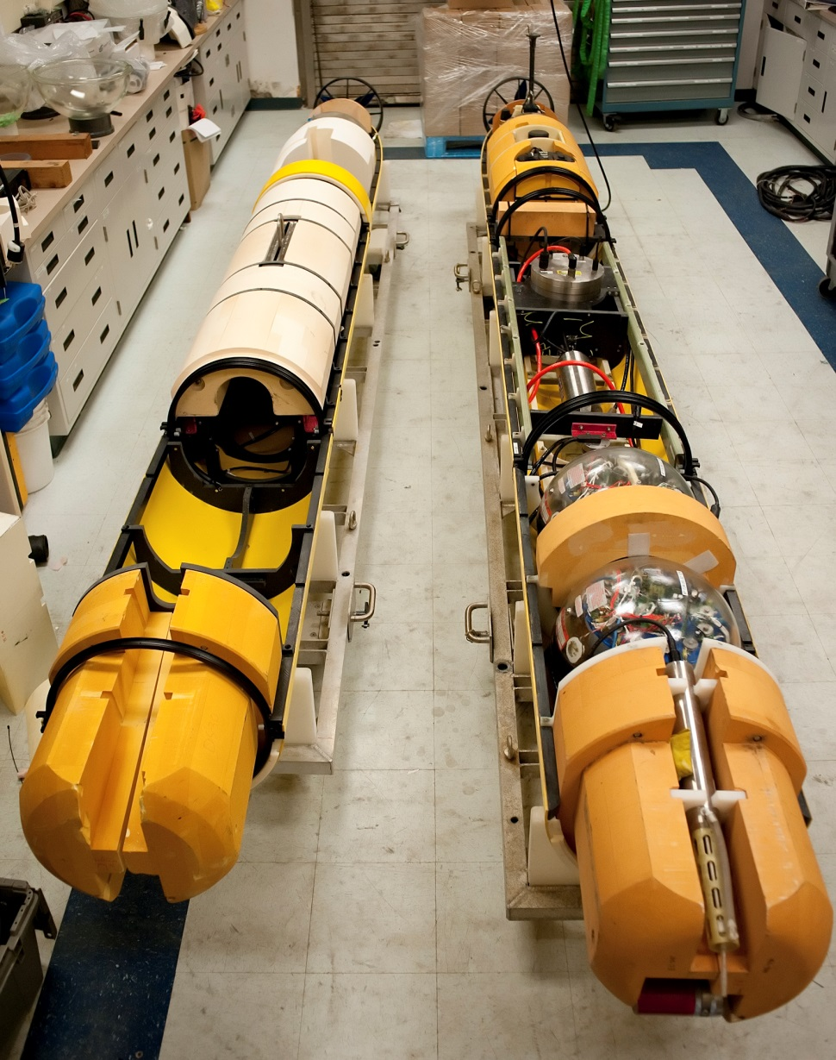
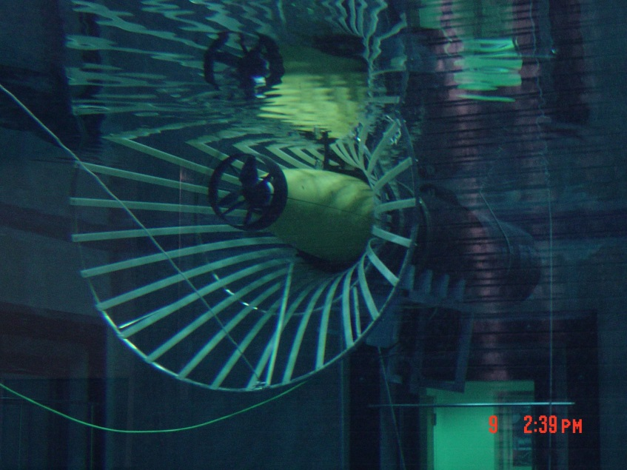
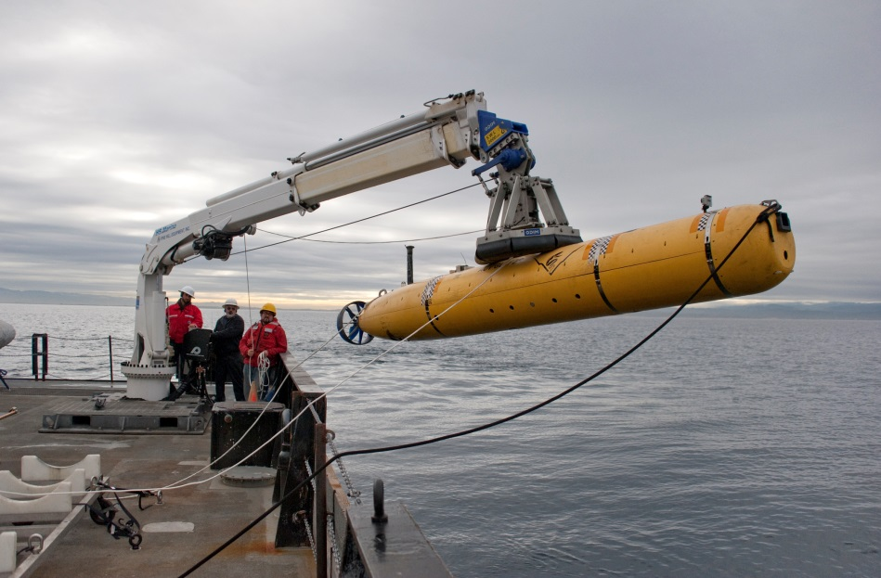
Dorado-Class AUV
Begun as a joint development project with Bluefin Robotics in 2000
21 inch diameter, up to 19 feet in length
Modular mechanical, electrical and software design
Several different vehicle configurations:
  Water column sampling
  Seafloor mapping
  Imaging
  Docking
  Experimental Instruments

Slide 3
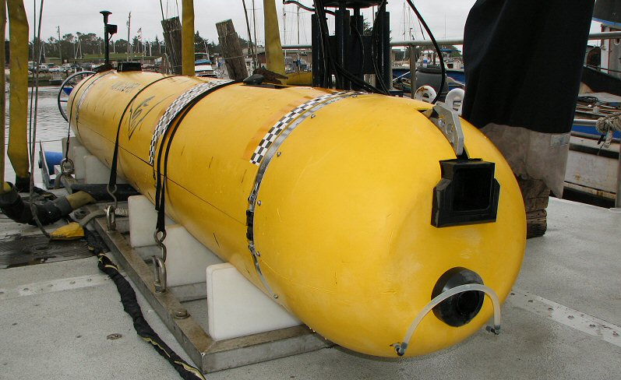
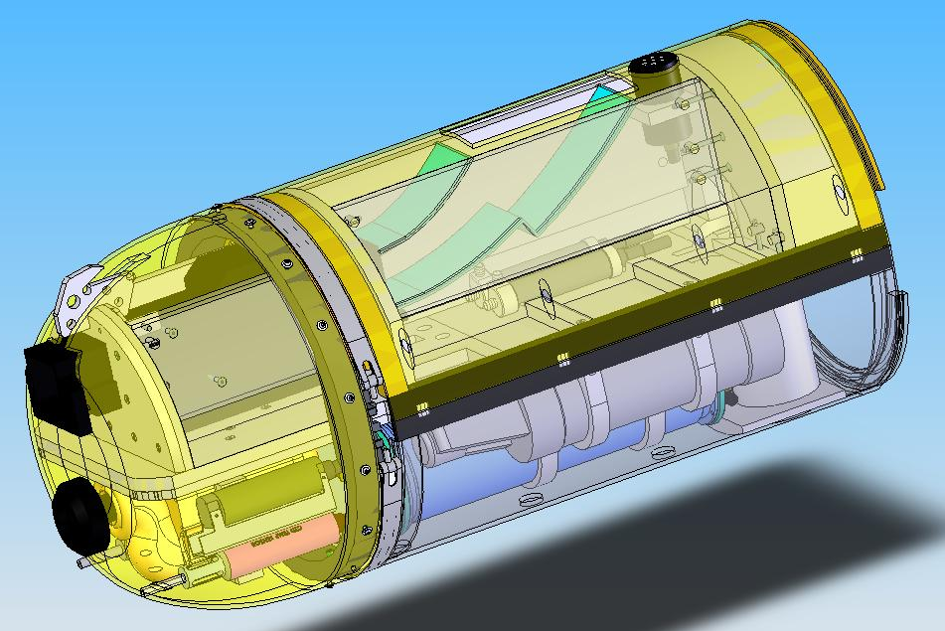
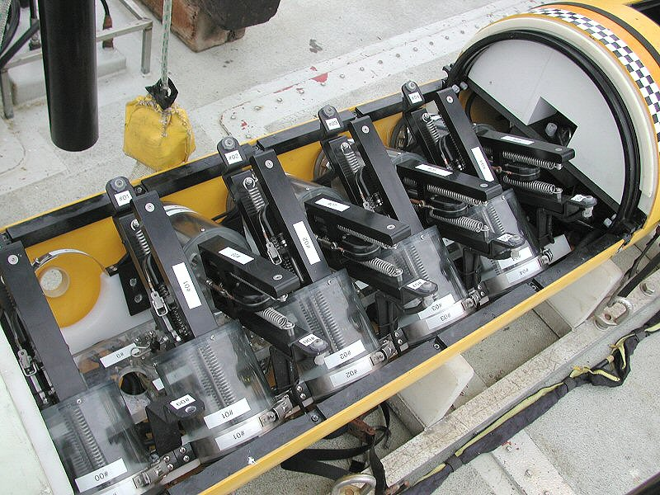
Water Column Survey & Sampling
19 hour endurance at 3 knots
Wide array of physical, chemical & bio-optical instruments
10 sample chambers (soon to be 20), 1.8 liter volume

Slide 4
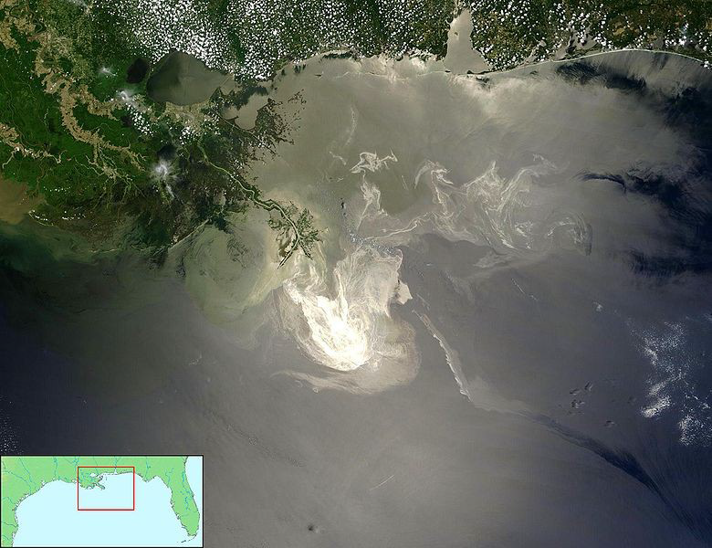
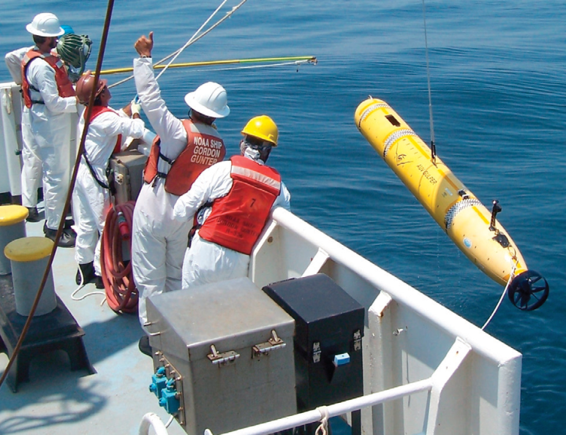
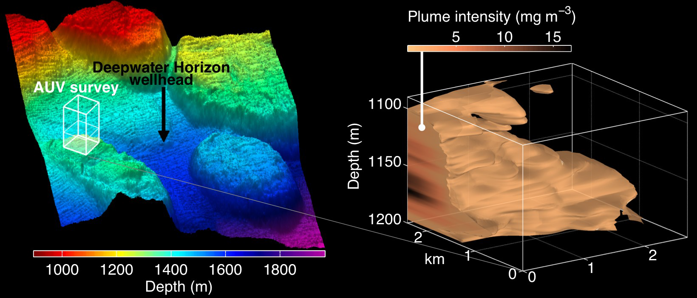
Deepwater Horizon Response Cruise
1 week mobilization of water column AUV and support team to GoM
Operated from NOAA ship Gordon Gunter as part of joint rapid response cruise
Adaptive sampling capability modified to precisely target hydrocarbon concentrations
Dorado provided capability to survey large, deep plumes unreachable by other AUVs on scene and return samples for in-lab analysis

Slide 5
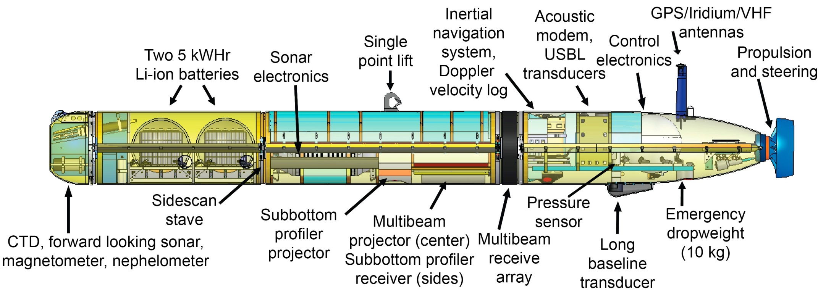
Seafloor Mapping
18 hour endurance at 3 knots
6 hour battery recharge
Initial data products in ~5 hours after recovery
Capable of >1m resolution bathymetry, operating at 50m altitude/200m swath
Provides ability to operate high resolution sonars near bottom in extreme terrain with high coverage rates & fast turnaround

Slide 6
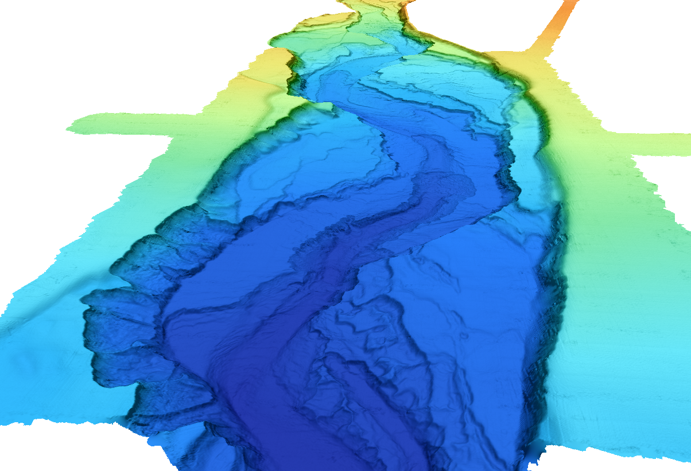
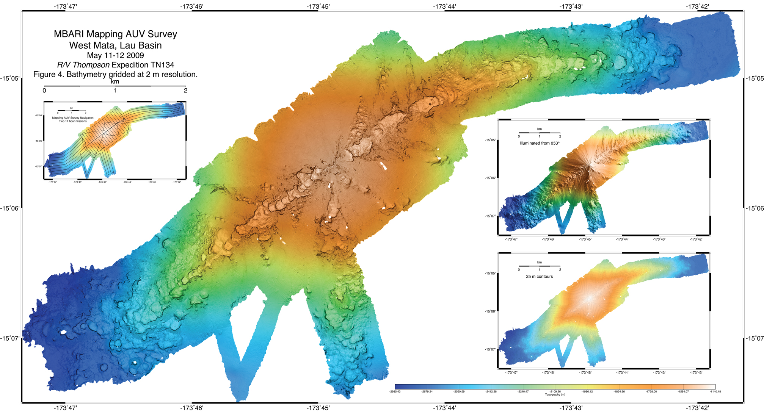
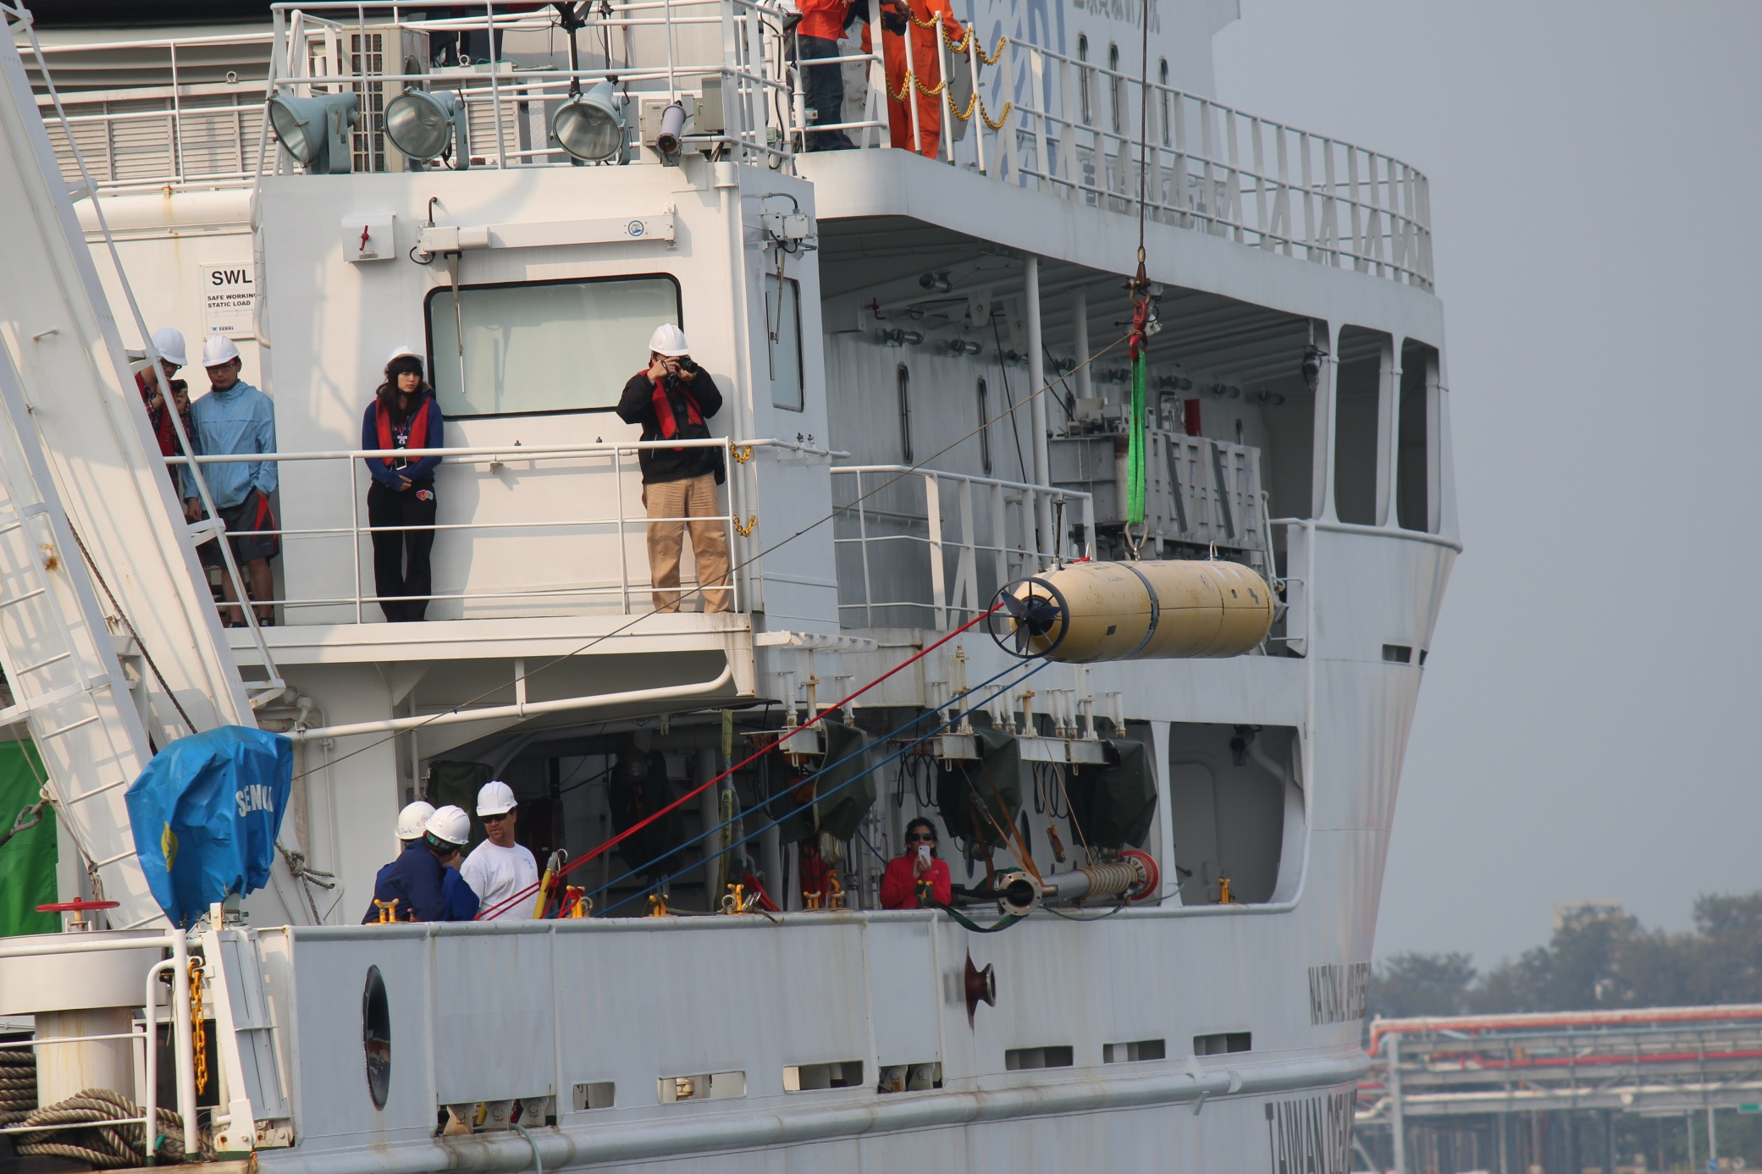
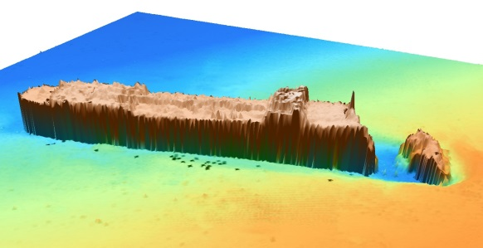
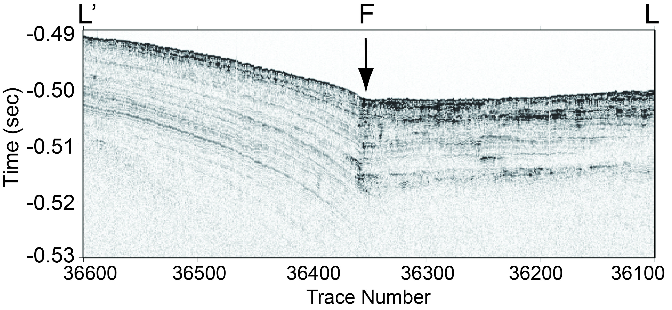
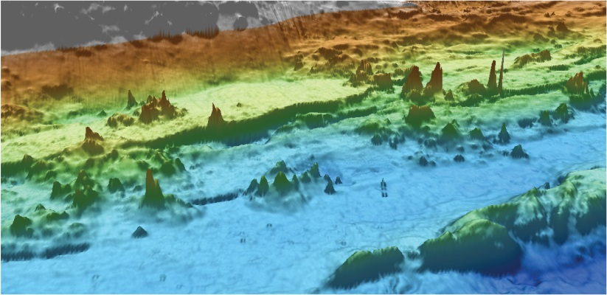
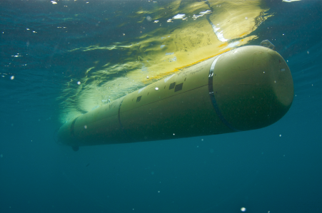
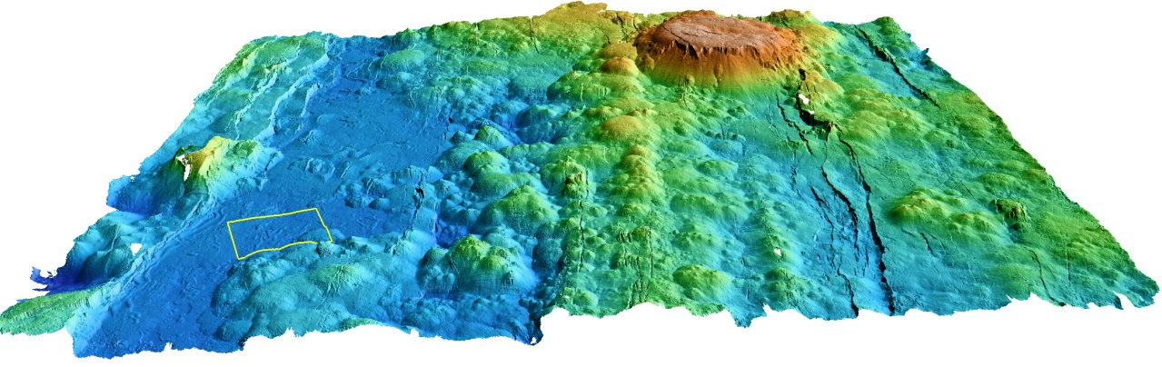
161 Successful Mapping AUV Survey Missions Since 2006…..
  Submarine Canyons: 59
  Seamounts: 12
  Hydrates: 18
  Spreading Centers: 38
  Lau Basin: 3
  Offshore fault zones: 21
  Fan systems: 14
  Slumps: 2
  Shipwrecks: 3
  Cable routes: 3
  Dumpsites: 1

Slide 7
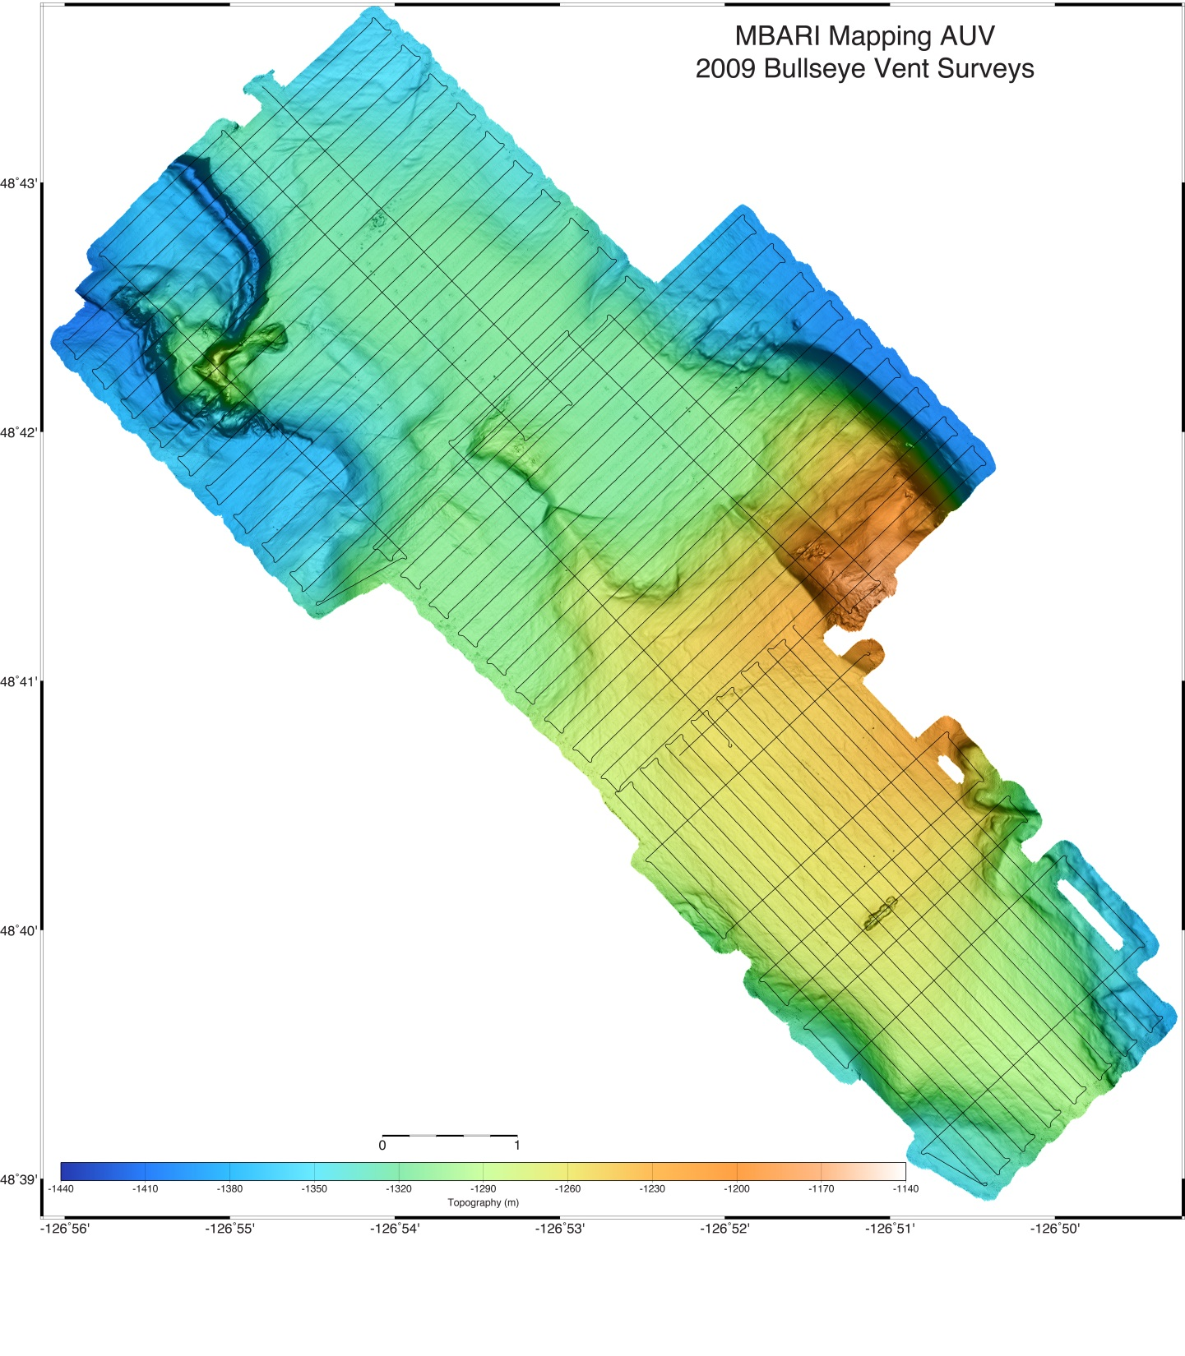
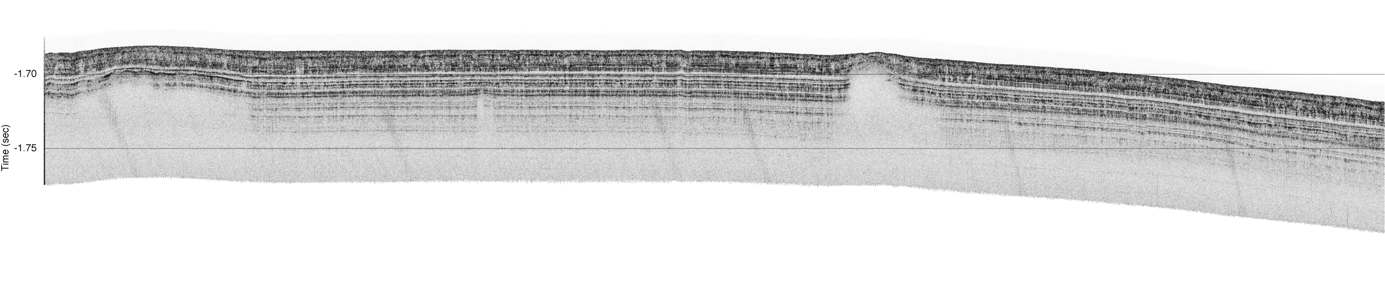
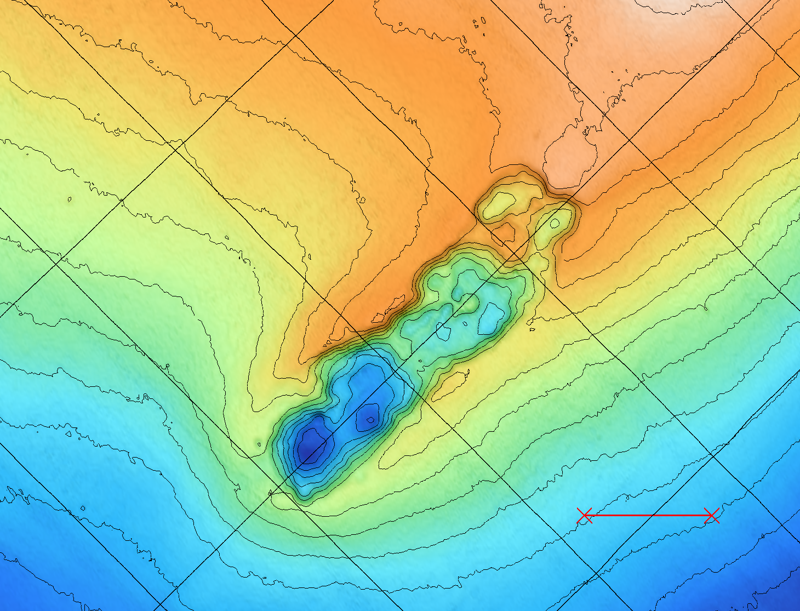
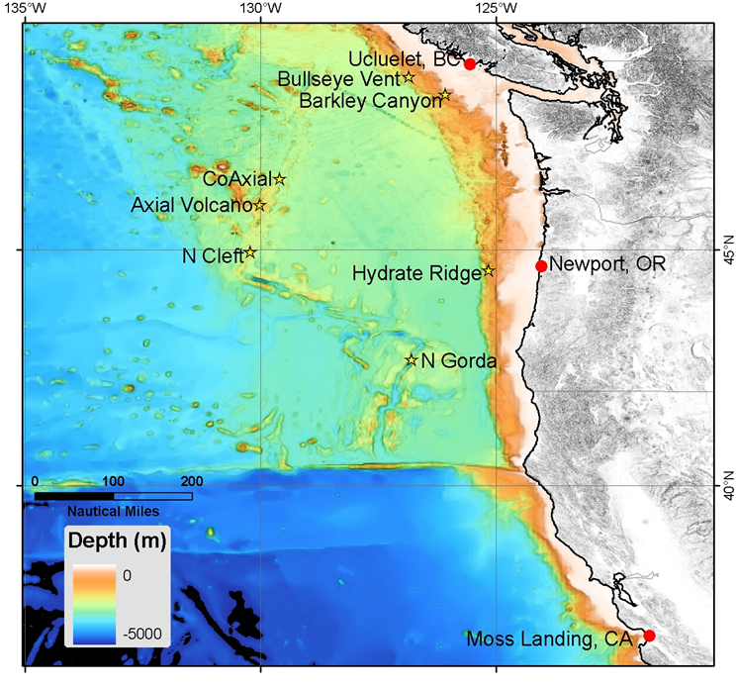
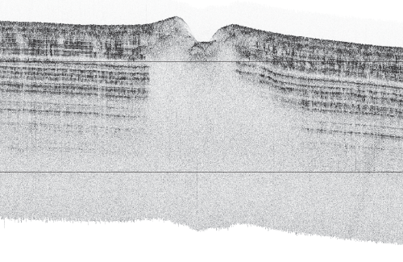
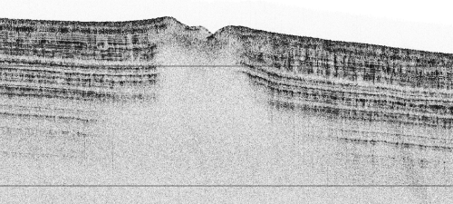
2009 Surveys of
Hydrate Deposits
Offshore British Columbia
A
A
B
up-turned sides
C
100 m
B
D
C
20 m
Material appears to be
missing from depression?
blanking - gas?

Slide 8
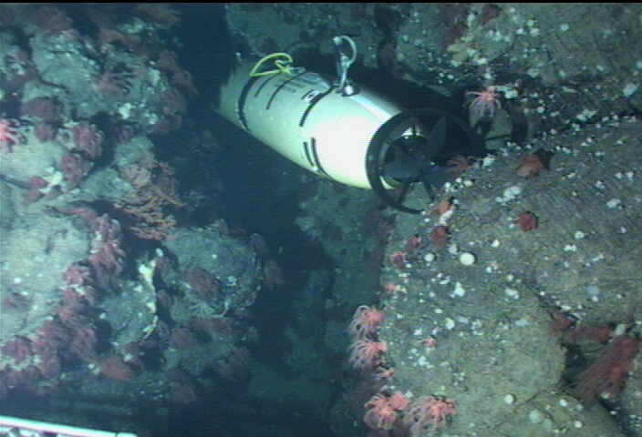
Processing Issues Particular to Swath Data Collected Using Underwater Platforms
Vehicle navigation is low precision relative to the lateral resolution of the seafloor mapping data
Mapping sonars on underwater vehicles are subject to interference problems due to propulsion and other active sonars
Vehicle depth derives from pressure measurements
  Pressure can be impacted by surface waves – observed in shallow surveys (vehicle depths < 50 m)
  Deep pressure sensors can be noisy relative to the sonar’s vertical precision
Tides matter in every survey
and if the vehicle doesn’t come back,
there are no data to process….

Slide 9
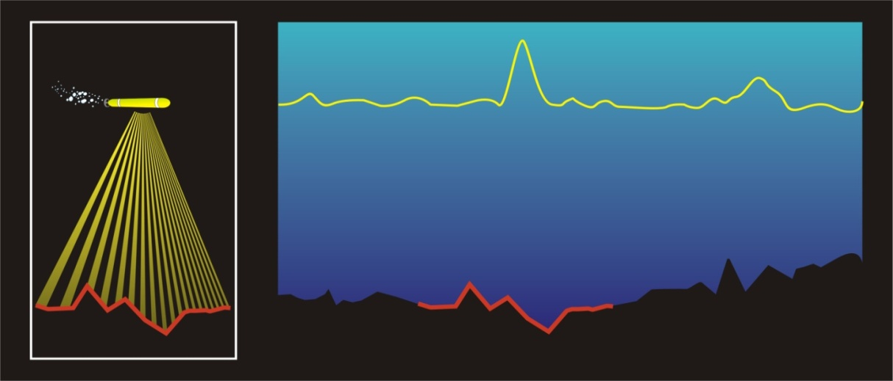
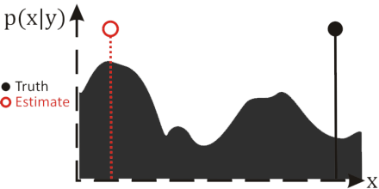
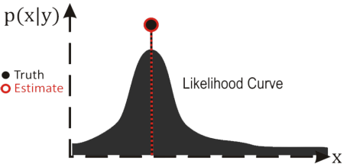
Terrain-Relative Navigation
Measurement
Likelihood Score
Terrain Map
Non-parametric filtering methods due to multi-modal distributions
Doppler Velocity Log (DVL) sonar used for correlation

Slide 10
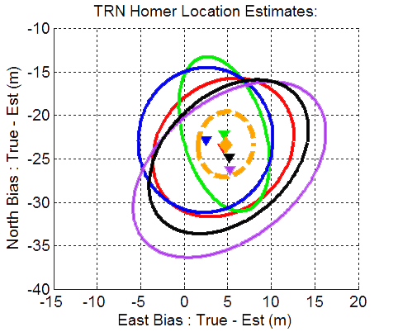
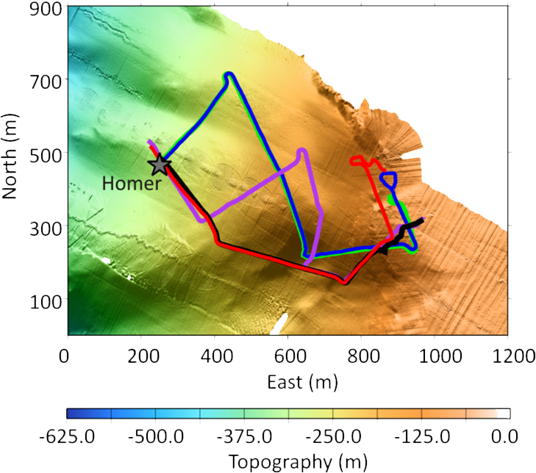
Georeferencing Errors
Repeat runs at Soquel Canyon

Slide 11
Conclusions
AUV hardware and sensors becoming more of a commodity technology
  Complex sonar systems, modular battery technology are a great example of this
Increasing emphasis on endurance and onboard intelligence and sensor processing
  Real-time adaptation to bio-optical sensors and sonars
  Active navigation and complex obstacle avoidance
  Intervention & autonomous manipulation are poised to become a reality

