Slide 1
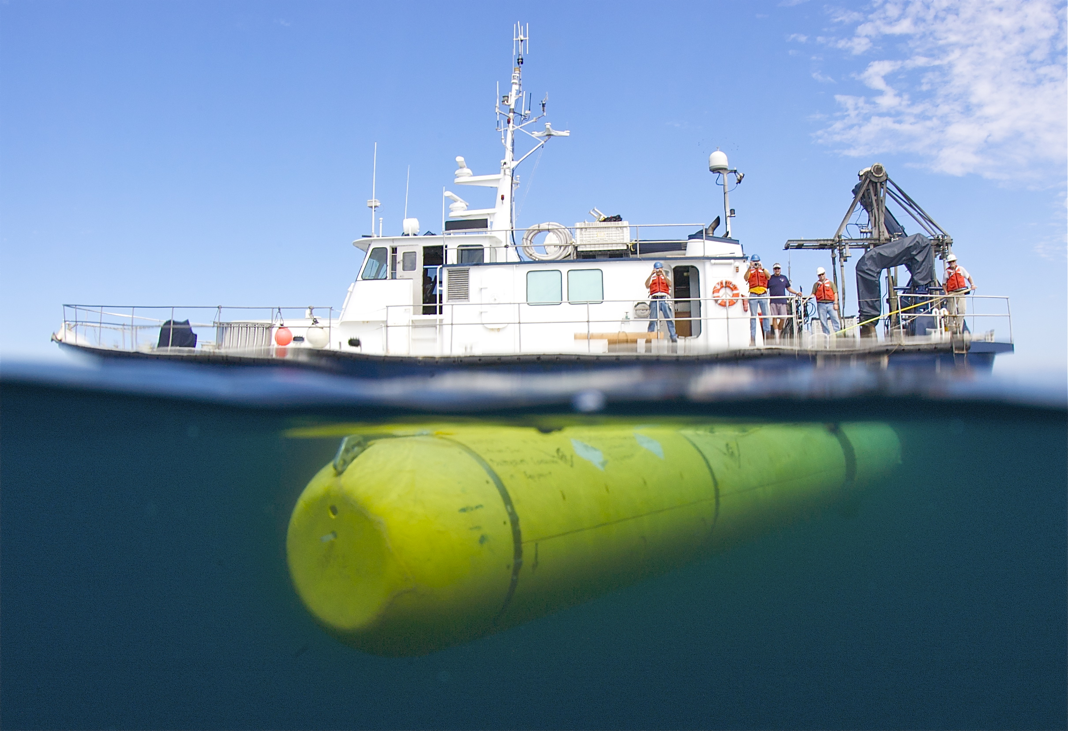

Dorado AUVs
Modular Vehicles for Diverse Science Customers
Hans Thomas
AUV Supervisor
Division of Marine Operations
Monterey Bay Aquarium Research Institute

Slide 2
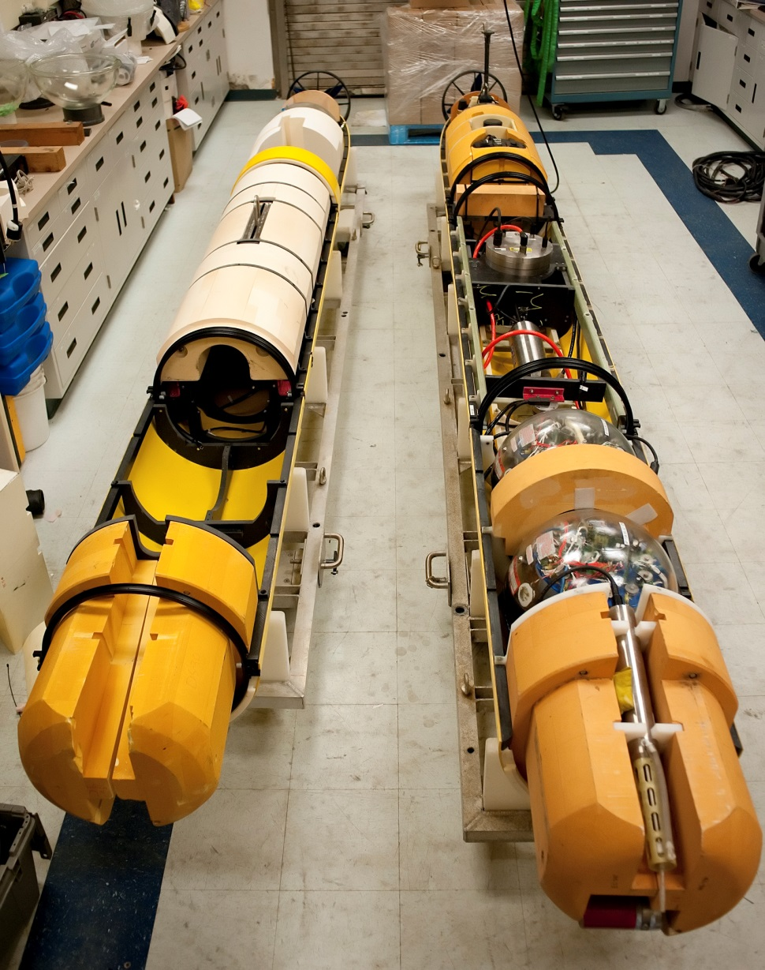
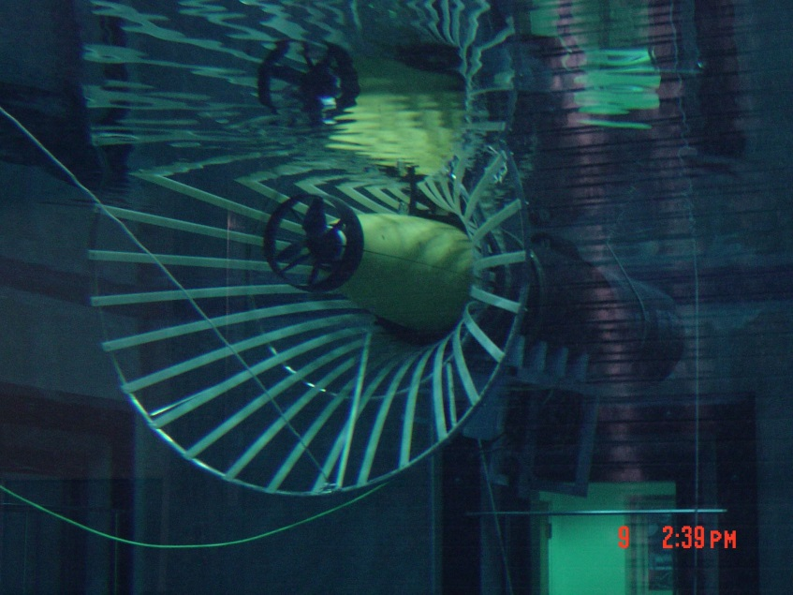
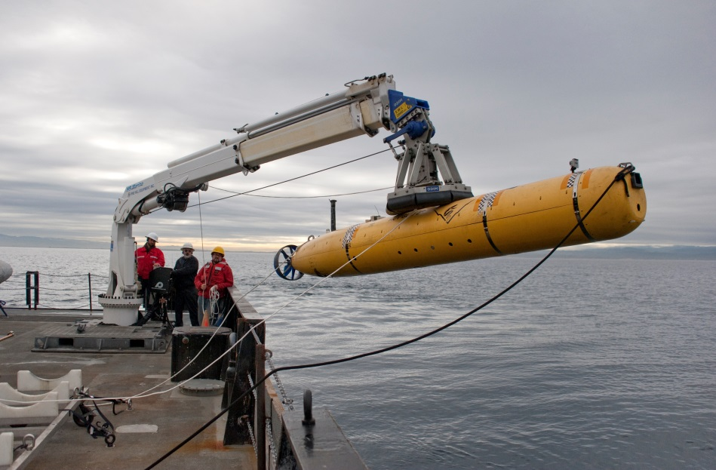
Dorado-Class AUV
Begun as a joint development project with Bluefin Robotics in 2000
21 inch diameter, up to 19 feet in length
Modular mechanical, electrical and software design
Several different vehicle configurations:
  Water column sampling
  Seafloor mapping
  Imaging
  Docking
  Experimental Instruments

Slide 3
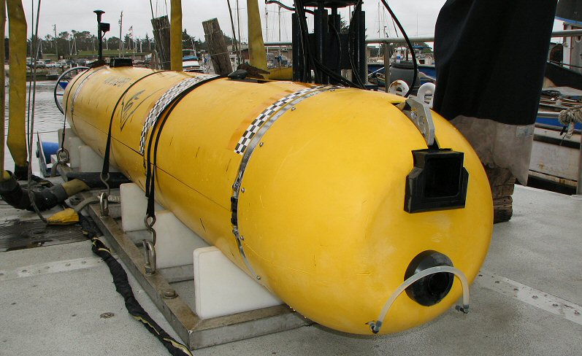
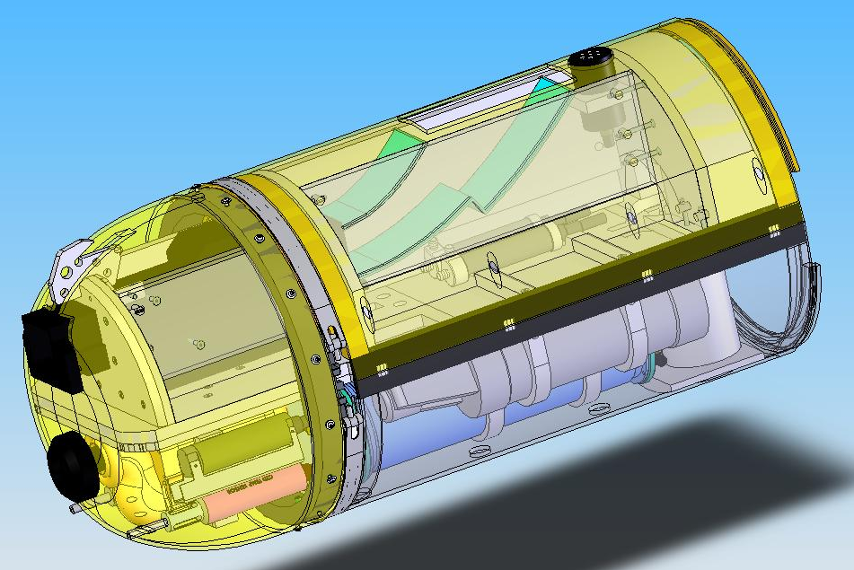
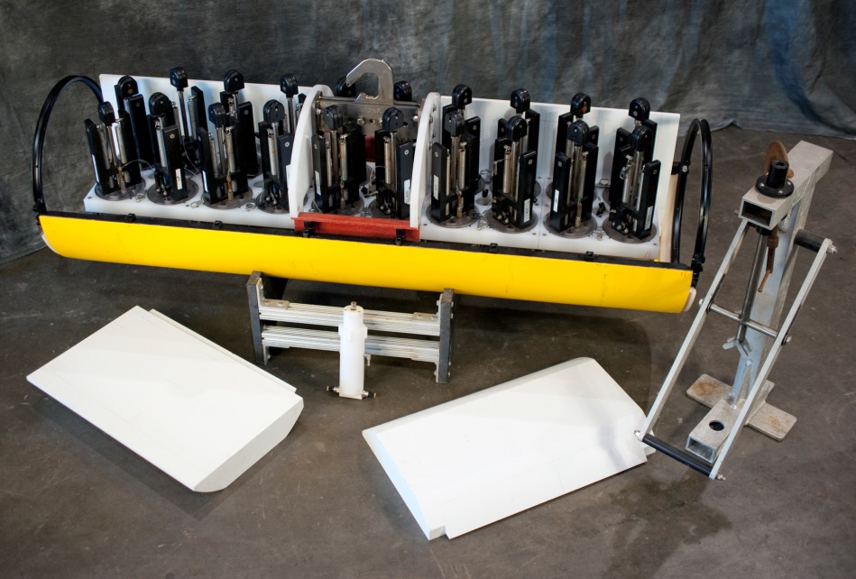
Water Column Survey & Sampling
19 hour endurance at 3 knots
Wide array of physical, chemical & bio-optical instruments
10 sample chambers (soon to be 20), 1.8 liter volume

Slide 4
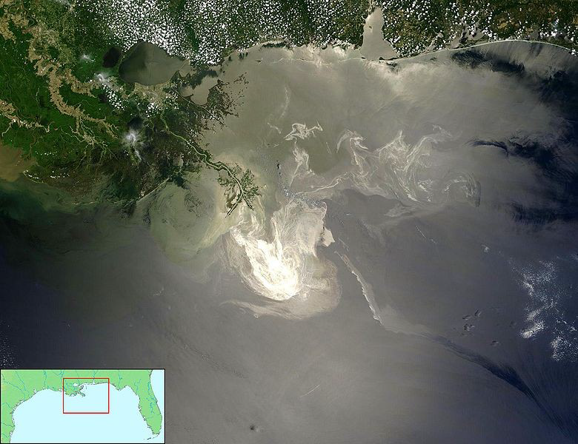
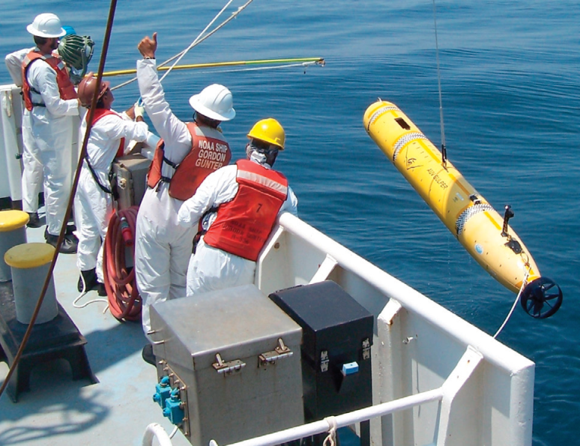
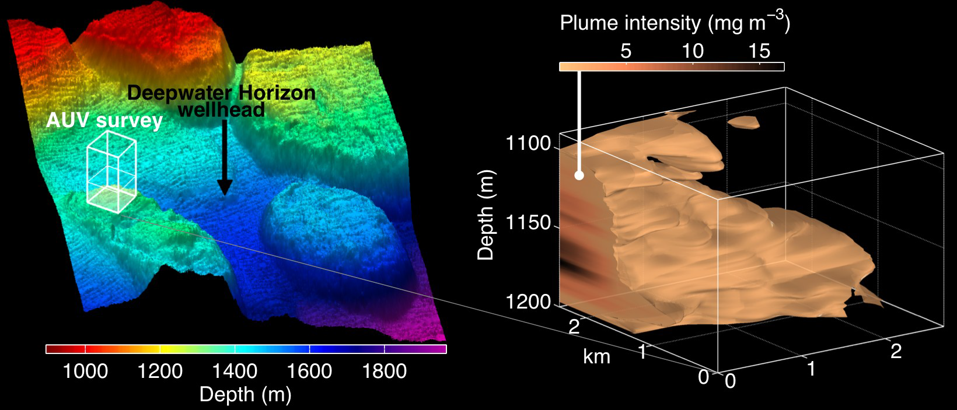
Deepwater Horizon Response Cruise
1 week mobilization of water column AUV and support team to GoM
Operated from NOAA ship Gordon Gunter as part of joint rapid response cruise
Adaptive sampling capability modified to precisely target hydrocarbon concentrations
Dorado provided capability to survey large, deep plumes unreachable by other AUVs on scene and return samples for in-lab analysis

Slide 5
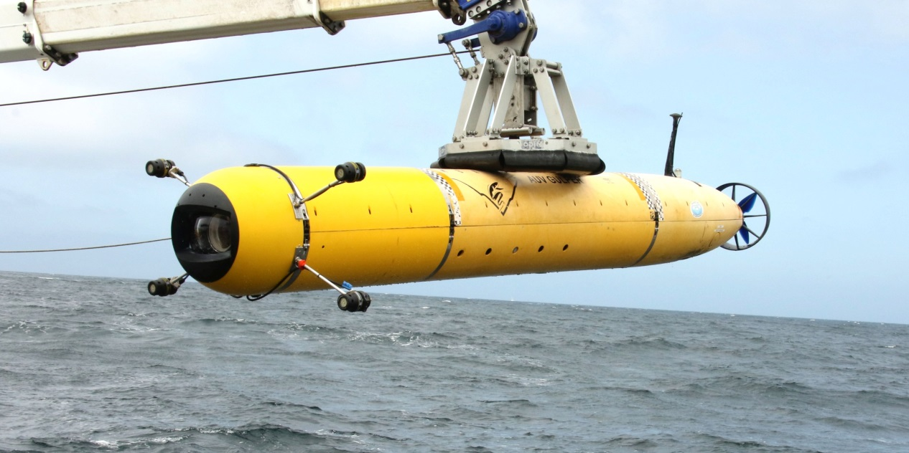
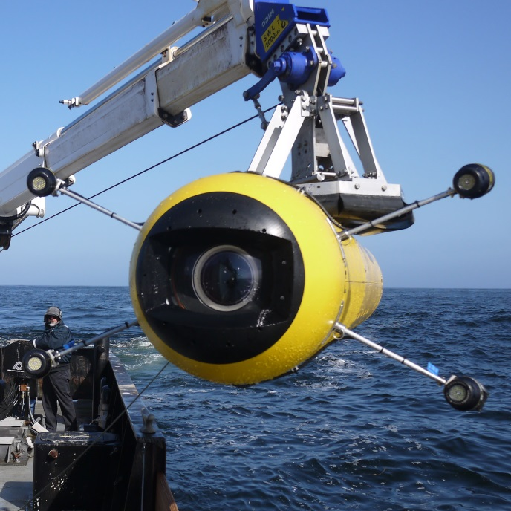
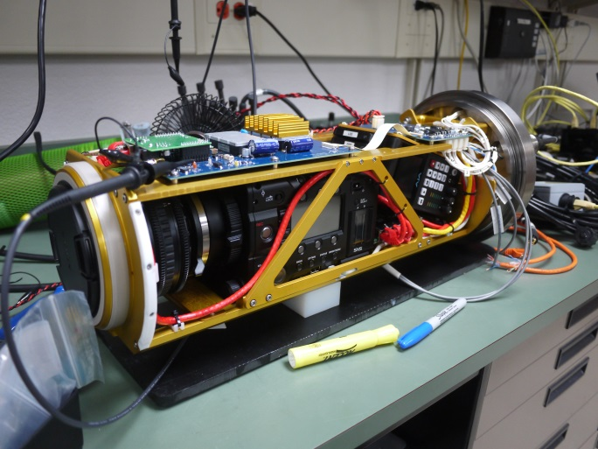
Midwater Imaging Configuration
Ship time costs can be reduced by :
  Combining with other missions
  Deploying from close to shore
HD or UltraHD video camera optimized for midwater transecting
Quiet
Potentially faster
Quiet and faster = less critter avoidance

Slide 6
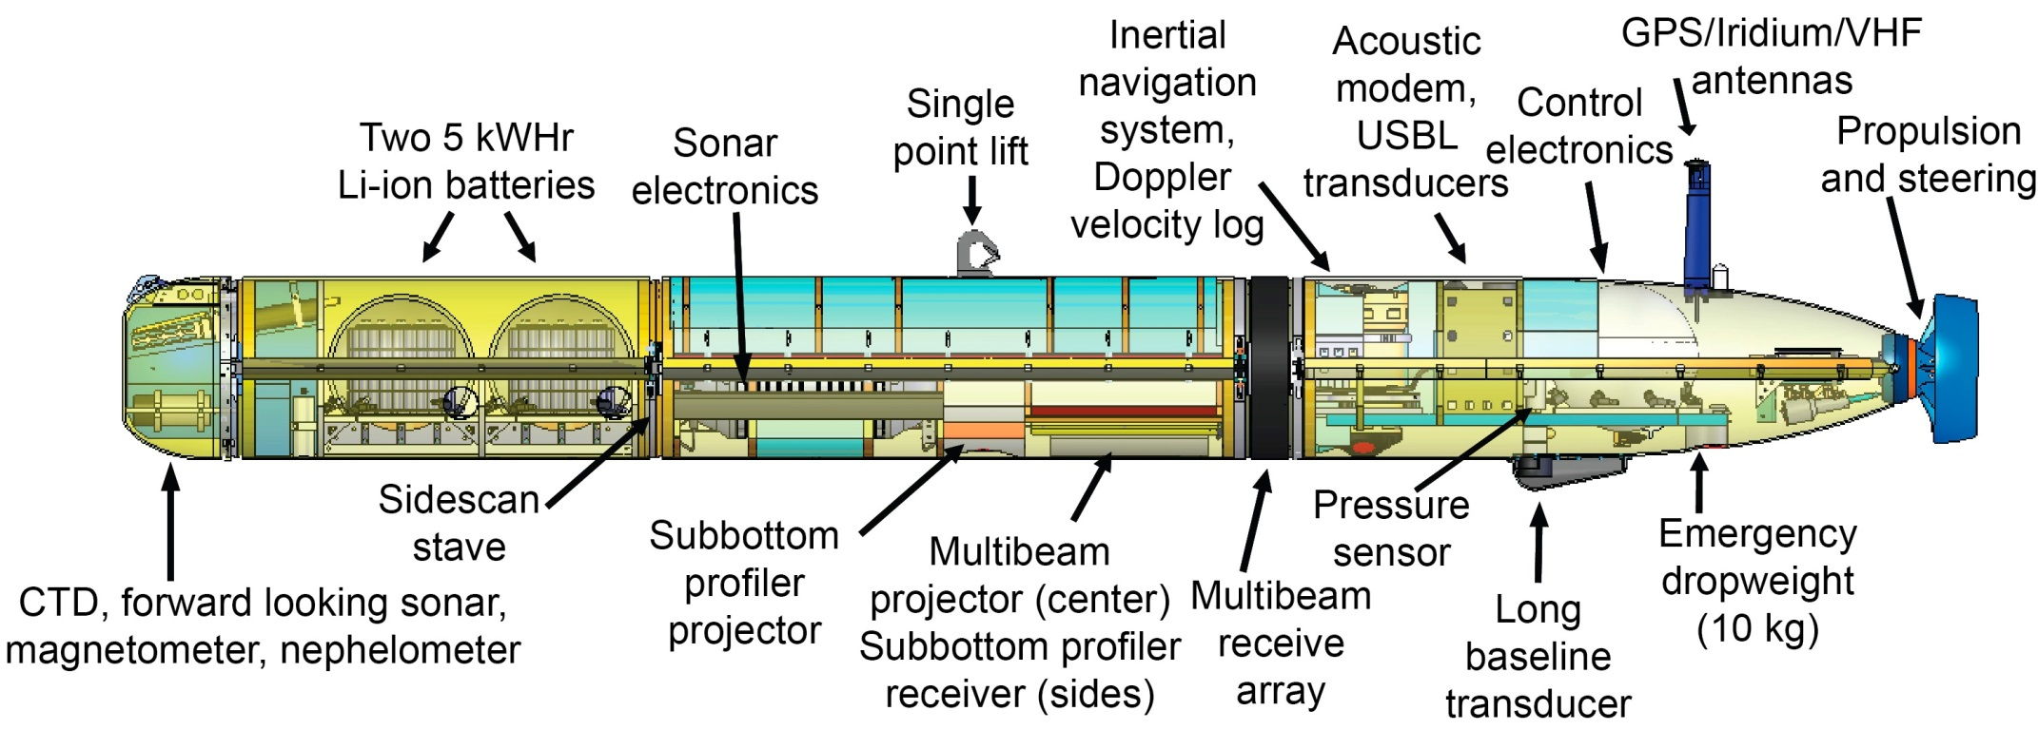
Seafloor Mapping
18 hour endurance at 3 knots
6 hour battery recharge
Initial data products in ~5 hours after recovery
Capable of >1m resolution bathymetry, operating at 50m altitude/200m swath
Provides ability to operate high resolution sonars near bottom in extreme terrain with high coverage rates & fast turnaround

Slide 7
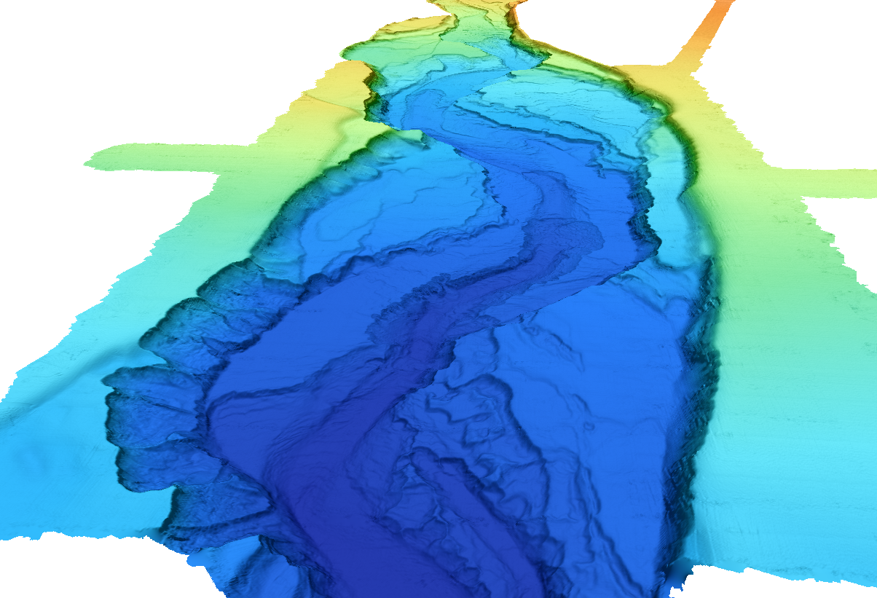
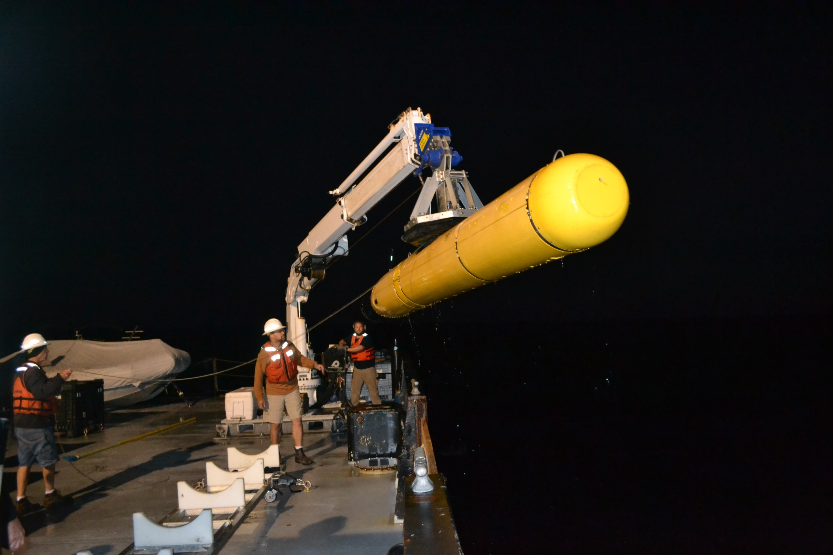
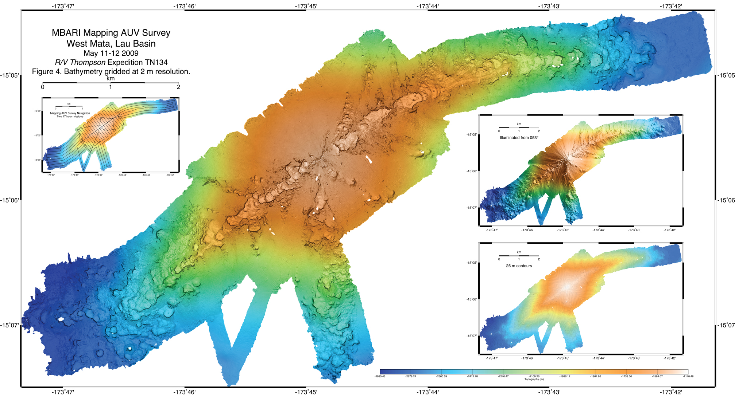
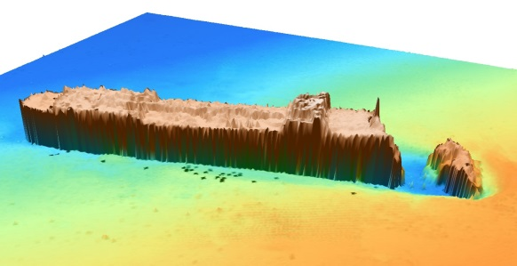
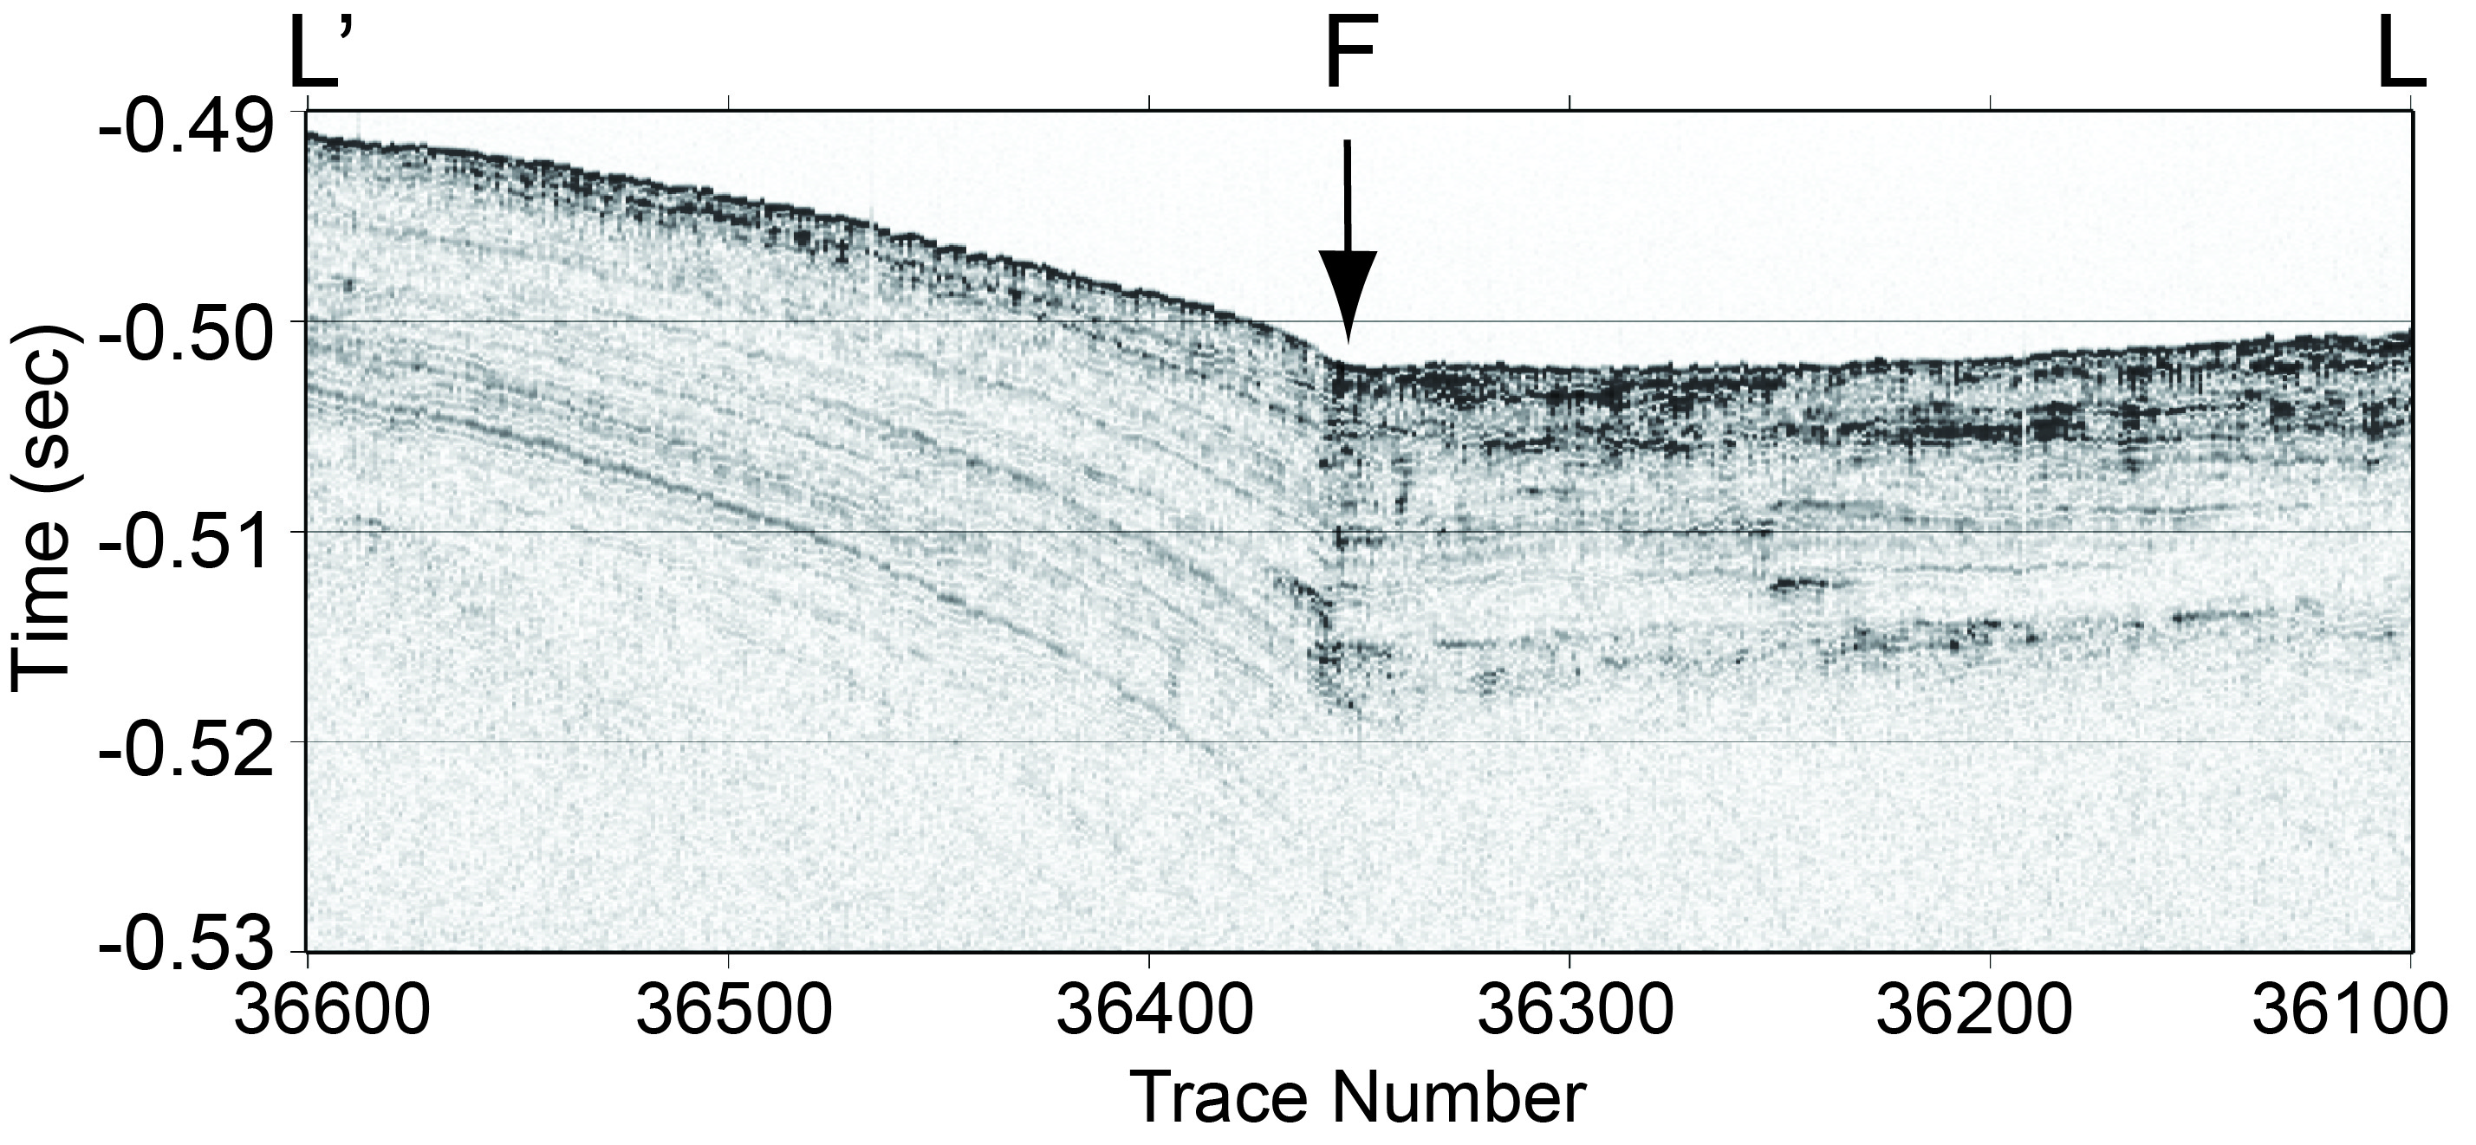
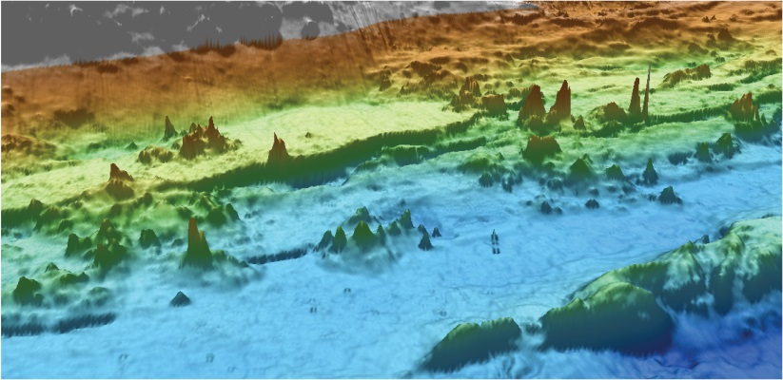
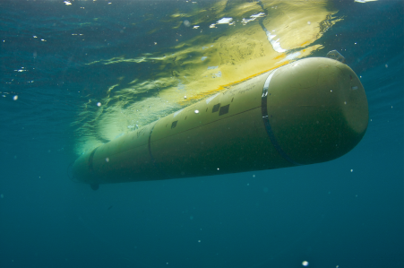
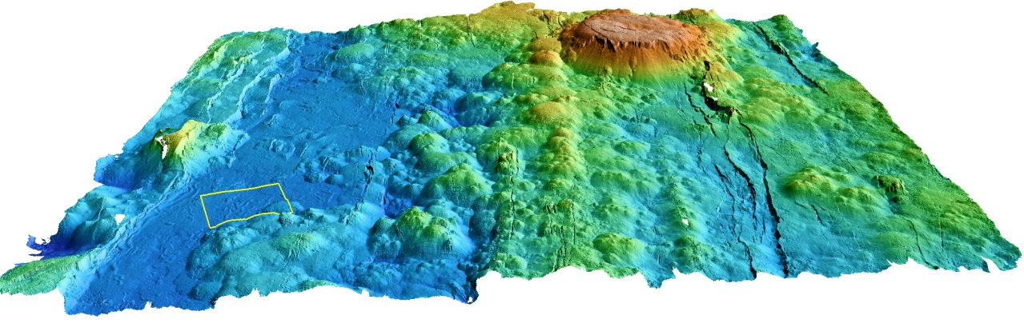
Successful Mapping AUV Survey Missions Since 2006…..
  Submarine Canyons: 59
  Seamounts: 12
  Hydrates: 18
  Spreading Centers: 38
  Lau Basin: 3
  Offshore fault zones: 21
  Fan systems: 14
  Slumps: 2
  Shipwrecks: 3
  Cable routes: 3
  Dumpsites: 1

Slide 8
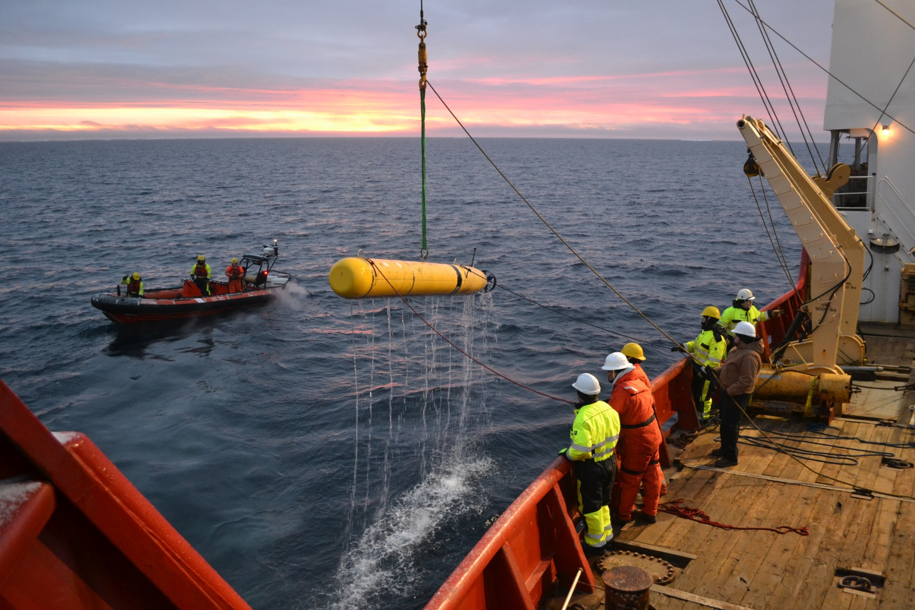
High Latitude Operations
October 2001 – Eastern Arctic
October 2013 – Canadian Arctic

Slide 9
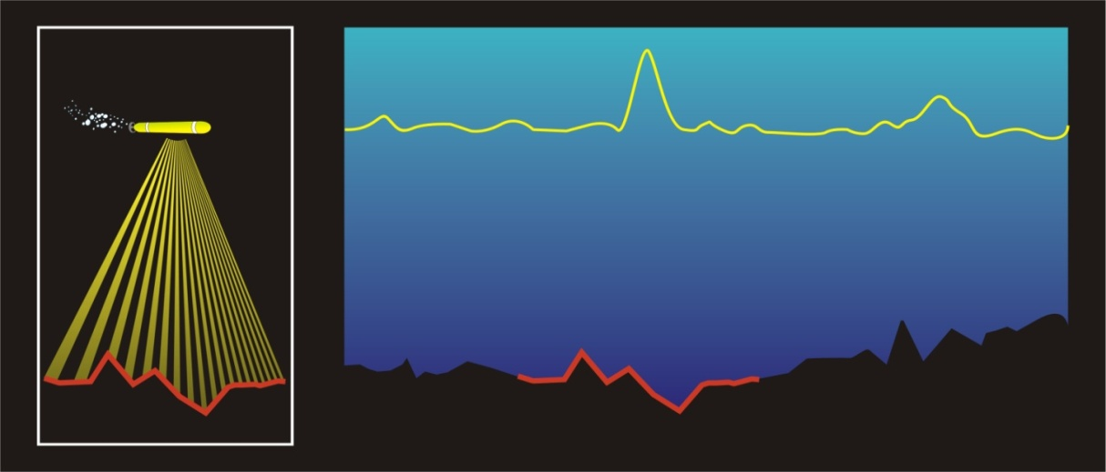
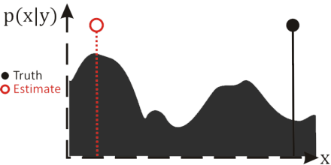
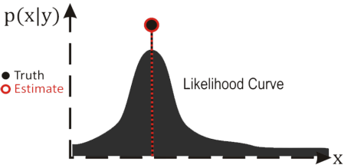
Terrain-Relative Navigation
Measurement
Likelihood Score
Terrain Map
Non-parametric filtering methods due to multi-modal distributions
Doppler Velocity Log (DVL) sonar used for correlation

Slide 10
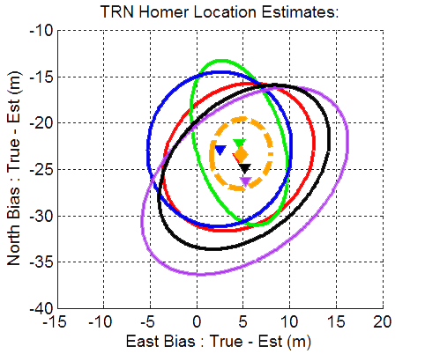
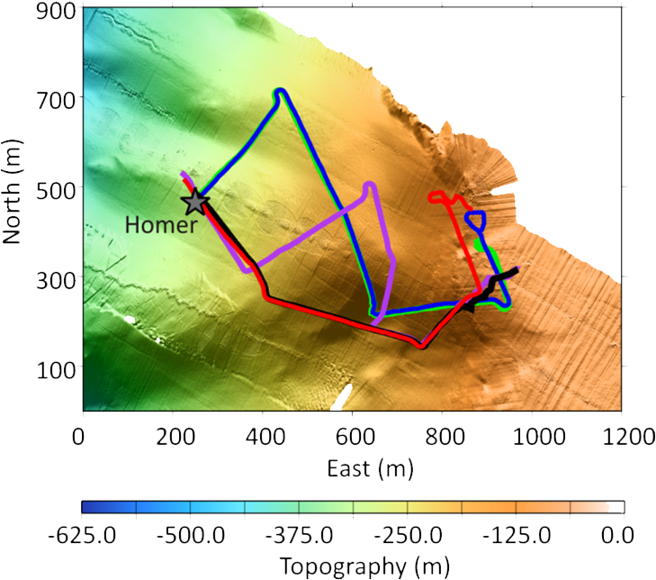
Georeferencing Errors
Repeat runs at Soquel Canyon

