Slide 1
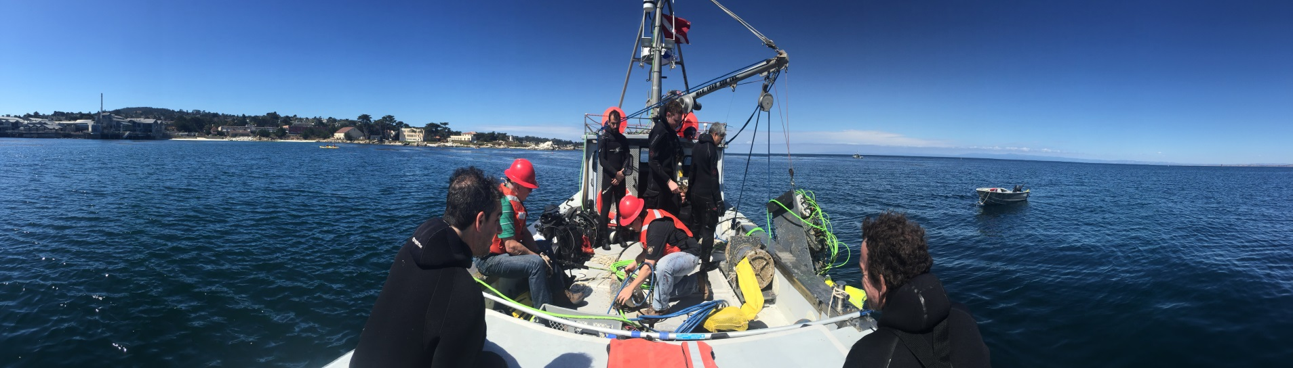
March 1, 2016
MARINE OPERATIONS UPDATE

Slide 2
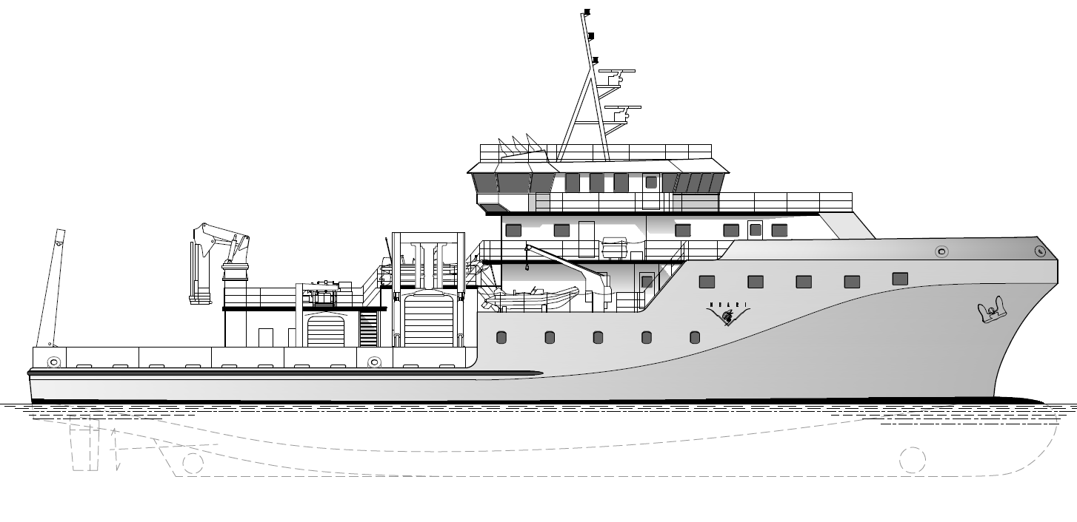
MBARI New Vessel (MNV)
Conventional monohull design
  Length Overall 170 ft.
  Beam 41 ft.
  Design Draft 12 ft.

Slide 3
MNV Key Characteristics
Endurance of 4000nm, and persistence up to 21 days
Ability to operate internationally; Mexico, Canada
Simultaneous operations of ROV and AUV
Large open work deck with A-frame and winch
Conduct scientific operations to at least Sea State 4
Capability for 24 hour operations
Central communications hub with high bandwidth link to shore, acoustic links to deployed network of platforms and sensors
Multibeam sounding system
Flexibility in transducer housings
Low acoustic signature

Slide 4
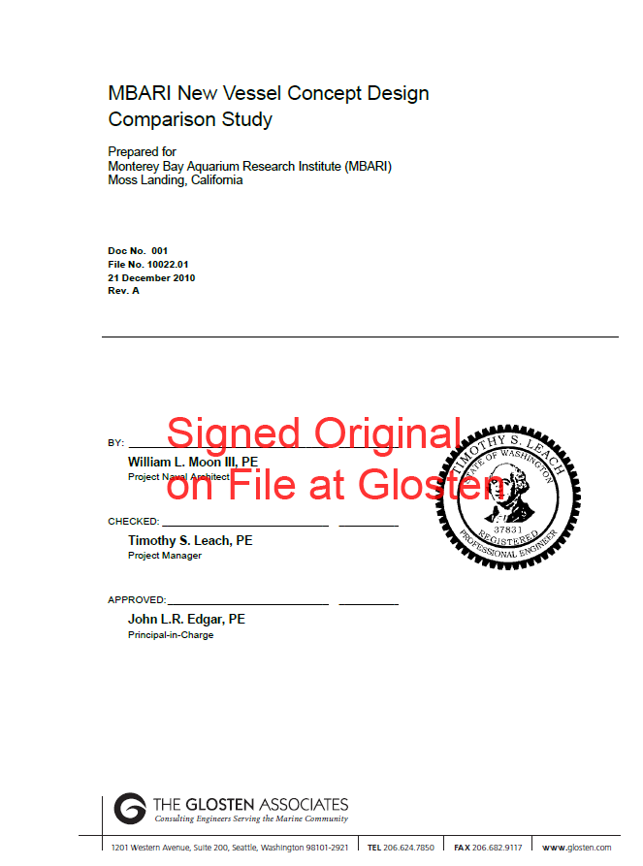
Completed Work
2009/2010 Significant work completed by MBARI and Glosten:
  Requirements
  Green initiatives
  Trade studies
  Conceptual designs
  Cost estimation

Slide 5
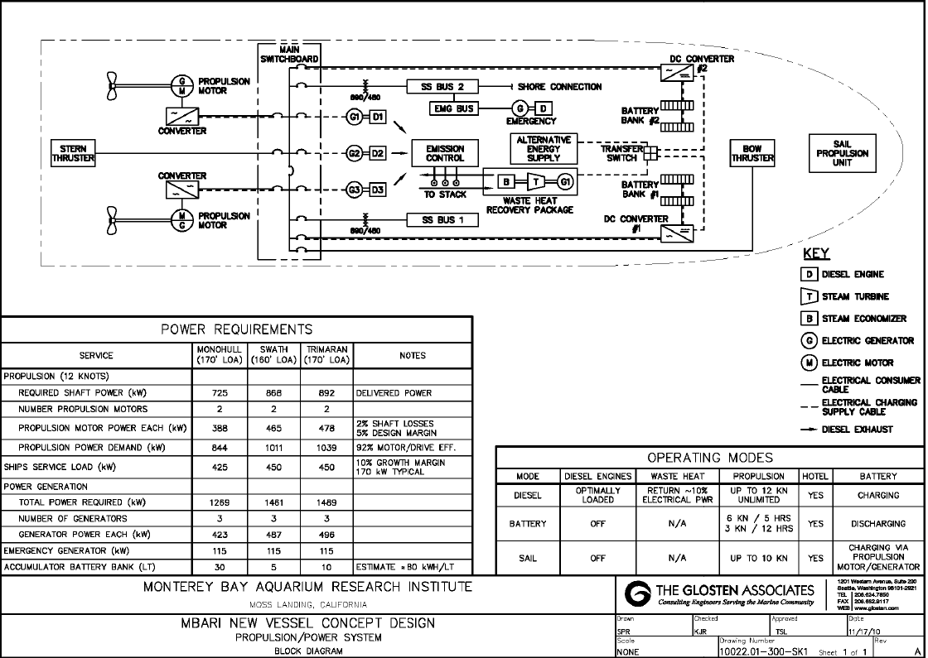
Green Initiatives
Advance Controls
Hybrid Power Plant
LED lights
Solar augmentation
Waste Heat Plant
Advanced Hull Coatings

Slide 6
MNV Proposed Construction Timeline

