Slide 1
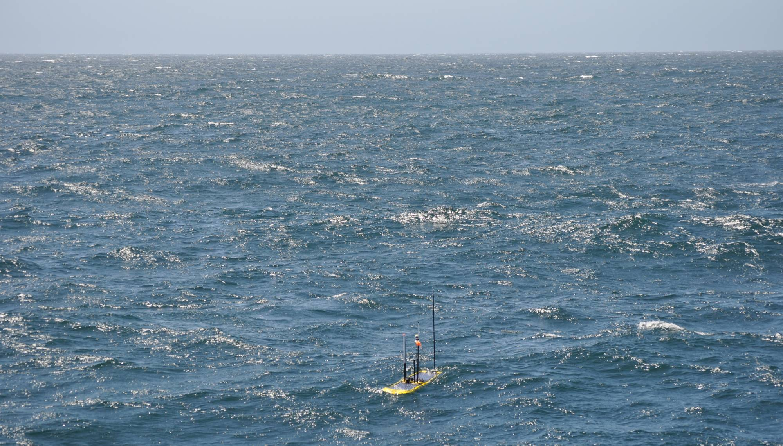
Wave Glider Communications HotSpot
Mark Chaffey
Project Team: Kanna Rajan, Tom O’Reilly, Frédéric Py, Thom Maughan, Mark Chaffey
Notes:
My presentation today is on a project we have been working on this spring, a Wave Glider based radio communications hotspot.
I should add that this presentation is very timely – we just conducted our initial field tests last week!

Slide 2
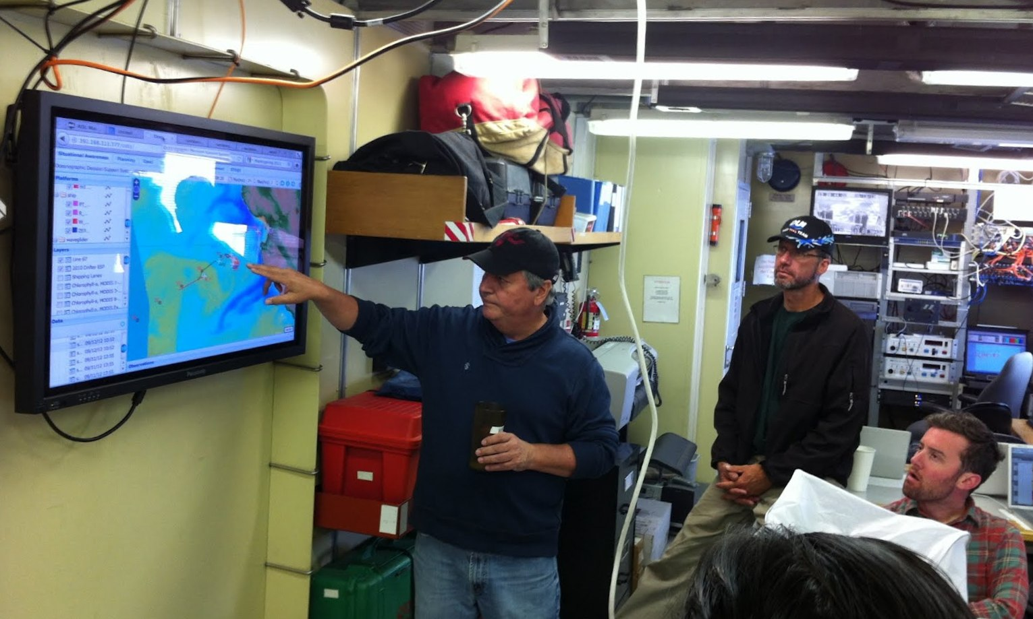
The Importance of Real Time Data Return
Provides raw data for the MBARI Ocean Decision Support System (ODSS) software application for coordinated mission planning.
Allows re-directing assets during dynamic field experiments with collaborative adaptive sampling, one of the major themes of our current field initiatives.
  Coordination of sampling decisions with the ESP where every sample counts.
  Determining where to take AUV Gulper water samples.
  Where to take water samples from a ship.
For returning high quality intermediate data from Tethys during long missions (up to 20 days!).
All possible due to the communications revolution.
Notes:
I would like to start by echoing a major theme of MBARI’s research and what we’ve been hearing about today, and that is the increasing dependence on real-time data for decision making during the course of field experiments.
Here we see Francisco Chavez using the comprehensive MBARI software application ODSS for a field experiment last Fall. Adequate real-time data is the raw material for ODSS’s visualization and decision making tools.
It’s a big ocean out there and real time data is necessary for making informed sampling decisions, a major theme of our field programs. This is especially important when you have limited capacity, for example the AUV Gulper water sampler or the Environmental Sample Processor.
The AUV Tethys is an exciting new tool with missions up to 20 days. The ability to return high quality intermediate data is of great importance.
Thanks to the revolution in communications that has been occurring over the last several decades more data is available in real-time from remote field experiments then has ever been possible before.

Slide 3
Current AUV Methods of Sending Data to Shore Data Servers and ODSS
Iridium – 2.4kbs – 340 byte messages
ODSS
IP WAN
MBARI network
Firewall
Dorado AUV
Tethys AUV
Data downloaded after each mission
Update rate once per operational mission (daily)
Data transmitted by Iridium satellite every 1-4 hours
Very reduced data set
Both vehicles are very constrained by AUV antenna height and space
Notes:
Before I go into the details of the HotSpot, let me describe the current method of returning real time data from MBARI’s two types of AUV’s .
The missions for our larger AUV, Dorado tend to last for less than 24 hours and the data from each mission is uploaded after the AUV is recovered and back on the deck of the support ship.
Our long endurance AUV, Tethys, sends very highly compressed data sets back through the Iridium satellite constellation when it surfaces for navigational fixes.
The resolution of this real time data set is limited by the AUV data communications constraints:
By necessity the surface time is limited. More time on the surface is less time performing the science mission.
The highly optimized nature of AUV’s makes it difficult to support multiple options for radio communications both inside the vehicle and in the outside antenna design.
Lastly the AUV antennas are very close to (or in!) the water and for any direction other then straight up they have very limited range.
All of these factors place large constraints on direct AUV to shore communications.

Slide 4
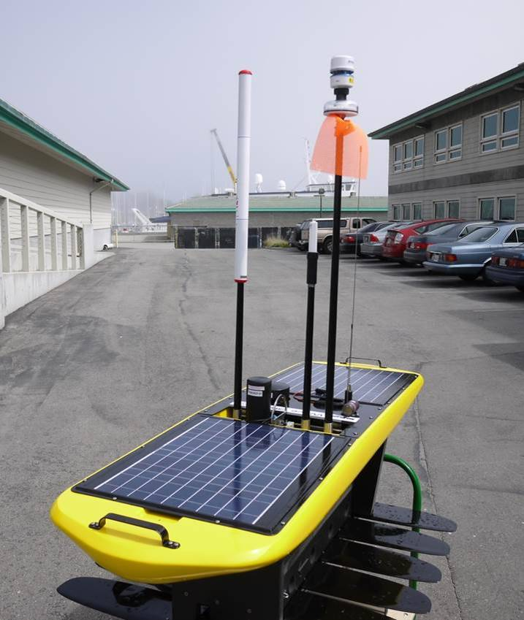
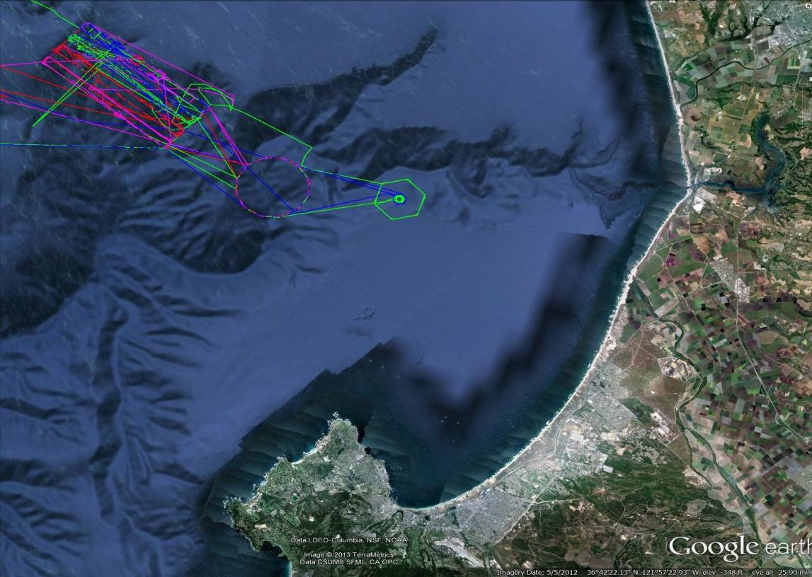
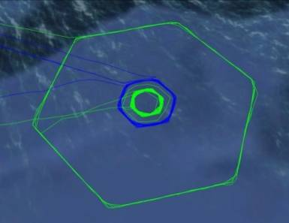
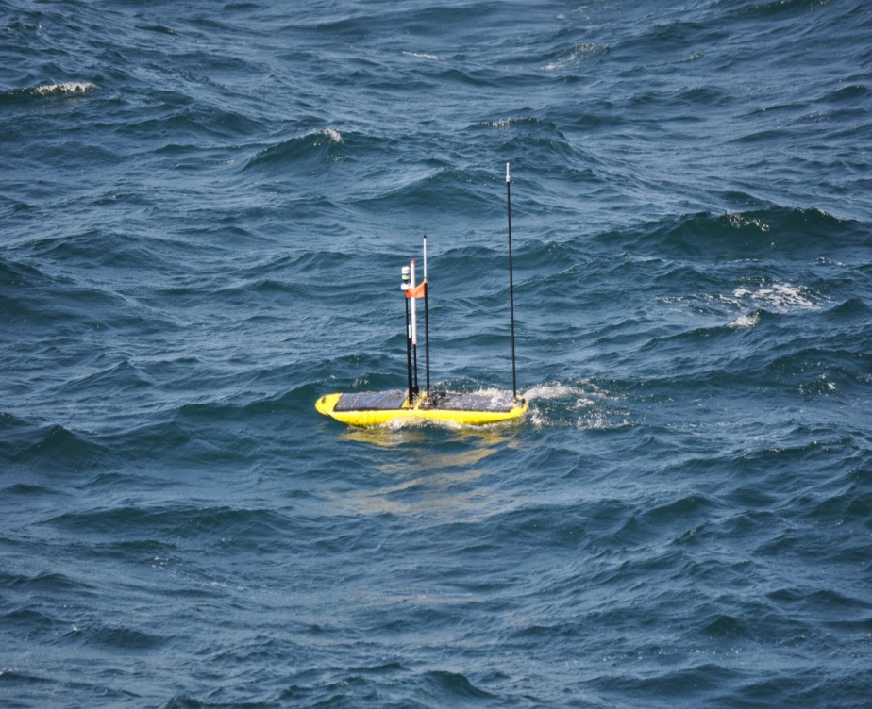
The Wave Glider – HotSpot Platform
+/- 15 meters
Notes:
Introducing the Wave Glider. This remarkable craft was invented and is being manufactured by the Liquid Robotics Company in Sunnyvale CA.
It’s forward mobility is powered completely by wave power, and uses electricity only for controlling it’s small rudder. This leaves ample electrical energy available for payloads.
The Wave Glider is shown here on a support frame, but in operation at sea these fins are about 20 feet below the surface craft and the two are connected by a stout cable.
It is very agile and in any kind of sea condition will average around 1.5 nautical miles per hour. This is about half the speed of an AUV. In this lower photo you can see that it is leaving a visible wake.
The Wave Gliders navigational accuracy and endurance are very impressive. Here is a series of tracks of four wave gliders (Benjamin, Piccard Maru, Papa Maru and Fountaine Maru) that were sea-trialing in Monterey Bay and then transited directly to Hawaii, over 2000 nautical miles!
The repeatability of track lines is about within about 30 meters as you can see when I zoom in.
As you can see, the Wave Glider has the mobility and navigational accuracy required for a rendezvous with an AUV.

Slide 5
The Advantage of a Wave Glider Surface Data Relay – a Radio “Hot Spot”
Flexibility and access of a surface platform allows the use of faster, less expensive data links.
  Continuous access to GSM Cellular phone or Satellite communications.
  Large energy budget for communications.
  Radio antennas can extend clear of the wave splash zone.
  Payload space for multiple high powered radios.
Notes:
Unlike an AUV, a Wave Glider can maintain continual connection with satellites and if within about 10 nautical miles of shore, the commercial cellular phone network.
Whereas an AUV must do all of it’s communications during a brief surface interval, a Wave Glider HotSpot can use less robust but higher data rate radio links. If data does not initially get through it can be continually re-sent until it does.
The HotSpot can use some intelligence on which radio system to use. It can first attempt a connection using the lowest cost option, then, if that is not reliable enough, it can switch to a higher cost but greater range data relay such as satellite.
The energy budget of the Wave Glider is greater than possible on an AUV and energy can be replenished using solar panels or other means.
Of course the mounting of antennas is much easier and they can be much higher above the water.
There is also plenty of space for radio hardware.
5

Slide 6
The Communications Revolution - Comparison of Data Rate and Costs for Surface HotSpot Radio Relay
Notes:
These two graphs compare the data rate and cost of the three radio communications options available for delivering real-time data.
Satellite services are in blue and cellular ground service in orange.
The Iridium satellite constellation short burst data service – the current Tethys system. This service offers high reliability, low power and worldwide coverage. Most importantly it has an availability of around 90-95% so AUV’s are almost always able to make a connection when they surface – very important – but the tradeoff is that it is correspondingly slow in sending data.
The Globalstar satellite constellation is shown here. It has an availability of around 40-50% but a higher data transfer rate. The poor availability makes it unsuitable for human-to-machine communications, but fine for machine-to-machine or M2M communications. A computer does not mind having to continually redial to get the entire data set through.
In orange here is the commercial 3G cellular phone network. Note the large change in scale. The data throughput is about 300-400 times the Iridium satellite system.
On the right we look at costs per byte. Here again there is a major scale change and the Globalstar satellite system is more than several orders of magnitude less expensive then the Iridium SBD messaging system.
With a data cost of $25 per GByte, the commercial 3G cellular phone network is essentially free in this application.
The bottom line is that AUV’s must use Iridium for robustness, but the Wave Glider HotSpot is not similarly constrained and can select the most appropriate radio link.

Slide 7
The Wave Glider HotSpot – a Mobile Surface Radio Relay Platform
HotSpot relays the AUV data through Verizon cellular service to MBARI
HotSpot collects data from AUV’s during the brief interval they surface for GPS navigational fixes
GSM Cellular – 900kbs 1 GByte + per day
IP WAN
ODSS
MBARI network
Firewall
AUV
7
Notes:
This schematic illustrates how the data transfer takes place from AUV’s to shore.
First a rendezvous is required between the AUV and the Wave Glider. I should mention that the optimization of the rendezvous provides a rich problem set for MBARI’s efforts in Autonomy research and development.
When the AUV surfaces for a navigation fix (and rendezvous) radio communications are established with the Wave Glider HotSpot.
The local communications between the AUV and HotSpot are short-range and take place over a high-speed radio link. This keeps the surface time of the AUV at a minimum.
This is important. The more time the AUV is on the surface the less time it is spending on it’s mission. It is vulnerable to collisions with surface vessels and can drift away from the sampling area requiring even more time to resume collecting data.
The next step is that data files are then transferred from the Wave Glider to MBARI’s servers and the ODSS application through the commercial cellular phone network.
7

Slide 8

How the Wave Glider HotSpot Works – a Mobile Surface Radio Relay Platform
Globalstar – 4.8kbs
25 MByte per day feasible
If beyond cellular range the HotSpot relays data through satellite service
ODSS
IP WAN
MBARI network
Firewall
AUV
8
Notes:
If the operational area is greater then 10 nautical miles off-shore, or in a remote area of coast then the cellular phone network may not be available.
In this case the Wave Glider HotSpot changes to satellite communications for the data link to shore.
8

Slide 9
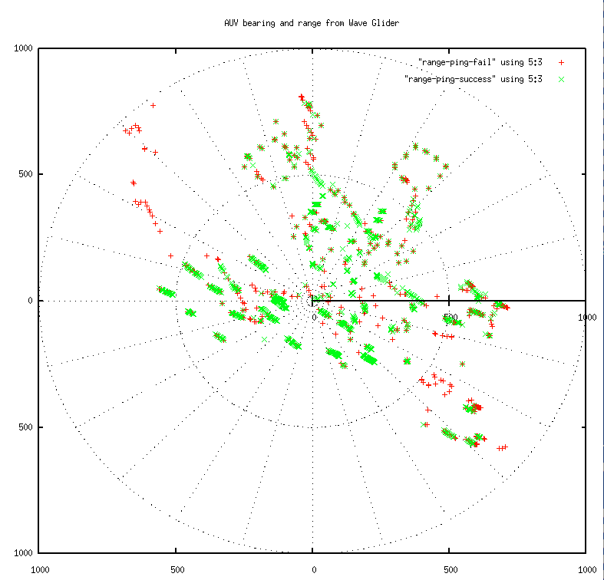
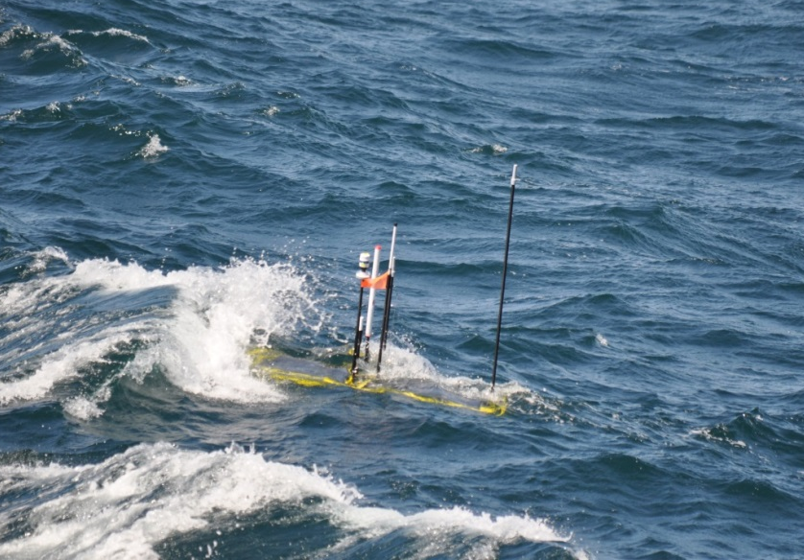
Field Test Preliminary Radio Range Results
Test conditions : significant wave height between 6-8.5 feet, average wind speeds ~20 knots
Notes:
We conducted field trials over two days using the AUV Dorado. The Wave Glider was put in a 100 meter box holding pattern and the AUV was commanded to a series of ranges from which we conducted radio tests of the data transfer rate between the AUV and Wave Glider with the AUV on the surface.
We really needed to find out if the very low AUV antenna would result in too short a line-of-sight radio range to be useful.
Obviously, the radio range needs to be greater then the predicted rendezvous error of the two platforms.
These very preliminary results show that we were able to get a solid radio connection and data transfer at 400 meters separation and a poor radio connection and very slow data transfer at 500 meters.
This plot on the left show successful Ethernet packets (or pings) in green and failed packets in red. Although you can see individual failures even at short ranges as waves block the radio signal, most of the packets are successful and we were able to achieve high data rates out to about 400 meters.
The next step is to conduct tests of the cellular phone connection to shore.

Slide 10
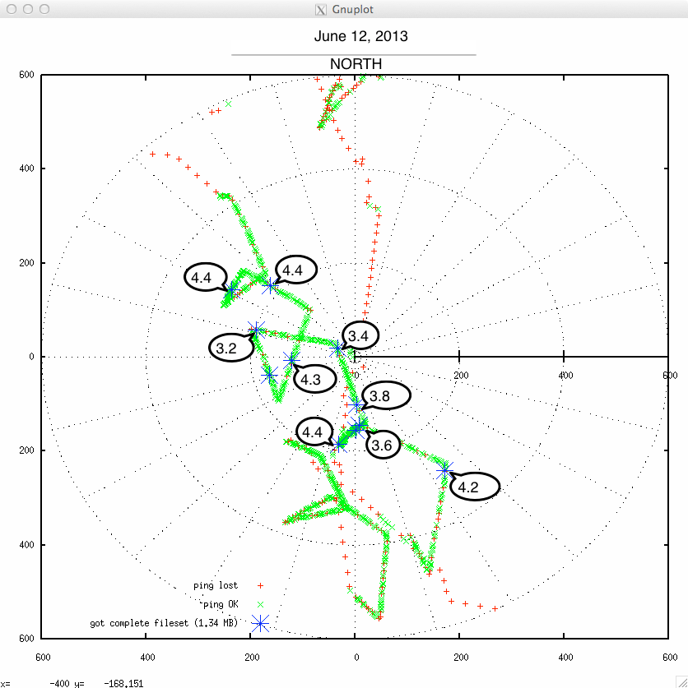
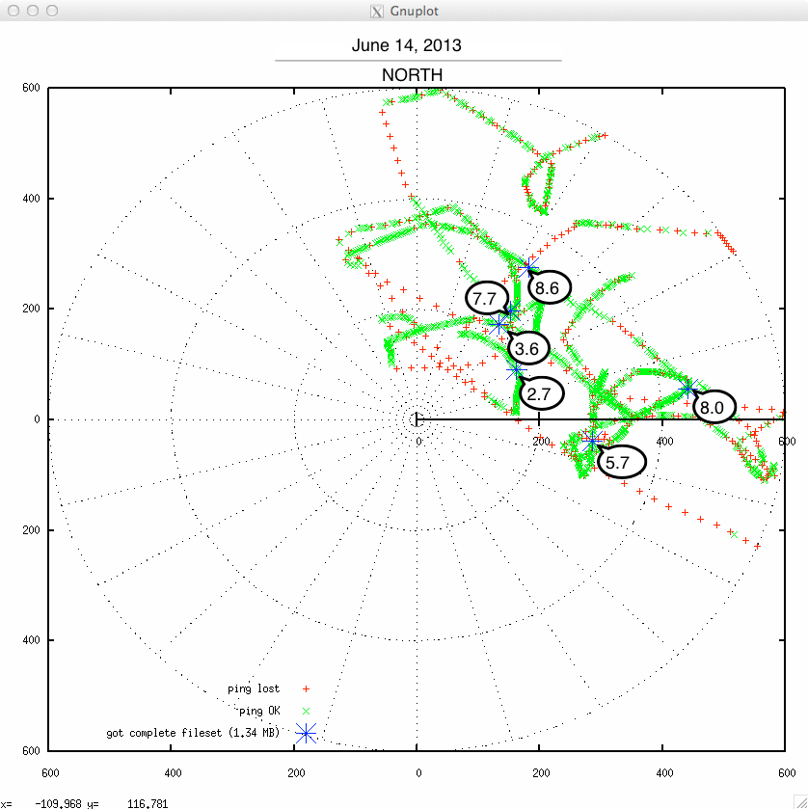
Preliminary HotSpot Radio Test Data – AUV Dorado to Wave Glider using 900mHz FreeWave Radio
Range with WG in center. Minutes to download 1.34MB data, sea state – rough, wave Hs 6-8 foot, winds 18-20 kt avg.
Tom O’Reilly & Mark Chaffey 19JUN13

Slide 11
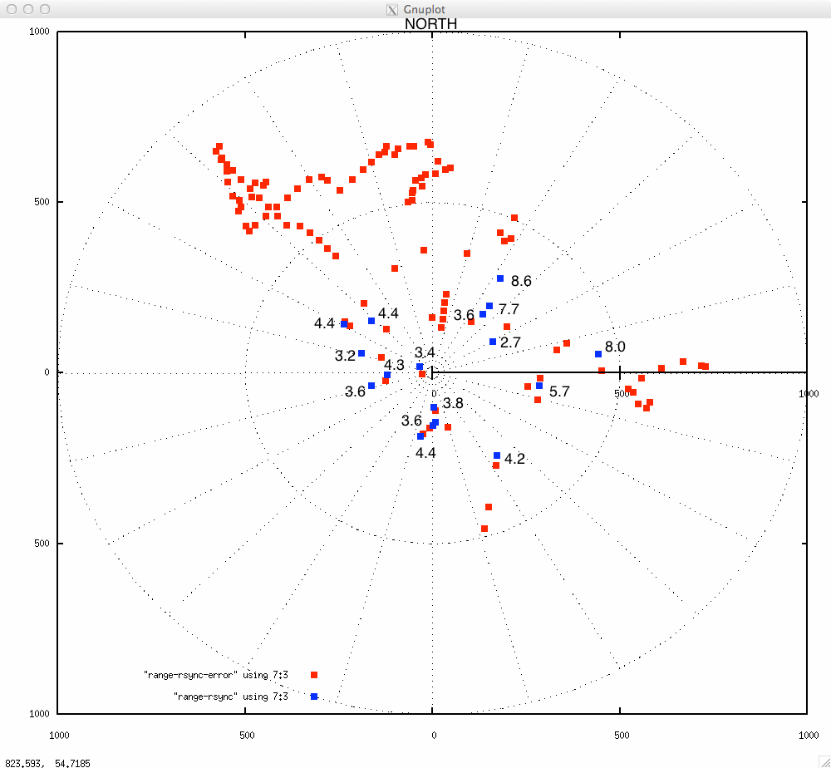
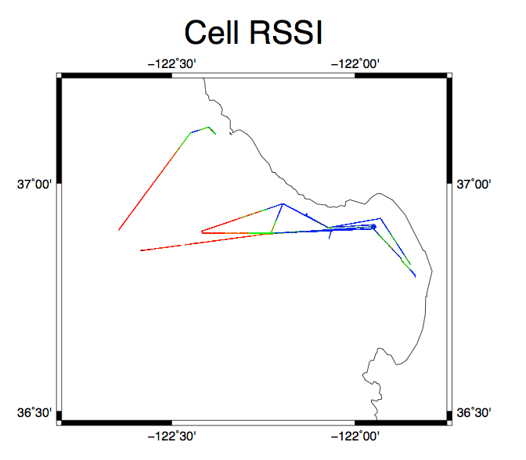

Slide 12
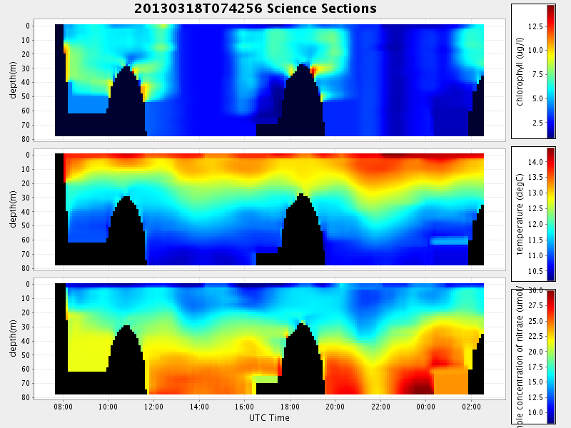
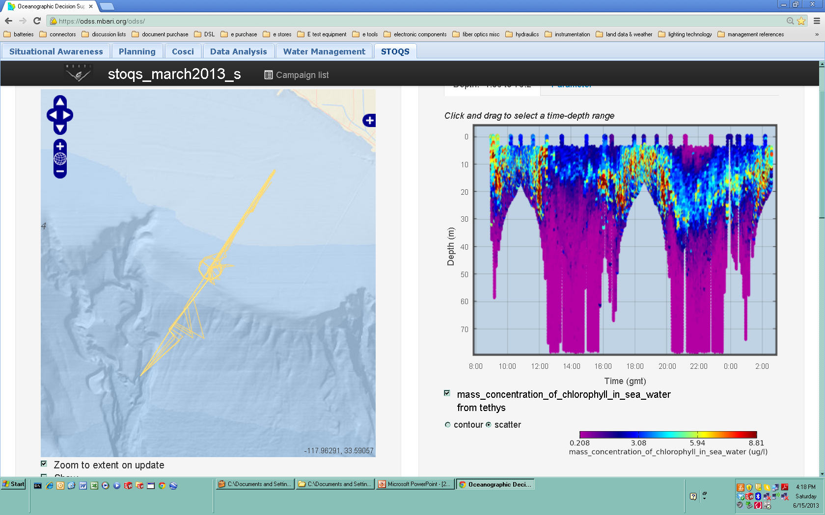
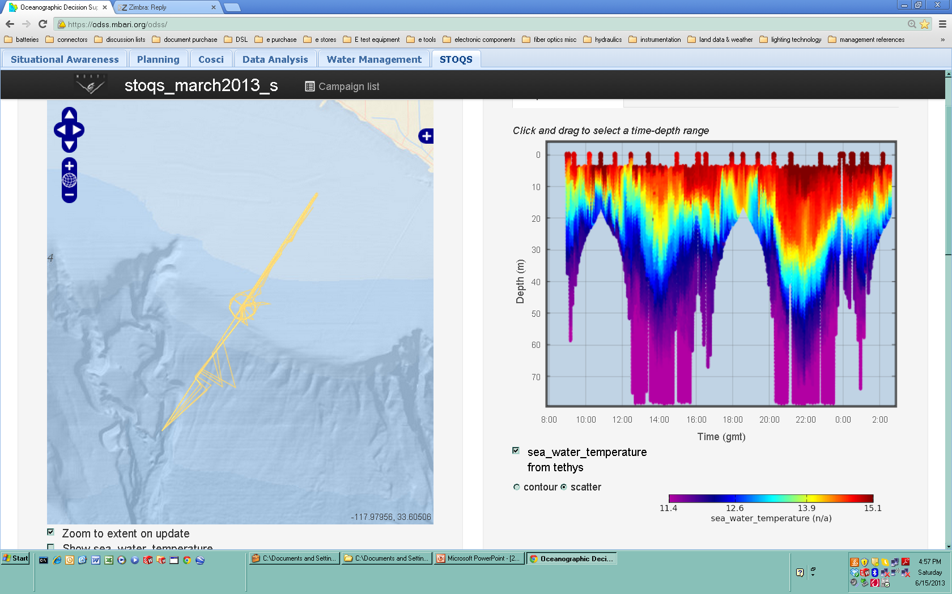
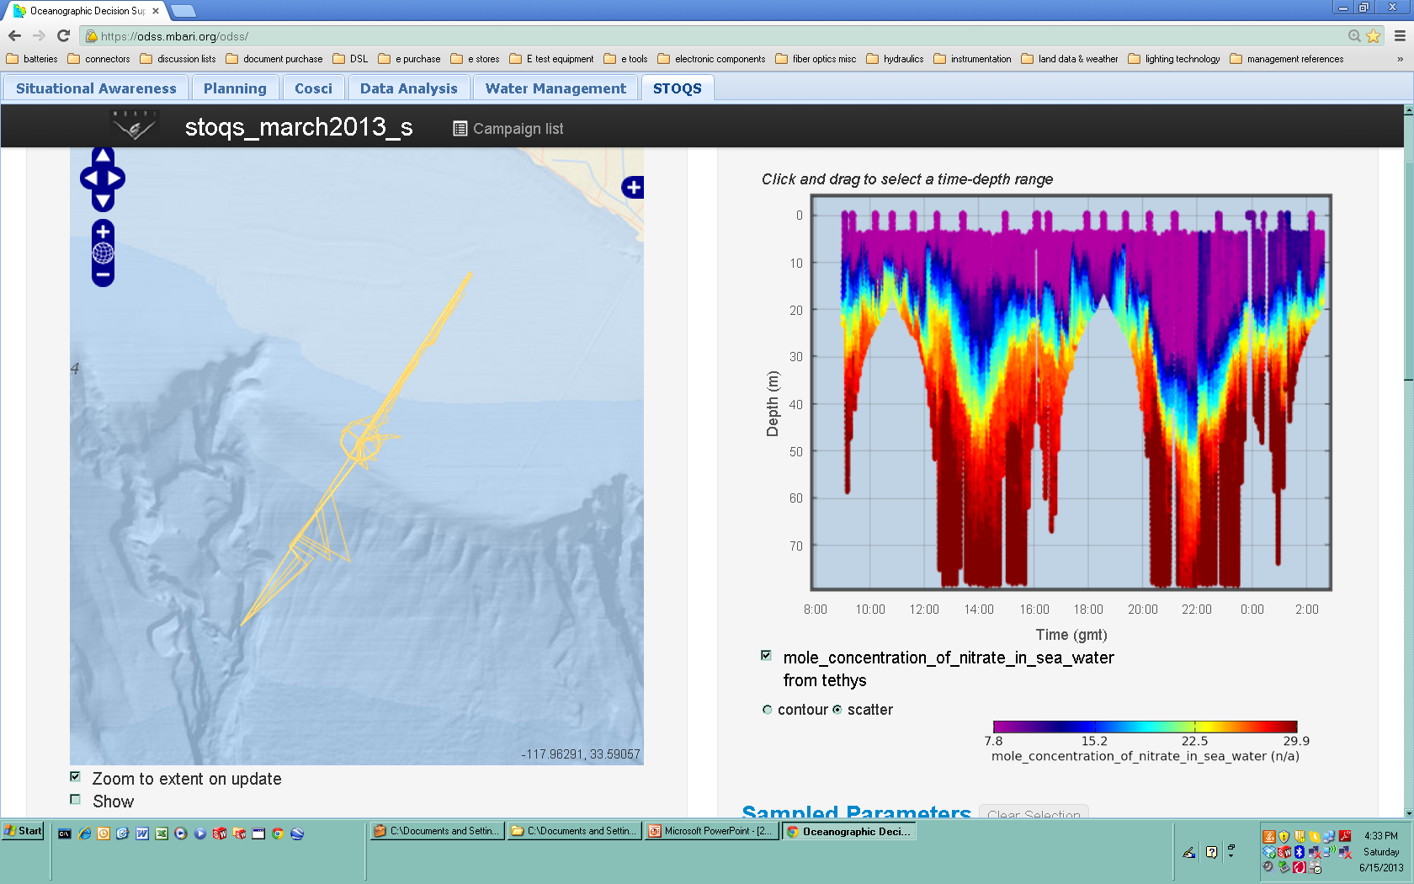
What Can We Expect From More Real-Time Data Return?
an example from Tethys ECOHAB data from March 18, 2013
Real-time returned data – contour plot
10% of all returned data – scatter plot
chlorophyll
temperature
nitrate
AUV surface interval restricted to 5 minutes maximum Each plot represents between 750 and 900 data values
Each plot 15,159 data values
Notes:
This slide of Tethys data from the ECOHAB experiment in March illustrates the effect of restricting the AUV’s surface time to 5 minutes for data downloading of real-time data in the current system. The vehicle sends back a very reduced data set as shown on the left side plots. I want it clear that the sparse data represented on the left is the result of restricting the AUV surface interval, and if the AUV was allowed to remain on the surface longer the plots would have more resolution.
The data in plots on the right side is a decimated version of the complete data set for each of the three parameters, chlorophyll, temperature and nitrate.
We predict however that based on the number of data values represented here and our experiments with the Wave Glider HotSpot, for future experiments similar to this one, if the AUV is within about 400 meters of the Wave Glider HotSpot, we should be able to bring back data sets in a 5 minute surface time comparable to the higher resolution plots on the right..
We should also be able to bring back complimentary data sets from the AUV’s in experiments such as this one that were not being returned at all in real time due to data rate and surface time limitations.

Slide 13
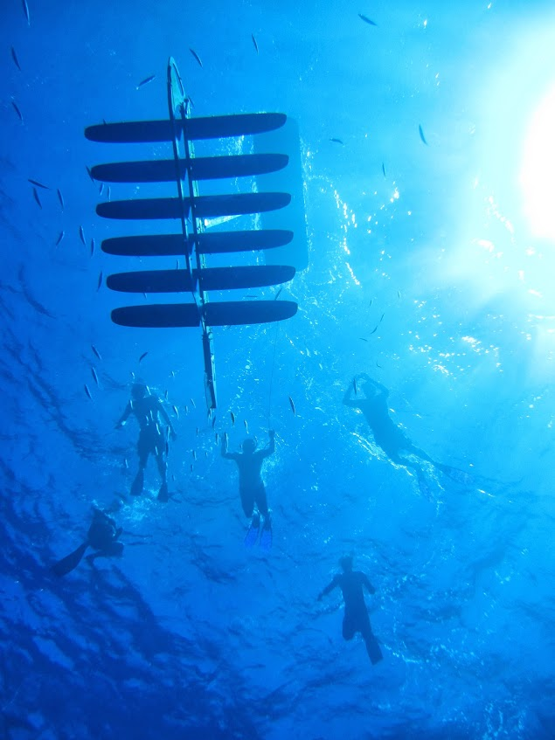
Other Potential HotSpot Applications
Returning high bit count data sets during a mission that are not currently feasible:
  Photo and video data
  Acoustic Doppler Current Profiler (ADCP) backscatter data for zooplankton detection
With the addition of an underwater acoustic modem.
  Returning small data sets without the AUV surfacing.
  Providing navigation data to AUV’s while underwater also reducing the frequency of AUV surfacing.
The Wave Glider is one of the most exciting oceanographic platforms of the decade and has the potential to return more real time data then ever before.
- The Wave Glider with HotSpot is next on the walking tour!
Notes:
Finally I would like to end by pointing out a few potential applications that the Wave Glider HotSpot opens up that have not been possible before:
We could return extremely large files such as photos and acoustic data from AUV’s in real-time.
With the addition of an underwater acoustic interface (already being experimented with by Brian Keift) we could greatly extend the duration of AUV underwater missions by allowing underwater transfer of data and navigation information.
If you would like to know more about these or other applications I recommend you visit the Wave Glider on display downstairs which is next on the walking tour and Brian Kieft and Thom Maughn will be here to go into more detail on these emerging uses.
Thank you and are there any questions?

Slide 14
End

