Slide 1
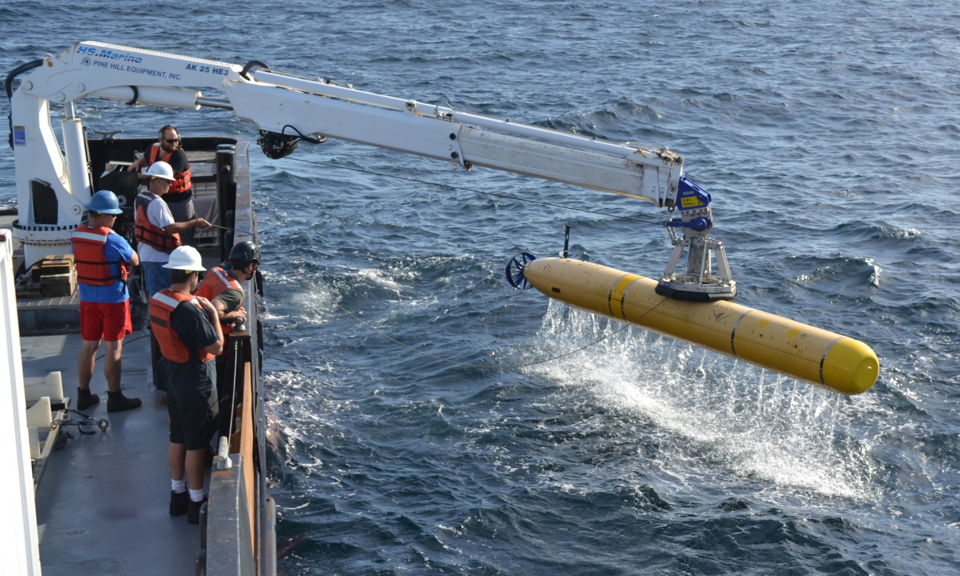
MBARI Dorado AUV Program
Hans Thomas
AUV Supervisor
Division of Marine Operations
Monterey Bay Aquarium Research Institute

Slide 2
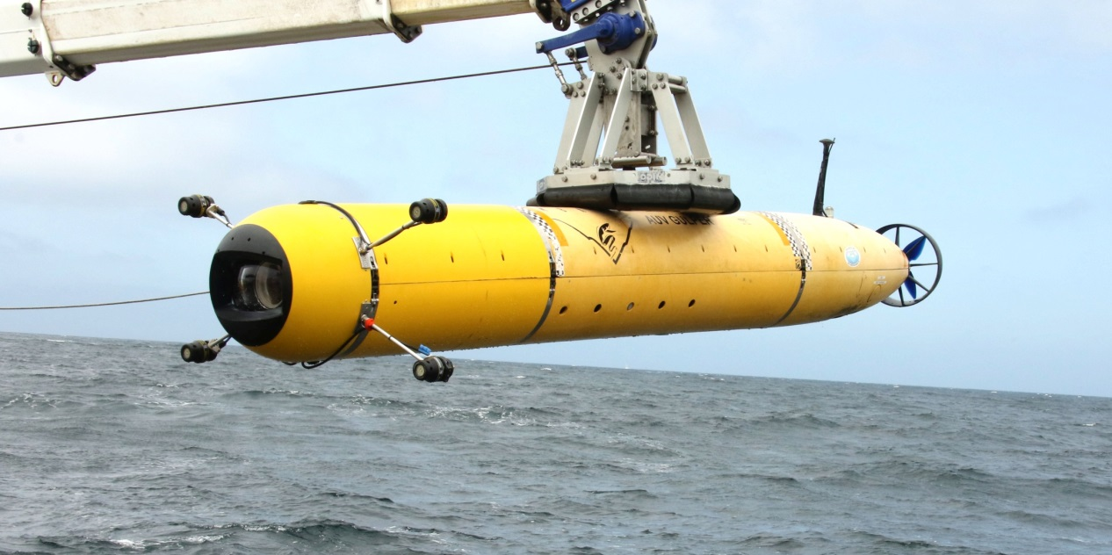
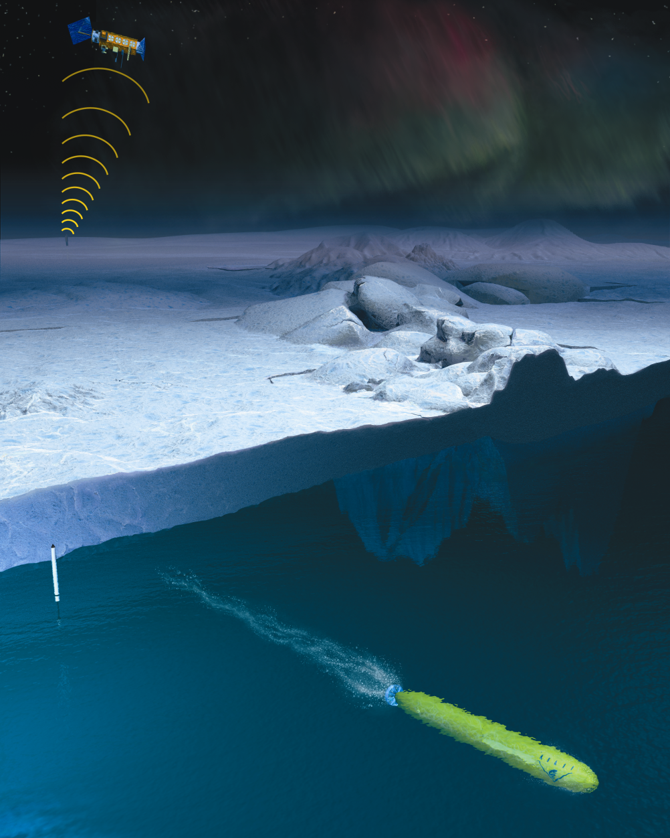
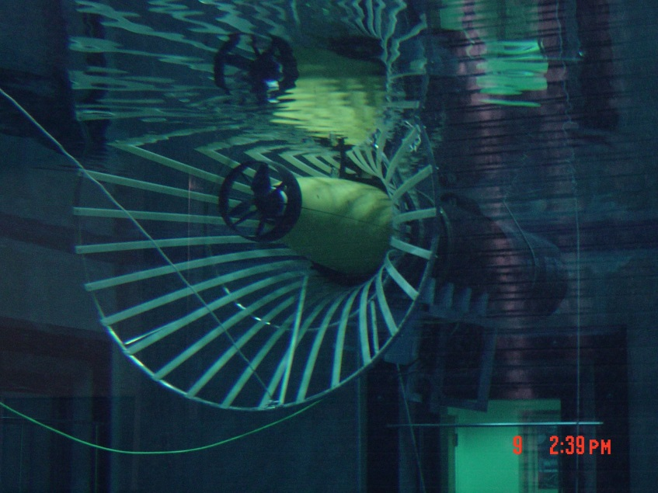
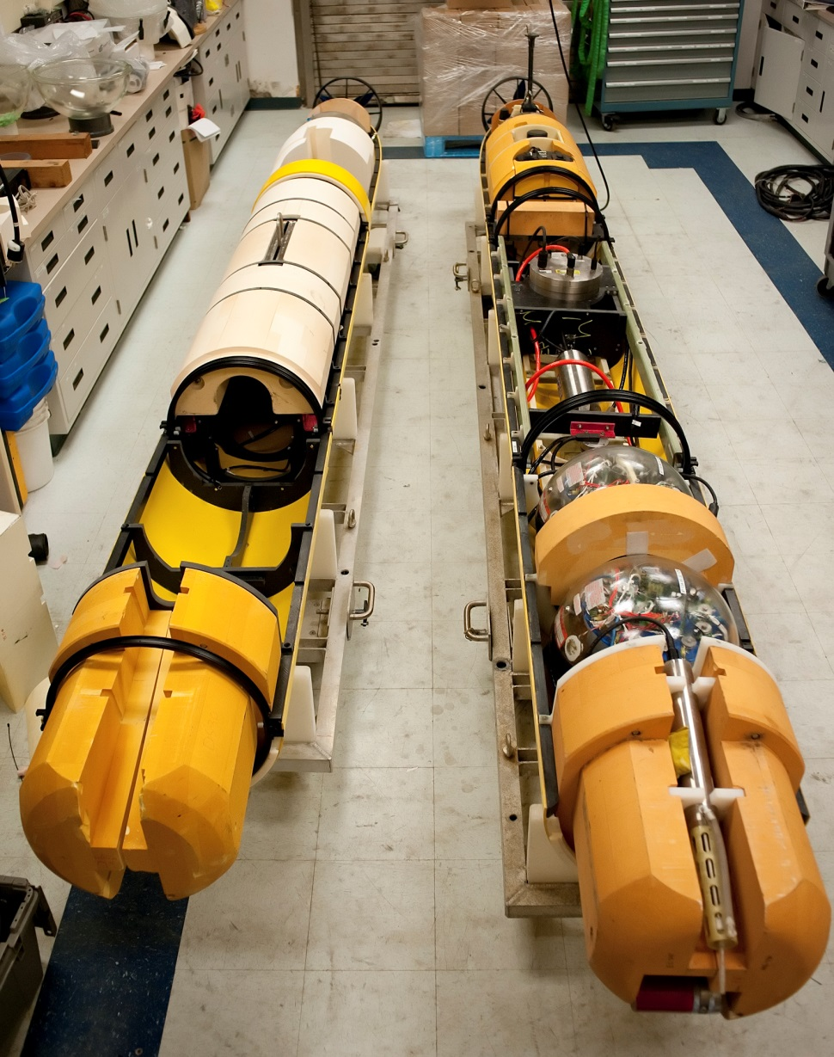
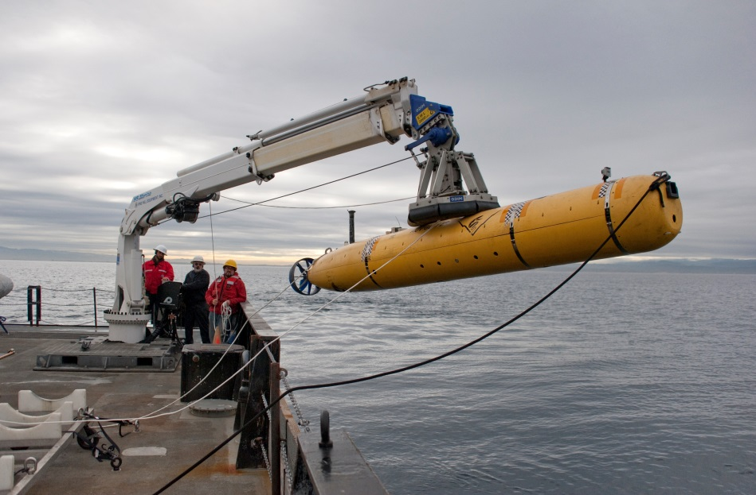
Dorado-Class AUV
Begun as a joint development project with Bluefin Robotics in 2000
21 inch diameter, up to 19 feet in length
Modular mechanical, electrical and software design
Several different vehicle configurations:
  Water column sampling
  Seafloor mapping
  Imaging
  Docking
  Experimental Instruments

Slide 3
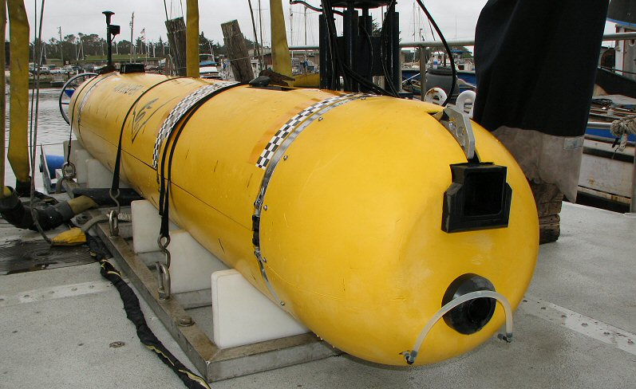
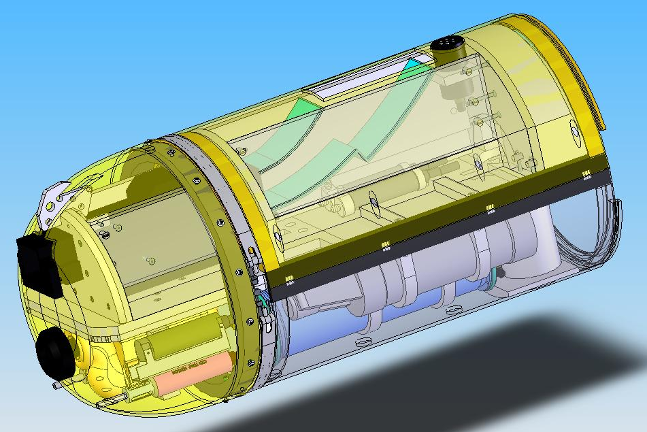
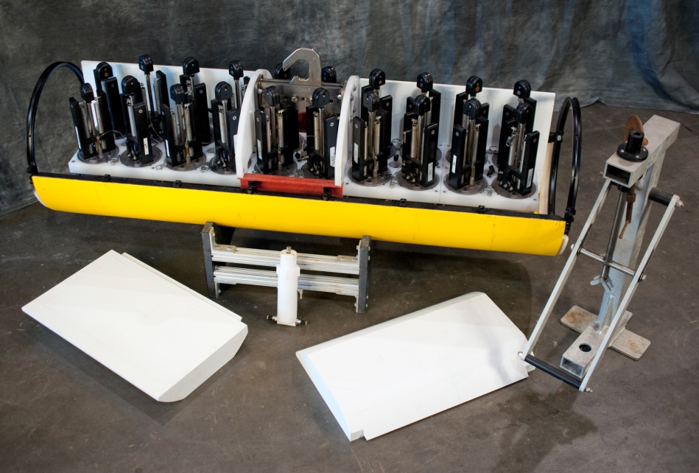
Water Column Survey & Sampling
24 hour endurance at 3 knots
Wide array of physical, chemical & bio-optical instruments
20 sample chambers, 1.8 liter volume

Slide 4
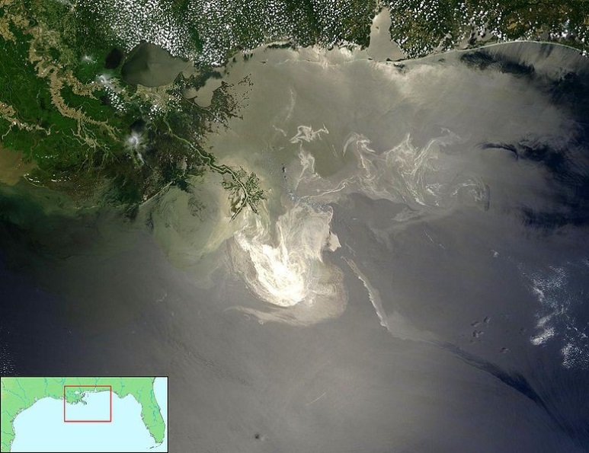
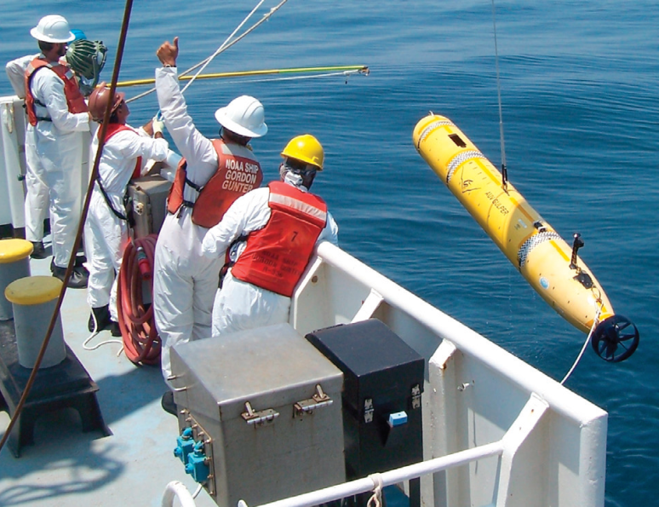
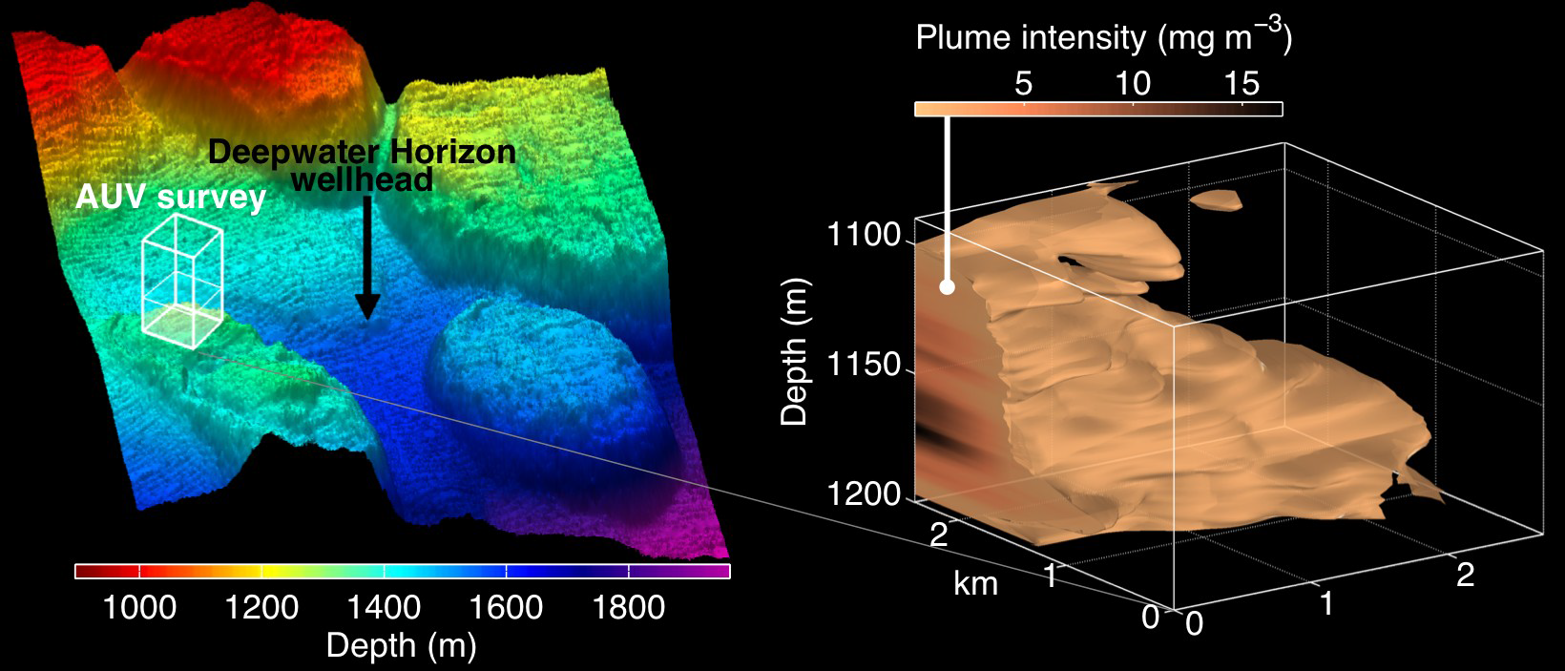
Deepwater Horizon Response Cruise
1 week mobilization of water column AUV and support team to GoM
Operated from NOAA ship Gordon Gunter as part of joint rapid response cruise
Adaptive sampling capability modified to precisely target hydrocarbon concentrations
Dorado provided capability to survey large, deep plumes unreachable by other AUVs on scene and return samples for in-lab analysis

Slide 5
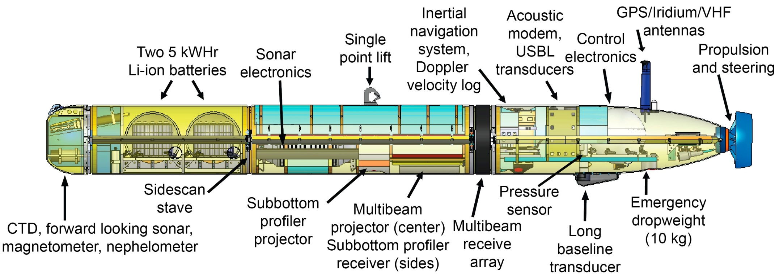
Seafloor Mapping
18 (24 in future) hour endurance at 3 knots with 6 hour battery recharge
200/400khz MBE, 1-6khz SBP, 110/420khz sidescan
DVL-Aided INS with USBL aiding via acoustic telemetry
Initial data products in ~5 hours after recovery
Capable of >1m resolution bathymetry, operating at 50m altitude/200m swath
Provides ability to operate high resolution sonars near bottom in extreme terrain with high coverage rates & fast turnaround
Two 6000m mapping systems currently operational, possibility of two more coming on-line in 2016

Slide 6
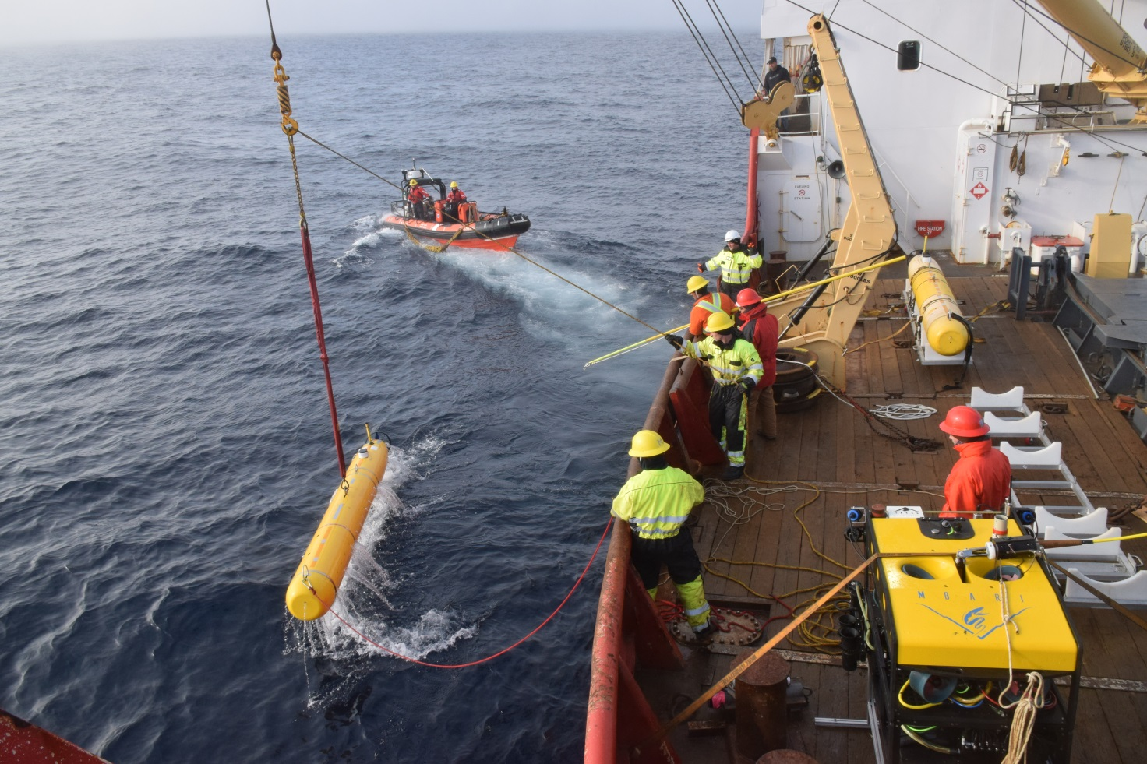
High Latitude Operations
October 2001 – Eastern Arctic
October 2013, October 2016, June & October 2017 (planned) – Beaufort Sea, Newfoundland

Slide 7
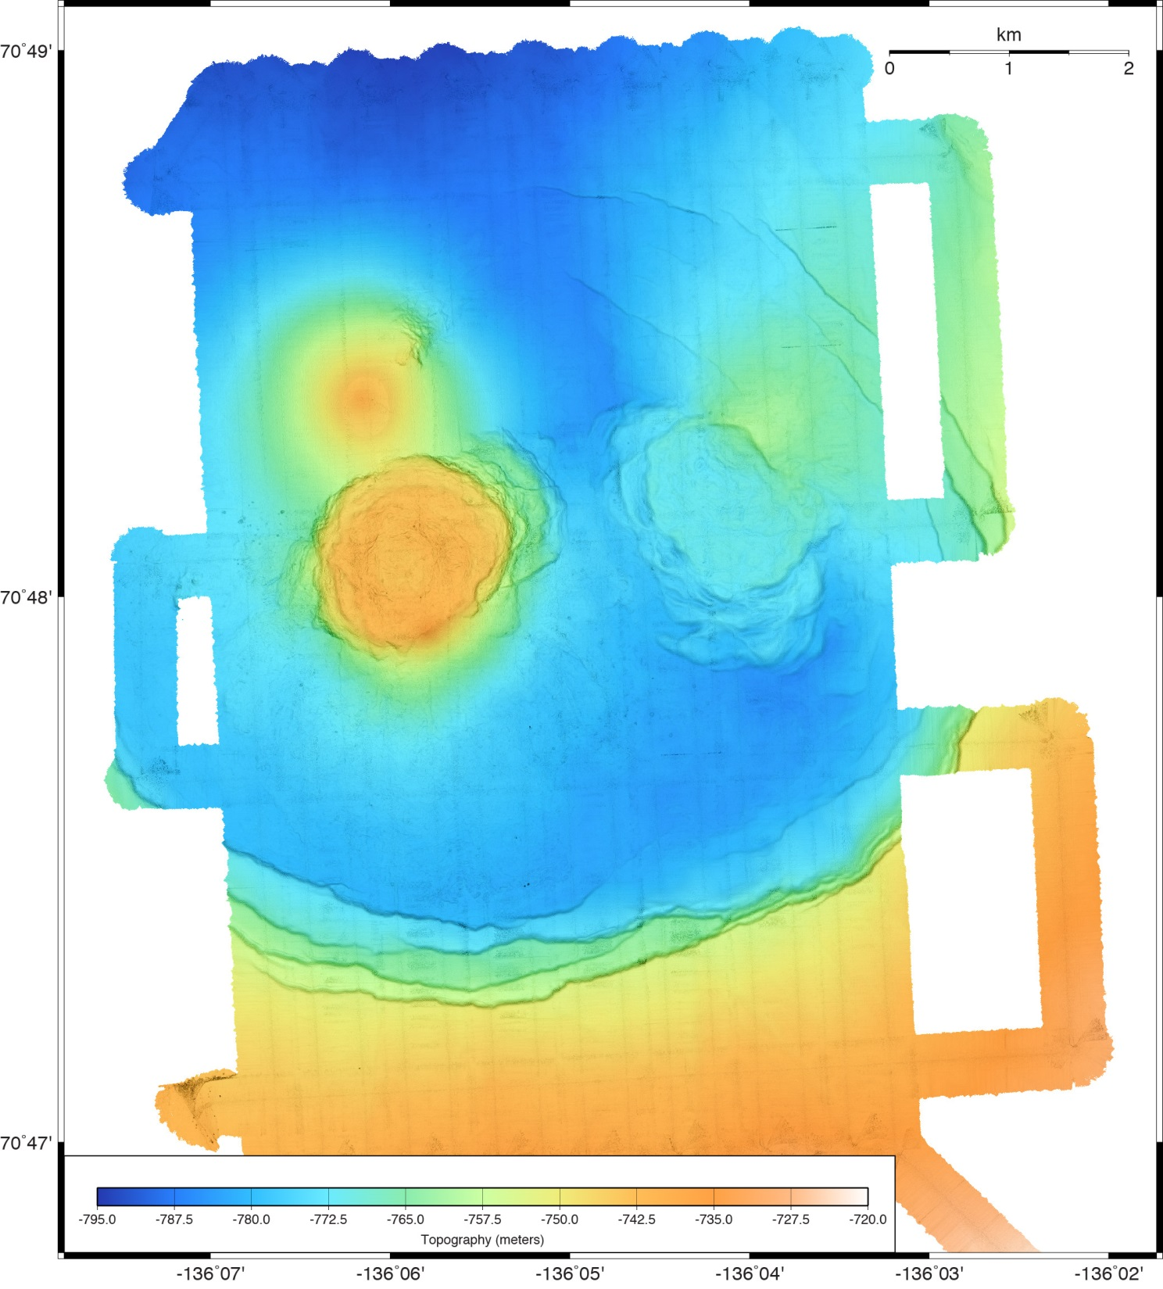
MBARI Mapping AUV
Fluid explusion on the Beaufort Sea margin, Arctic Ocean
Multibeam bathymetry

Slide 8
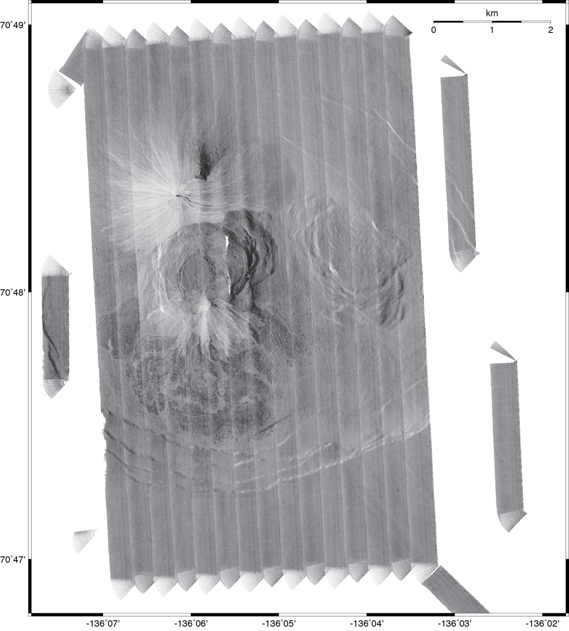
Fluid explusion on the Beaufort Sea margin, Arctic Ocean:
110 kHz chirp sidescan mosaic
1-m resolution sidescan laid out on 1-m resolution bathymetry
Amplitude corrections made using 3D grazing angle corrections

Slide 9
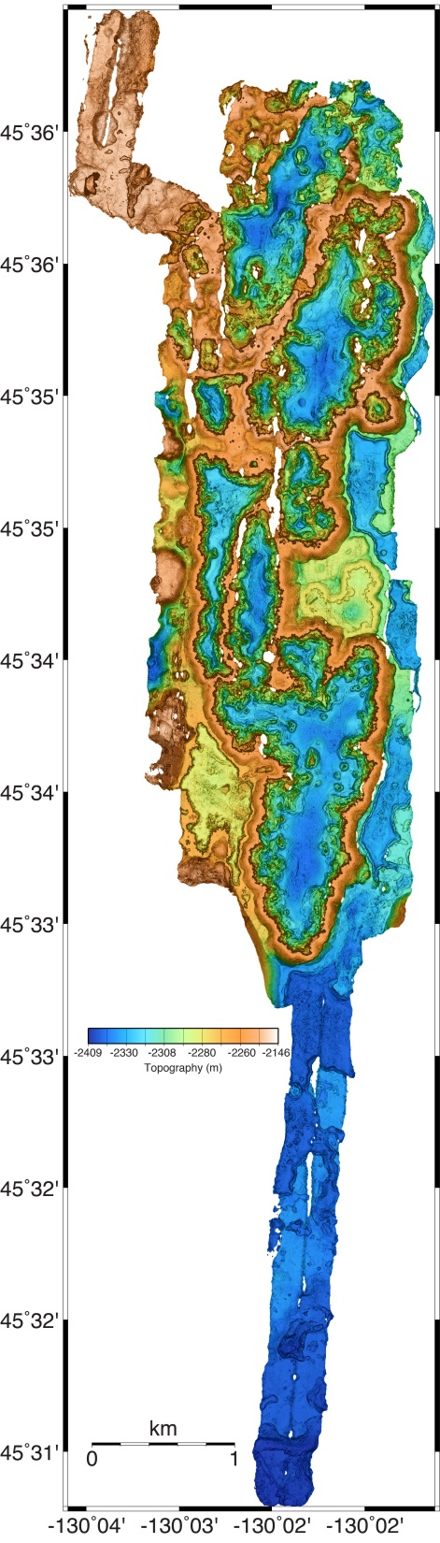
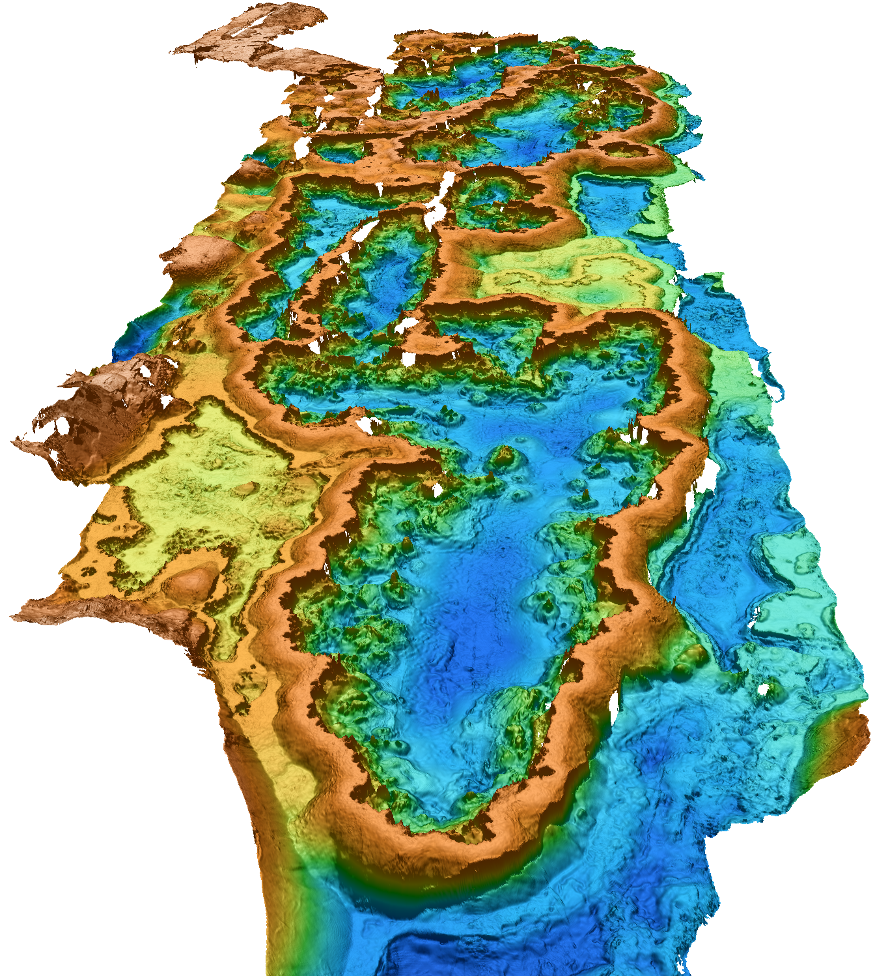
Mapping AUV Survey of 80 m high drained lava ponds along the south rift of Axial Seamount

Slide 10
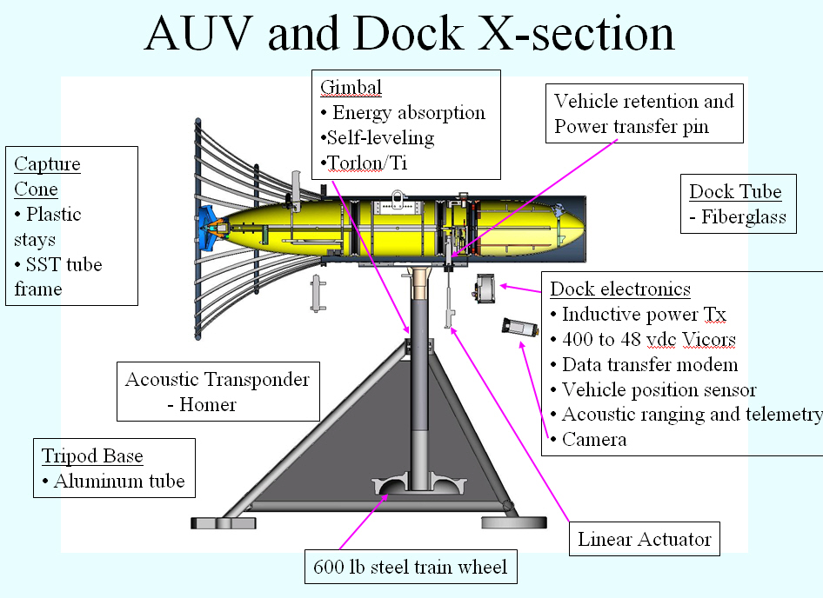

Slide 11
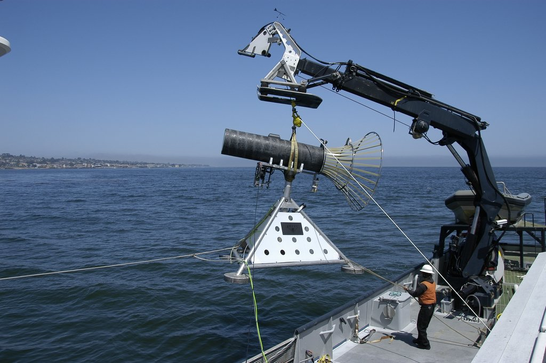
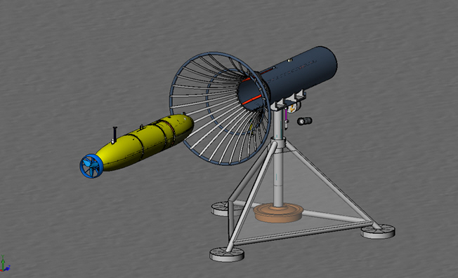
AUV Dock

Slide 12
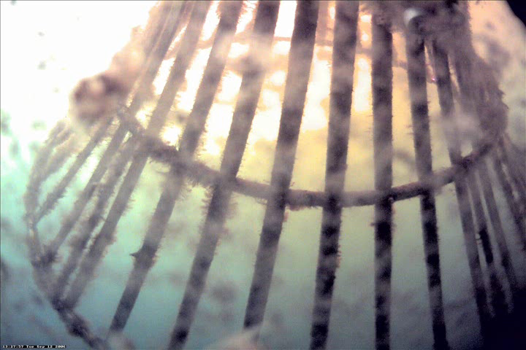
AUV Docking Run

Slide 13
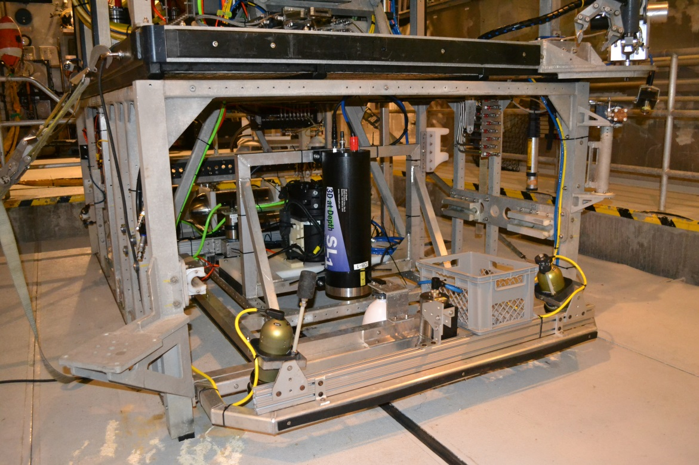
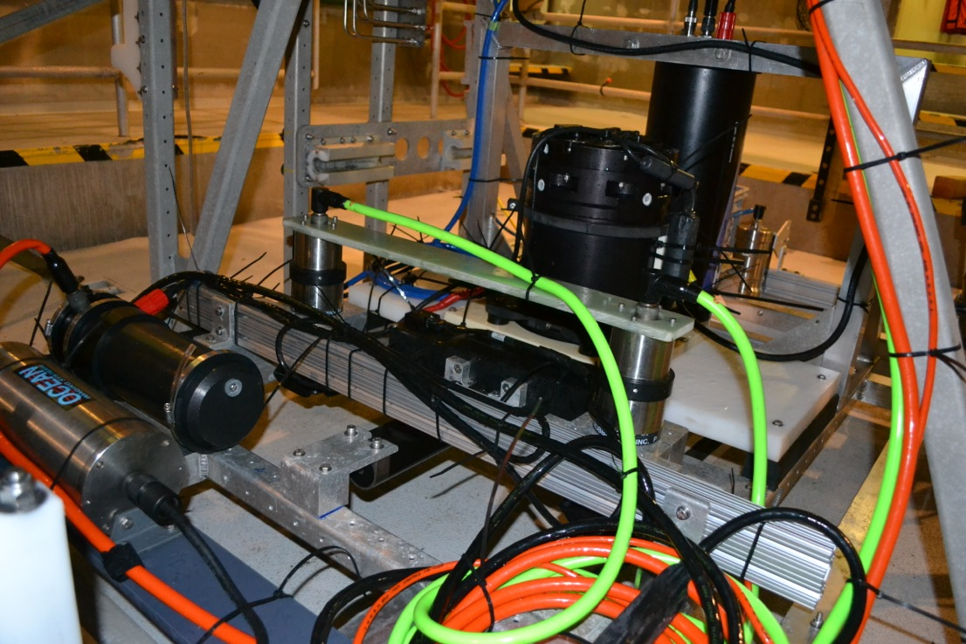
ROV-Based Millimeter-Scale Seafloor Mapping
Low (2-3 meter) altitude seafloor surveys combining acoustic and optical sensing
Topography
  Multibeam sonar: 5-cm lateral-resolution
  Lidar: 1-cm lateral-resolution
Photographic Imagery
  2-mm resolution
Precision Navigation
  .005% Paroscientific Pressure Sensor
  DVL-Aided INS
  Long-baseline Acoustics
Now operated from either ROV Doc Ricketts or ROV Ventana
Multibeam Sonar
Cameras
INS
Strobe
Lidar

Slide 14
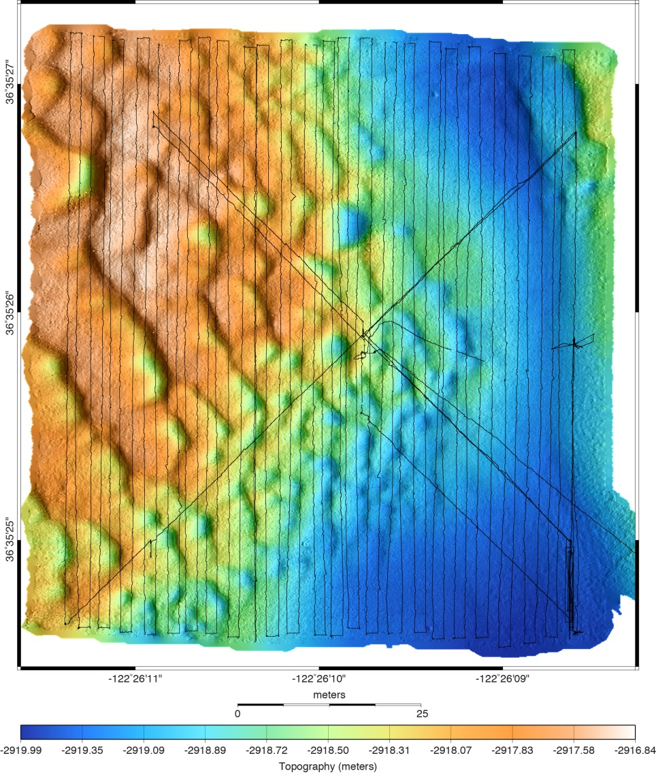
Ocean Imaging Site 2:
Bedforms
5-cm resolution multibeam bathymetry
2-mm resolution photography
50 cm
50 cm
50 meters
50 meters

Slide 15
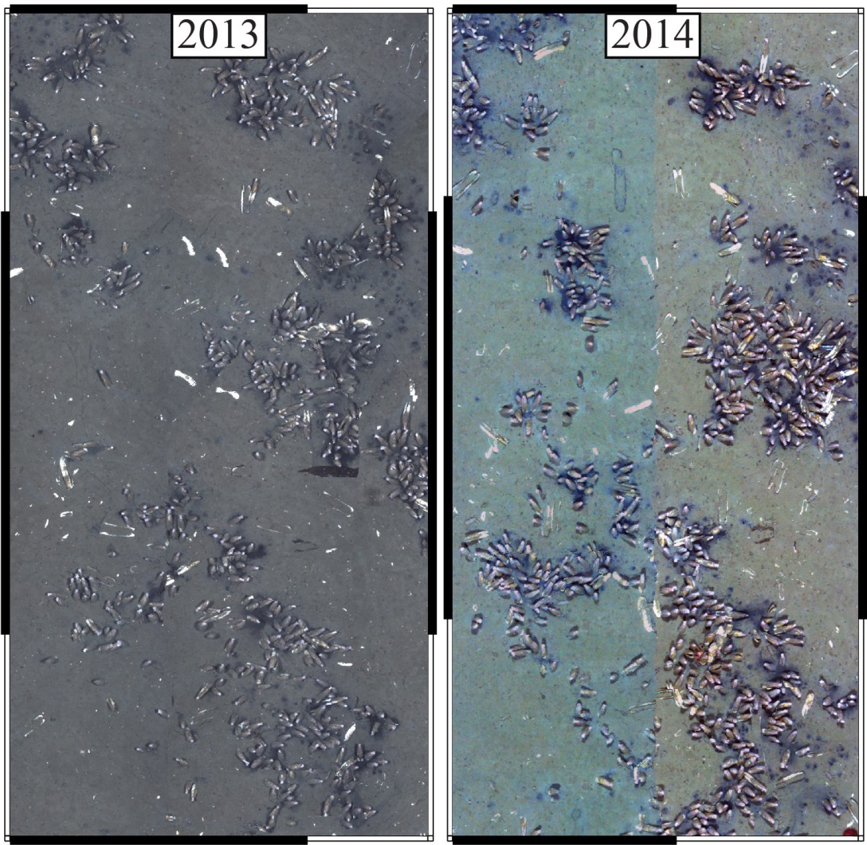
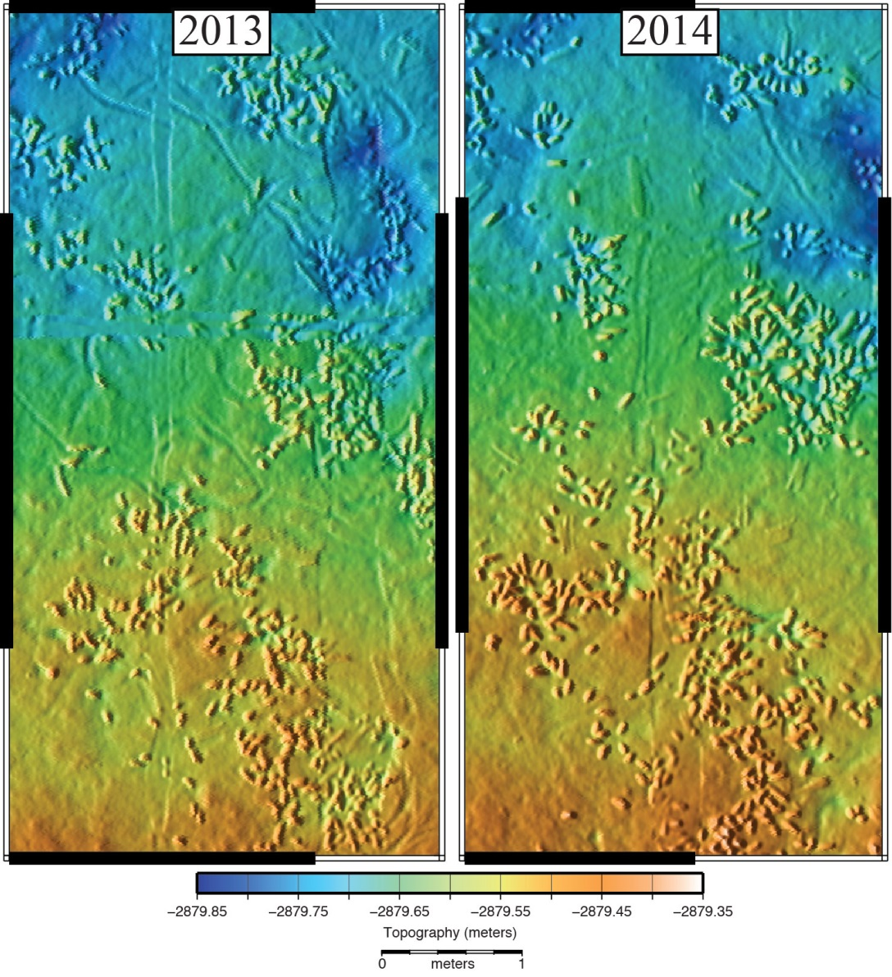
Example Lidar Bathymetry from Ocean Imaging Site 0:
Chemosynthetic Clam Community at 2850 m Depth

