Slide 1
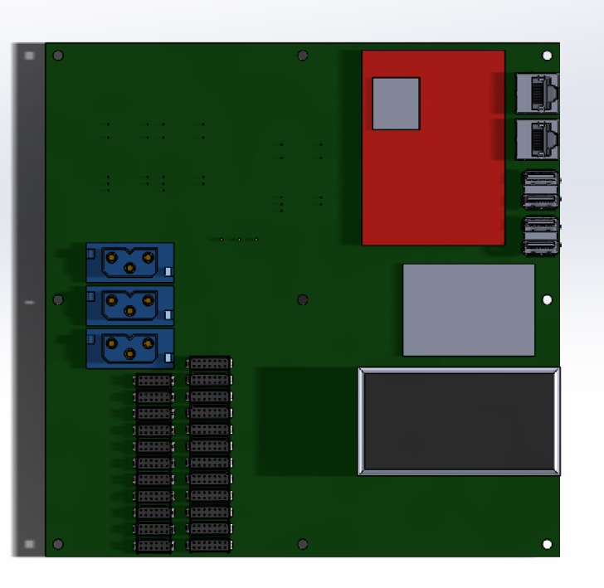
Power Connectors
Changed to from all
3w3’s to mix of
3w3, Molex microfit
3mm, and Harwin 12
Serial changed to Harwin
14 pin
DC/DC Filters &
Monitoring
(converters on bottom
TS4100
Freewave
MM2
SBD Warrior
(DG 16 & Splitter
Above?)
Power
Serial

