Slide 1
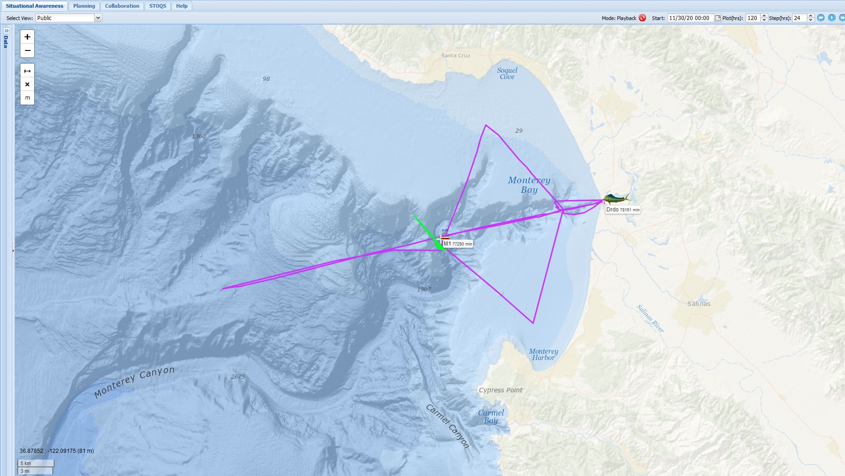
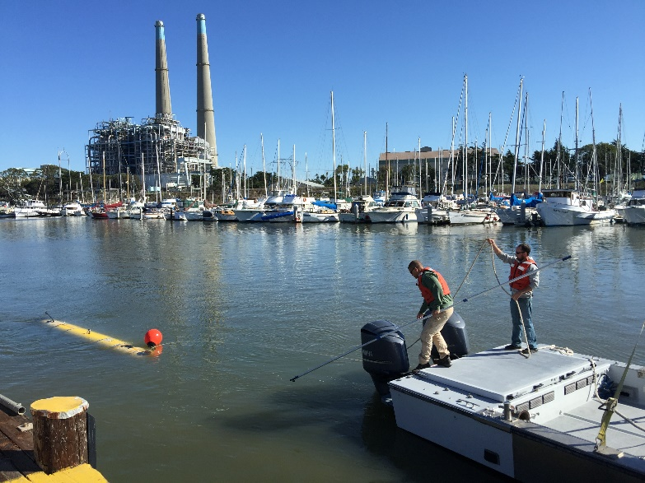
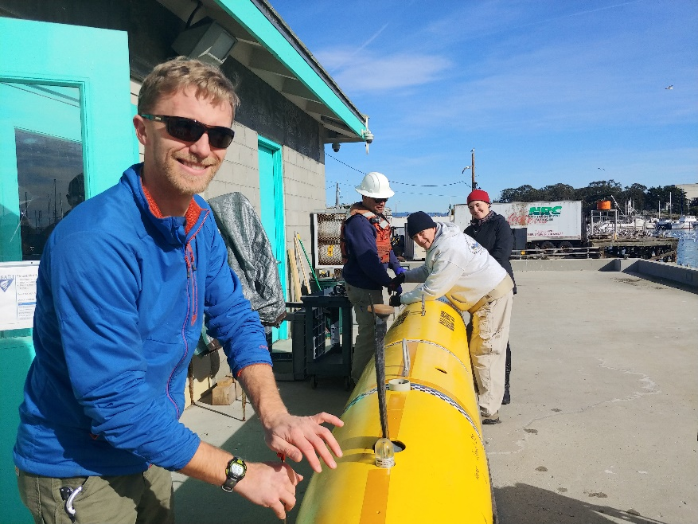
A Week In the Life of the
Midwater Dorado
Autonomous Monterey Bay Time Series
Deploy morning day 1, recover morning day 2
3 knot survey speed around bay
Recover samples and recharge
Deploy morning day 3, recover morning day 5
2 knot survey speed from C1 to M2
Transects YoYo to 100m, profiles to 200m
Able to profile at M1 and M2 during daylight to to allow PAR measurements
Monday 11/30 To Tuesday 12/1
66km Cross Bay Survey
200m profile
10 samples total
Wednesday 12/2 To Friday 12/3
110km C1/M2 Survey
200m profile
10 samples total
Paragon Dorado Deployments
Routine operations, emergency recoveries and kelp clearing
Additional equipment for RDF tracking and towing
12 hour turnarounds

Slide 2
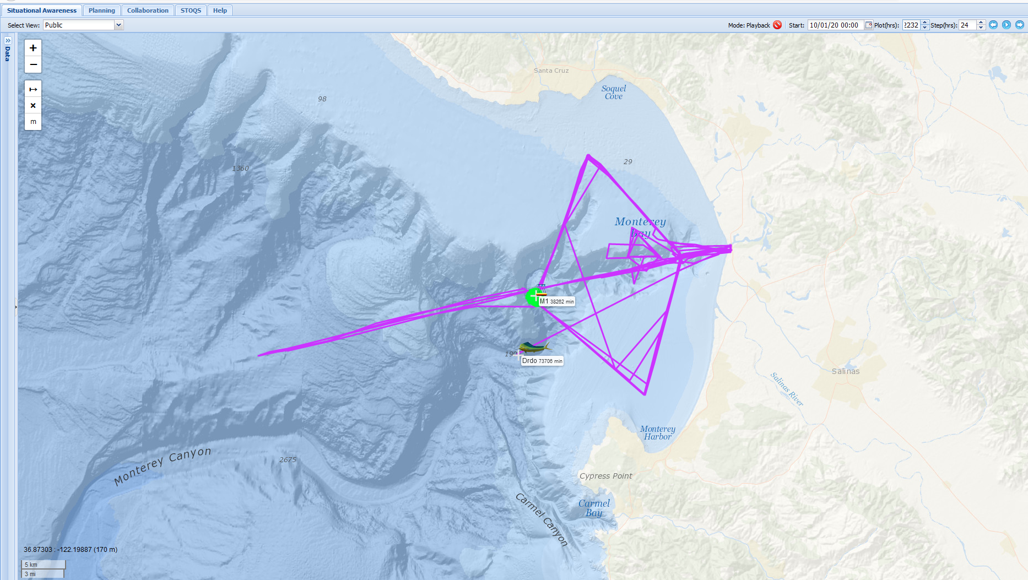
Cumulative CTD/I2MAP Operations
10/1/2020 to 12/30/2020
Six Cross Bay
Gulper Surveys
Two C1/M2
Gulper Surveys
Attempt to Perform
I2MAP Survey
Before Shutdown
Aborted Dive due
To GPS Failure

