Slide 1
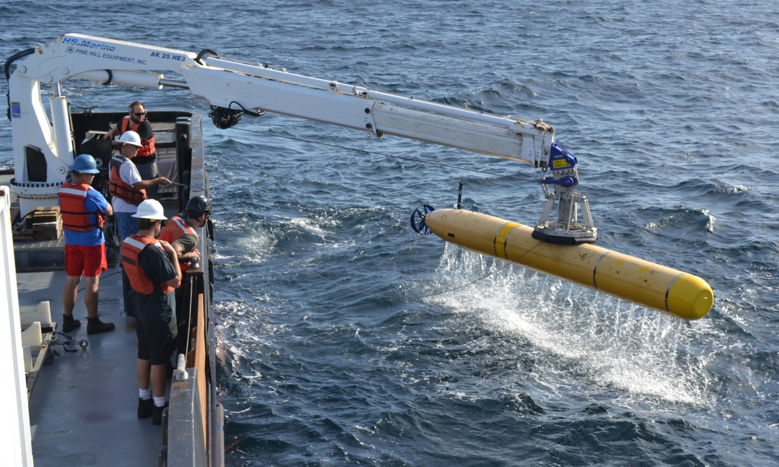
MBARI AUV Capabilities & Saab Collaboration
Hans Thomas
AUV Supervisor
Division of Marine Operations
Monterey Bay Aquarium Research Institute

Slide 2

David Packard
Masters of Science, Electrical Engineering from Stanford, 1938
Hewlett Packard founded 1939
Deputy US Secretary of Defense 1969 to 1971
Monterey Bay Aquarium Foundation 1978
David and Lucile Packard Foundation 1985
MBARI 1987

Slide 3
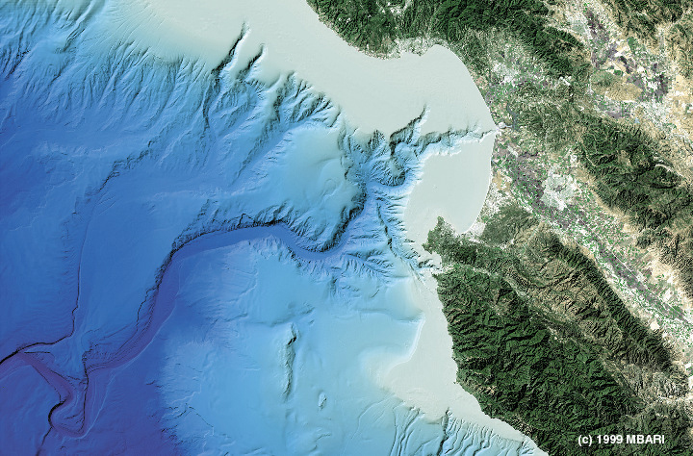
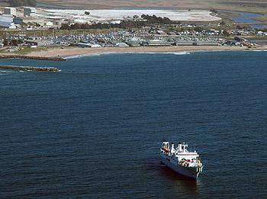
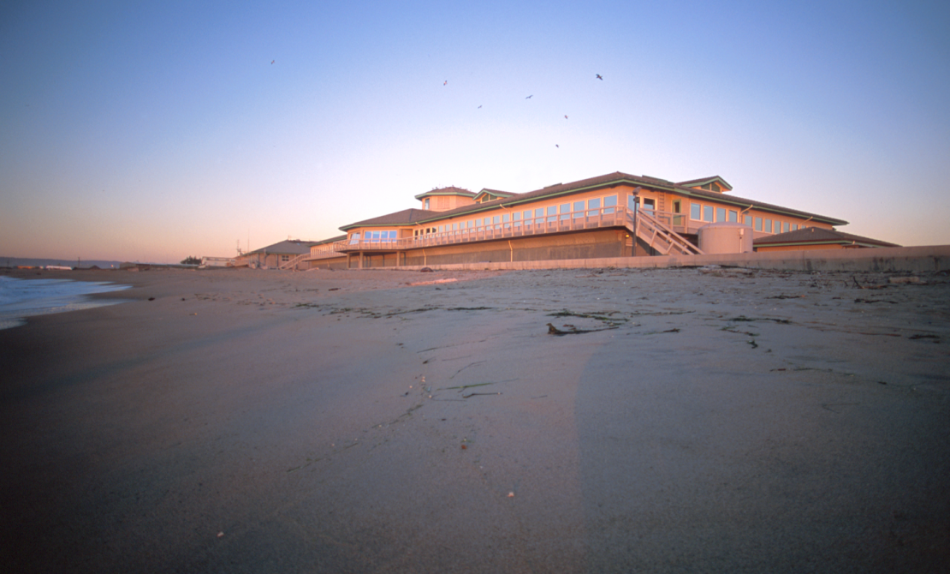
MBARI’s Mission
Santa Cruz
Moss Landing
X
Monterey
“…to achieve and maintain a position as a world center for advanced research and education in ocean science and technology, and to do so through the development of better instruments, systems, and methods for scientific research in the deep waters of the ocean….”
David Packard

Slide 4
Organizational Structure & Funding
5 major Divisions
  Research, Engineering, Marine Operations, Information Technology/Dissemination, Exec Director & Support
~220 employees, no tenure
Not a degree granting institution
Annual budget ~$40 million per year
  ~80+% of funding from Packard Foundation annual grant
  ~20+/-% from outside sources
Research directions & Projects coordinated thru core management team & annual proposal process
  New start project proposal due June 21
  Initial proposals due July 20
  Final proposals due Sept 7

Slide 5
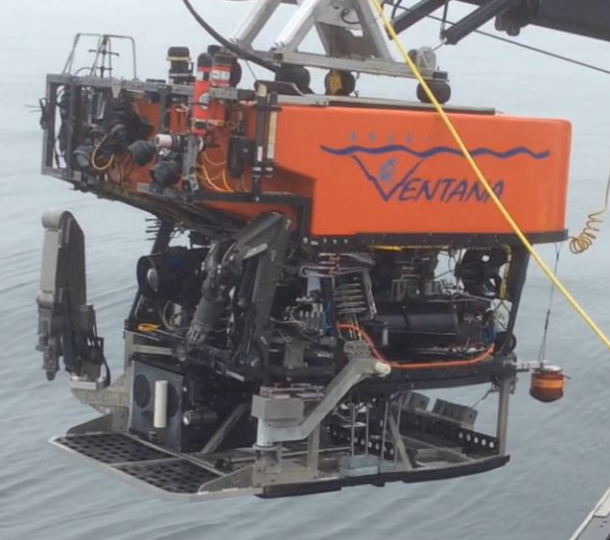
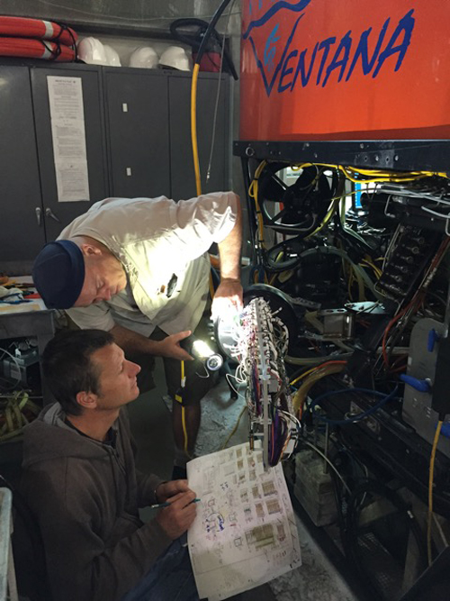
ROV Ventana
Original vehicle built by International Submarine Engineering in 1987 (not much original left)
Light workclass system (40hp/2000m max depth)
Provides daily access to sites near MBARI (also expeditionary access)

Slide 6
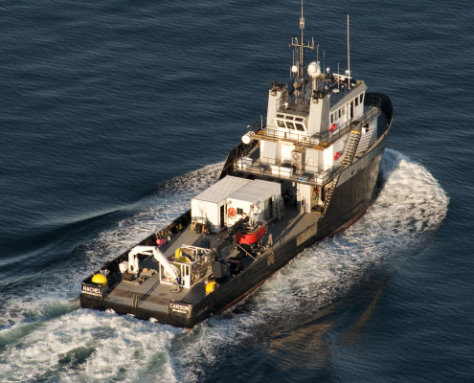
Research Vessel Rachel Carson
135 foot long x 34 foot beam former OSV
Main support vessel for Ventana and AUV Operations
Daily access to Monterey Bay
Capable of 7 to 9 day voyages and long expeditionary transits

Slide 7
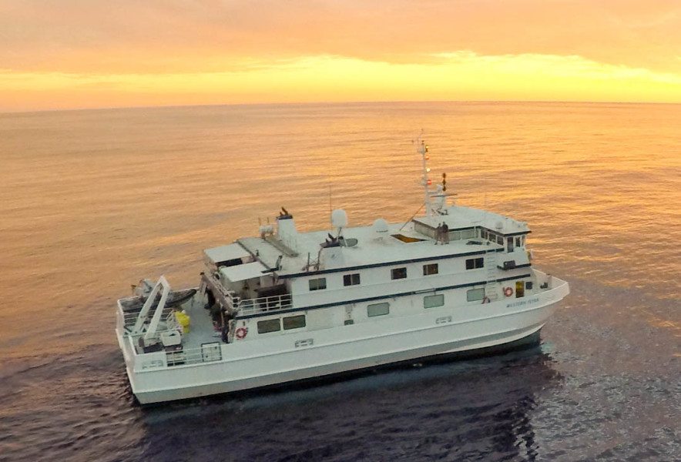
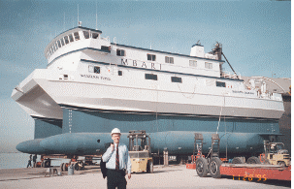
Research Vessel Western Flyer
MBARI’s second research vessel acquired 1997
Custom Small Water Plane Area/Twin Hull (SWATH) design in aluminum, 117 feet long by 53 feet beam
Main support vessel for deepwater ROV Operations
  ROV Tiburon (1997-2009) & ROV Doc Ricketts (2009-present)
Capable of 14 day voyages

Slide 8
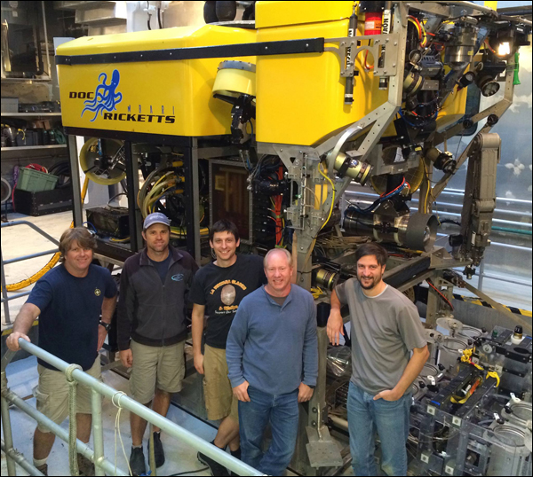
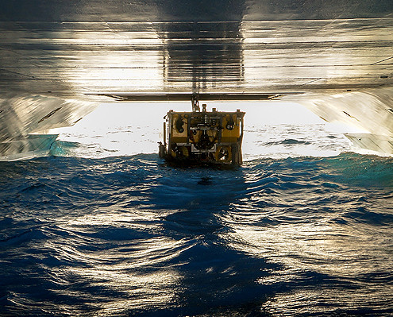
ROV Doc Ricketts
Customized SMD Hydrovsion Quantum vehicle
  10500 pounds in-air weight, 4000m depth capability
  .688in/17.1mm tether
    5 single-mode fibers & 5 power conductors
    75hp hydraulic power
    8kw available for science payload

Slide 9
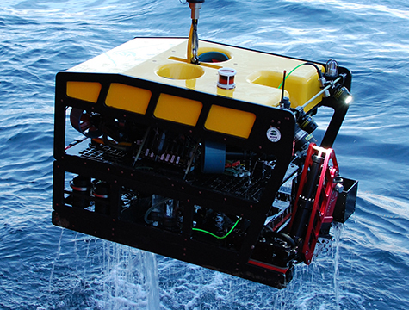
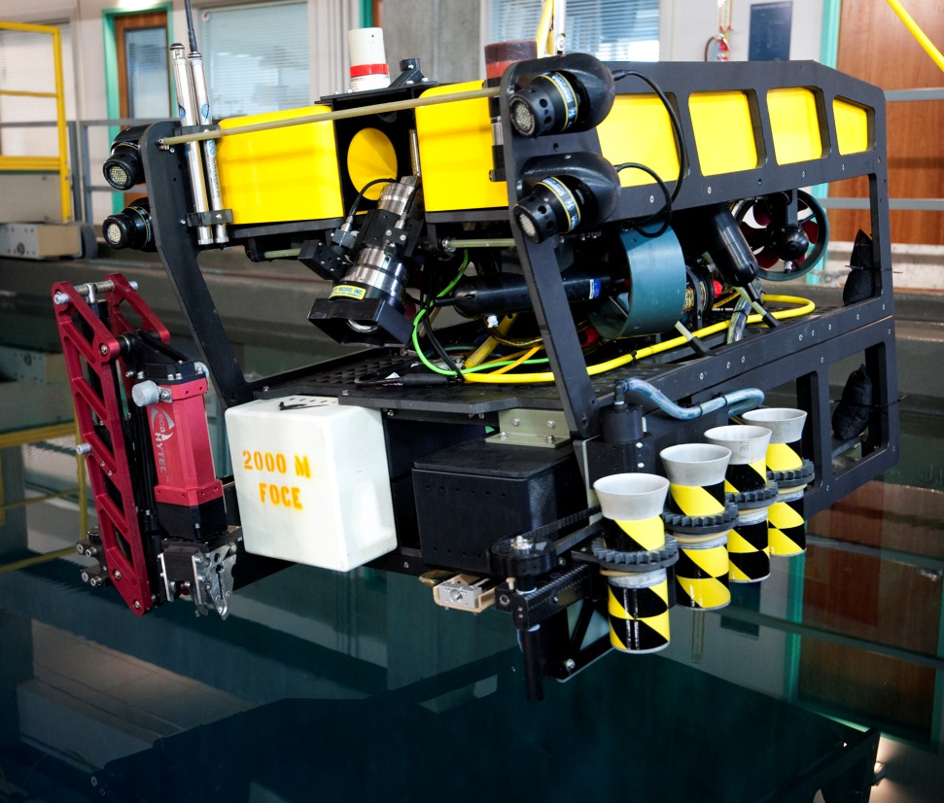
MBARI 1500m Portable ROV
1500m all-electric ROV
5 function electric manipulator
Separate core vehicle and toolsled
Autonomous navigation and control functions
Self contained in two 10 foot shipping containers

Slide 10
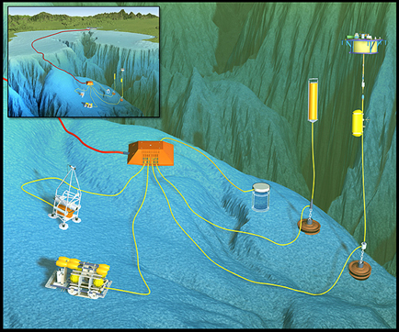
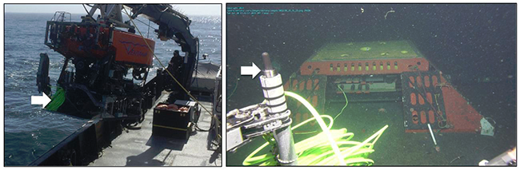
Monterey Accelerated Research Site (MARS) Cabled Observatory
52km cable running from Moss Landing to main science node in 891m water depth
Eight primary science ports w/ 375VDC/500W, 48VDC/100W, 10/100BT
ROV servicing from Moss Landing

Slide 11
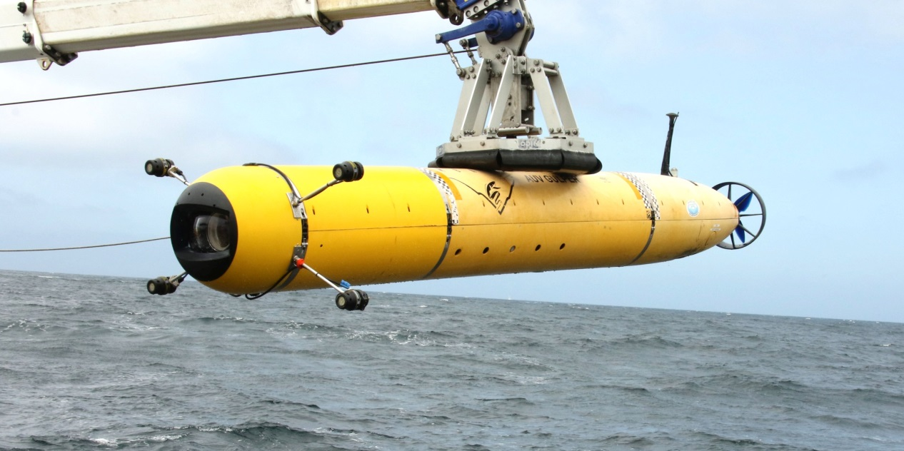
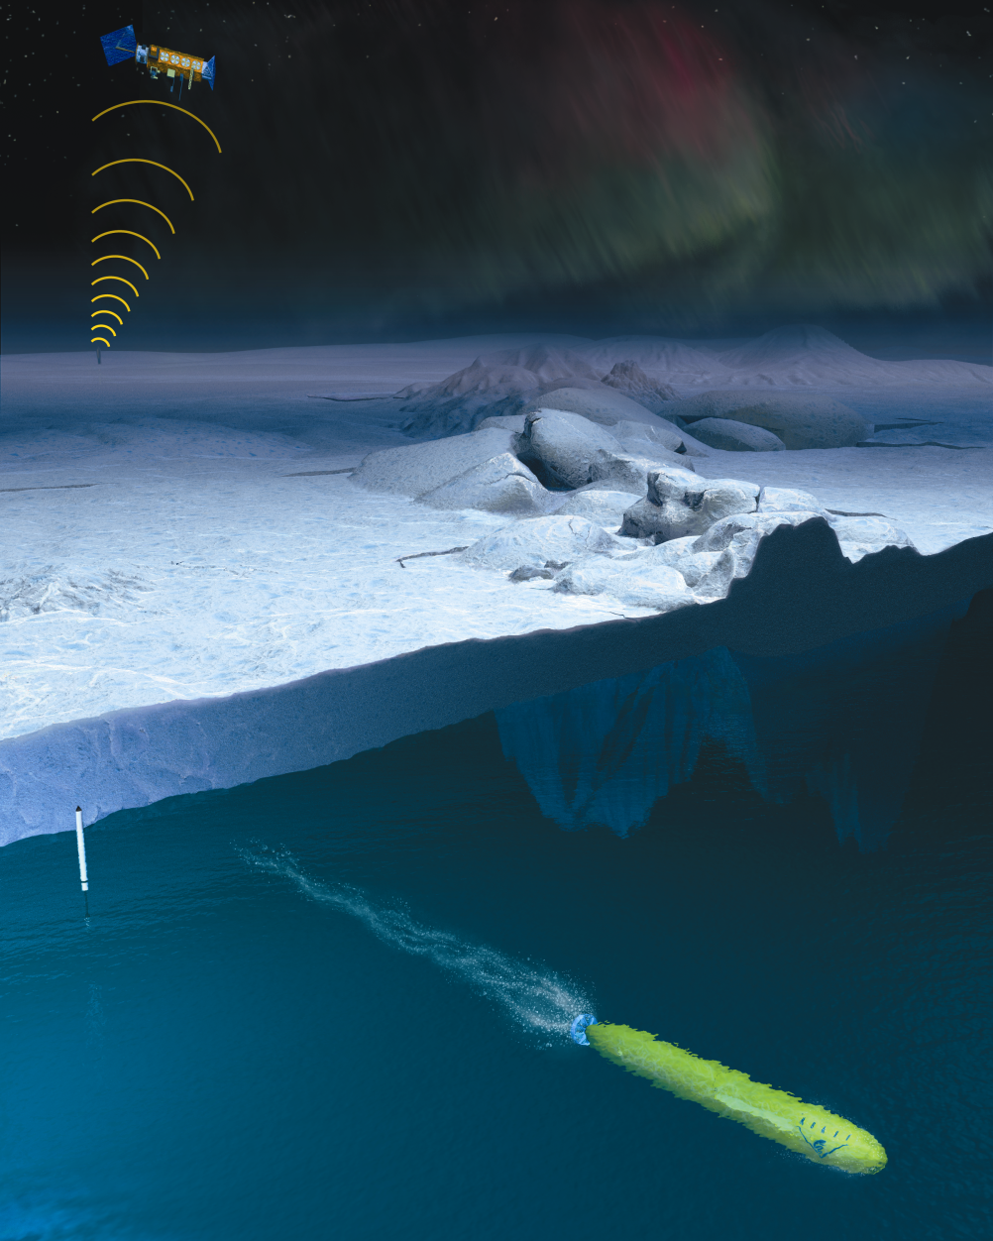
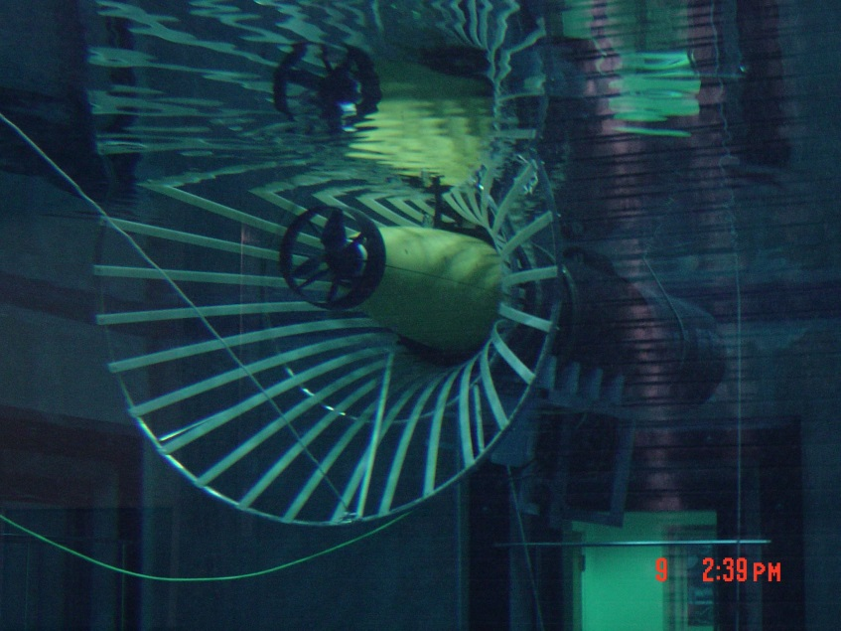
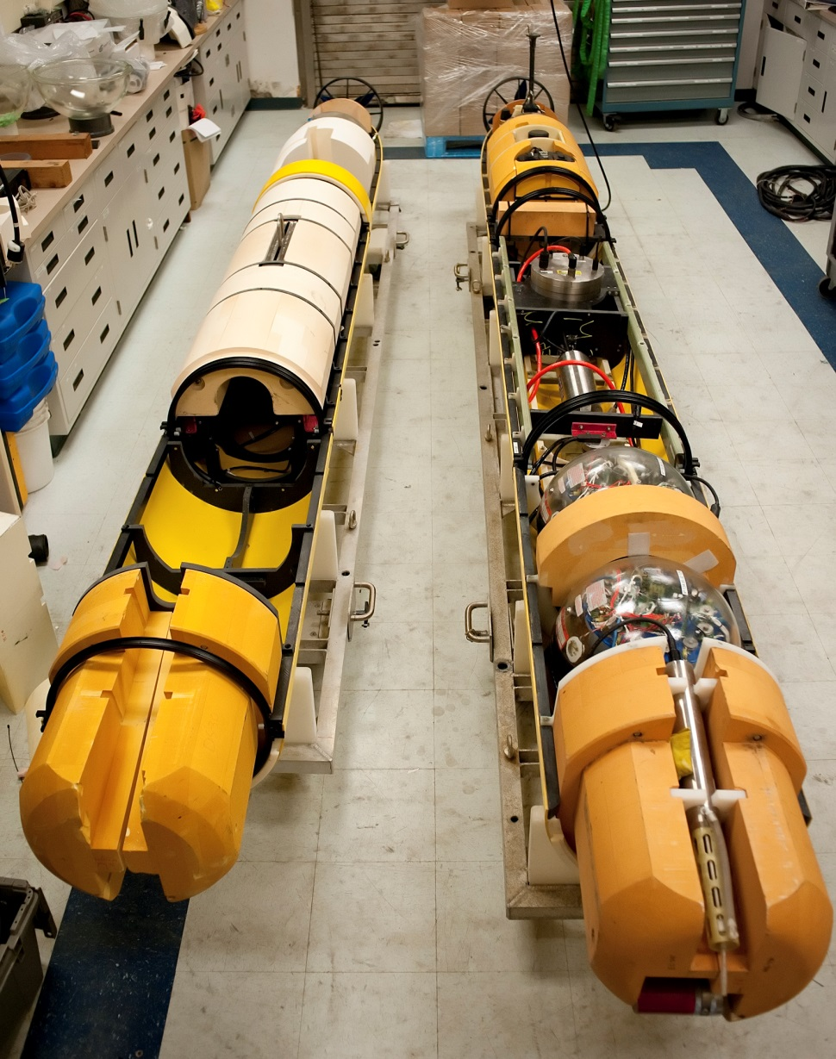
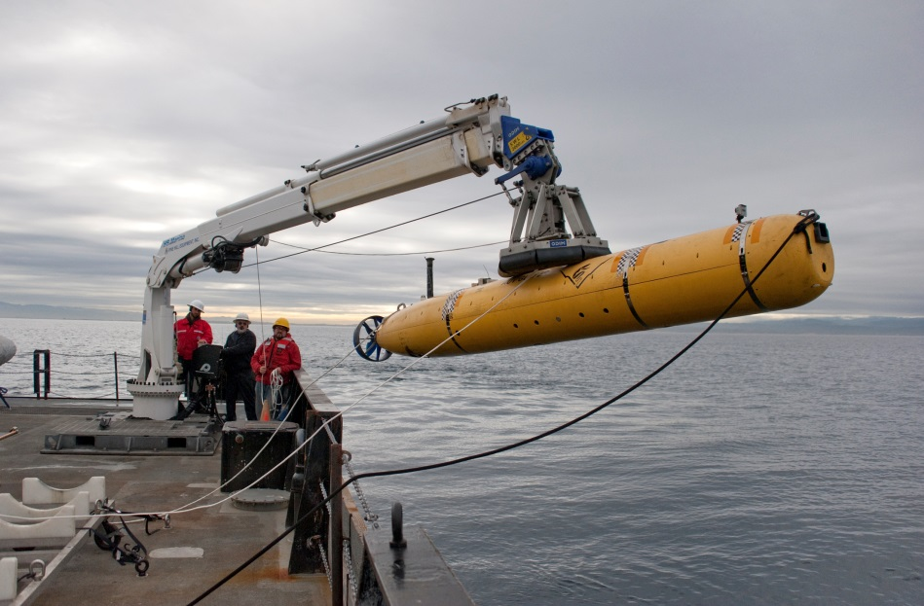
Dorado-Class AUV
Begun as a joint development project with Bluefin Robotics in 2000
21 inch diameter, up to 19 feet in length
Modular mechanical, electrical and software design
Several different vehicle configurations:
  Water column sampling
  Seafloor mapping
  Imaging
  Docking
  Experimental Instruments

Slide 12
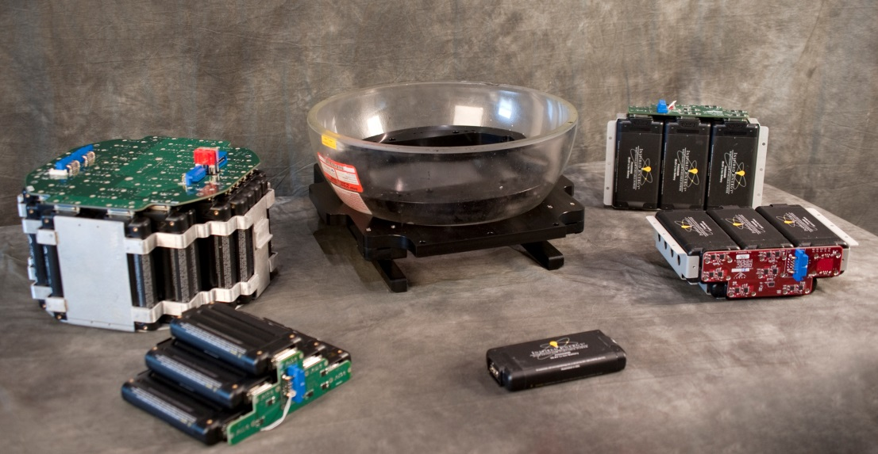
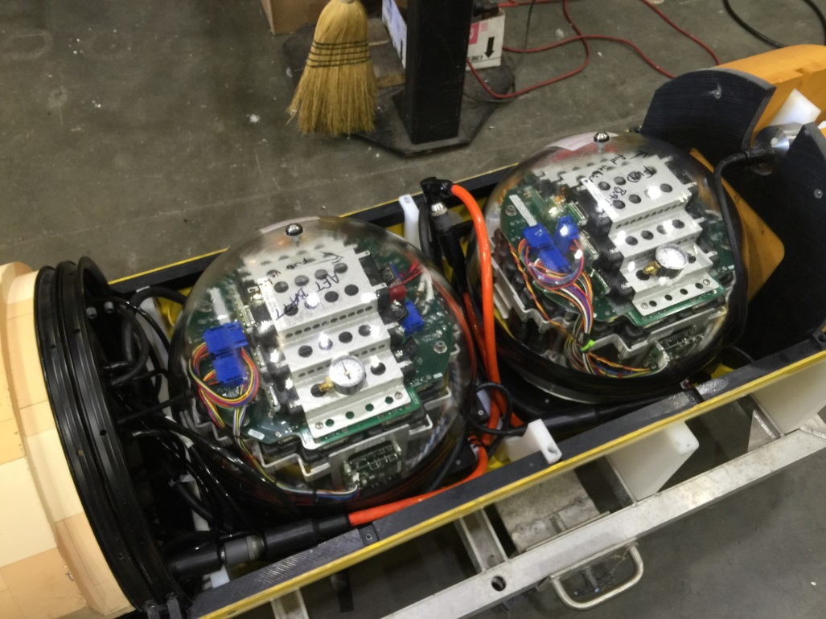
Modular AUV Battery
Low Cost ($11K parts)
High Density (4.5 to 5.5 kwhr)
Modular
  55 Individual cell packs
  PCBs for main & auxiliary cell stacks
  Minimal wire harnessing
~5kg in-water

Slide 13
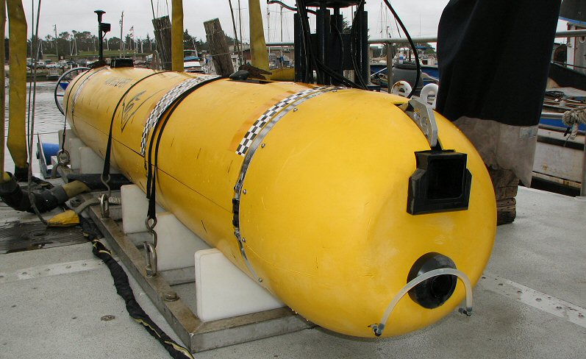
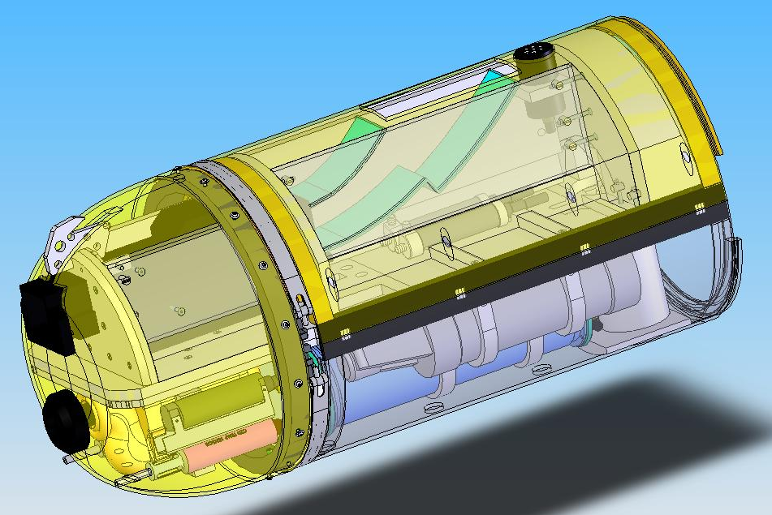
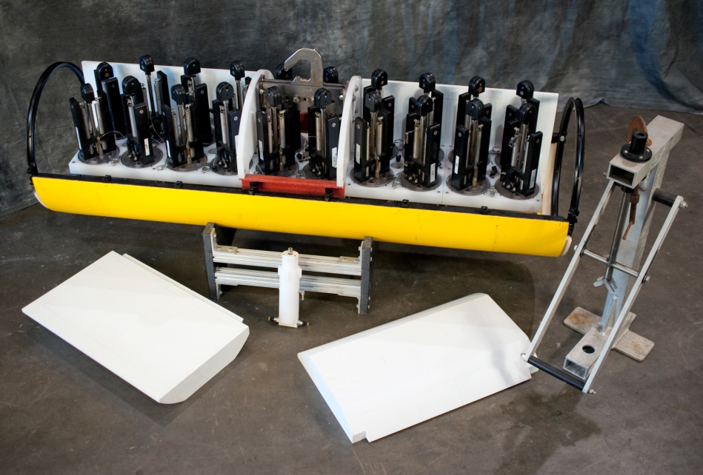
Water Column Survey & Sampling
24 hour endurance at 3 knots
Wide array of physical, chemical & bio-optical instruments
20 sample chambers, 1.8 liter volume

Slide 14
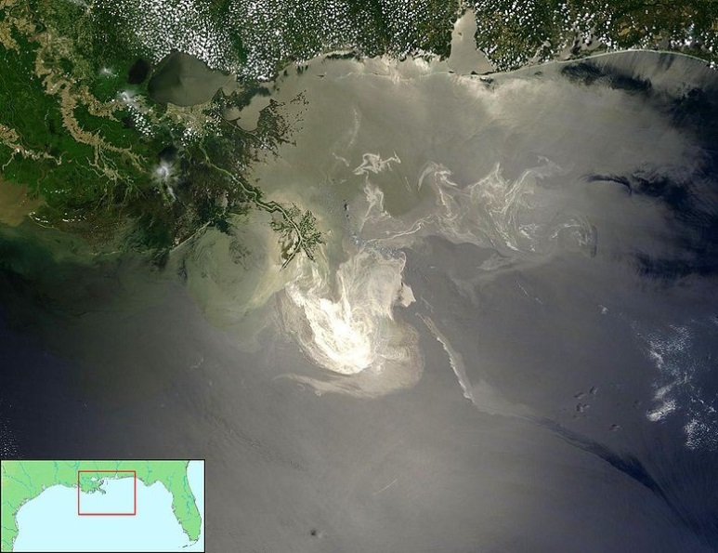
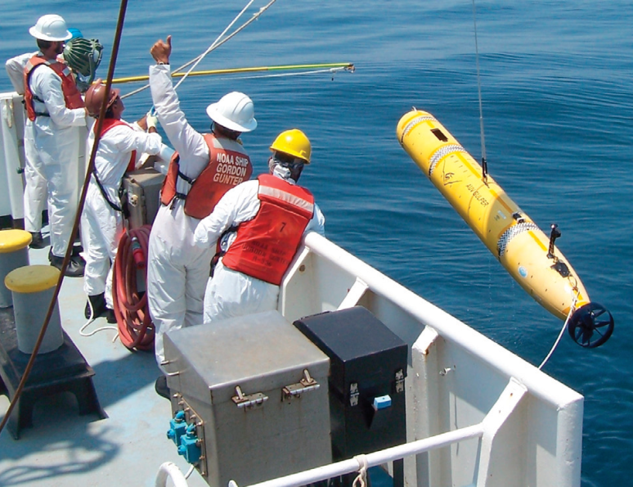
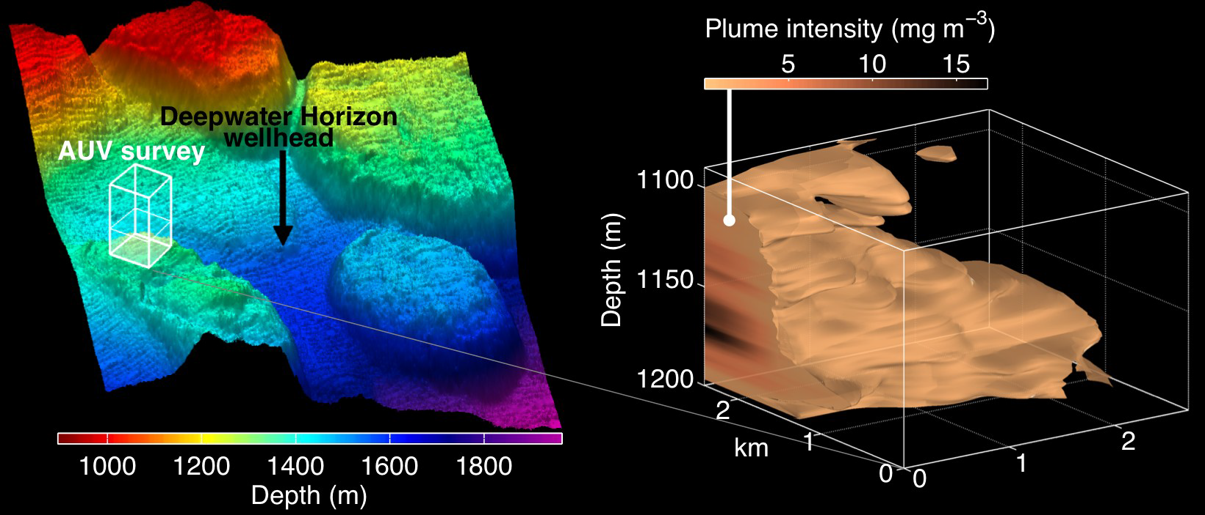
Deepwater Horizon Response Cruise
1 week mobilization of water column AUV and support team to GoM
Operated from NOAA ship Gordon Gunter as part of joint rapid response cruise
Adaptive sampling capability modified to precisely target hydrocarbon concentrations
Dorado provided capability to survey large, deep plumes unreachable by other AUVs on scene and return samples for in-lab analysis

Slide 15
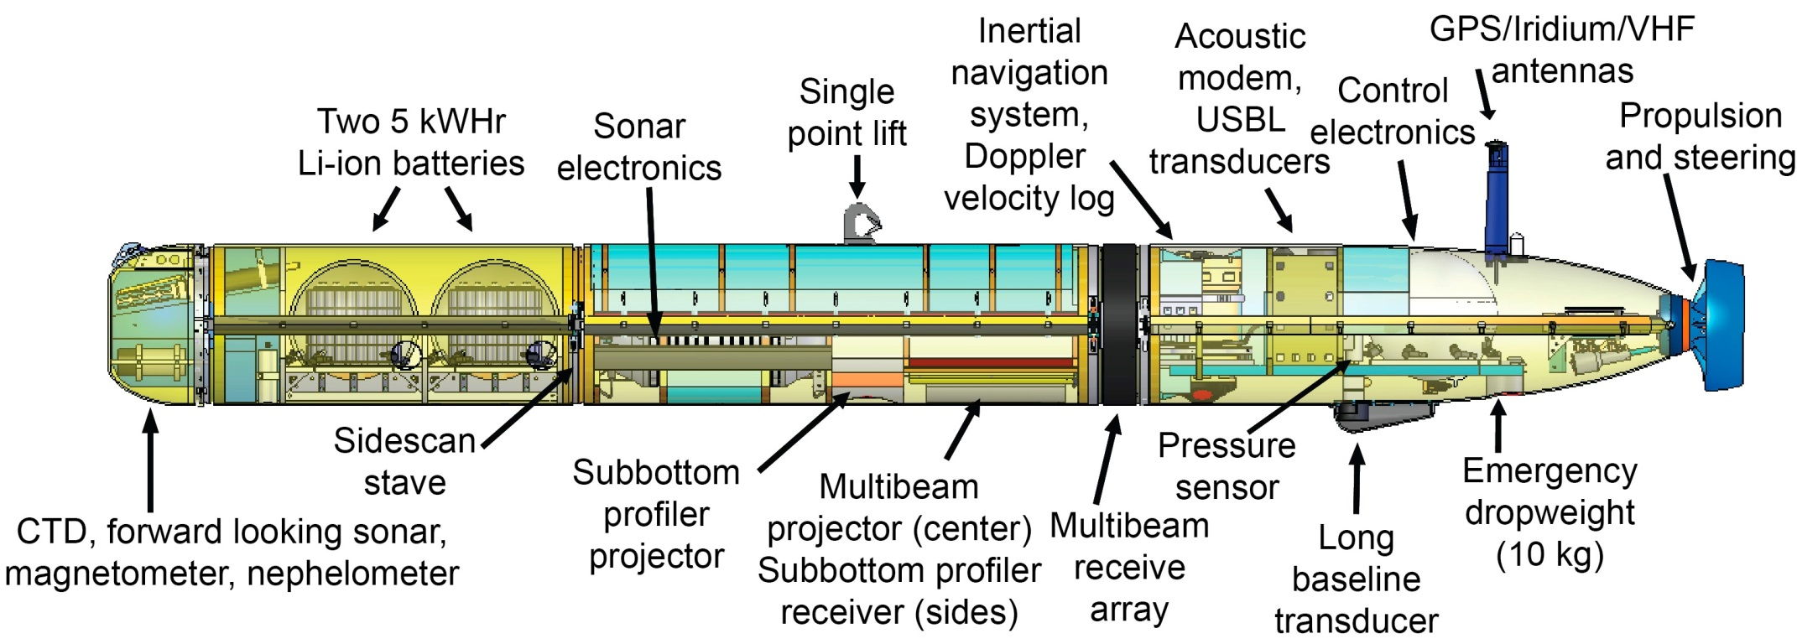
Seafloor Mapping
18 (24 in future) hour endurance at 3 knots with 6 hour battery recharge
200/400khz MBE, 1-6khz SBP, 110/420khz sidescan
DVL-Aided INS with USBL aiding via acoustic telemetry
Initial data products in ~5 hours after recovery
Capable of >1m resolution bathymetry, operating at 50m altitude/200m swath
Provides ability to operate high resolution sonars near bottom in extreme terrain with high coverage rates & fast turnaround
Two 6000m mapping systems currently operational, possibility of two more coming on-line in 2016

Slide 16
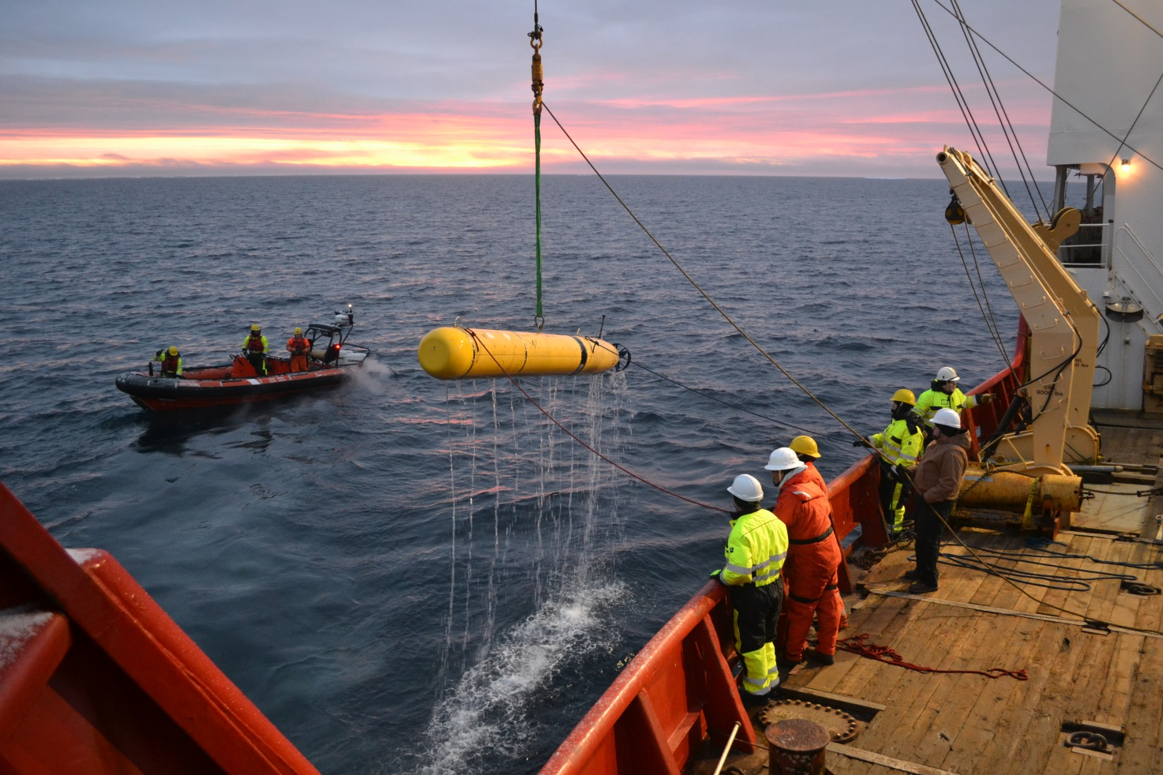
High Latitude Operations
October 2001 – Eastern Arctic
October 2013 & October 2016 & October 2017 (planned) – Canadian Arctic

Slide 17
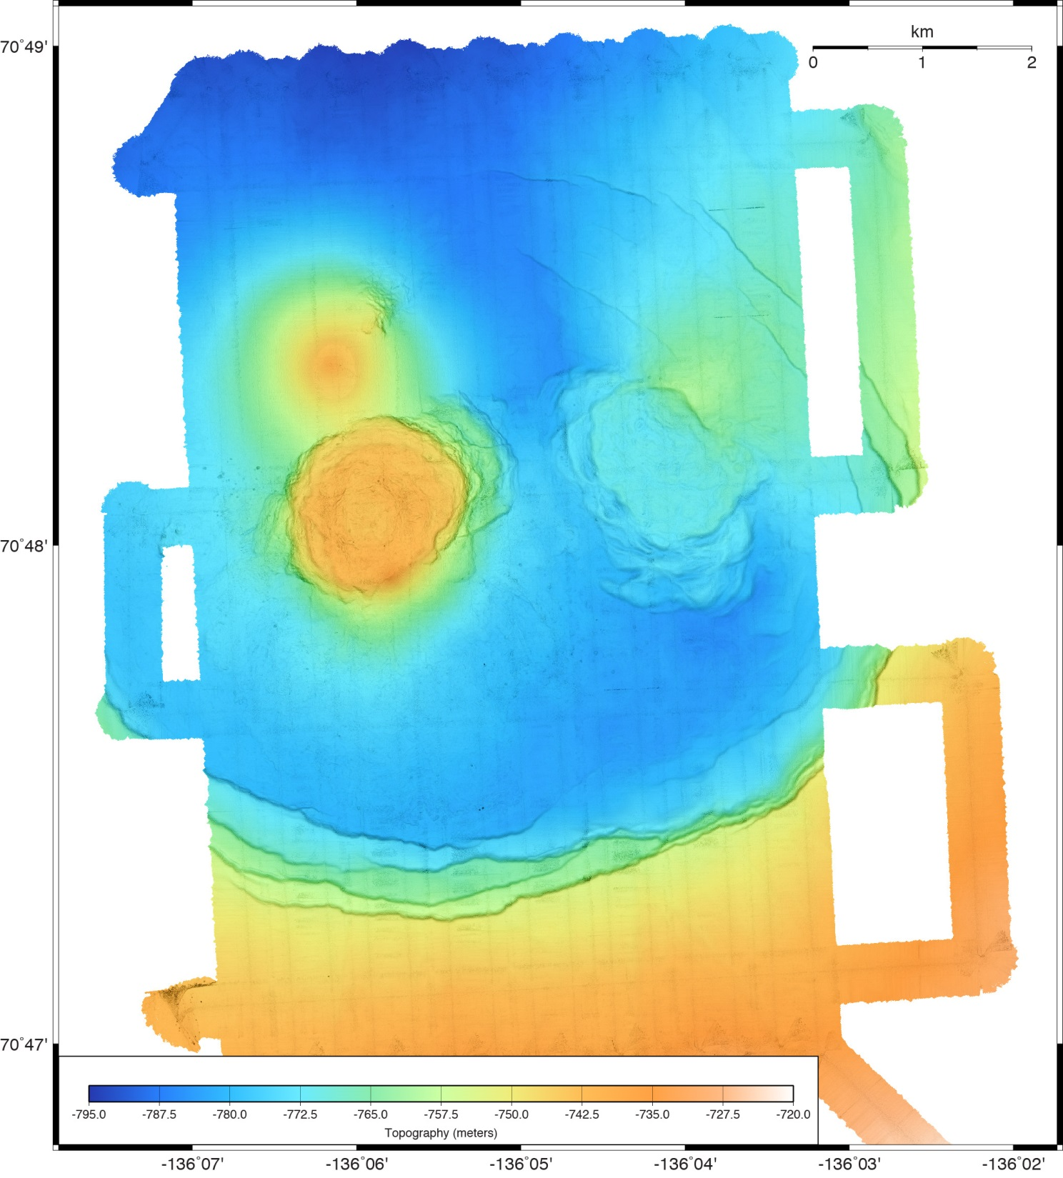
MBARI Mapping AUV
Fluid explusion on the Beaufort Sea margin, Arctic Ocean
Multibeam bathymetry

Slide 18
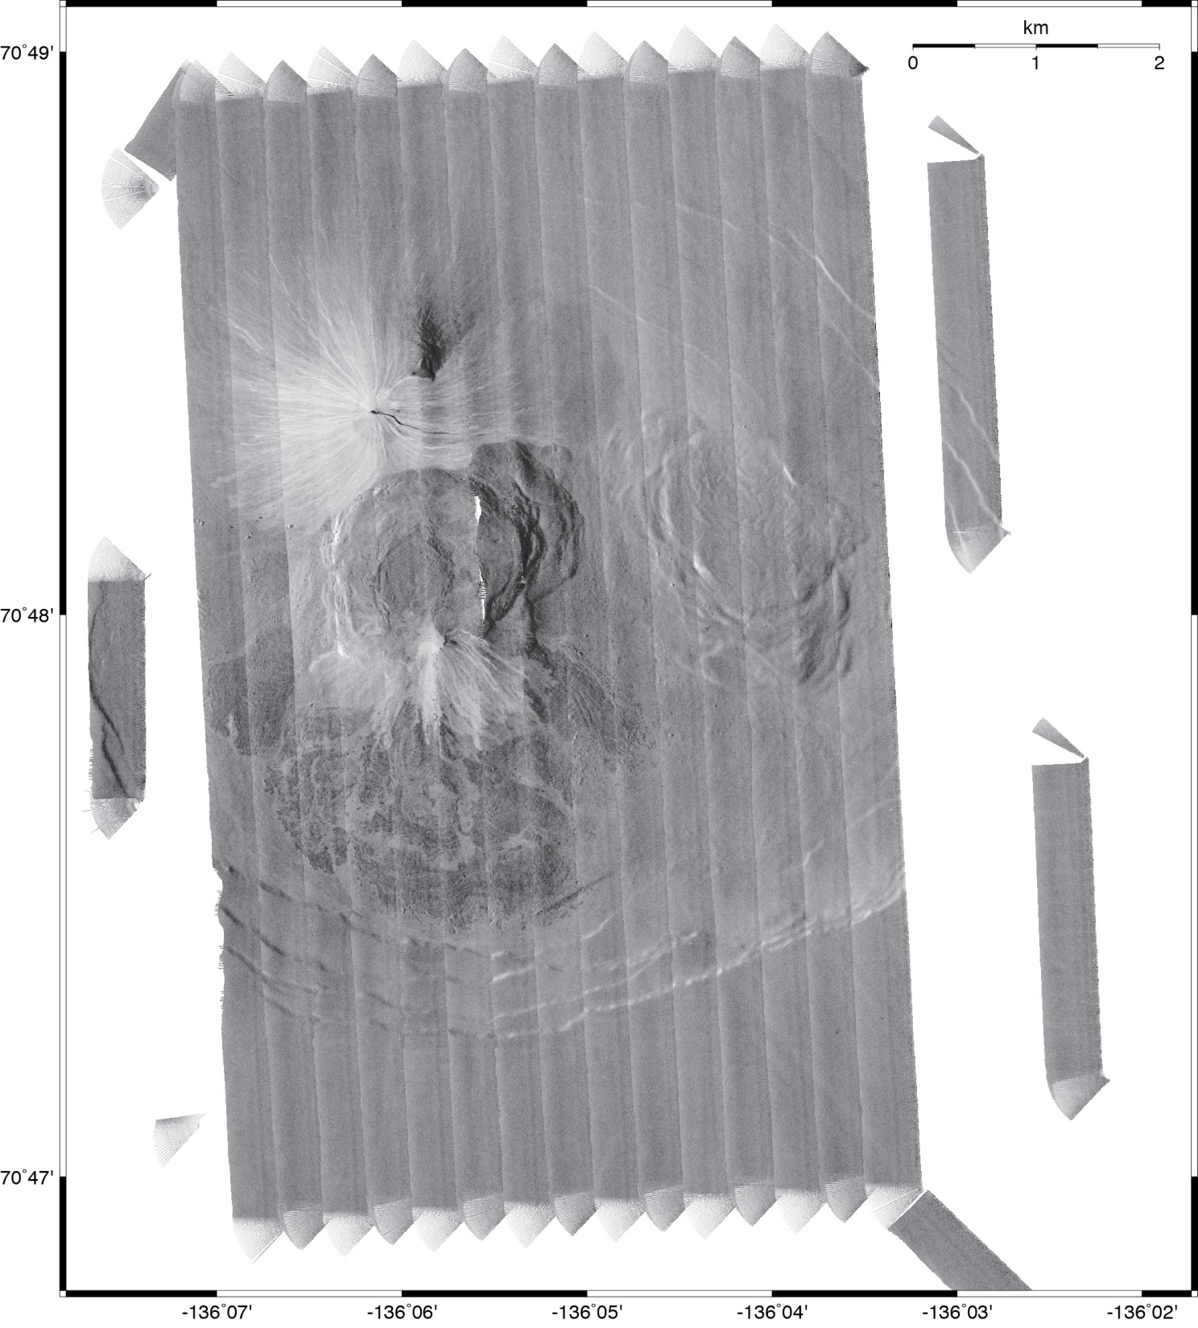
Fluid explusion on the Beaufort Sea margin, Arctic Ocean:
110 kHz chirp sidescan mosaic
1-m resolution sidescan laid out on 1-m resolution bathymetry
Amplitude corrections made using 3D grazing angle corrections

Slide 19
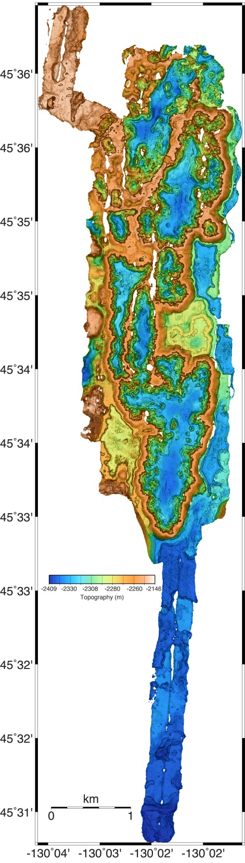
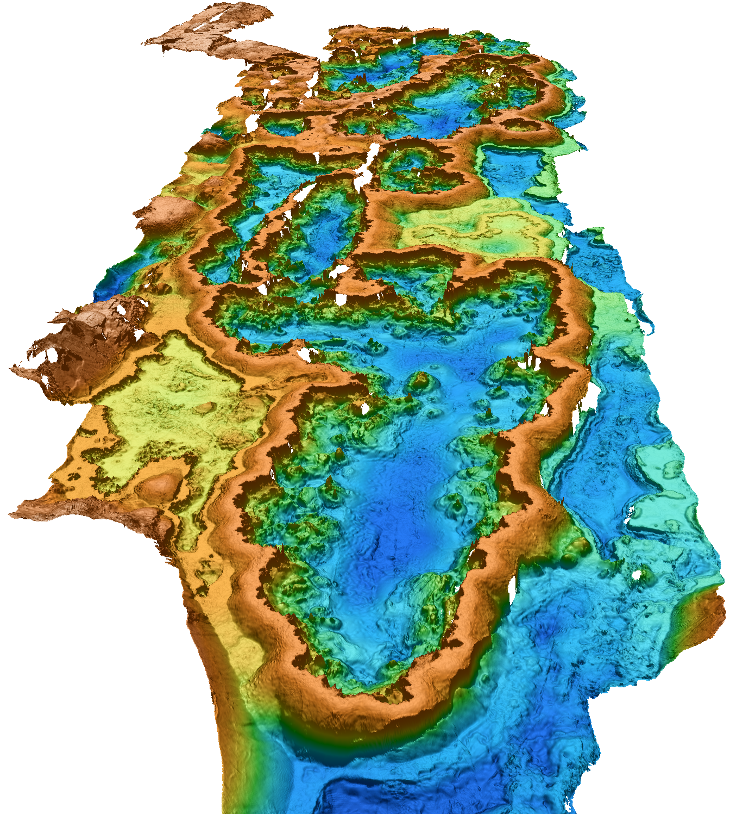
Mapping AUV Survey of 80 m high drained lava ponds along the south rift of Axial Seamount

Slide 20
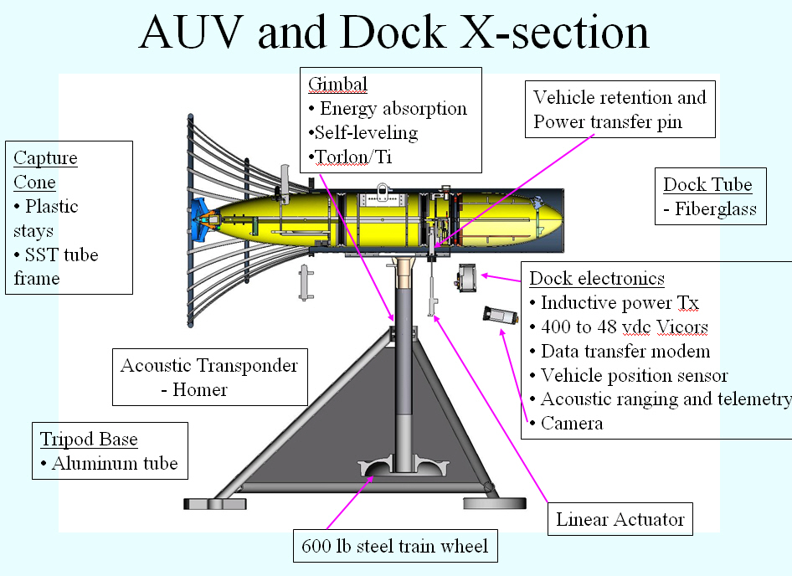

Slide 21
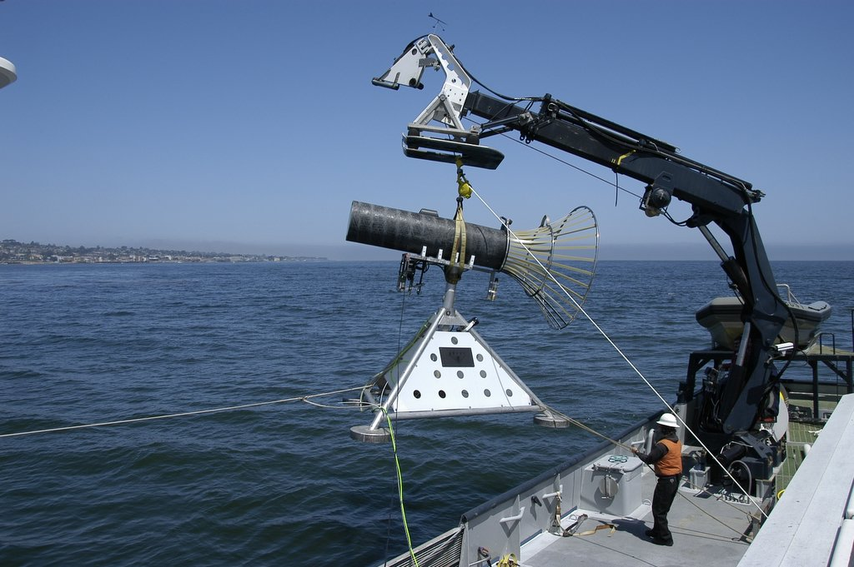
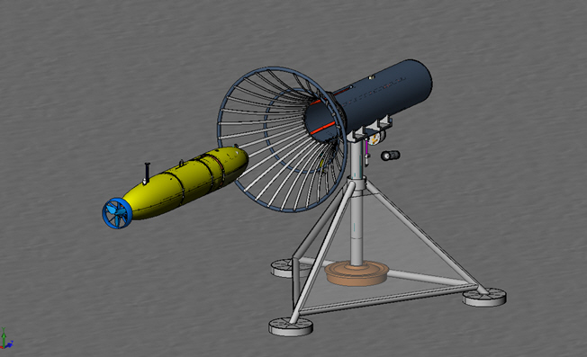
AUV Dock

Slide 22
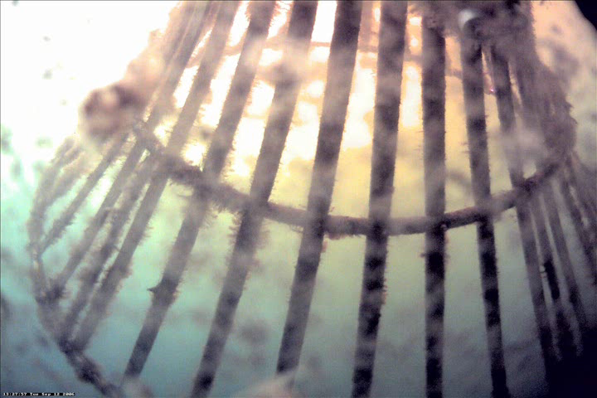
AUV Docking Run

Slide 23
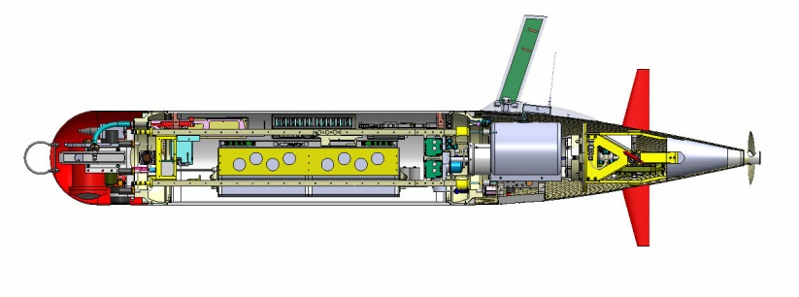
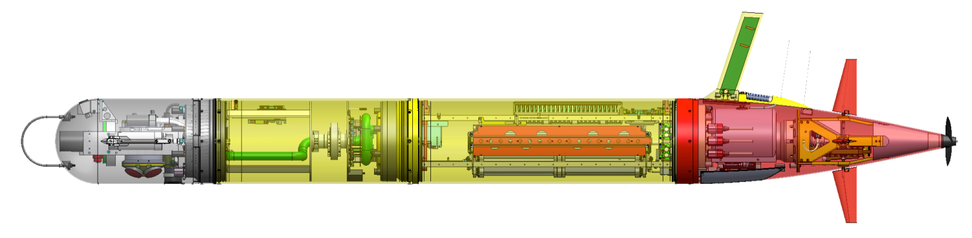
MBARI LRAUV Specifications
Core sensors: DVL/ADCP (Rowe), Fluorometer/ Backscatter (WetLabs), CTD (Seabird), PAR, O2 (Aanderaa)
Iridium, GPS, WiFi and Cellular in mast
Backup argos and VHF
Buoyancy Engine allows neutral drift in water column
Load Control System
18 configurable channels
Isolates load, circuit breaker, ground fault detection
Efficient low-speed propeller
Paired Rudder and Elevator Control Surfaces
6 kWh rechargeable,
11 kWh expendable
Shifting Mass allows controlled angle of attack during flight
3G ESP Sampler Module
Short Nose
With 3G ESP Nose
Mass: 110 kg ( 240lb) dry weight 160 kg (354 lbs)
Size: 0.3m (12”) diameter, 2.47m long 3.18 m long
Speed: 0.5 – 1.2 m/s plus hover
Long Nose Range Est.: 400 Ah energy, ~1 Ah/h rate, ~3km/h:
~13 days, 945 km at full speed

Slide 24
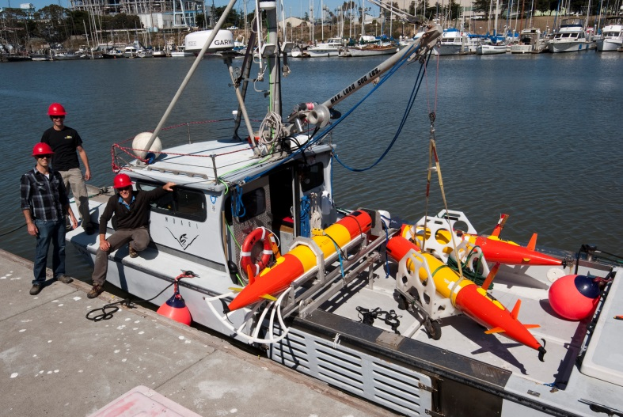
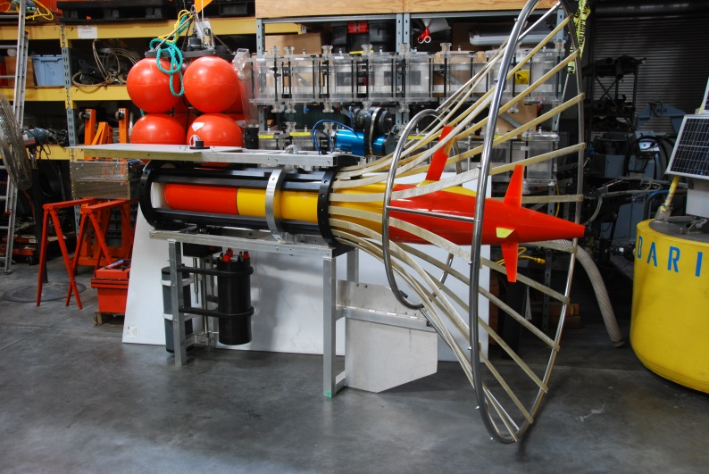
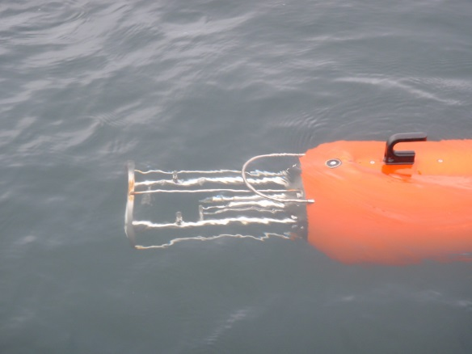
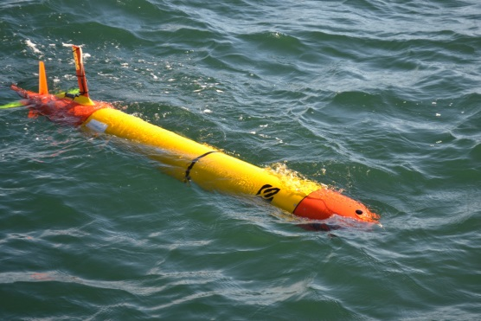
Development Topics
Multi-AUV, Collaborative Missions
AUV Docking
Sensor Payload Development

Slide 25
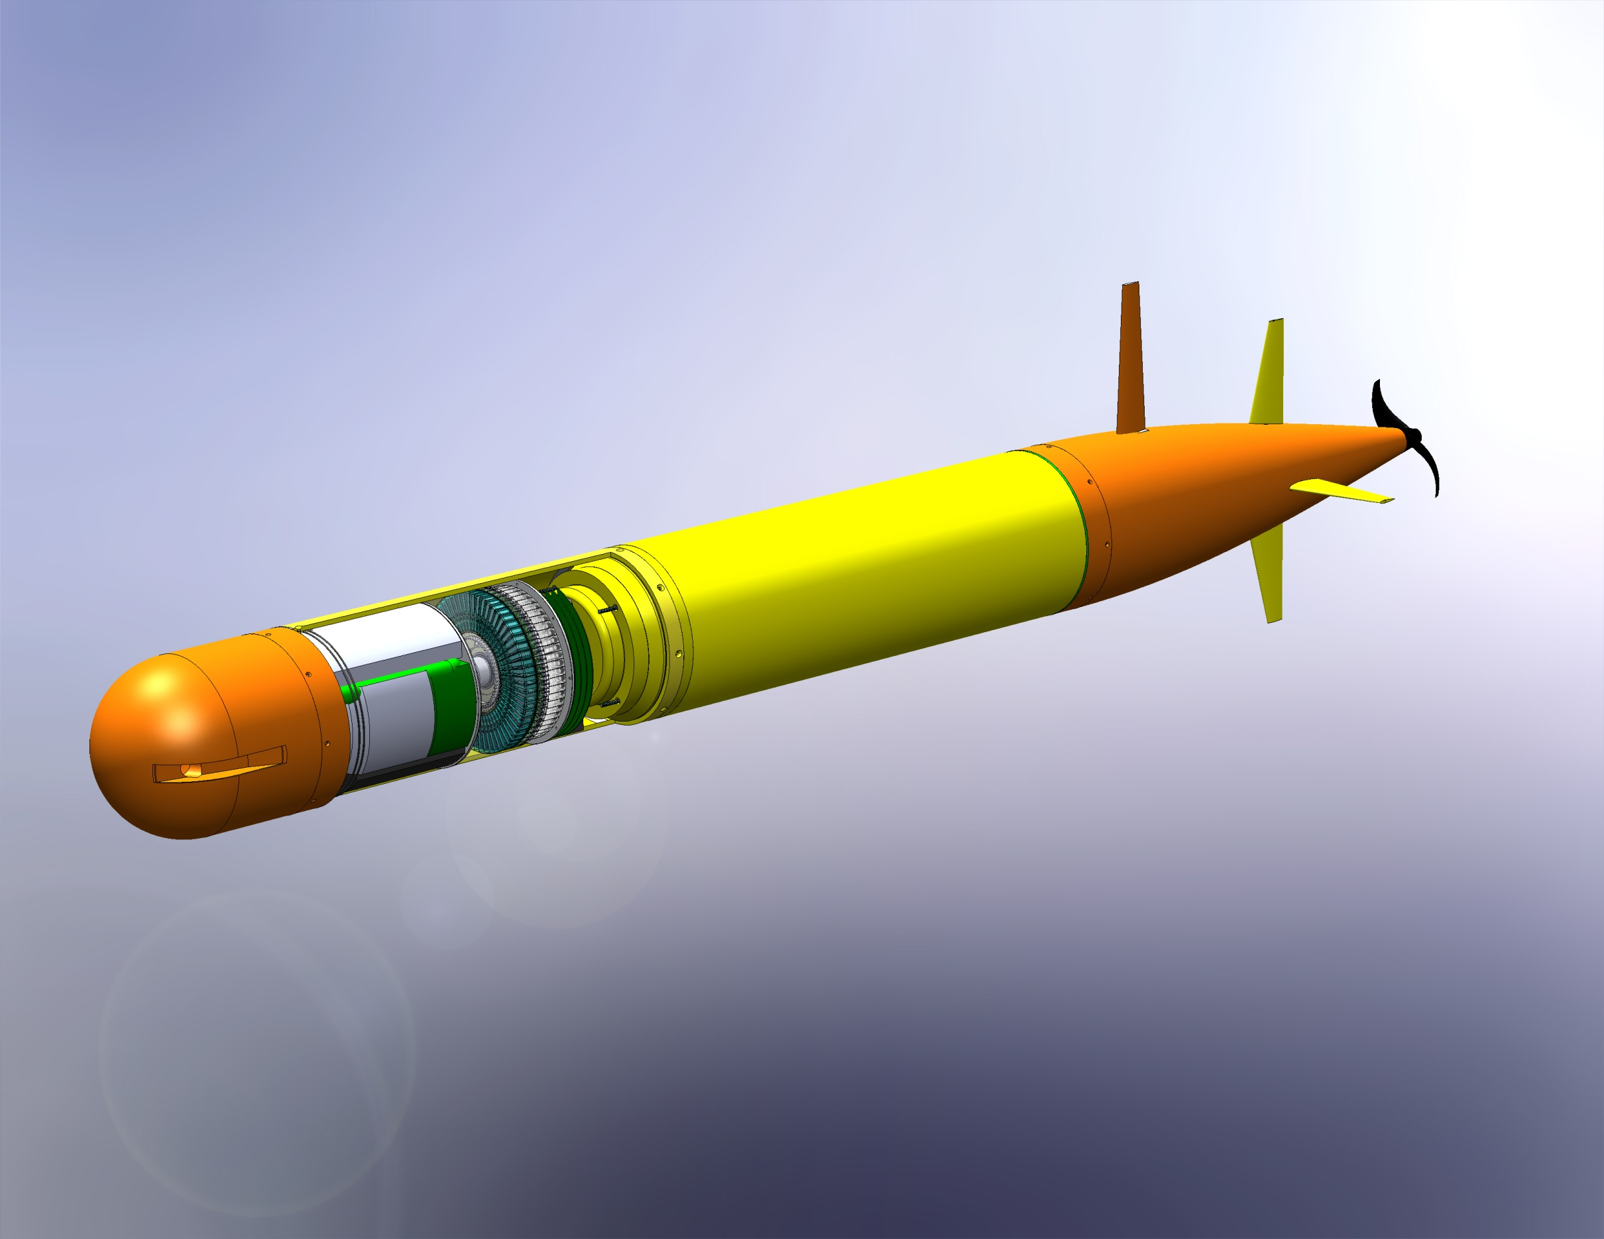




3G ESP/Long-Range AUV
.7m Extension
3m Vehicle

Slide 26
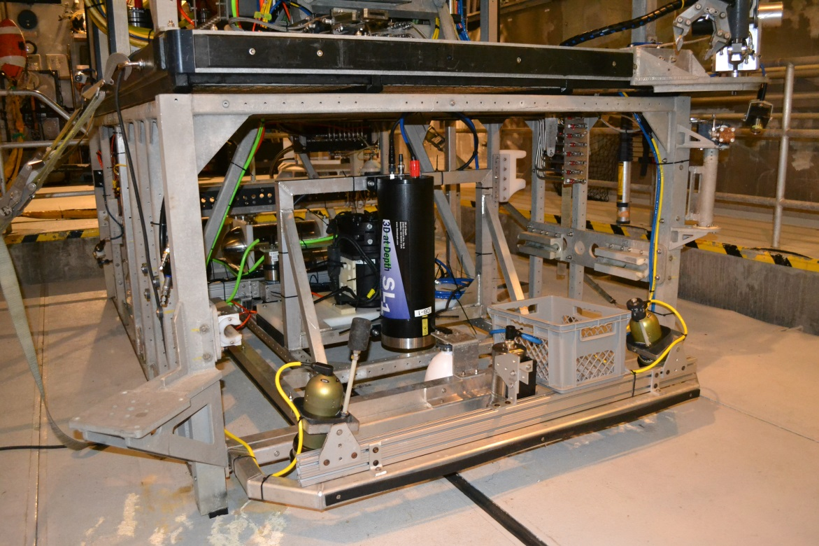
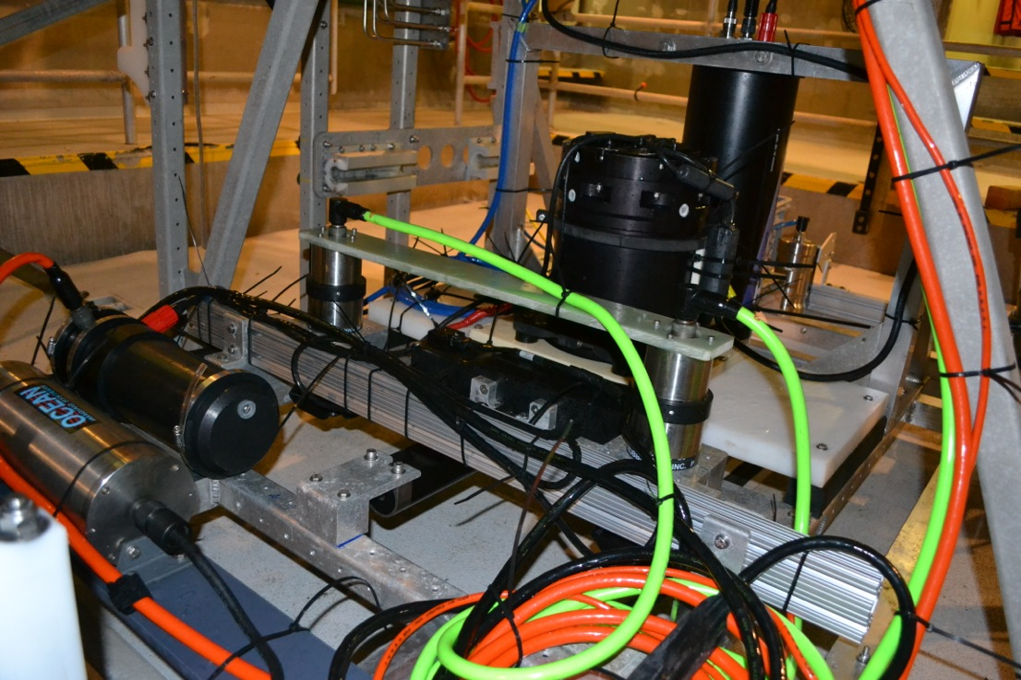
ROV-Based Millimeter-Scale Seafloor Mapping
Low (2-3 meter) altitude seafloor surveys combining acoustic and optical sensing
Topography
  Multibeam sonar: 5-cm lateral-resolution
  Lidar: 1-cm lateral-resolution
Photographic Imagery
  2-mm resolution
Precision Navigation
  .005% Paroscientific Pressure Sensor
  DVL-Aided INS
  Long-baseline Acoustics
Now operated from either ROV Doc Ricketts or ROV Ventana
Multibeam Sonar
Cameras
INS
Strobe
Lidar

Slide 27
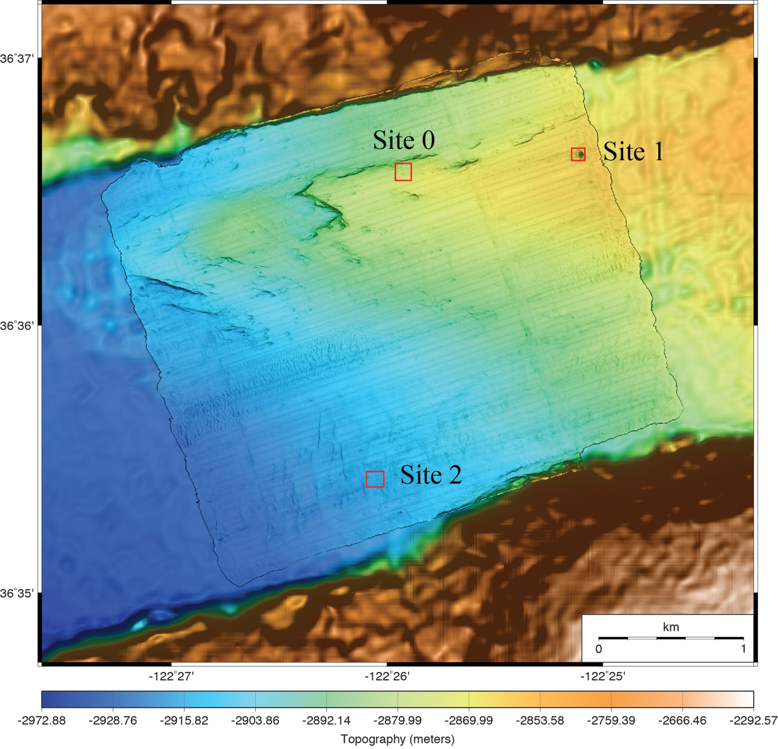
MBARI Low Altitude Survey
80-m by 80-m surveys at 2-3 m altitude from ROV Ricketts
5-cm lateral-resolution multibeam bathymetry
1-cm lateral-resolution LIDAR bathymetry
2.5-mm resolution photomosaics
Repeated surveys beginning in 2012
ROV is now autonomously flown

Slide 28
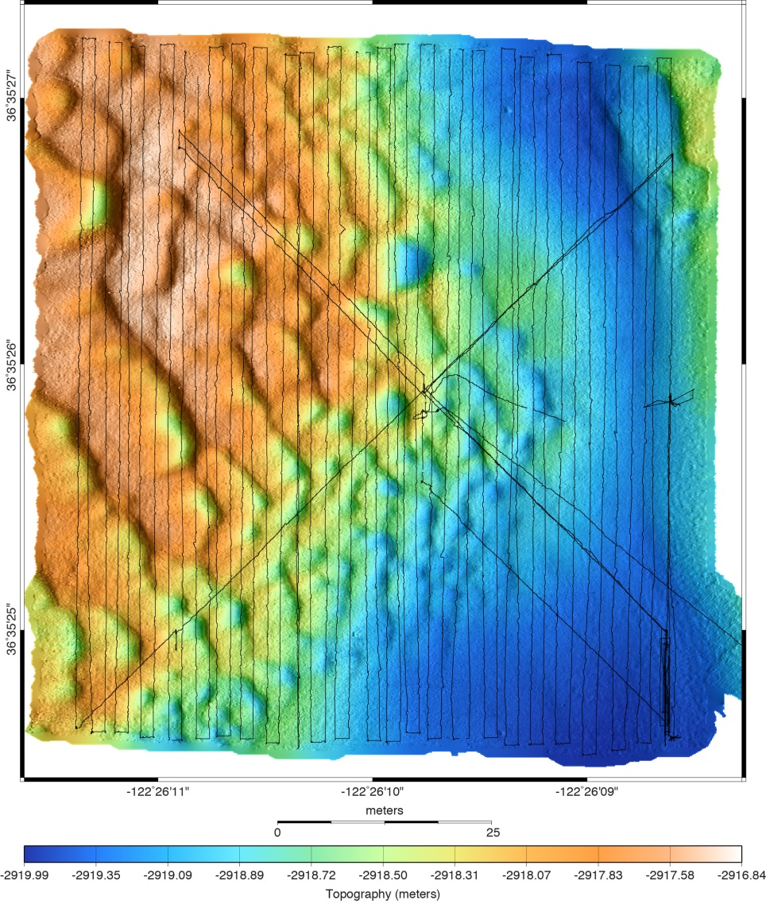
Ocean Imaging Site 2:
Bedforms
5-cm resolution multibeam bathymetry
2-mm resolution photography
50 cm
50 cm
50 meters
50 meters

Slide 29
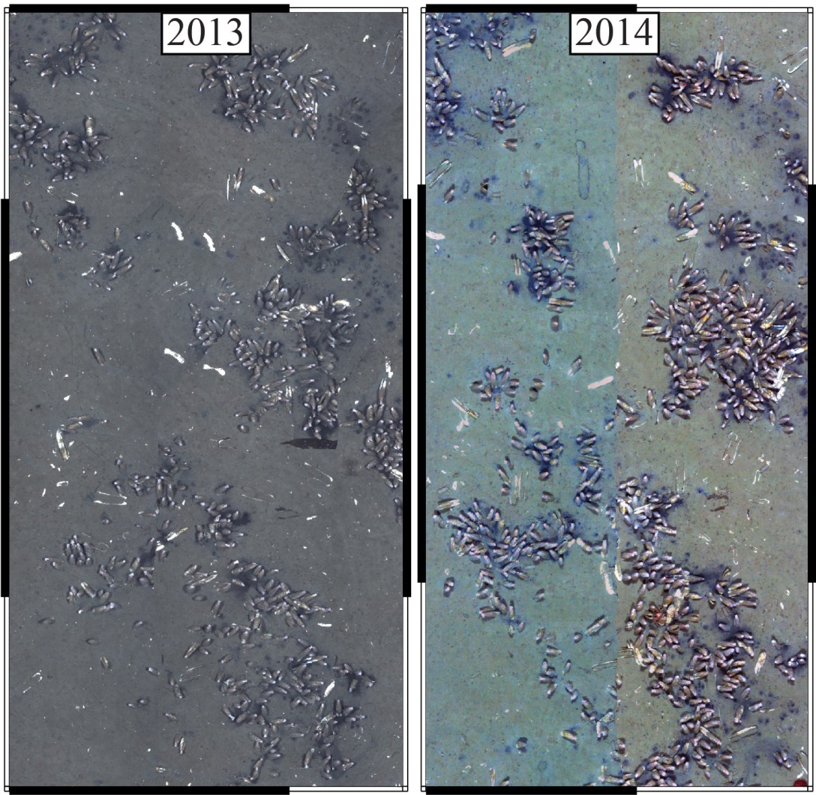

Example Lidar Bathymetry from Ocean Imaging Site 0:
Chemosynthetic Clam Community at 2850 m Depth

Slide 30
MBARI Goals
4000m to 6000m hover-capable AUV systems capable of performing near-bottom surveys in complex terrain with a high-resolution imaging system
  MBARI is already committed to development of sensor payload, control software, and data processing software
  Interested in partner for platform development
Robust AUV docking, power & data transfer (for hovering and non-hovering vehicles)
Leverage relationship with industrial and academic collaborators to minimize cost, risk & schedule and provide avenue for technology transfer

