Slide 1
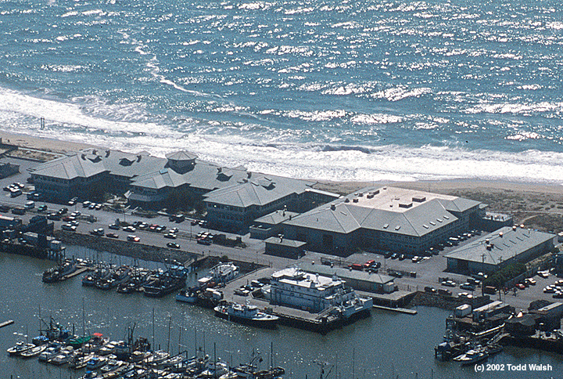
Steve Etchemendy
Director, Marine Operations (MBARI)
Project Manager, MARS (Monterey Accelerated Research System)

Slide 2
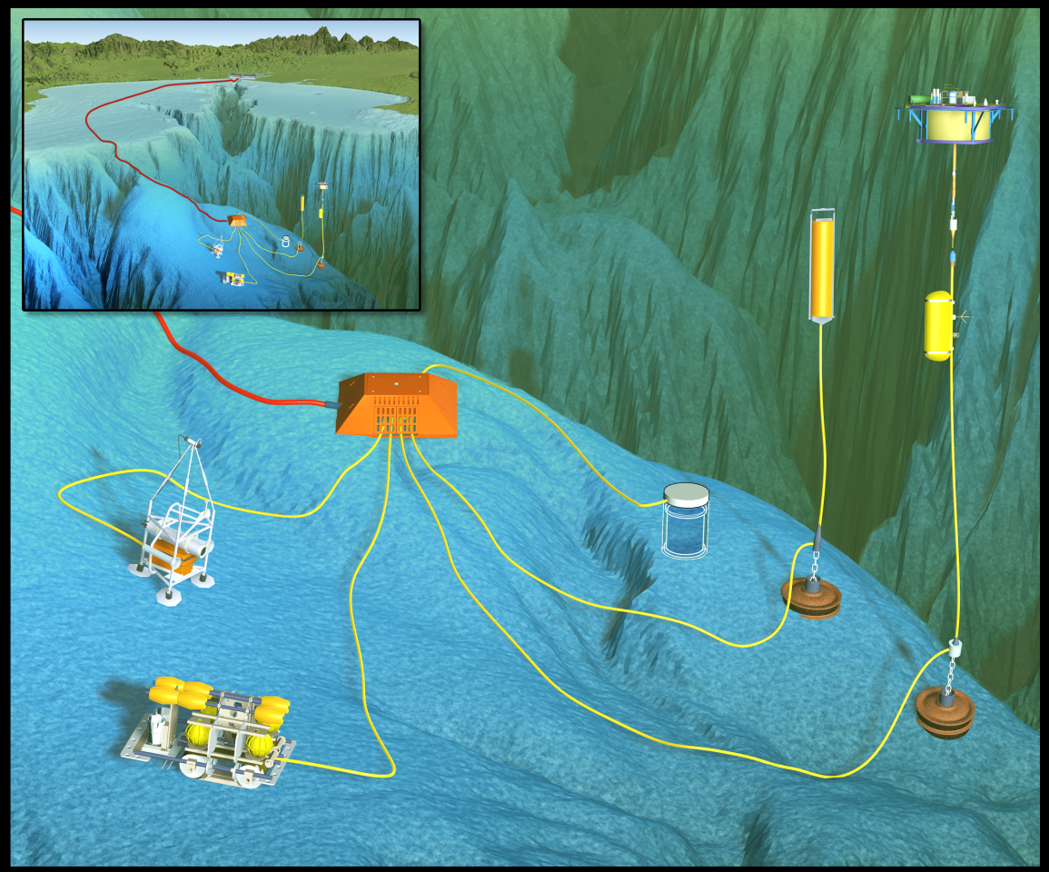
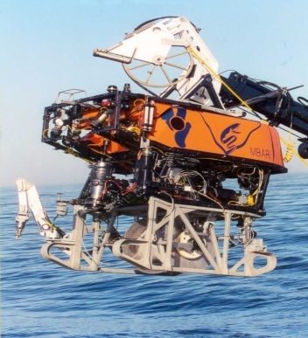
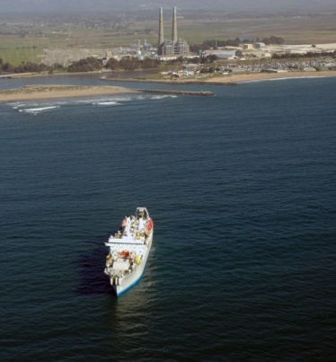
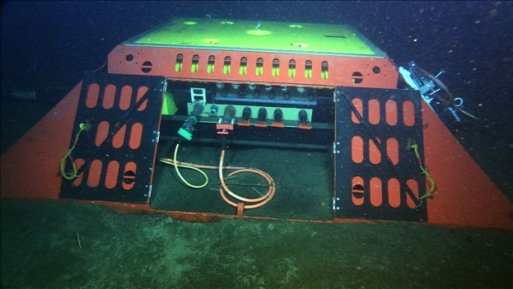
MARS
Monterey Accelerated Research System
A test bed, cabled observatory
9 kW of power for science
8 science ports providing 100 Mbit/sec Ethernet and Precision time distribution ~5 uSec
Deep water - 890 meters
Accessible - 2 hrs from port
Data routed to science users’ IP address
MBARI Cable Laying Toolsled

Slide 3
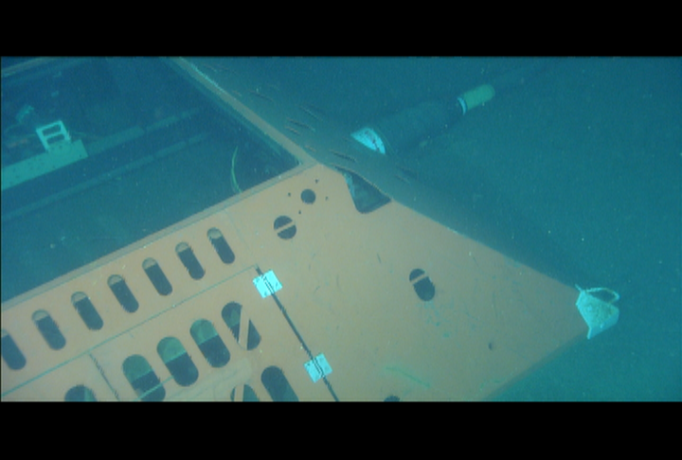
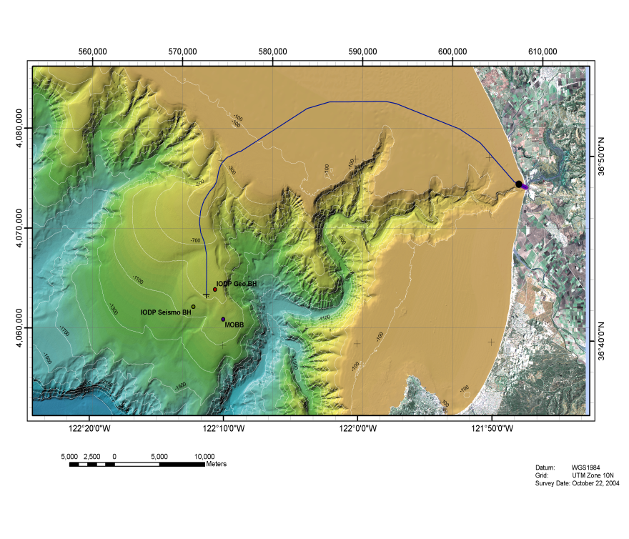
What is MARS?
MARS is a single "science node" 891 meters below the surface of Monterey Bay, California. The MARS science node has eight ports. Each of the eight ports is equipped with an underwater mateable connector. The science node is connected to the shore through 52-km of subsea telecom cable that carries data and power.

Slide 4
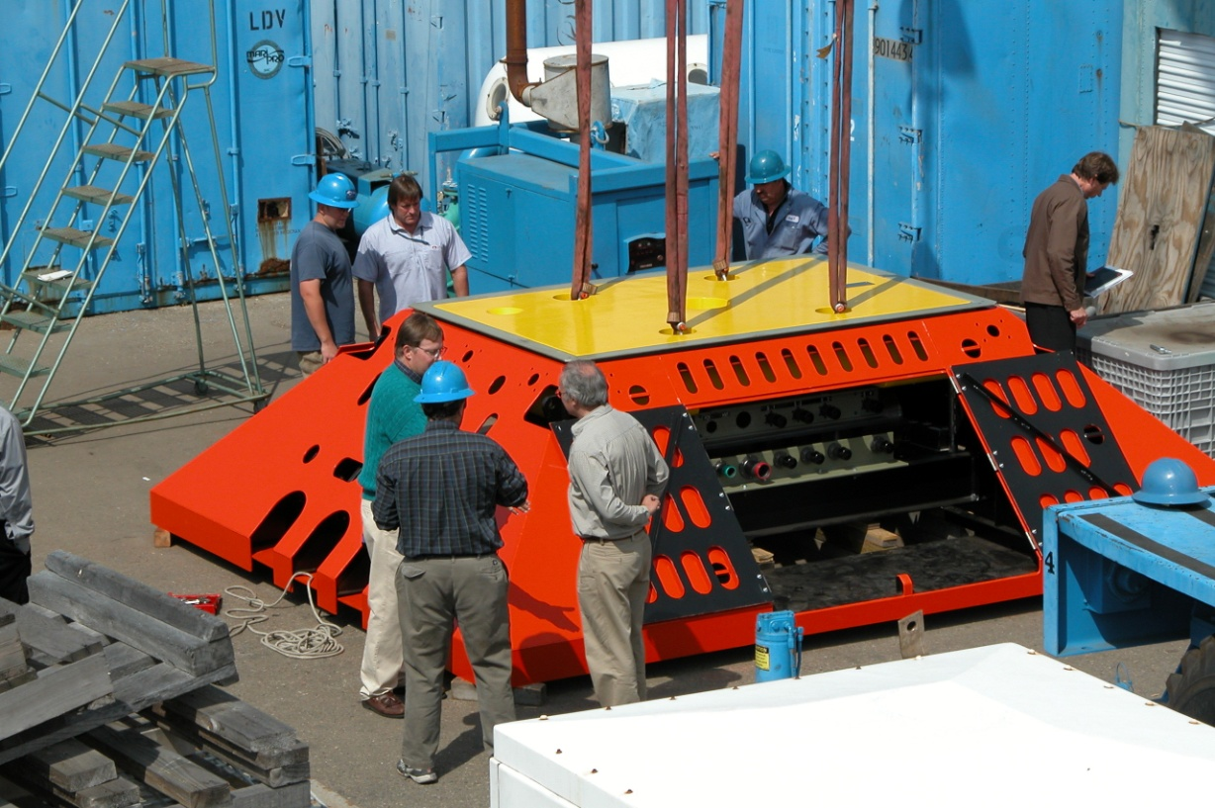
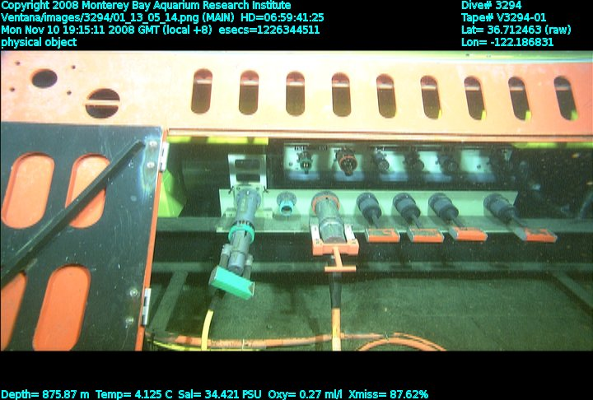
The yellow portion houses the MARS electronics in an ROV removable section.
The MARS trawl-resistant frame.
ROV access door is open underwater connectors inside
On November 10, 2008, the ROV Ventana connected the main MARS telecom cable’s power and fiber optic links to the MARS electronics node

Slide 5
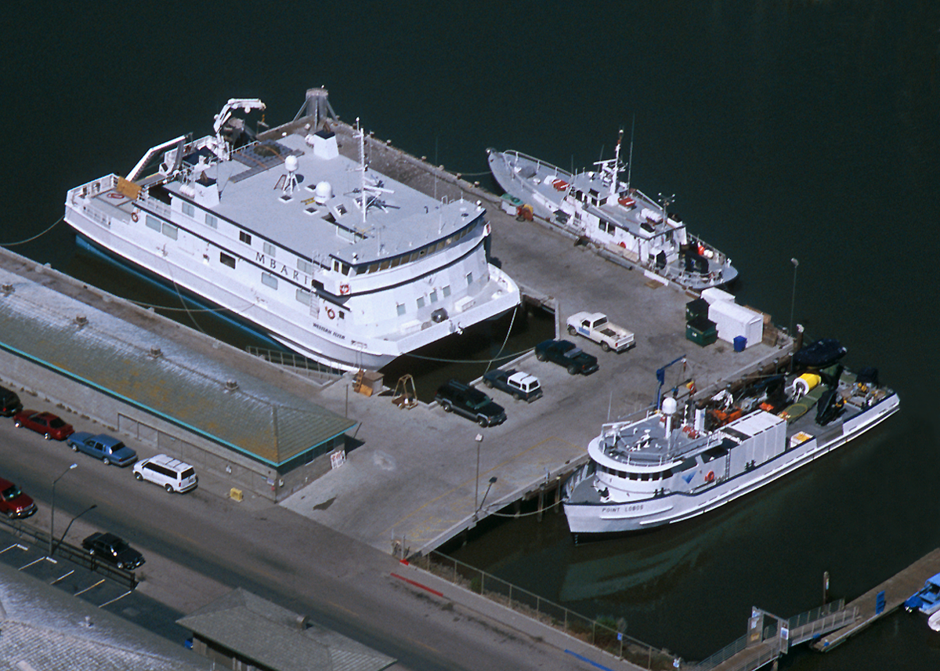
RV Western Flyer / RV Point Lobos / RV Zephyr
Ocean Observatory Group
ROV Tiburon / ROV Ventana / AUV Group
Marine Operations Technicians
MARS
MBARI Marine Operations

Slide 6
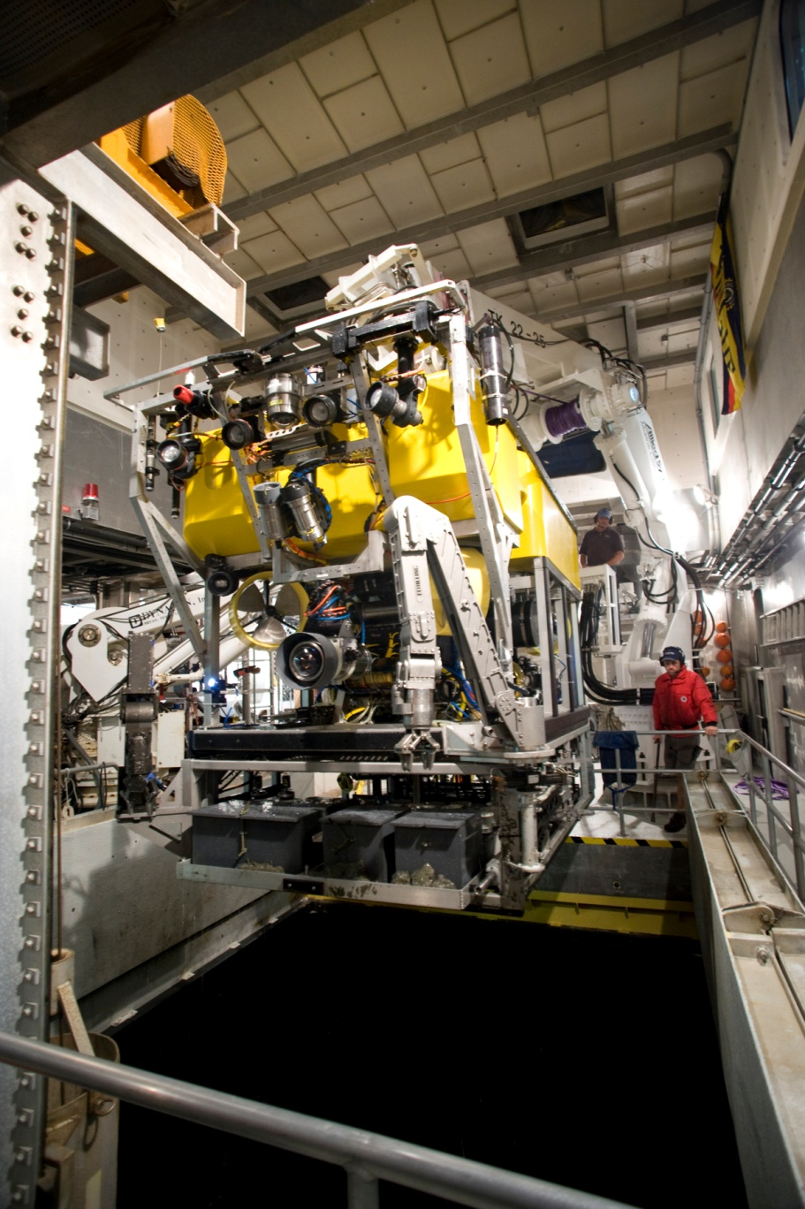
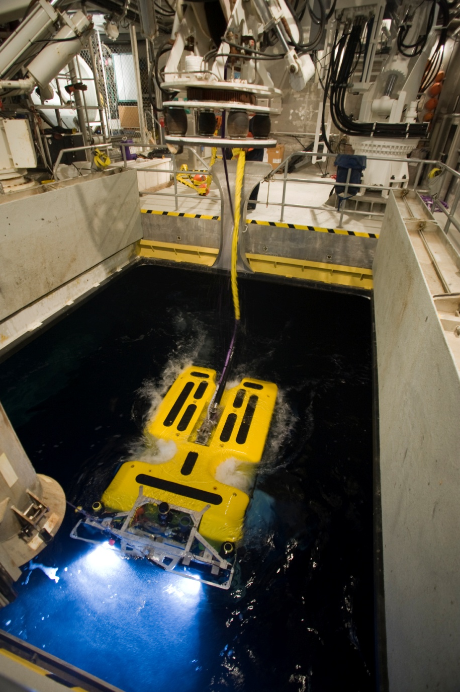
The ROV Ricketts
75 HP (56 Kw) 4000 meters max depth

Slide 7
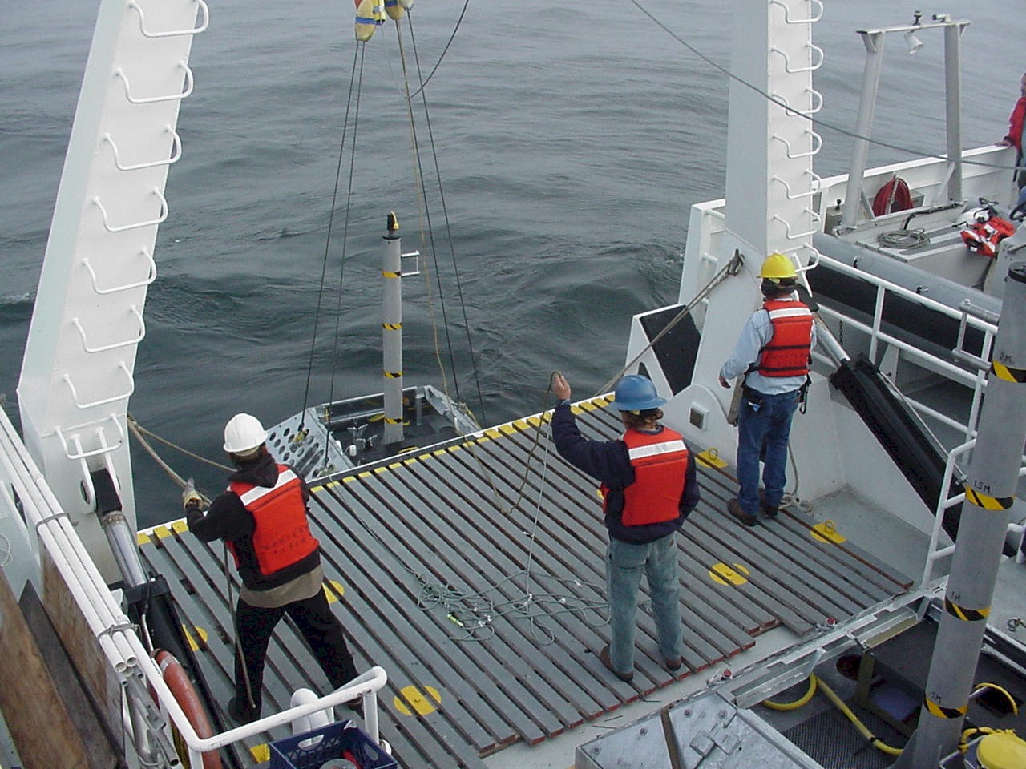
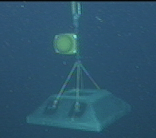
The RV Western Flyer deploying a benthic node to the sea floor

Slide 8
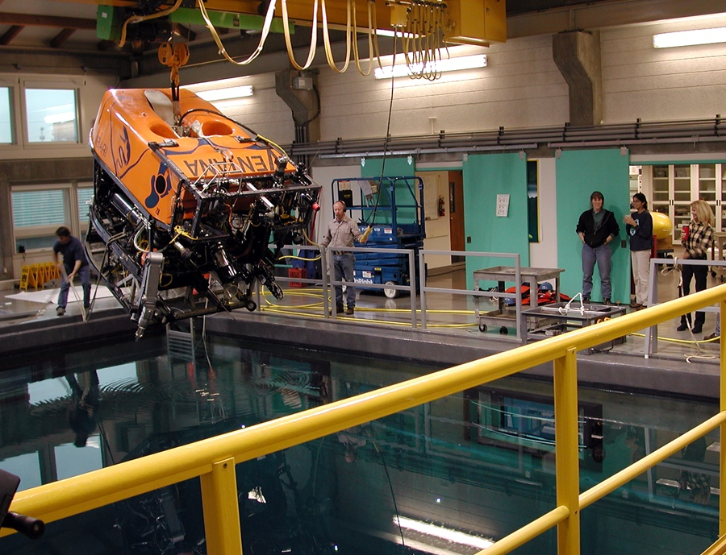
MBARI test tank with the ROV Ventana

Slide 9
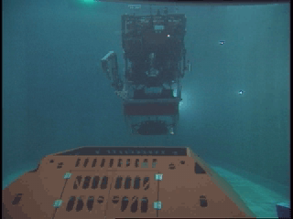

Slide 10
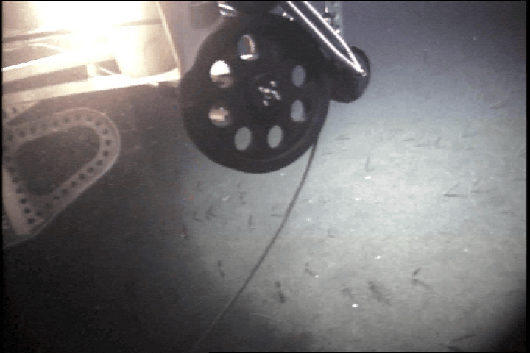
The ROV Ventana laying 2.5 Km of cable from MARS to the MOBB seismometer

Slide 11
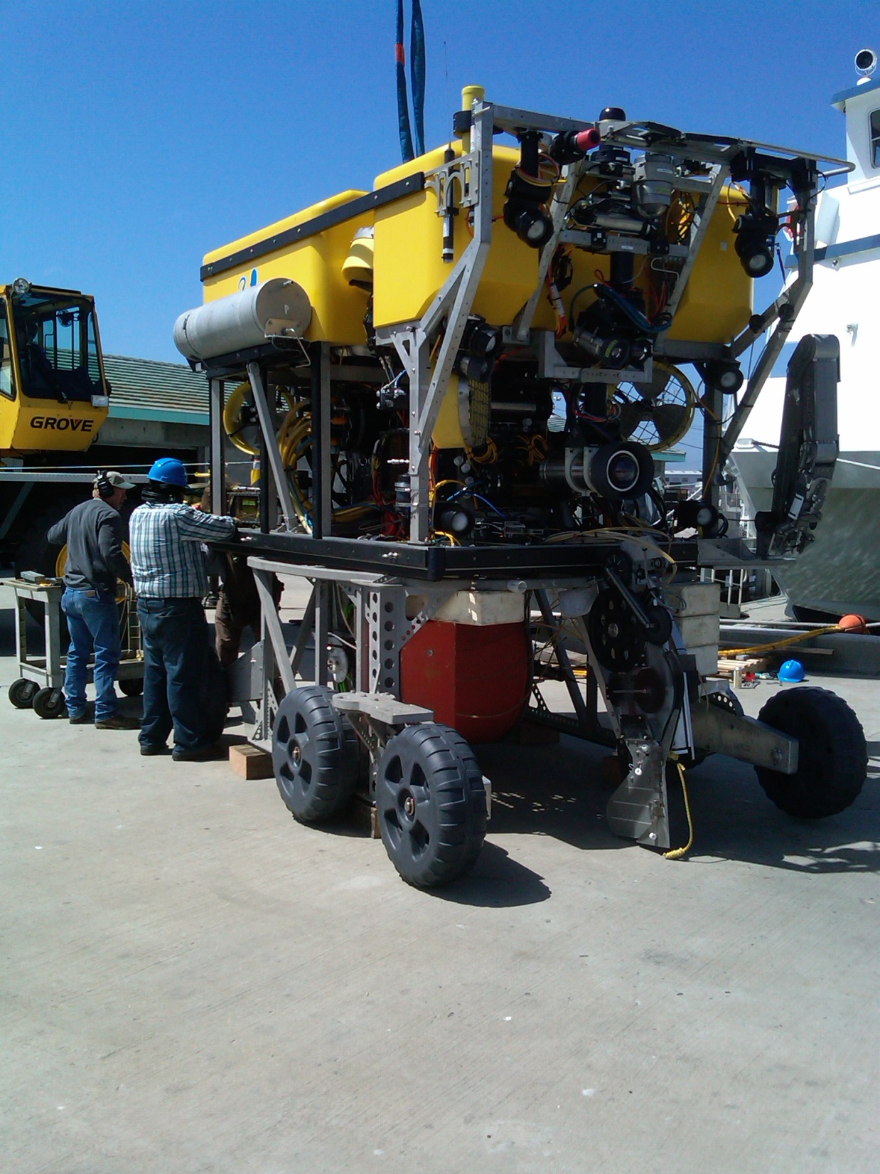
The ROV Doc Ricketts with the cable laying and plow toolsled
Capable of laying 4Km of 9.5 mm fiber optic and power cable. Depth of burial dependent on bottom hardness.

Slide 12
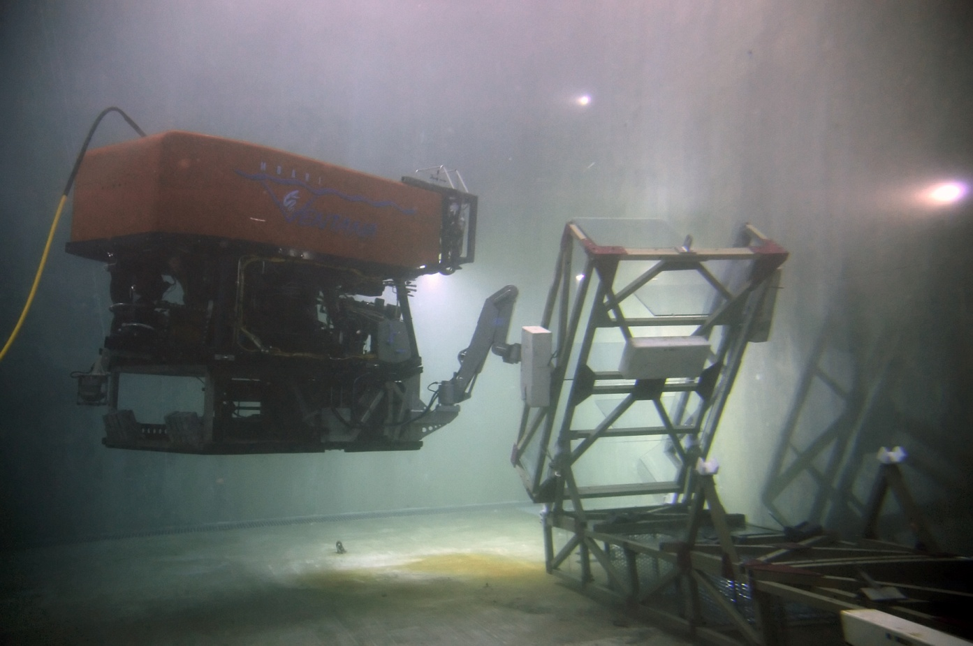
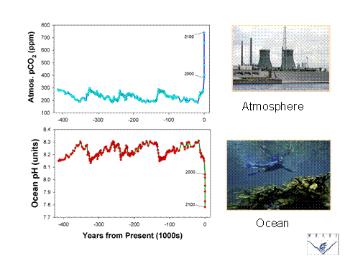
While over-fishing was the ocean crisis realized in the 20th century, ocean acidification will be the crisis of the 21st century.
What will be the ecology of the acidic ocean? How will the food chain be altered? What management practices will need to be changed?
FOCE
Free Ocean CO2 Experiment
Dr. Peter Brewer
http://www.mbari.org/mars/general/foce.html
Deployed Dec 9, 2008

Slide 13
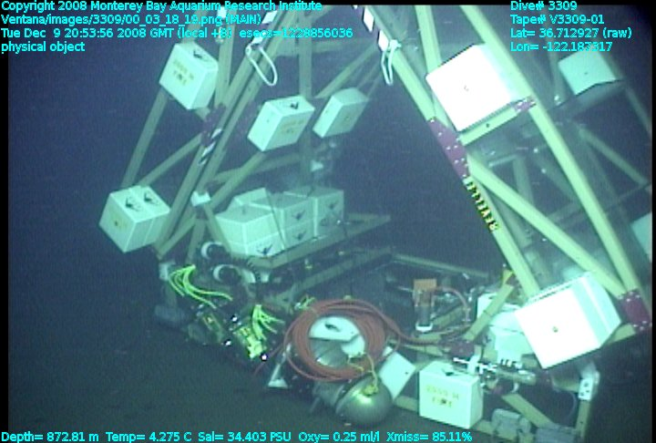
FOCE prior to unfolding on the bottom

Slide 14
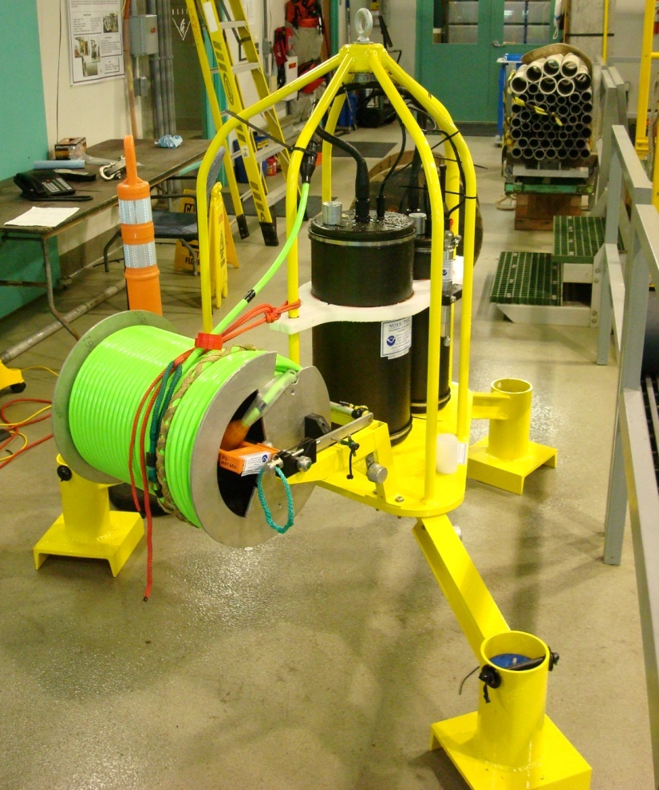
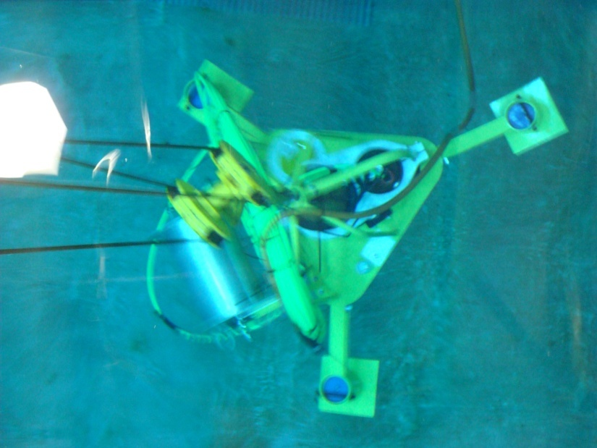
Bottom Pressure Recorder (BPR)/Tilt Meter
Precise pressure and tilt sensors
  Measure vertical movements of seafloor
Designed to monitor submarine volcanoes
Initial Wet Node Simulator testing June 17.
Bill Chadwick, Chris Meinig, Scott Stallin, Nick Delich and Dirk Tagawa (OSU/PMEL).
Notes:
Bottom Pressure Recorder/Tilt meter
Precise pressure and tilt sensors that can
Measure vertical movements of seafloor
Which are indicators of volcano inflation and deflation,
magmatic intrusions and eruptions
Initial Wet Node Simulator testing June 17
WNS testing required of all users
prototype instrument test on MARS for 6 months
After testing, plans include an array of these units on Axial Seamount (OOI)
Left- BPR on the test tank deck read for testing
Right- in water tests look for gnd flts and measure in water weight.

Slide 15
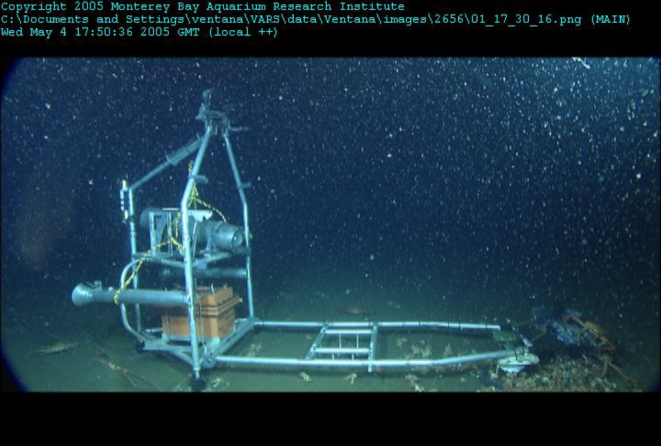
Eye-in-the-Sea
Dr. Edith Widder http://www.oceanrecon.org/research.htm
Deployed January 21, 2009
Objective is to collect unobtrusive video observations of deep sea animal behavior using red lights, no thrusters
Connected to significant education and outreach program

Slide 16
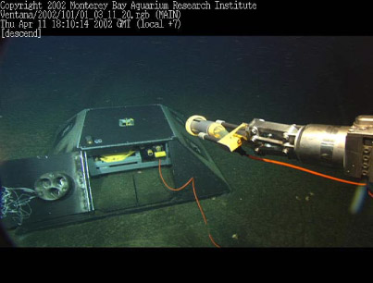
MOBB
Monterey Ocean Bottom Broadband
Dr. Barbara Romanowicz UC Berkley
Deployed February 26, 2009
Seismic Observatory
Only continuously recording seismometer west of the San Andreas fault system
Hookup to the MARS cable provides data in real time, avoiding use of lithium batteries

Slide 17
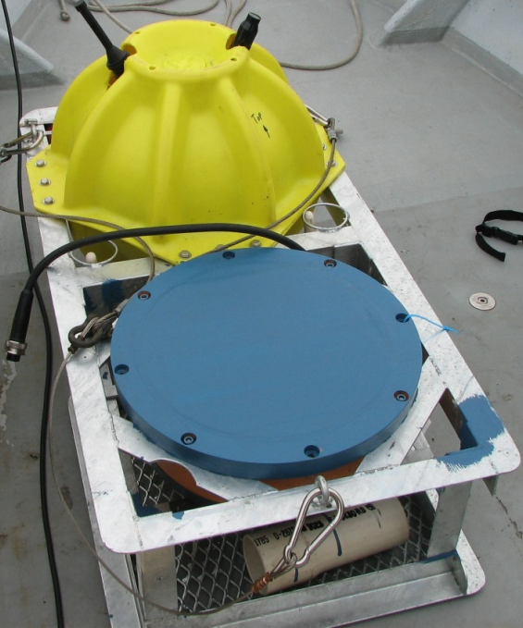
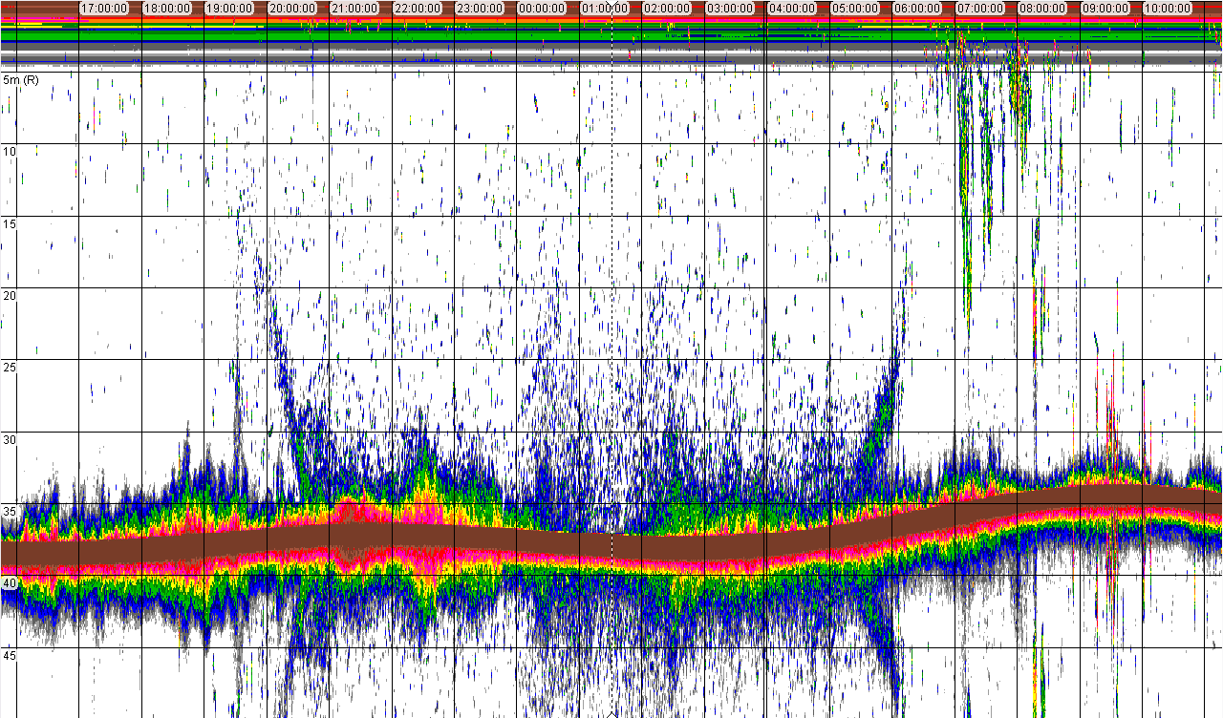
EK60 Echosounder Specifications
Deployed Feb 2009
Echosounder: Simrad EK60; 38 kHz; 7º beam
custom mounted in Benthos sphere
real-time monitoring and display via internet
Fish diel vertical migration
17:00
10:00
Bottom
~35 m
Surface

Slide 18
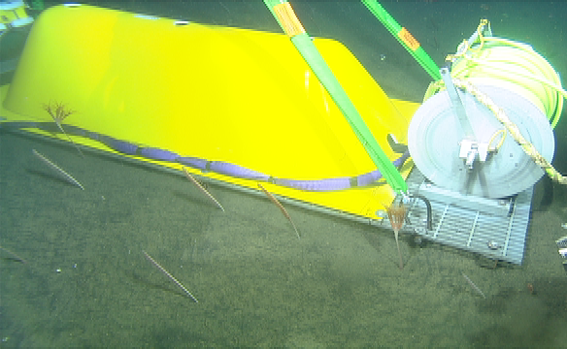
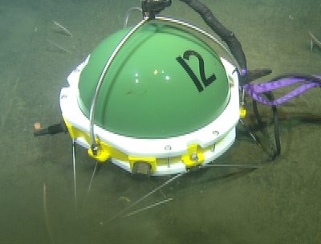
LOOKING- OBS
Laboratory for the Ocean Observatory Knowledge Integration Grid
Ocean Bottom Seismometer
Test software used to integrate seafloor sensors with the Ocean Observing Initiative
NSF funded to use MARS as originally intended, a test bed for OOI/Neptune
John Orcutt, Frank Vernon Glen Offield, Gary Austin, and Martin Rapa. Scripps Institute of Oceanography.
Notes:
Laboratory for the Ocean Observatory Knowledge Integration Grid is
an Ocean Bottom Seismometer or OBS.
these instruments have been deployed in many locations around the globe.
The main goal of this deployment is to
Test software used to integrate seafloor sensors with the Ocean Observing Initiative (OOI)
and other observing systems
It uses Advanced Messaging Queuing Protocol (AMQP).
A new messaging system used by banks and investment companies.
The project is NSF funded to use MARS as originally intended, a test bed for OOI/Neptune

Slide 19
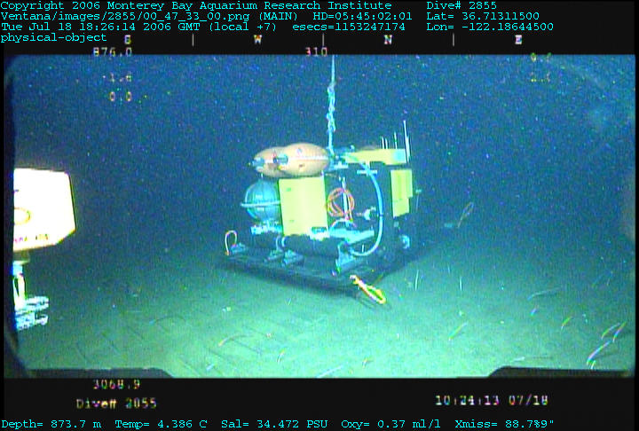
Benthic Rover
Dr. Ken Smith, MBARI http://www.mbari.org/mars/general/rover.html
Deployed August 6, 2009
Typically used in autonomous mode, connected to MARS for testing and refinement
Performs a time series of measurements at the sediment interface, thus avoiding numerous separate expeditions and ROV dives

Slide 20
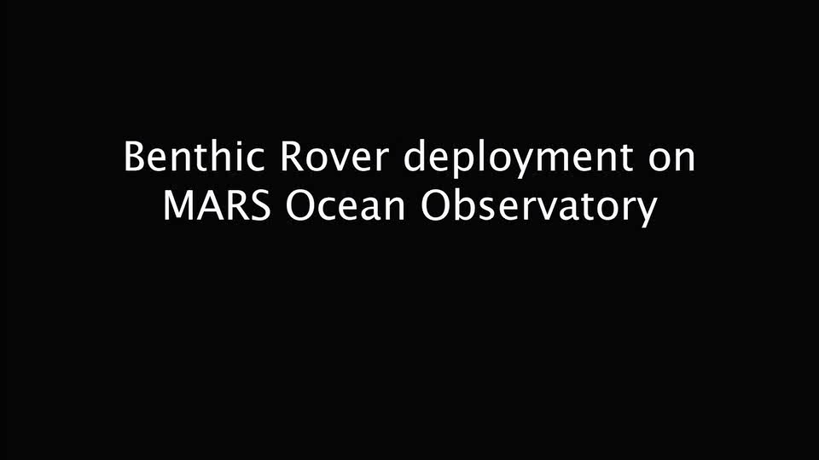

Slide 21
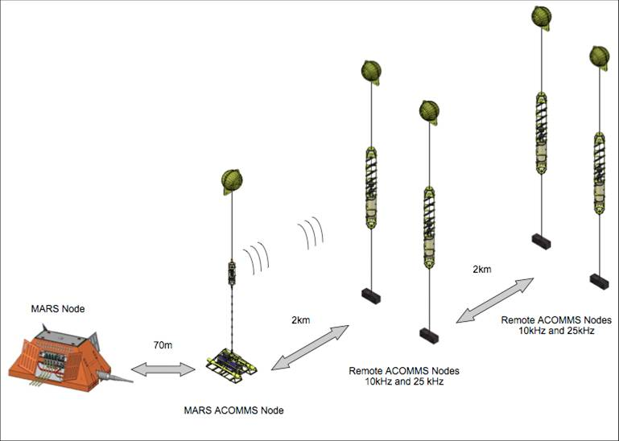
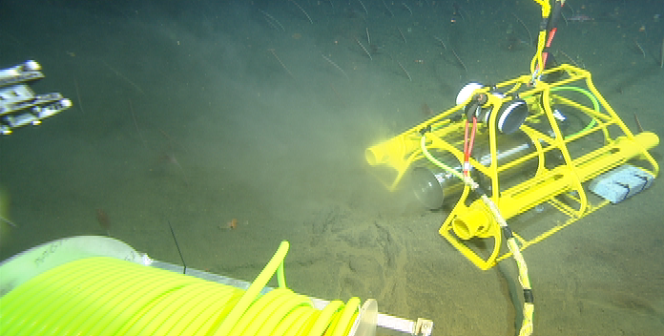

Acoustic Communications for Deep-ocean Observatories
Acoustic modem
Prototype system for connecting remote instruments to a cabled observatory
Reduce the need for ROV services.
Deployed Feb 2010
Lee Frietag, Keenan Ball, and Peter Koski (WHOI)
Notes:
Acoustic Communications for Deep-ocean Observatories
or ACCOMS is an Acoustic modem powered and communicated with through MARS
It is a prototype system for connecting remote instruments to a cabled observatory
One of the major goals is to reduce the need for expensive and difficult to come by ROV services
to deploy and connect and
then recover instrument packages.
The modem is plugged in to the observatory
and four moorings, 2 at 2km and 2 at 4km have been deployed to conduct testing of acoustic transmissions
the moorings represent the remote instruments that could be connected to the observatory.
traffic is simulated between the moorings and the observatory.
Lee Frietag, Keenan Ball, Peter Koski WHOI

Slide 22
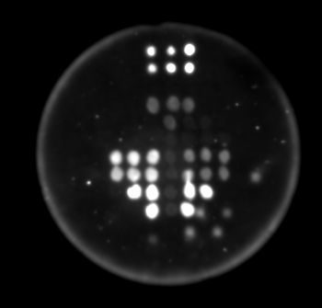
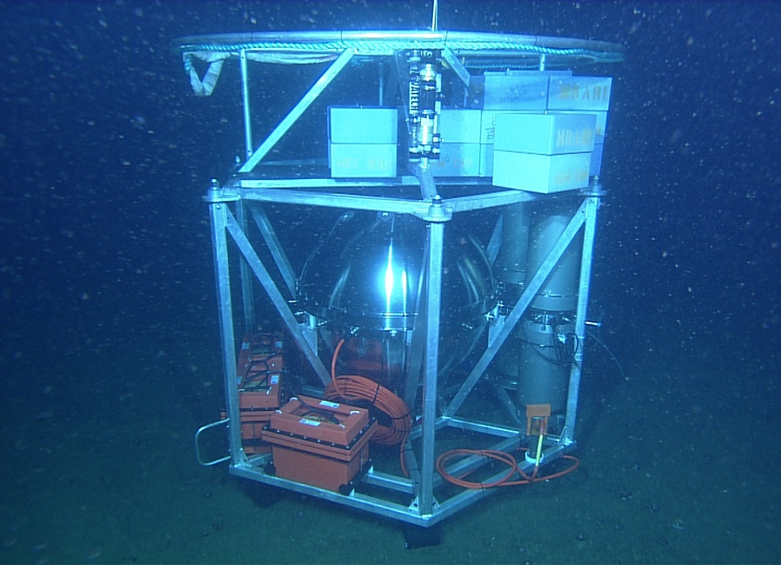
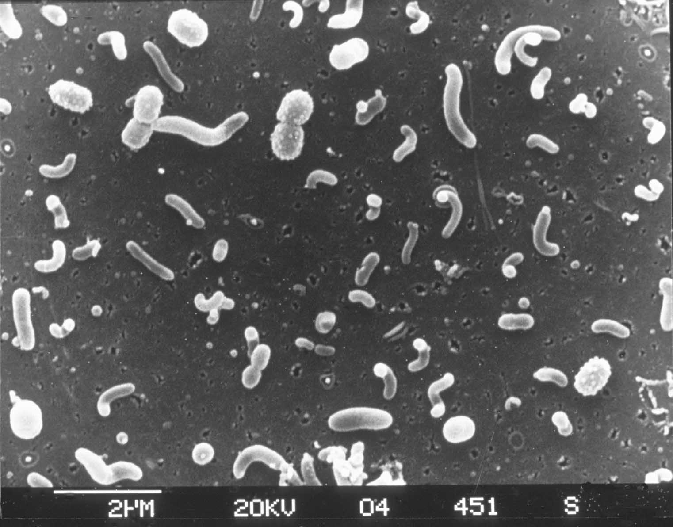
Environmental Sample Processor – ESP
Detection of invertebrate larvae, pennate diatoms and groups of bacteria on a single array:
Chris Scholin, MBARI
chemistry control and
intensity standards
“all eukaryotes”
125 ml whole water sample
0.45μm filter
2ml homogenate

