Slide 1
DORISS II PC/104 Upgrade Selection
Design Requirement & Preliminary Concept Review

Slide 2
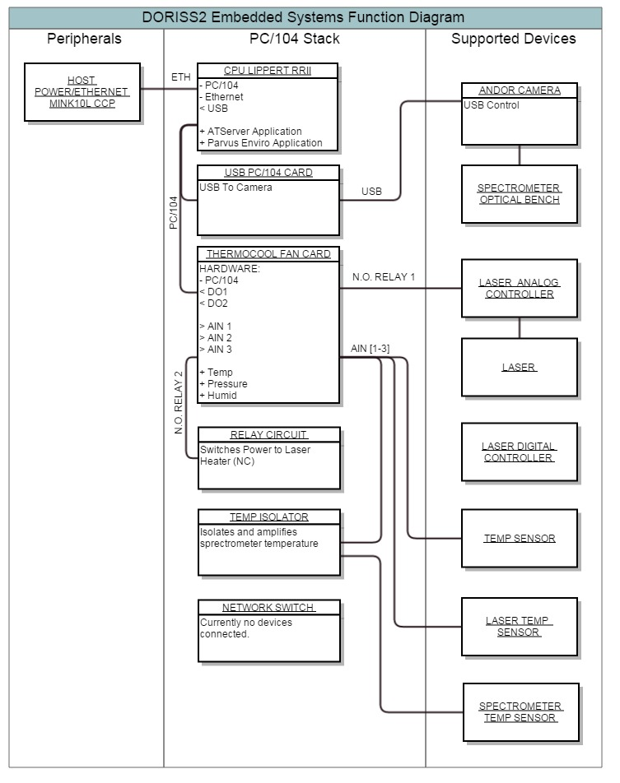
Current System Diagram

Slide 3
Electrical Requirements
Employ existing temperature sensors:
  Only the spectrometer temp sensor cannot change.
Provide Switched control of the laser output
  two-pin closure enables lasers, must be normally open
Incur as little change to power electronics as possible.
Provide an ethernet 4-wire interface compatible with both Ventana, Doc Ricketts, and laboratory systems.
Provide a USB 2.0+ Port for camera communication
Replace the existing humidity sensor.

Slide 4
Software Requirements
Windows 7 or newer to support legacy Andor and KOSI software that exists as part of current and future systems.
Newer version of HoloGRAMS is HoloPRO, requires Windows 7 and does not have a distributed control system solution off-the-shelf.
Simple interface for laser control and temperature/humidity sensors.

Slide 5
Vestigial Items
Laser Heater Relay
Power-on Delay Circuit
  This can remain until the space is required to replace it.
Network Switch
  PC/104 is the only component with an interface, newer NICs will have auto-negotiation.

Slide 6
Solution Candidates
Three Form Factors Considered:
  PC/104: The existing form factor
  PicoITX
    Very Compact Class, low power and ruggedized connectors.
  EPIC:
    Very large industry format, large connectors and many peripherals.
All Candidates Presents:
  Cost estimate: total cost including software licenses, development kits, and mass storage.
  Labor estimate: MBARI labor only.
  Risk estimate

Slide 7
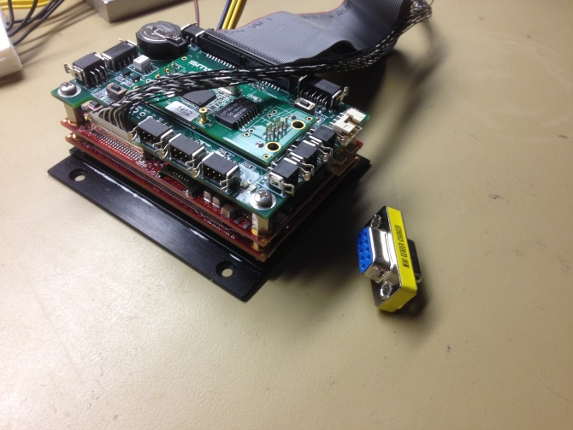
Falcon SBC (Versalogic Corporation)
Extremely Small Form Factor (2.2”x3.3”)
Used in AUV Operations
WES7 installed on SATA SSD
Analog Input Requires Custom Software
  Vendor Supplies Windows Driver and API
Laser control software already written and tested (console application + external relay).
Requires a vicor swap as it requires 12VDC input
Cost Estimate: $1,800.00
Labor Estimate: 40 hours
Risk Estimate: Low
  MBARI hardware is built using very similar requirement using this hardware.

Slide 8
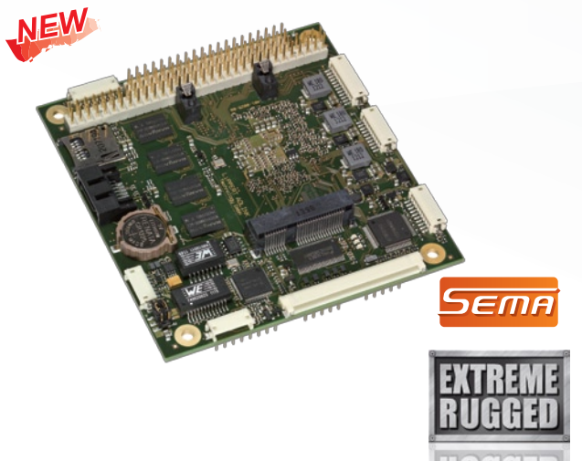
CM1-86DX2 (Lippert Adlink)
1GHz Vortex CPU // 1GB RAM
One Board, all peripherals
Slowest processor of all options.
Lowest Reliable connectors.
Cost Estimate: $800.00
Labor Estimate: 50 hours
Risk Estimate: Medium
  Analog input drivers aren’t well described as Versalogic.
  Slower processor may not support future design as well.

Slide 9
Intel Bay Trail Based Options
Newest Intel multicore System on Chip (SoC)
Released in October 2013 by Intel, major providers are just starting to release hardware supporting this platform, many in PC/104 form factors.
Excellent balance of processing power/consumption and a 7th generation SOC from Intel provides reliability.
Great support for Windows Embedded 7 drivers.
X86 architecture with ARM-like performance.

Slide 10
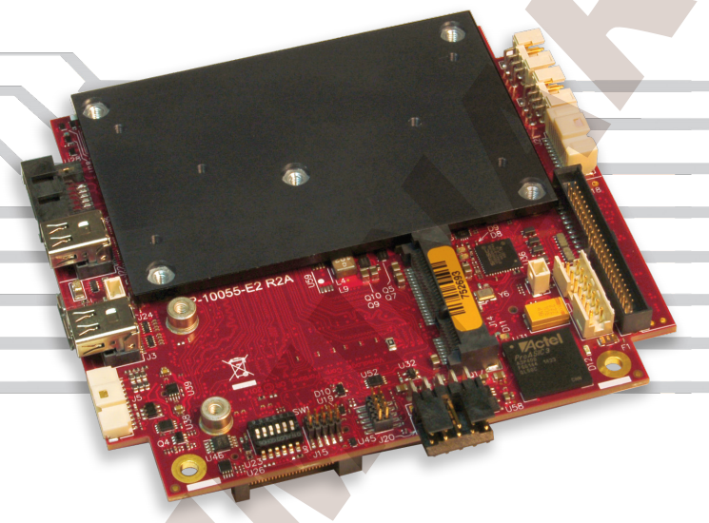
Bengal PC/104 (Versalogic Corp)
Lower-cost base board, modular system requires multiple additional electronics, all available from the manufacturer.
Excellent WES7 Support.
Simply API driver/libraries for rapid development of DIO and ADC requirements, Windows ready.
Most peripherals are on a single connector, requires a fanout board (similar to the falcon).
Current requirements would not require fanout for USB only.
Next run not available for ~30days.
Cost Estimate: $1,800.00
Labor Estimate: 50 hours
Risk Estimate: Medium (modular components)

Slide 11
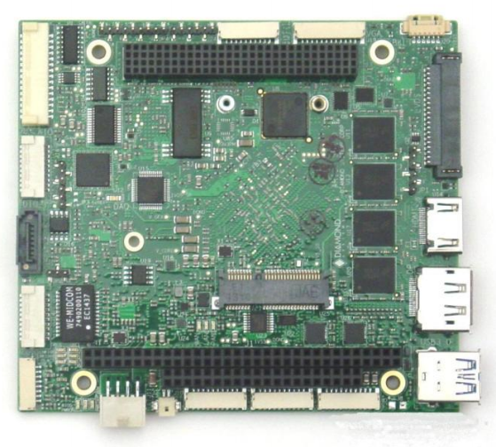
Aries SBC (Diamond Systems)
Silver bullet, no ancillary boards required.
Windows image pre-installed.
Unavailable for min 30 days
No manual exists which is not a good sign.
Cost Estimate: $1,800
Labor Costs: 45 hours
Risk Estimate: High (no manual to properly assess labor req)

Slide 12
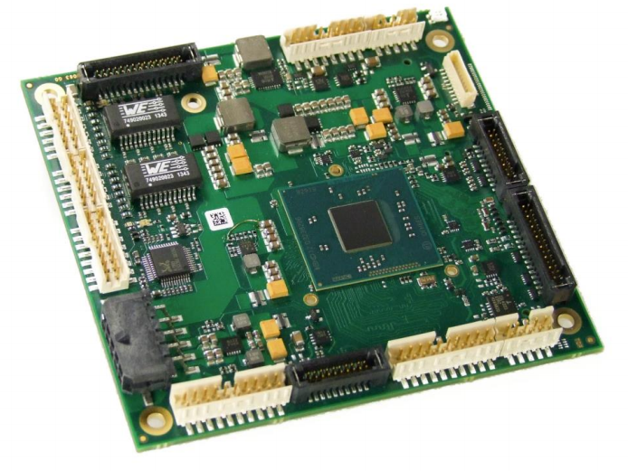
ADLE3800PC (ADL Solution)
Highly ruggedized: all core components soldered on.
ADC and DIO equip unspecified.
Still Working on quote.

Slide 13
Epic Form Factor
A larger form factor, which can fit into the existing space.
Essentially flatten out a tall stack.
Would require moving the power-on delay components.
Not reccomended, just considering all options.

Slide 14
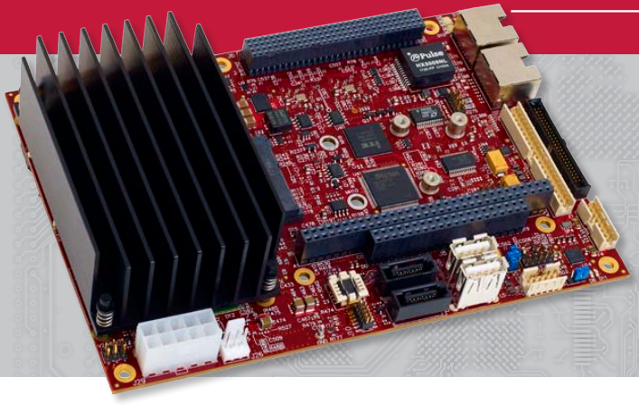
Iguana EPIC SBC (Versalogic)
No ancillary boards required.
No changes to voltage requirements.
WES7 Board Support Packages
Excellent windows API driver/libraries for rapid development.
Lowest-cost, highest performance, lowest-risk solution, but largest size option in horizontal dimensions.
Cost Estimate: $1,316.00
Labor Estimate: 35 hours
Risk Estimate: Medium-low (size constraints)

Slide 15
Detailed Feature Comparison
Excel Worksheet available at:
  \\Atlas\projectlibrary\600045.DORISS\DORISS.Engineering\DORISS.EE.Dwgs\docs\Upgrades 2015\worksheets\DORISSII_Worksheet.xlsx
This presentation available at:
  \\Atlas\projectlibrary\600045.DORISS\DORISS.Engineering\DORISS.EE.Dwgs\docs\Upgrades 2015\Concepts\DORISS II PC.pptx

Slide 16
Next Steps
We already have Falcons in house and built up. I would like to purchase an A/D msata module for evaluation
  ~10 hours, $250
  Could produce satisfactory solution.
Peter Walz is investigating Win7 options from KOSI regarding HoloGRAMS and existing system.
  Will attempt to install and test existing software. Peter can evaluate.
Some boards are available for purchase under 30-45 day evaluation periods. If Falcon doesn’t pan out, choose a couple of those presented and test.

