Slide 1
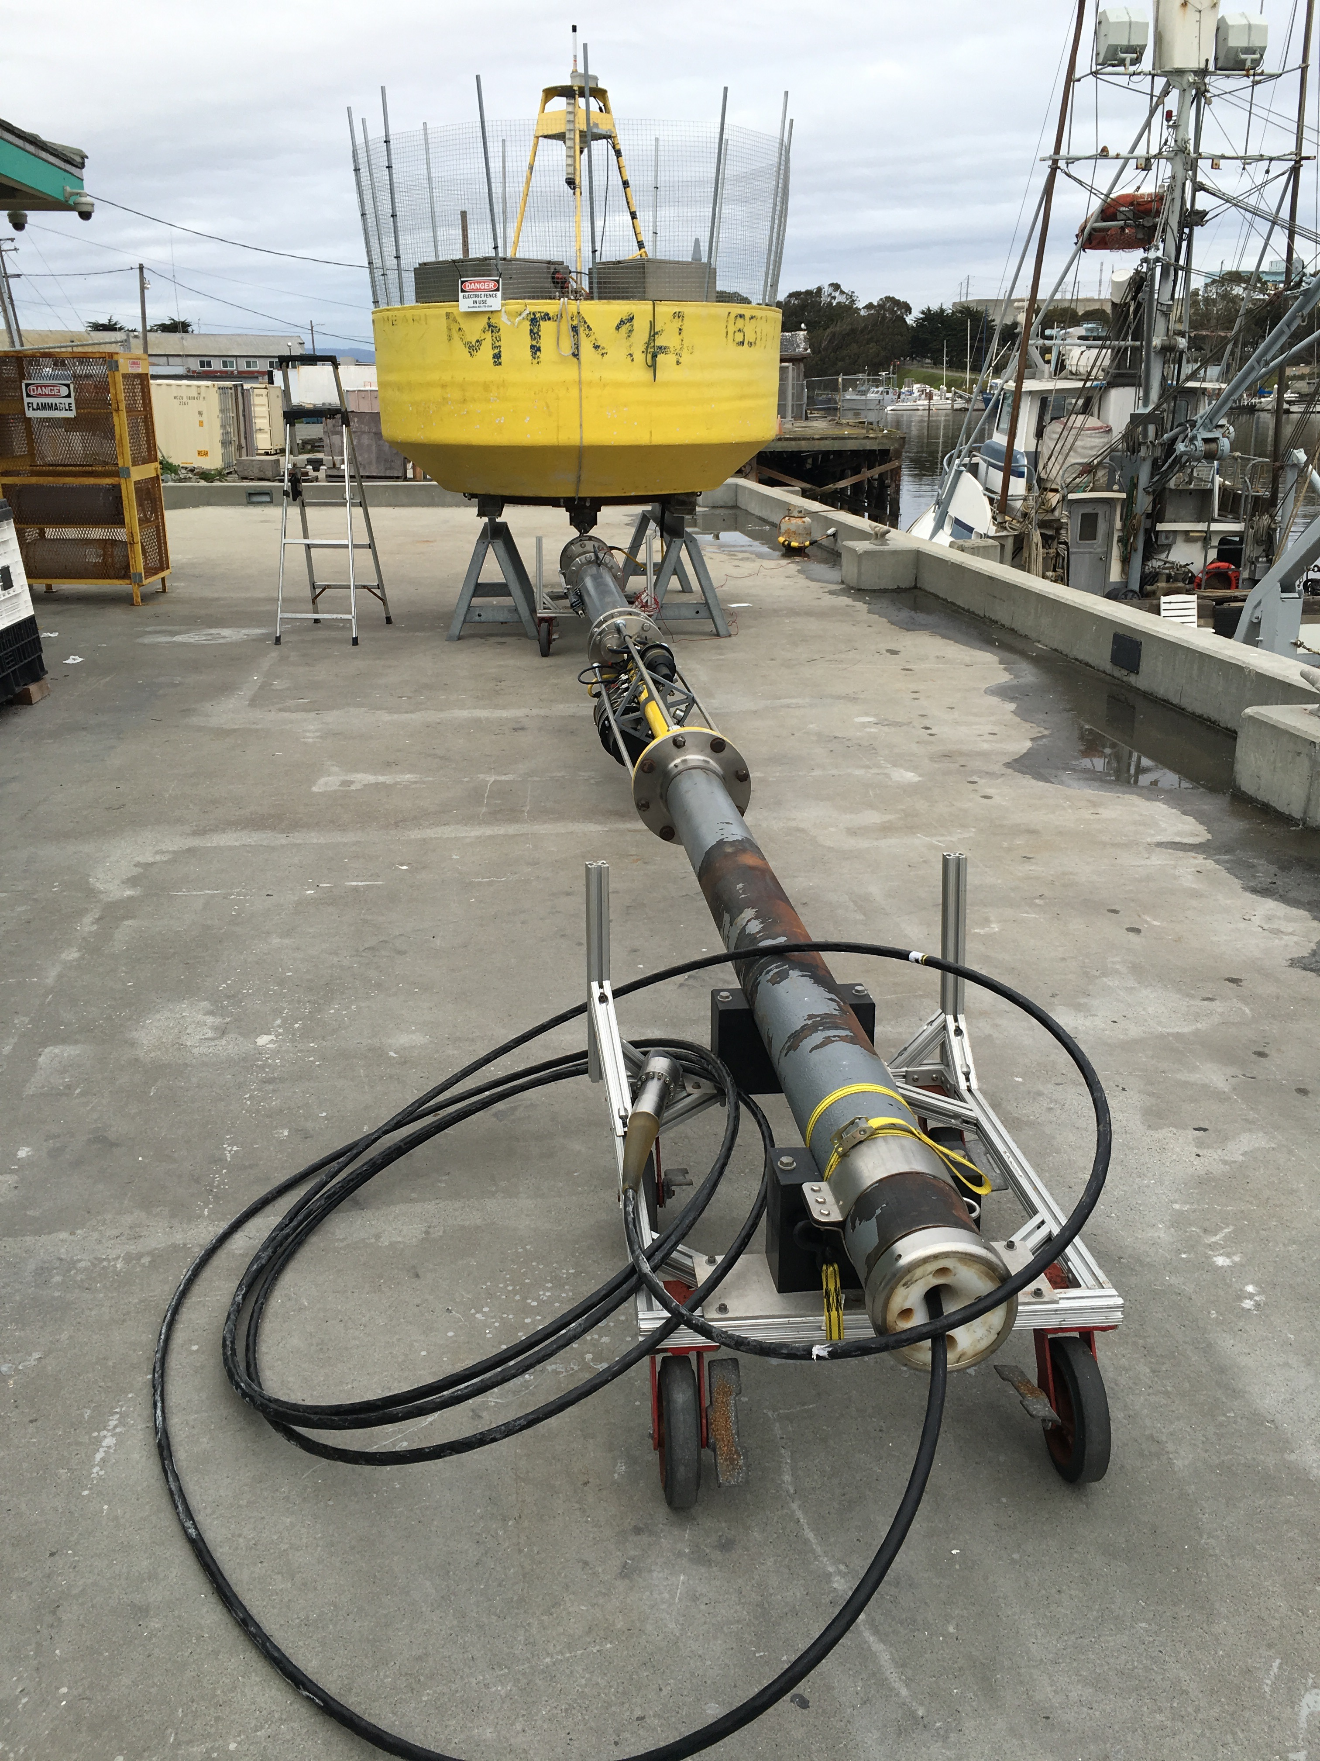

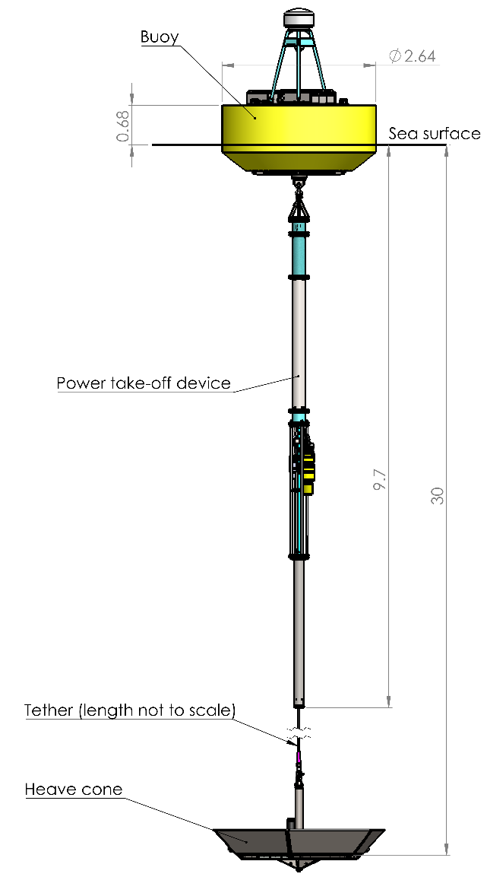
MBARI Open Wave-Energy Control System Development Platform
Andrew Hamilton

Slide 2
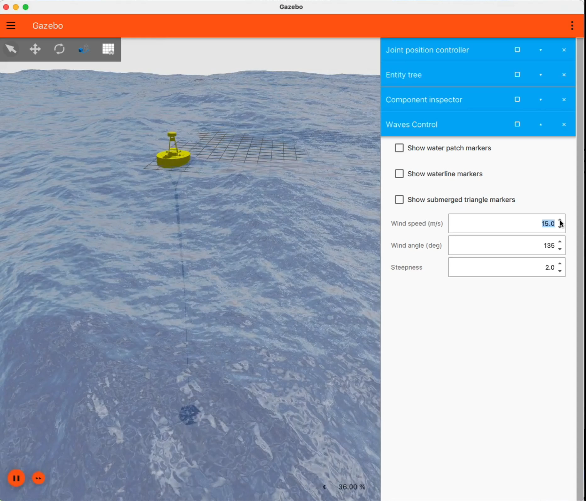
Digital-Twin Vs Simulation
Gazebo/ ROS
Software interface is identical to deployed hardware.

Slide 3
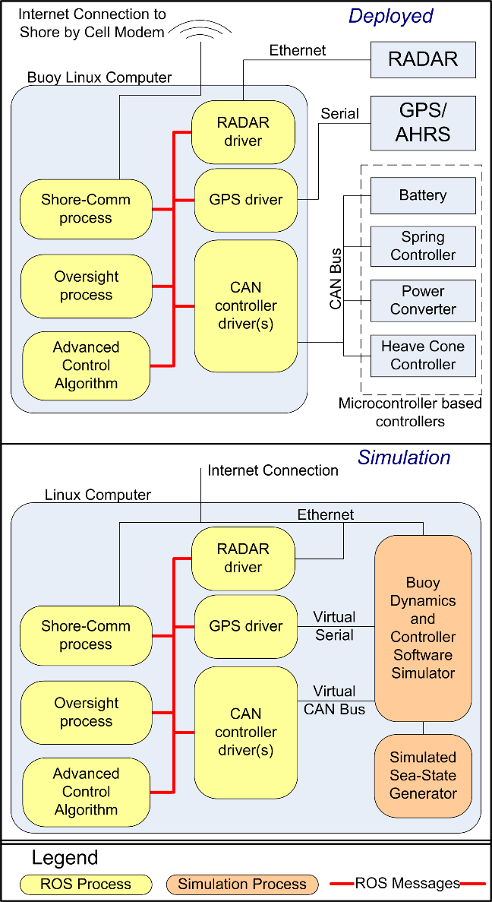
Simulation Environment
Goal: Control software can not tell if its running on the on real buoy or on the simulator

Slide 4
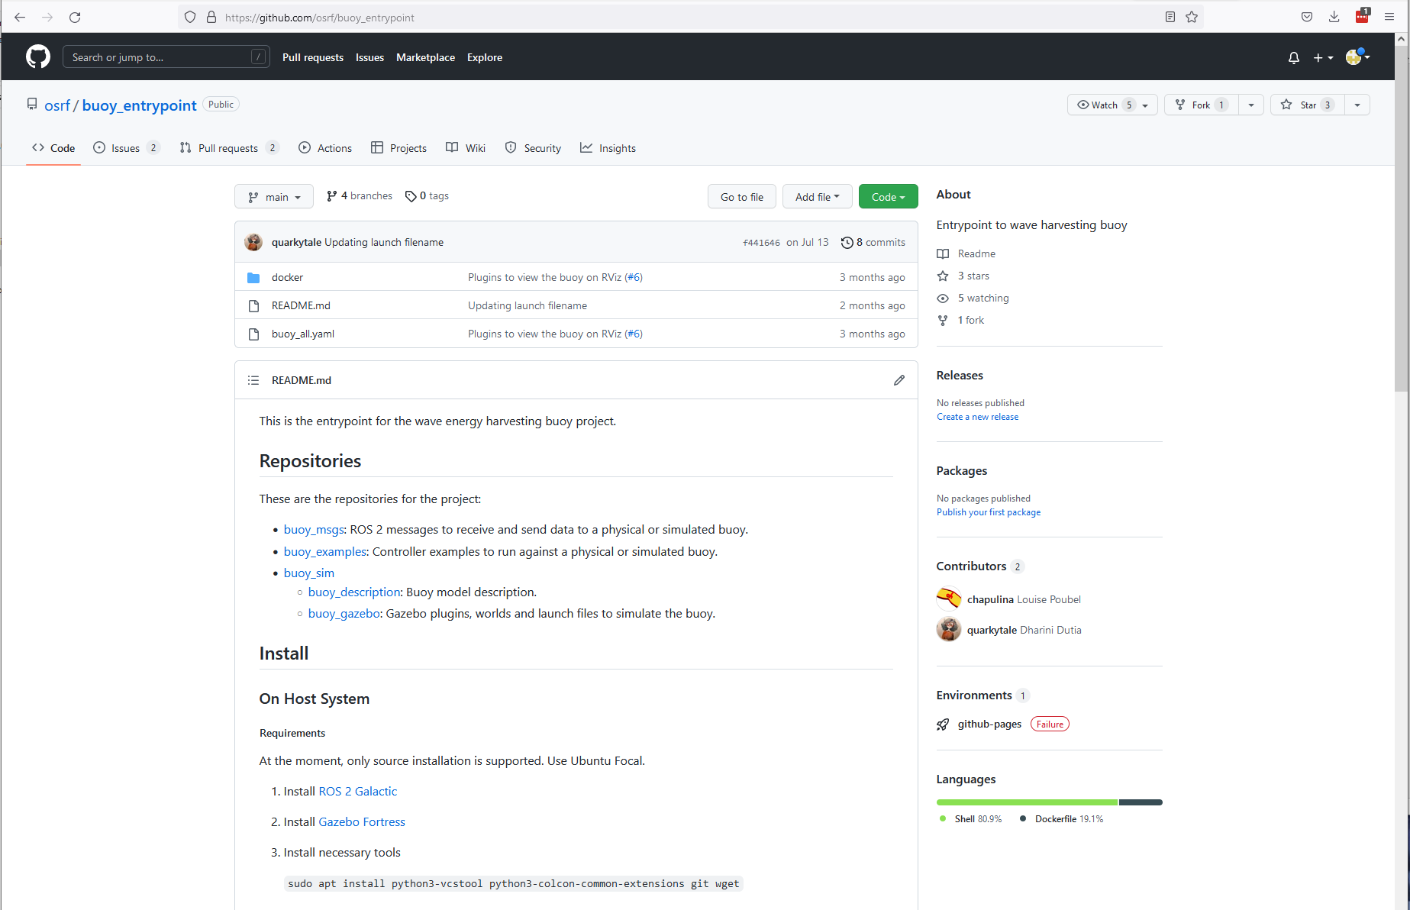
Engagement
https://github.com/osrf/buoy_entrypoint
Largest Challenge
Resources:
User Guide
Tutorials
Webinar
Forum
hamilton@mbari.org

