Slide 1
Open Wave-Energy Control System Development Platform
FOA/Topic
Marine Energy Foundational Research and Testing Infrastructure (DE-FOA-0002234)
Topic Area 1 (Foundational Research and Development)
Team Member Organizations
Monterey Bay Aquarium Research Institute
Open Robotics
Technical Points of Contact
Andrew Hamilton, Ph.D.
Monterey Bay Aquarium Research Institute
Tully Foote, Community & Business Development Manager
Open Robotics

Slide 2

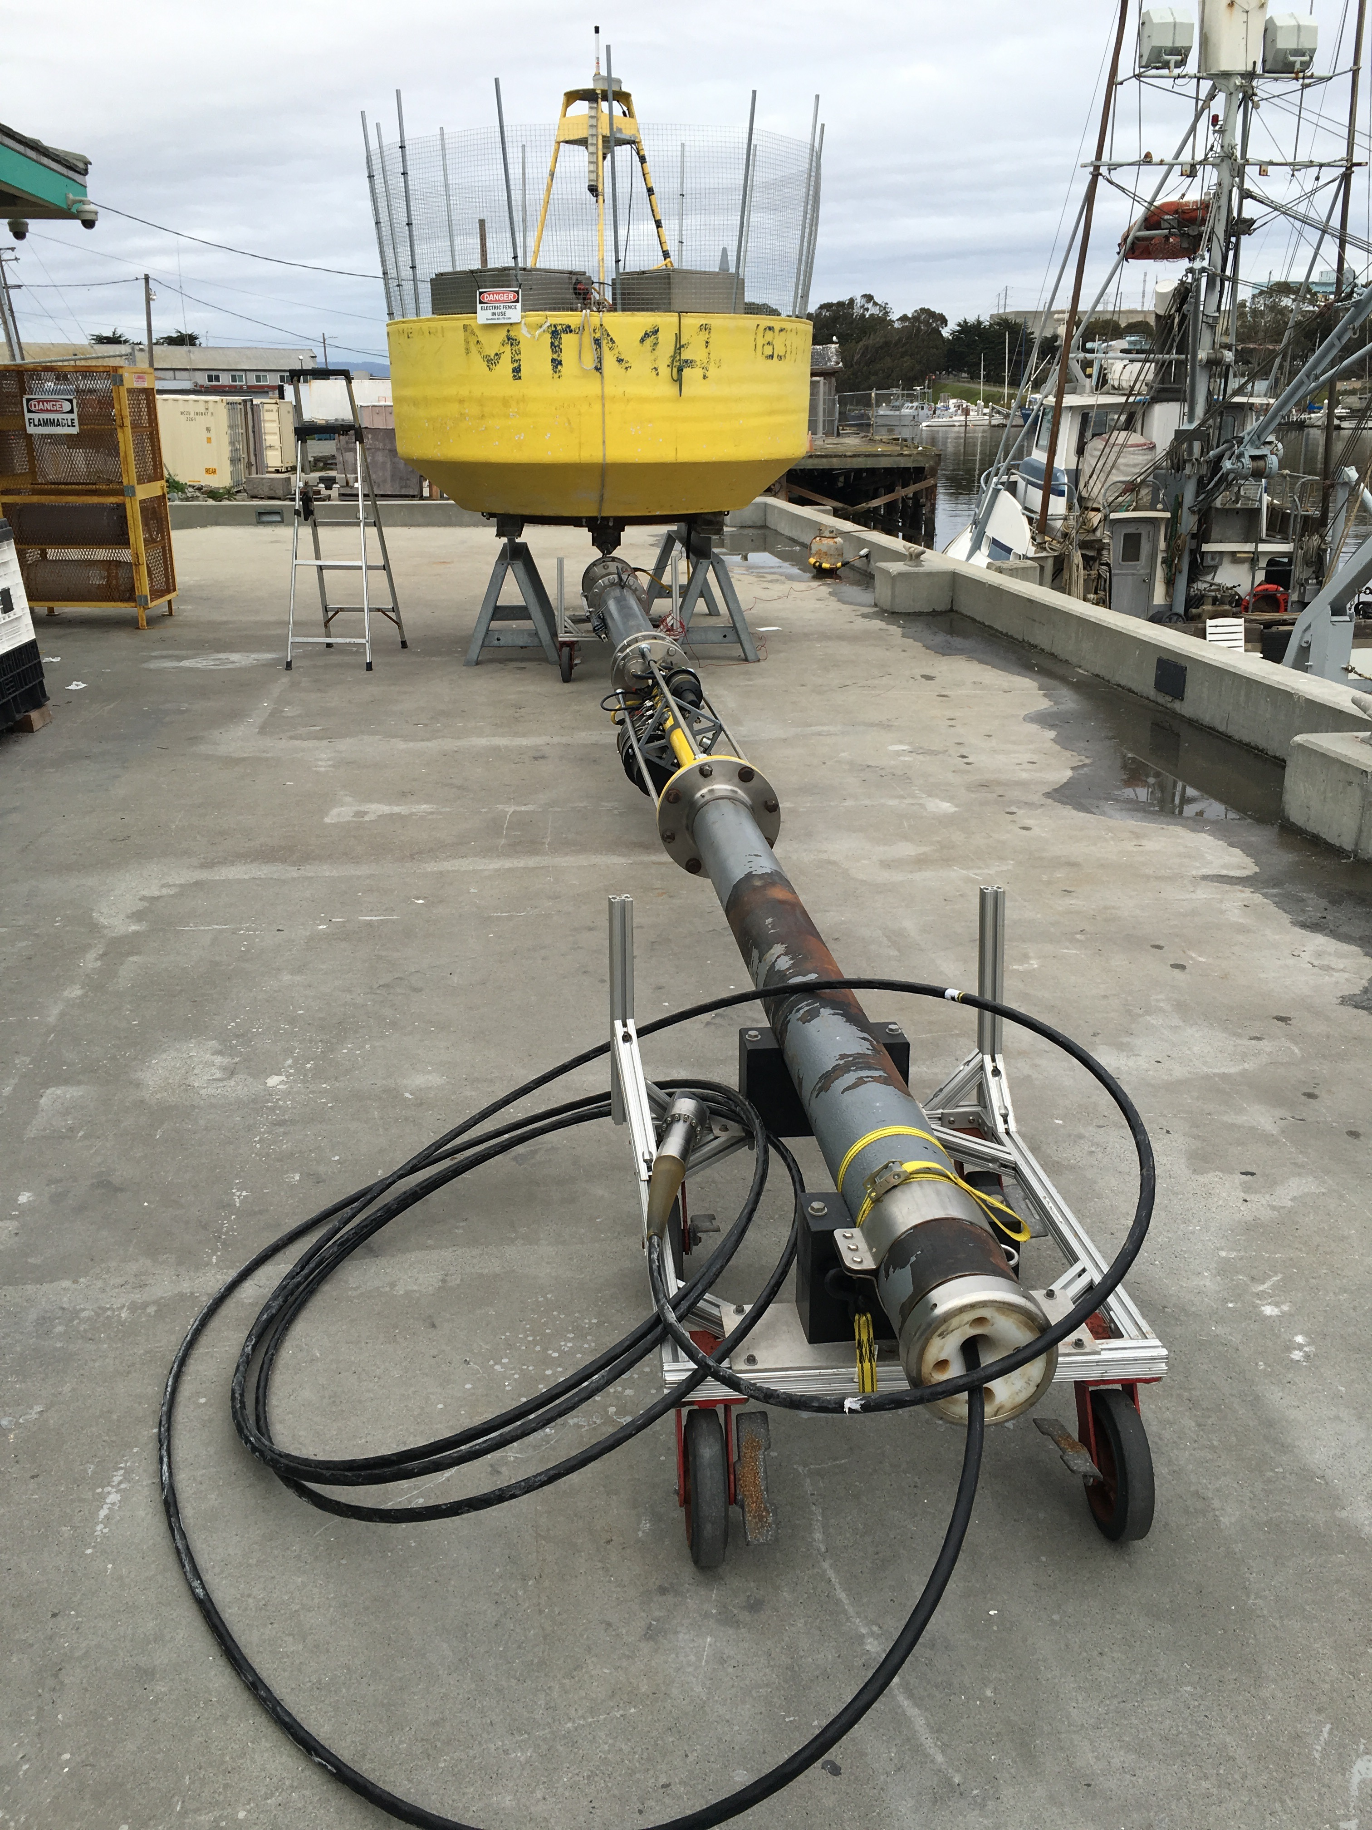
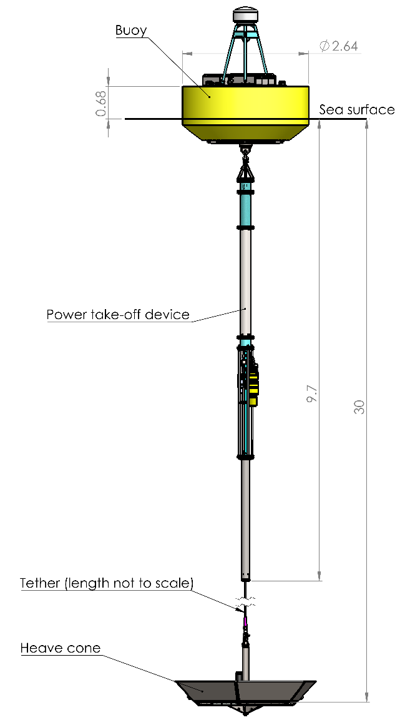

Slide 3
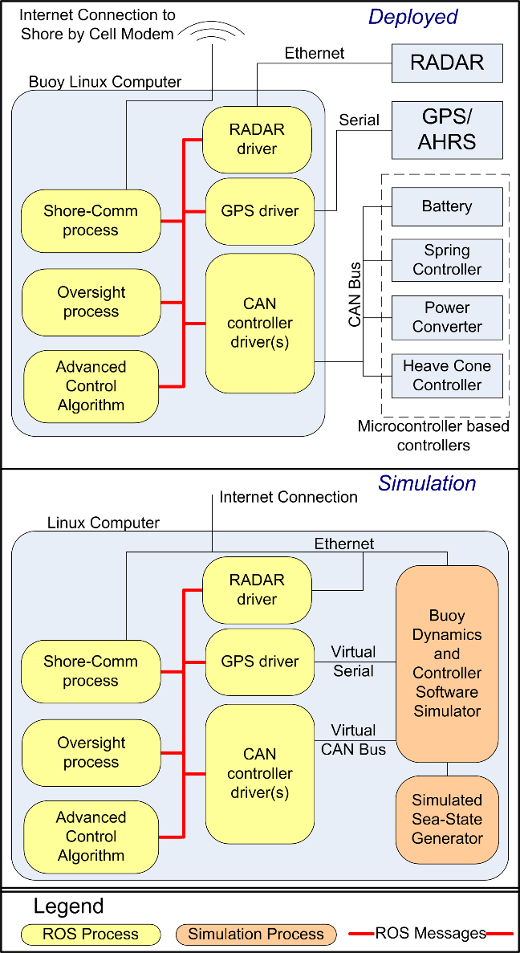
Integrate ROS2 into our existing Wave-Energy Buoy
Linux Computer
Micro-controllers

Slide 4
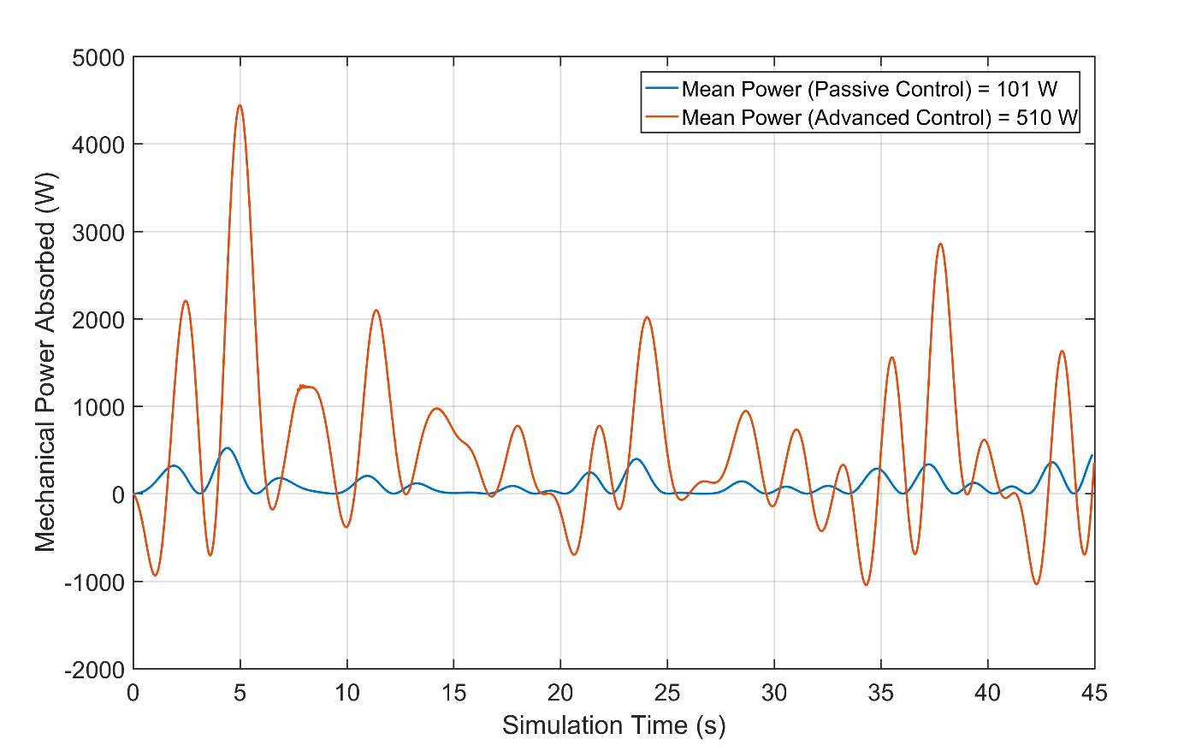
Advanced Controls

Slide 5
Components of our Proposed Project
- Integrate ROS2 into our existing Wave-Energy Buoy
- Create a simulation environment
- Entrain external researchers. Simulation and then at-sea testing.

Slide 6
Entrain external researchers
Perhaps the most challenging part of this project.
We have a few initial candidates: Sandia National Labs, Ted Brekken at Oregon State, JHU/APL. And other candidates…
Simulation First, then on-buoy operations.
These researchers may be ROS2 beginners, so we need to make the system approachable. Simplest solutions possible.
Good tutorials and examples
Easy access. Docker, Cloud based, etc.
Active and responsive forum.

Slide 7
Create a simulation environment
Options:
Matlab/Simulink/WecSim
Ignition Gazebo
Other Options
Decisions:
Tools
Architectural choices

Slide 10
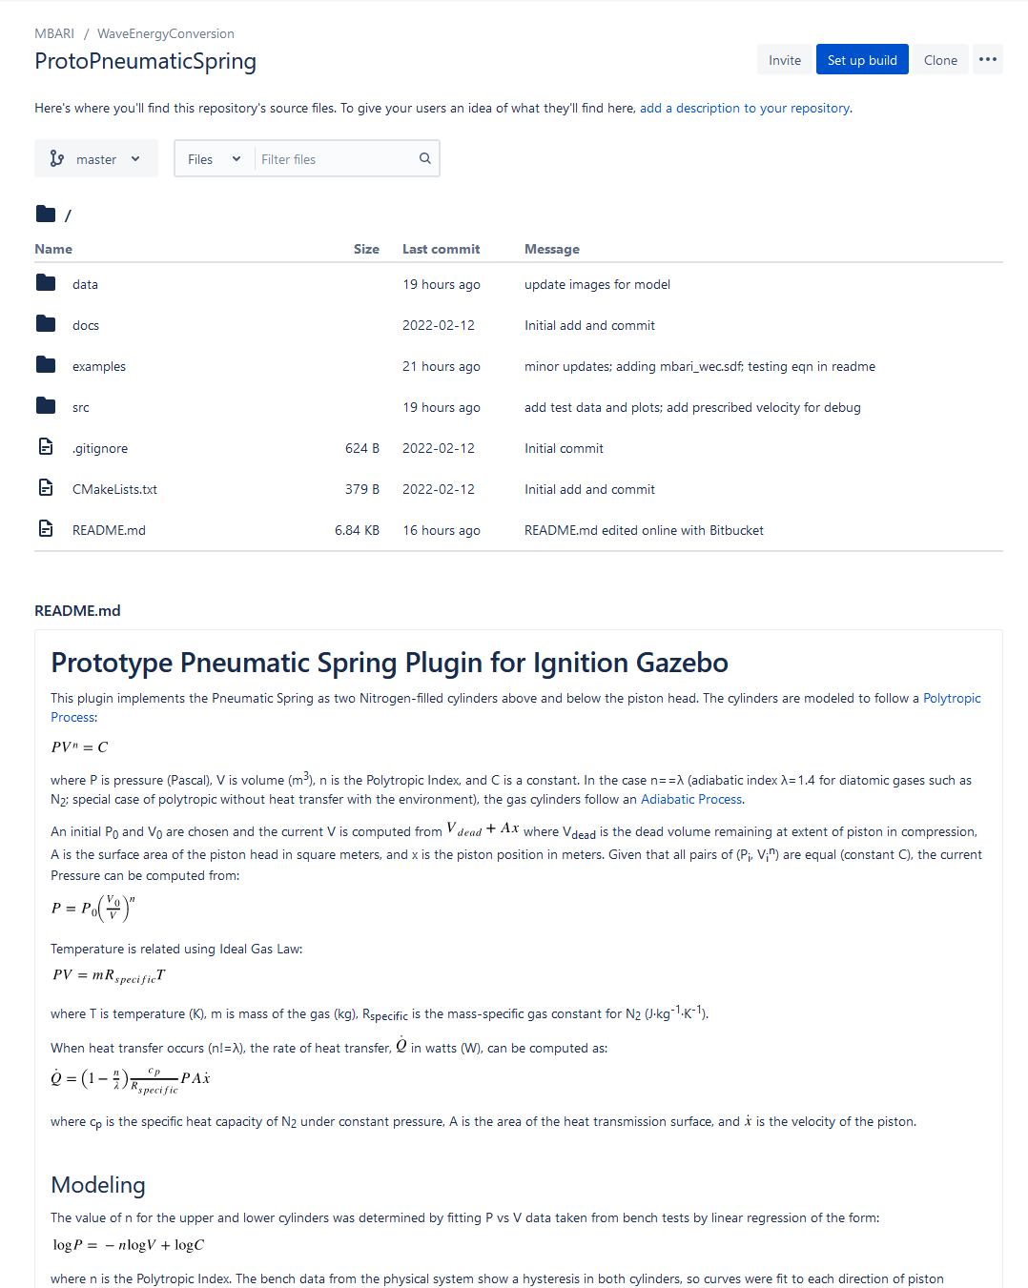
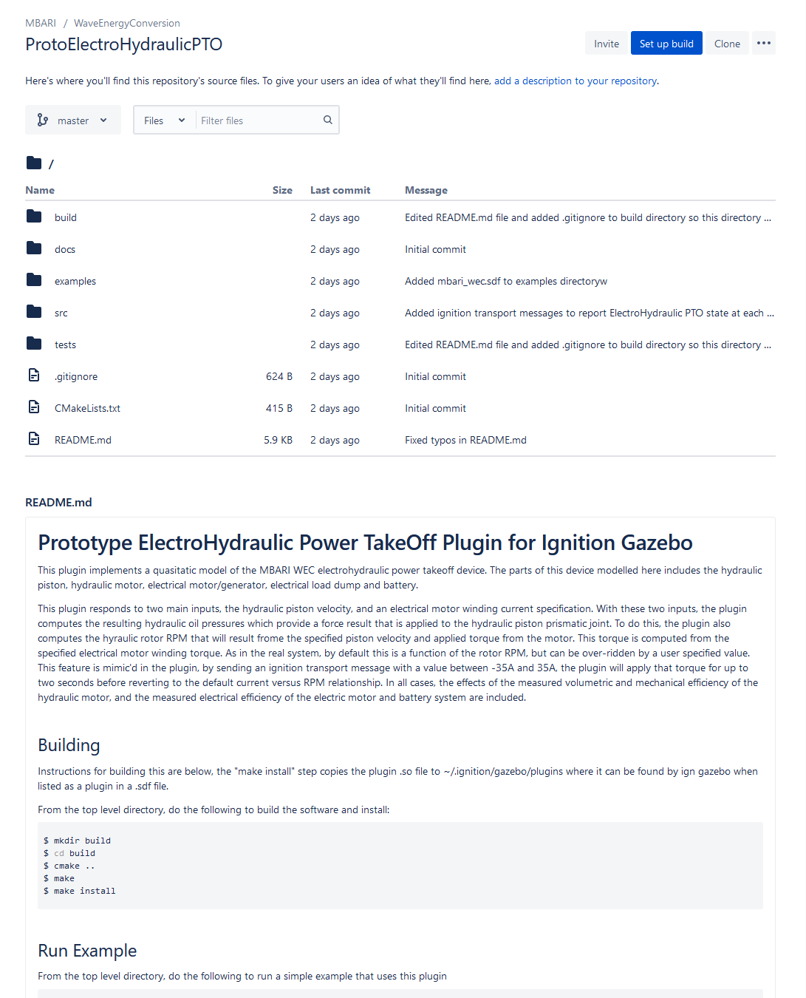

Slide 11
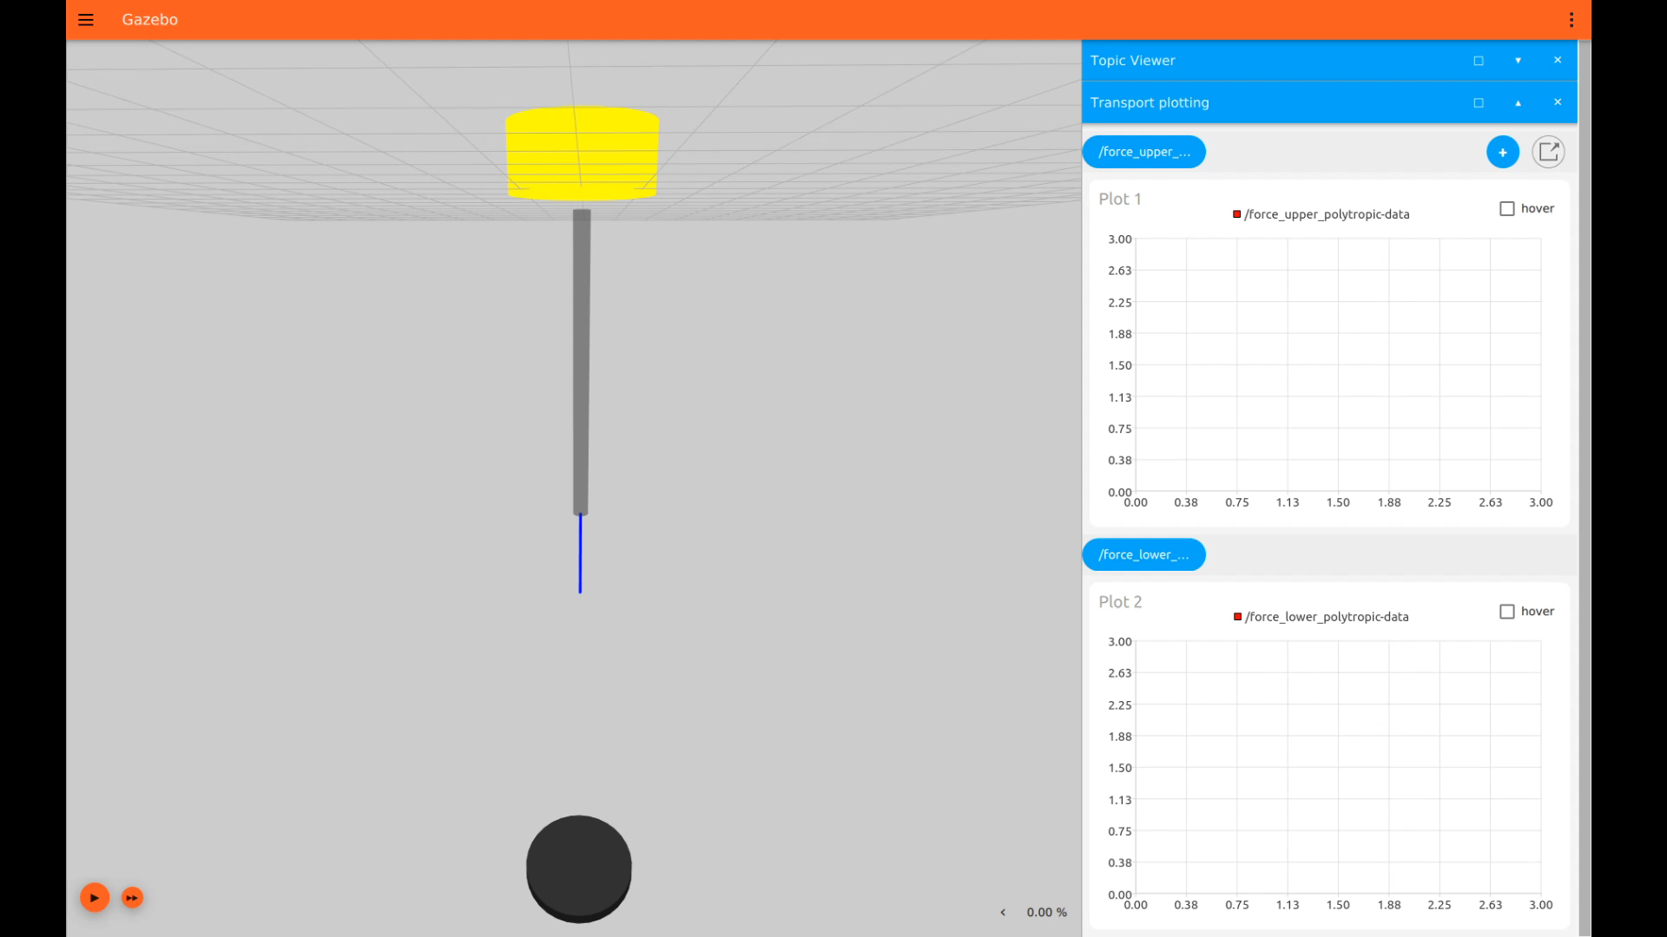

Slide 14
Ignition Gazebo Details
- Added Mass Handling
- ODE Solution. DART (Euler Method O(dt))
- State augmentation.
Development Process
- Testing and CI
Deployment Options
- User access…

Slide 16
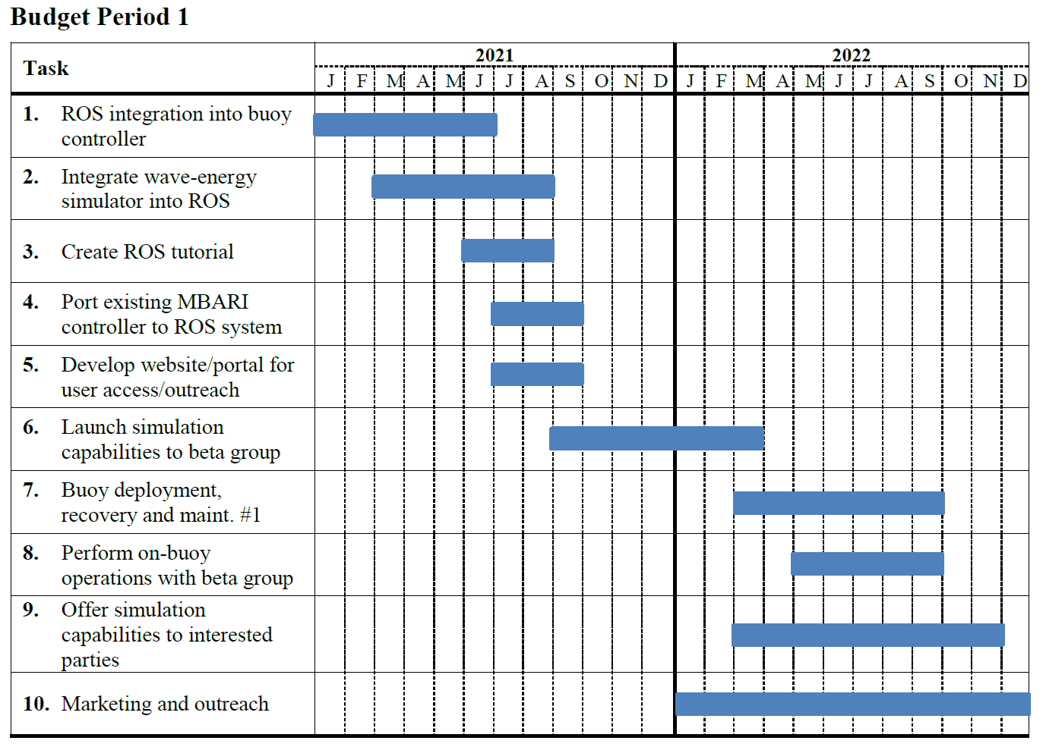

Slide 17
Simulation Challenge and Existing Tools
Not just rigid-body dynamics. Pneumatic spring and electro-hydraulic system.
Wave-body interaction problem, specialized hydrodynamics.
  Input: Wave-field
  Output: Wave-energy converter behavior (motions, forces, electrics)
Existing Simulink tools, are sophisticated, but Simulink…
Ignition tools. What existing capabilities are present, and what capabilities that we add would be most useful for that ecosystem of tools.
Architectural decisions…

