Slide 1
Open Wave-Energy Control System Development Platform
Andrew Hamilton
DOE FOA/Topic
Marine Energy Foundational Research and Testing Infrastructure (DE-FOA-0002234)
Topic Area 1 (Foundational Research and Development)
Team Member Organizations
Monterey Bay Aquarium Research Institute
Open Robotics

Slide 2
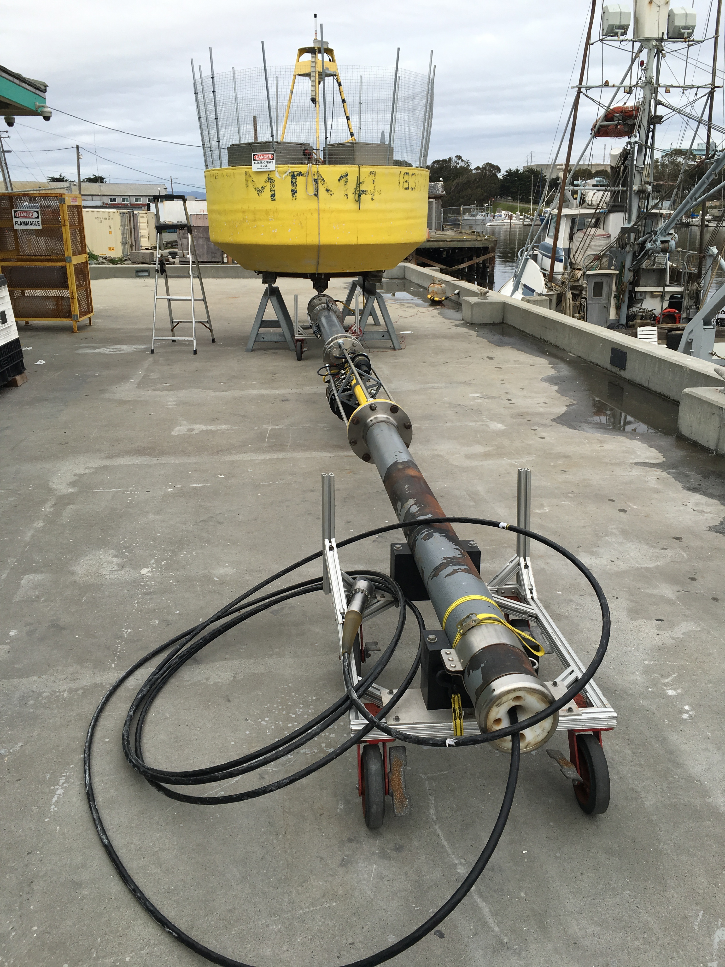
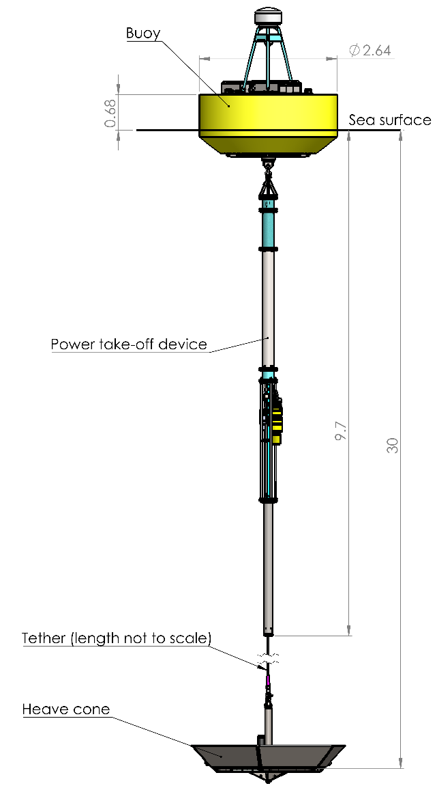

MBARI WEC

Slide 3
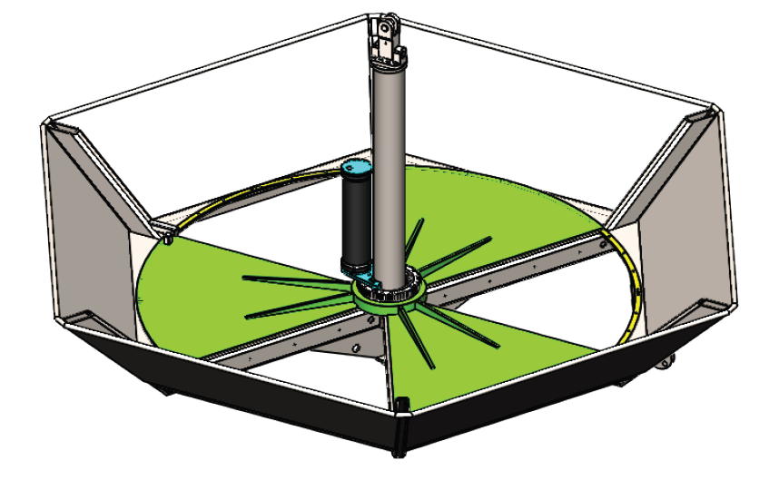
MBARI Oceanographic WEC
2.6m diameter Buoy
Electro-Hydraulic PTO and Pneumatic Spring
Heave-Cone w/ Trefoil doors
225W Device (Averaged through the seasons)
4-Quadrant Power Electronics, 6kW-Hr Battery
24V Power Supplies and Ethernet Network (instruments)
Linux Control Computer and Cell Connection
Regular Deployments

Slide 4
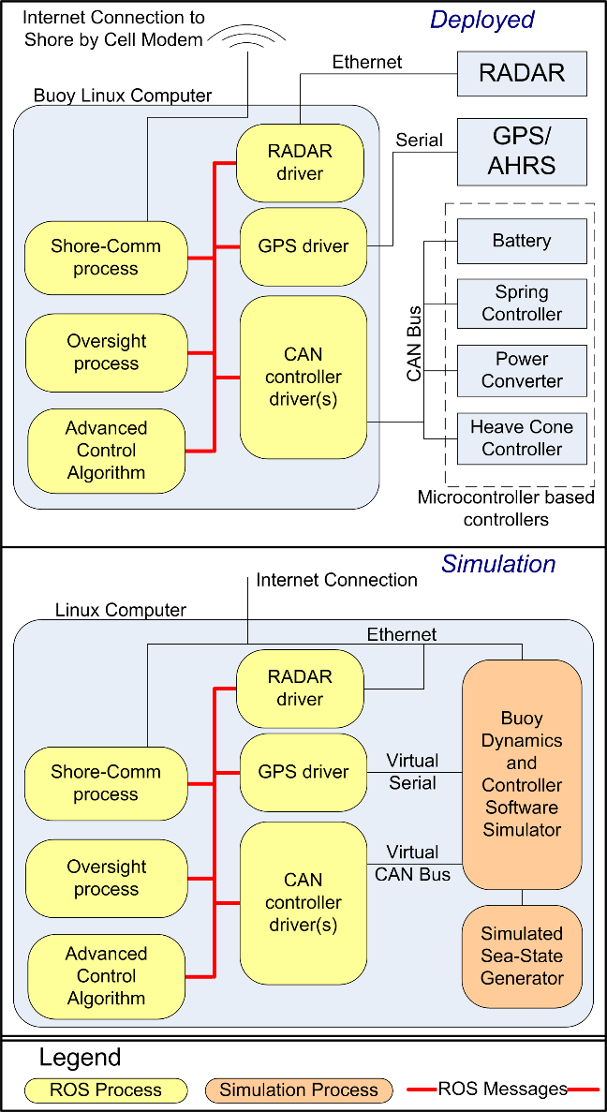
Compute and Control Architecture
Linux Computer
Micro-controllers

Slide 5
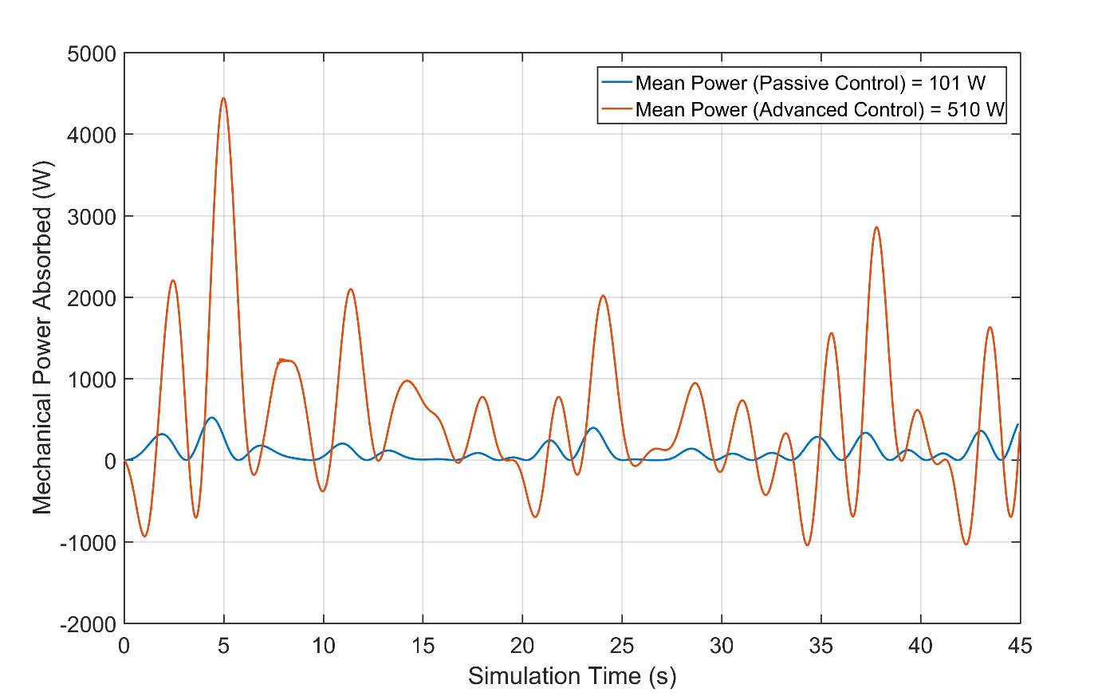
PTO Control
Linear Damping: Torque = -k*RPM, k is adjustable.
Variable Spring Constant:
System natural period = 2-3 seconds
Control Opportunity
Make device smaller
Stroke constraint
Increase robustness
Increased energy capture

Slide 6
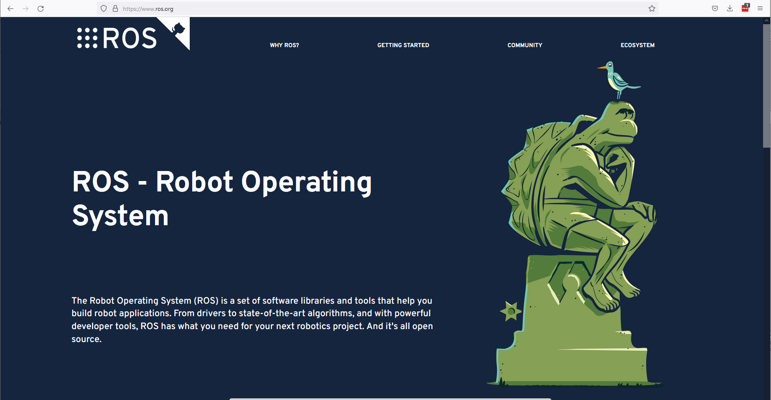
Open Software Interface
Goal: Make the MBARI WEC available to outside researchers
Approach: ROS2 software on buoy Linux computer provides all
telemetry data to user process and allows control of WEC (i.e. Set
motor winding current to be different than default)
ROS2
Publish/Subscribe message infrastructure.
Very popular in robotics
Python/C++ Bindings
One user process on Linux controls buoy

Slide 7
Simulation Environment
Goal: Control software can not tell if its running on the on real buoy or on the simulator

Slide 8
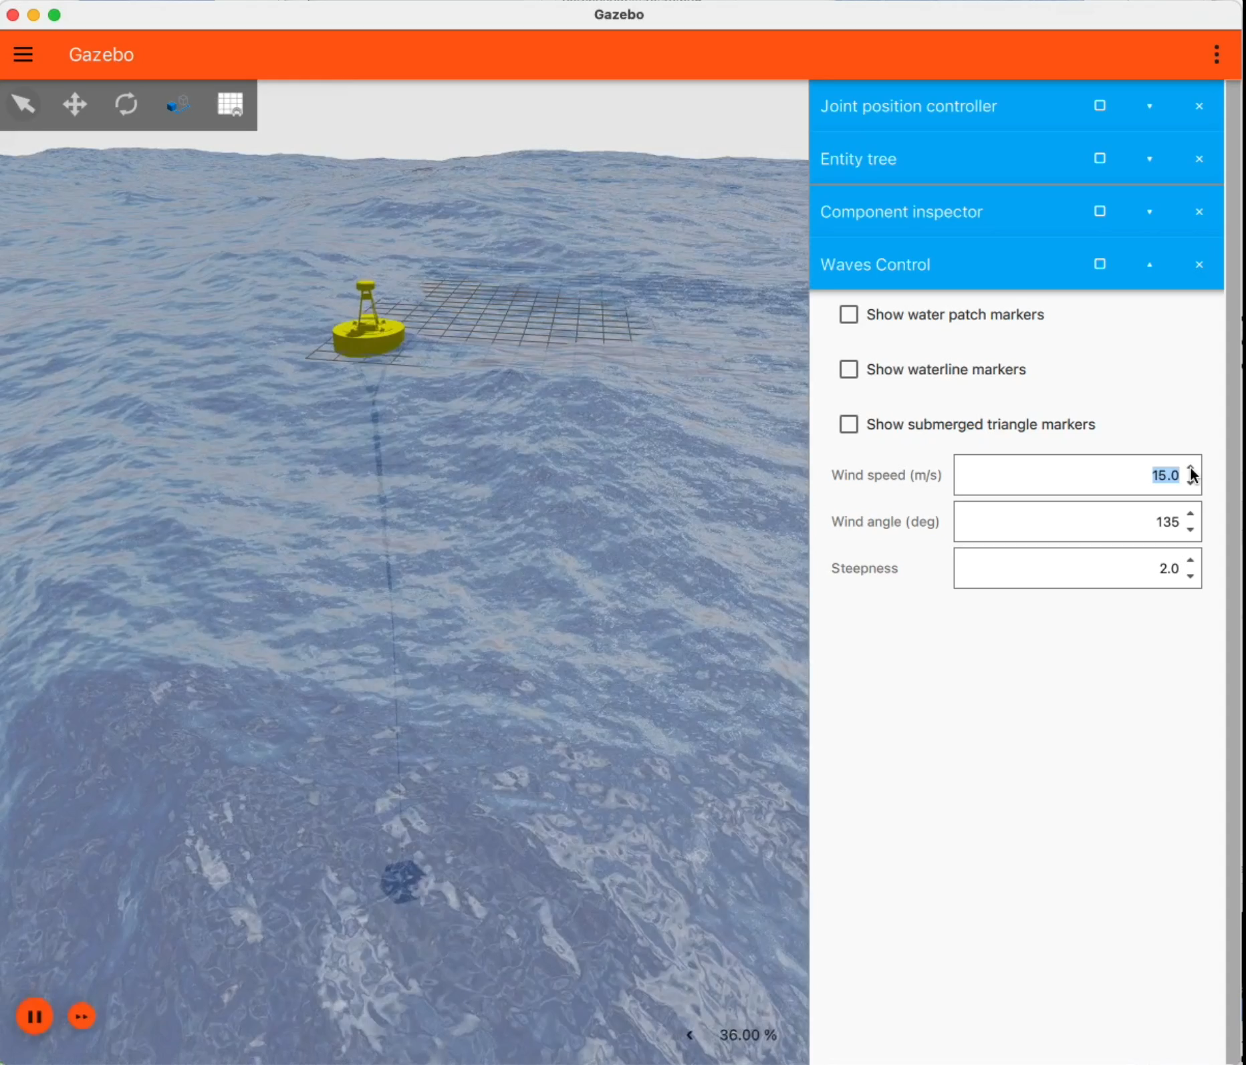
Simulation
Gazebo: Open Robotics supported simulation environment.
Provides physics simulation (rigid body dynamics of joined bodies)
Plugin based, designed for new forcing's to be added.
  Pneumatic Spring
  Electro-Hydraulic PTO
  Free-surface hydrodynamics
  Flexible tether
Lacked support for added-mass terms!
While running, the ROS interface provided to user software is exactly the same as the real buoy.
Plus, addition information only available in simulation…

Slide 9
Workflow
- Dow

Slide 10
Workflow
Perhaps the most challenging part of this project.
We have a few initial candidates: Sandia National Labs, Ted Brekken at Oregon State, JHU/APL. And other candidates…
Simulation First, then on-buoy operations.
These researchers may be ROS2 beginners, so we need to make the system approachable. Simplest solutions possible.
Good tutorials and examples
Easy access. Docker, Cloud based, etc.
Active and responsive forum.

Slide 11
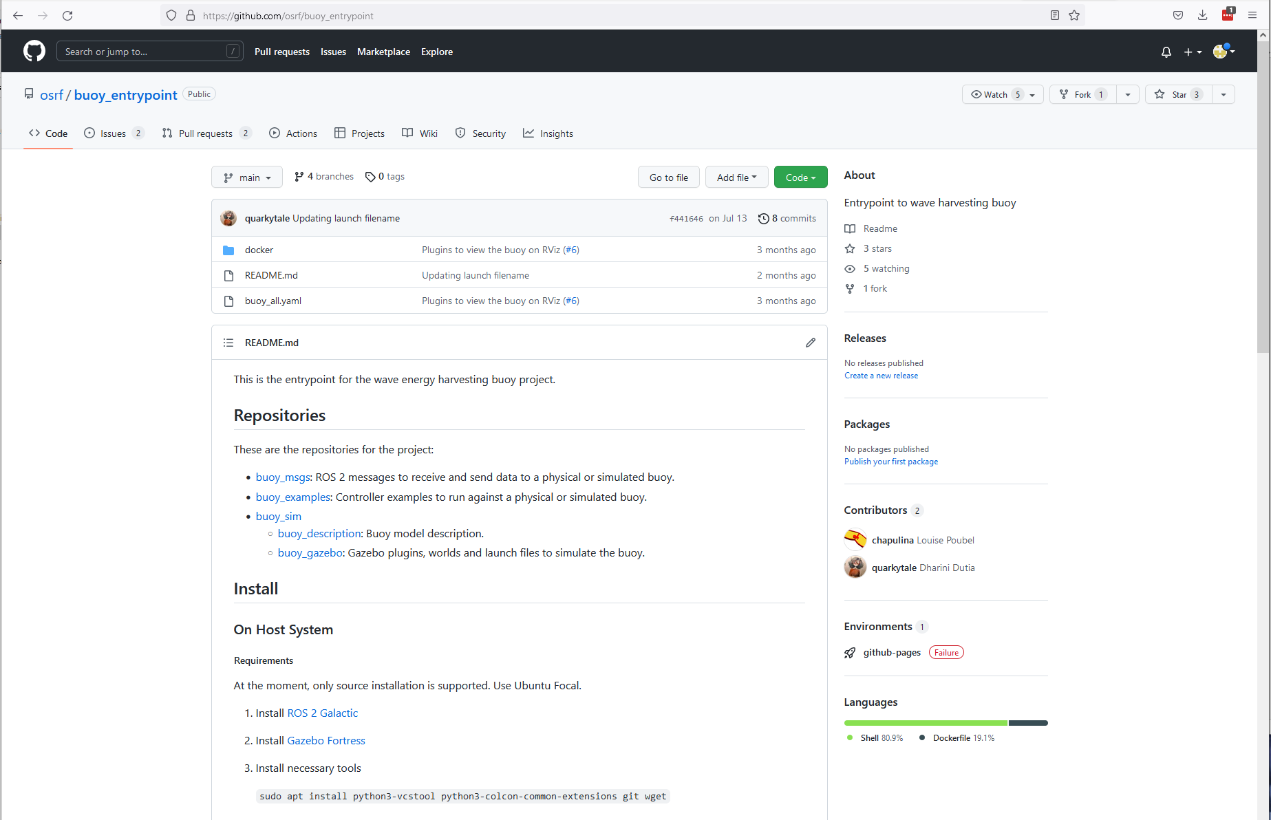
Resources
https://github.com/osrf/buoy_entrypoint

Slide 12
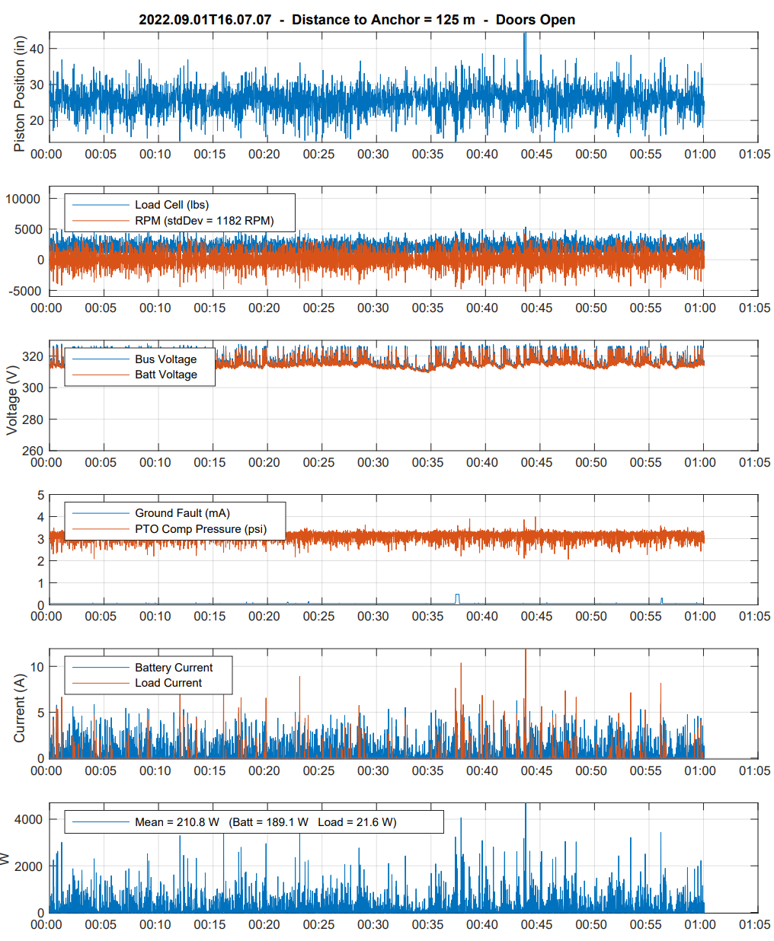
Resources
https://ftp.mbari.org/pub/Hamilton/LatestQuickViewPlot.pdf
User Guide
Tutorials
Webinar
Forum
hamilton@mbari.org

