Slide 1
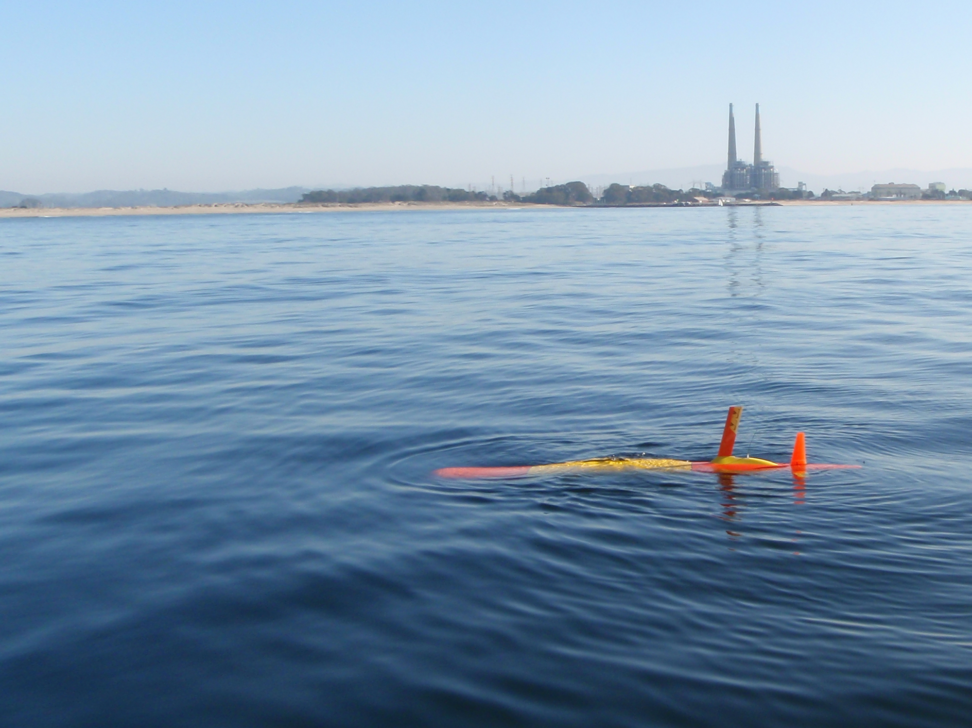
LRAUV Project Update
Long-Range Autonomous Underwater Vehicle
Notes:
Still actively developing new capabilities, but MTBCF* over 140 hours when we stop fiddling and just let it work.
Iridium messages are 270 bytes. Typically we get a couple messages a minute. So how to we interact? How do we keep a common ops picture?

Slide 2
LRAUV Project Update
Long-Range Autonomous Underwater Vehicle
MBARI Goals:
1. Develop
or adapt innovative technologies that allow researchers to identify and resolve important questions and advance our understanding of the ocean.
2. Utilize
those developments to explore and understand how natural ocean systems operate and how they respond to natural and anthropogenic change
3. Transfer
the knowledge gained, solutions devised, and the technology developed to communities outside of MBARI—researchers, educators, policy makers, resource managers, industry, and the general public.
Notes:
Still actively developing new capabilities, but MTBCF* over 140 hours when we stop fiddling and just let it work.
Iridium messages are 270 bytes. Typically we get a couple messages a minute. So how to we interact? How do we keep a common ops picture?

Slide 3
LRAUV Project Update
Long-Range Autonomous Underwater Vehicle
MBARI Goals:
1. Develop
or adapt innovative technologies that allow researchers to identify and resolve important questions and advance our understanding of the ocean.
2. Utilize
those developments to explore and understand how natural ocean systems operate and how they respond to natural and anthropogenic change
3. Transfer
the knowledge gained, solutions devised, and the technology developed to communities outside of MBARI—researchers, educators, policy makers, resource managers, industry, and the general public.
Notes:
Still actively developing new capabilities, but MTBCF* over 140 hours when we stop fiddling and just let it work.
Iridium messages are 270 bytes. Typically we get a couple messages a minute. So how to we interact? How do we keep a common ops picture?

Slide 4
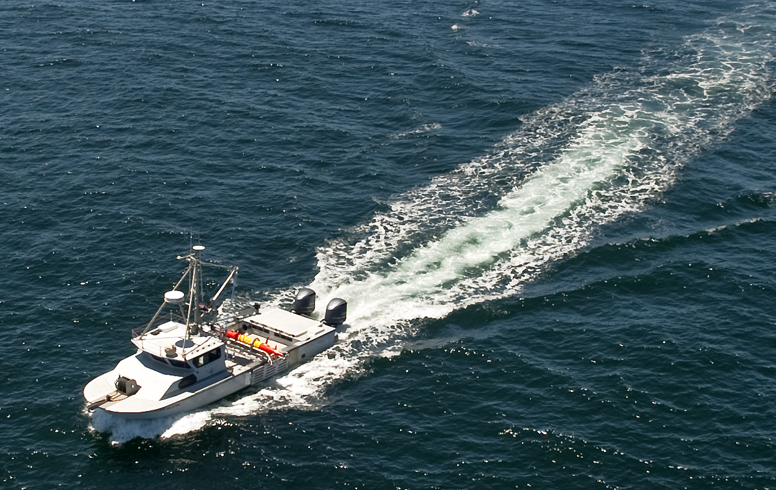
Develop - MBARI Long Range AUV:
(Jim Bellingham), Brett Hobson, Brian Kieft, Ed Mellinger, Jon Erickson, Denis Klimov, Brent Jones, Carlos Rueda, Tom O’Reilly, Kent Headly, Jordan Stanway
Jim Schofield, Paul Coenen, Tom Marion, Jose Rosal
Utilize - Active LRAUV Pilots:
Brian Kieft, Jordan Stanway*
Brett Hobson, Ed Mellinger, Denis Klimov, Yanwu Zhang,
Brent Jones, Chris Wahl, Kris Walz, John Ryan, Monique Messie, Roman Marin, Reiko Mischisaki, Bill Ussler, Ben Raanan
Share - Early Adoptors for Science
Francisco Chavez – MBTS, CANON
Chris Scholin – 3G ESP, MiVEGAS
Yanwu Zhang – Targeted Sampling
Kelley Benoit-Bird, Mathieu Kemp
Outside MBARI (require funding)
University of Hawaii – CMORE
USGS Great Lakes Science Center
License technology for general sales

Slide 5

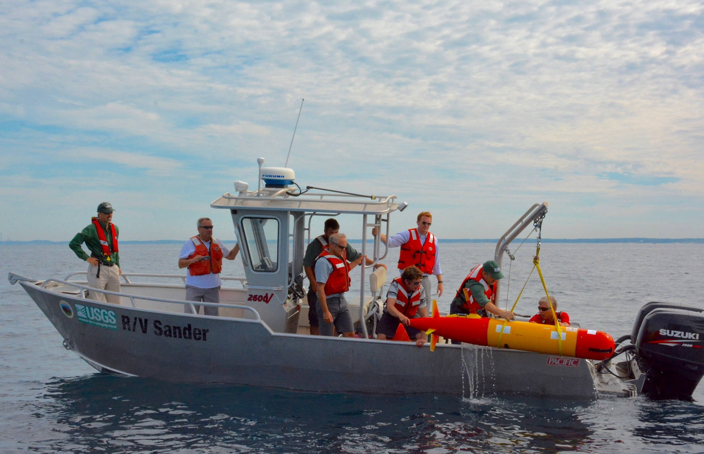
GREAT LAKES LONG RANGE AUV A New Kind of Expedition
Project Summary – Peter Esselman, Dave Warner, Brett Hobson, Brian Kieft

Slide 6
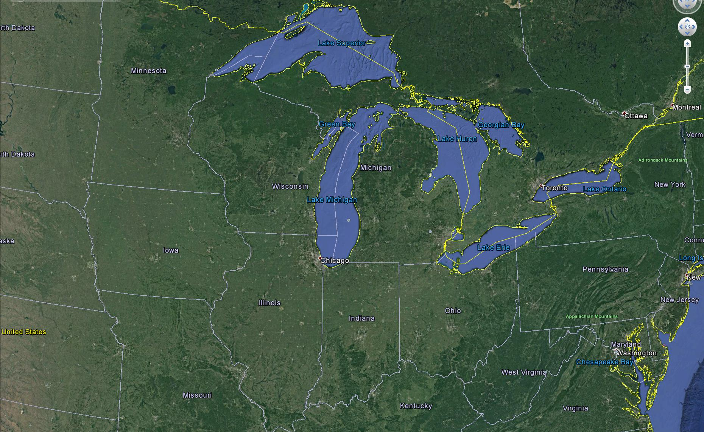
Lake Michigan
3200 mi coast
< 6 mi from water
116 lighthouses
Non ship-based
Basin scale synoptic observing
More with less

Slide 7
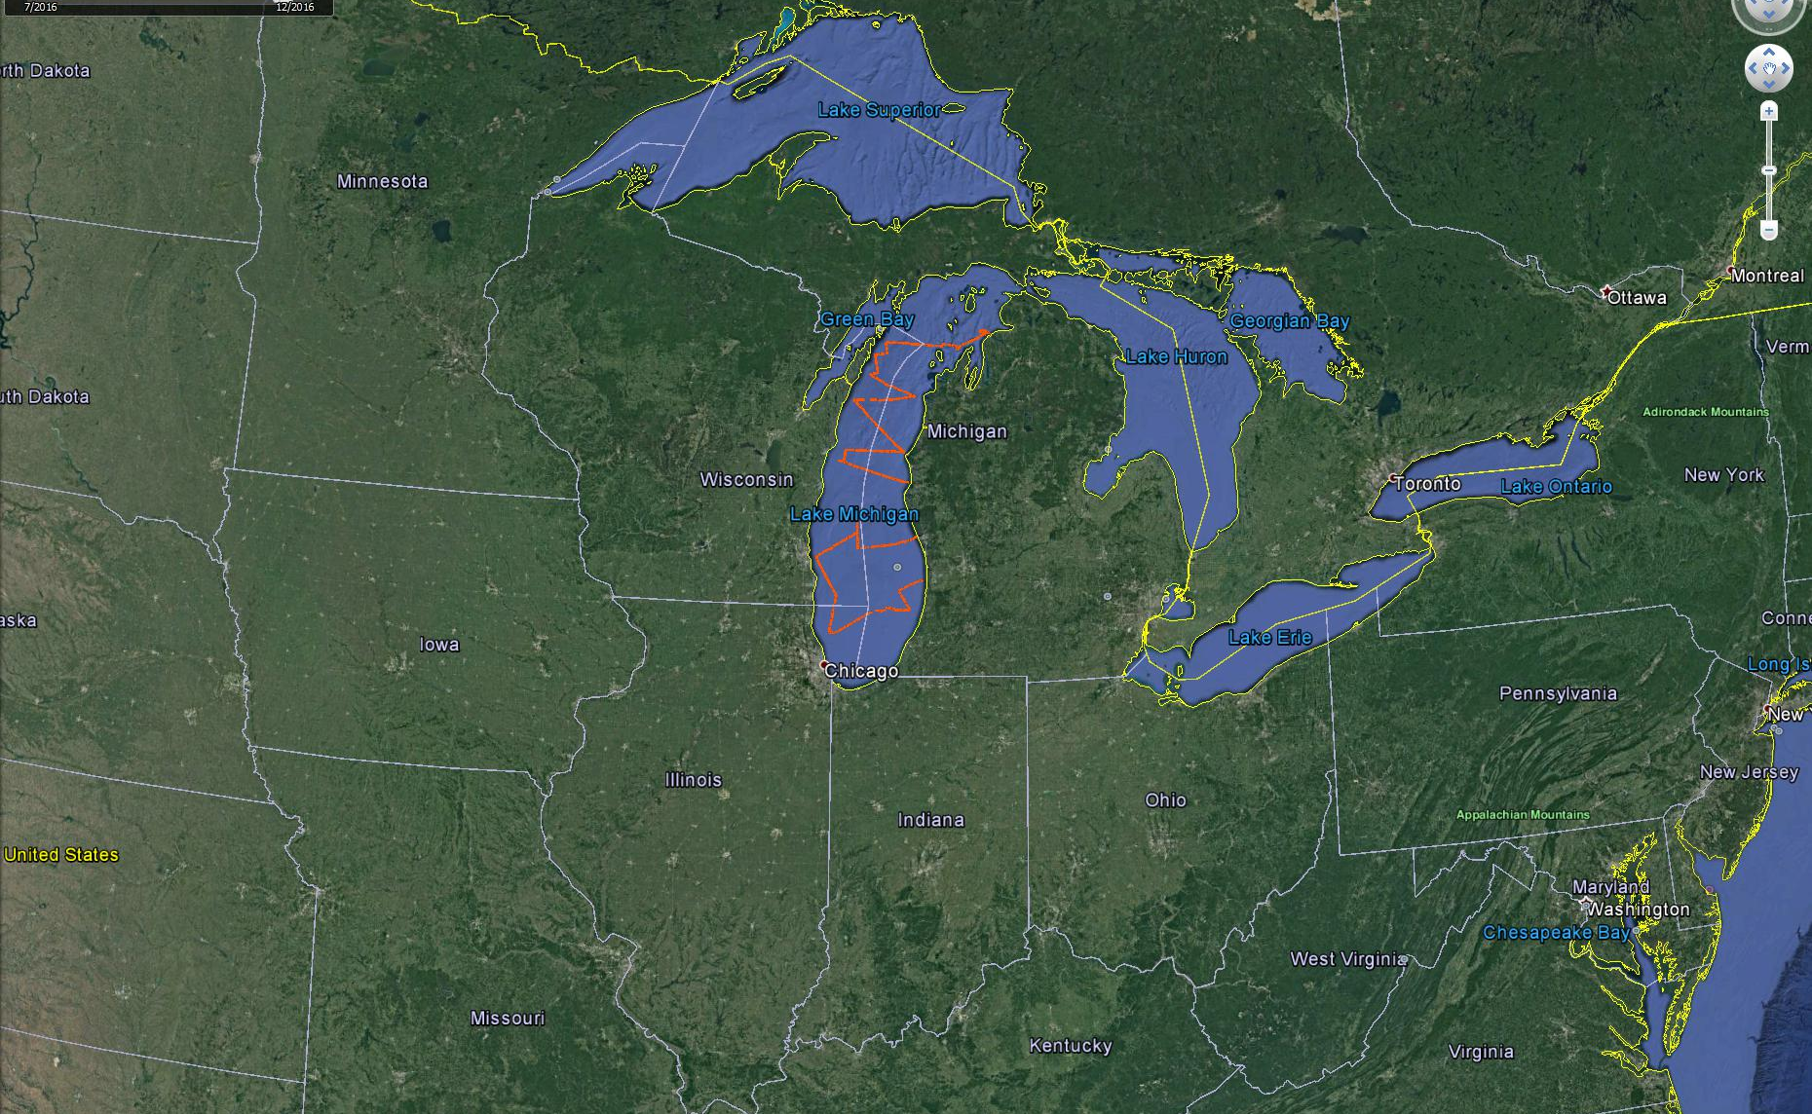
Lake Michigan
1400 km
1 month
< $65k
Non ship-based
Basin scale synoptic observing
More with less

Slide 8
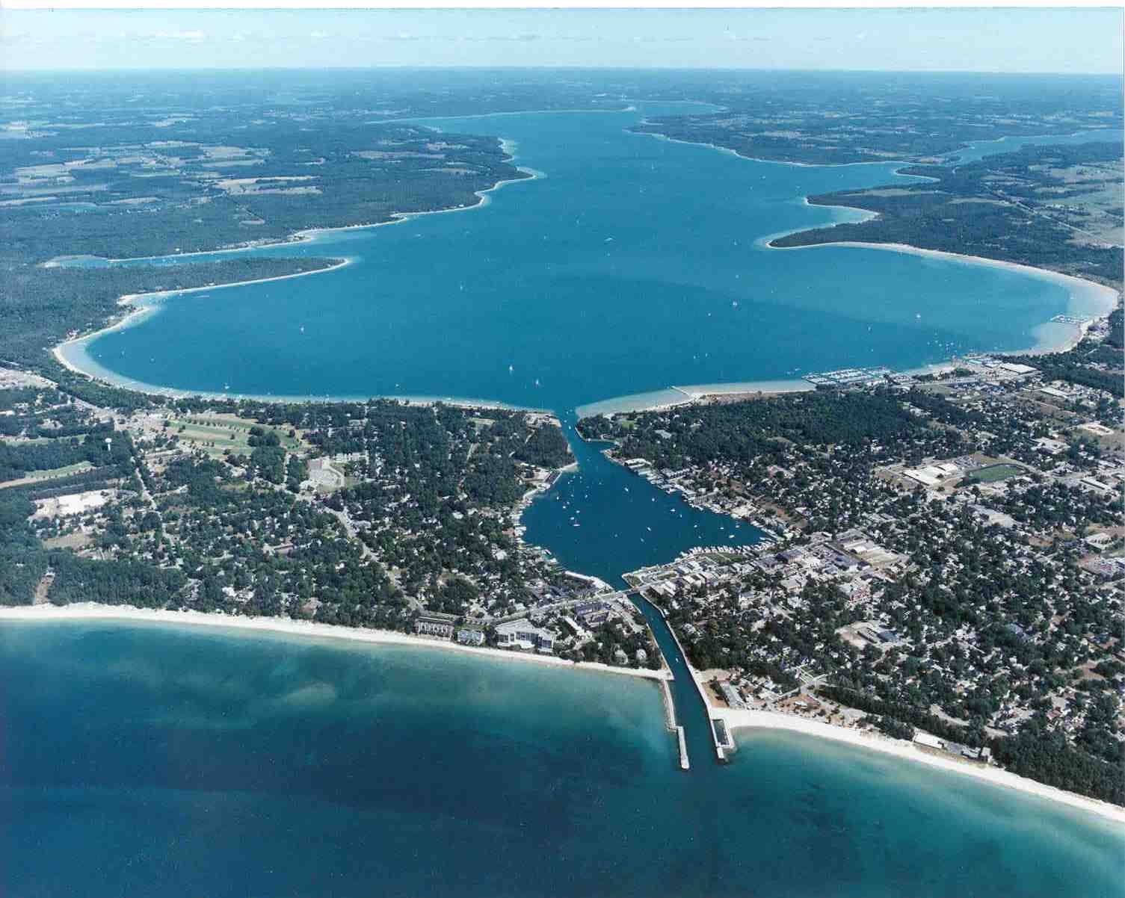
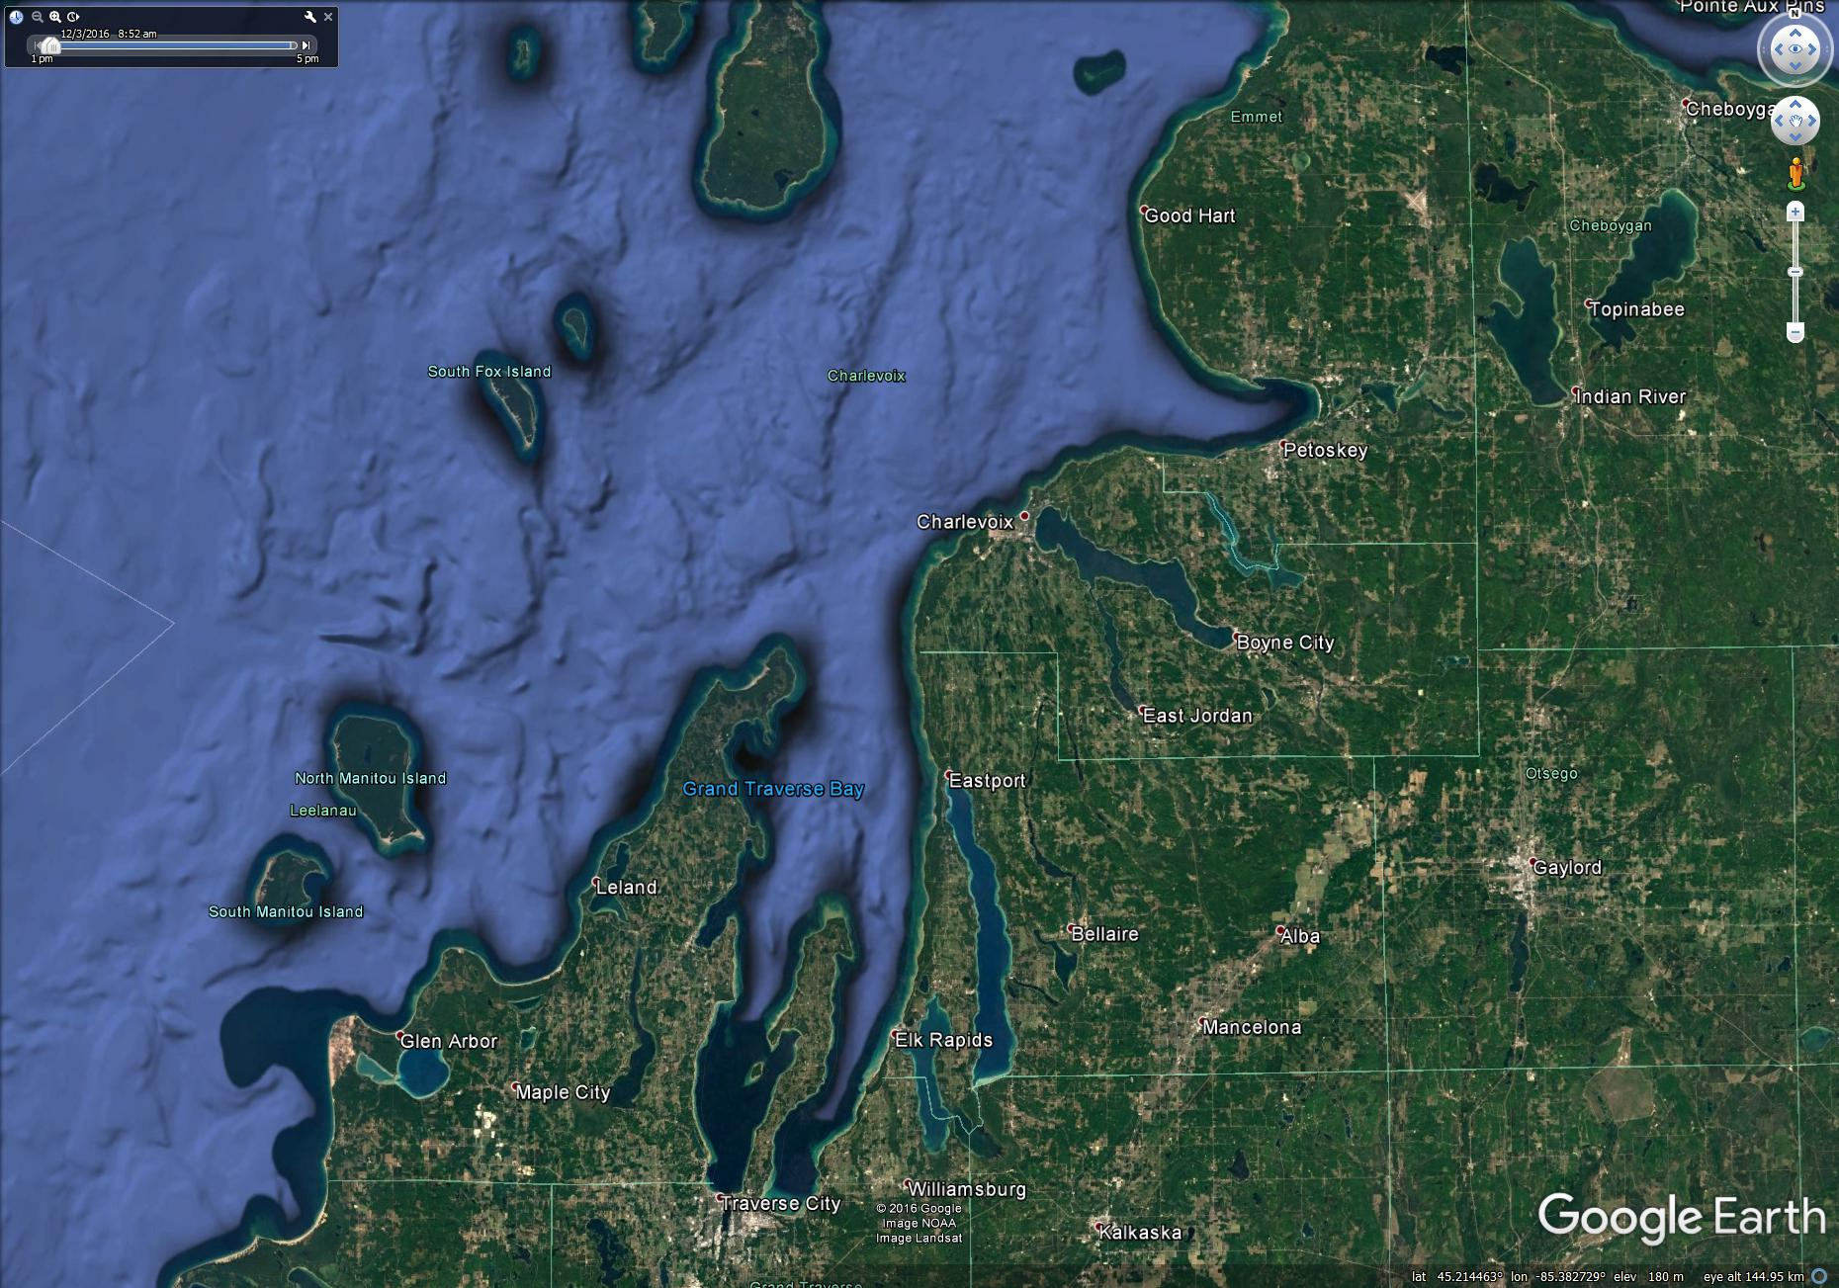
Great Lakes
Charlevoix

Slide 9
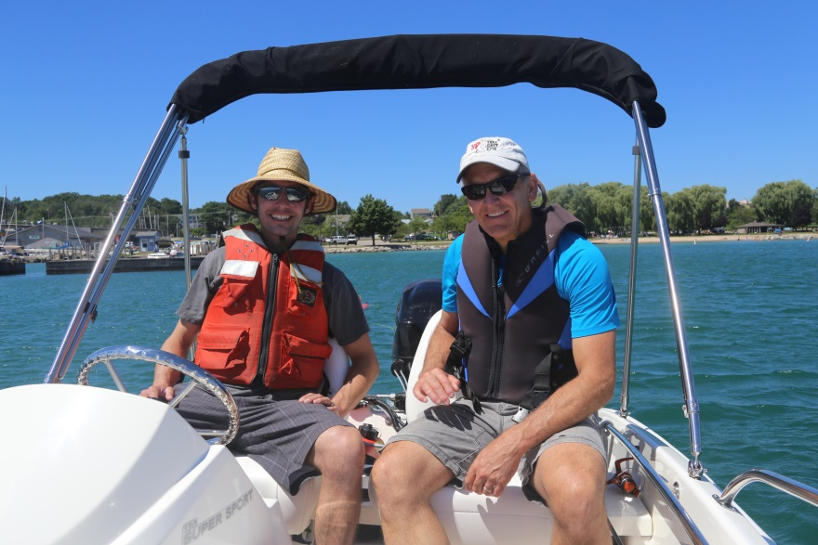
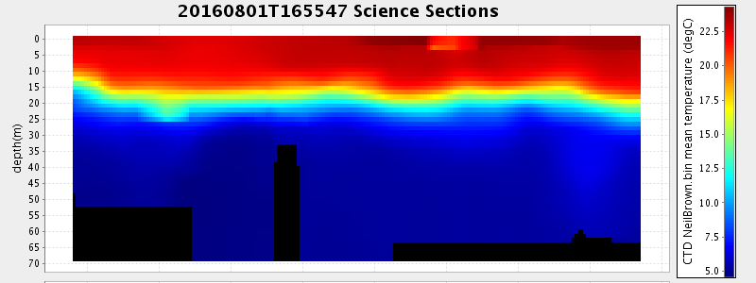
Great Lakes
Different:
Freshwater
Shallow (280m)
ROV?
New ADCP/Altimeter
Transport logistics
> 45° North
UTM zone / charts
Wide temp range
No sharks
Same:
Small boat ops
Unattended

Slide 10
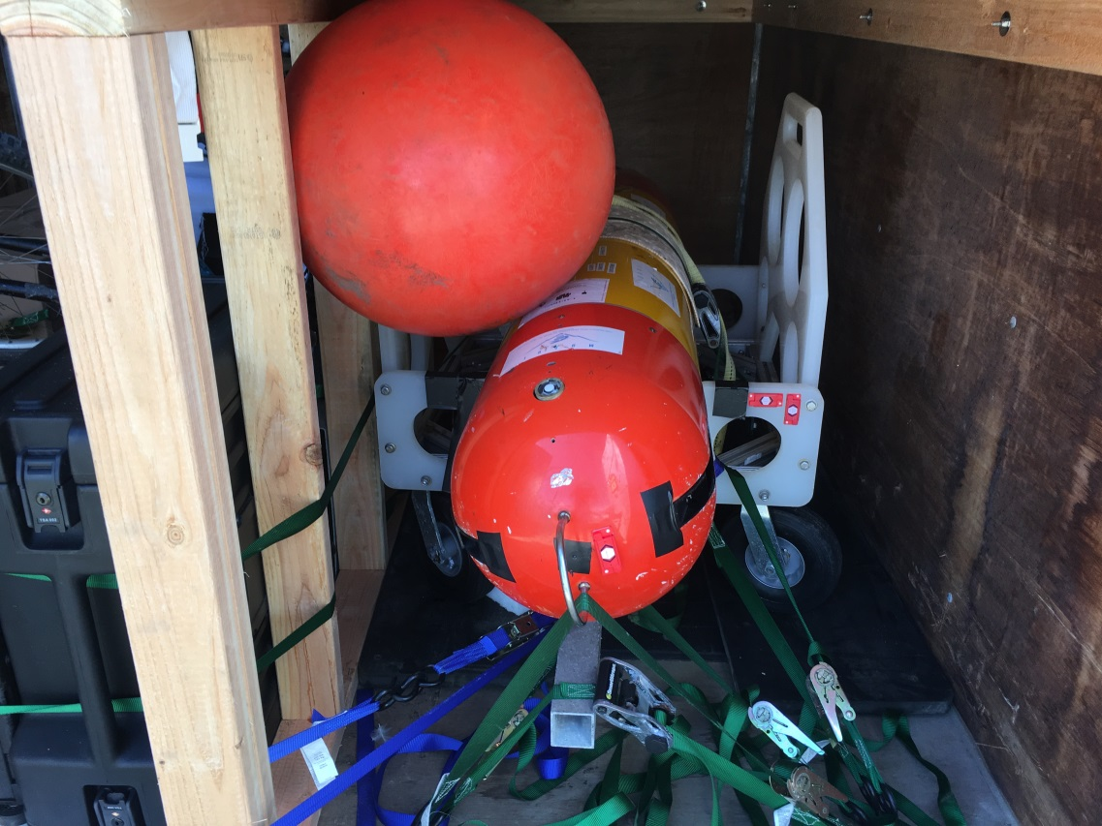
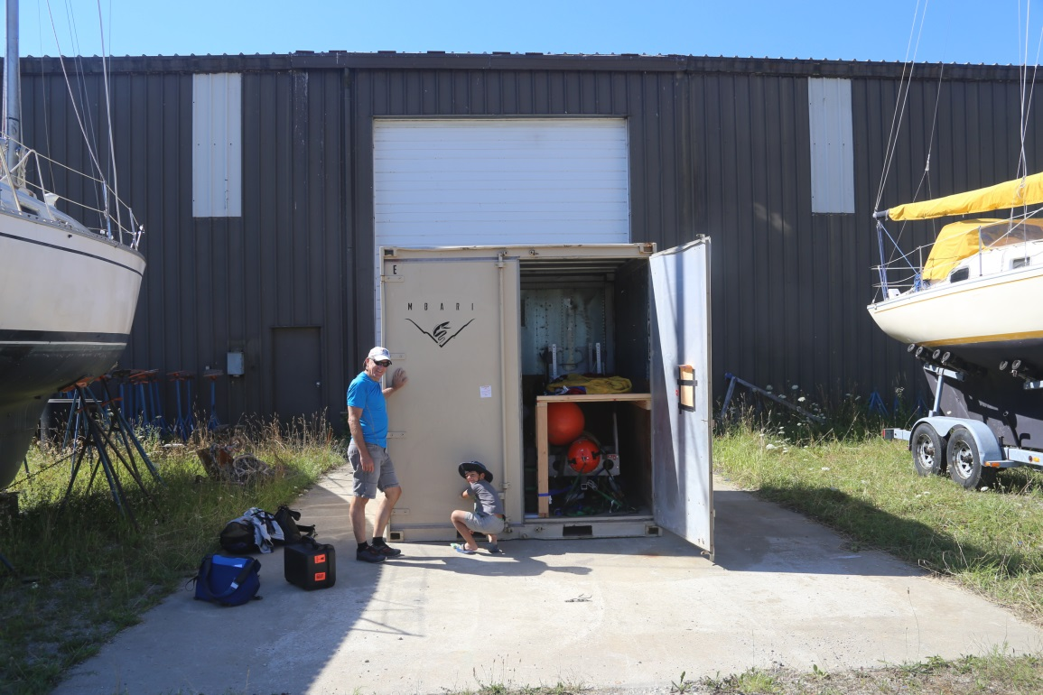
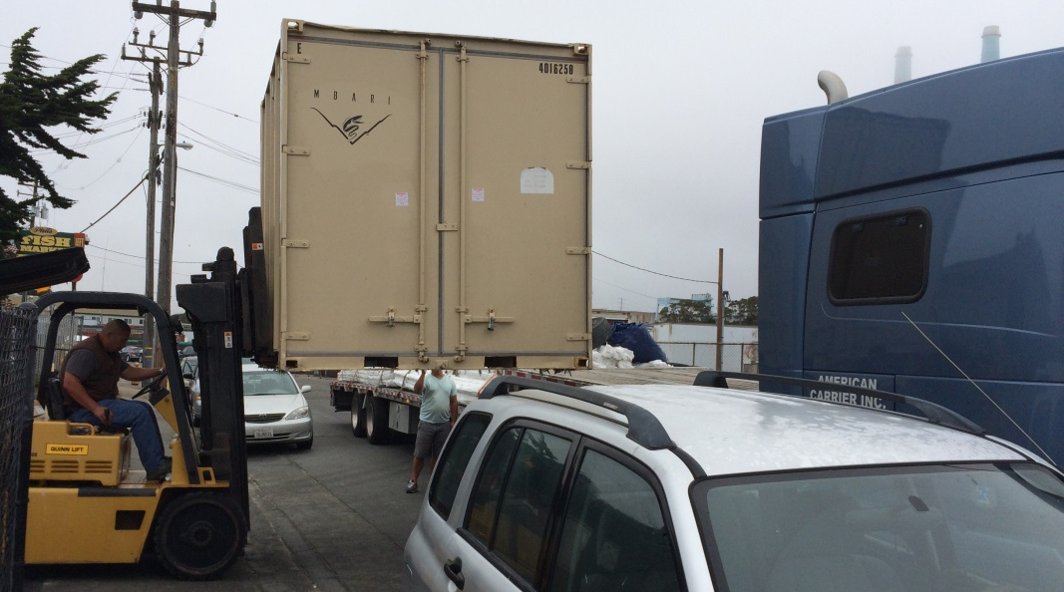
Shipping

Slide 11
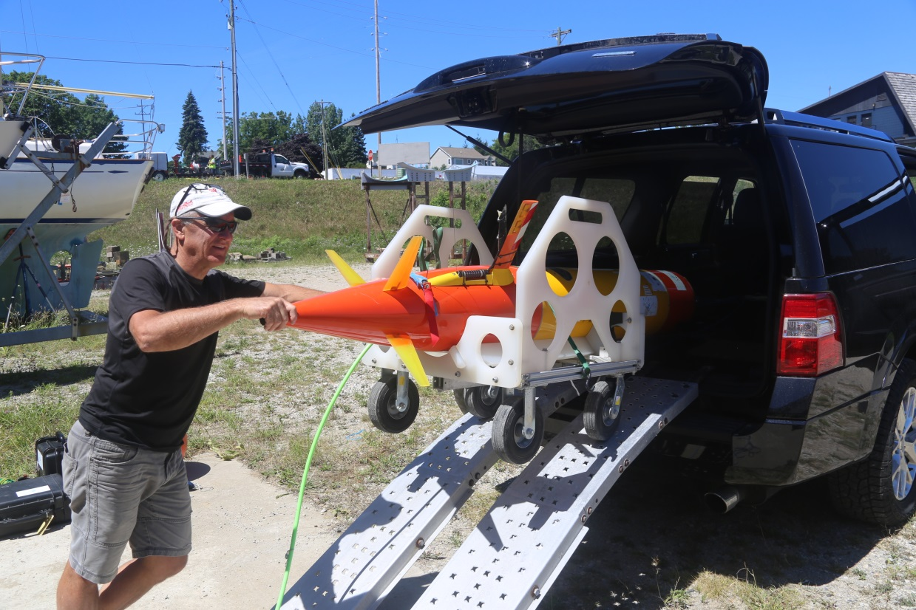
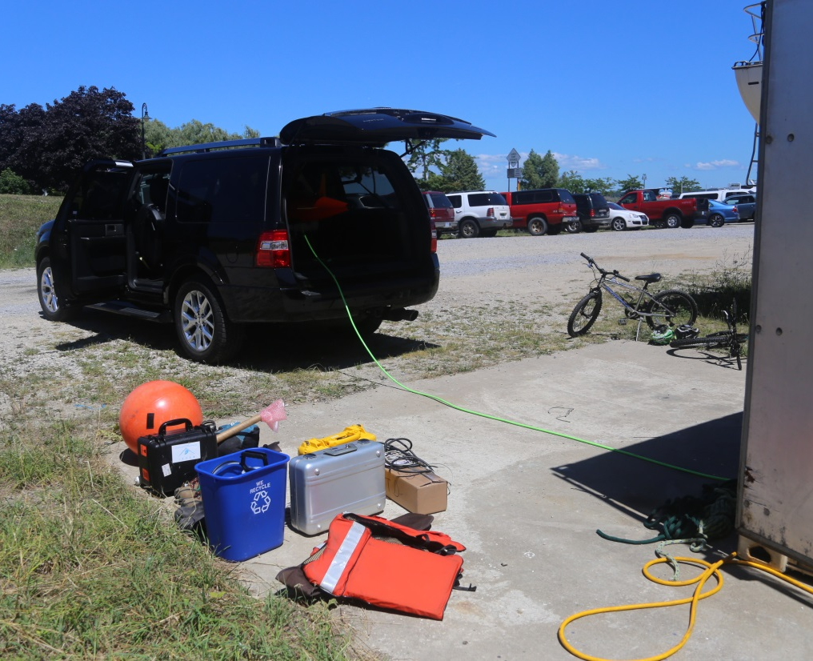
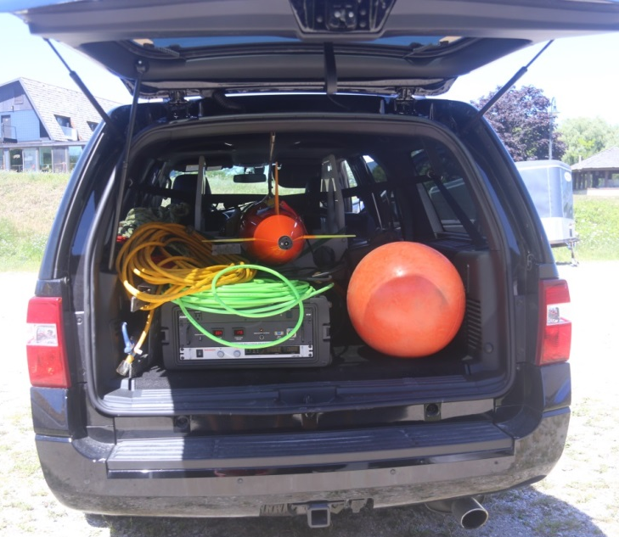
Great Lakes
Transport

Slide 12
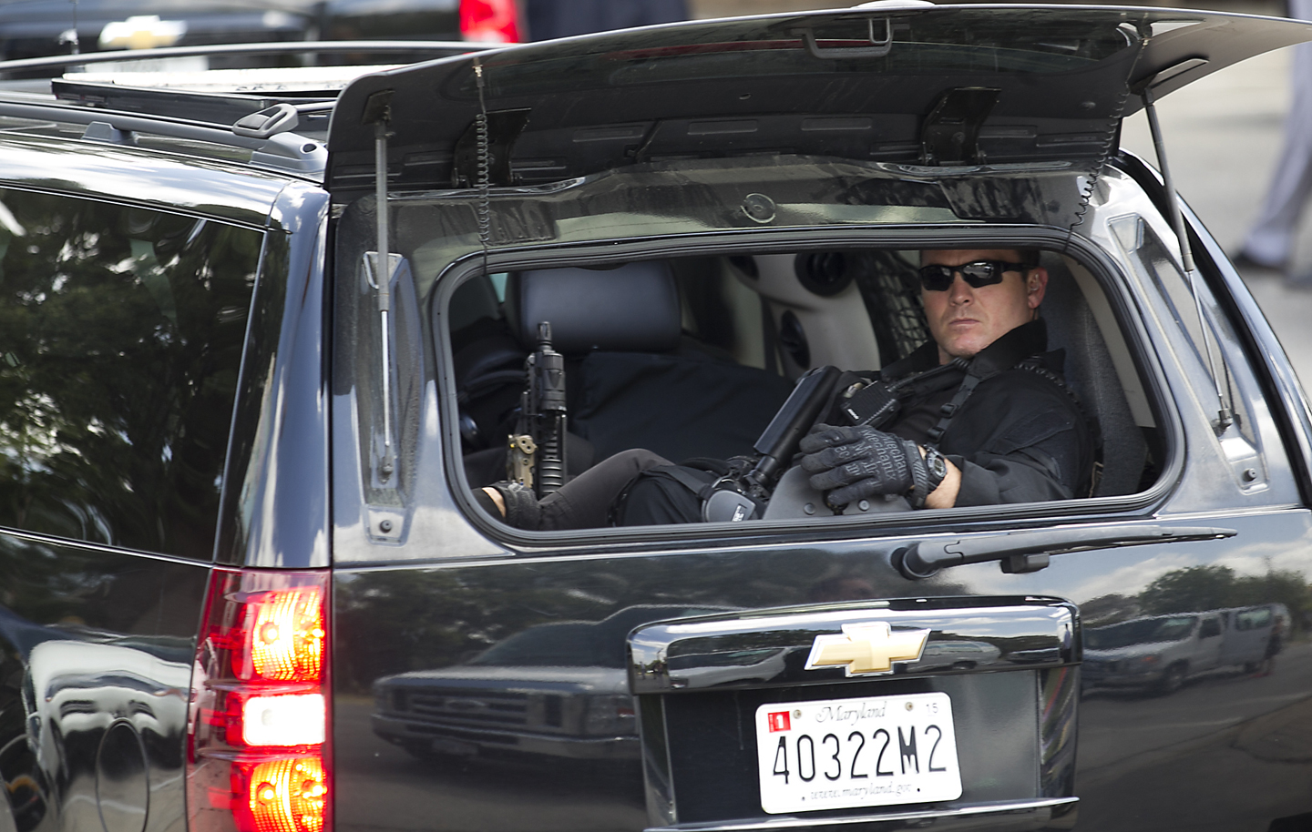
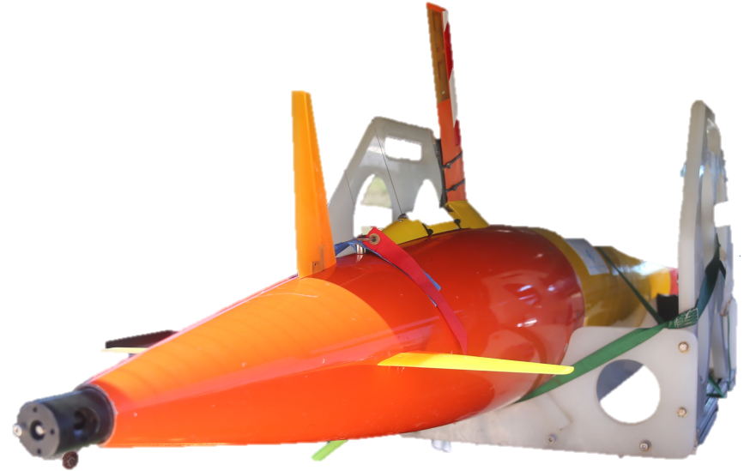
Great Lakes
Transport

Slide 13
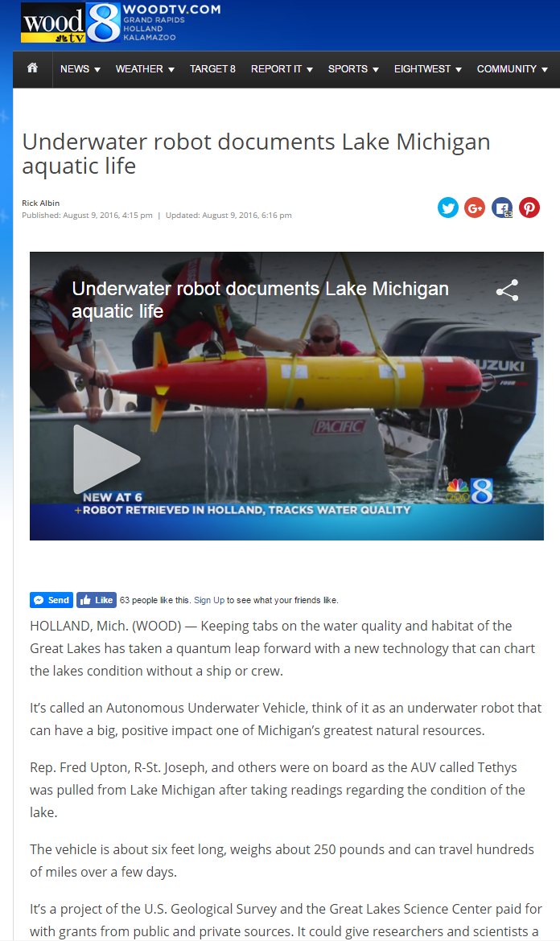
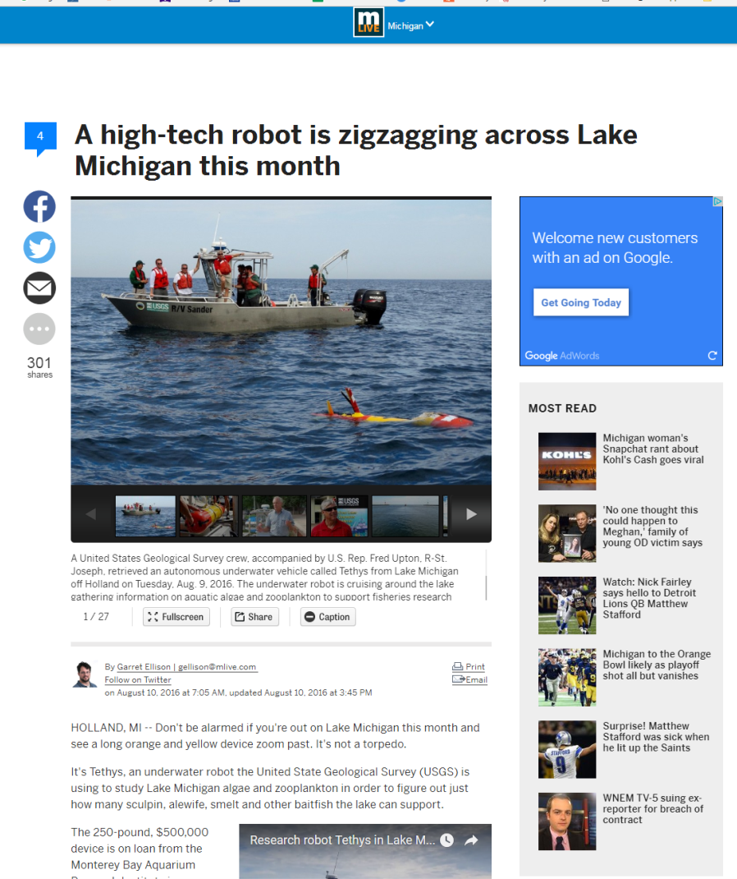
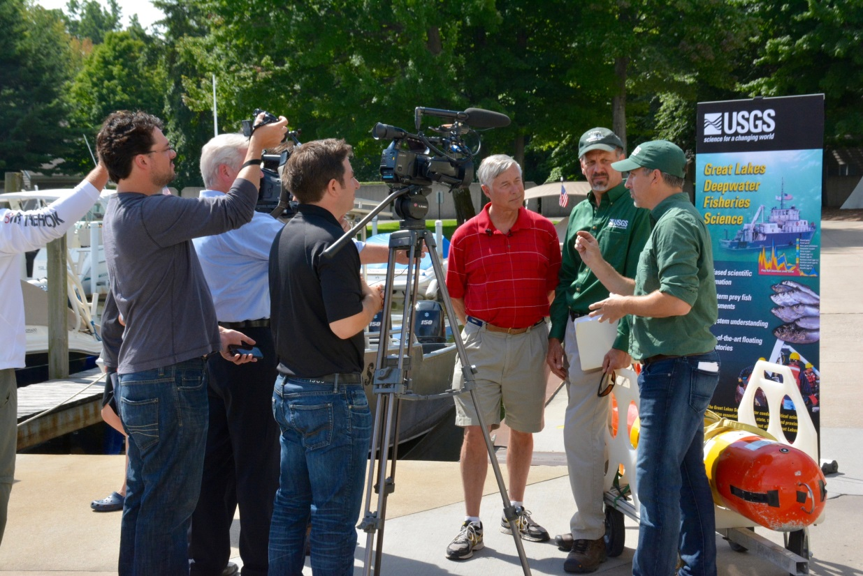
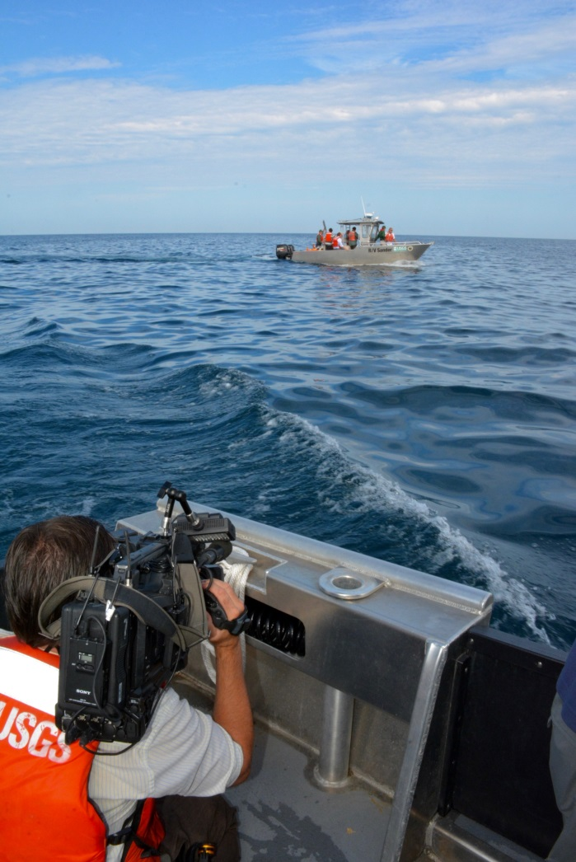
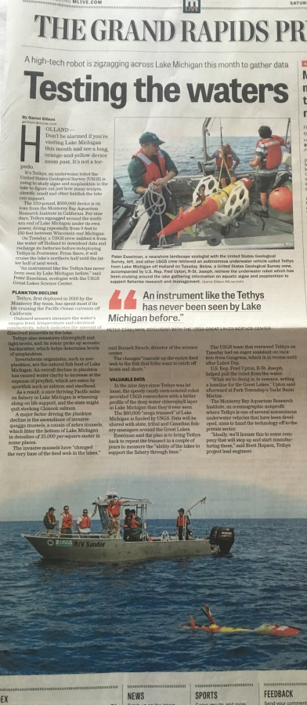
Great Lakes
Publicity

Slide 14
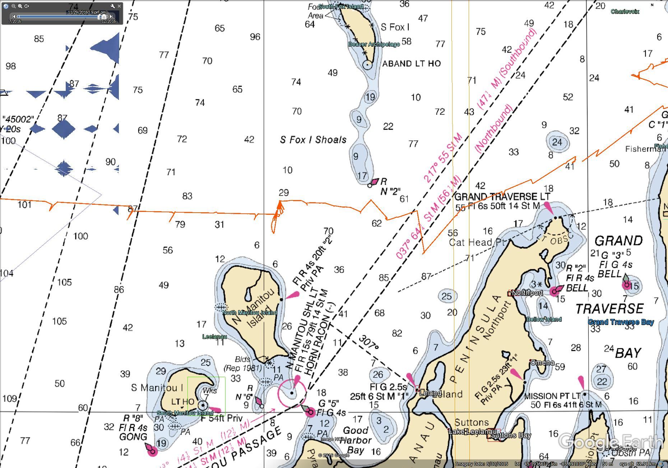
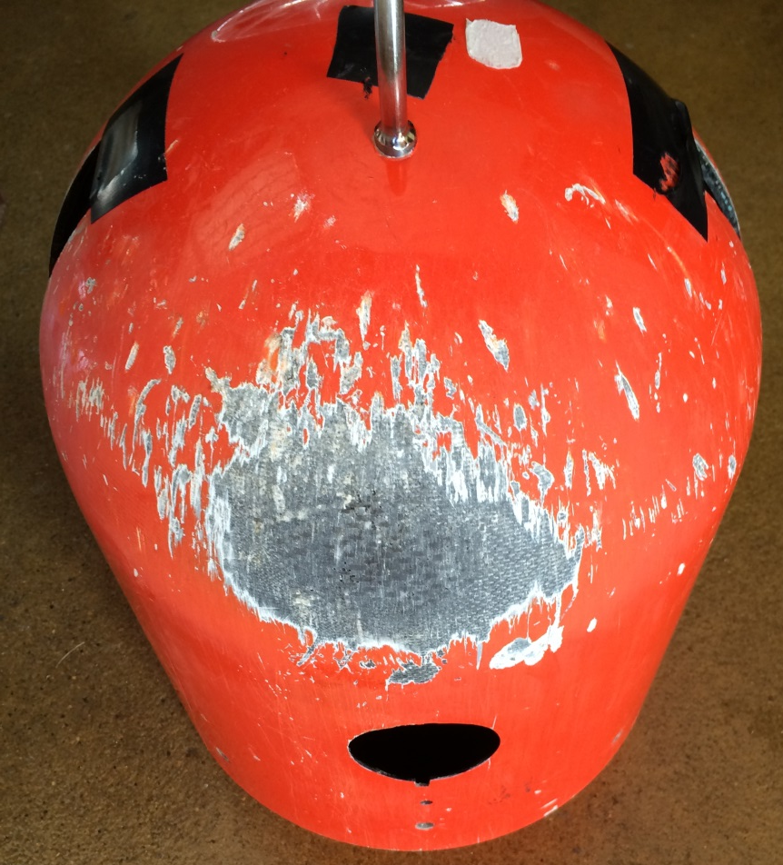
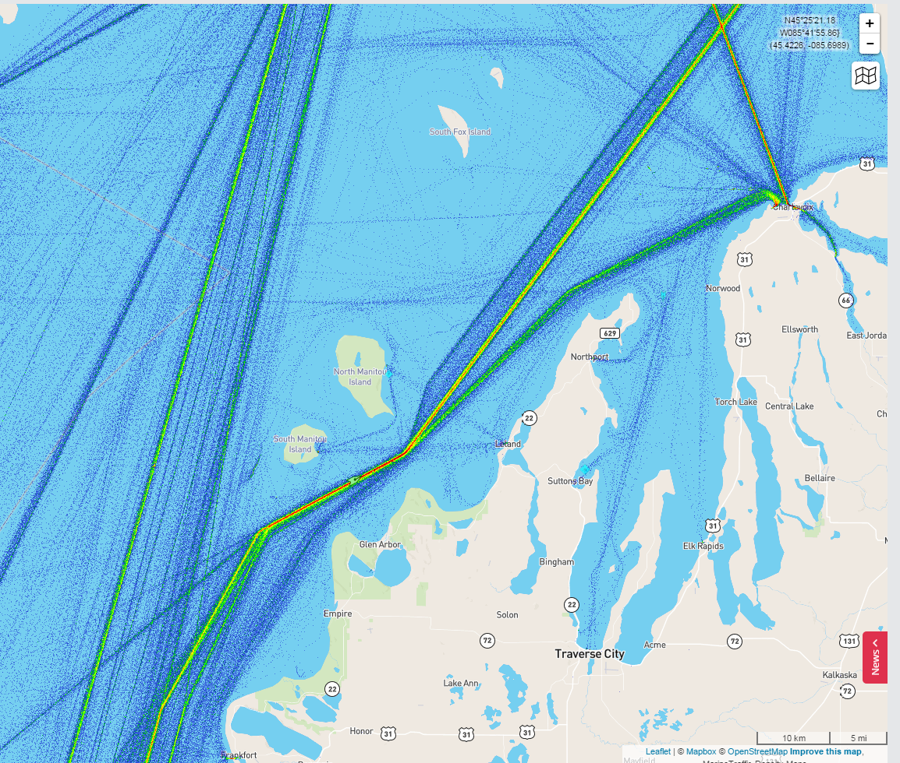
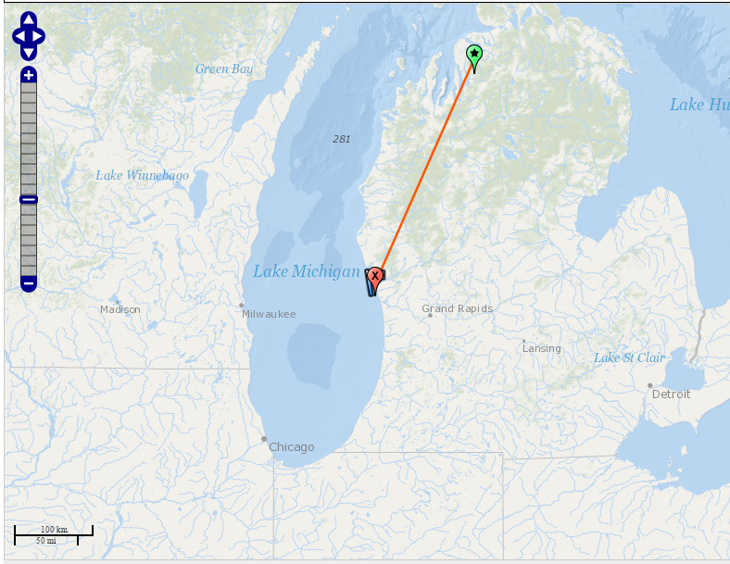
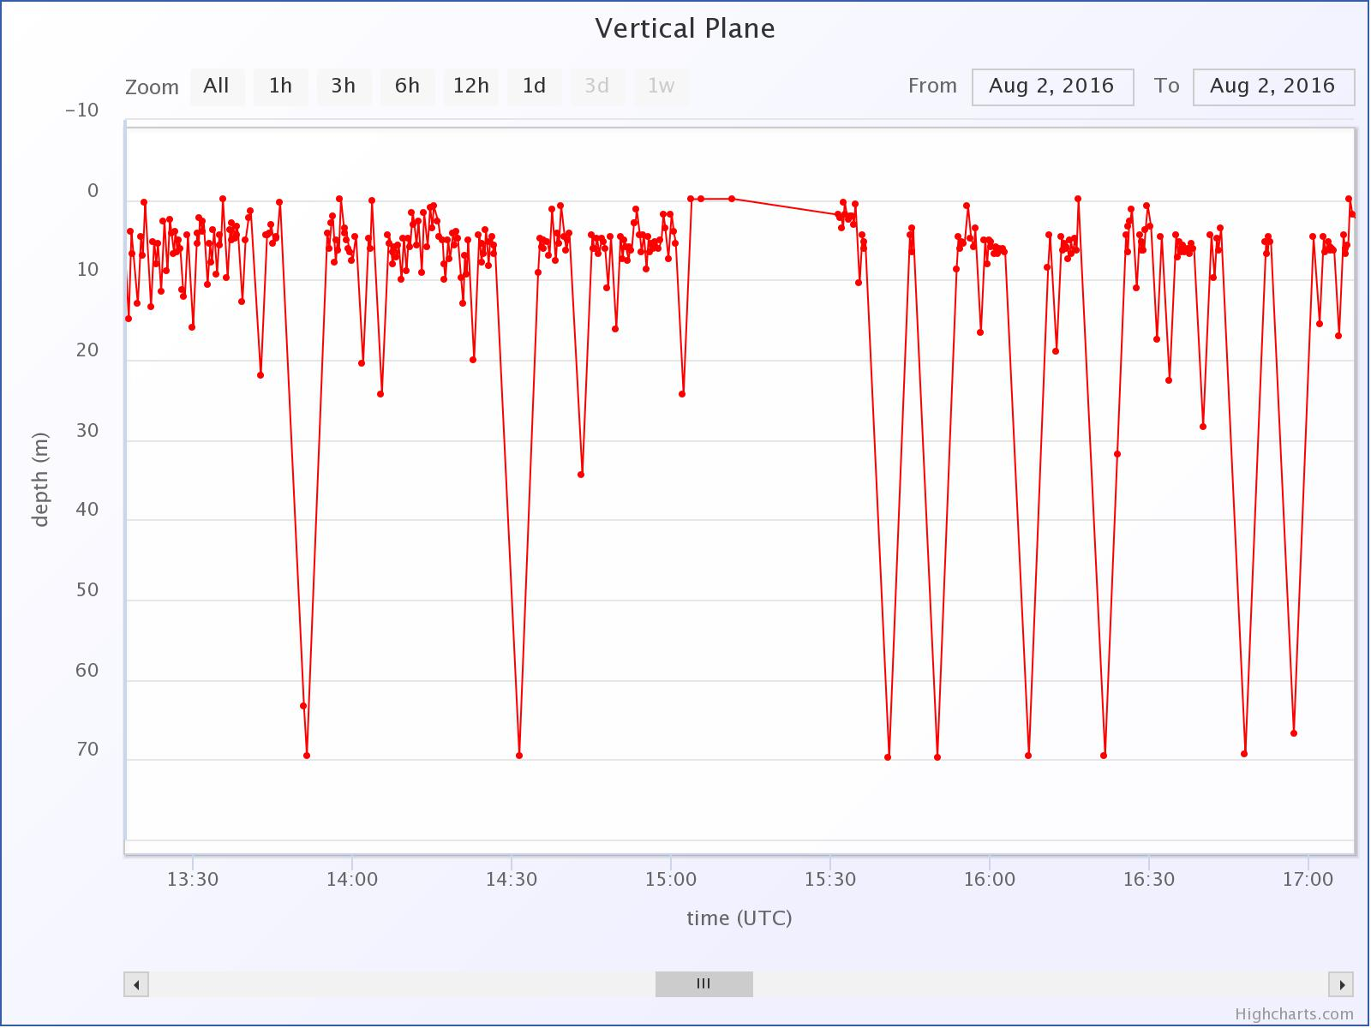
Great Lakes
Challenges:
Charts
Altimeter
Network Outage

Slide 15
