Slide 1
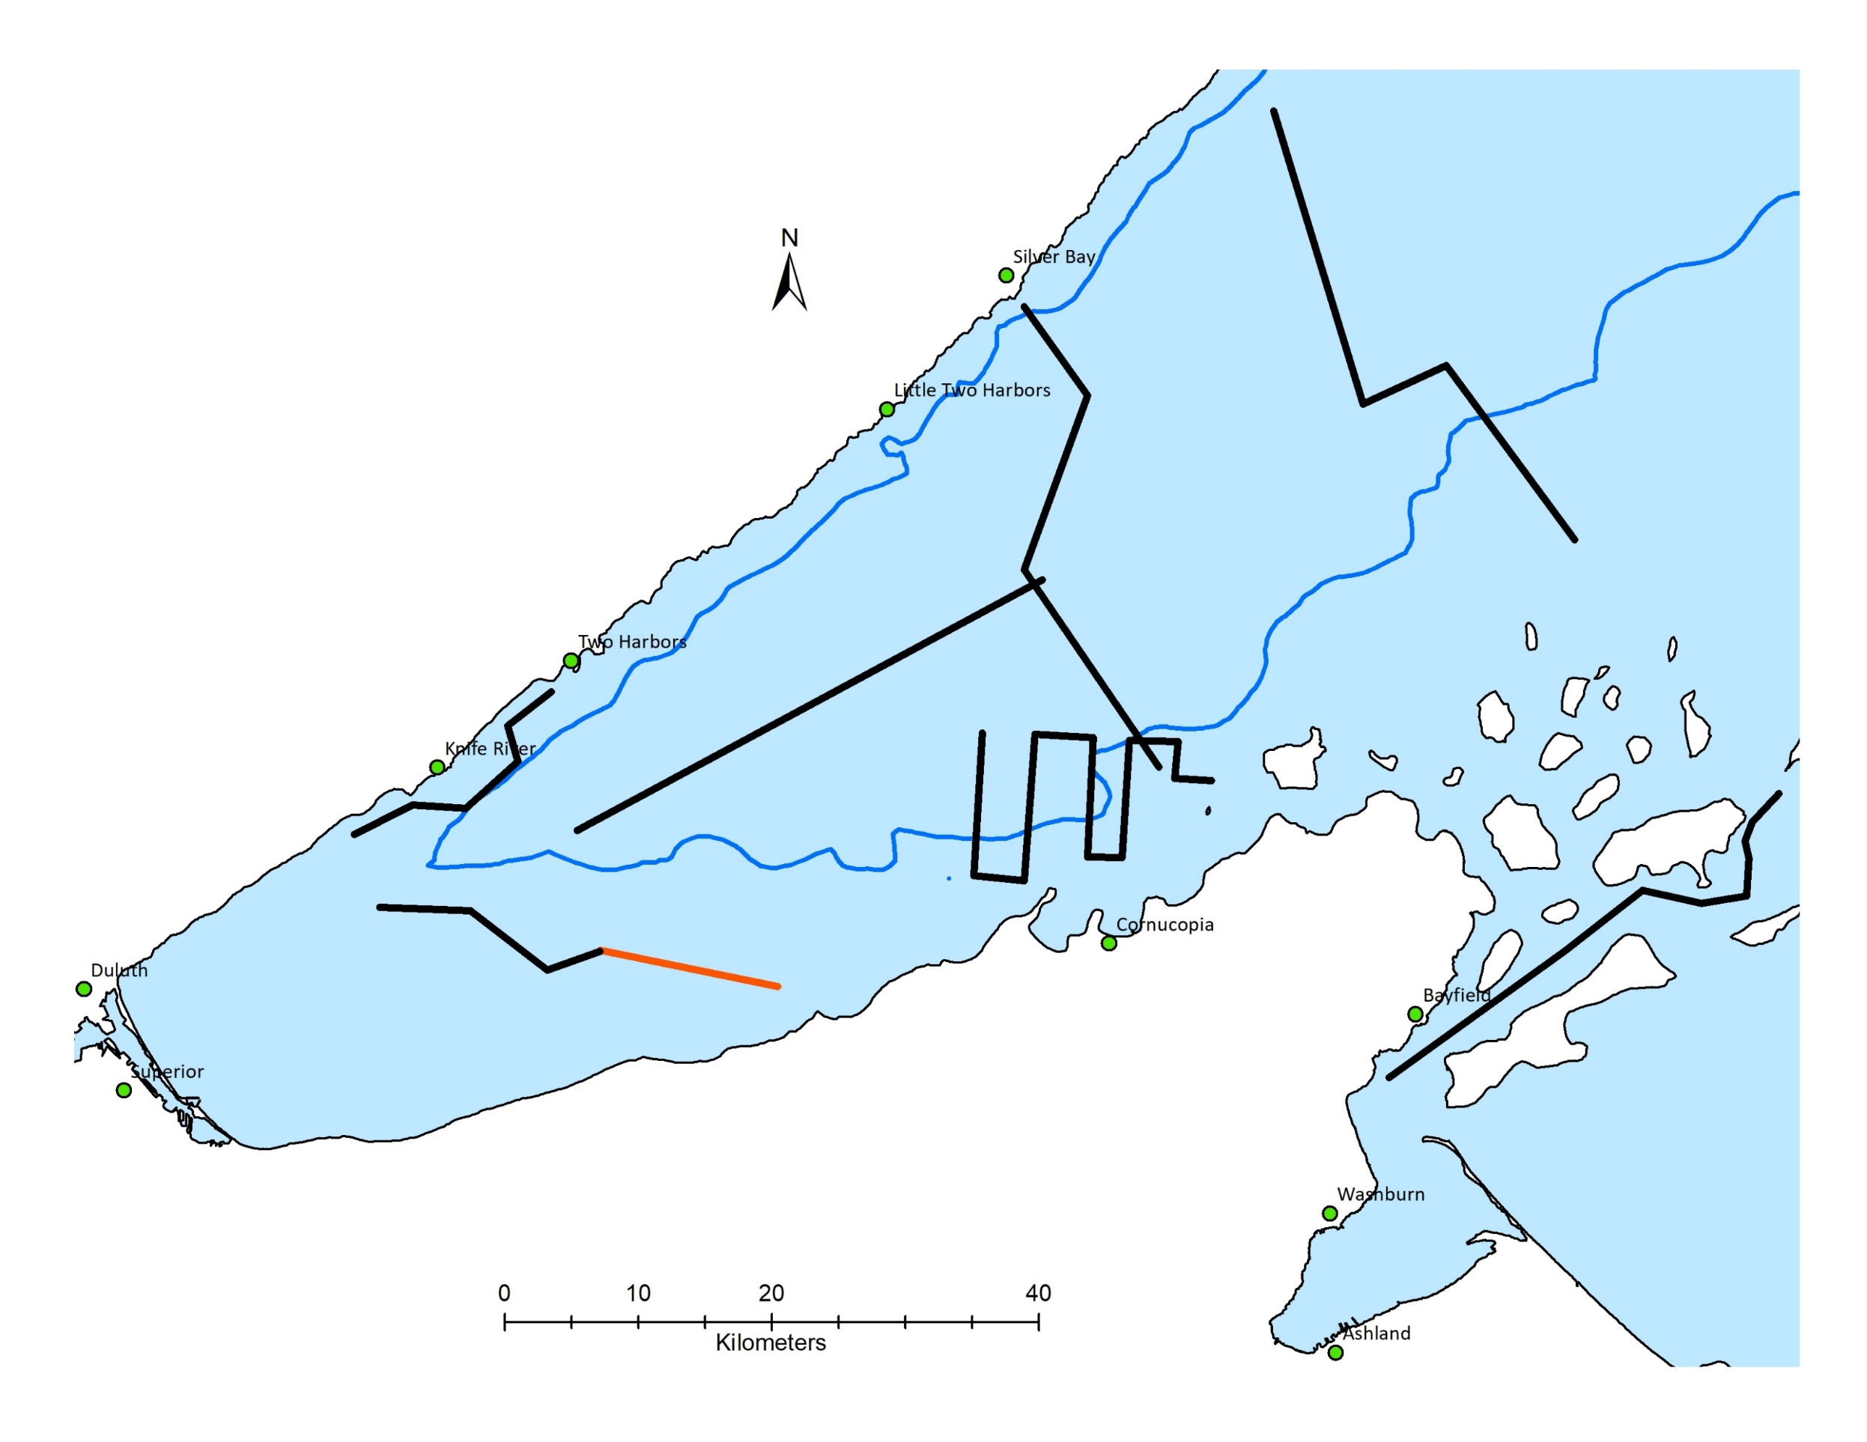
Possible Lake Superior transects
The idea is for MBARI AUV, Saildrone and the USGS R/V Kiyi to all run these @
night.

Slide 2
Possible logistics
Night | Transect | Distance (km) | Day transit to next to next transect (km)
1 | Inner Apostle Islands | 40 | 13
2 | Transect 3 | 46 | 24
3 | Transects 2 | 40 | 4
4 | Sand Island | 59 | 12
5 | Sand to Duluth | 40 | 19
6 | Transect 1 | 34 | 6
7 | Two Harbors | 21
Propose launch from Washburn, WI & retrieving @ Two Harbors, MN.
Yule has asked local FWS to deploy and retrieve AUV but that commitment is still TBD.
In the Echogams that follow I refer to waypoints sent in Possible AUV transects.xls

Slide 3
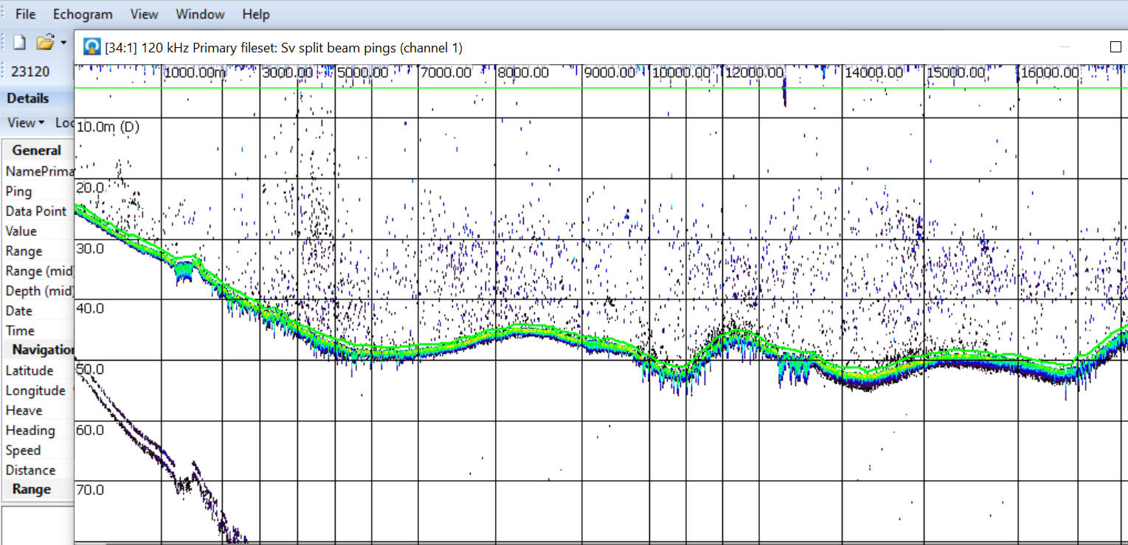
Inner Apostle Islands (25-50 m depths)
AII-1 to AII-2 (16 km)
AII-1 AII-2

Slide 4
There are some gaps along the Inner Island transect that
Yule has no acoustic data, but he can provide chart soundings.
Gaps include AII-2 to AII-3
AII-6 to AI-7
AII-8 to AII-9

Slide 5
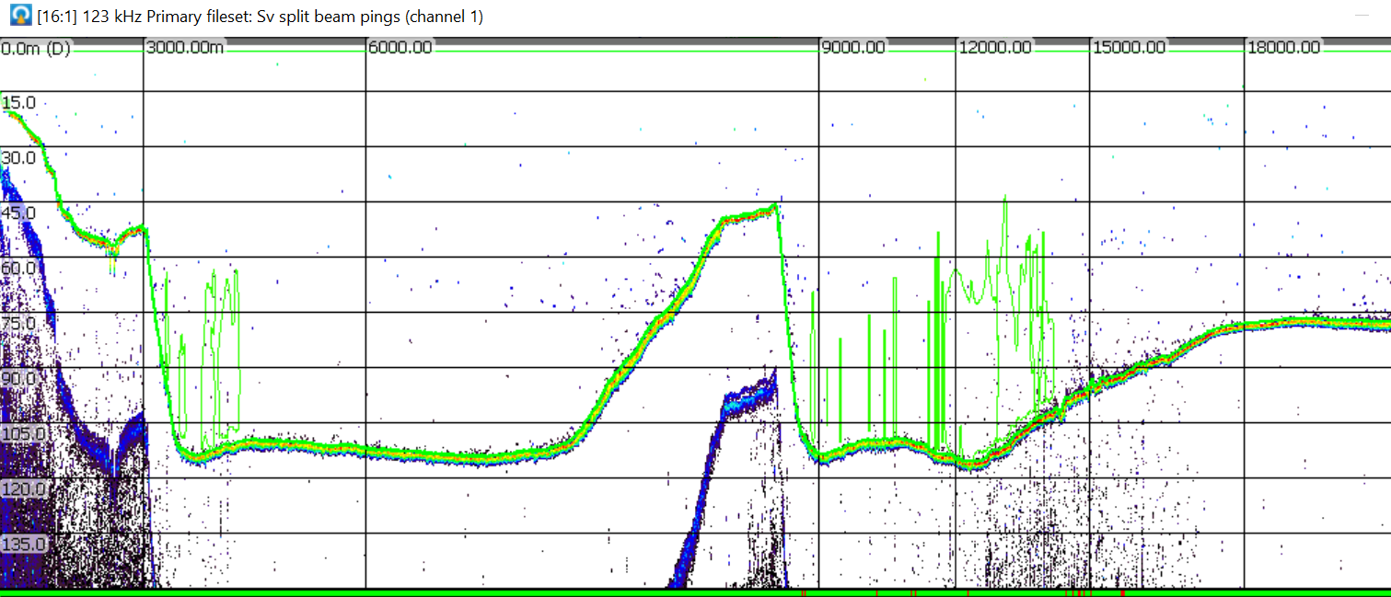
Inner Apostle Islands Continued (45 -110 m)
AI-4 to AI-5
AII-6 AII-3

Slide 6
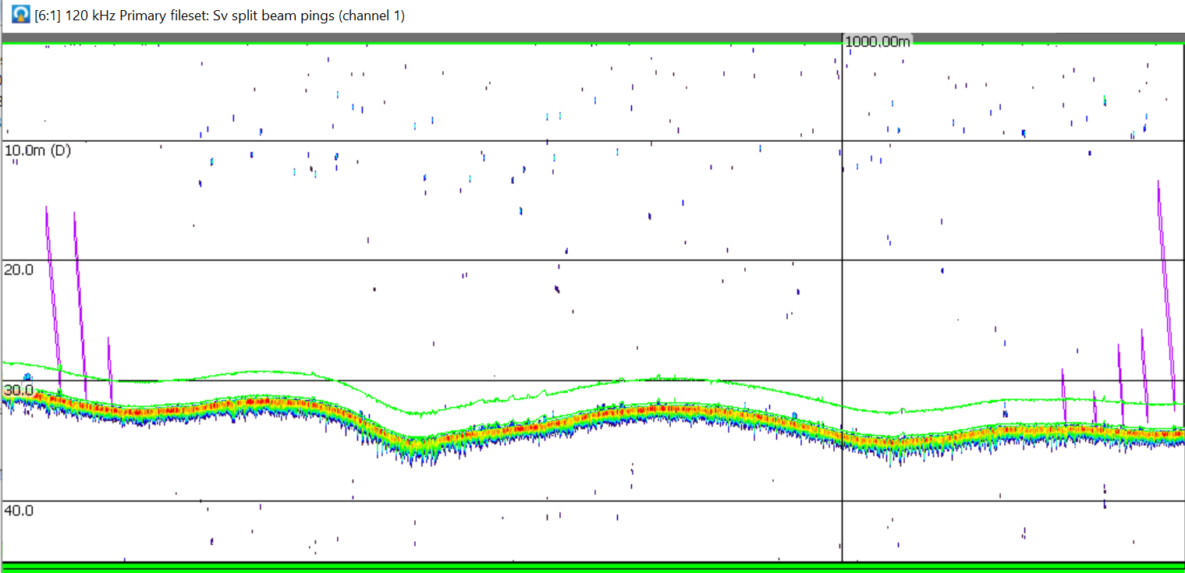
Inner Apostle Islands Continued (30 m)
AI-7 to AI-8 (1.5 km)
AI-8 AI-7
This segment east of Stockton is a known whitefish honey hole.

Slide 7
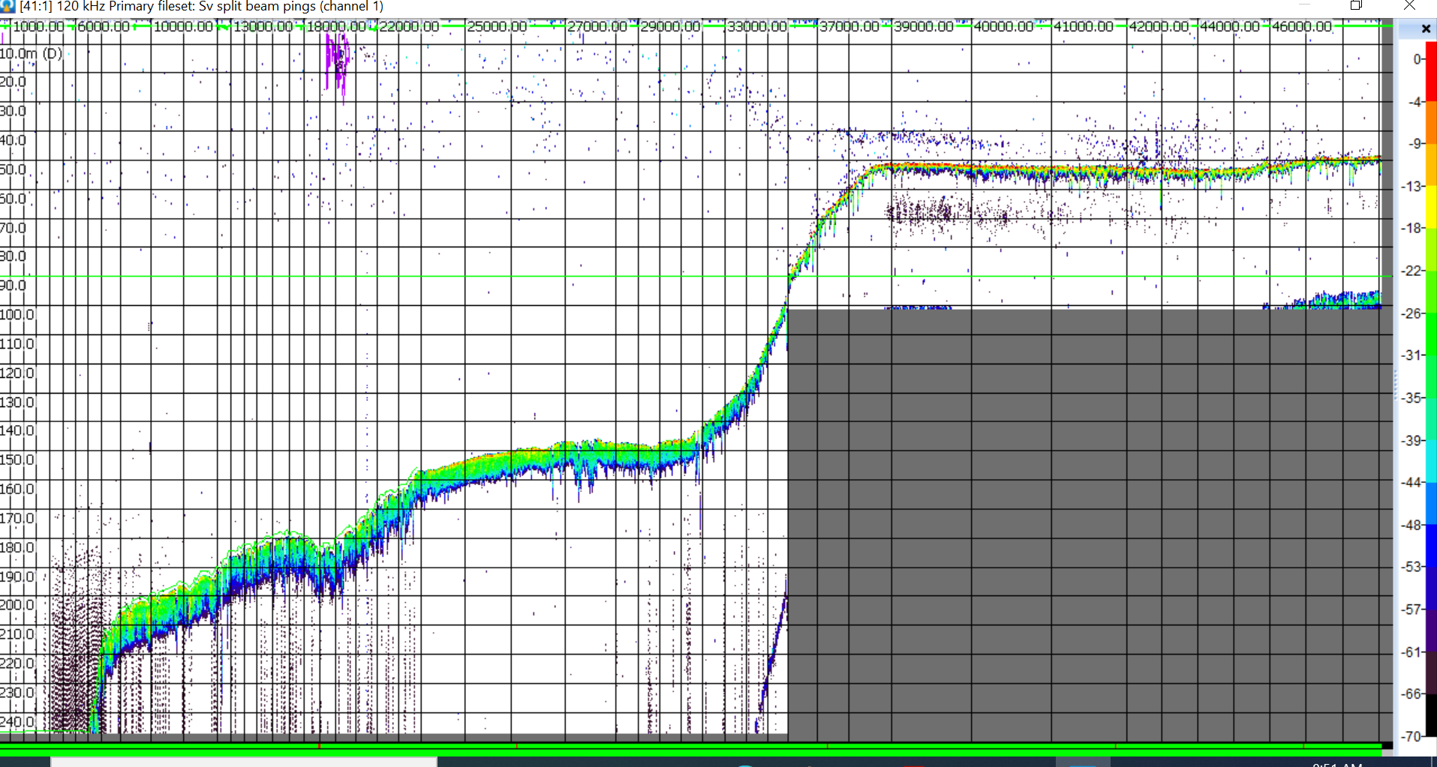
Transect 3 (50-250 m depths)
T3-3 to T3-1 (46 km)
T3-4
T3-1

Slide 8
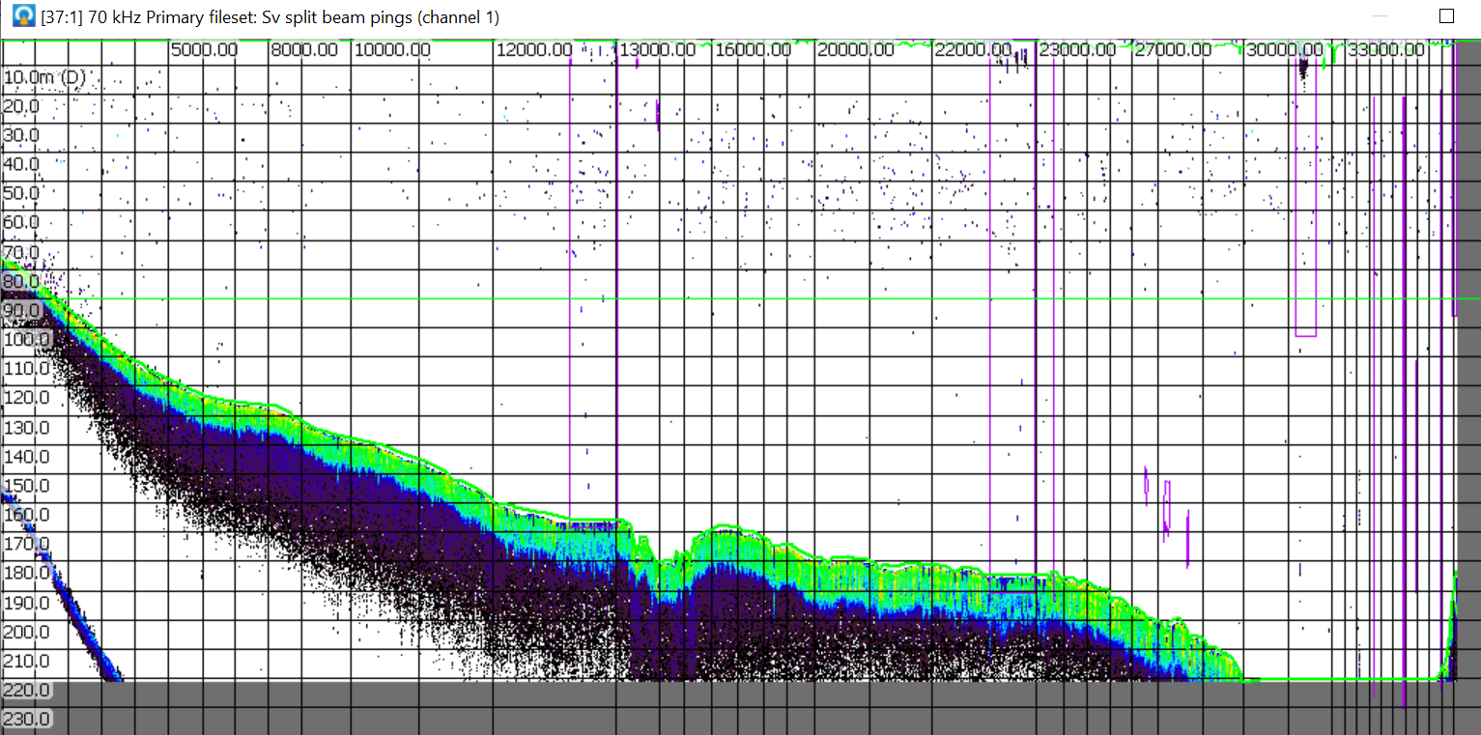
Transect 2 (70-220 m depths)
T2-1 to T2-4 (40 km)
T2-4
T2-1

Slide 9
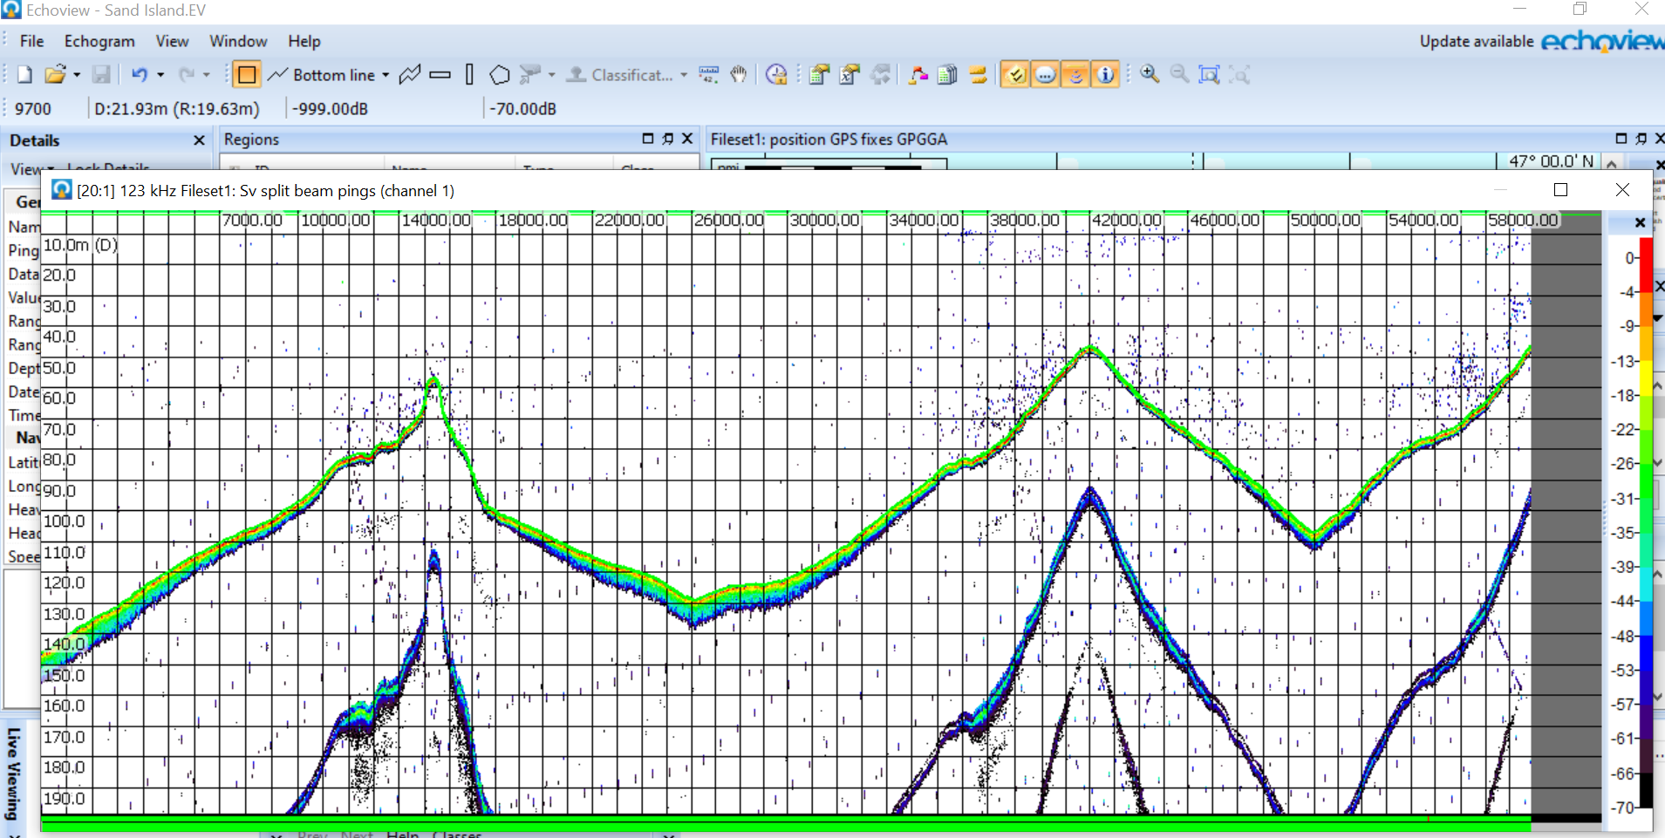
Sand Island (50-140 m depths)
SI-1 to SI-11 (59 km).
SII-11
SII-1

Slide 10
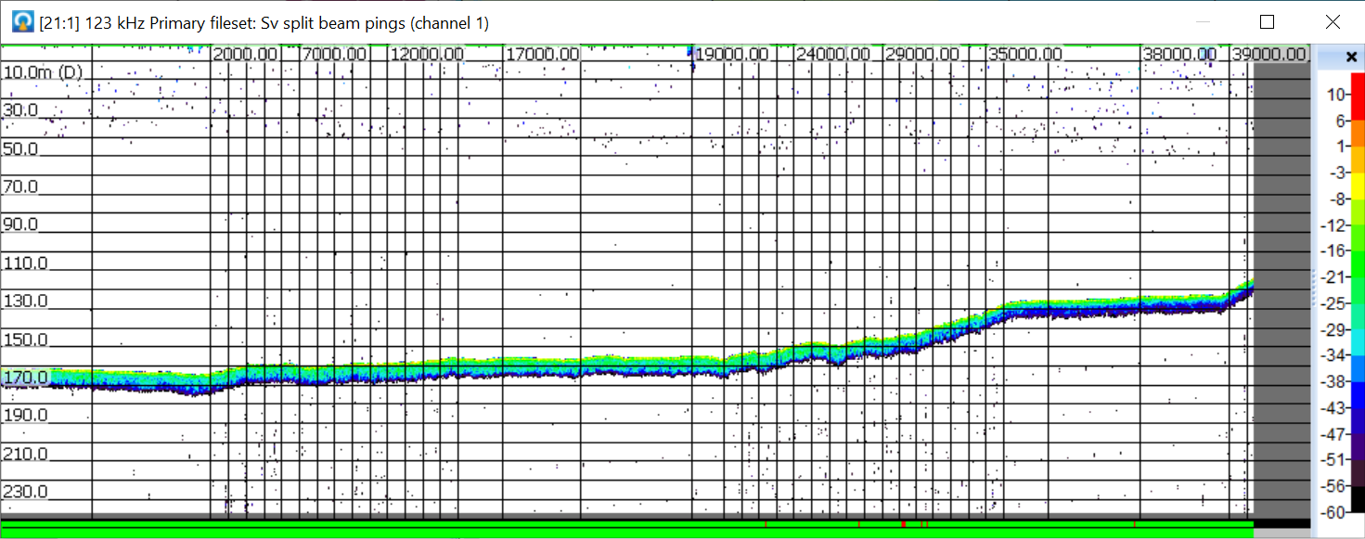
Sand to Duluth (120-160 m depths)
SID-1 to SID-2 (40 km)
SID-1
SID-2

Slide 11
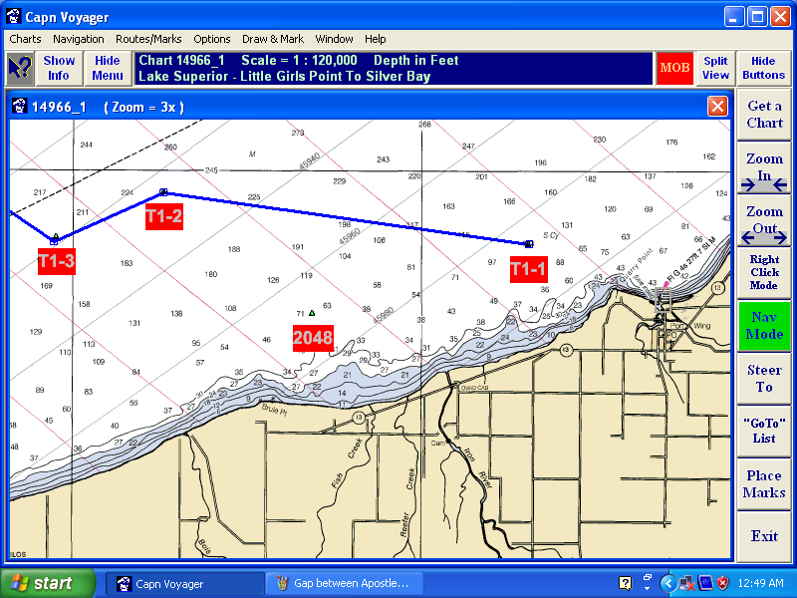
Yule has no acoustic data between T1-1 and T1-2 of Transect 1.
This is what the chart looks like. Readings are in feet.

Slide 12
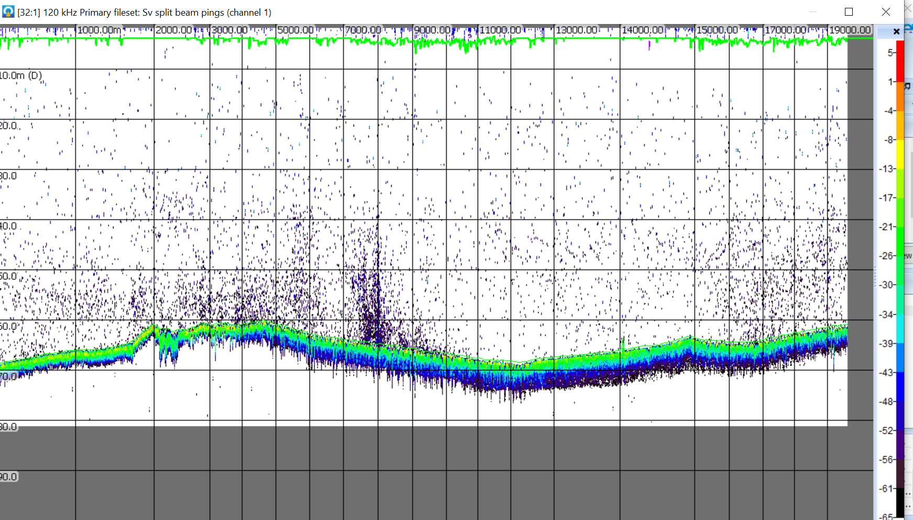
Transect 1 (60-70 m depths )
T1-2 to T1-5 (20 km)
TI-2
TI-5

Slide 13
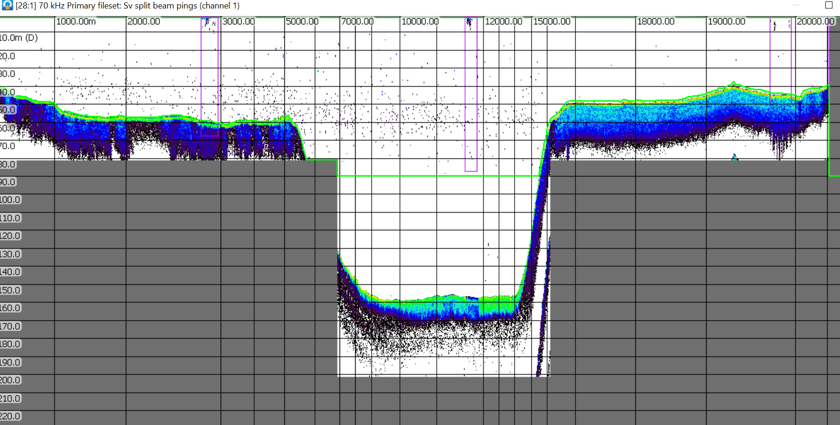
Two Harbors (40-160 m depths)
TH-1 to TH-6 (20 km)
TH-1
TH-6

Slide 14
Prey fish distributions in Lake Superior
These plots combine 2011 & 2016 CSMI bottom trawl and midwater trawl samples
%s are estimated areas
occupied.
Smelt have the smallest
spatial extent (16%).
Bloater, cisco, smelt & kiyi are
all common in western arm.
Rosinski et al. (2020)
Notes:
These maps give some idea of the geographic distributions of the main players. The % are the estimated surface areas occupied. We have a lot of bloater in the western arm, especially on the south shore & in the Apostle Islands. Juvenile cisco are nearshore & adults can be found everywhere. Kiyi are offshore. The lake is rather deep in most places so smelt are confined to about 16% of the lake surface area. We have good numbers of all the main players to study in the western arm.

Slide 15
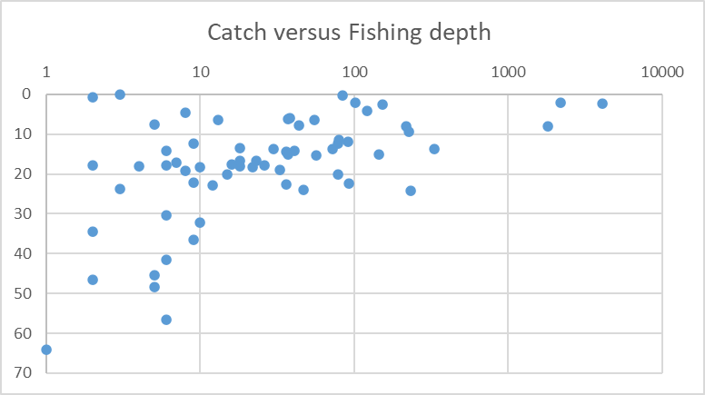
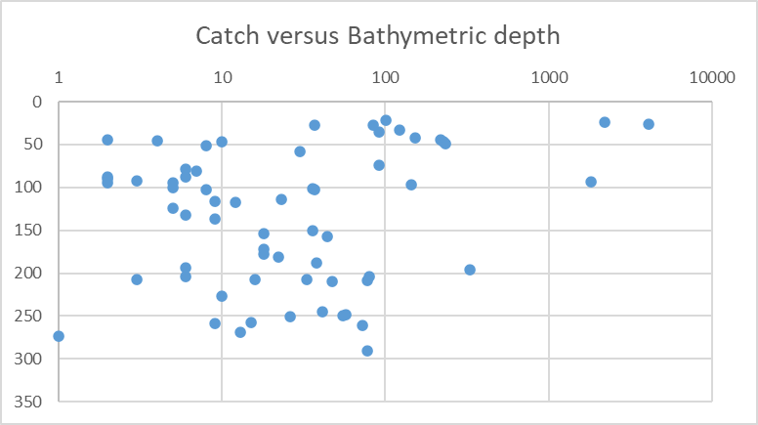
2016 Lake-wide midwater trawl survey (N =64)
Catches are on y-axes &
log scale.
Fishing depth is headrope &
MTR mouth is ~10 m high.
Catches below 35 m water column depth are trivial.
Catches also drop rapidly @ bathy depths >100 m.
Again – surface is where the action is at!
Notes:
Here are the catches from the 2016 MTR survey shown in a different way. Catches are on the y-axis on a log scale. Catches are plotted against headrope depth in the top graph and bathy depth in the bottom graph. The actual trawl mouth opening is about 10 m. Two things to note. Catches drop quickly below 35 m water column depths. Again, most of the action is at the surface. Catches are also much lower where bathymetric depths are less than 100 m because smelt drop out.

