Slide 1
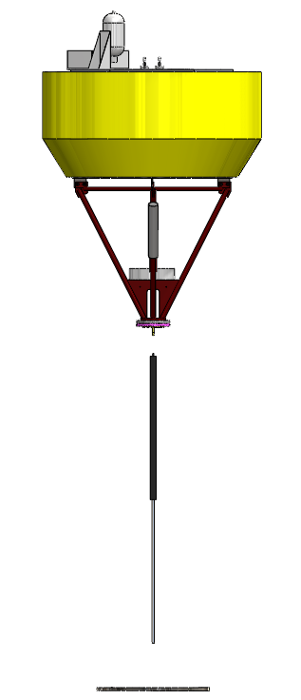
Validation Test – Experimental Set up
Two-body system with a linear spring
Buoy
Mass = 1100 kg
Radius = 1.2 m
Height = 2.7 m
-Floats on the water surface
-Wave Follower
Hydraulic Cylinder
Length = 1.5 m
Is used to simulate a spring system
Flat Circular Plate
Mass = 600 kg
Radius = 0.6 m
Is submerged to a depth of 20 m

Slide 2
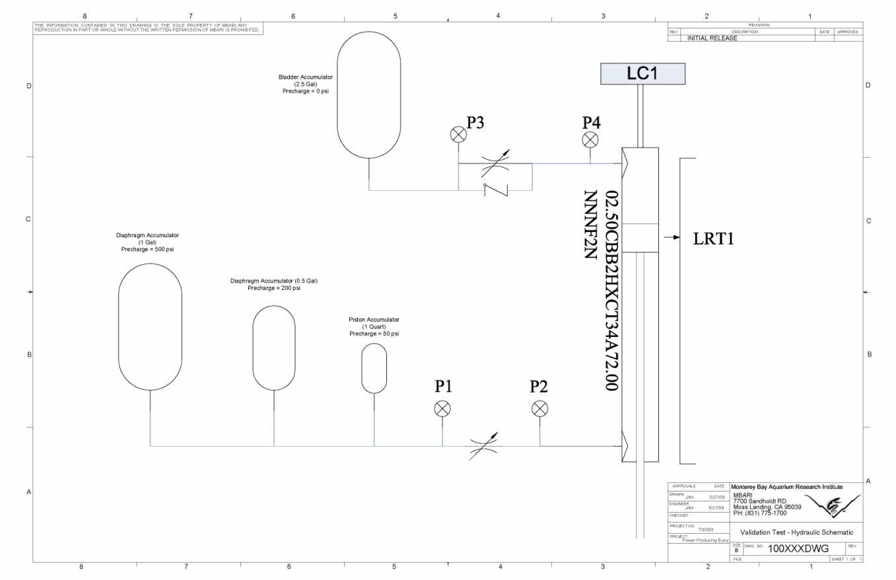
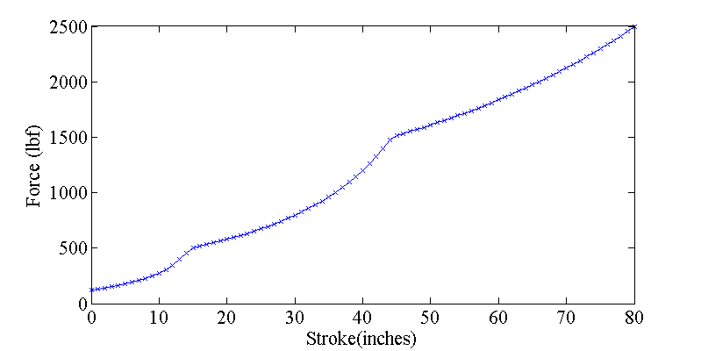
Hydraulic Spring
Hydraulic Cylinder Model
-nearly Linear Spring
-Can handle Tether tension
up to 2000 lbf (9000 N) or spring elongation < 60 inches ( 1.5 m)
-Validation tests will be conducted in a wave climate with
Hs = 1m
Tp = 5 s
(values based on P-M spectrum)

Slide 3
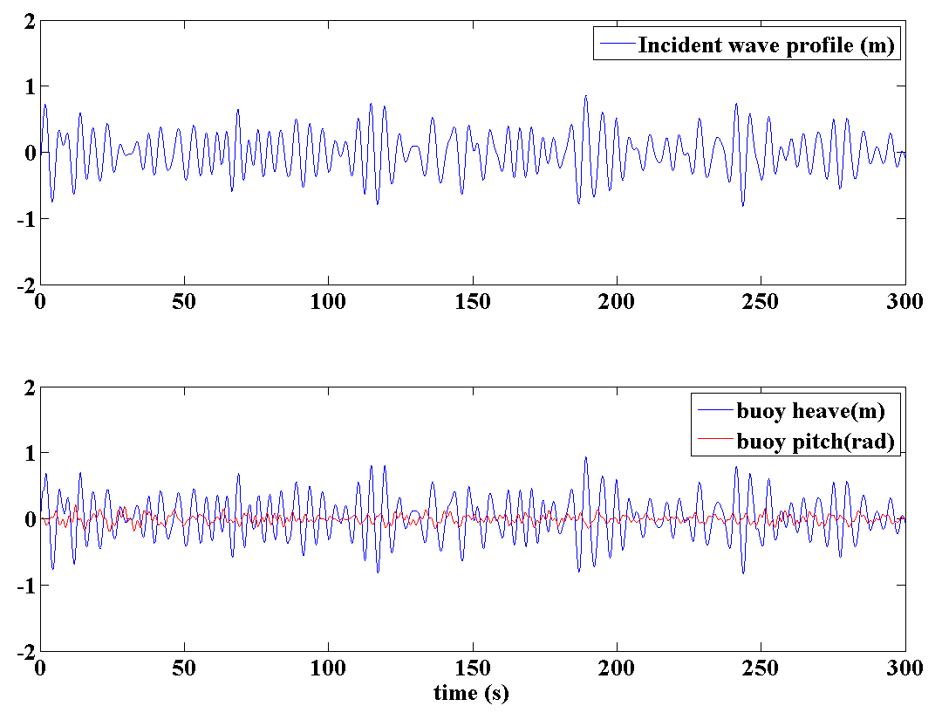
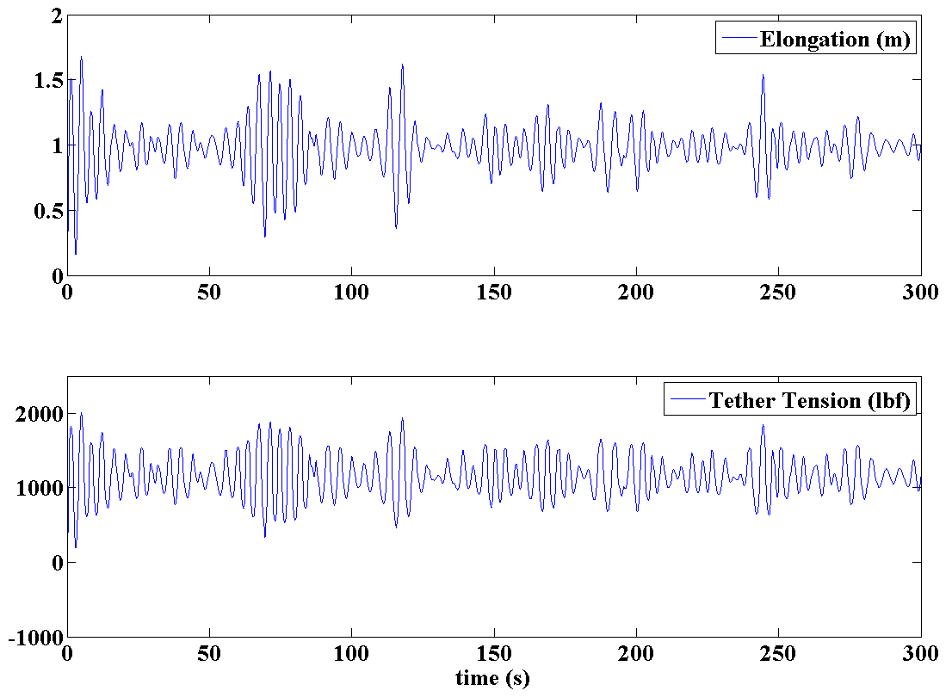
Validation Test Model Results
TIME –DOMAIN ANALYSIS
Case 1 : Circular Disc (radius = 2 feet)
Incident wave
Pierson-Moskowitz Spectrum
(Hs = 1m, Tp = 5s)
Buoy – wave follower
Pitch angles in the range of 15 degrees
Relative motion – represented in terms of spring elongation
Plate dimensions – Optimized to restrict elongation below 2 meters

Slide 4
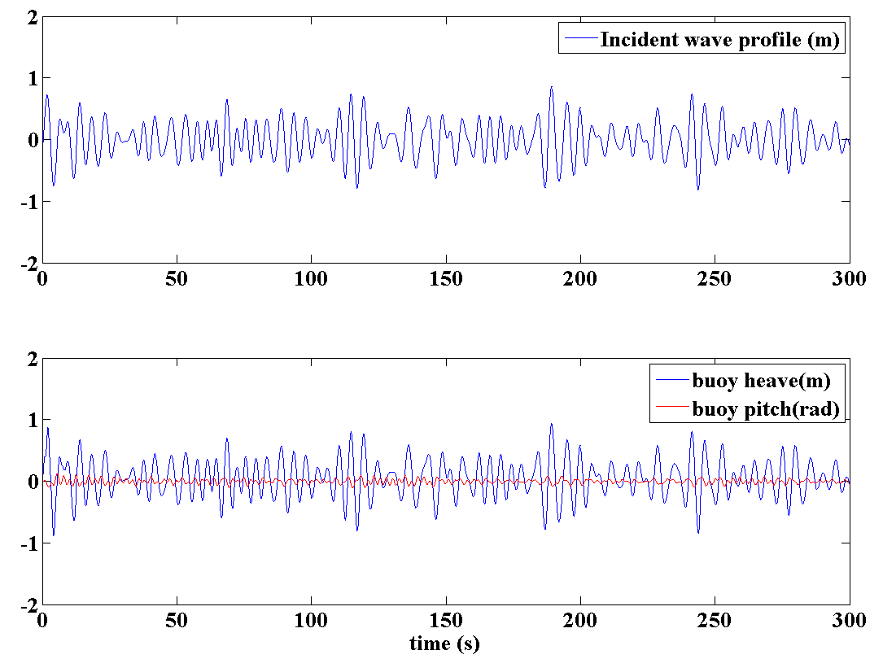
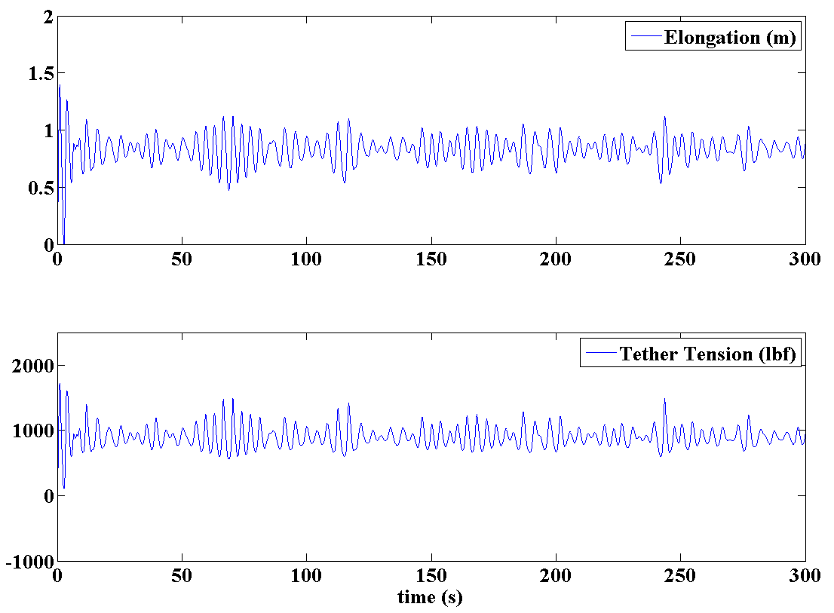
TIME –DOMAIN ANALYSIS
Case 2 : Solid Sphere (radius = 1.2 feet)
Identical wave conditions
Buoy heave motion –
remains unchanged; follows incident wave
Much reduced Pitch motions
Spring elongation is lower than the flat plate case – relatively more buoyancy
Simplified example – identical frequency domain coefficients in ‘x, y and z’ directions

