Slide 1
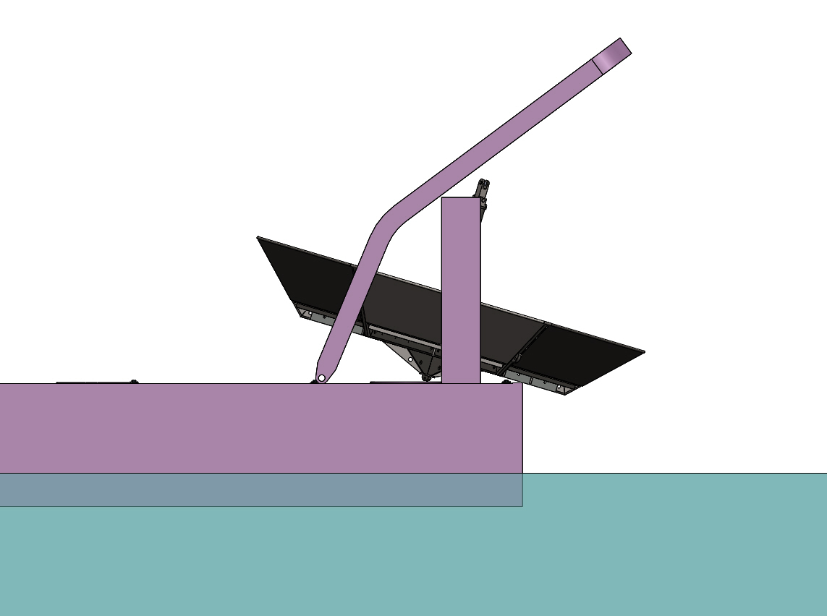
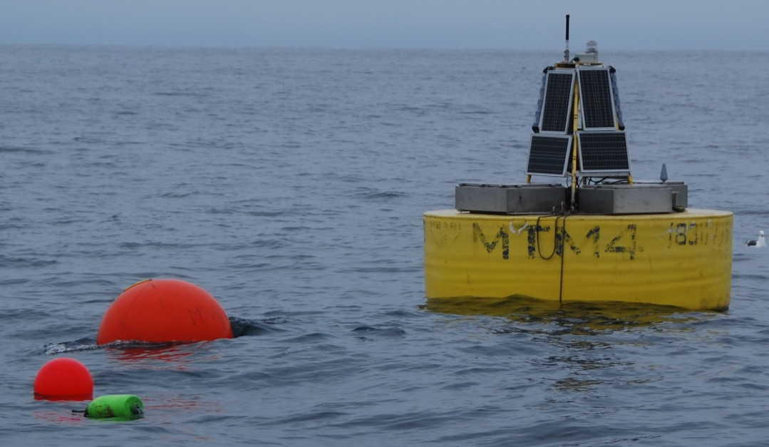
Transit:
The heave cone will be placed on the deck as shown above. Dunnage and straps will be used to keep it from moving.
The buoy will be towed through the A-frame as usual. A large float will be used to keep the PTO afloat. A small float will be attached to the end of the tether and will trail behind.
Once on site, the buoy will be released, and the tether will be reacquired and attached to the heave cone.
The PTO will be released from the large float.
The boat will move slowly with the buoy behind it and get in position for deployment.

Slide 2
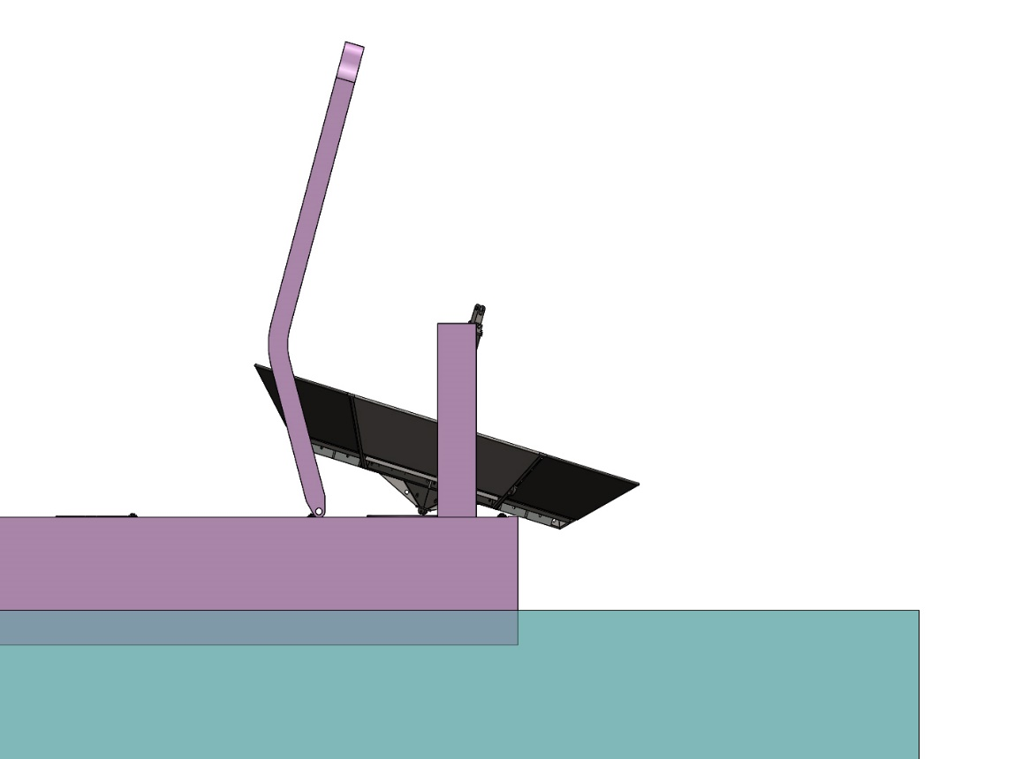
The A-frame will be moved all the way forward and the heave cone will be picked up with the slip line.

Slide 3
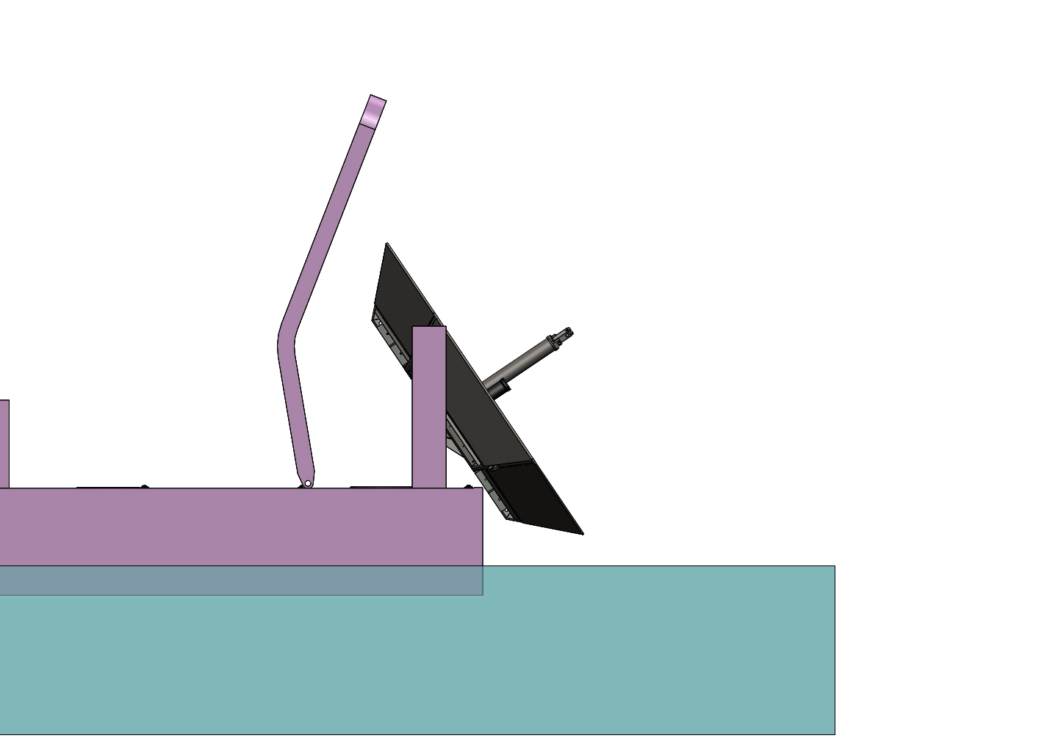
The A-frame will be moved out slowly and the heave cone will be lowered in the water.
At the same time the anchor wire will be paid out.

Slide 4
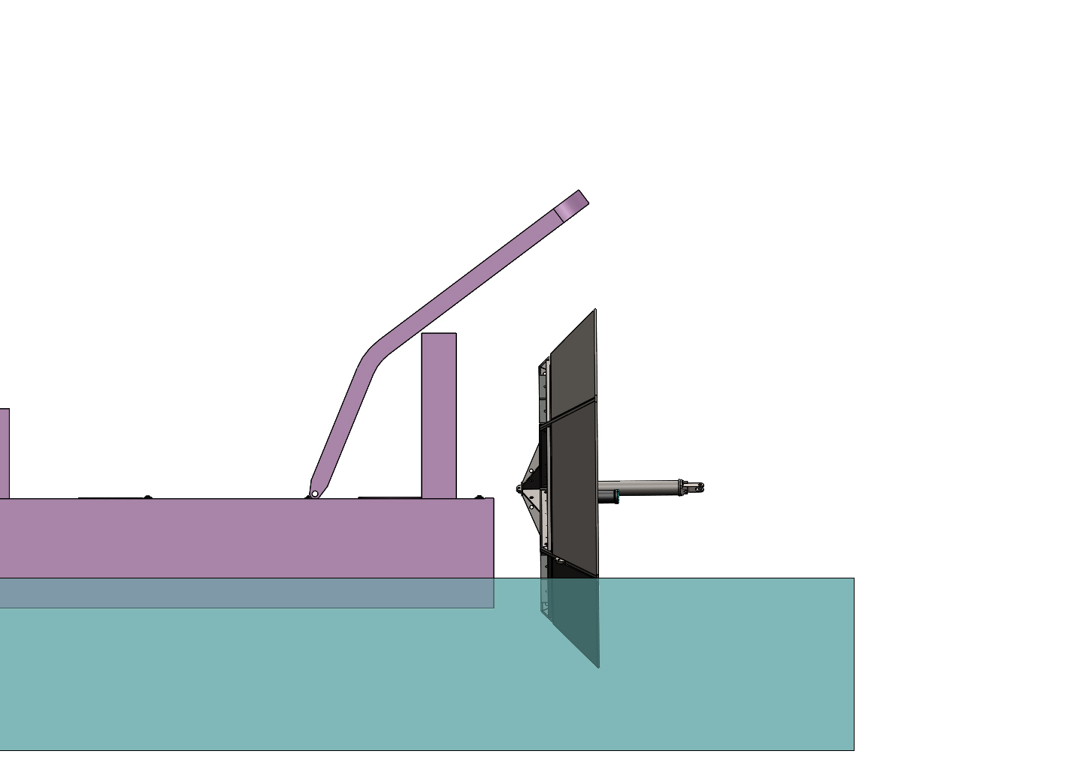
The heave cone will be lowered until it hangs on the buoy and the slip line will be recovered.
The rest of the anchor wire will be paid out. (the spool will have been placed on a horizontal support rod, see photo on next slide). When getting to the end of the wire, the chain will be attached to it. The chain and finally the anchor will be thrown in the water.

Slide 5
