Slide 1
Wave-Power and High
Capacity Buoy Designs

Slide 3
Buoy Requirements
10 m² water plane area: diameter = 3.55m (140”)
Water displacement < 5m³ (176 ft3)
Reserve buoyancy > 2 m³ (70 ft3)
Battery carrying capacity: as much as possible

Slide 4
Concept designs
Hull (steel, aluminum or fiber glass)
+ More storage volume, lighter.
- Sinkable, hazardous for boats, challenging design and fabrication, expensive.
Foam ring and housing
  + Unsinkable, safer, simpler design, cheaper, can be containerized more easily.
  - Less storage volume. Heavier

Slide 5
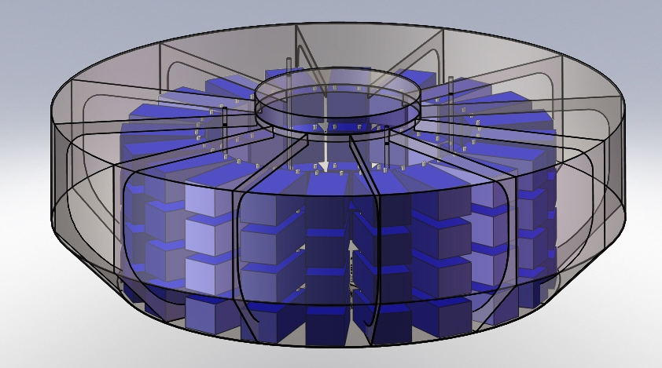
Hull Form – Max Capacity
80 Power sonic 12 V 220 AH batteries

Slide 6
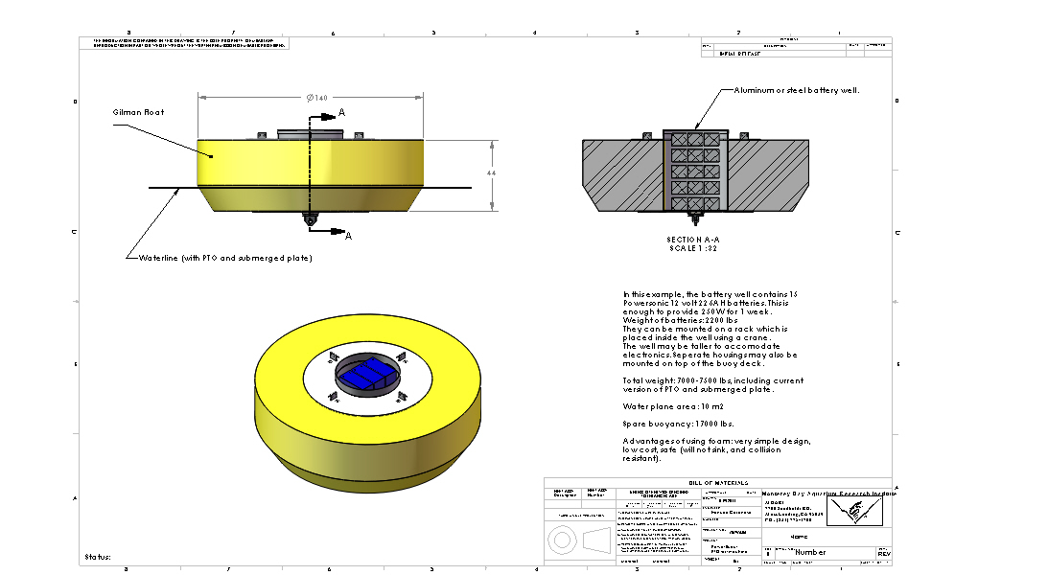

Slide 7
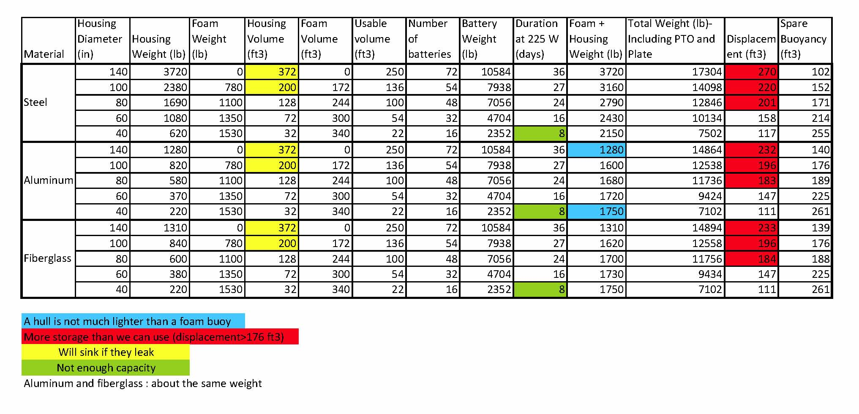

Slide 8
Lithium-Ion Batteries
3:1 increase in power to weight ratio.
Expensive!
Safety issues
We’ve spoken to the Tesla car founders and they are interested in designing a modular battery pack for this application.

