Slide 1
Strength of components in the load path of the wave energy buoy
Engineer: François Cazenave
Date: December 18 , 2019

Slide 2
Recorded loads
I used load cell data from the last two deployments to determine how much load would be applied to the components.
Mean load over entire deployment = 2700 lb
Mean peak load = 3400 lb
Max load during strong wave event: 8000 to 9000 lb
Absolute max load >10000 lb (the exact value is unknown because the load cell was saturating). This only occurred 3 times, when the piston was bottomed out. It’s reasonable to assume that the max load never exceeded 15000 lb. Considering that the tether has a breaking strength of 35000 lb, the factor of safety is 2.3.
All components must have a breaking strength of at least 35000 lb

Slide 3
Peak loads summary
Peak load range (PSI) | Number of Peaks | Extended to one year | Number of peaks in or above range (1 year) | Percent of peaks in or above range | Percent of peaks in on below range
>3000 | 263000 | 1411190 | 8171273 | 99.98 | 0.02
3000-4000 | 819000 | 4394542 | 6760083 | 82.72 | 17.28
4000-5000 | 335000 | 1797523 | 2365541 | 28.95 | 71.05
5000-6000 | 90510 | 485653 | 568018 | 6.95 | 93.05
6000-7000 | 13230 | 70989 | 82364 | 1.01 | 98.99
7000-8000 | 2036 | 10925 | 11376 | 0.14 | 99.86
8000-9000 | 78 | 419 | 451 | 0.01 | 99.99
9000-10000 | 1 | 5 | 32 | 0.00 | 100.00
10000-15000 | 5 | 27 | 27 | 0.00 | 100.00
Total | 1522860 | 8171273
Data set length is 68 days and was recorded during winter. Peak loads during the rest of the year are likely to be much lower.

Slide 4
Histogram of load peaks

Slide 5
Fatigue
There is large difference between the max expected peak load (15000 lb) and loads that occur regularly enough to cause fatigue. 99.9% of load cycles do not exceed 8000 lb.
So, it’s safe to assume that if the stresses in the components do not exceed the fatigue limit when the load is 8000 lb, fatigue is very unlikely to occur.
If components have a breaking strength of 35000 lb of more, the stress in the components at 8000 lb is well below the fatigue limit.
Steels have fatigue limits around 50% of their tensile strength (shighley).
Fatigue limit of 17-4 PH ss: 90000 PSI for 10E6 cycle.
Fatigue limit of 316 ss: 21000 PSI (different sources show a wide range of values. This is the lowest found)

Slide 6
Mooring system
Wind load on buoy:
F= 0.5 * ρ * u² *Cd * A = 686 N = 154 lb
Ρ = 1.22 kg/m³ u = 25 m/s Cd= 1 A=1.8 m²
Water drag: unknown, assumed to be lower than wind drag
Components | Expected max load | Breaking strength | Notes
400 lb DORMOR anchor | 1000 lb | Dor-Mor has holding strength of 3600 lb with 3:1 scope
5/8" shackle | 1000 lb | 32500 lb (4000 lb SWL)
1/2" long link chain (20 meters) | 1000 lb | 40000 lb
5/8" shackle | 1000 lb | 32500 lb (4000 lb SWL)
Basic swivel | 1000 lb
5/8" shackle | 1000 lb | 32500 lb (6500 lb SWL)
5/16" nilspin wire with Crosby sage sockets, 125m | 1000 lb | 9900 lb
3/4" shackle | 1000 lb | 32500 lb (6500 lb SWL)
Swivel | 1000 lb
3/4" shackle | 1000 lb | 32500 lb (6500 lb SWL)
1/2" long link chain (2 meters) | 1000 lb | 40000 lb
3/4" shackle | 1000 lb | 32500 lb (6500 lb SWL)
Heave cone bottom eye | 1000 lb | 15000 lb

Slide 7
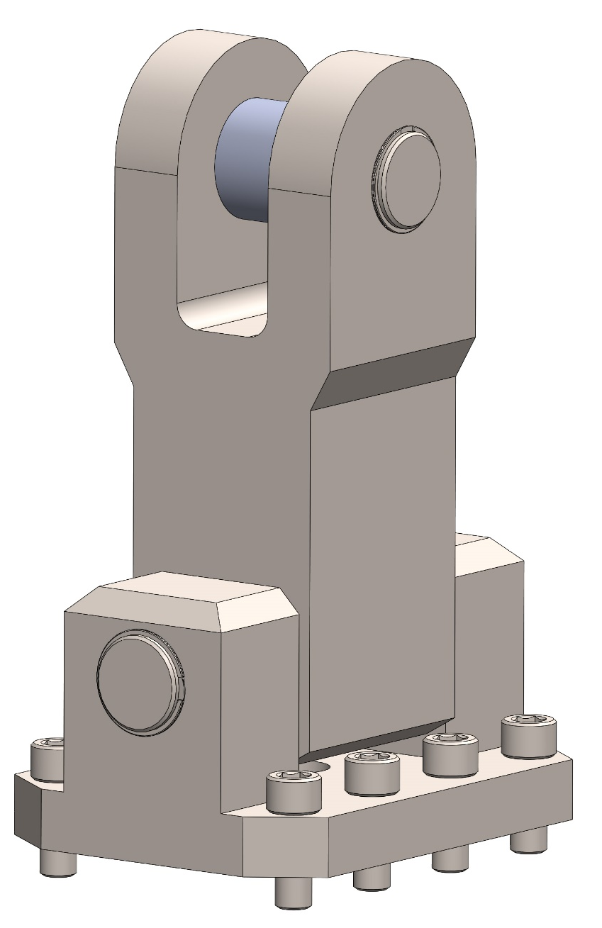
Tether link pins:
Pins: 1” diameter, stainless steel.
Cross section area = = r²x pi x 2 = 1.57 in²
Yield in shear = 47100 lb. Failure = 109000 lb
Factor of safety = 109000/15000 = 7.3
Screws:
Size: 3/8-16
Material: BUMAX 88. Strength data from manuf. website.
Total preapplied load = 4743 x 8 = 37944 lb
Total breaking strength = 74640 lb
Factor of safety = 74640 / 15000 = 5
Even is load is unevenly distributed, fatigue will not occur.

Slide 8
Bearings
Maximum static load of GAR-MAX: 30000 PSI.
Ultimate compressive strength of GAR-MAX: 60000 PSI.
The upper bearing is 2 times shorter that the lower one, therefore it is that much weaker in compression.
Upper bearing area = bearing ID x length = 1” x 1.25” = 1.25 in²
Upper bearing compressive strength =
1.25 x 37500 = 375000 lb
Factor of safety = 37500 / 15000 = 2.5
FOS is relatively low but failure of bearing would not cause immediate failure of connection. Divers can inspect this part and detect significant wear.

Slide 9
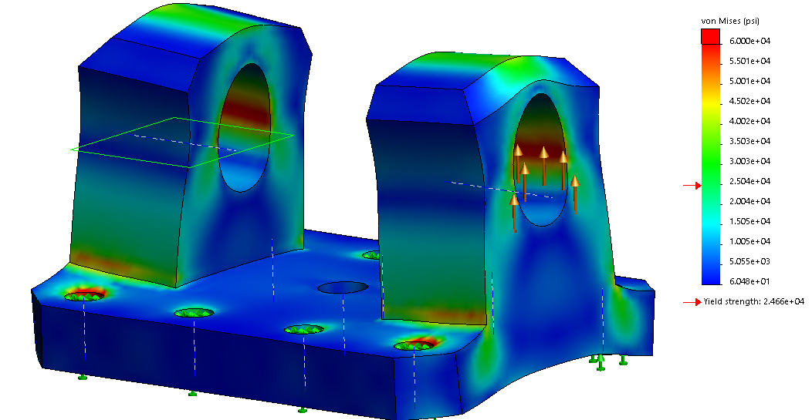
Base
Yield load: 20000 lb
Failure load: 56000 lb
FOS = 56000 / 15000 = 3.73
Cross Section area of ‘bridge’: 2 x 0.46 in2.

Slide 10
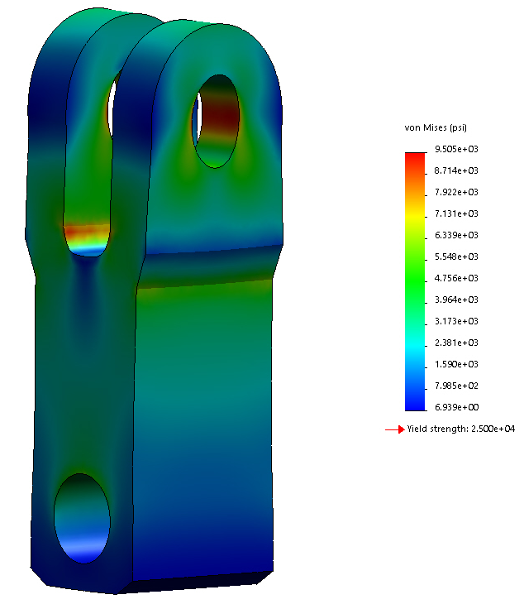
Body
This part has been modified, due to the risk of failure of the upper holes.
Yield load of lower hole = 18300 lb
Failure load of lower hole = 42700 lb
Yield load of upper holes = 47000lb
Failure load of upper holes = 109600 lb
Factor of safety = 42700/15000 = 2.85
Cross Section area of lower ‘bridge’: 0.93 in2.
Cross Section area of upper ‘bridge’: 2 x 0.64 in2.

Slide 11
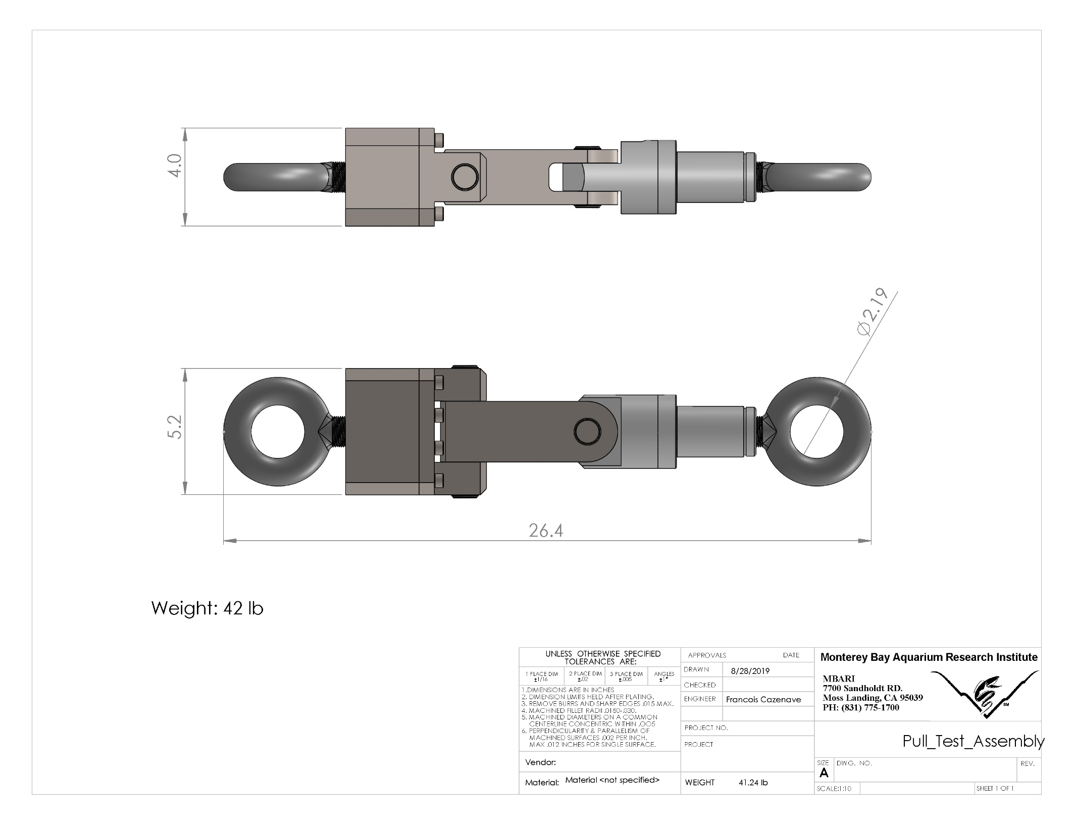
Pull testing is a possibility.
Cost at Carpenter rigging: $550

Slide 12
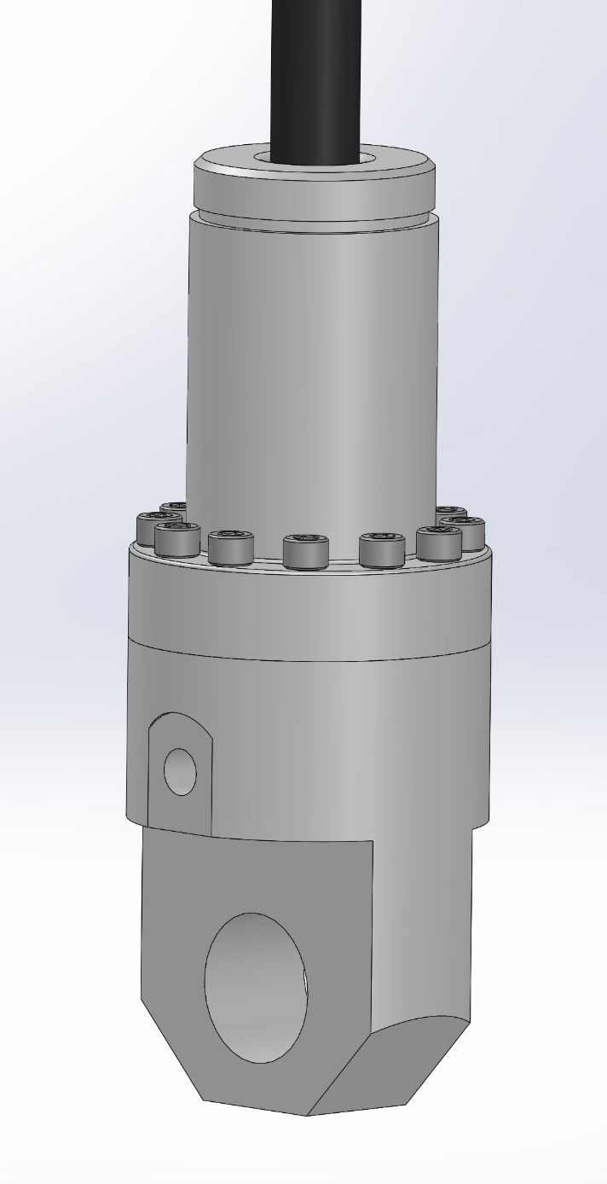
Bottom Tether termination
Screws:
12 x ¼“-20 Bumax screw. Total breaking strength = 3820 lb x 12 = 45840 lb
FOS = 45840 /15000 = 3
Lower hole:
Over 50000 lb breaking strength (17-4PH stainless steel)
Cable socket termination:
100 % cable strength

Slide 13
Tether
9/16” 3x19 wire rope: 32500 lb breaking strength
5/8” flex 6 wire: 45400 lb breaking strength

Slide 14
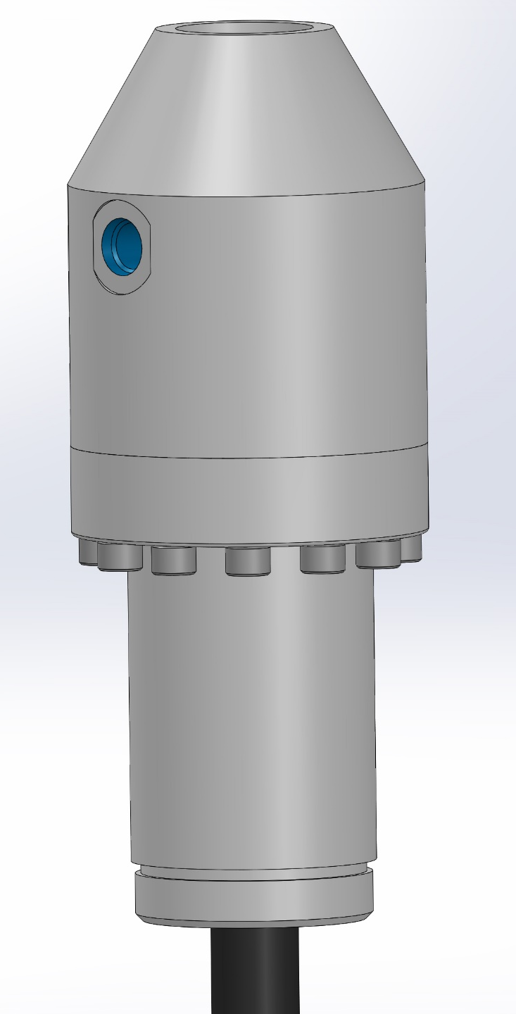
Top Tether termination
Cable socket termination:
100% cable strength
Screws:
12 x ¼“-20 Bumax screw. Total breaking strength = 3820 lb x 12 = 45840 lb
FOS = 45840 /15000 = 3
Threaded connection to rod:
>50000 lb

Slide 15
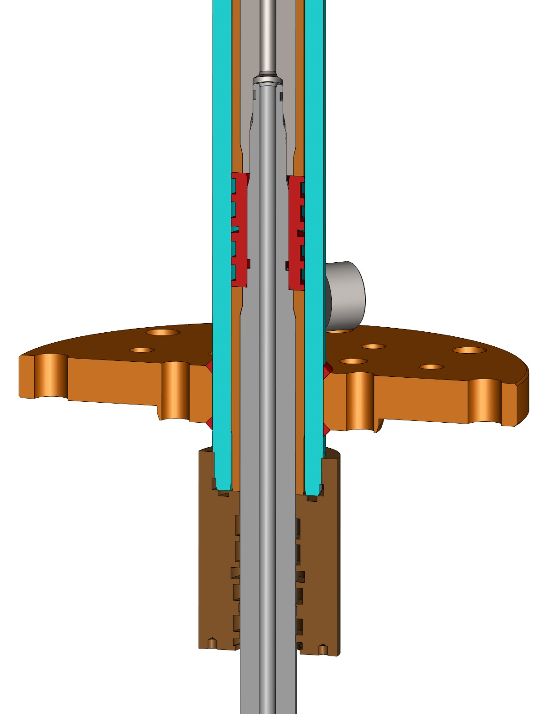
Lower hydraulic rod:
88400 lb breaking strength
Threaded connection between rods:
>50000 lb

Slide 16
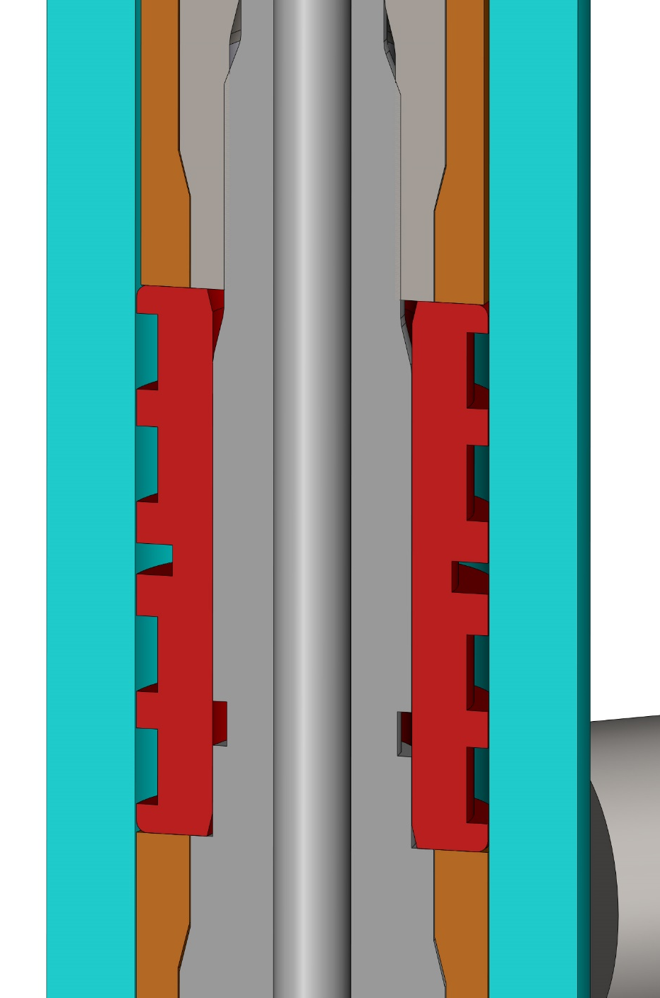
Contact area between upper rod and top of piston (in compression) :
Area = 0.377 in2
Compressive strength of piston material = 65000 psi
0.377 x 65000 = 24500 lb compressive strength
By comparison: clamping load of 1-12 grade 5 bolt = 52000 lb.
Area may yield a bit during assembly.
Piston and stop tube:
>50000 lb

Slide 17
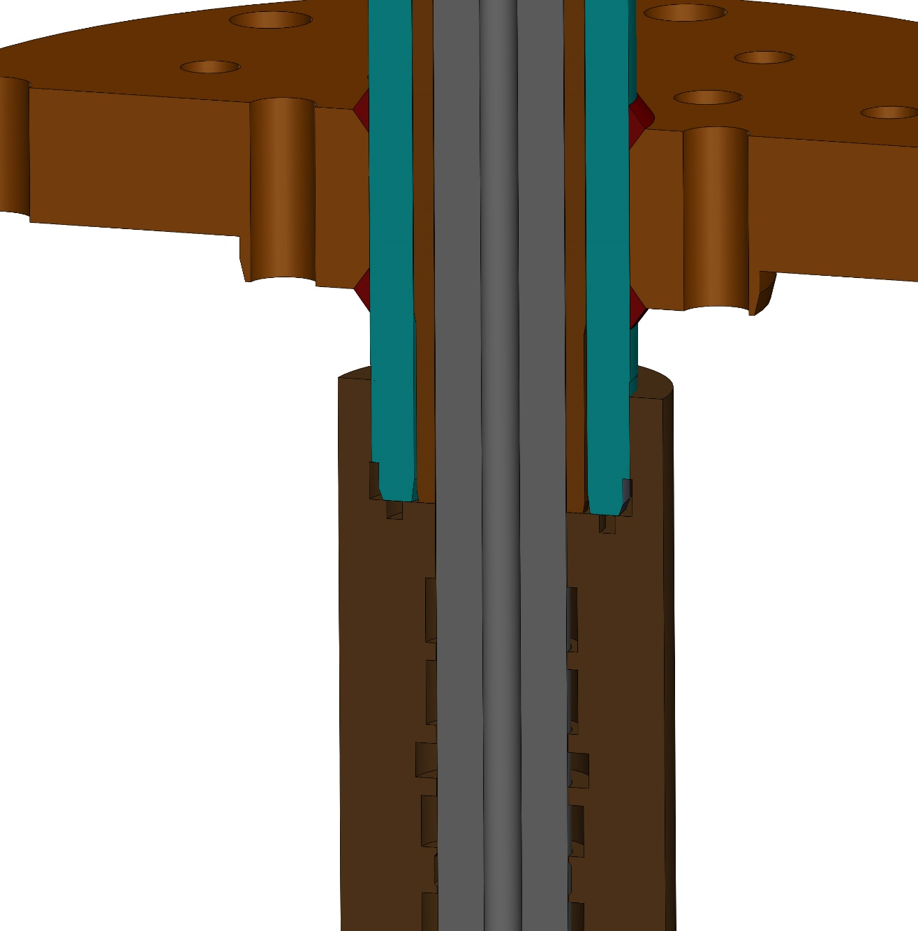
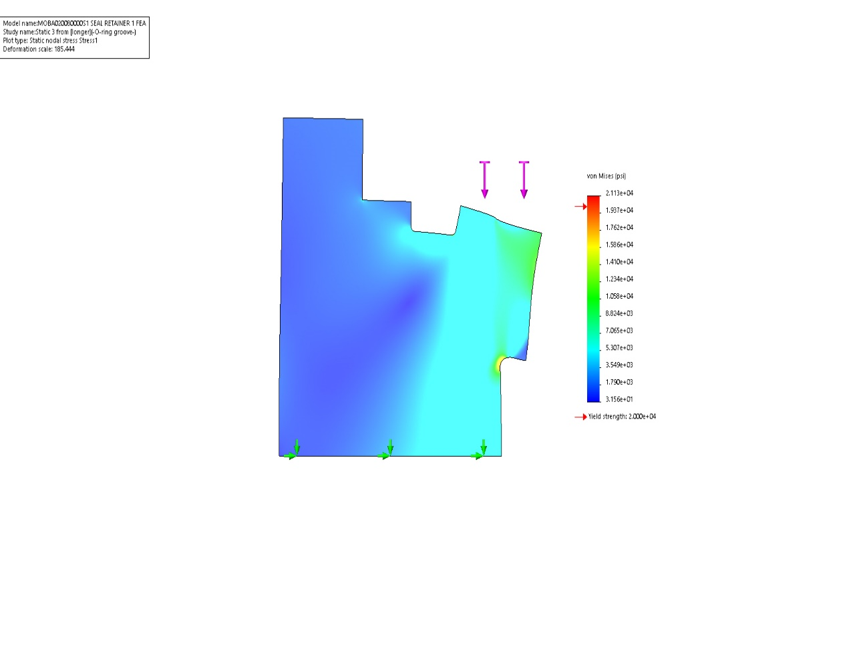
Contact area between stop tube and seal retainer:
Groove is now 3/16” instead of ¼”.
FEA shows yield starting around 13000 lb. Serious damage occurs at about 25000 lb.

Slide 18
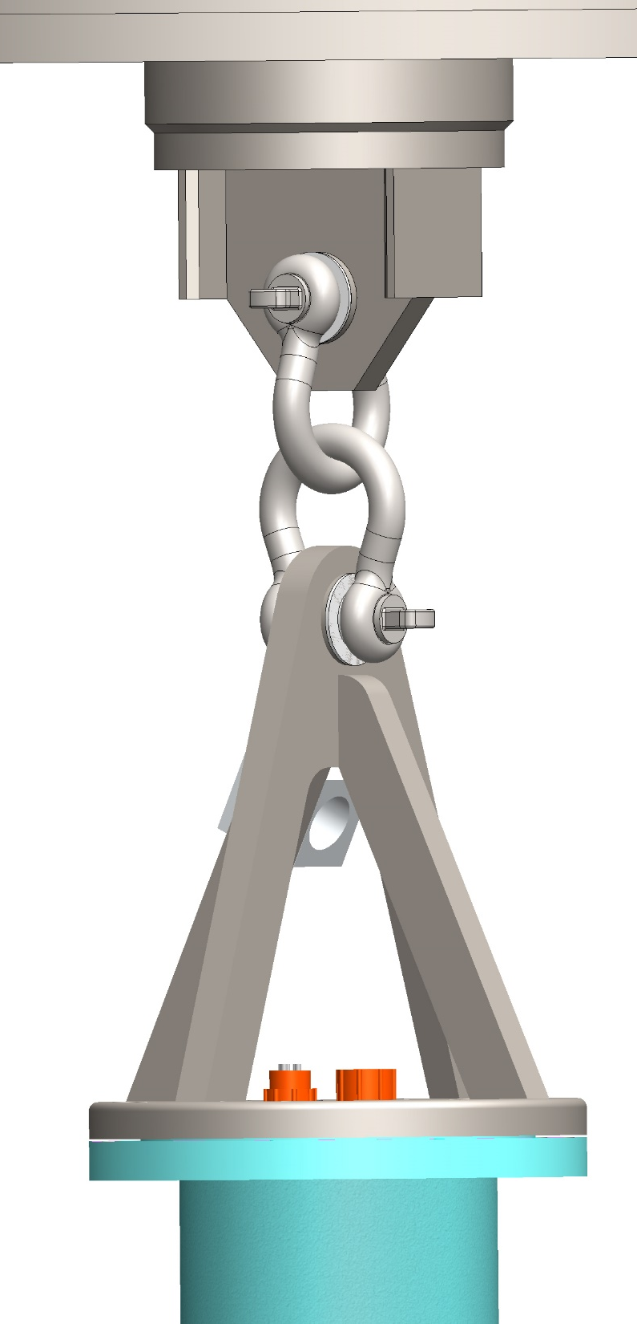
PTO body:
>50000 lb
Bronze bearings:
>50000 lb compressive strength, but they do wear.
1” stainless steel shackles:
>50000 lb (10000 SWL)
Buoy bottom pad eye
>50000 lb
4 x 3/4"-10 316SS bolts for pad eye
>50000 lb

Slide 19
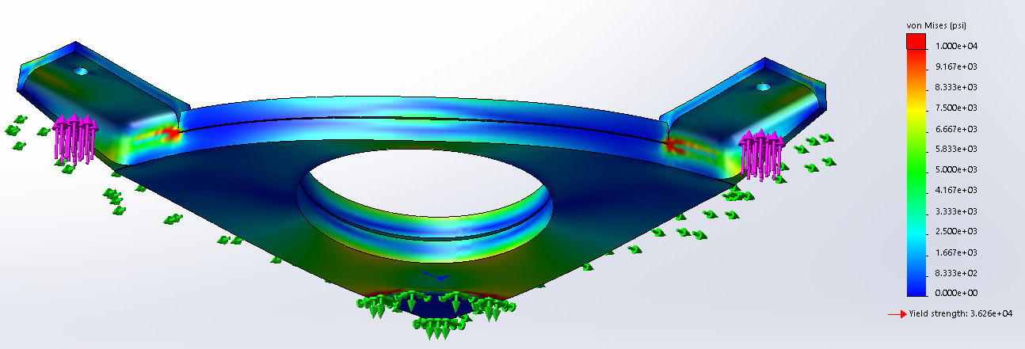
Buoy bottom plate:
>50000 lb
Buoy rods
>50000 lb
Buoy top plate
>50000 lb

Slide 20
Conclusion
15000 lb is the max expected load. All component must have a
strength equal or greater than the tether (35000 lb breaking strength).
Most components are far stronger than the tether.
The heave cone’s tether link has been modified and has a higher FOS.
The lower seal retainer’s contact area with stop tube is likely to yield at 13000 lb but complete failure would occur at much greater load. The new retainer is stronger than the old one, which yielded but did not cause any problems.
Fatigue failure is unlikely to occur because stress in the components is lower than the fatigue limit most or all of the time.
A spreadsheet saved in this folder contains a list of all the components, their breaking strength and factor of safety.

Slide 21
Appendix:
Notes on tether link bearing:
I inspected the bearings that were used on the tether link during the 2018 and 2019 deployments of the heave cone. The upper bearing have measurable wear. At the ‘top’ of the bearing (where the load was highest), the wear was approximately 0.005”.
Considering that the bearing is 0.125” thick, that’s about 4%. At this rate (0.0025” per month), it would take many months to wear through the entire bearing. The new longer bearing will wear even more slowly.
There was no measureable wear on the stainless steel pins.

