Slide 1
Powerbuoy tether selection
Date 8/29/2024
MBARI

Slide 2
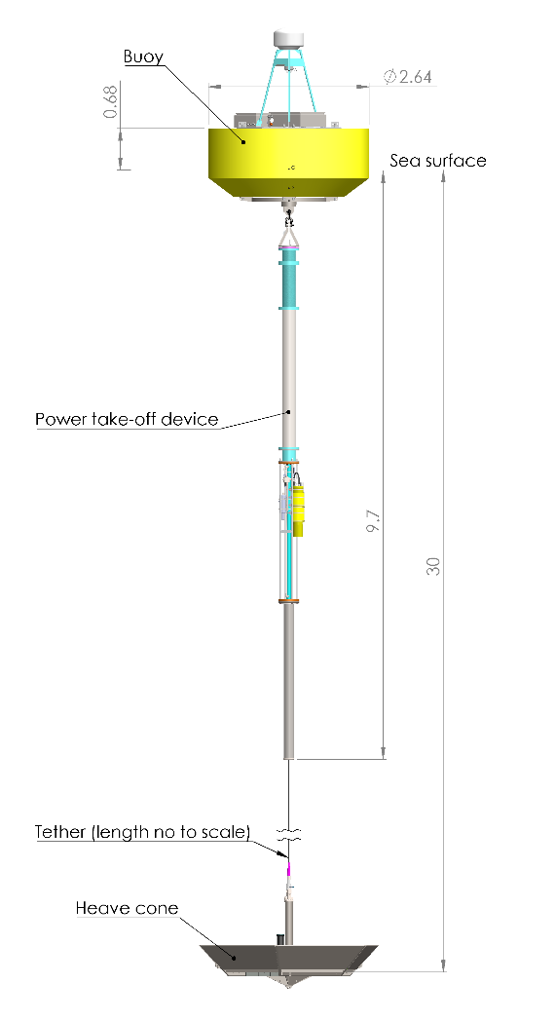
Tether length: 20 m
Mean load: 2000 b
Typical load range: 0 to 7000 lb
Max load: 10000 lb
Wave period: 8 s
Number of cycles: 4 x 10⁶ (one year of operation)
Bend radius at tether guide: 60”

Slide 3
Old tether no longer available

Slide 4
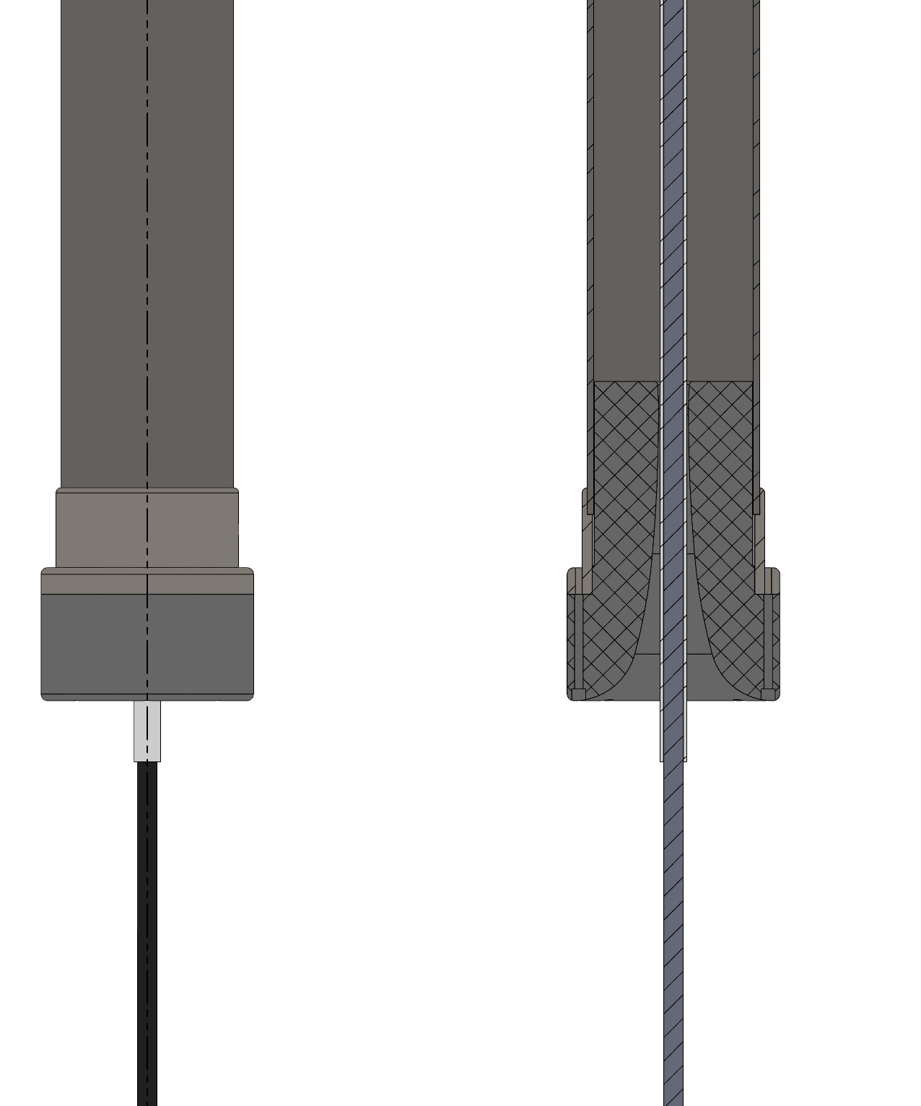
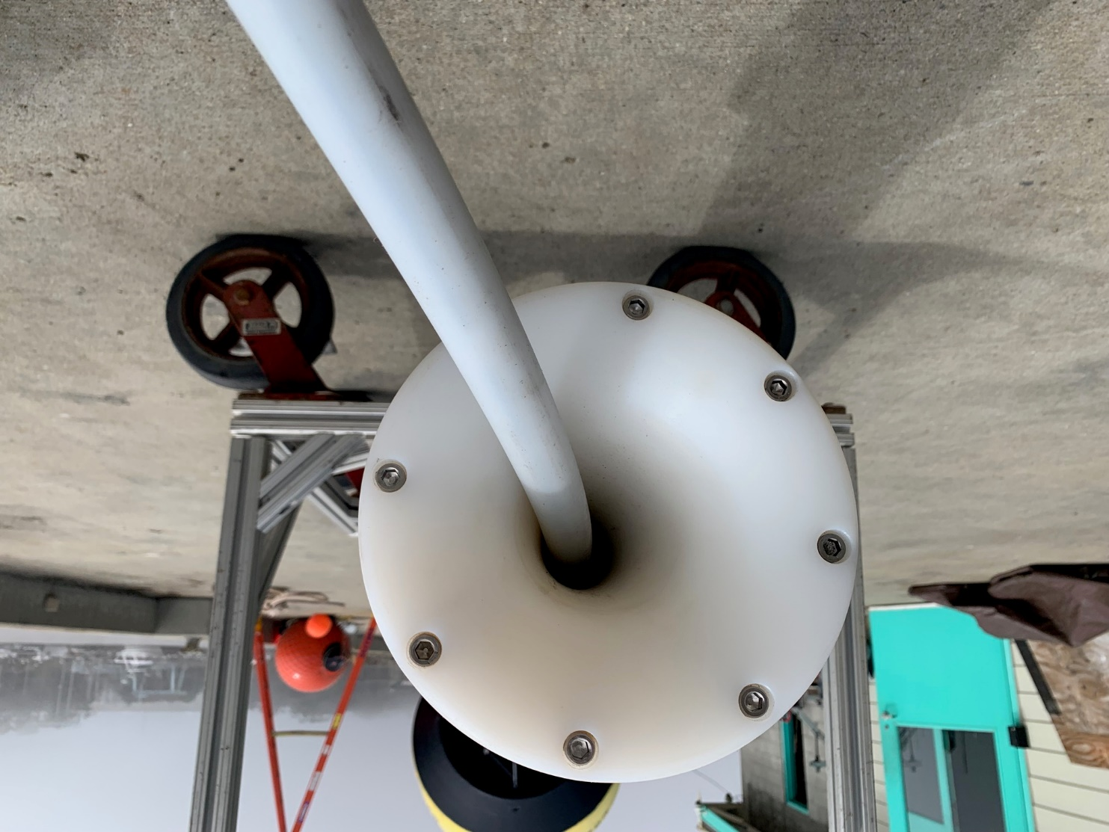
HDPE sleeve reduces friction and protects cable
Also dictates OD of tether (0.74”)

Slide 5
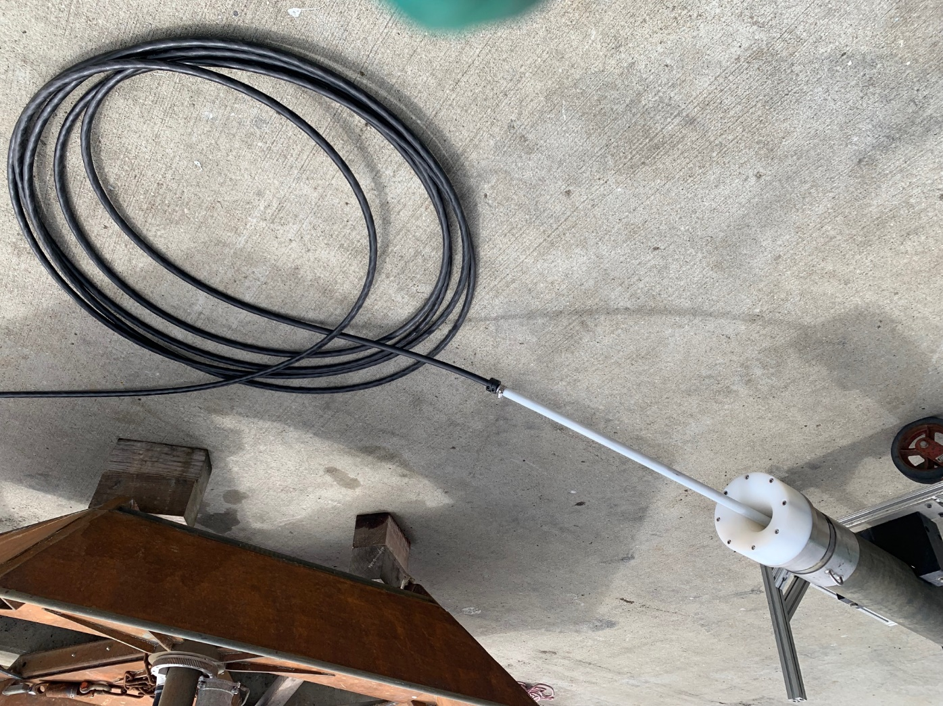

Slide 6
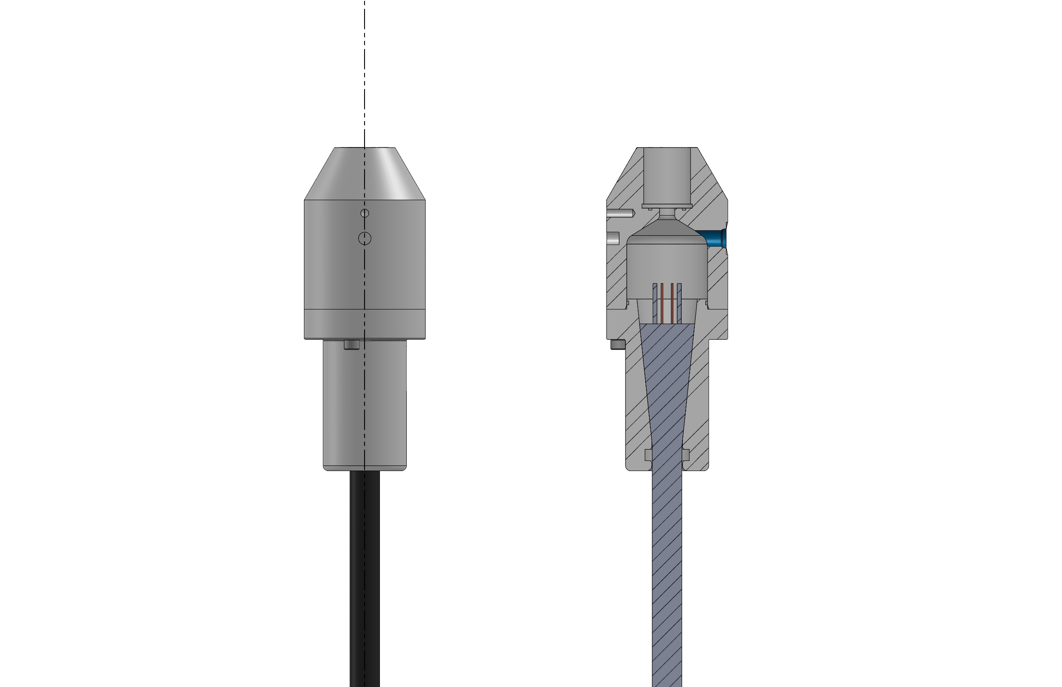
Current tether termination

