Slide 1
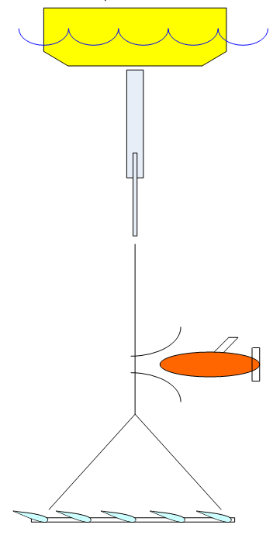
AUV Docking on the Power Buoy

Slide 2
Steps for Docking
Find the dock
  In our case, the current position of the buoy is sent to the AUV over satellite comms
2) Home to the dock
  Probably need the dock to specify approach heading
    Need comms between dock and AUV: acoustic or RF (?)
3) Align the AUV to the dock
4) Secure/latch the AUV
5) Transfer power and Communications
6) Perform diagnostics before releasing AUV
7) Release the AUV

Slide 3
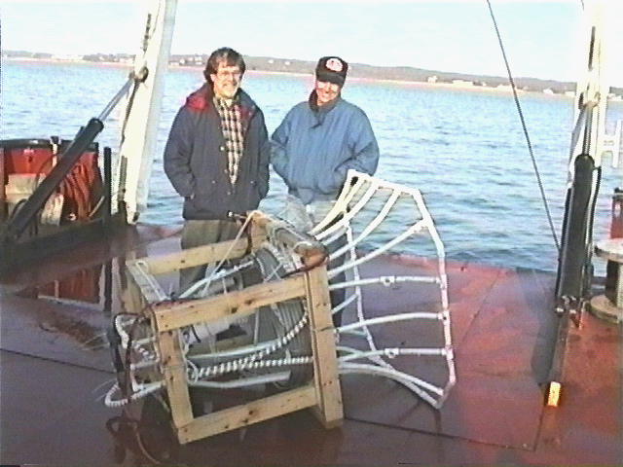
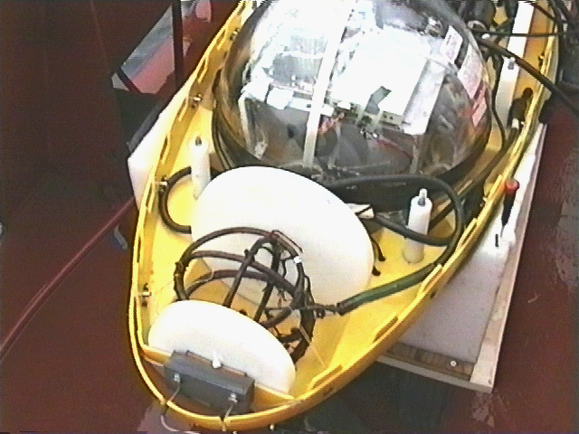
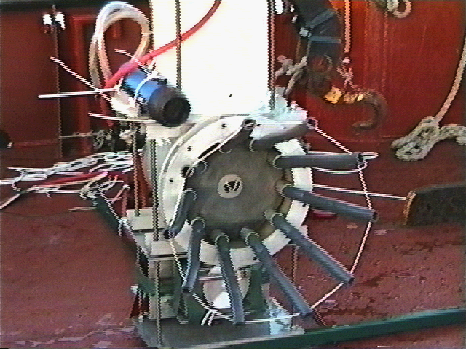
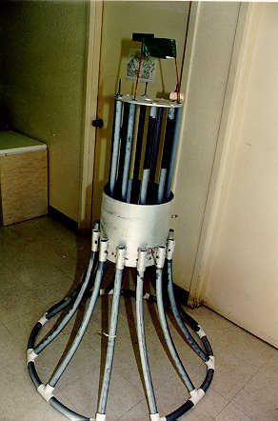
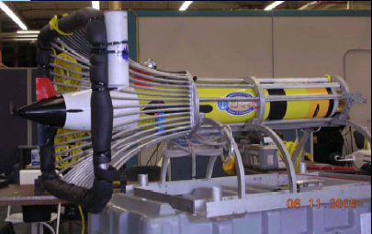
Previous Designs: Fixed Cone/Funnel Docks
WHOI/EDC/EM Homing
KRISO/KORDI
NRaD/Flying Plug/Odyssey Optical Homing
REMUS

Slide 4
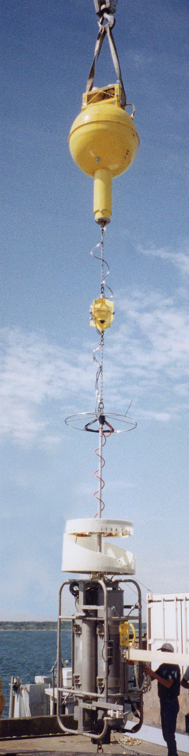
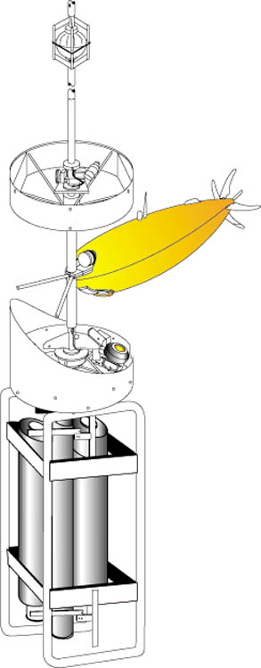
Previous Dock Designs: Pole Dock
Advantages:
Vehicle can approach from any direction (lands into the “wind”).
Large allowable variation in depth control.
Disadvantages:
Vehicle must carry or deploy an arm to grab the pole with.
Difficult to make power/data connection since vehicle is not rigidly attached.
WHOI/AOSN Dock

Slide 5
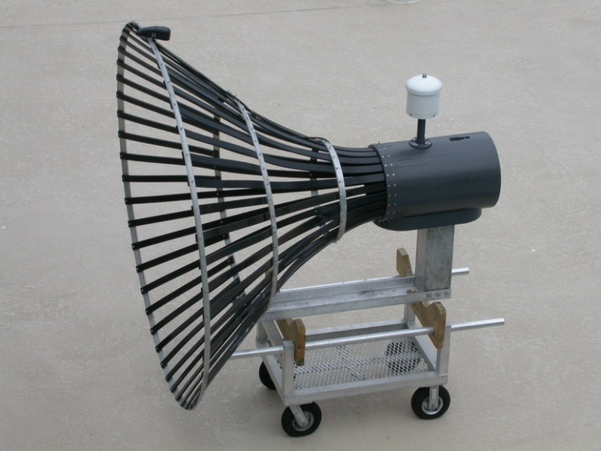
Previous Design: Benthic Weathervane Cone
Advantages:
Vehicle approaches upwind.
Vehicle can be captured and parked securely.
Power and data connection easier.
Disadvantages:
Vehicle must fly a precision near-bottom approach.
Dock is complex.
  Dock must transmit its heading to the vehicle.
  Power and data must pass through an underwater slip-ring type of connection.
Florida Atlantic University

Slide 6
Previous Designs: Benthic Fixed Cone
Advantages:
Vehicle can be captured and parked securely.
Power and data connection easier.
Dock can be simple.
  No moving parts.
Disadvantages:
Vehicle must fly a precision near-bottom approach.
Vehicle may have to approach in a “cross wind.”
  Control loop must crab the vehicle.
REMUS
KRISO/KORDI

Slide 7
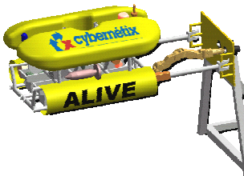
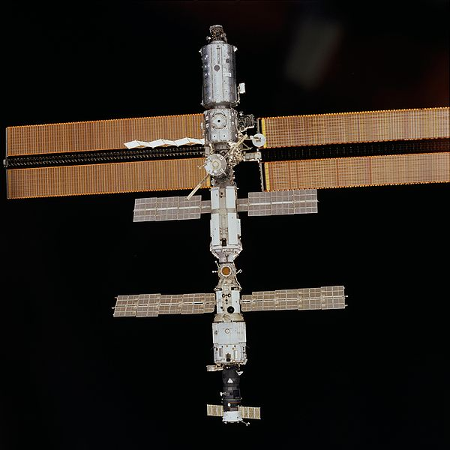
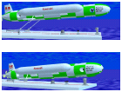
Many Other Designs
Hovering Dock
Tail-hook
Net (one-time capture)
ALIVE Dock
Kawasaki Docking System

Slide 8
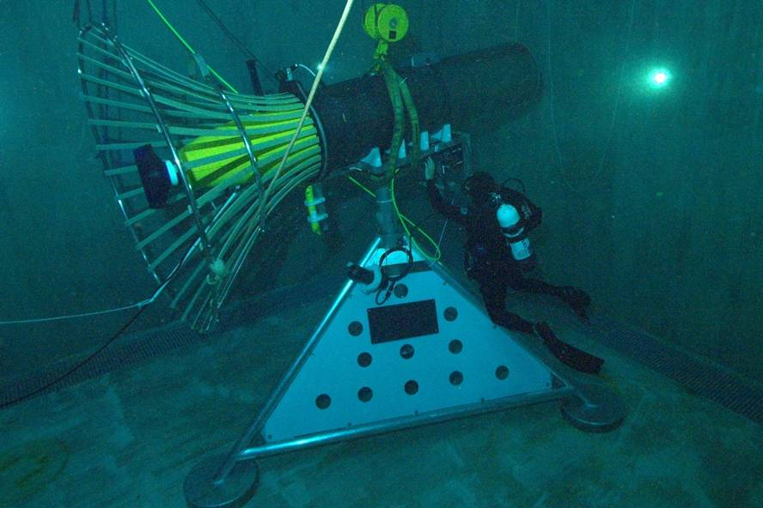
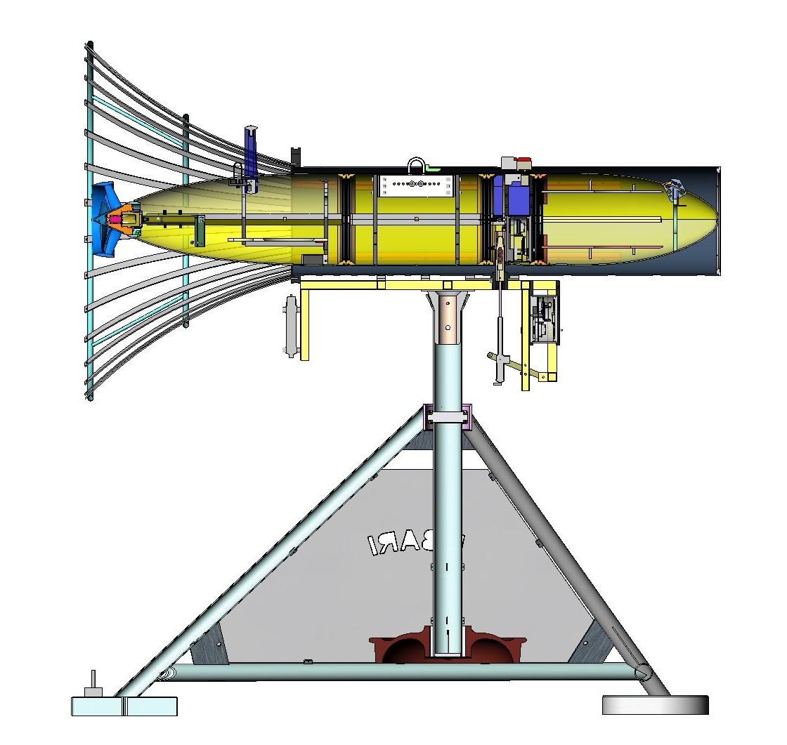
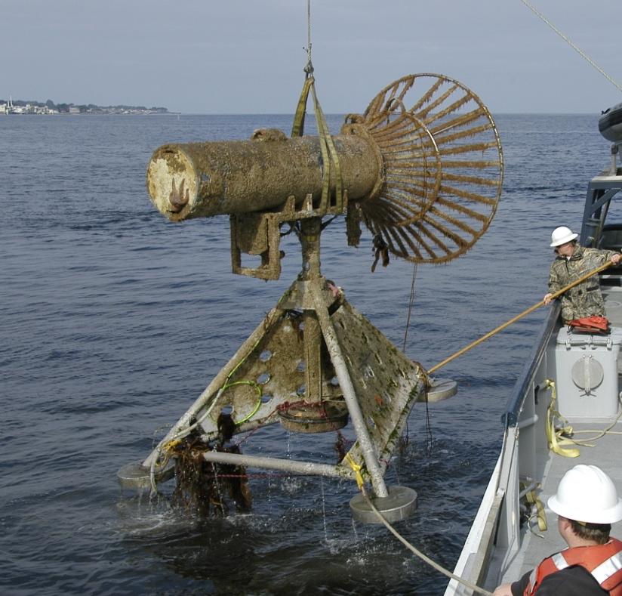
MBARI’s AUV Docking Station

Slide 9
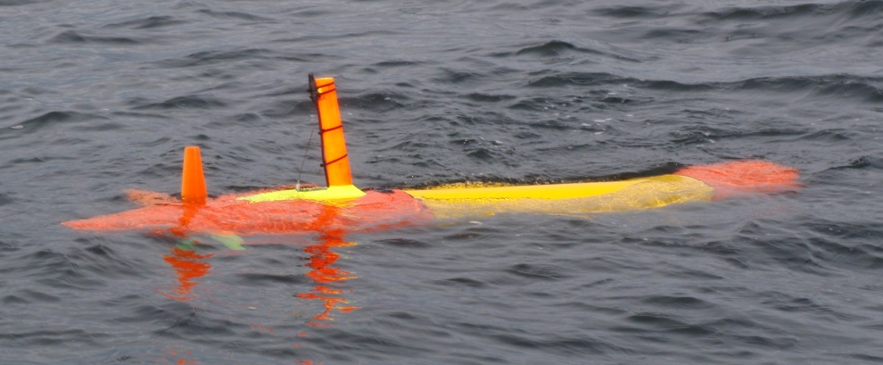
Issues
Which AUV to use?
  21” Dorado
    Old hardware exists, though needs updating and significant work to re-assemble and test
    21” vehicles can go deep
      Compatible with DARPA DSOP program
  Tethys
    Easy access for testing
    Active development program
    Resources committed to integrate a iUSBL (homing sensor)
    Originally told DARPA this is the platform
    Long endurance is consistent with PB capabilities

Slide 10
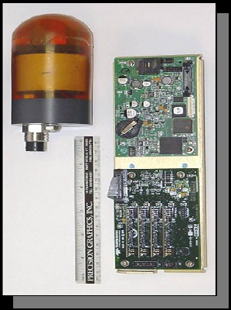
Where is the Dock Mounted ?
On Buoy?
On PTO?
On Cable?
Above submerged plate?
Below Submerged plate?
What Homing Sensor?
Optical homing with laser
Elecro-magnetic
Acoustic
  Hydroid, Sonardyne, Linkquest, Benthos
Benthos DAT
  Integrated with data modem
    needed to communicate dock heading
  size compatible with Tethys
  2 degree accuracy, > 1 km range

Slide 11
Issues
Does vehicle aim for dock, or estimate docks position at time of impact?
We need a better dynamic model of AUV
  Stability derivatives
    Airflow Sciences can derive these
What are the first field tests?
  Camera above submerged plate filming virtual dock
    Add a hoop or hoops to fly through
When are these first tests?
  Shoot for May/June
Do we worry about alignment/capture, power and data transfer?
  Should have a design, but may not be able to afford sea-test
Bio-fouling
  copper or some other poison in dock
How does the dock affect the PB system?
Reliability of AUV and dock

