Slide 1

2015 PowerBuoy Effort
Sub-Sea Power and Communication Link
250 Watt mean power capture
Reliability increasing with each deployment
Power transmission to submerged element needed to enable AUV docking
Station-keeping still desirable
Notes:
The MBARI Wave-Energy conversion buoy continues to be refined and is becoming more reliable with each deployment.
The power captured depends on sea-state as can be seen in the plot of hourly averages. Long term averages are about 250W, depending on season.
For 2015 there are three efforts underway
Refine the power electronics to increase the amount of electricity that is stored after capture
Make a power/data connection between the surface buoy and sub-surface plate (conductors must pass through the power-take off device). This is necessary to enable AUV docking activities.
Explore station-keeping options.

Slide 2
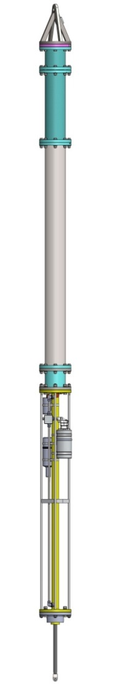
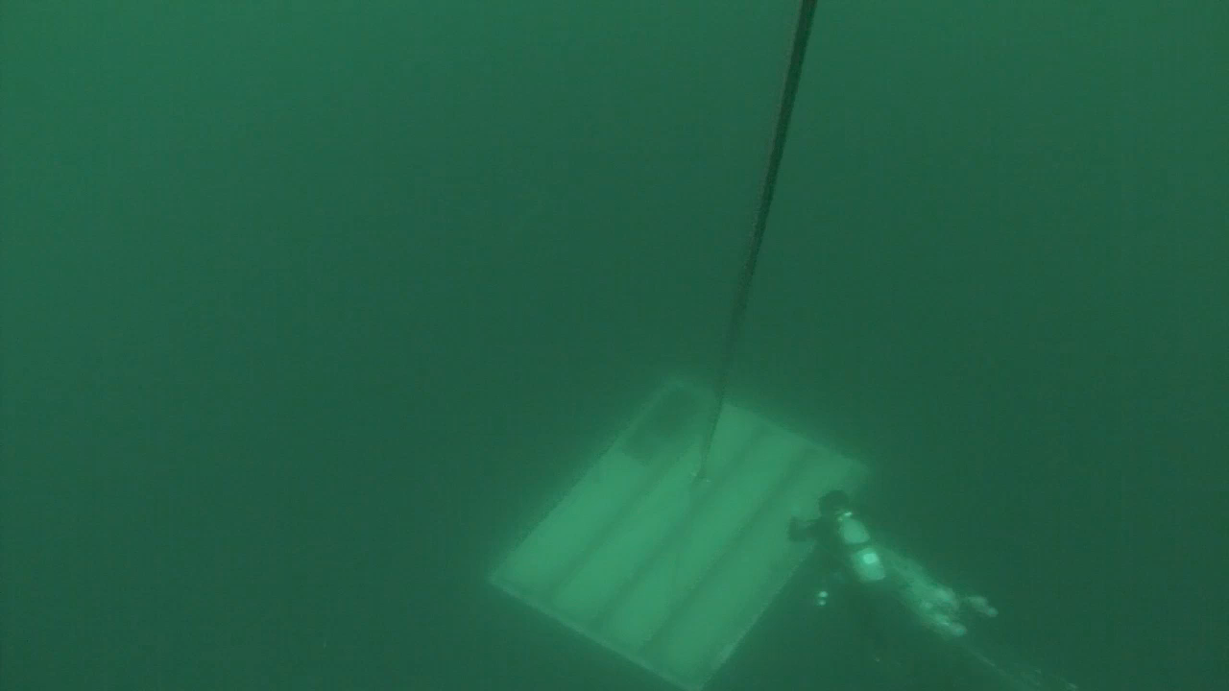
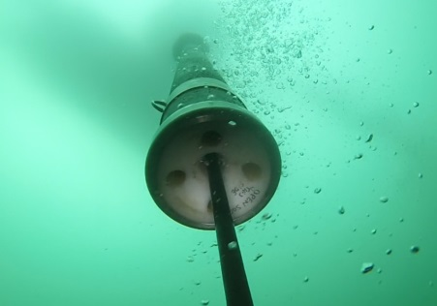
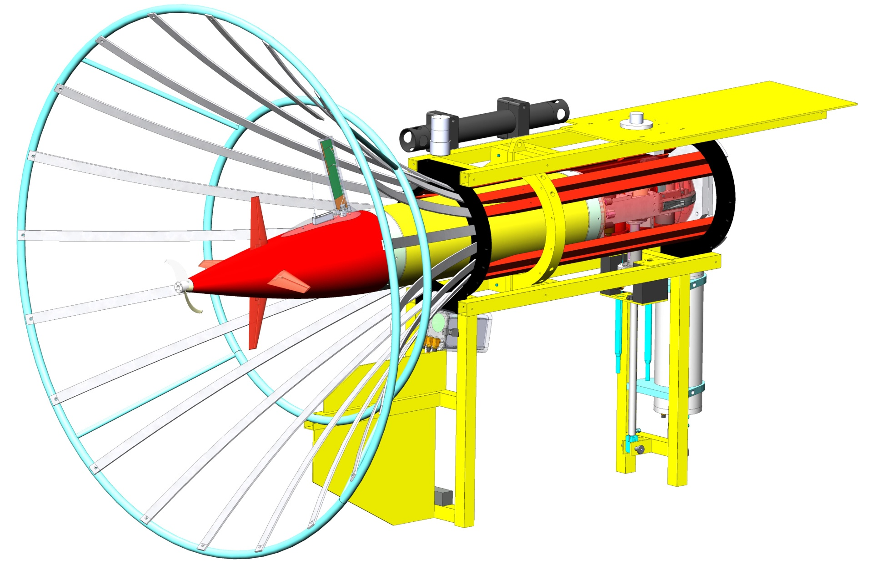
Notes:
To deliver power to the sub-surface plate, a copper wire connection must be made from the buoy, down through the power-takeoff device, out the bottom, and through the main tether to the sub-surface plate. This is challenging because the PTO necessarily has moving parts.
The middle image is the bottom of the power take-off device and shows the tether that comes out of it and connects to the submerged plate. An electro-mechanical cable is being developed and tested to pass power and communications through this critical part.
The movie shows the submerged plate itself, with the recently added stabilizing flaps. The SeaStar camera can be seen, it is there for two months, recording 60 seconds of video every 8 hours, allowing us to measure the flap motion.
In addition to being a natural home for an AUV dock, the flapping plates seen here could be modified to provide station keeping capabilities along the lines of the Liquid Robotics Wave-Glider. We are trying to establish a collaboration with that company to work on this.

