Slide 1

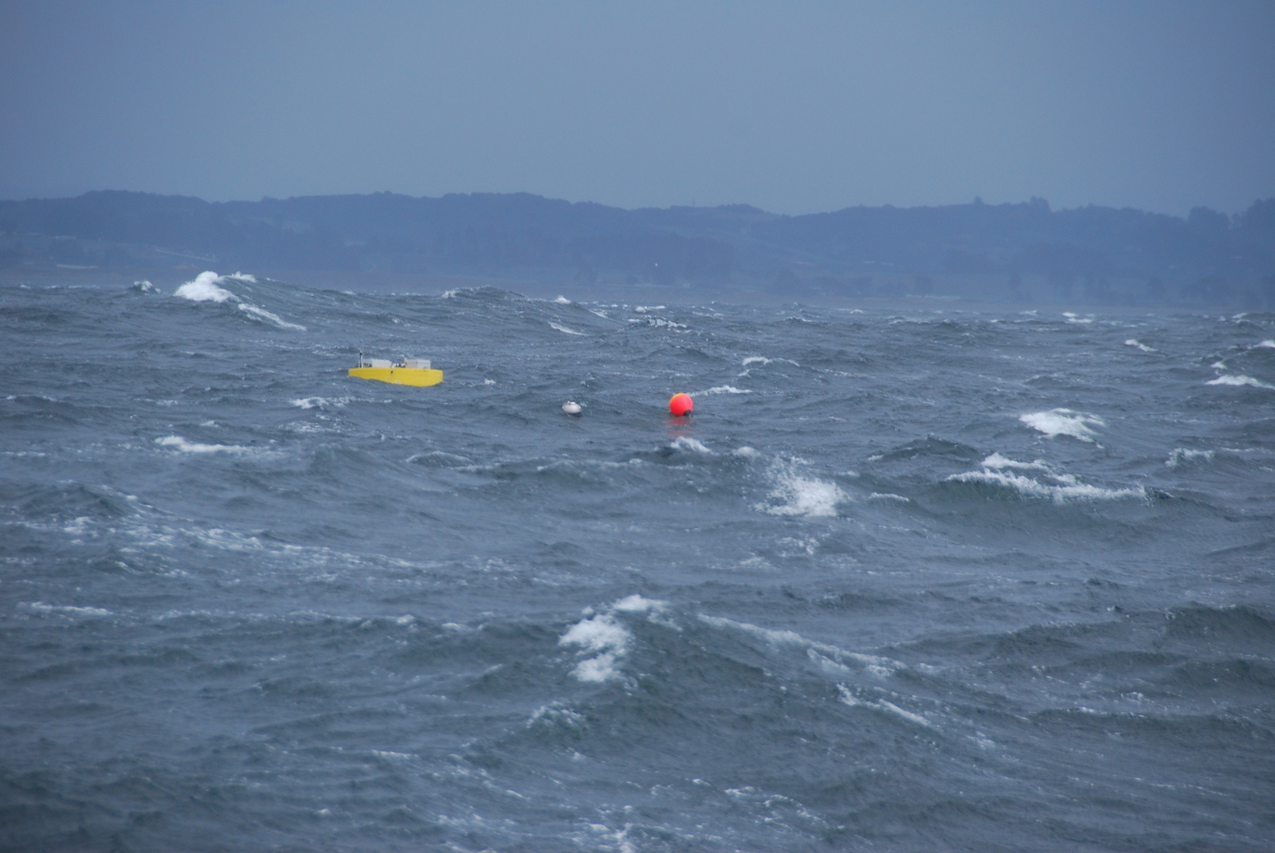
Wave-energy systems have the potential to expand the capabilities of unattended systems at sea.
Wave-Power Buoy Prototype
Demonstrated Average Power >300W
Demonstrated deployments up to 2 months
Work in 2014 is to increase the systems reliability and longevity in the difficult marine environment
Notes:
This is a technology development intended to provide significantly higher amounts of energy during long term at-sea experiments (> 1 month)
Prototype development to date has been supported by external funds.
We have completed 5 extended deployments (4-7 weeks) in the past two years, many of the system components have been used in all of the deployments.
Many aspects of the system are performing very well (power take-off system)
Longevity has been an issue, partly because the original hardware was designed for short-term deployments, and partly because the submerged plate motions have been more dramatic that anticipated and have caused some fatigue/wear problems.
Some innovation is required to re-design the submerged plate elements and we are working hard to demonstrate improvements in reliability in 2014.

Slide 2
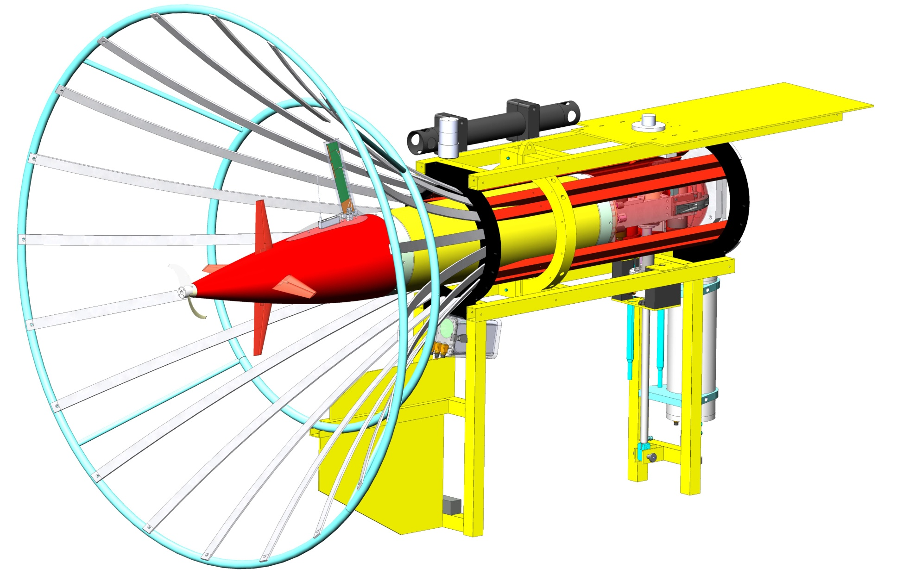
Two Pending Developments anticipated for future years
Station-Keeping
Current system works as either a moored or freely drifting system. Utility would be enhanced by an ability to keep station without being moored.
A good technological solution would be to couple the wave-energy extraction system to a system similar to the Liquid Robotics propulsion unit. We know how to do this engineering but need to collaborate with Liquid Robotics for IP issues.
AUV Docking – Wave Buoy would allow long term (1 year) deployments of AUV’s in remote locations.

