Slide 1
Introduction and Project Overview

Slide 2
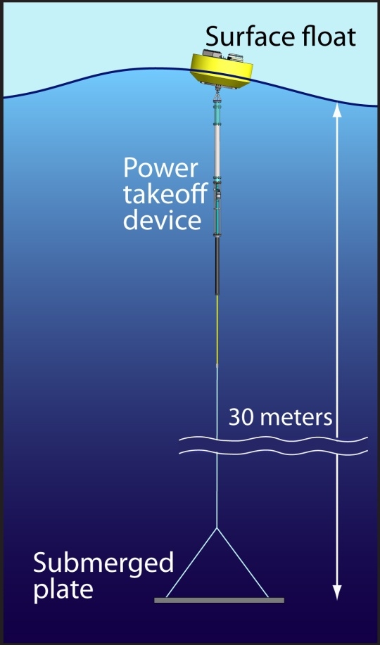
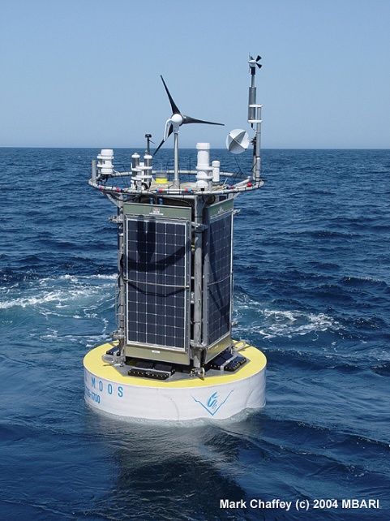
Wave-Energy Powered Oceanographic Systems
MBARI Mooring with
Wind and Solar Collection:
Weight Avg. Power
5000lbs 60W
Wave Power Buoy Prototype
Weight Avg. Power
5000lbs 300W-600W
Potential for significant increase in the amount of power available on autonomous platforms.
(AUV’s, Buoy Based Instrumentation, etc)

Slide 3

Project Activities
- Development of a numerical modeling tool specific to this task
Build and test a proof-of-concept system
AUV homing and docking
Engineering Challenges
System Dynamics
Power Take-Off System
Station Keeping
Survivability
AUV Docking
  Vehicle Maneuverability
  Homing
  Capture and Connect

Slide 4
Numerical Modeling Tools
Developed a tool to analyze floating wave energy extraction devices.

Slide 5
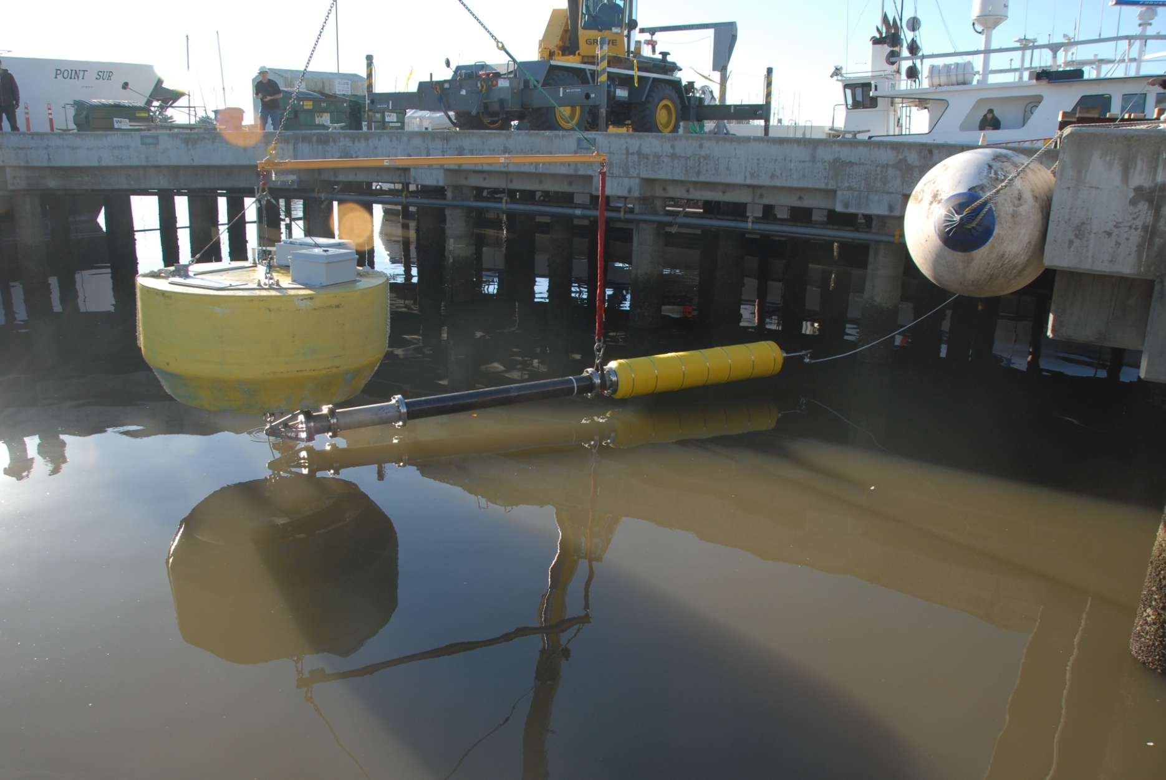
Buoy and Power-Take

Slide 6
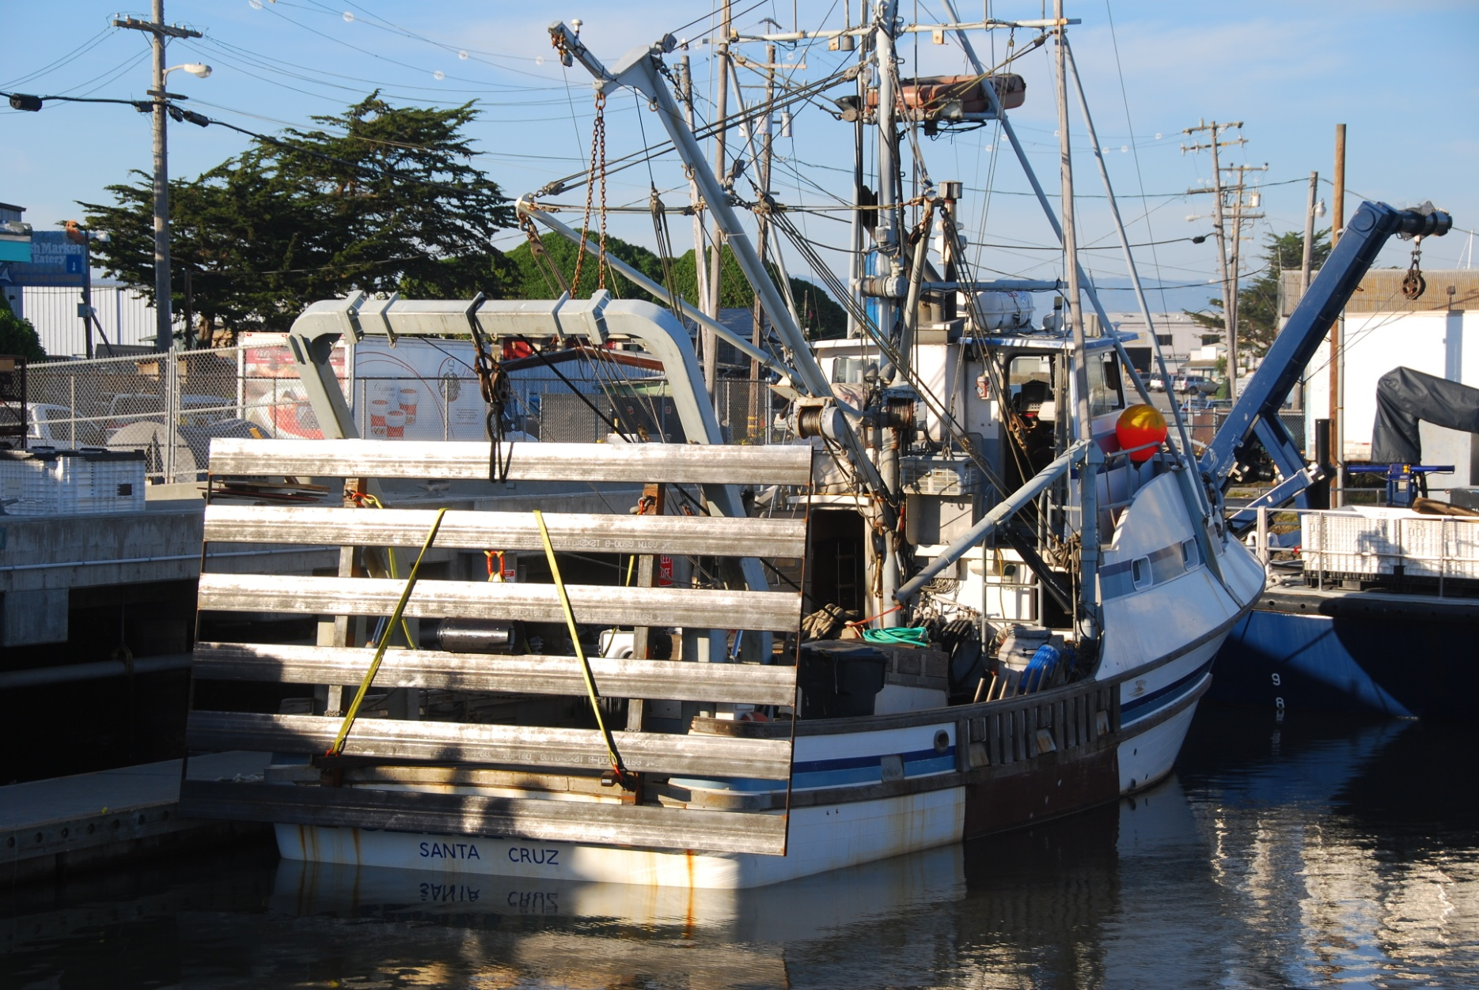
Submerged Plate

Slide 7
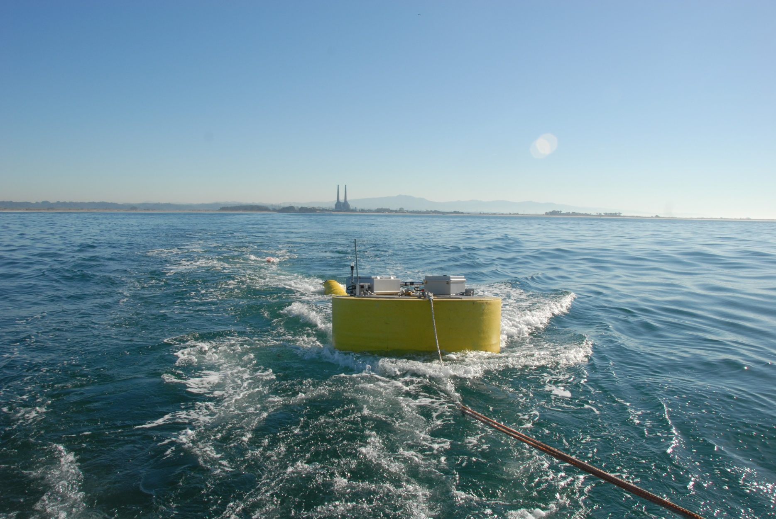
Wet Tow Deployment

Slide 8
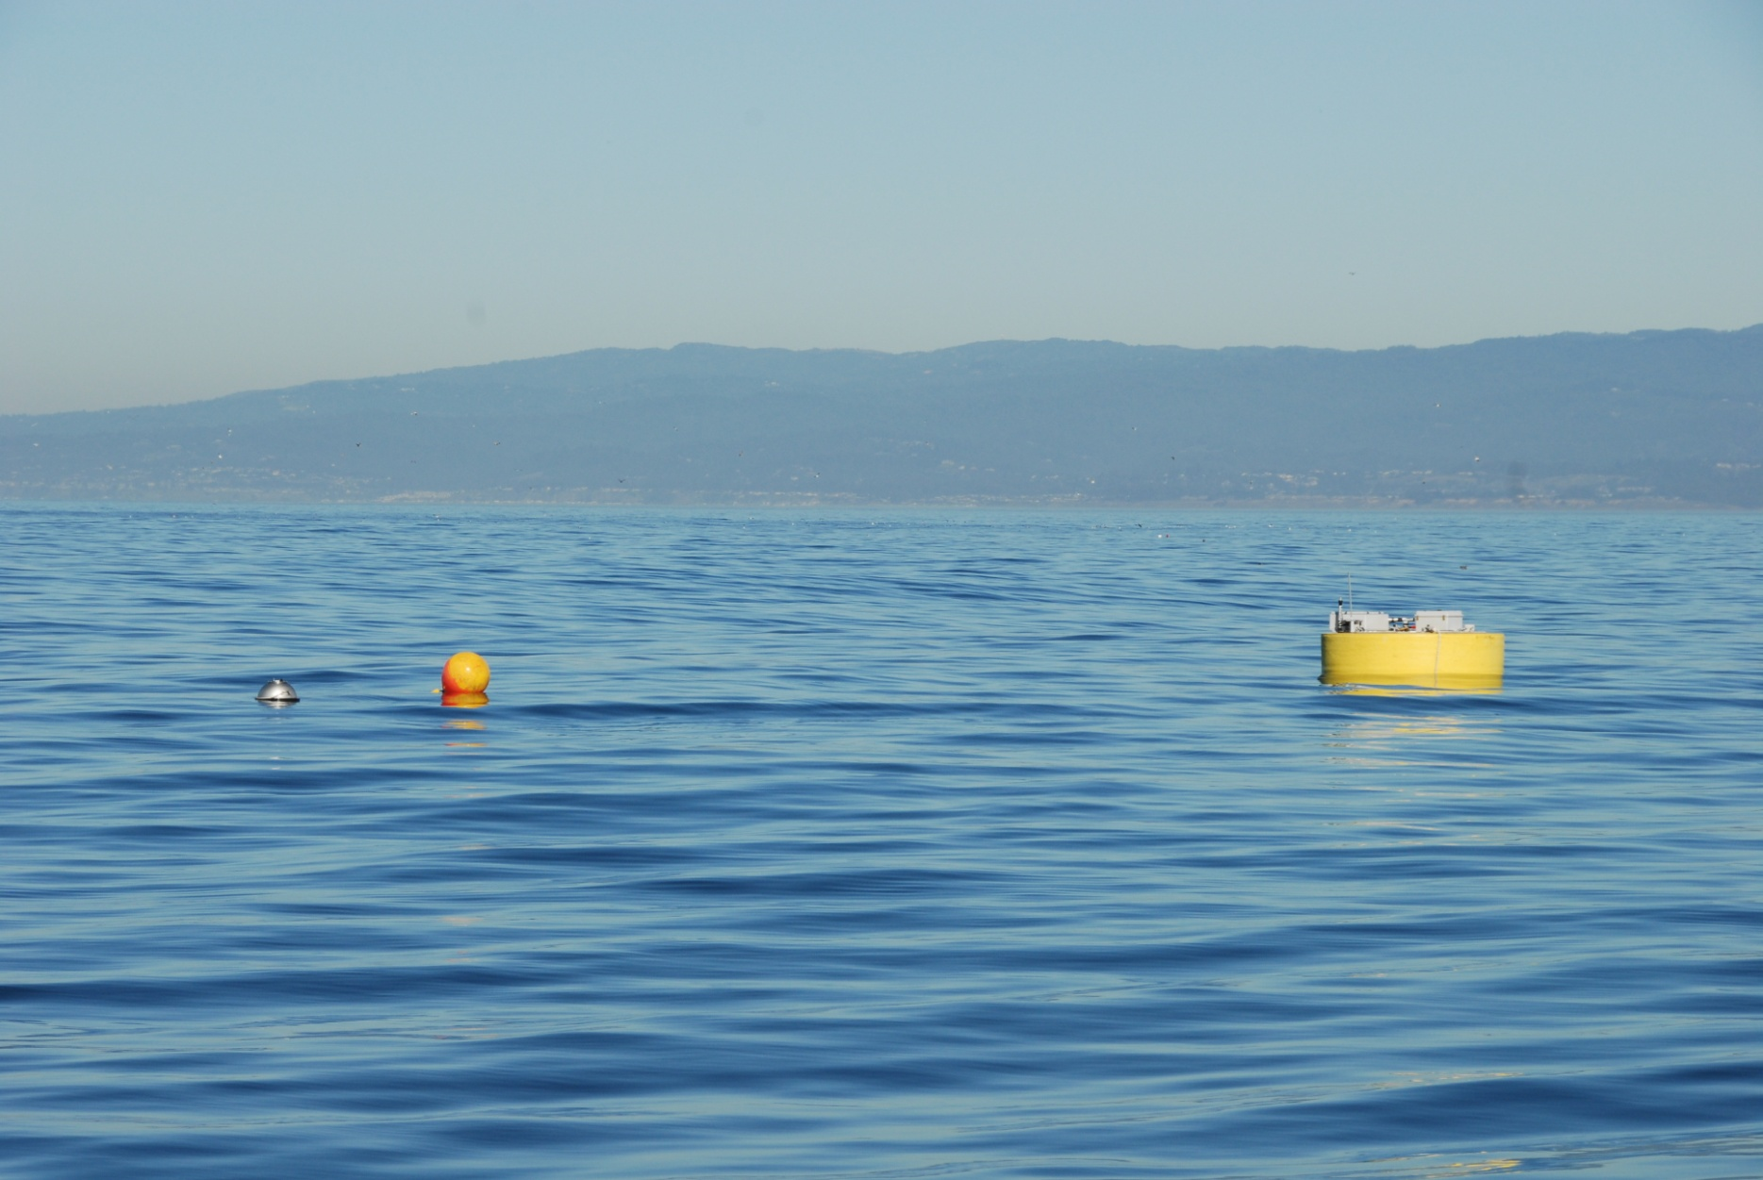
Deployed with Wave-Rider
January 11, 2011

Slide 9
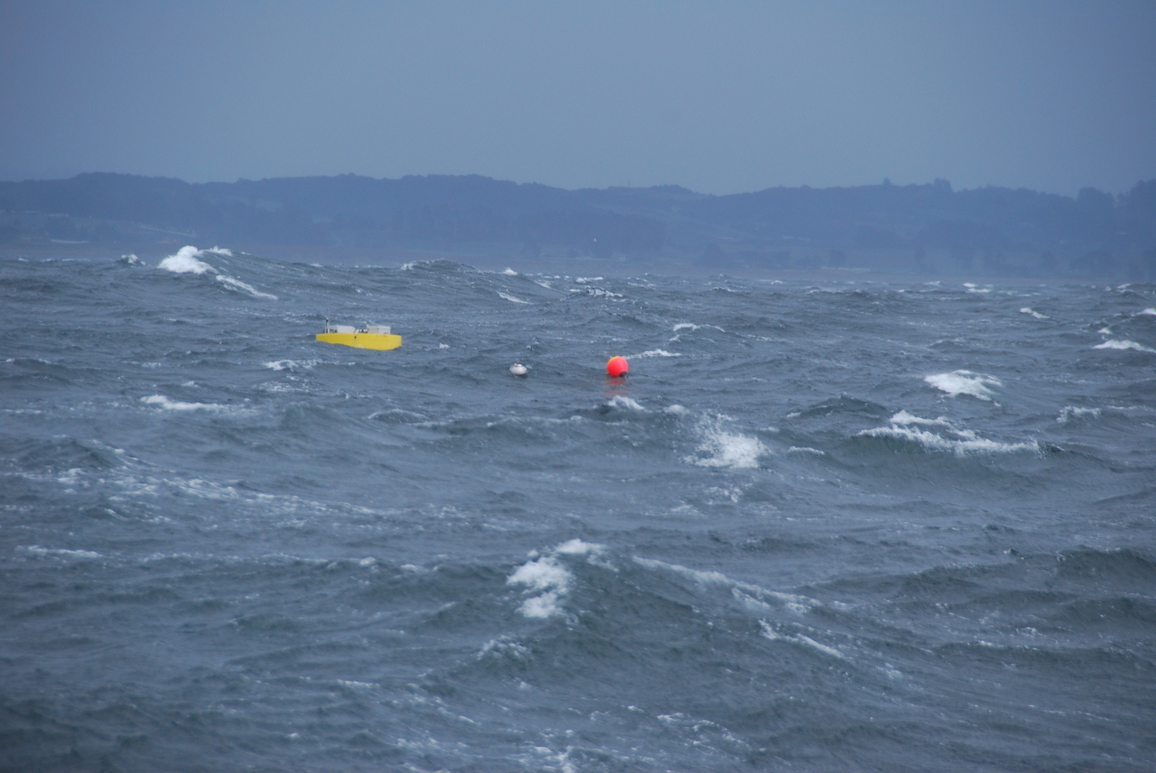
Rough Conditions
January 25, 2011

Slide 10
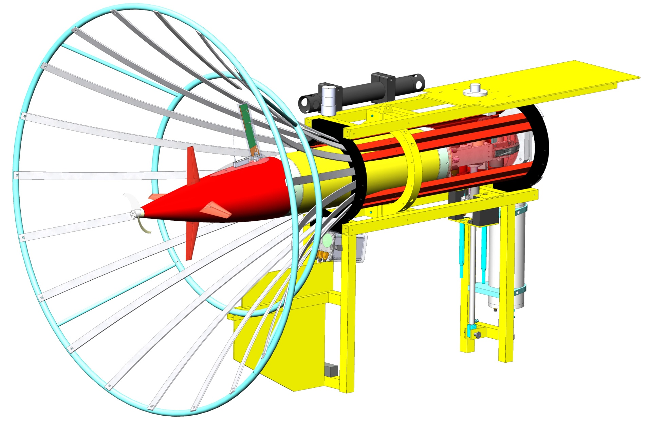
LRAUV in Dock

Slide 11
PB/AUV Dock Deployment

