Slide 1
AUV Docking for RASP
Background
Development Strategy
Technical Approach
  Modeling
  Homing
  Dock
  Testing
Phase 2

Slide 2
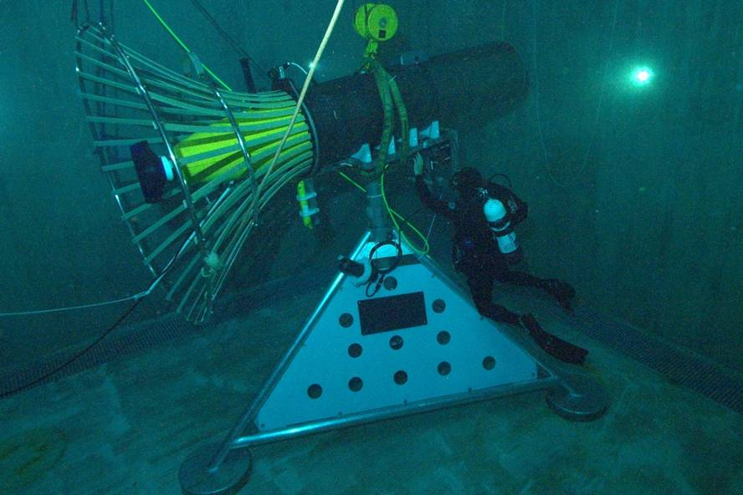
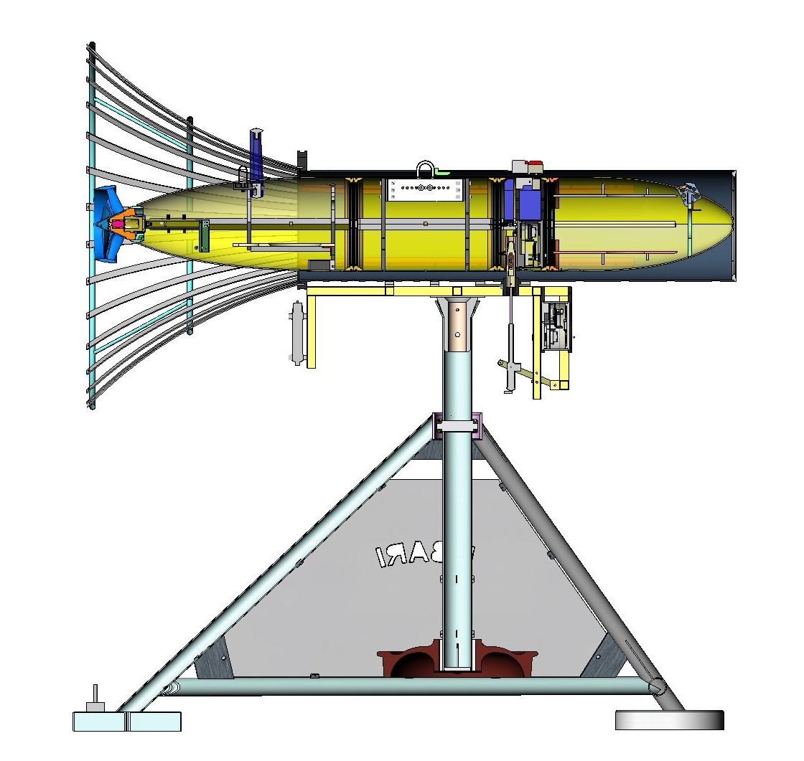
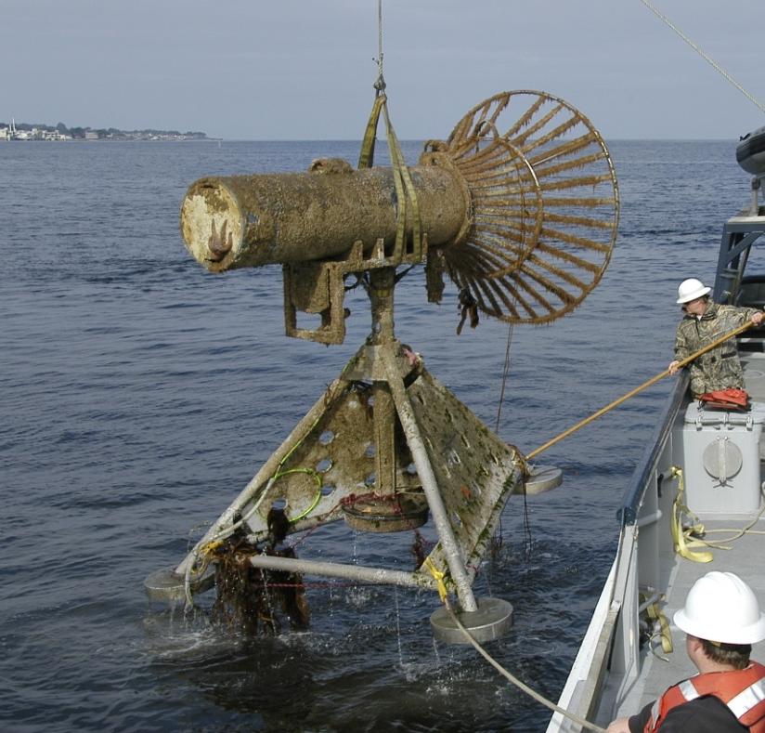
Background
MBARI’s AUV Docking Station

Slide 3
Docking Sequence
1
Current
Dock
2
Heading
3
x_{B}
y Cross-Track Error
Bearing
−ΔΨ
N
Pure Pursuit Homing & Navigation Fix
Cross-track control (Waypoint)
Cross-track USBL control (Docking)
Outer Marker
Waypoint
y_{B}
Vehicle
4 states; ΔΨ, r, y, v
ΔΨ is heading deviation
y is cross-track error
E
Inertially Fixed
Coordinates

Slide 4

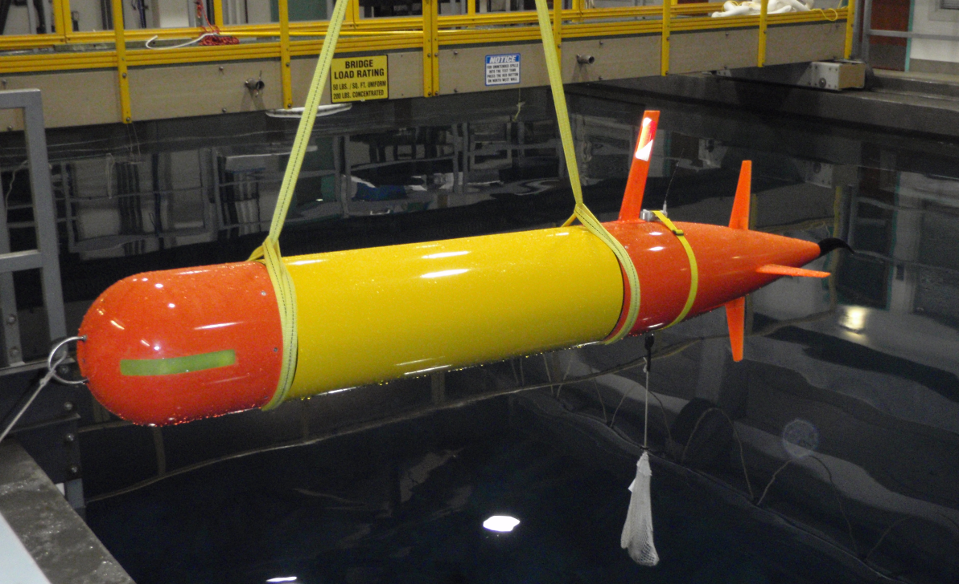
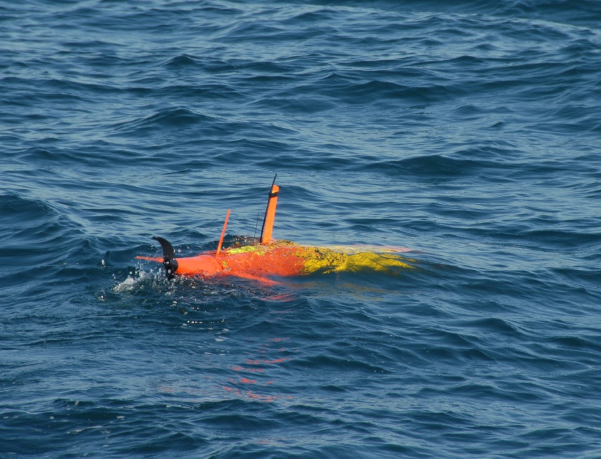
Background 2
Tethys,
Long Range AUV
Vehicle #1 operational for 16 monts
110 kg dry weight
Ability to carry 8 W sensors more than 1000 km at 1 m/s
Ability to cover more than 4000 km with minimal sensors at 0.5 m/s.
Ability to trim to neutral buoyancy and drift.
Low enough cost to be operated in significant numbers.
Minimal ship requirements.

Slide 5
Development Strategy
Model dock motion and ability of AUV to match motion; validate with at-sea testing
Develop a dock design and AUV sub-systems for docking
  Leverage legacy AUV Docking, existing Tethys AUV and a commercial iUSBL acoustic homing system
Demo basic homing to a beacon; add mock dock; install and test dock w/o latch or power/data transfer
Phase 2 will refine dock and add latching and power/data transfer

Slide 6
Technical Approach: Modeling
Designed and built a motion logging system for the submerged plate
Deployed during the Feb. sea trials
Compared these empirical data with model predictions
  The plate moved about 1m up and down
  This should be worse-case motion
  Good agreement between measured and modeled

Slide 7
Technical Approach: Modeling 2
How well can the AUV match the motion of the plate?
Control simulations have been run that assume “optimal control”
  Aft mounted control surfaces: force tail down, nose rotates up to new depth, control surfaces lift tail back up to straight line flight
  1m depth step change would take ~ 10 meters
Tethys was designed for long-range, low speed operation
  Low bandwidth control and relatively small control surfaces
  Best response:1m depth step change ~ 20 meters

Slide 8
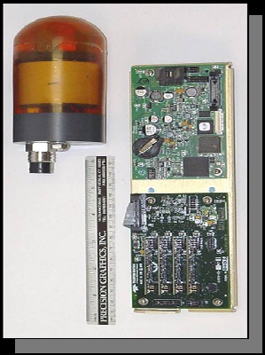
Technical Approach: Homing
What Homing Sensor?
Optical homing with laser or lights
Elecro-magnetic
Acoustic
  Hydroid, Sonardyne, Linkquest, Benthos
Benthos DAT
  Integrated with data modem
    needed to communicate dock heading
  size compatible with Tethys
  2 degree accuracy, > 1 km range
Terminal Phase Technique
Home to centroid of dock position
Perform one course correction ~ 5m out:
    up, down, left, right

Slide 9
Technical Approach: Homing 2
Extensions to previous work
Dock Now Has Motion in All Six DOF. Most Important are:
  Heading
  Vertical
  Lateral
Dock-to-Vehicle Communication Now Required
Plan:
  About 300 m out: Vehicle Surfaces & Updates Navigation.
  Buoy is Transmitting Location and Plate Heading to Vehicle using DAT.
  200 m out: Vehicle Transits to Approach Path.
  30 m out DAT Switches to 2 Hz Bearing-Only Updates. Vehicle Homes on Centroid
  (High Sea State) 5 m out: Vehicle May Swerve to Intercept Dock

Slide 10
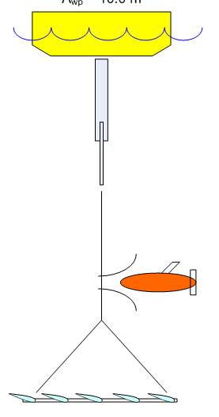
Technical Approach: Dock
What type of dock?
Cable capture
Tail hook
Cone dock
Where is the Dock Mounted ?
On Buoy?
On PTO?
On Cable?
Above submerged plate?
Below Submerged plate?

Slide 11
Testing 1
Basic Homing

Slide 12
Testing 2
Mock Dock

Slide 13
Testing 3

Slide 14
Phase 2 - unfunded
Add:
  AUV Latching
    Actuator driven pin
  Power Transfer
    Inductive or direct connect plug
  Data Transfer
    RF or direct connect plug
  Multiple docks
  Develop a deep-rated, larger AUV

Slide 15
End

Slide 16
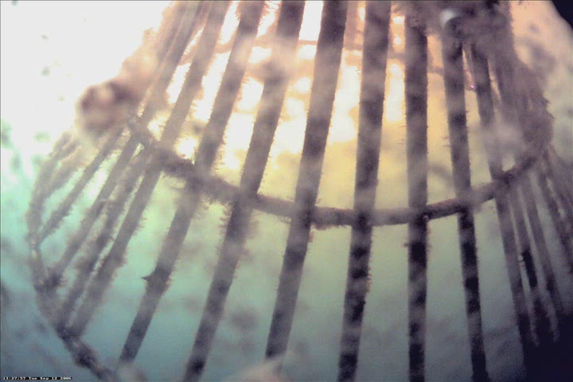
Docking Video
Will show other three docks last

Slide 17
Question: How Much Motion?
Wave-Induced Plate Motion: Extracted From Sea Test Data
Vehicle Agility

Slide 18
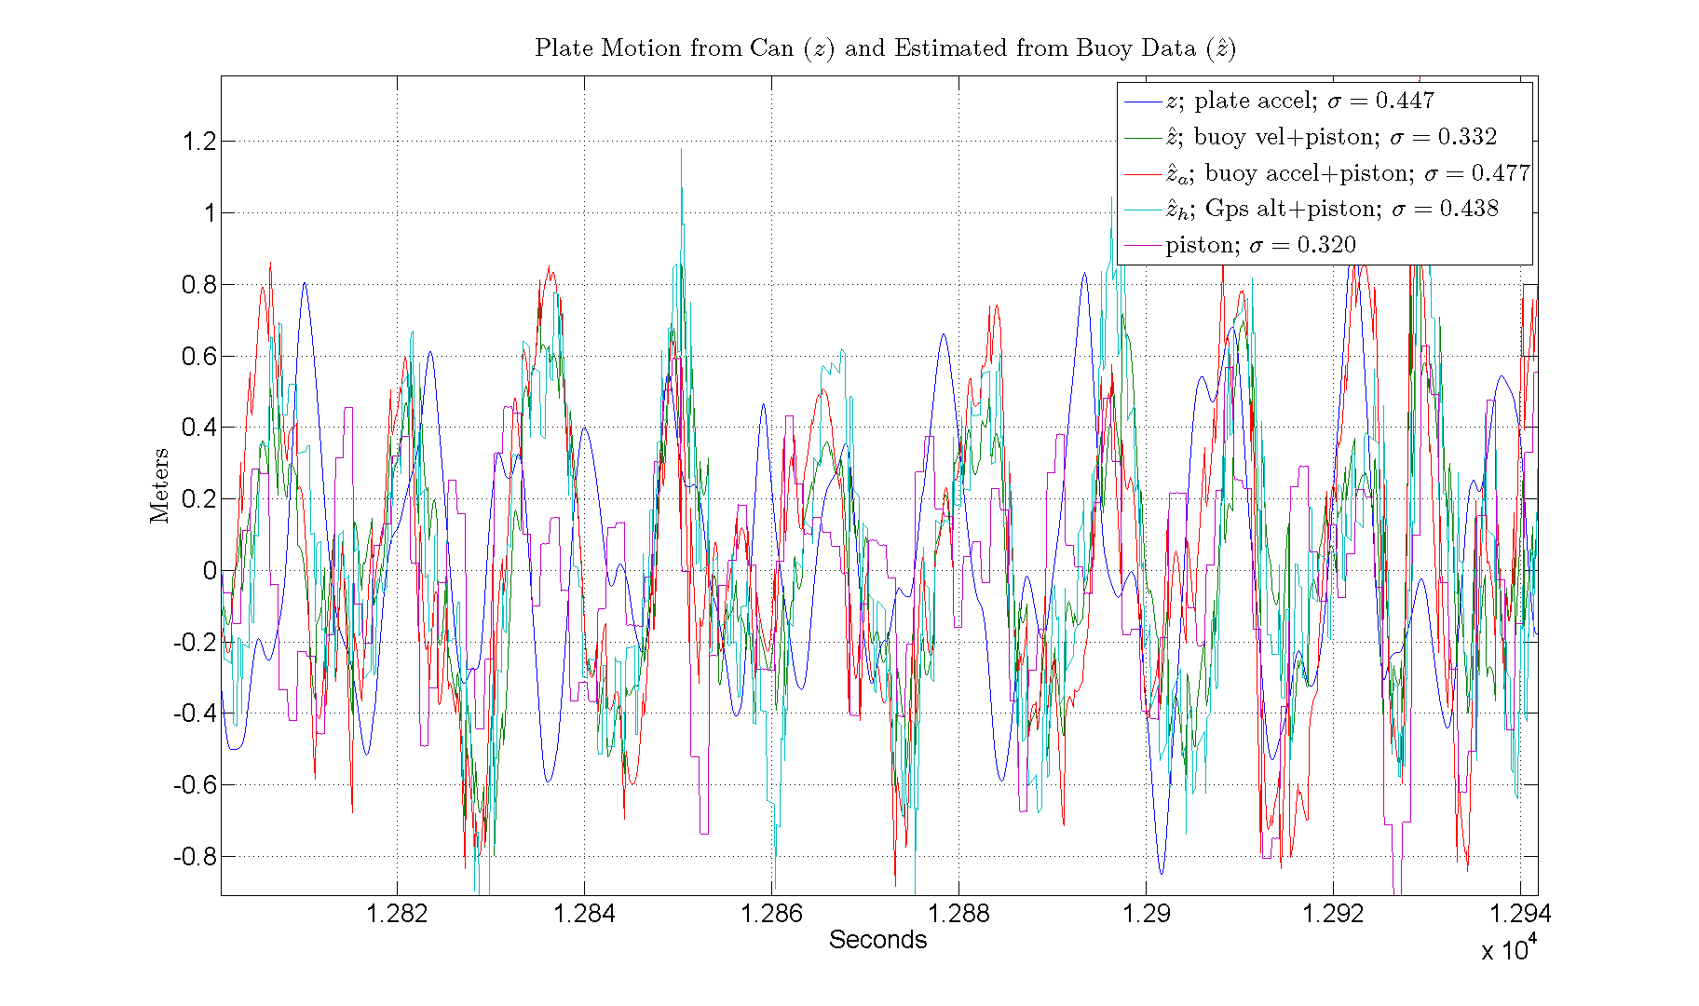
Vertical Plate Motion
Will next extract heading and lateral motion

Slide 19
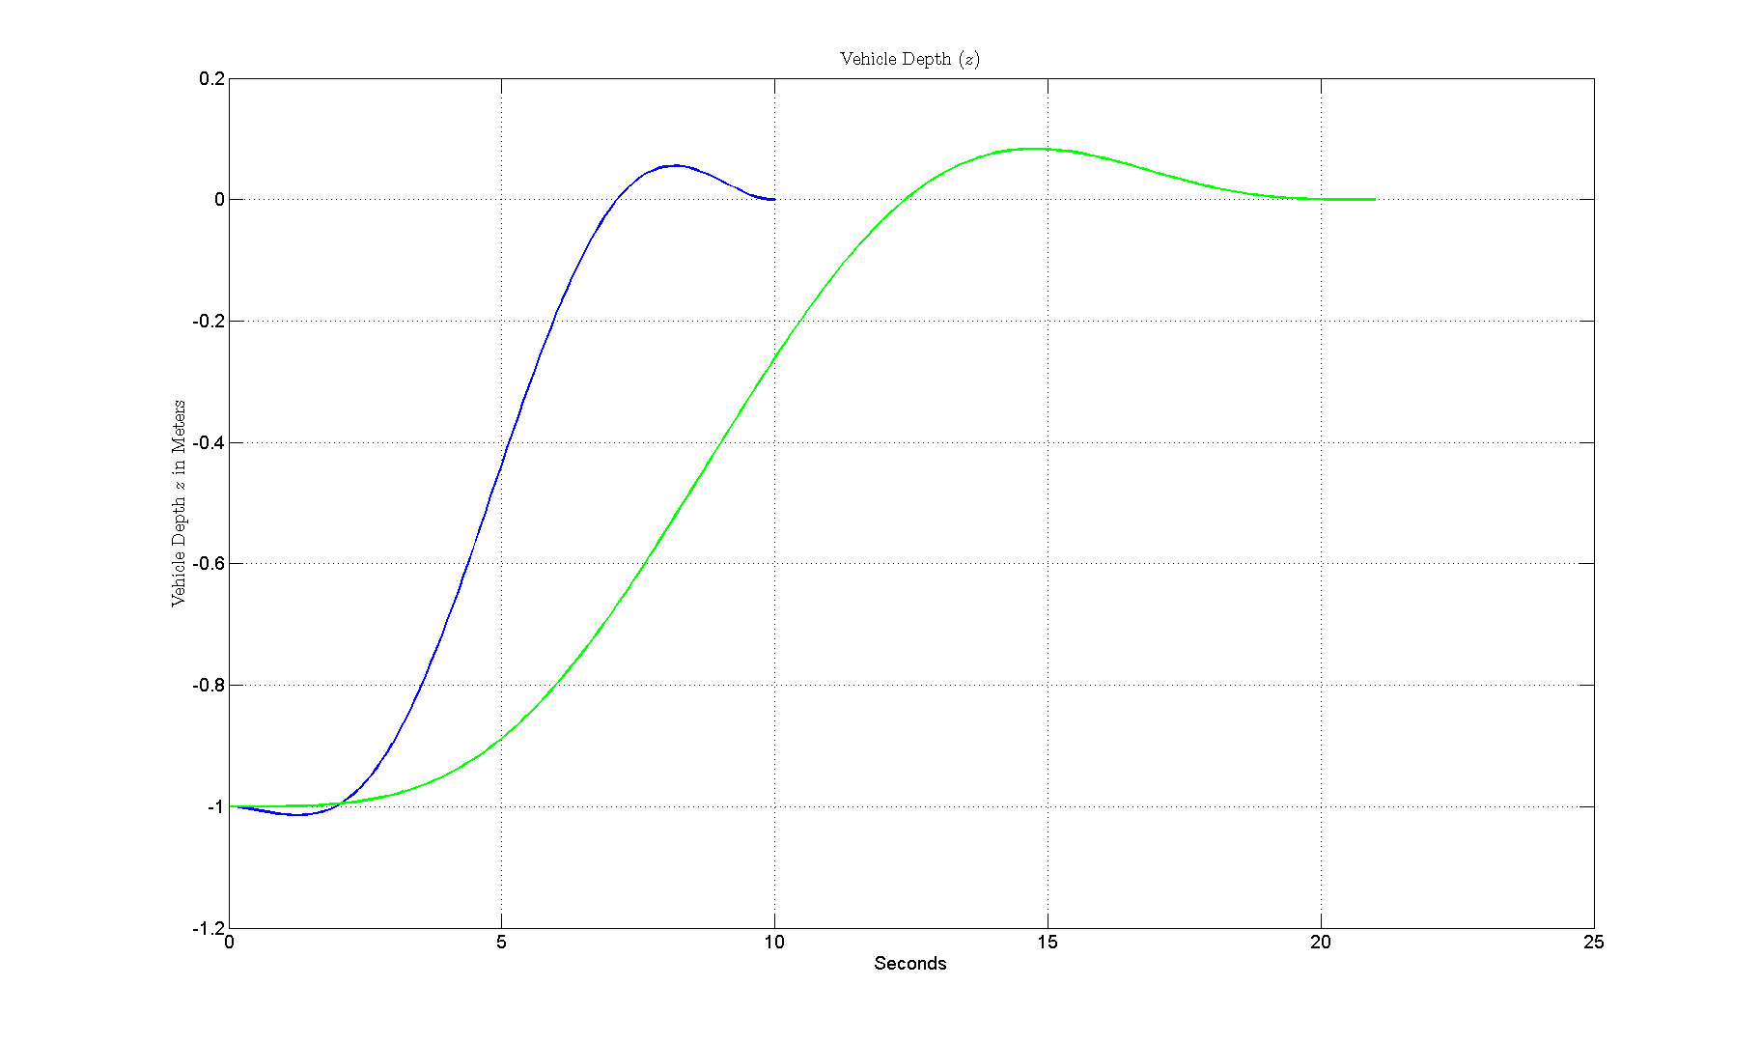
Optimal Step Response

Slide 20
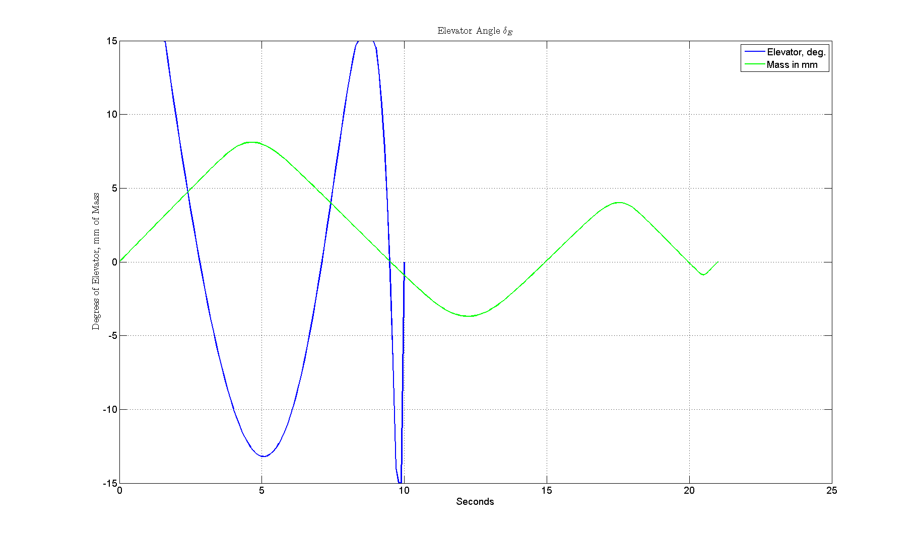
Optimal Step Response

