Slide 1
Wave-Energy Conversion for Powering
Oceanographic Instrumentation
Andrew Hamilton
MBARI

Slide 2
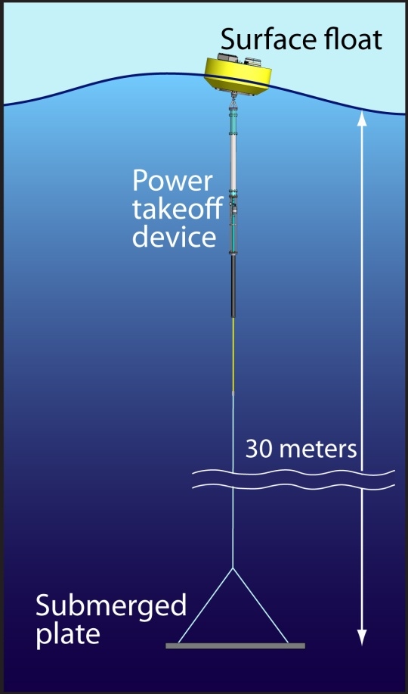
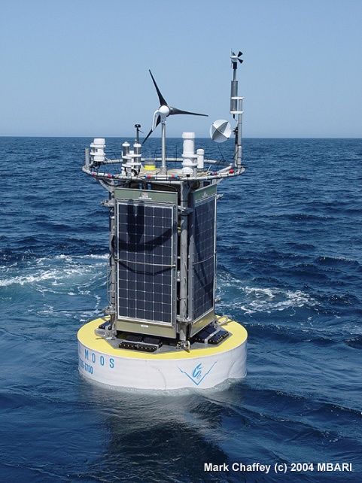
Wave-Energy Powered Oceanographic Systems
MBARI Mooring with
Wind and Solar Collection:
Weight Avg. Power
5000lbs 50W
Wave Power Buoy Prototype
Weight Avg. Power
5000lbs 200W-300W

Slide 3
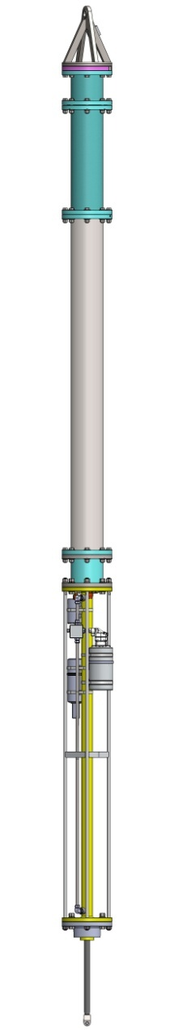

Project Activities
- Development of a numerical modeling tool specific to this task
Build and test a proof-of-concept system
AUV homing and docking
Engineering Challenges
System Dynamics
Power Take-Off System
Survivability
AUV Docking
  Vehicle Maneuverability
  Homing
  Capture and Connect

Slide 4
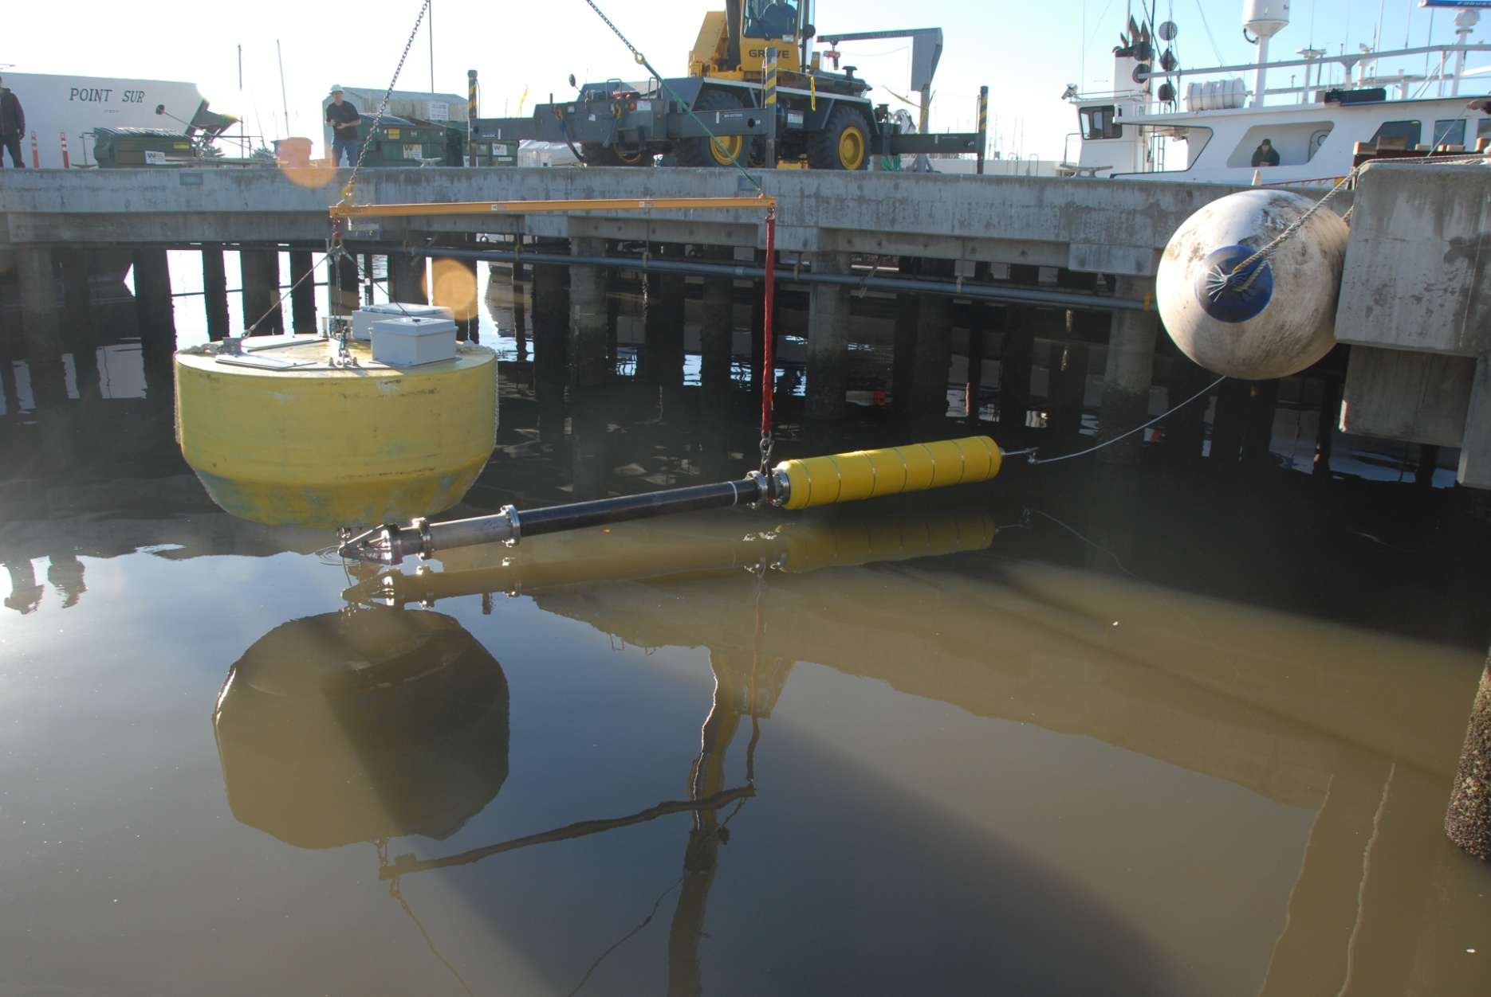

Slide 5
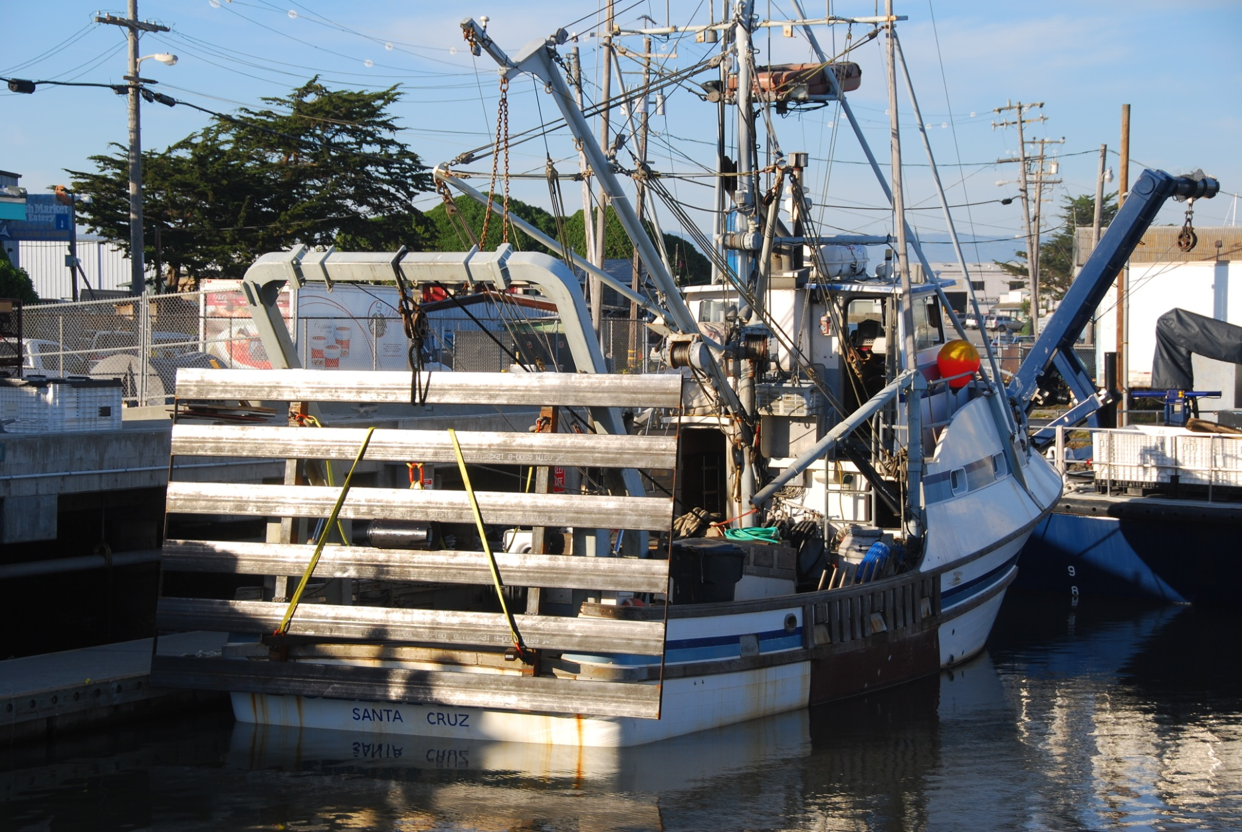

Slide 6
Numerical Modeling Tools
http://sourceforge.net/projects/tdxxx/

Slide 7
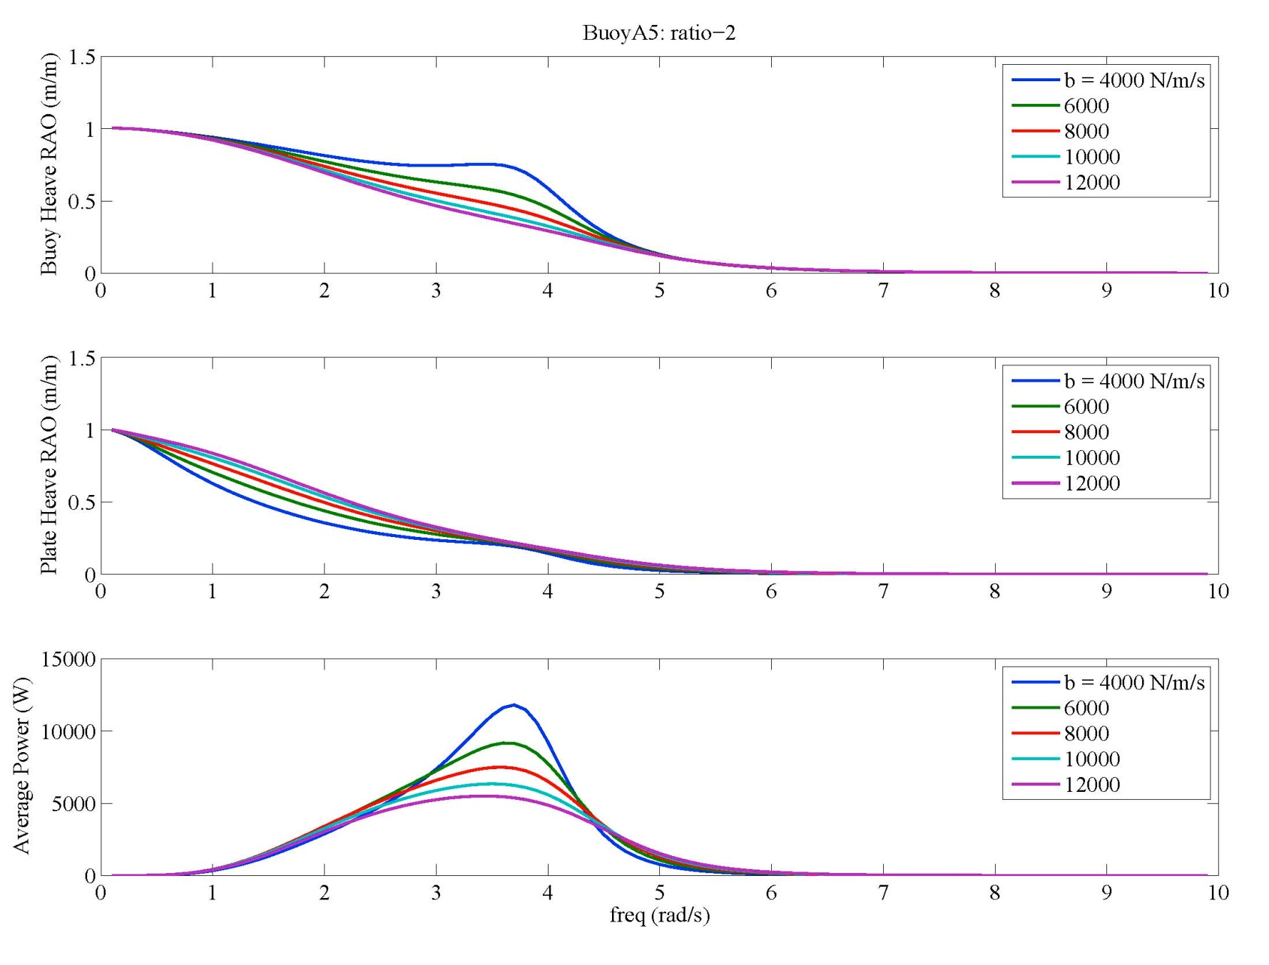
Frequency Domain Results

Slide 8
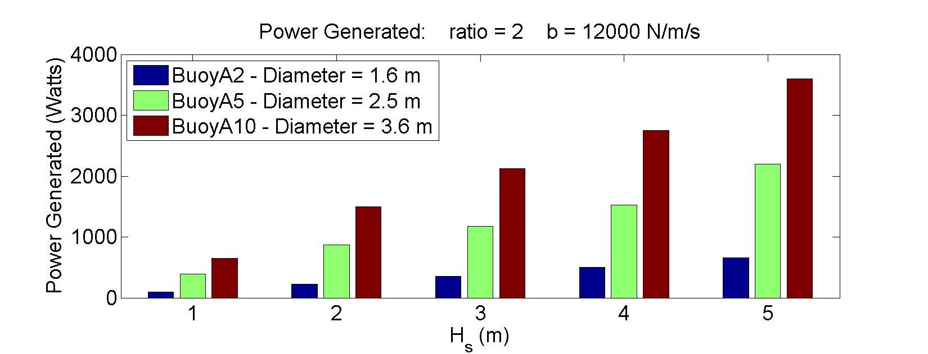
Non-Linear Model Results
Assuming perfectly efficient Power Take-Off Device
Quadratic drag forces
Non-linear power-take forces

Slide 9
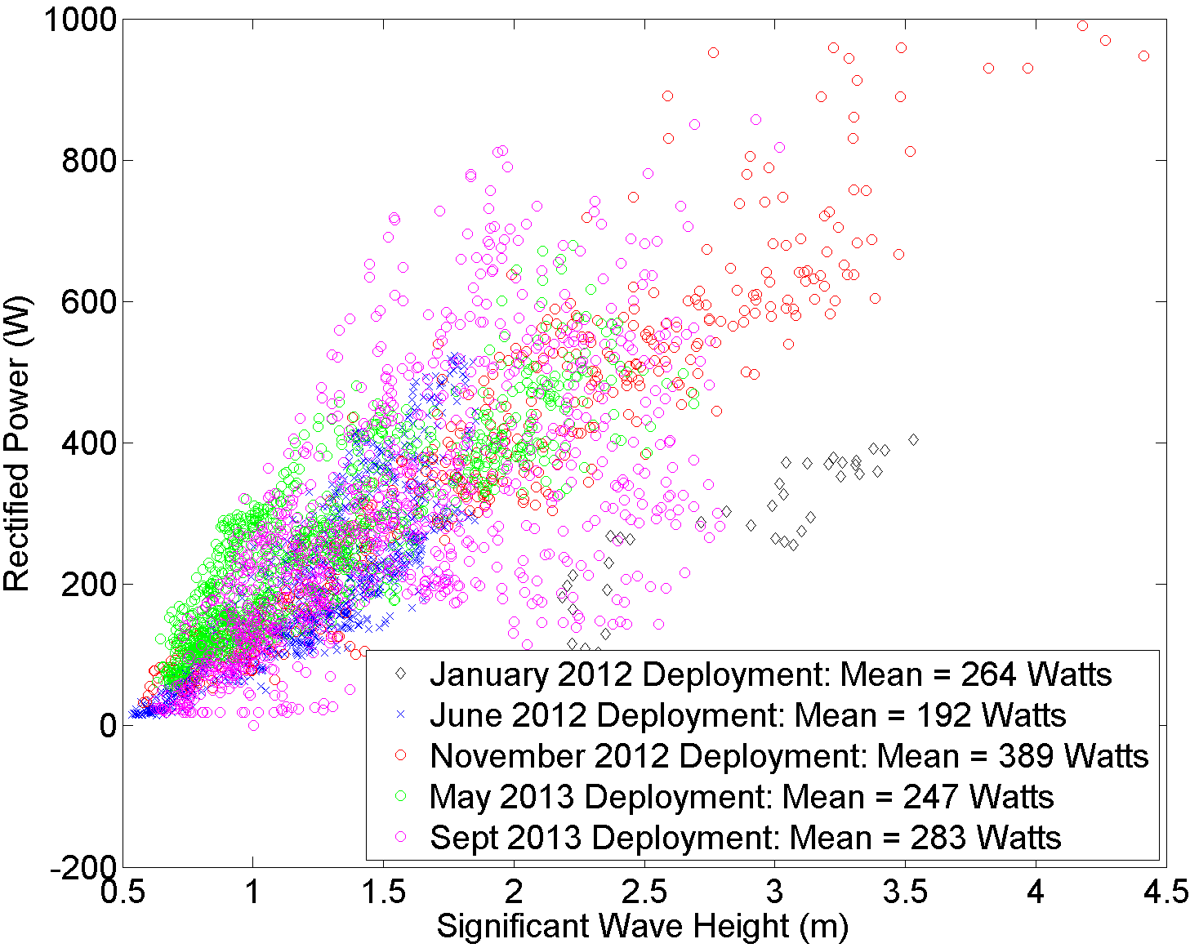
Fielded System Power Output
Average Power (W)

Slide 10
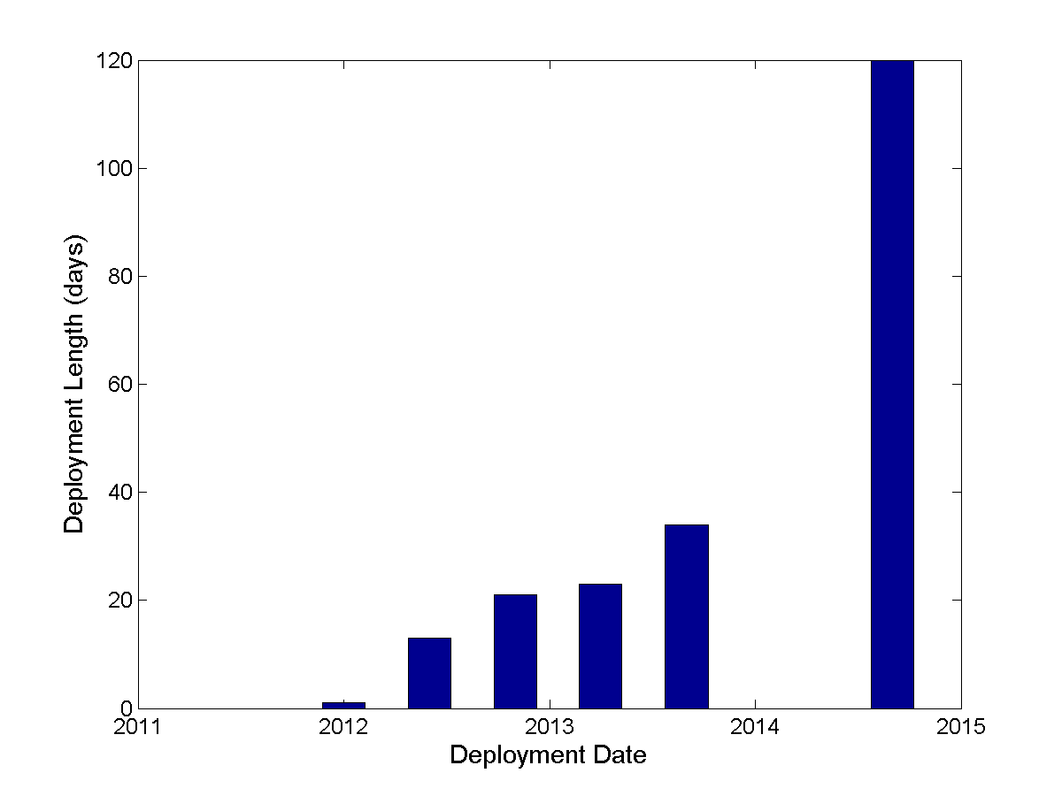
Longevity
Issues:
Peak Forces
Tether
Hydraulic Seals

Slide 11
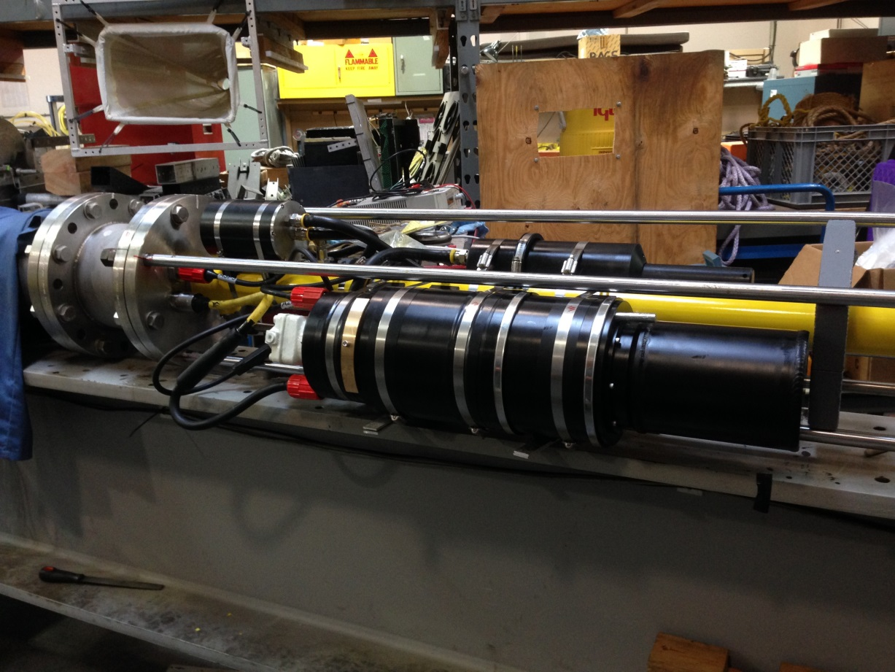
Power Take-Off Device

Slide 12
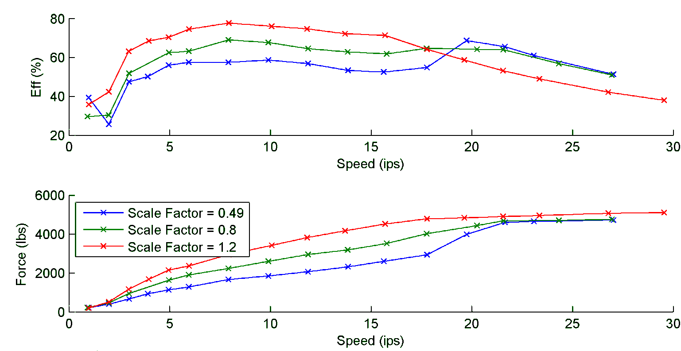
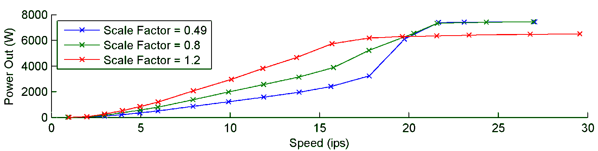
Power Conversion Performance

Slide 13
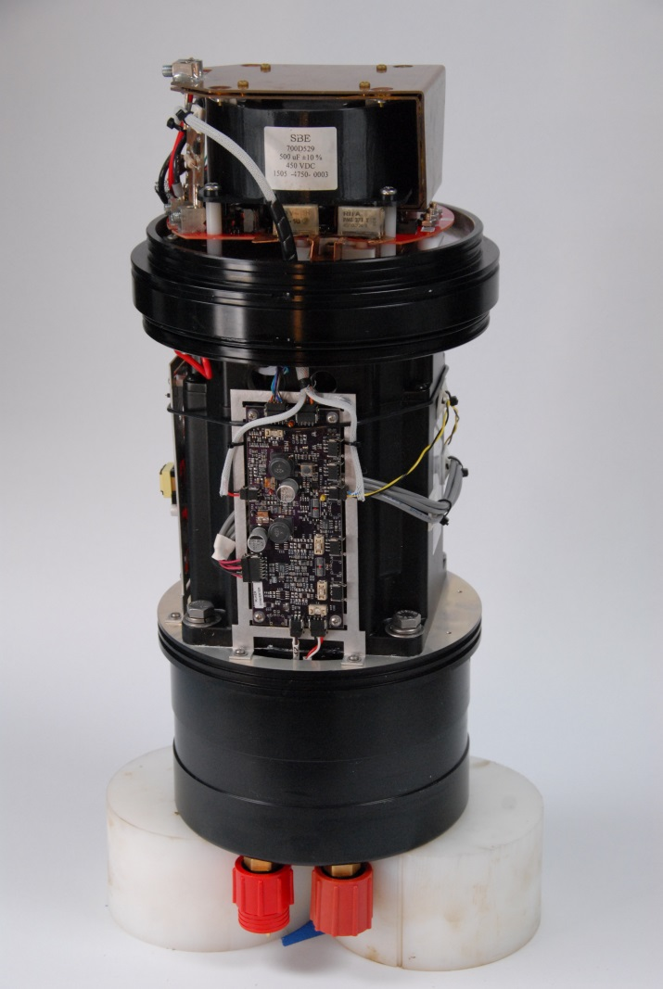
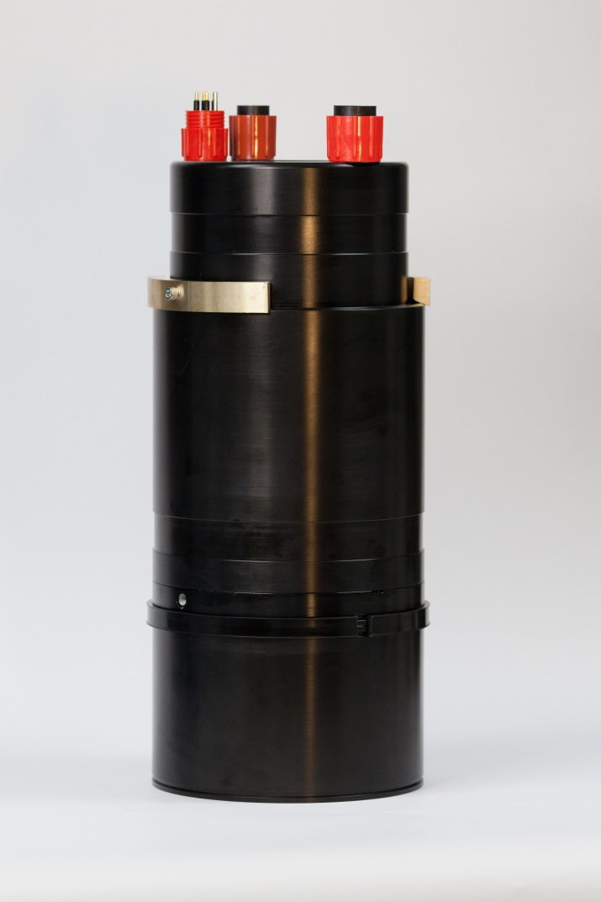
Power Conversion Electronics
Boost converter to 300V Battery System
Integrated Load Dump
Reversible
Creates 3W additional load

Slide 14
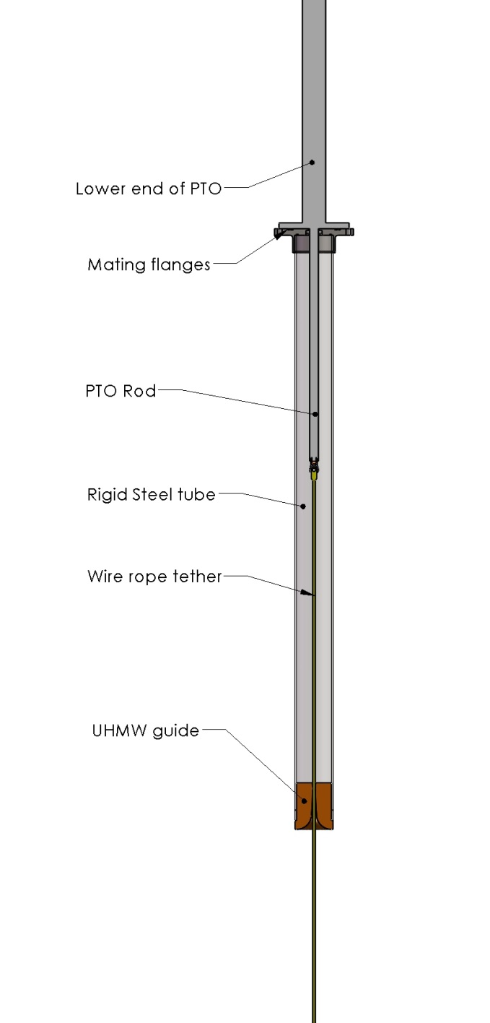
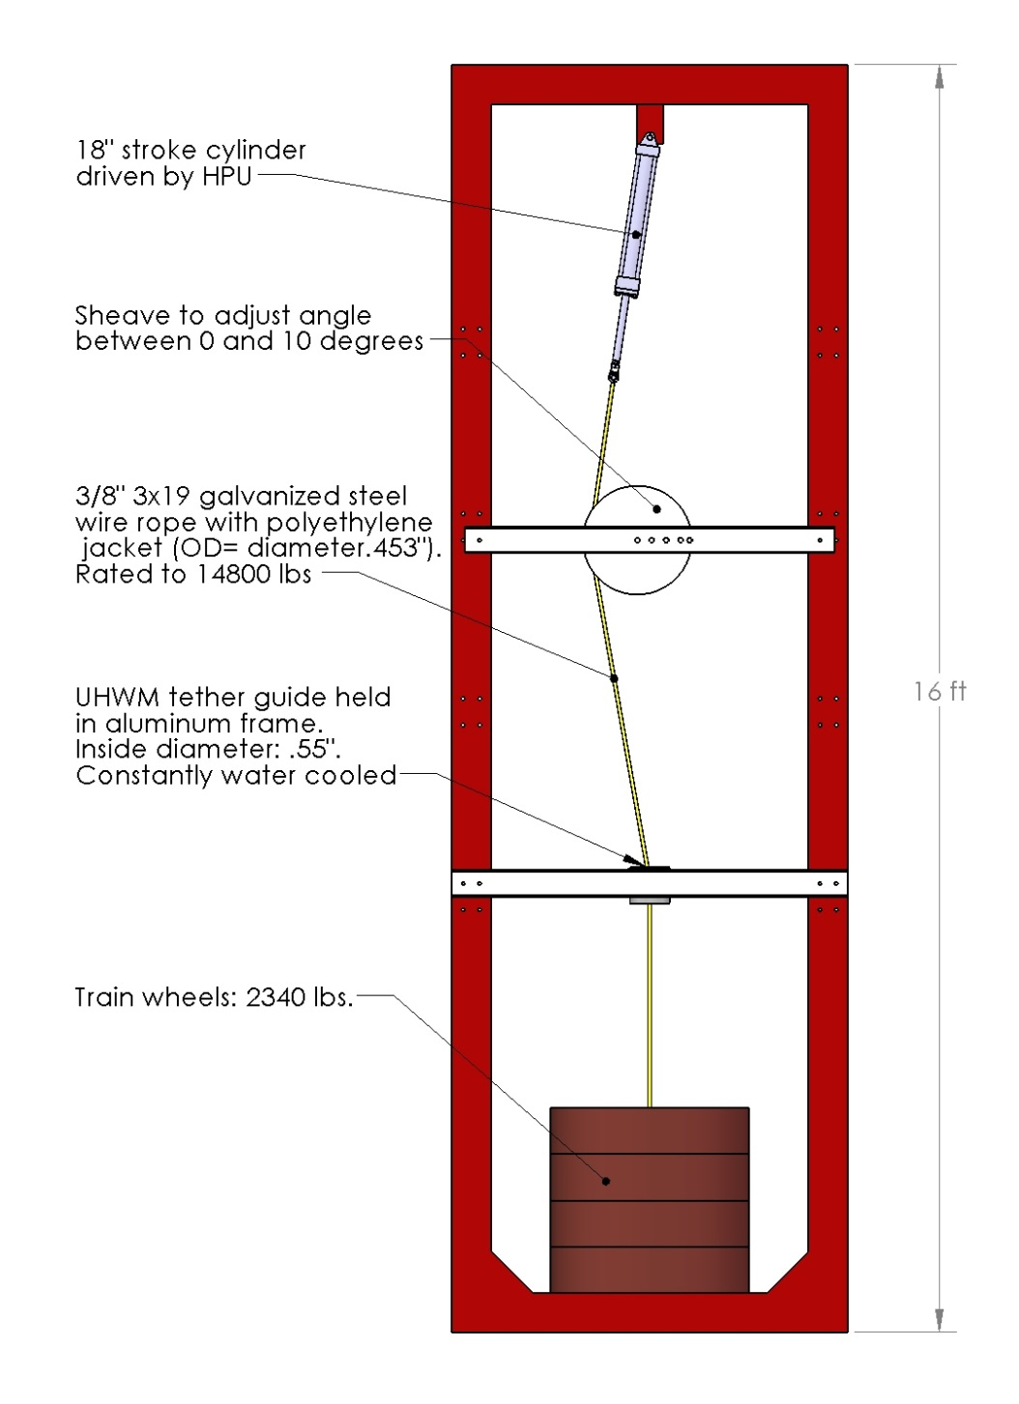

Slide 15
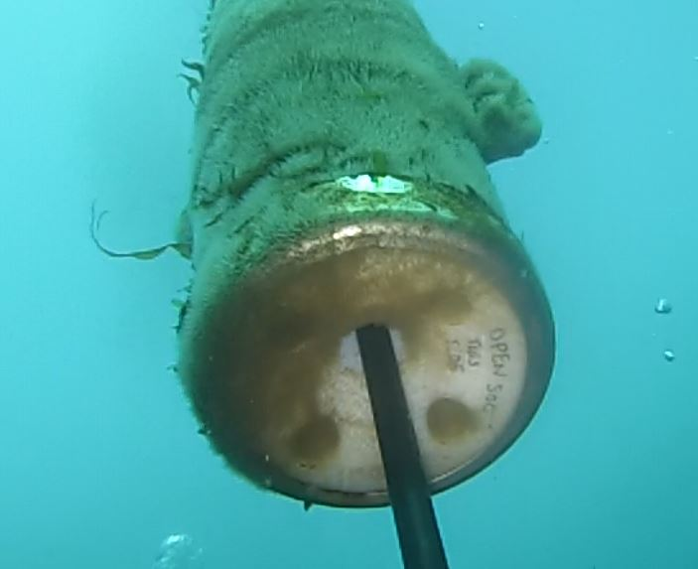
Electro-Mechanical Cable

Slide 16
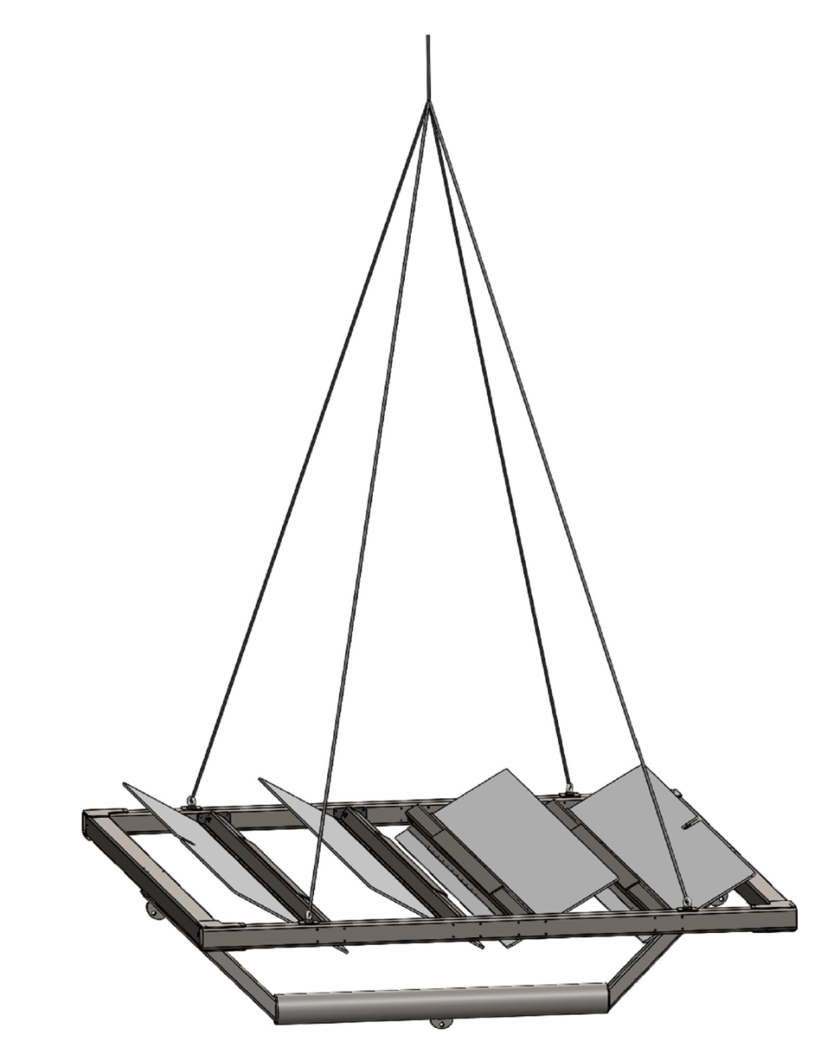
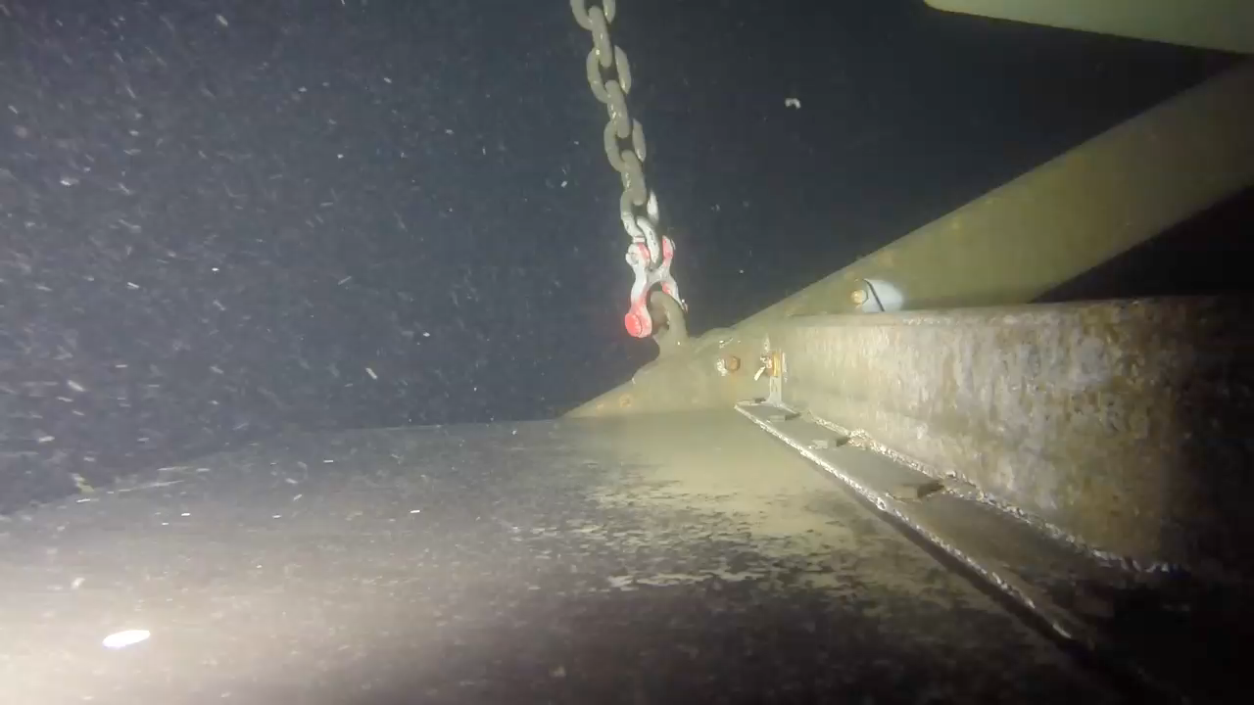
Compliant Plate

Slide 17
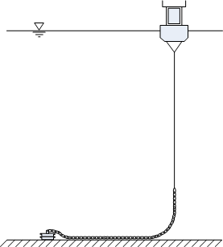
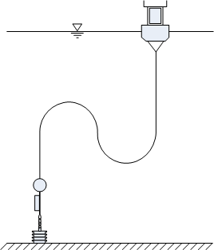
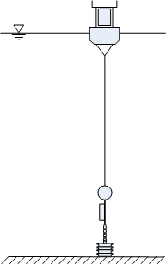
Deep-Water Potential
We haven’t done much work on mooring this in deep water.
There are issues related to static loading.
It is perhaps possible to for-go the submerged plate component.
Analysis/Testing required.

Slide 18
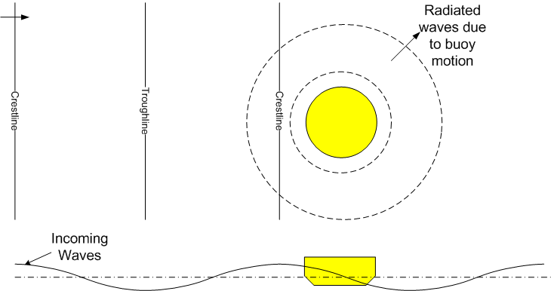
 |  | Numerical Model Predictions |  | Sea-Test Results
Sea State | Absorbable Power | Power Coupled to PTO | Power Converted to Electricity | Measured Electrical Power
 | (W) | (Watts) | (Watts) | (Watts)
Nov 9, 2011 9-10 PDT | 957 Watts | 25 W (2.6%) | 14 W (1.4%) | 10W (1.0%)
Nov 10, 2011 11-12 PDT | 3676 Watts | 386 W (10.5%) | 238 W (6.4%) | 357 W (9.7%)
Jan 5, 2012 18-19 PDT | 4350 Watts | 602 W (13.8%) | 360 W (8.3%) | 405 W (9.3%)
Jan 5, 2012 20-21 PDT | 4010 Watts | 498 W (12.4%) | 299 W (7.4%) | 369 W (9.2%)

Slide 19
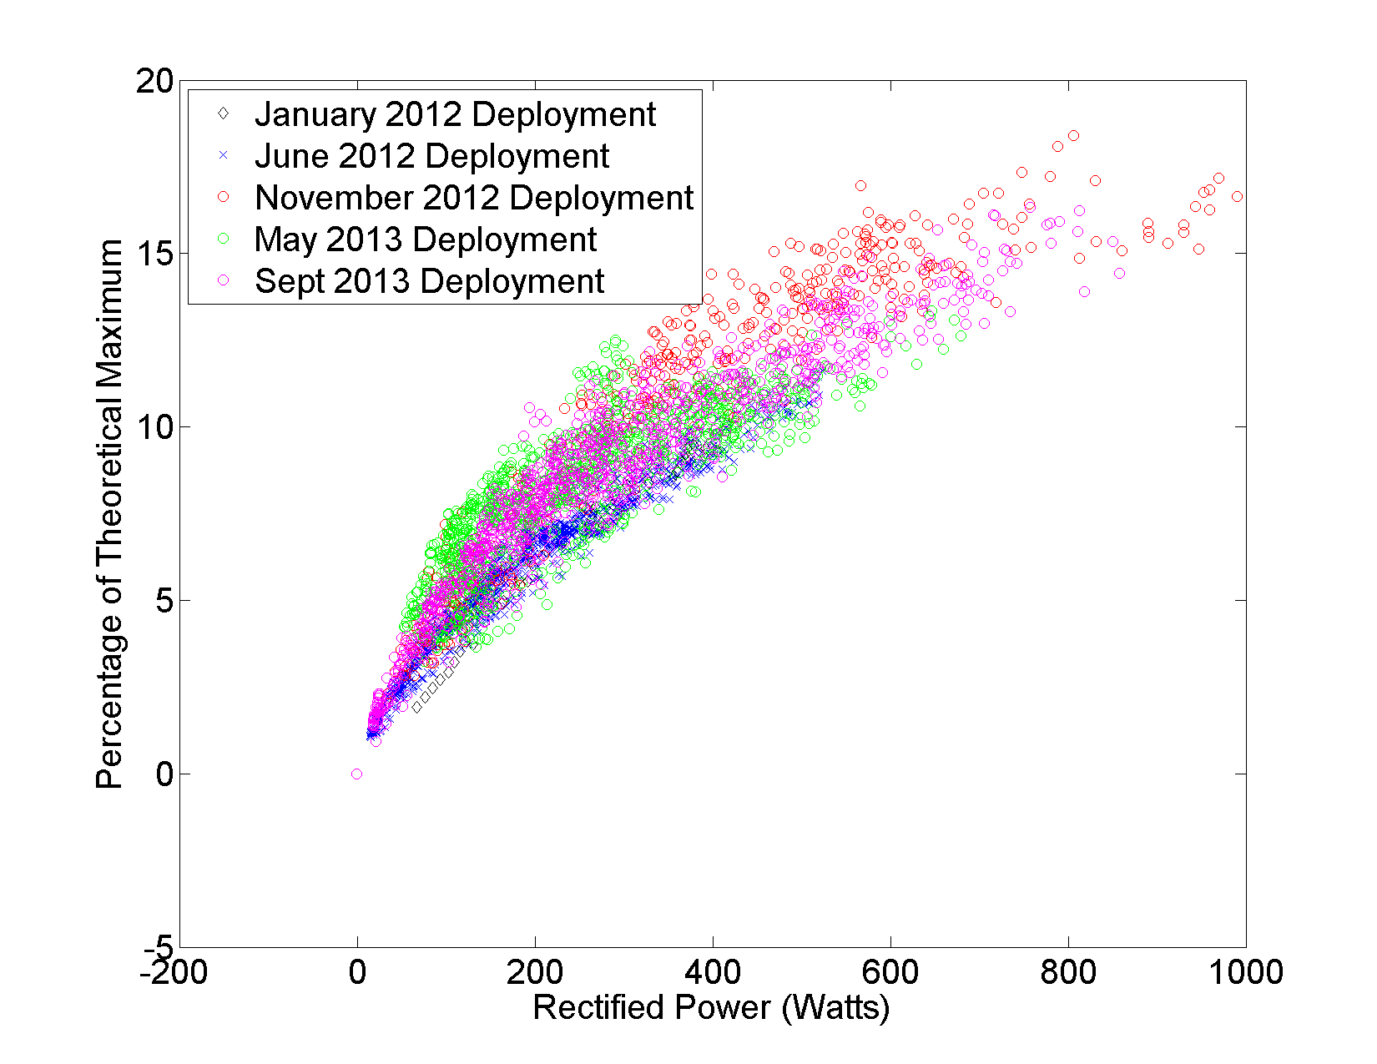
Average Power (W)

Slide 20
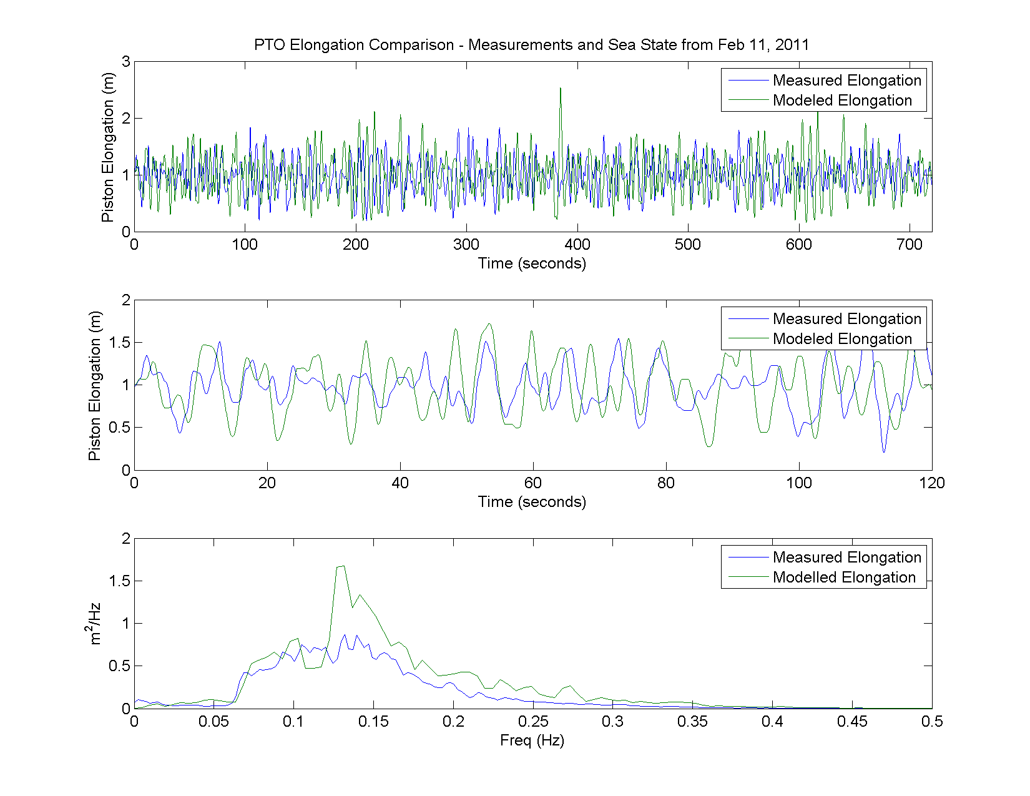
Model-Measurement Comparisons

