Slide 1
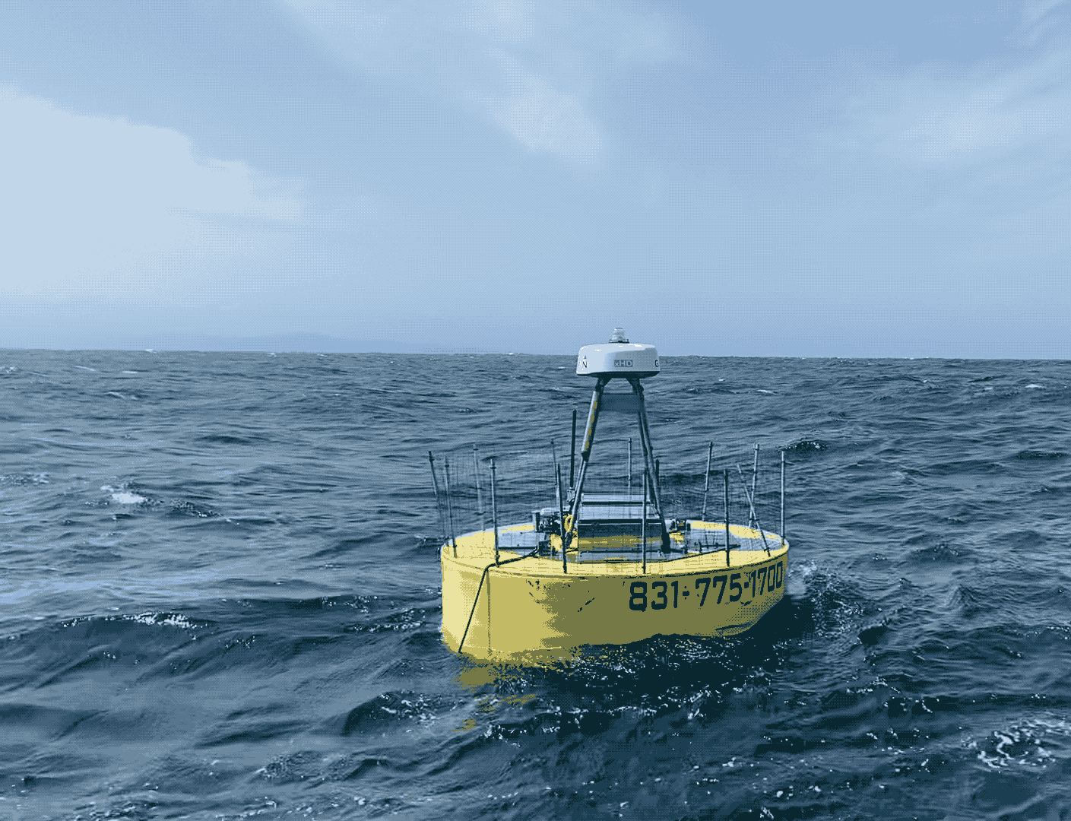



Nov, 3 2022
Power Buoy IFCB
Patrick Daniel
PhD Student
Kudela Lab
Department of Ocean Sciences
UCSC
Video: Brent Jones

Slide 2
Thank you!
IFCB integration onto the Power Buoy has been an overwhelming success!
Most interesting and highest quality data of the dozen IFCBs in California!
Thanks to the Wave Energy Team!
MBARI IFCB Team:
Francisco
Tom
Denis
Henry (CeNCOOS)
Brent (Wire Walker!)
UCSC IFCB Team:
Raphe Kudela
Kendra Negrey
Jaime Walton (Berkeley)
Anna McGaraghan

Slide 3
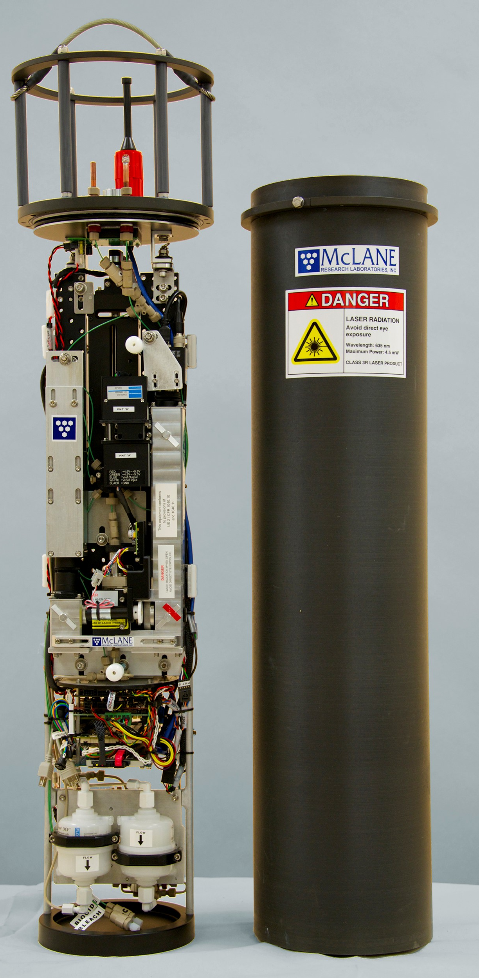
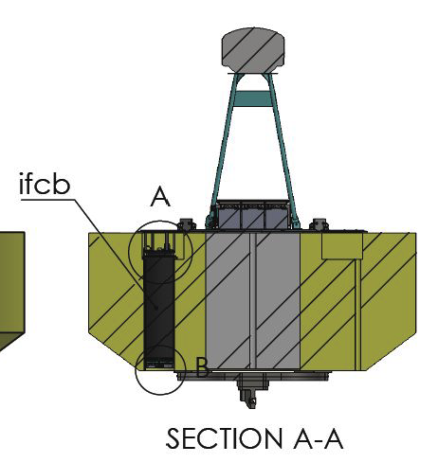
Power Buoy IFCB Quick Facts
Sampling freq: 20-30 mins
Sampling Vol: ~5 ml
Size Range: <10 μm to 150 μm
Image Resolution: ∼ 3.4 pixels/micron
1000s of images generated every hour
Over 190 days of Operation!
Intake
~190 Gb of images
Photo: McLane

Slide 4
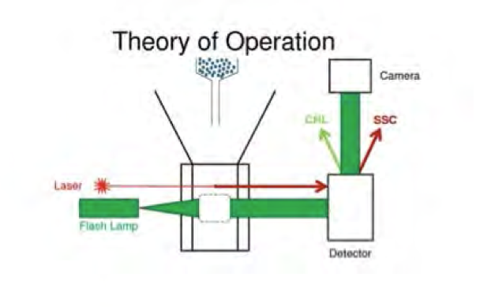
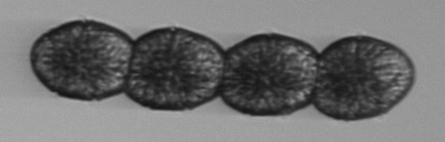
IFCB Theory in 1 minute
Needle injects particles into sheath fluid, sorts and aligns particles into thin line
Cell passing through quartz Cuvette
Image is taken with Camera
Cell passing through a laser
Cocholodinium sp.
Chl-a fluorescence is detected and
triggers a flash lamp
Source: McLane

Slide 5
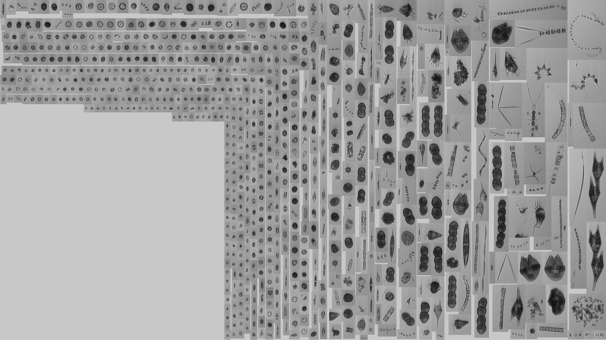
Sample from this Morning
~ 839 images
General Rule: More smaller things
Too much to look at manually.

Slide 6
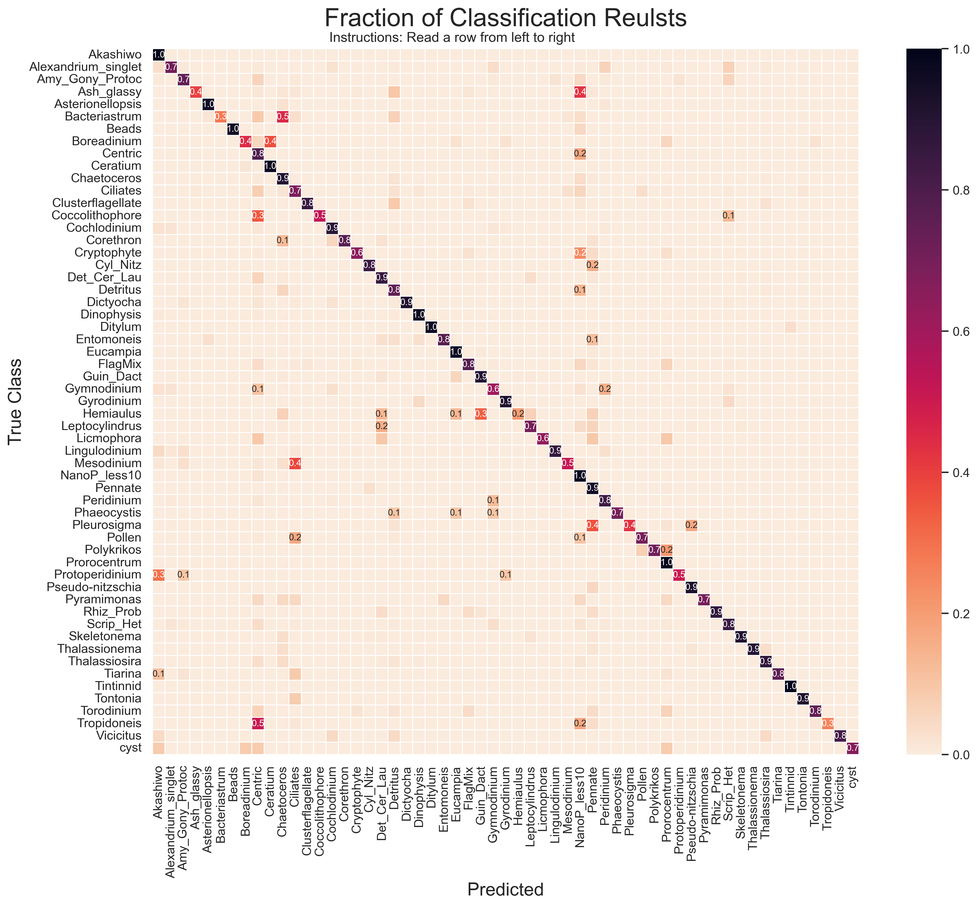
Classifier
51 class CNN (Xception)
100k + manually classified images
Work in progress…
Accuracy (f-1 score) = .93
Confusion Matrix:
True images vs Class Prediction

Slide 7
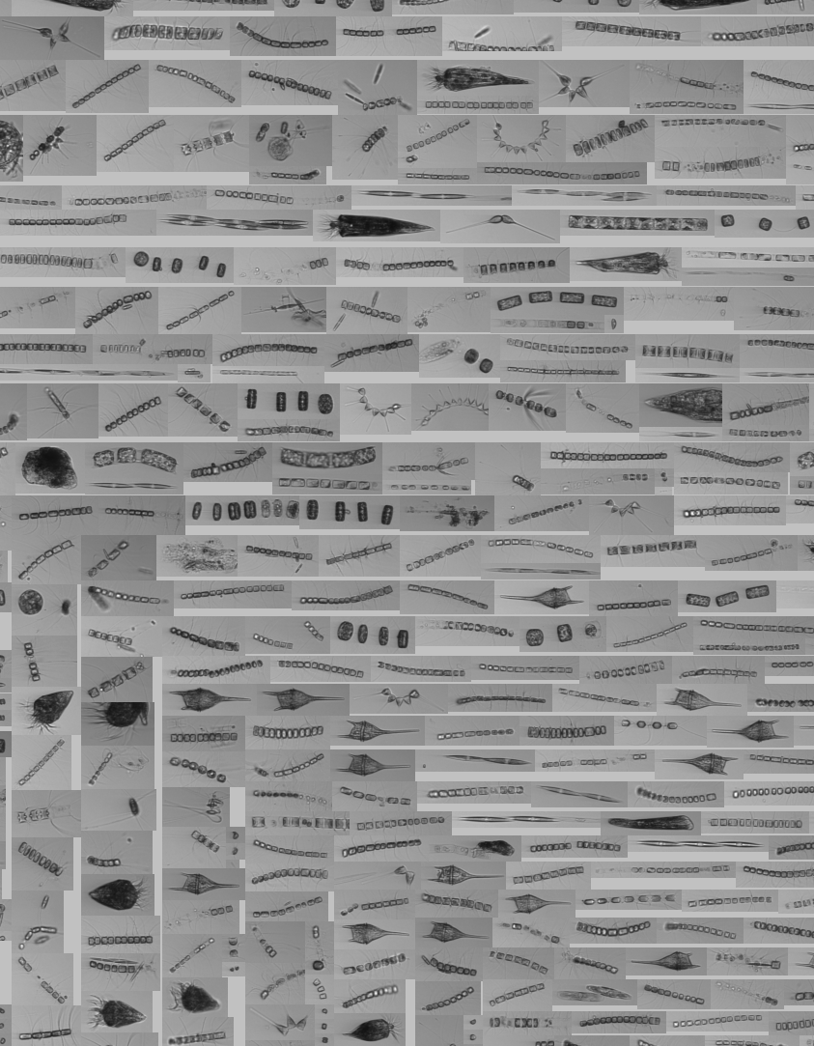
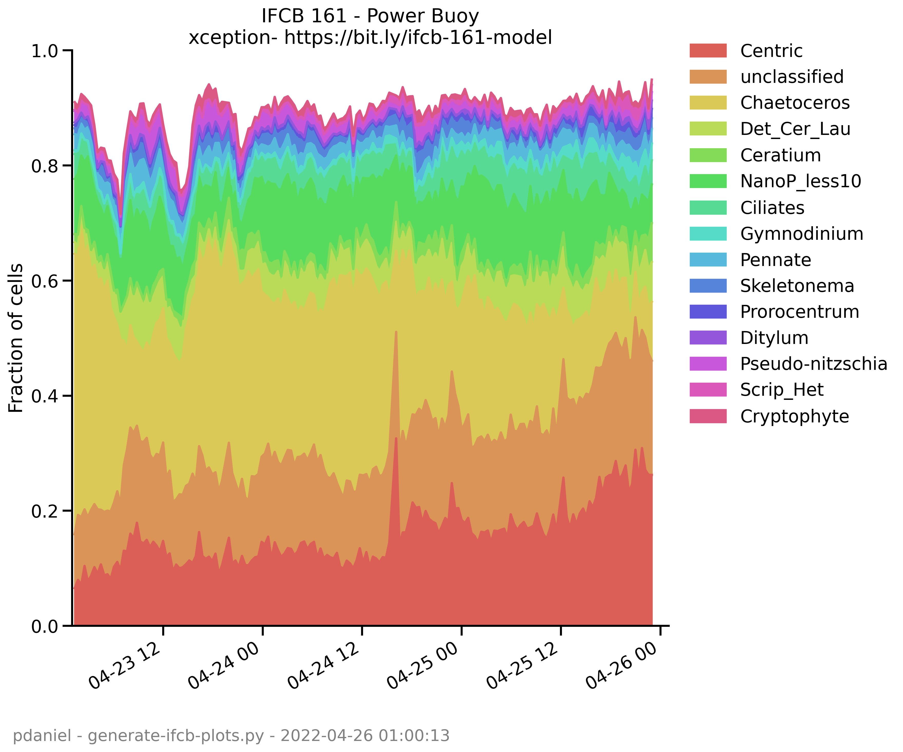
Data in Action
Chaetoceros Bloom
Chaetoceros

Slide 8
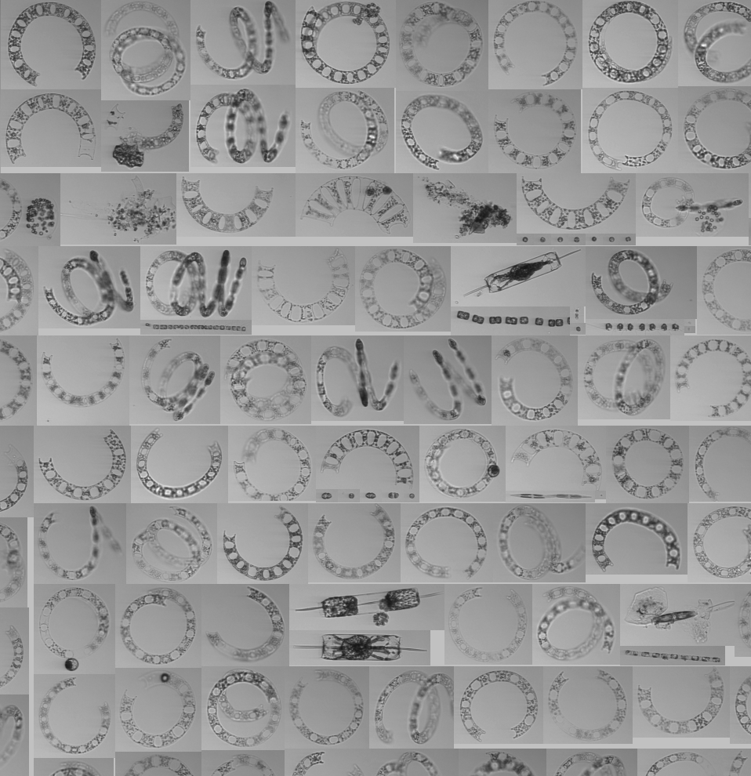
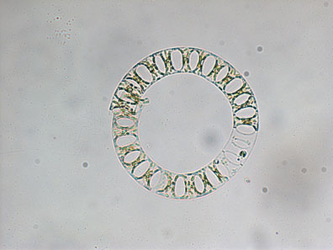
Eucampia sp. Bloom
Eucampia zodiacus
source: Kudela Lab
Efficient at N-Uptake, can outcompete Nori in farms and cause bleaching
May 2022

Slide 9
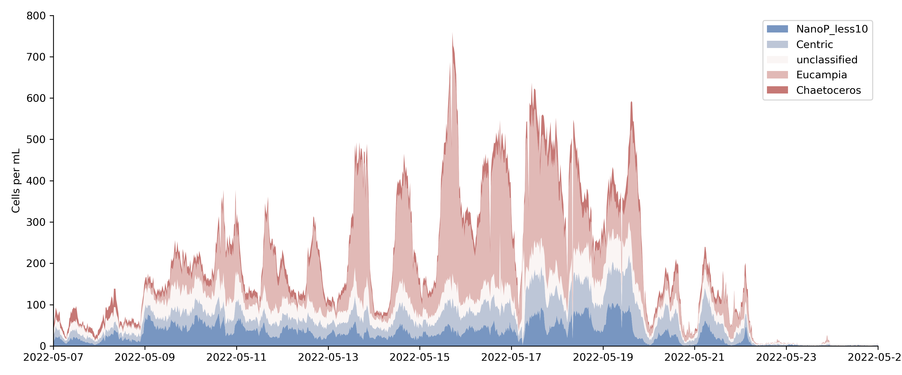
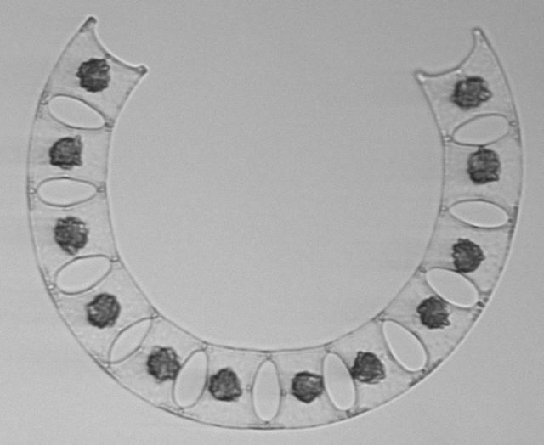
Eucampia Bloom
Other species abundance == Doesn’t Change
Is Eucampia outcompeting other Diatoms?

Slide 10
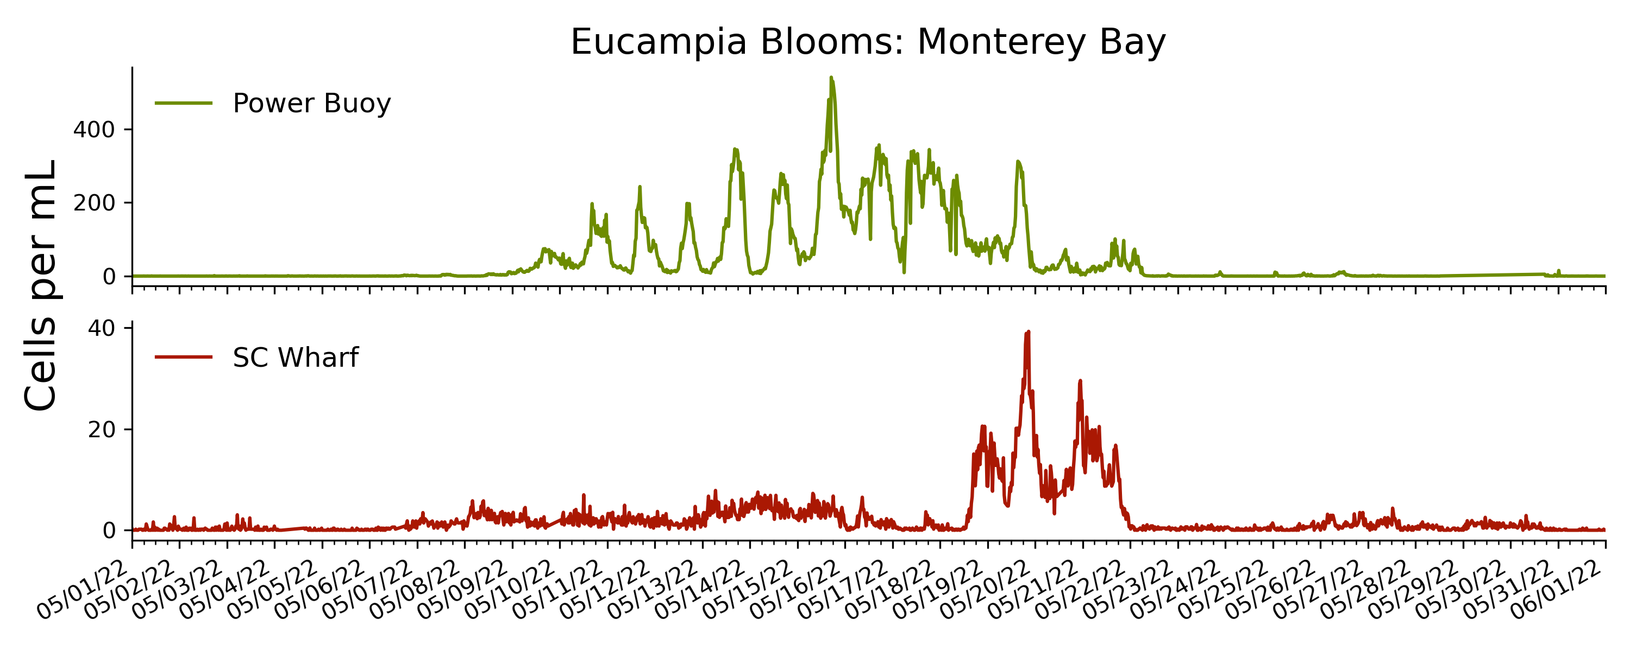
Eucampia Bloom
Power Buoy
Santa Cruz Wharf

Slide 11
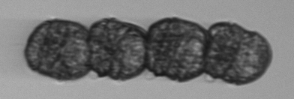
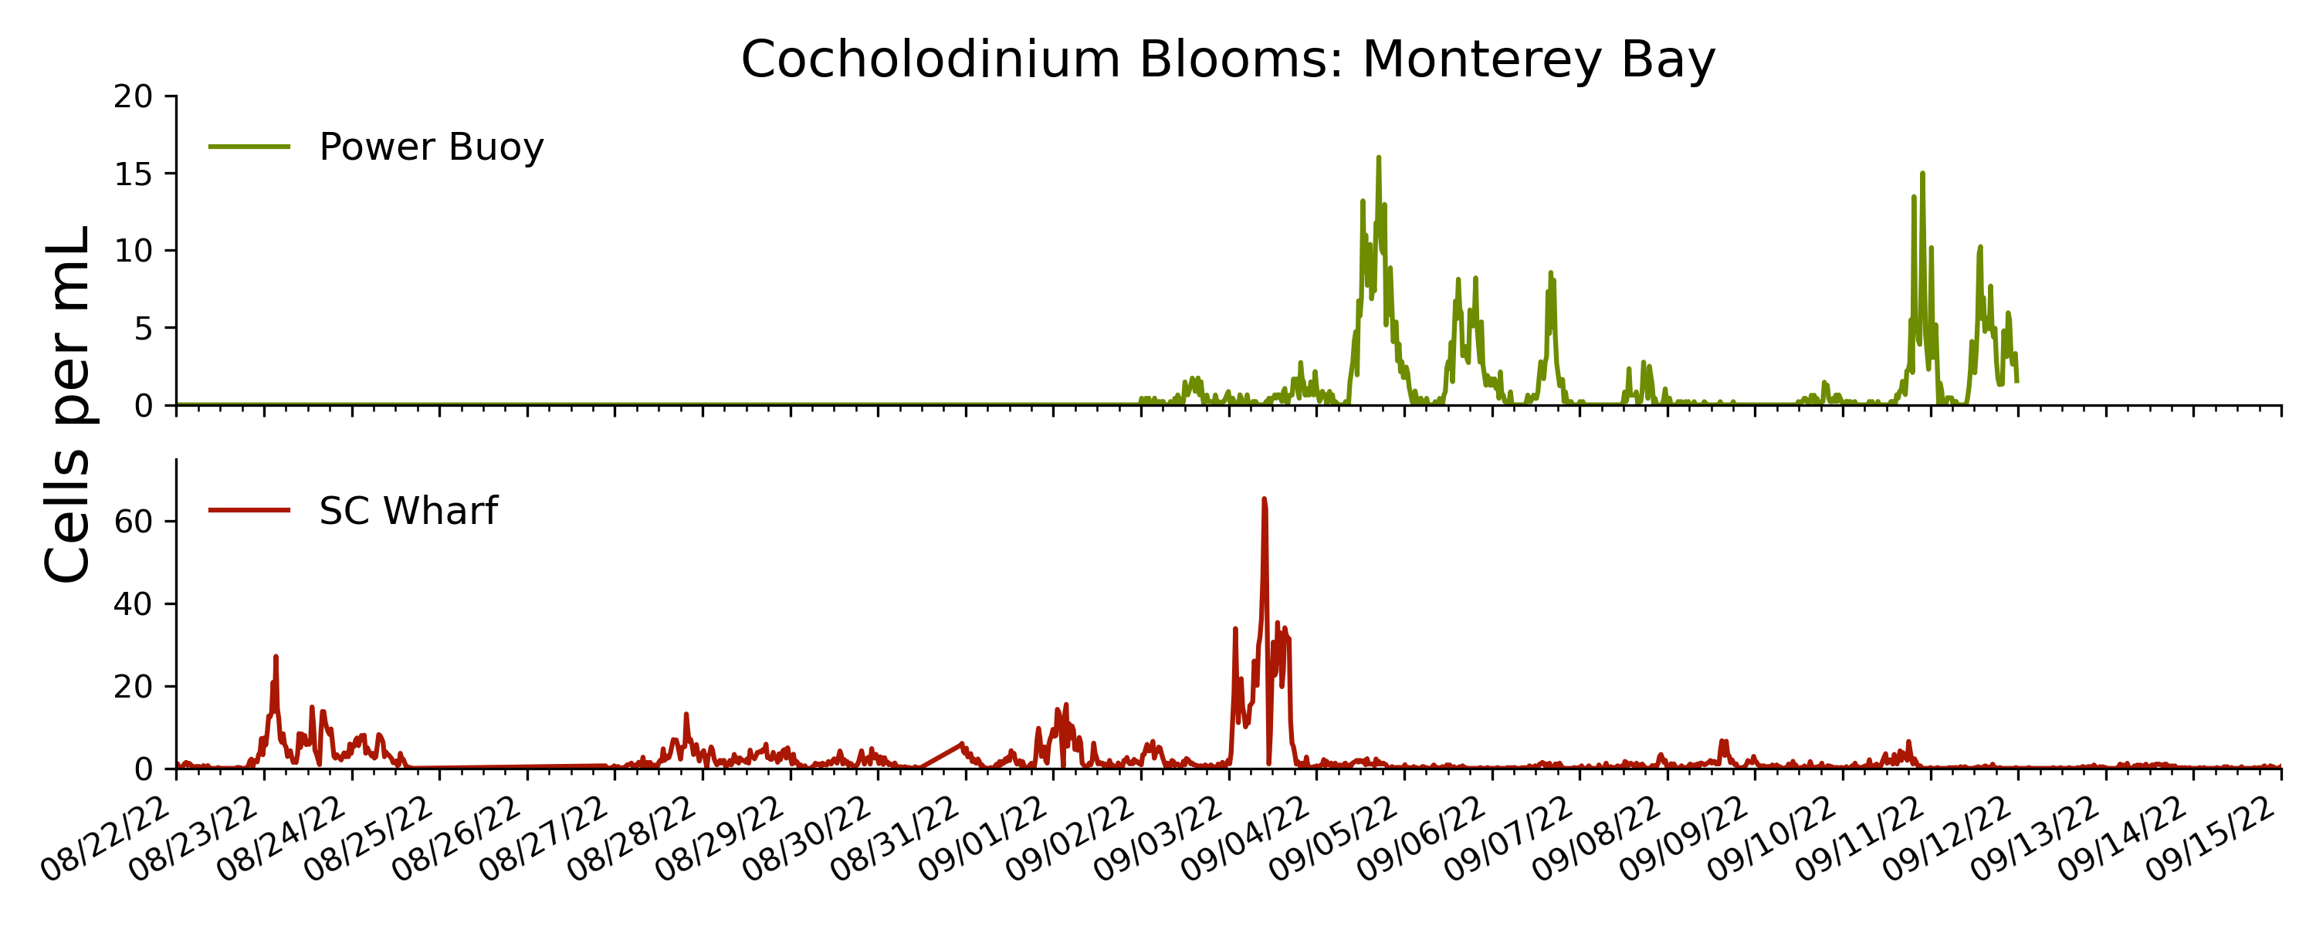
Margalefidinium (Cochlodinium)
Red tide forming
Toxin producing
Present in background since late summer year
Power Buoy
Santa Cruz Wharf

Slide 12
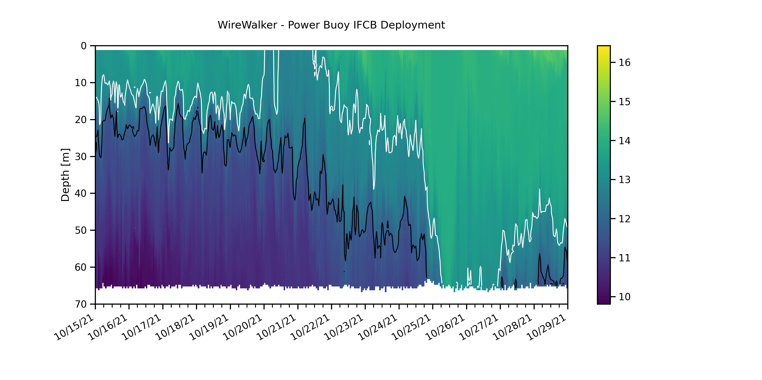
A Physical View: Wire Walker
Co-located profiling CTD – Hourly Casts

Slide 13
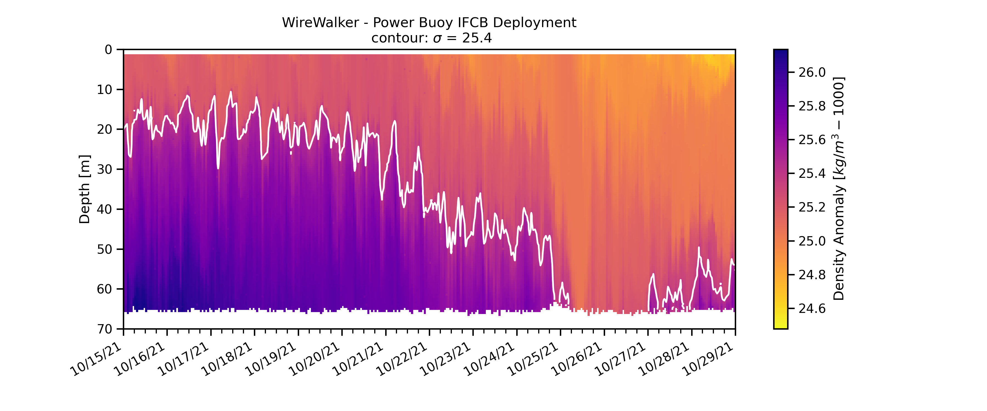
Internal Waves

Slide 14
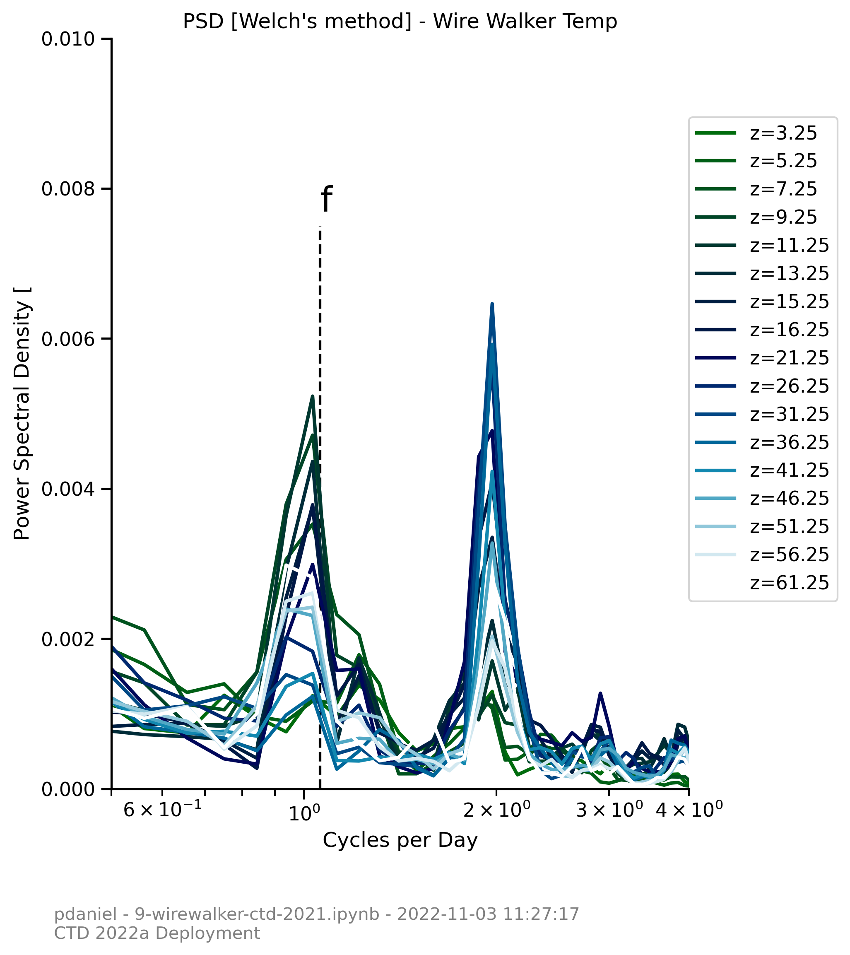
Density: PSD
At Surface: Diurnal Variability is greatest
At Depth: semi-diurnal variability is greatest

Slide 15
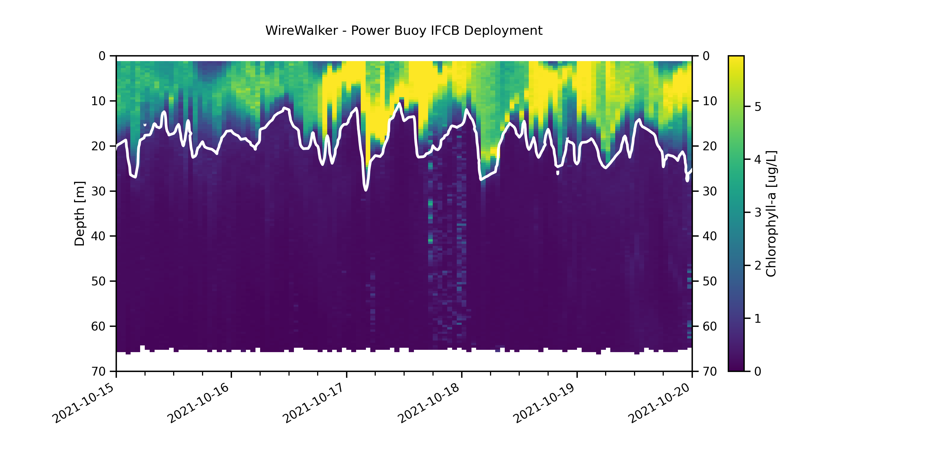
Fluorescence – Chl-a
contour: 25.4 Isopycnal

Slide 16
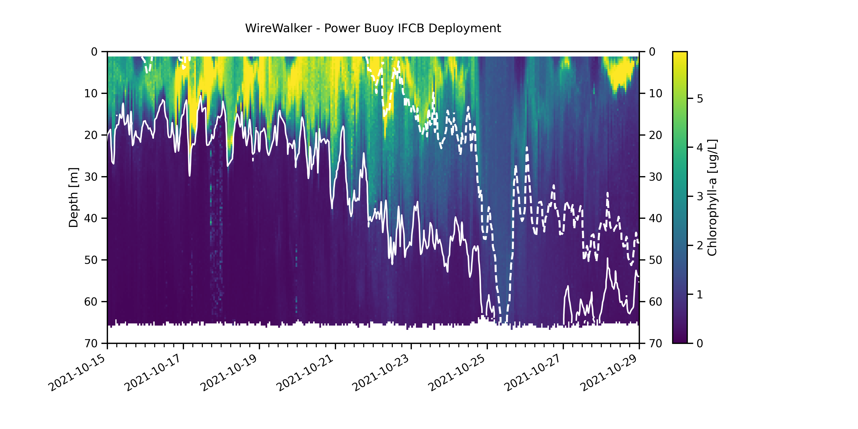
Zoomed Out
Low Biomass
Mixed Layer

Slide 17
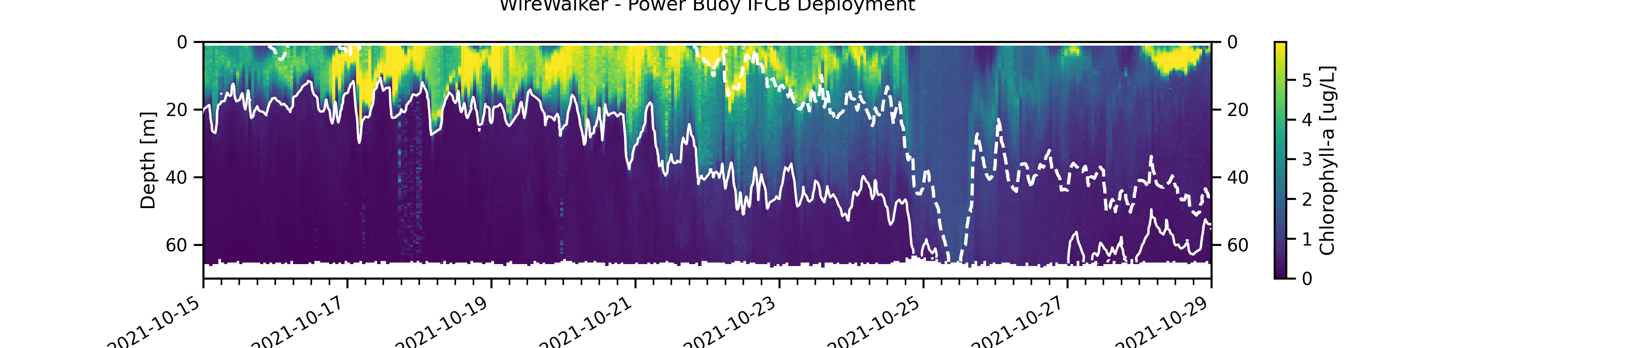
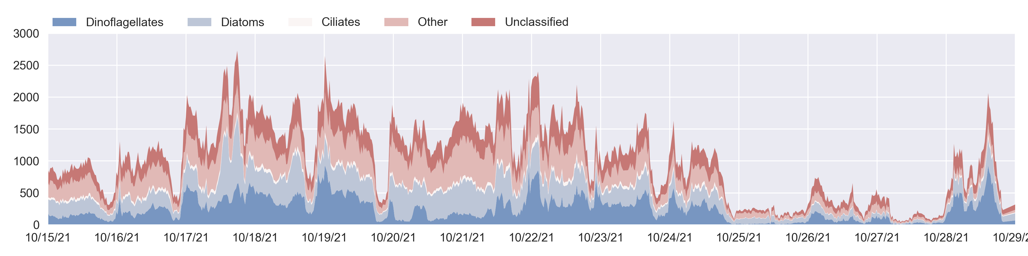
Low Biomass
The Wire Walker confirms what we see with IFCB

Slide 18
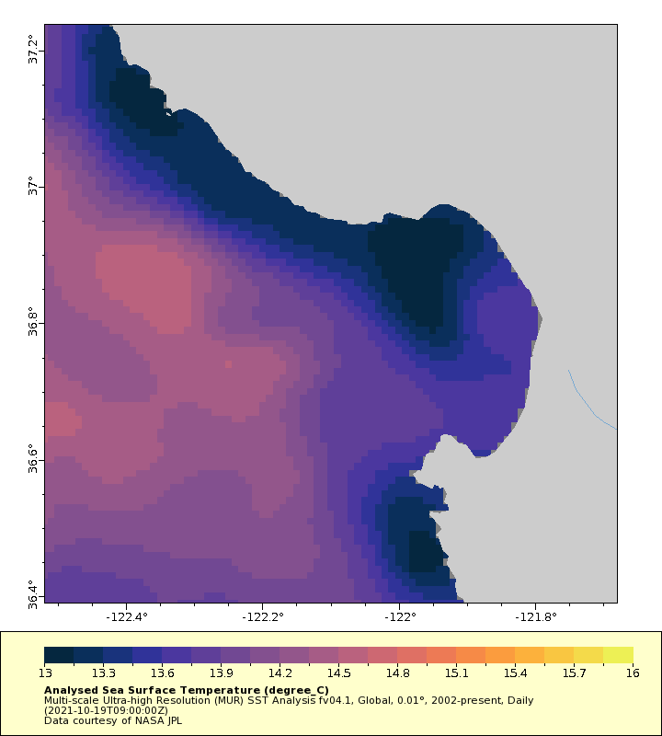
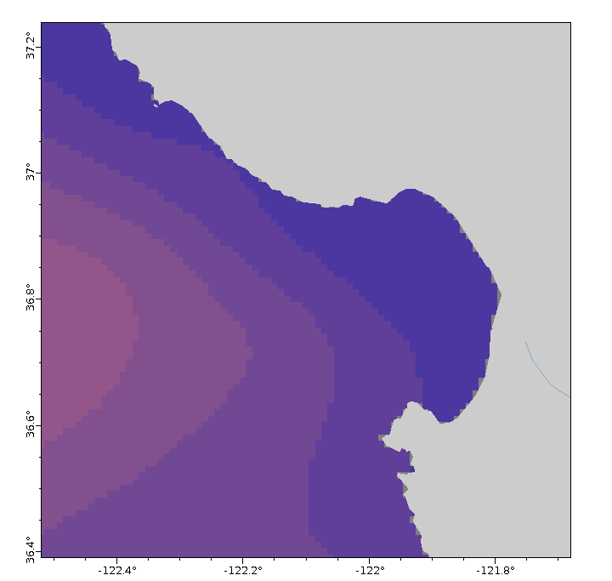
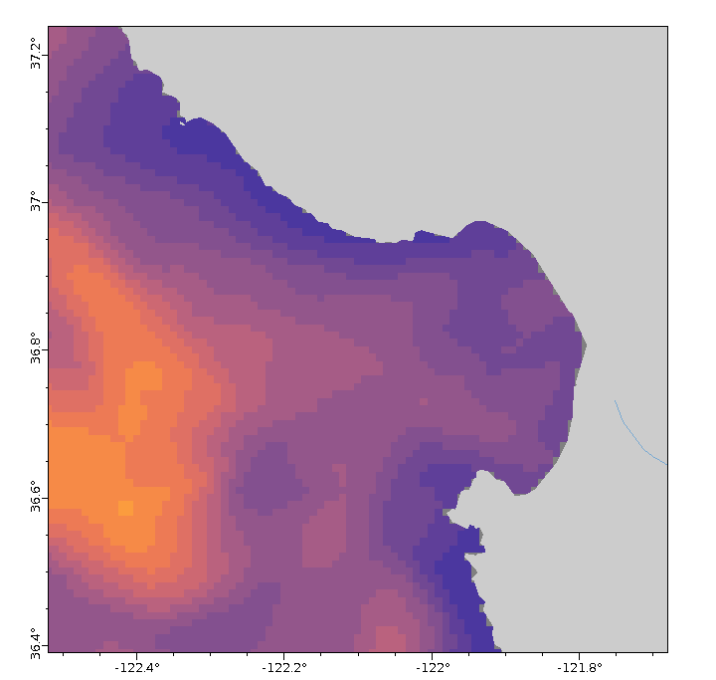

Slide 19
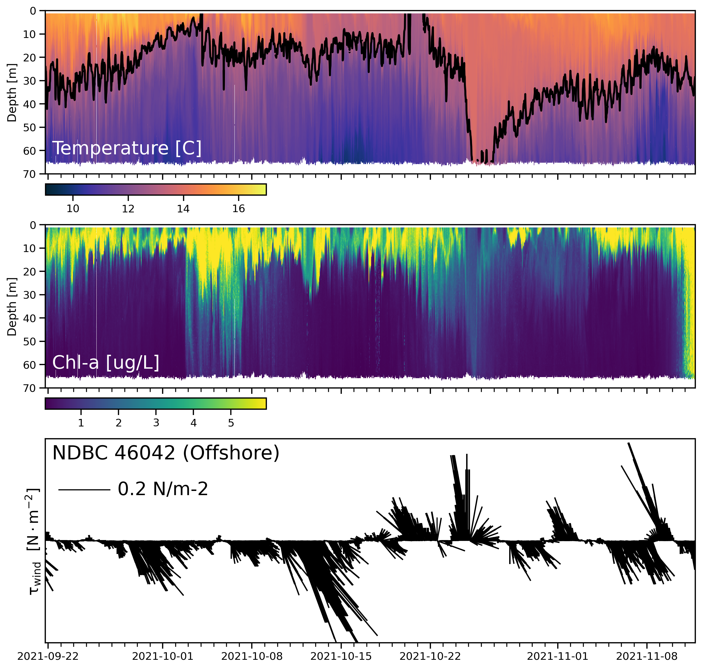
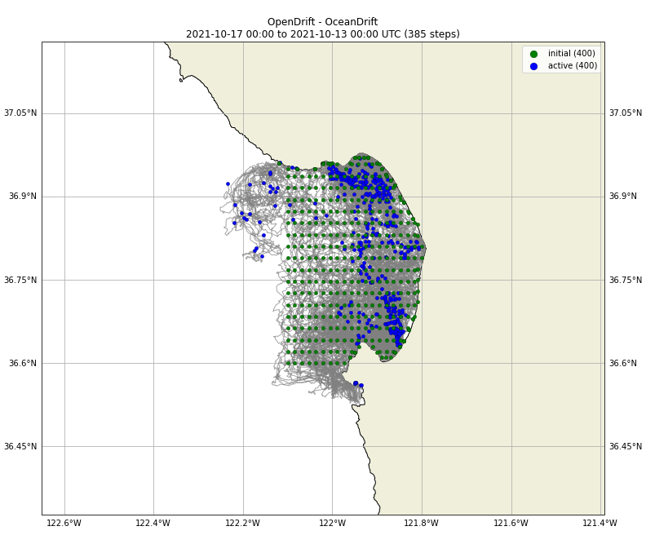
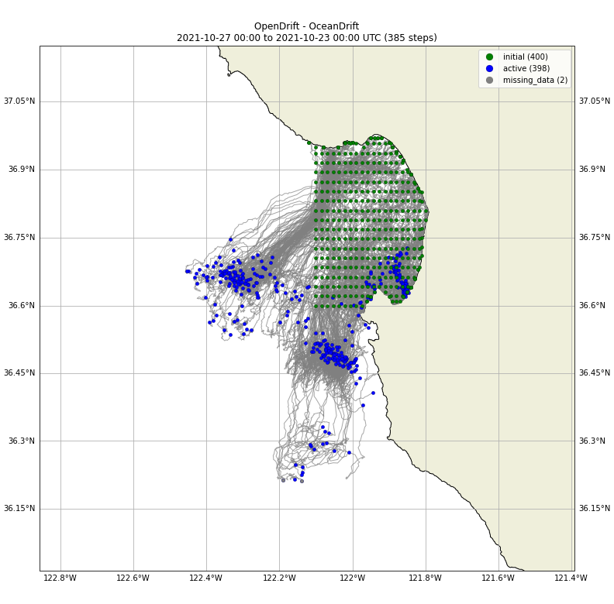
Particle Tracking: HF Radar
Estimate origins of surface water mass.
Release Point
Backward Propagation Path
Upwelling/Retention
Downwelling/Relaxation
Changes in Circulation → Shift in community structure + Biomass

Slide 20
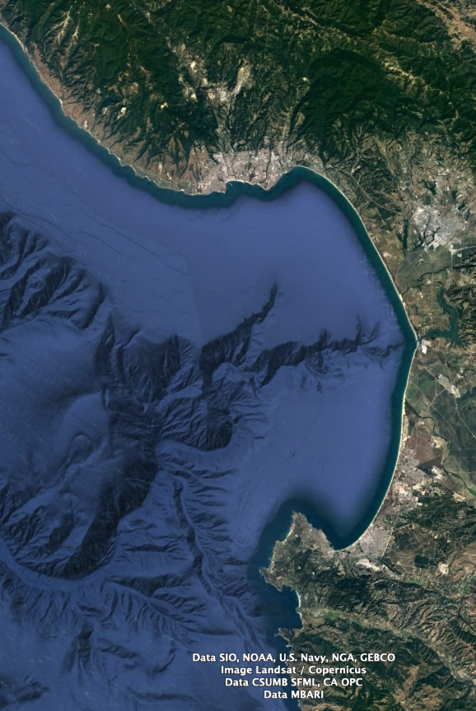
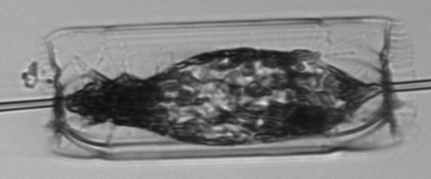
Any questions?

