Slide 1
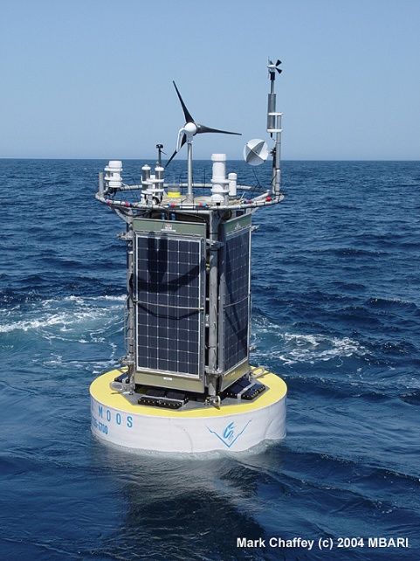
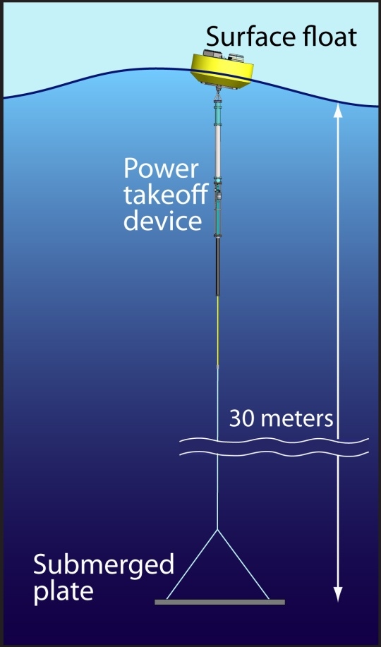
Technology needed:
Vehicles (Capability, Reliability)
Autonomy
Instrumentation
Energy
Communications
Energy
For extended presence you must either:
(1) Bring energy along (in batteries).
(2) Collect energy from the environment.

Slide 2
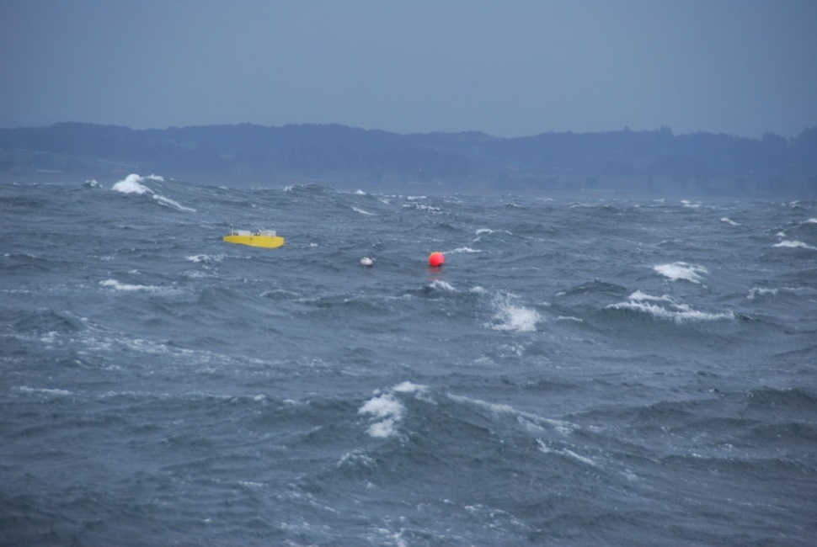

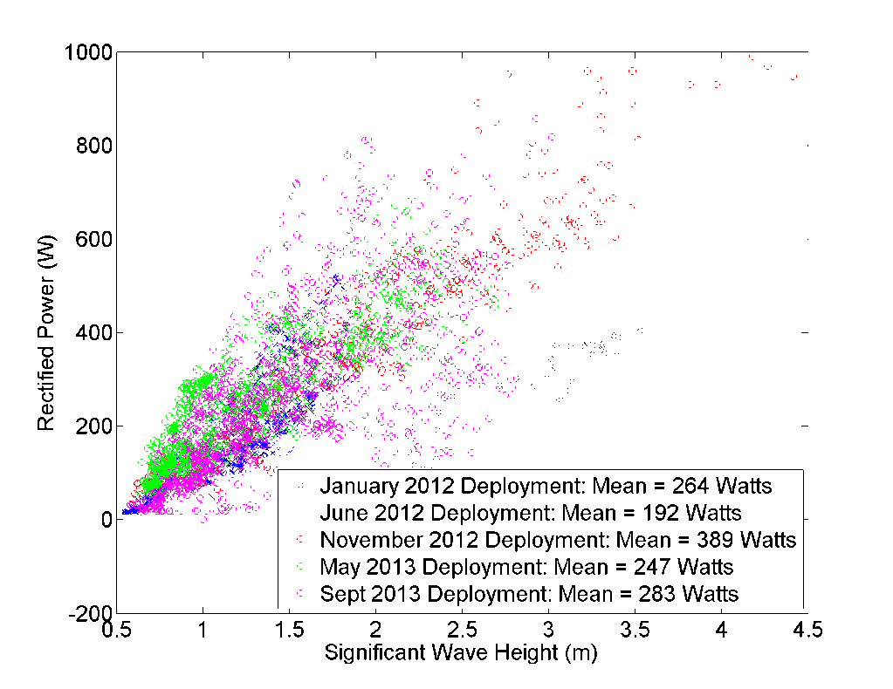

Slide 3
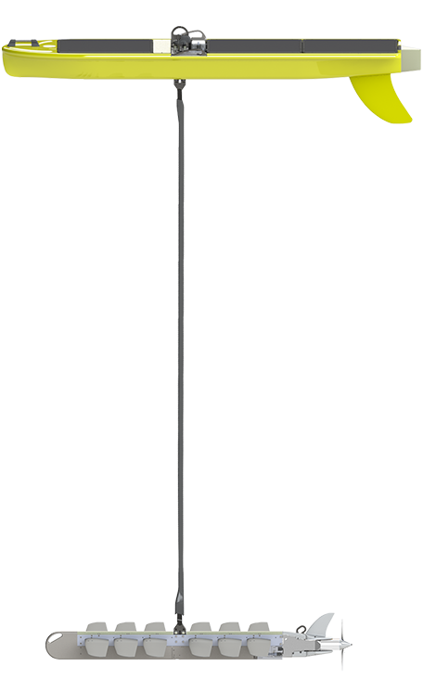
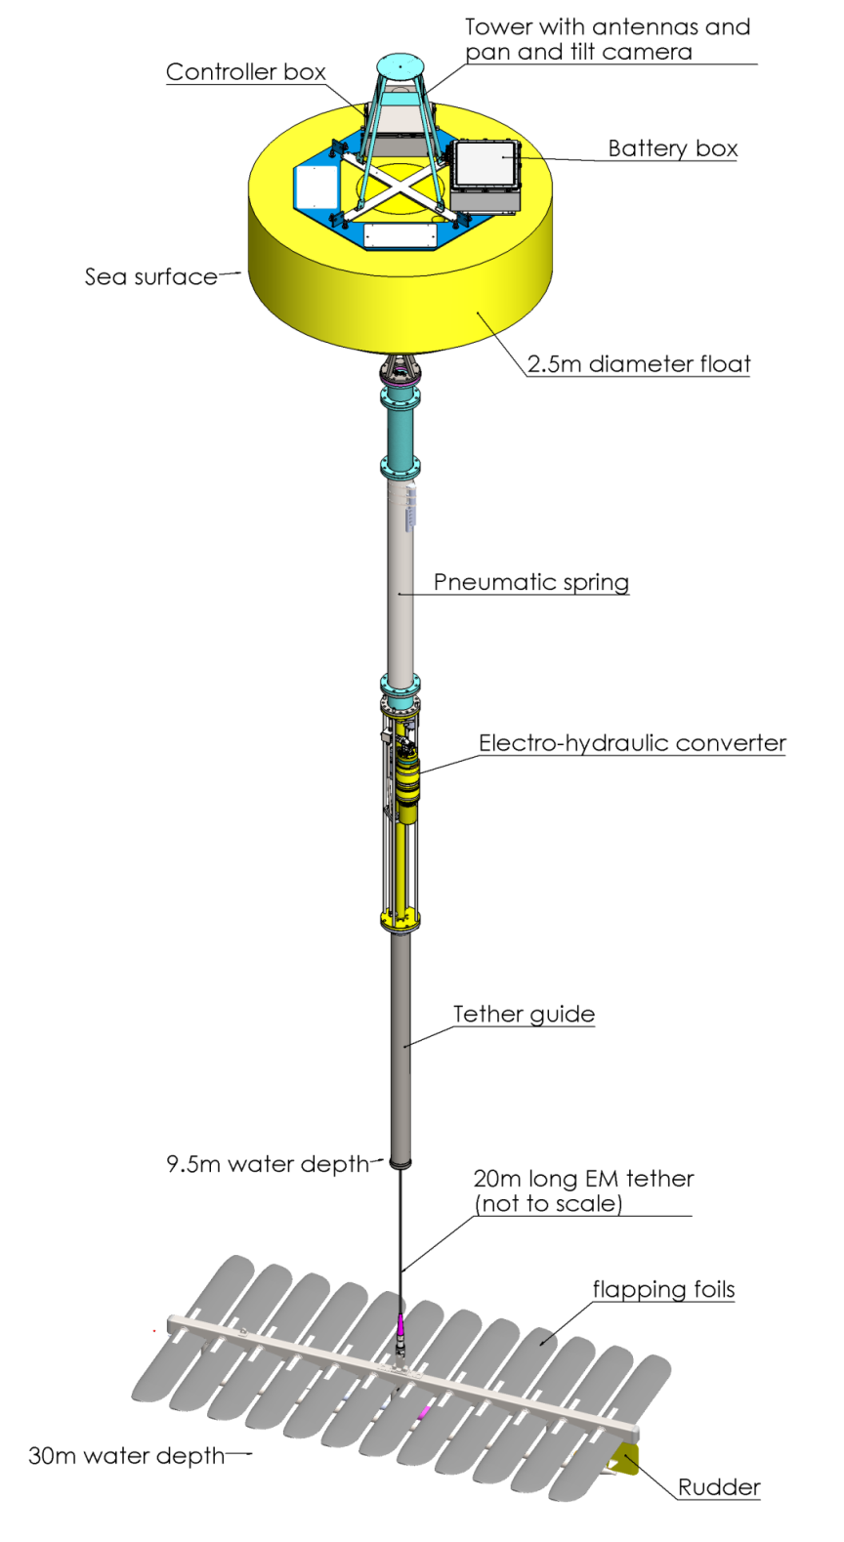
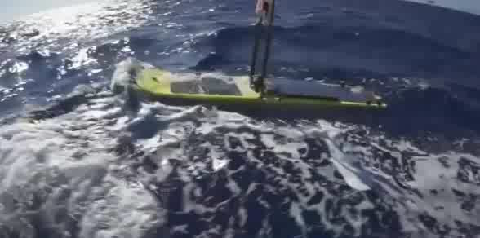

Slide 4
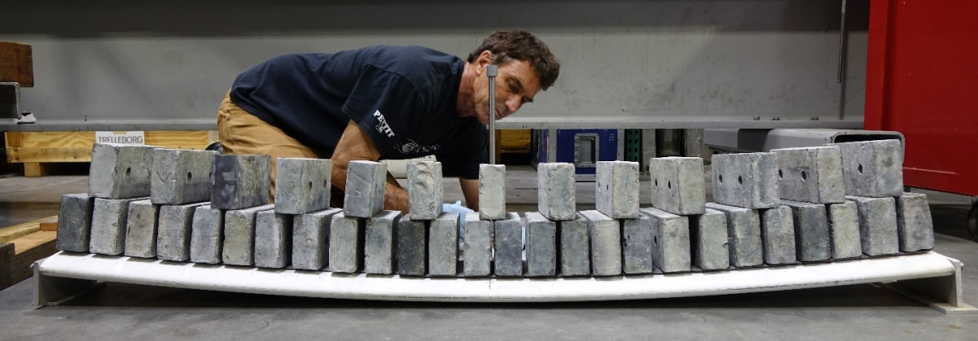
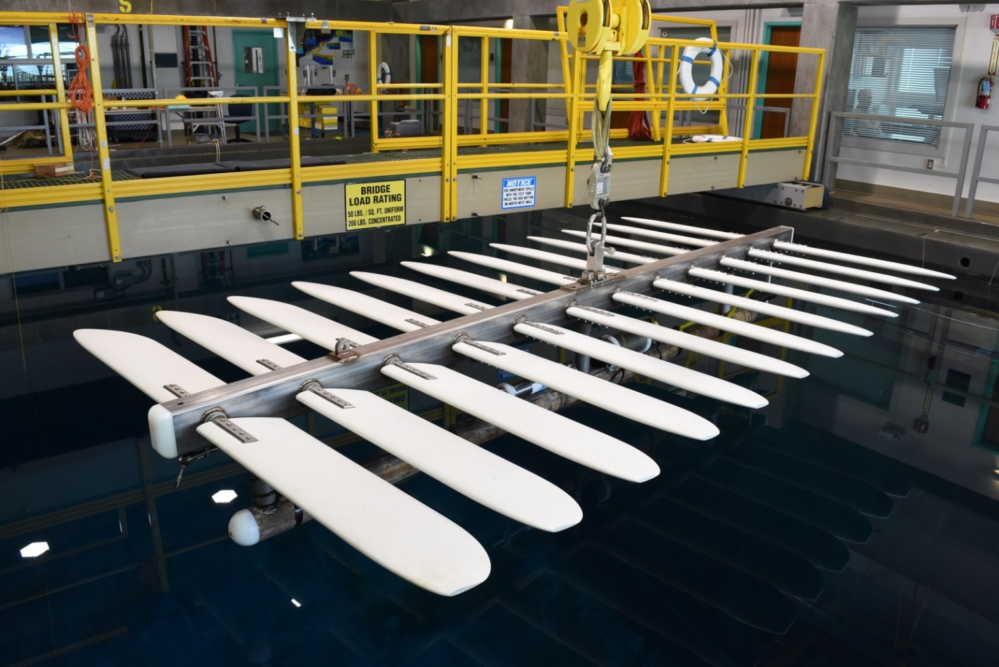

Slide 5
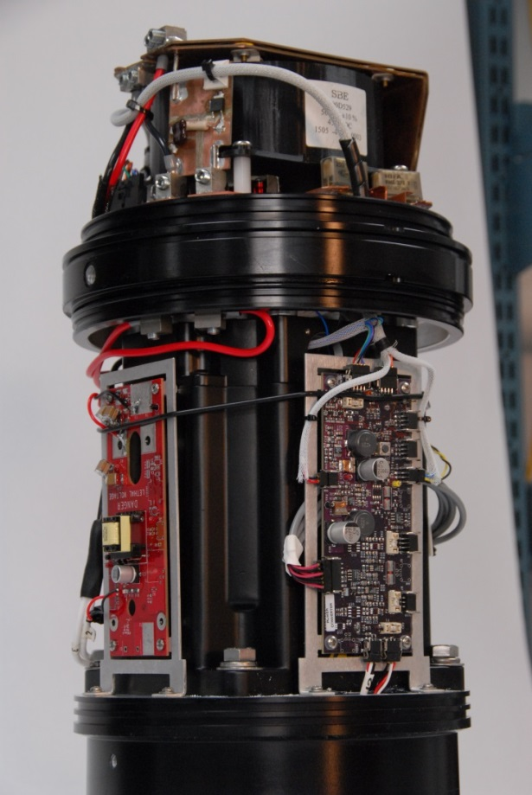
Technical Challenges:
Energy Capture Mobility
Power Electronics
Reliability
AUV Docking
Current Work:
Model Predictive Control Technologies
CFD study of flow over flapping foils
LRAUV line capture

