Slide 1
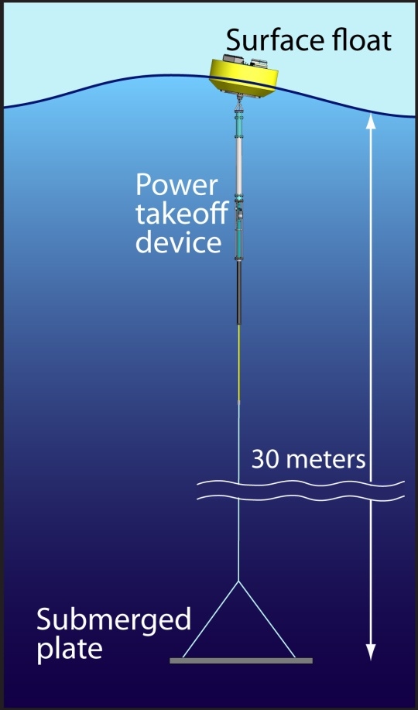
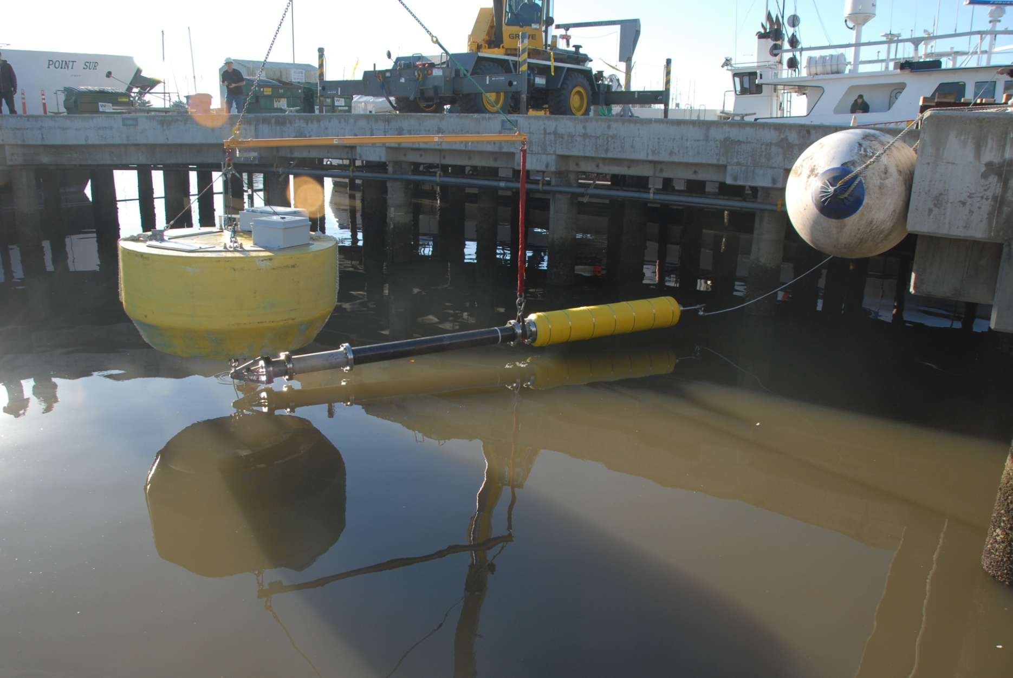
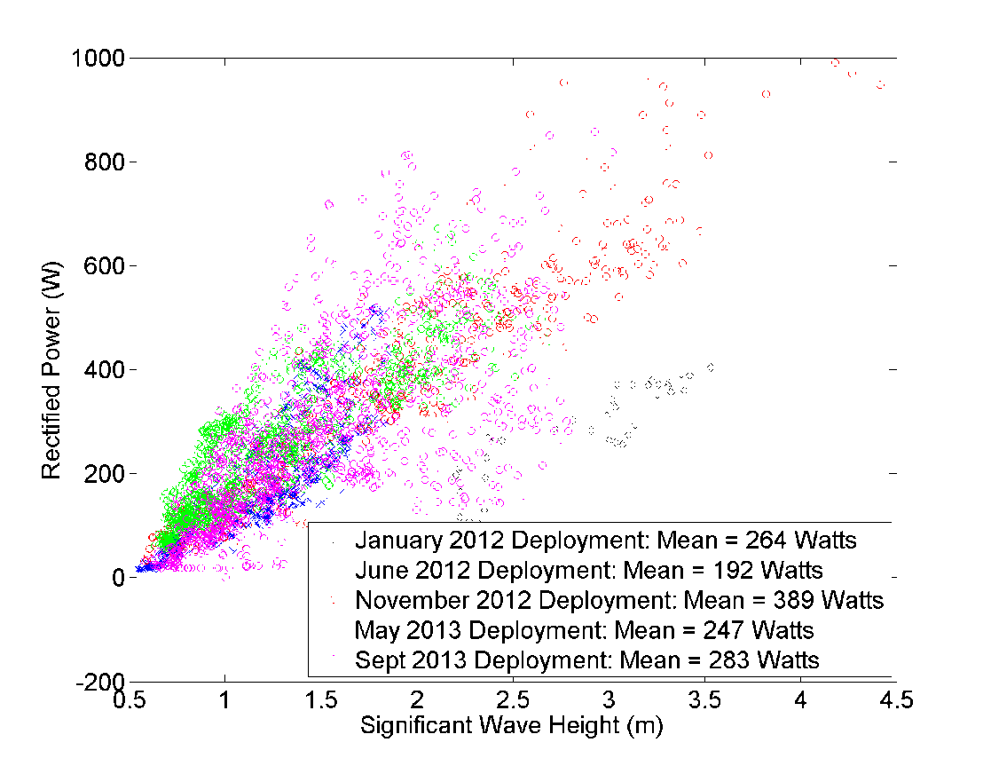
Notes:
The MBARI Wave-Energy converter under development at MBARI is a two-body system consisting of a floating surface buoy (2.5m diameter) and a submerged anti-heave plate (10m^2) connected by an electro-hydraulic power take-off device. This system has been deployed at sea a half-dozen times or so for periods of 1-3 months. The power generation depends highly on sea-state and has averaged greater than 250Watts. Shown are hourly averages versus wave height, instantaneous power can be as high as 10 kW.
The aim of this system is to ultimately provide a power for persistent presence of AUV’s and other instrumentation. The challenges are as follows, along with an estimate of where things stand.
Wave-Energy Capture. This is working about as well as can be expected for a two-body system of this size. Small systems like this don’t match well with the physics of wave-energy conversion, so to get to a kW system or higher would require a significantly larger system.
Survivability. For long-term deployments there are a lot of fatigue-type issues that can only be uncovered and addressed through testing. With each deployment we are working through these. We currently have the system deployed and intend to leave it in place through the winter.
Efficient and robust power take-off device. This device is proving itself to be effective, there has been considerable development done here at MBARI on this and this is a key contribution we are making.
Station-keeping. Little to no progress, we deploy with an anchor. For this platform to really meet the goals, this needs to be incorporated and the Liquid Robotics flapping foil concept is very attractive. Numerical modeling at MBARI has demonstrated that the flapping foil concept can be effective without adversely affecting the power-generation characteristics.
AUV docking. We have designed and built a proto-type of a dock for the MBARI LRAUV, but this has only undergone limited testing. There are a lot of issues related to docking the AUV to the moving submerged plate that remain unexplored. We are currently lab testing an electro-mechanical tether design to allow power and communications delivery to the submerged plate. Implementation of that data link in 2015 will allow a better understanding of the environment and also allow active stabilization techniques to be evaluated.

Slide 2
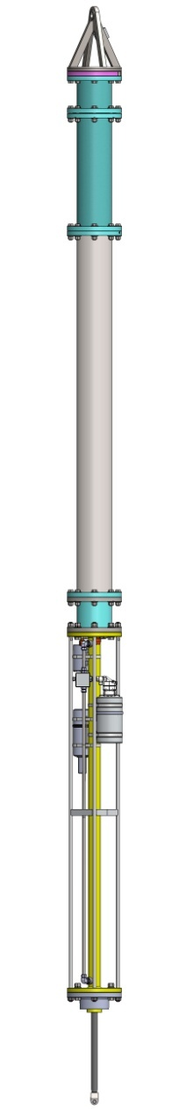
Electro-Hydraulic Power Take-Off Device
70%-80% efficient (Mechanical->Electrical)
Survivability testing on-going (currently deployed)
Notes:
The MBARI power take-off device consists of they hydraulic pistons, pneumatic spring, electro-hydraulic generator, and power conditioning electrons and is proving to be fundamentally reliable and effective. Although there has been some refurbishment between deployments, the fundamental device and most of the components have been used in all deployments, totally >8 months at sea. The hydraulic motor and piston seals haven’t shown appreciable wear. The key longevity item in this system is the tether between the bottom of the PTO and the submerged plate, post-deployment testing has demonstrated little weakening.

