Slide 1
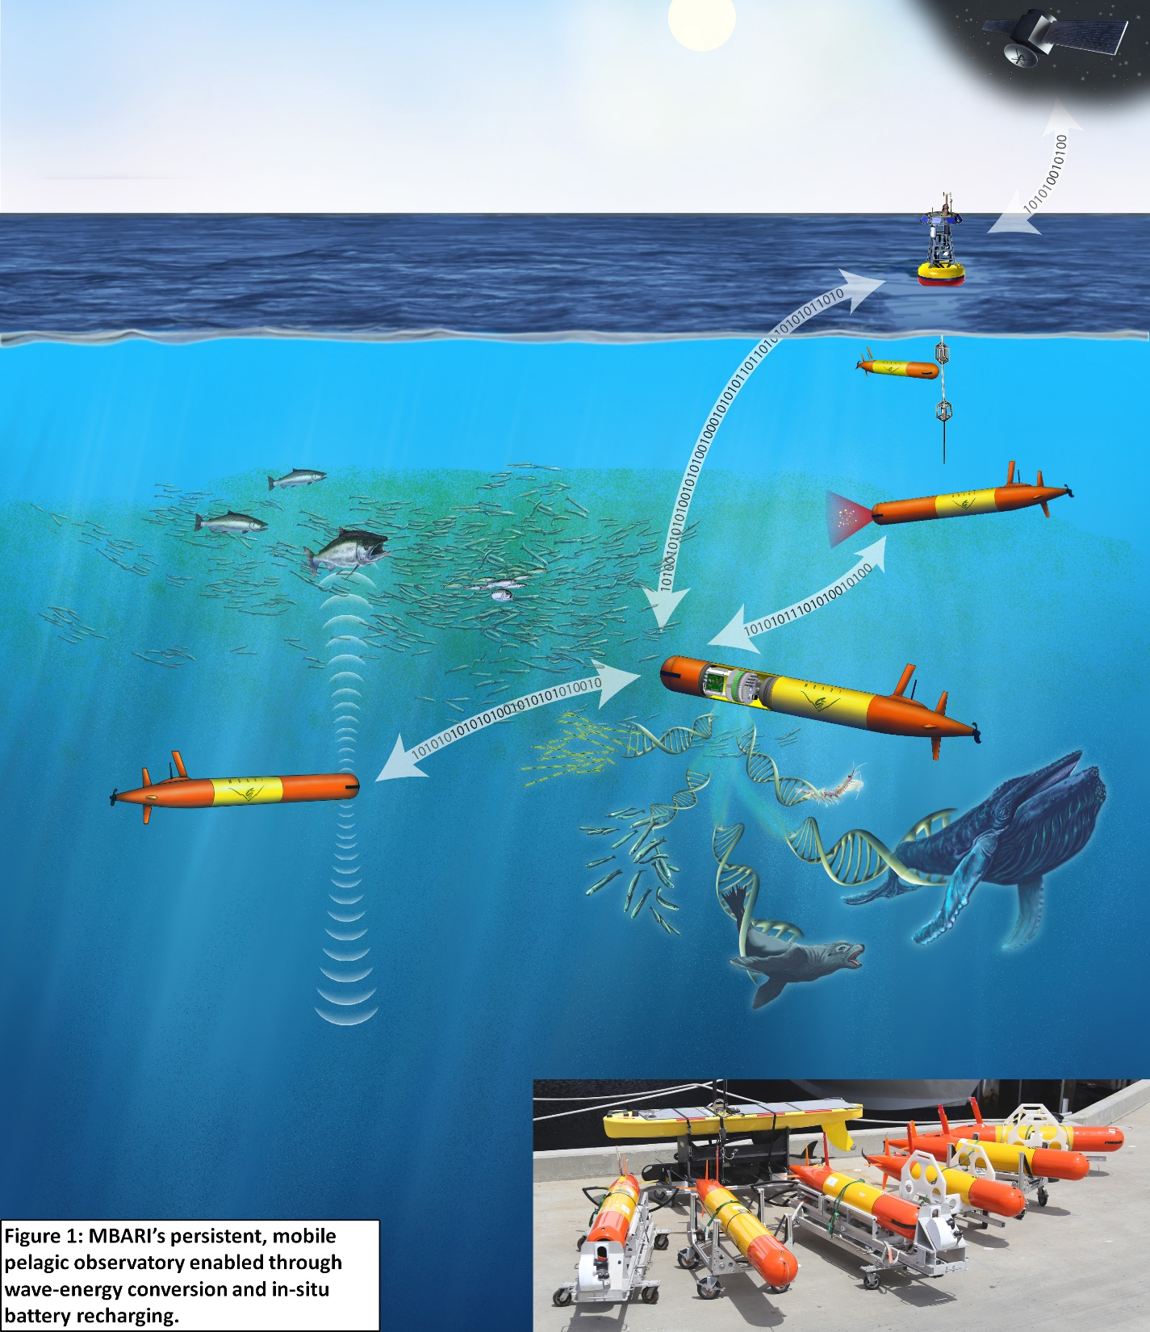
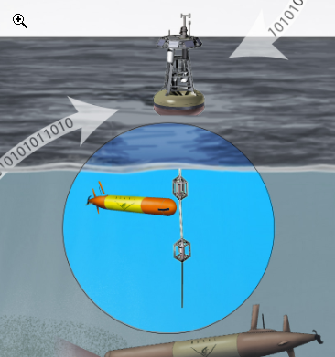
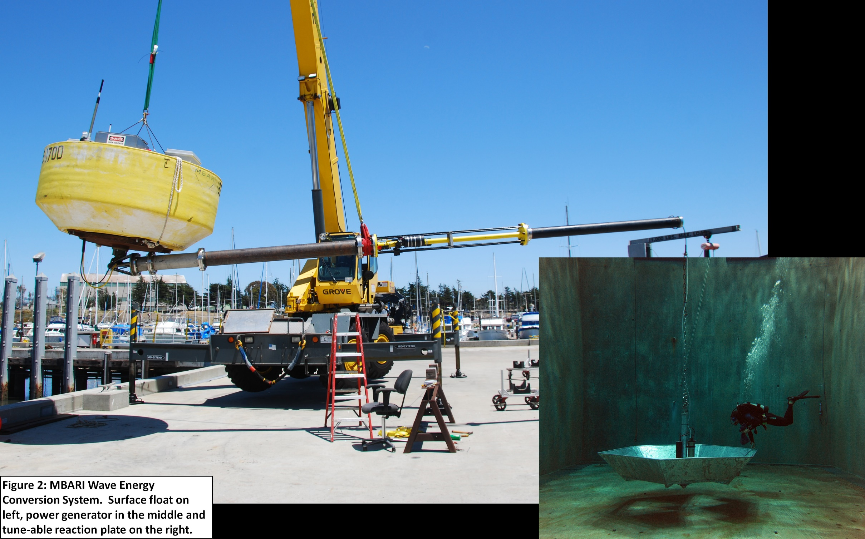
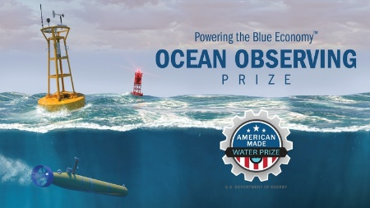

Powering-Up Ocean Science
Develop AUV Dock and Recharge Capability to Bridge
AUV-Based Open Ocean Observatory with Wave Energy Conversion

