Slide 1
Power Buoy Power Converter
Concept Review

Slide 2
Power Conversion
d
24 V
D
Power Converter
(DC Current, Voltage)
A
=
π
(
D
2
-
d
2
)/
4
p
Piston Area
Electrical Generator
(AC Current, Voltage)
=
Hydraulic Piston
(Force, Velocity)
Hydraulic Motor
(Torque, RPM))

Slide 3
Design Challenges
Power converter must:
Handle widely varying input voltages
Dump excess power to load bank
Perform maximum point power tracking
Precisely regulate output voltage and current to charge batteries
Deliver peak powers in the kilowatts

Slide 4
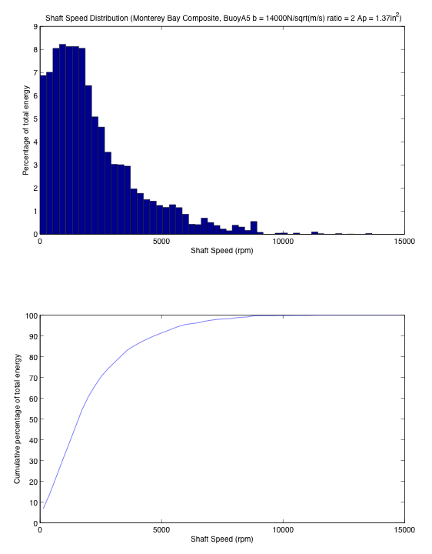
Wide Dynamic Range

Slide 5
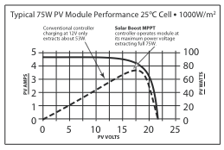
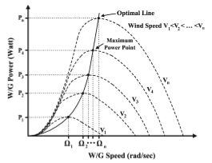
Maximum Power Point Tracking
Many different algorithms:
Perturb and Observe
Incremental Conductance
Constant Voltage
Model Based

Slide 6
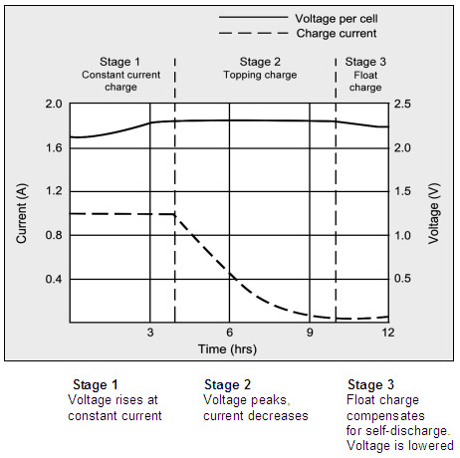
Charging Lead-Acid Batteries

Slide 7
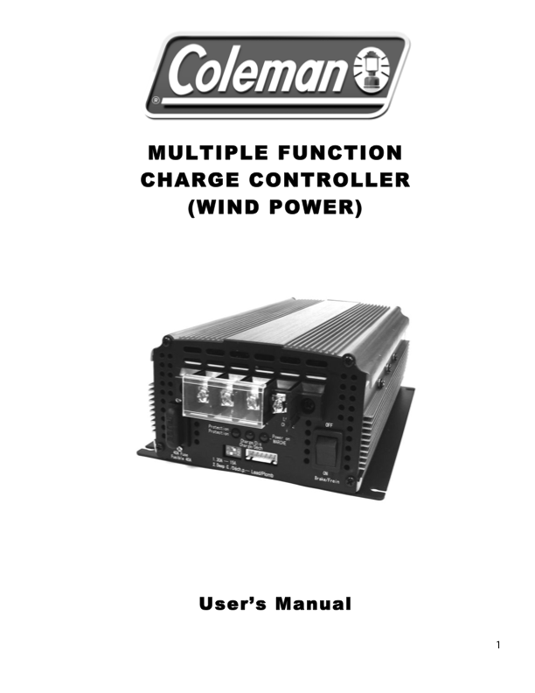
Buy a Power Converter?
Solar
Micro Hydro
Wind

Slide 8
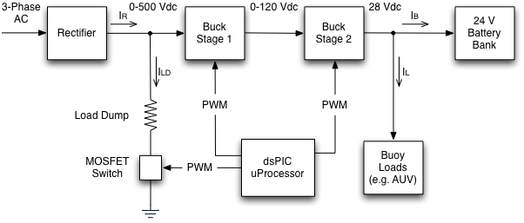
Power Converter Block Diagram

Slide 9
What does the Load Dump do?
Provides mechanical damping to system
Gets us quickly to optimal loading

Slide 10
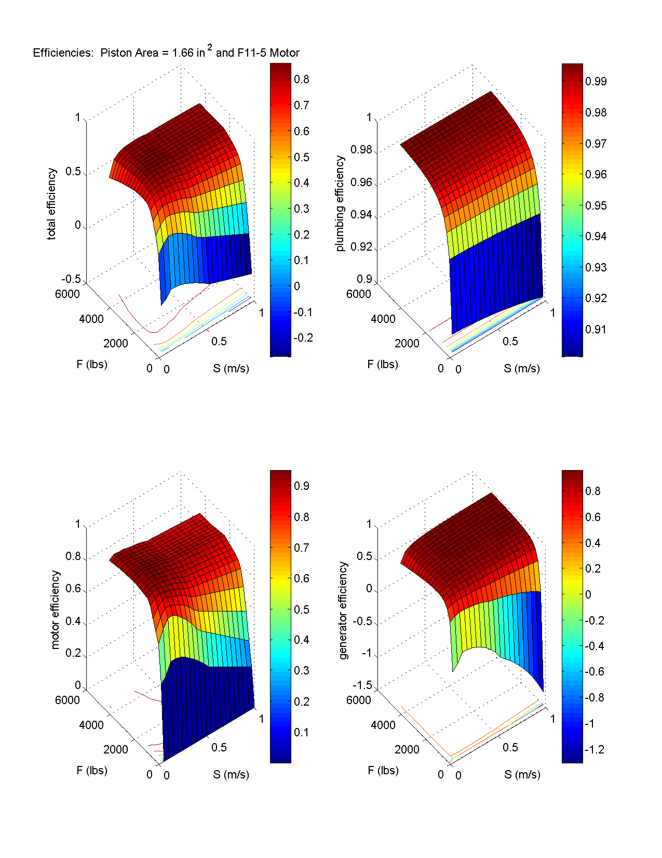
Avoid the
COEDs!

Slide 11
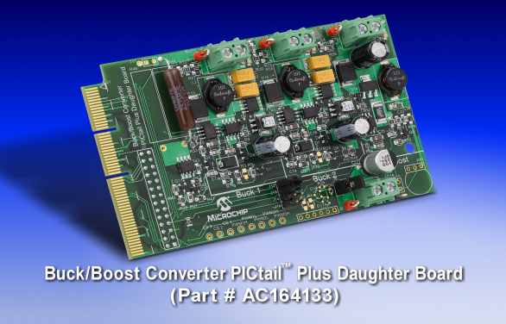
Getting From Here to There

Slide 12
Proof-of-Concept Small-Scale System
Proto Board
Buck/Boost Board
Current
Sensor
Buck
DC-DC
15 – 24 V
Power
Supply
12V
SLA
Battery
Load
Load
MOSFET
MOSFET
Explorer 16 Board
A to D
A to D
PWM
PWM
PWM

Slide 13
Proof-of-Concept Load Dump
Proto Board
Current
Sensor
0 - 500 V
Power
Supply
Load
MOSFET
Explorer 16 Board
A to D
PWM

Slide 14
Initial Hardware
Load
Dump
PC Board
Current
Sensor
2-Stage
Buck
Converter
0 - 500 V
Power
Supply
24V
SLA
Battery
MOSFET
Explorer 16 Board
A to D
A to D
PWM
PWM

Slide 15
Schedule
• PoC Small-Scale System – 10Oct11
PoC Load Dump – 1Nov11
Design Review for Initial Hardware – 1Dec11
Initial Hardware – 16Jan12
Final Hardware - ?

