Slide 1
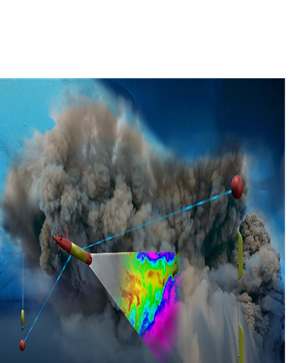


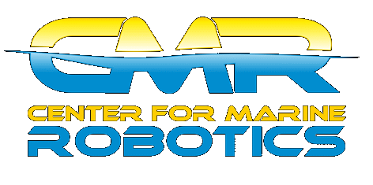
ADAC Year 5 Biannual Review
(LRAUV) for Under-Ice Mapping of Oil Spills and Environmental Hazards
Lead PI Dr. Jim Bellingham PI/PM Amy Kukulya (WHOI), (WHOI) PI Brett Hobson (MBARI)

Slide 2
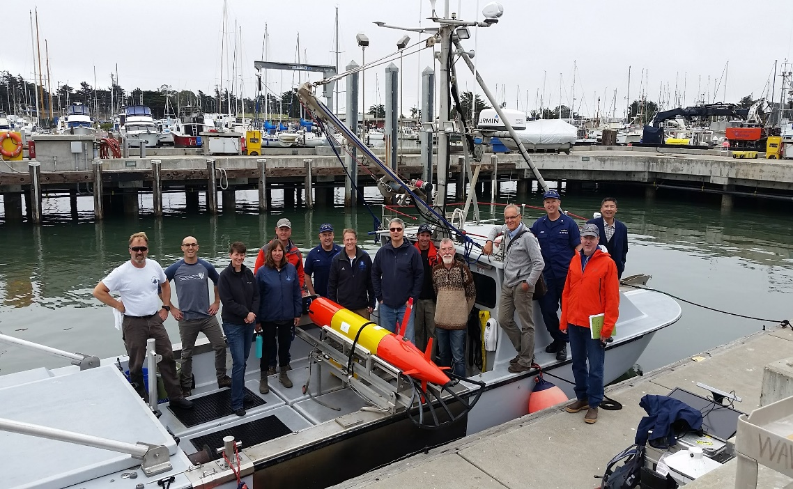
ADAC Project: LRAUV for Under-Ice Mapping of Oil Spills and Environmental Hazards
ADAC Program Year 5 Biennial Review
Project Principal Investigator(s):
  Lead PI Dr. Jim Bellingham (WHOI),
  PI/PM Amy Kukulya (WHOI),
  PI Brett Hobson (MBARI).
Project Organizations
  Woods Hole Oceanographic Institution,
  Monterey Bay Aquarium Research Institute.
Project Supporting Team:
  Dr. Chris Reddy,
  Daniel Gomez-Ibanez,
  Sean Whelan.
Project Champion:
  Kirsten Trego, HQ USCG MER
Project Advocates:
  Dr. Robyn Conmy, EPA,
  USEPA/NRMRL/RTEB,
  USCG Research and Development Center
  Dr. Jay Choy BSEE/Oil Spill Preparedness Division,
  Dr. Lisa Dipinto, NOAA, Office of Restoration and Response.

Slide 3
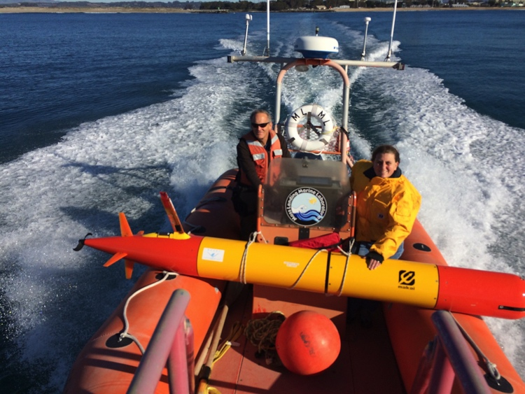
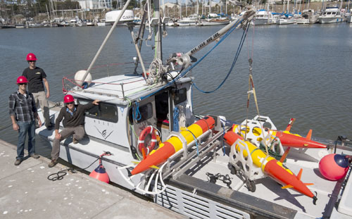
Project LRAUV: Description and Baseline
ADAC Program Year 5 Biennial Review
Project Description:
  Platform: To develop an Autonomous Underwater Vehicle (AUV)-based approach leveraging a small, reliable COTS system, called the Tethys Long-Range AUV (LRAUV). The LRAUV is helicopter portable, carrying an environmental mapping payload, allowing rapid response to provide situational awareness and damage mitigation decision making understanding for USCG led on-scene response.
  Navigation and Communication aide: Project team is fabricating 3 x Arctic communications buoys to allow LRAUV to be ready deployable as an under ice capable oil spill characterization system.
  Training aides: Project team is providing Arctic oriented LRAUV simulator and training products to assist non-AUV specialized operators.
Baseline:
  Currently, there is no USCG baseline for an AUV to meet the unique demands of Arctic operations that requires a minimal logistical footprint, a small operational team and oil detection and mapping capability.

Slide 4
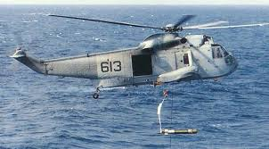
Project LRAUV: Relevance and Method
ADAC Program Year 5 Biennial Review
Relevance to DHS and USCG: This project’s goal is to create a rapidly deployable platform for oil spill characterization in ice-covered oceans that has minimal logistical overhead, that can get “sensors on scene, well ahead of current surface delivered systems."
  LRAUV is well suited to be the ‘last seat in the helicopter’...to get out to the scene, operate autonomously, characterize and communicate” the oil spill.
  If first responders are operating at the far end of their logistical support capability, the system must maximize operational capability, minimize logistical support and operate autonomously.
Research Method: A task-oriented team of expert marine mechanical and electrical engineers to conclude the creation of a readily deployable, easily handled, variable speed, and long range AUV capable of detecting and mapping oil spills under ice. The team leverages prior investments in AUV research and oil sensor technology, and under-ice operations. The overall objective is to leverage mechanical and electrical engineering to fine-tune the Tethys vehicle with sensors, navigation, and chemical mapping to operate under ice.
LRAUV offers extended ranges (one to three weeks), comparatively small size and its ability to be operated by a remote support team via an Iridium communication link, all by using commercially available off-the-shelf sensors (COTS). Through adding dynamic docking capability, LRAUV can stay tethered for weeks to months baring extreme weather events.

Slide 5
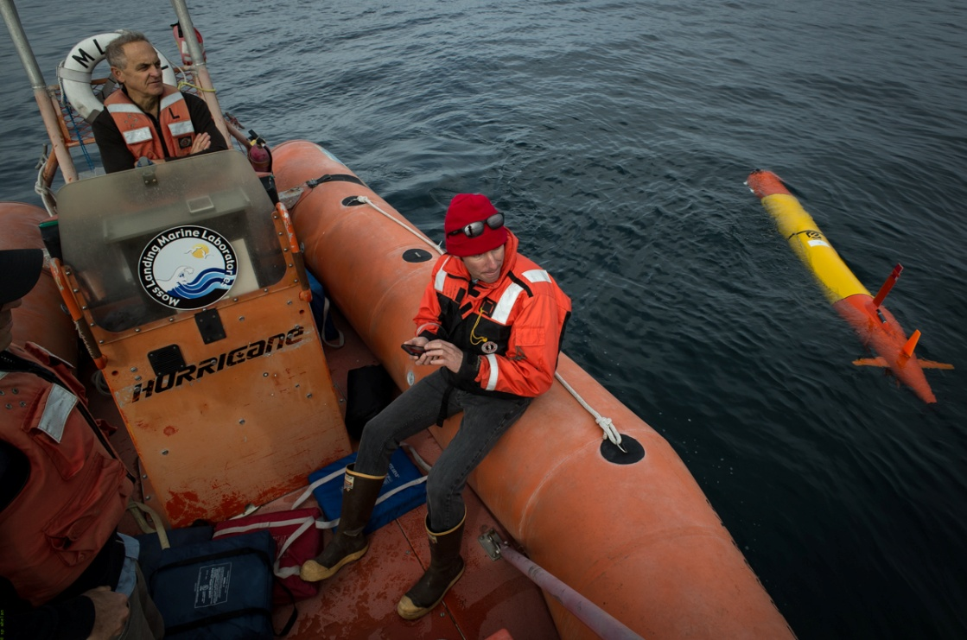
Project LRAUV: Research Achievements & Progress
ADAC Program Year 5 Biennial Review
    Prior:
      Researched, designed, prototyped, developed software, assemblies and fabricated Tethys platform to characterize oil spills under ice with long range and loiter;
      Integrated Arctic/oil science payload to the platform;
      Conducted open water testing and plume mapping/training exercise at MBARI (September 27, 2018);
      Developed LRAUV mission simulations with Chukchi Sea Berger site data
      Designed Arctic buoys (LBL, USBL, ACOMMS, WiFi, RF, Iridium, thermistor)
    Current:
      MBARI is performing further offshore testing of vehicle;
      Implementation and testing umodem and USBL functionality
      Implementing LBL navigation capability;
      Building three Arctic buoys;
        Developing firmware for buoys for three subsurface capabilities (LBL, USBL, ACOMMS)
      Planning oil specific sensing in open ocean and under-ice testing
LRAUV can be launched from a cell phone

Slide 6
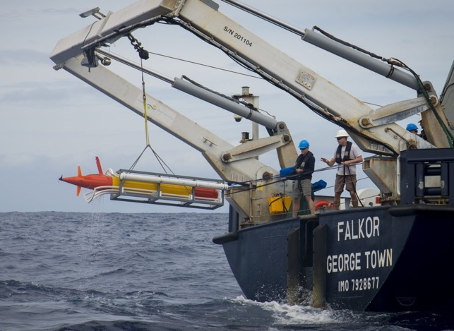
Project LRAUV: Projected Developing Arctic Capable Vehicle System
ADAC Program Year 5 Biennial Review
Buoy completion in late Feb (ahead of schedule)
Under-ice test in New Hampshire lake with either Arctic buoy or surrogate* transponder to test USBL and ACOMMS capability under-ice
Planning for MC20 (Gulf of Mexico) oil seep survey
Conduct extensive testing of LRAUV at WHOI in open water/ice
Develop mission macros for plume mapping
Build vehicle boat launcher*
Conduct MC20 survey with anchored Arctic buoys
Evaluate performance, further testing in Woods Hole
Finish Capture Nose integration nose and testing, test line docking
Field testing/water component

Slide 7
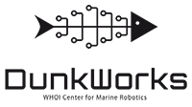
Project LRAUV: Projected - Perform low cost vehicle study at WHOI, CMR “DunkWorks”
ADAC Program Year 5 Biennial Review
Research Reduced Cost Vehicle Fabrication: Using WHOI's maker space known as “Dunk Works”, the WHOI LRAUV team along with designated student interns accomplished the following in order to reduce vehicle costs:
  Evaluate LRAUV BOMs and identify machined parts that can be 3D printed with less people labor and less expensive materials.
  Produce drawings and prototypes of vehicle components, such as chassis, end comes, end caps, vehicle shells, etc.
  Evaluate third party licensing of the LRAUV with ADAC and MBARI approval.

Slide 8
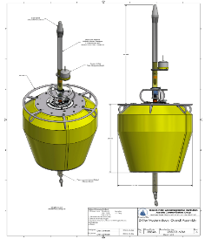
Project LRAUV: Current Schedule and Metrics
ADAC Program Year 5 Biennial Review
  Test/Transition LRAUV to WHOI: Underway​
  Collect Navigation Performance Data: September 2018​
  Complete Delivery/MBARI transition to WHOI: February 2019
  Process data and further develop software behaviors: February 2019​
  Plan adaptive mission in GoM for oil mapping, February 2019​
  Add: Under-ice test in New Hampshire, March 2019
  Add: USBL/ACOMMS testing, March 2019
  Perform low latitude oil mission Gulf of Mexico, June 2019​
  Complete software development for data visualization, June 2019
  Plan High latitude Mission: May, 2019 –Great Lakes and Frozen NH Lake for preliminary tests​
  Complete fabrication of Arctic Buoys: May 2019​ (Feb 2019)
  Test Arctic Buoys in open water: June 2019​ (Now May 2019)
  Evaluate data, software enhancements, training: June 2019​
  Low cost vehicle evaluation: June 2019​
  Execute Transition/additional research plan: June 2019
LRAUV Arctic Buoys
Field testing/water component

Slide 9
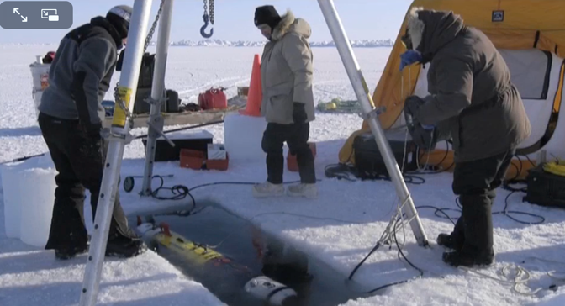
Project LRAUV: Key Accomplishments
ADAC Program Year 5 Biennial Review
  MBARI/WHOI Research team has combined the best AUV technologies to make a mission-purpose Arctic capable platform:
    Researched & evaluated COTS sensor packages (split beam, multibeam, methane, optics);
    Performed two vehicle demonstrations to stakeholders (WHOI &, MBARI)
    Researched. designed and tested software and firmware;
    Designed LRAUV and vehicle agnostic Arctic buoys;
    Fabricated operational LRAUV for oil detection;
    Developed vehicle current modeling simulator;
    Presented and published two IEEE papers on conducted research;
    Built collaborations with USCG RDC, EPA, NOAA and BSEE.
Barrow Alaska WHOI REMUS Deployment
Sea Owl tests at Gulf of Mexico MC20 site (via REMUS platform)

Slide 10
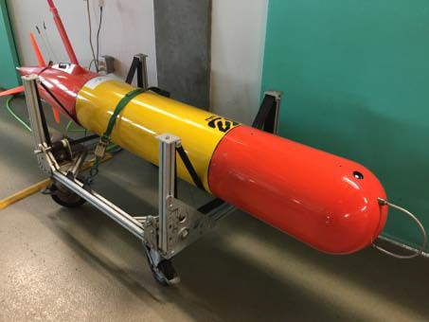
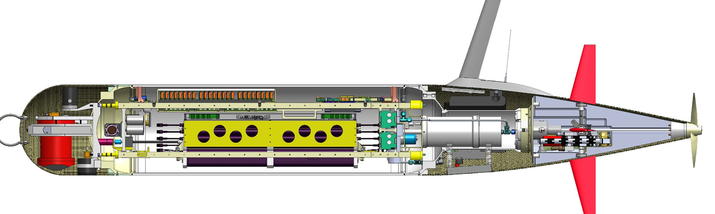
Project LRAUV: Transition Plans
ADAC Program Year 5 Biennial Review
ADAC and LRAUV project team seek an integrated approach with USCG RDC and HQ USCG to acquire and develop additional LRAUVs commensurate with USCG mission needs. In accordance with DHS S&T UP-ADAC Grant Terms and Conditions
ADAC recommends DHS S&T UP and HQ USCG consider a research agenda in Program Year 6 and 7 that includes an investigation partnership with USCG Research and Development Center (RDC). The proximity between LRAUV research members at Woods Hole Oceanographic Institution’s (WHOI), Woods Hole MA to USCG RDC at New London CT, make hands on research collaboration readily achievable.
ADAC and the project team recommends LRAUV transition should occur in three stages:
  Conducting advanced testing in collaboration with USCG RDC to test the system in complex Arctic conditions and advance low cost research methodologies. Consider building one or more systems additional systems for the USCG as part of this phase.
  Commercialize the resulting platform and communications system.
  Work with DHS and USCG acquisition process to field needed systems to meet USCG mission requirements.

Slide 11
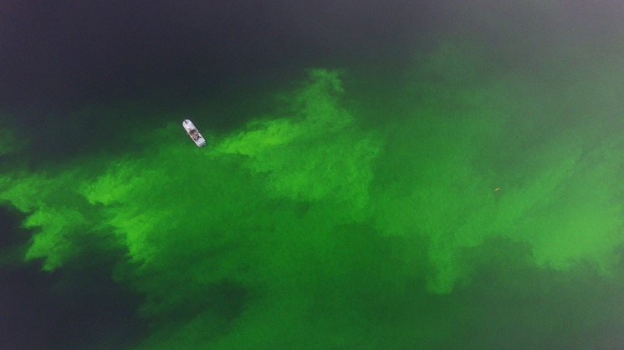
LRAUV Ready for questions
ADAC Program Year 5 Biennial Review
What needs improvement?
Other research/mission areas to consider?
  Sensing of oil against the ice and seafloor?
  More sensor payloads-Bathymetric sonar, Cameras, Water sampling?
  Lower vehicle costs
  More operational time for shake-down and training
  Software development (behaviors)
Who should we connect with to improve collaboration?
Monterey Bay Field Test, 27 Sep 2019
Thank you for your time and consideration
Notes:
Thank you for the gift of your time and attention.

