Slide 1
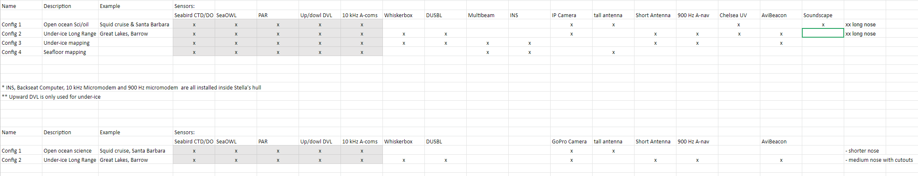
Core payload: Seabird CTD/DO/Chl (SeaOwl)/PAR, Up/Down DVL
Config 1, Long Range Open ocean, science or oil
  Tall antenna, camera, 10 kHz modem/receive array, Chelsea UV, Soundscape, camera
  No multibeam sonar, no whisker box, no DUSBL, no AviBeaconINS and 900 Hz nav powered off,
Config 2, Long Range Under-ice
  Whiskerbox, DUSBL, 10 kHz modem/receive array, 900 kHz, Avi Beacon, short antenna, camera
  No multibeam sonar, no INS (not powered), or soundscape
  Freshwater in Great Lakes requires removal of camera and addition of 100m depth-rated foam packs
Config 3, Under-ice Mapping –
Whiskerbox, DUSBL, 10 kHz modem/receive array, 900 kHz, Avi Beacon, short antenna
  Upward looking Norbit WBMS, INS
  No Chelsea, Soundscape, camera, or PAR
Config 4, Seafloor mapping
  Downward looking Norbit WBMS, INS, 10 kHz modem/receive array, Tall antenna, Soundscape
  No whiskerbox, DUSBL, camera, Chelsea, avi beacon or soundscape

Slide 2
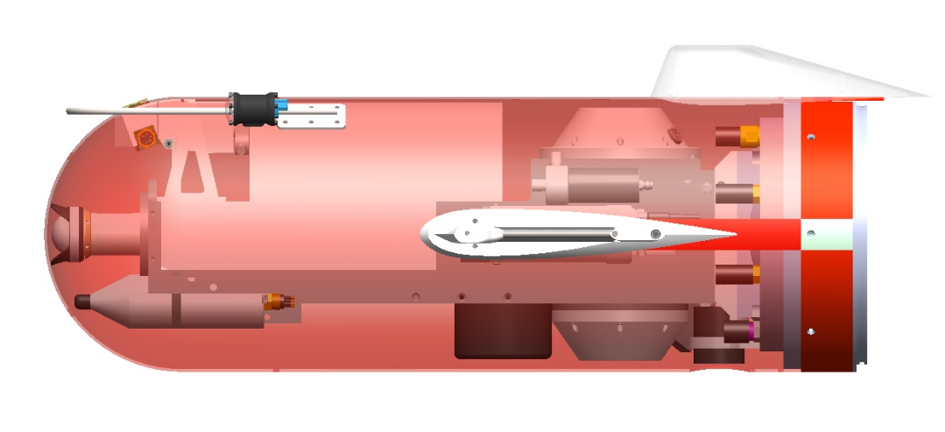
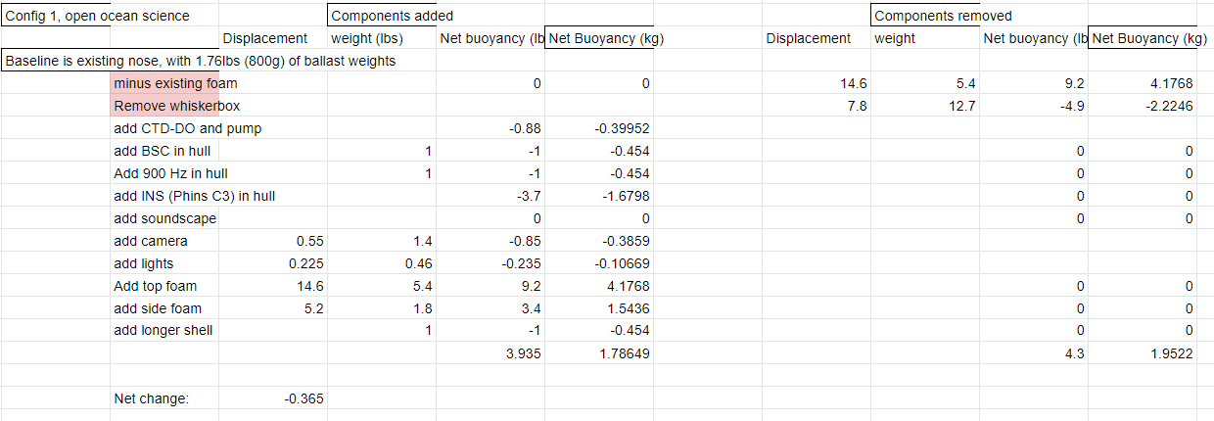
Config 1: Long Range Open Ocean
Core Science: CTD, DO, PAR, Chl/OBS/Oil
Camera
Soundscape
Chelsea UV oil
10 kHz Comms/Nav with receive array in tail
Optional INS

Slide 3
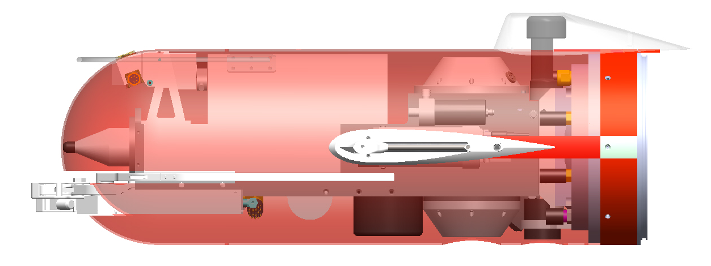
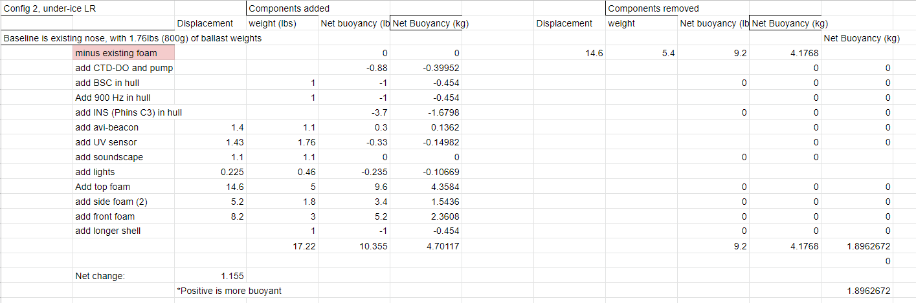
Config 2: Long Range Under-ice
Core Science: CTD, DO, PAR, Chl/OBS/Oil
Line Capture with Acoustic Homing
10 kHz Comms/Nav with receive array in tail
900 Hz Long Range Navigation
Soundscape acoustic recorder
Chelsea UV oil
Avalanche Beacon
Short Antenna

Slide 4
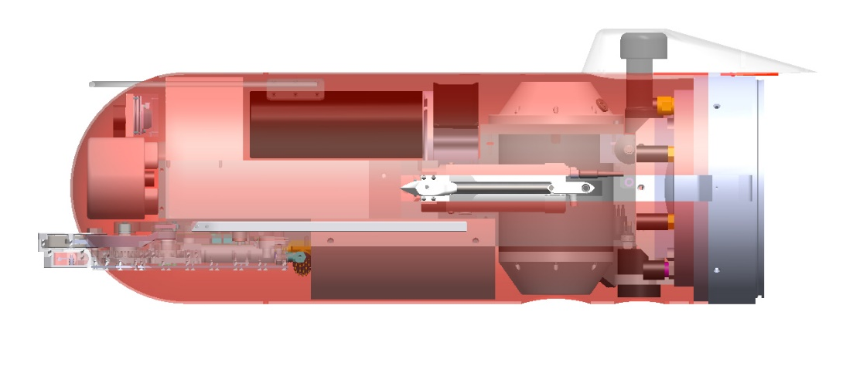
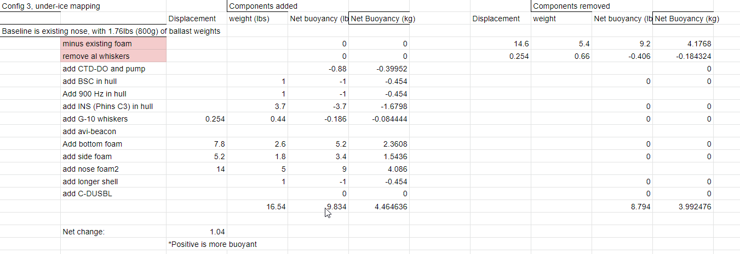
Config 3: Under-ice Mapping
Core Science: CTD, DO, No PAR, Chl/OBS/Oil
Line Capture with Acoustic Homing
10 kHz Comms/Nav with receive array in tail
900 Hz Long Range Navigation
Upward looking Multibeam mapping
Avalanche Beacon
Short Antenna

Slide 5
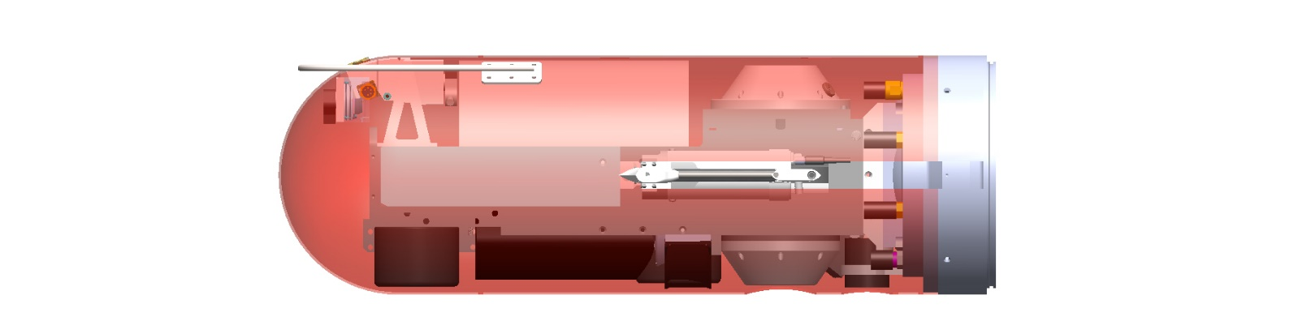
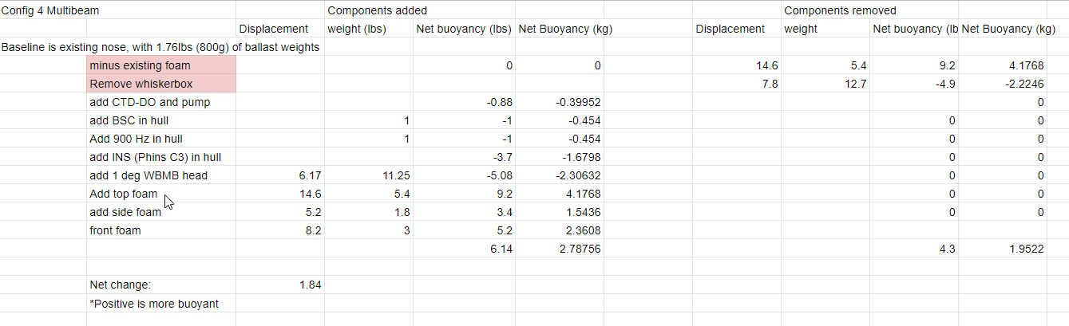
Config 4: Seafloor Mapping
Core Science: CTD, DO, PAR, Chl/OBS/Oil
Norbit Narrow Beam Multibeam Mapping Sonar
Phins C3 INS
10 kHz Acomms and LBL
Tall Antenna
Camera?

