Slide 1
Components:
Multibeam Sonar: Norbit WBMS, 0.9 x 1.9 degree, 400 kHz, 5-210 degree swath, 24 vdc, 40 watts
  https://norbit.com/media/PS-120005-24_WBMS-bathy_Pn_12003-AACDB4_A4.pdf
INS: IxBlue C3, 0.2% DT, 12 watts
  https://www.ixblue.com/sites/default/files/2020-02/phins-compact-series-datasheet-.pdf
Depth: Keller 33 RS485 into DGI Interface PCB, output RS232 Parosci format
GPS + 1 PPS from NAL

Slide 2
AUV Function
Controls power
  Powers on/off INS, Sonar, Sonar DAQ
Sends mode change commands to DVL to switch between PD6/PD13, ext. trigger/Free-run modes, depending on if Sonar is running (former)
Drives the bus
  Uses on-board, low power AHRS, depth, GPS for transits
  When available, uses INS data published over LCM by BSC
  Runs missions from waypoints translated from MB System planner
Upgrade could send LBL ranges to INS when available

Slide 3
INS function
Publishes position, depth, orientation in UDP packets on Ethernet
Reads GPS on Serial 1, when available
  1 PPS, ZDA time
Reads Depth on Serial 2
  Keller33, Parosci format
Reads DVL speed in PD6 from downlooking DVL on Serial 3
Optaionally reads LBL ranges from AUV over Ethernet, when available
Mounted in the main vehicle hull
24 volts, 12 watts, split between IMU and board stack

Slide 4
Sonar DAQ on BSC
Runs Norbit’s program to read and write in S7K format sonar data on Ethernet 1 port
Runs a new software program
  log INS (Ethernet 2) and Depth (serial 1) at about 25 Hz.
  Re-send INS data sub-samped at 2.5 hz to AUV in LCM format over Ethernet
  Sends setup config message to sonar after power up
Sync computer time to GPS time using 1 PPS (serial 2) and ZDA (serial 3)
Run NTP time server, broadcasting to sonar via TCP/IP on Ethernet 1
Large mass storage (>TB) on SATA II
Two Ethernet ports: GigE download and comms
Backseat Computer is mounted in the main vehicle PV
ADLE computer

Slide 5
Sonar Function
After power up, sonar accepts configuration parameters from DAQ on TCP/IP Port 2209 and NTP time
Listens to 1 PPS on pin 7/8 to discipline internal clock
Runs at fixed rate, e.g. 3 Hz
Sends trigger out on pin 5, with 100ms transmit delay
Sends a stream of Bathy data out TCP/IP Port 2210

Slide 6
Depth, DVL, GPS, Trigger
Keller Depth outputs depth to Sonar DAQ, INS and AUV through a passive serial splitters in a Parosci standard format
Downlooking DVL (Pathfinder 600 kHz) sending PD6/PD13 format speed data to the AUV and INS through a passive serial splitter. Down DVL fires on external trigger
Precision timing is supplied by the modified NAL 1 PPS trigger and serial ZDA message to the Sonar DAQ and INS through a serial splitter.

Slide 7
RS-232 serial
GPS Antenna
Depth (Impact Subsea)
Aft Antenna Port
1 PPS coax
100b Ethernet
Triplexer
Cradelpoint Cell/WiFi
1000b Ethernet
Trigger, TTL
Sonar DAQ:
ADLE
Antenna Splitter
RF Coax
GPS: DGI/108185
NAL GPS/Irid
GigE download Port
Exchange sonar for download cable
Ethernet Switch:
Existing MB3 100B
INS Phins C3
AUV computer
Multibeam Sonar
(Norbit WBMS)
Port 8 Sonar
DVL:
Pathfinder Up and Down
Port 7 DVL
AUV Umbilical

Slide 8
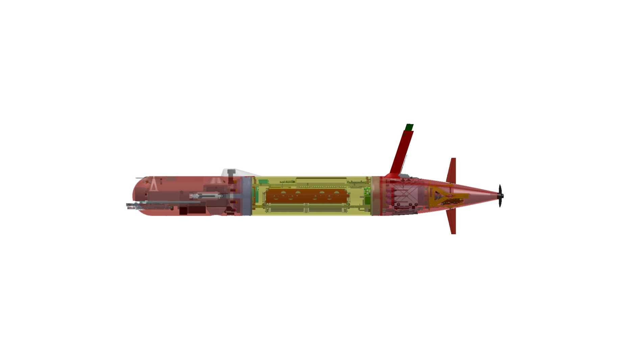
Phins C3 INS
Sonar DAQ Computer
Impact Subsea Depth
Norbit WBMS
GPS antenna splitter
GPS timing board

Slide 9
Potential Issues:
Are passive serial splitters on depth and DVL a problem?
  Find some active splitters or can a NMEA repeater be used?
How powerful computer is required for Sonar DAQ?
  Start with the low power and upgrade if necessary
  Adding Water column, backscatter or snippets might need more
Can we do all the tasks on the Sonar DAQ with one program (plus the Norbit logger)? - log INS, Depth at high rate, send sonar setup config at boot-up then re-publish position at 2.5 Hz in an LCM message and host NTP server?

Slide 10
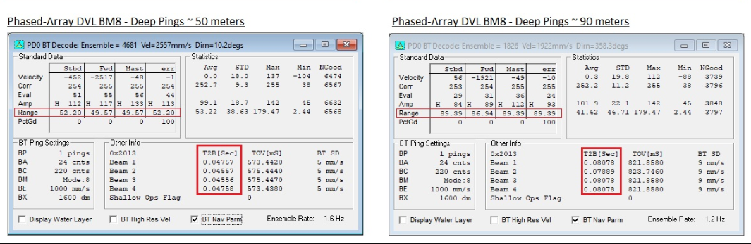
Trigger Schedule
1 second
100ms Sonar transmit delay after trigger
Multibeam
DVL Down
DVL Up
Transmit
Receive
Trigger Pulse
50 ms Trigger Delay
Sonar runs on a fixed rate (3 Hz): Trigger Mode 1, Set_rate 3
Trigger out from sonar has a 100 ms transmit delay after trigger set_trigger_mode and set_trigger_delay ref
Single trigger line into the DVL housing and into the Down DVL, then additional 50ms delay to Up DVL
  This might also be possible using the Down DVL’s trigger out, though these pins aren’t currently wired out of the OEM case
Pathfinder Deep Pings take ~50ms at a 50m range, and ~80 ms at 90m range

