Slide 1
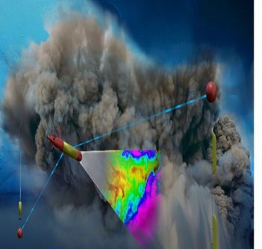
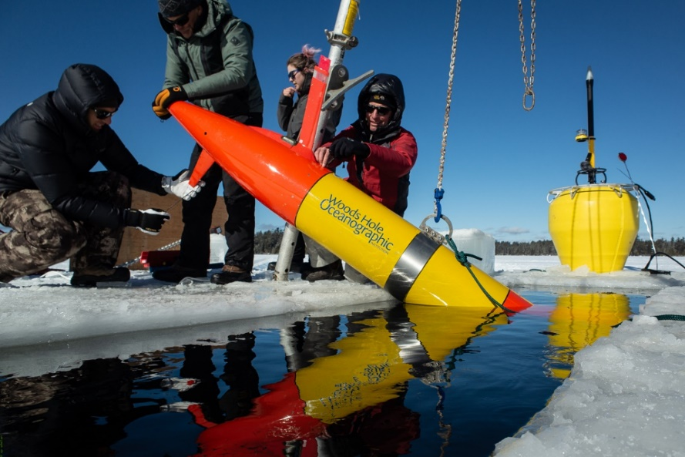


ADAC Year 6 Quarterly Review
ADAC Project Briefing
(LRAUV) for Under-Ice Mapping of Oil Spills and Environmental Hazards
PI Amy Kukulya (WHO), PI Dr. Jim Bellingham (WHOI),
PI Brett Hobson (MBARI)

Slide 2
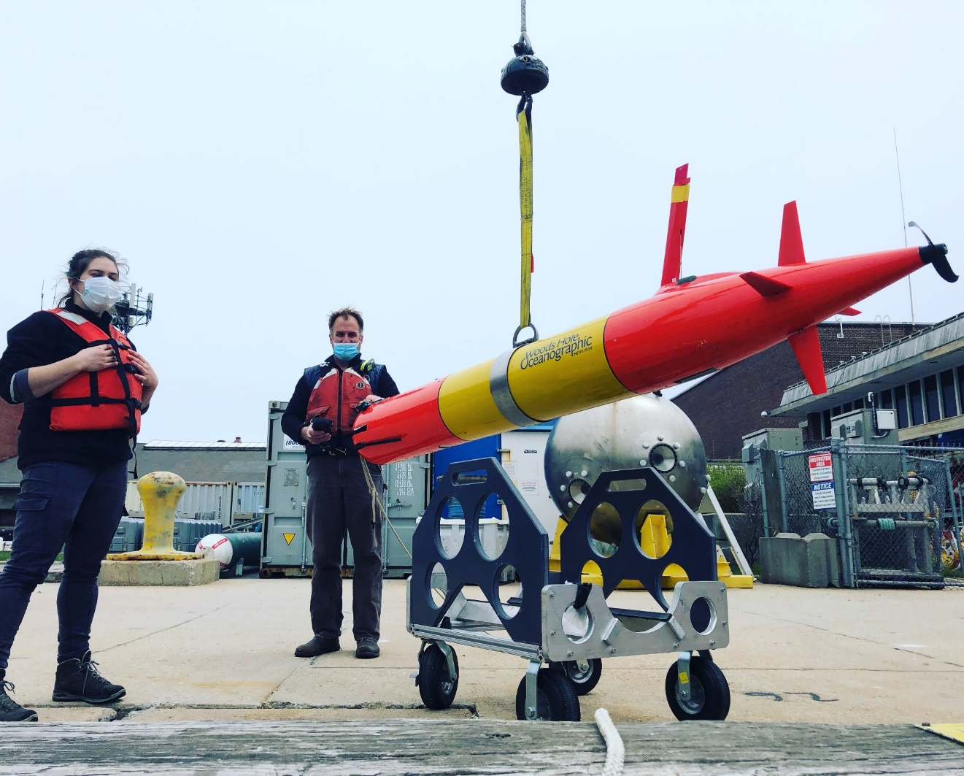
ADAC Project (LRAUV) for Under-Ice Mapping of Oil Spills and Environmental Hazards
ADAC Program Year 7 Quarterly Review 24 September 2020
Project Principal Investigator(s): PI Dr. Jim Bellingham (WHOI), PI/PM Amy Kukulya (WHOI), Co-PI Brett Hobson (MBARI)
Woods Hole Oceanographic Institution, Monterey Bay Aquarium Research Institute
Supporting Team: Daniel Gomez-Ibanez, Sean Whelan, Noa Yoder, Amanda Besaw, Brian Kieft, Ben Raanan, Ryan Govostes
Project Champion: Kirsten Trego, HQ USCG MER
Project Advocates: Dr. Robyn Conmy, EPA USEPA/NRMRL/RTEB, USCG Research and Development Center, Dr. Jay Choy BSEE/Oil Spill Preparedness Division, Dr. Lisa Dipinto, NOAA, Office of Restoration and Response, Mr. Brian Dolph, USCG R&D Center

Slide 3
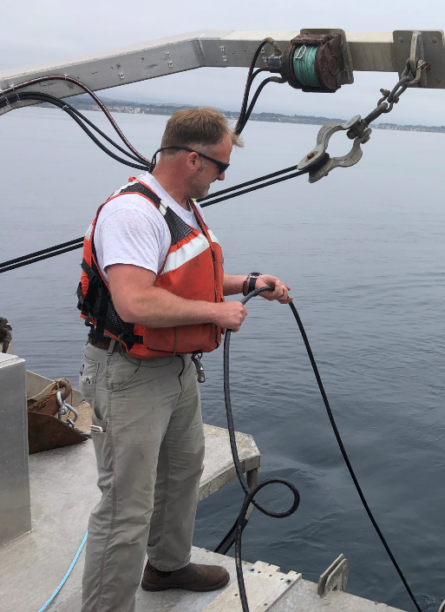
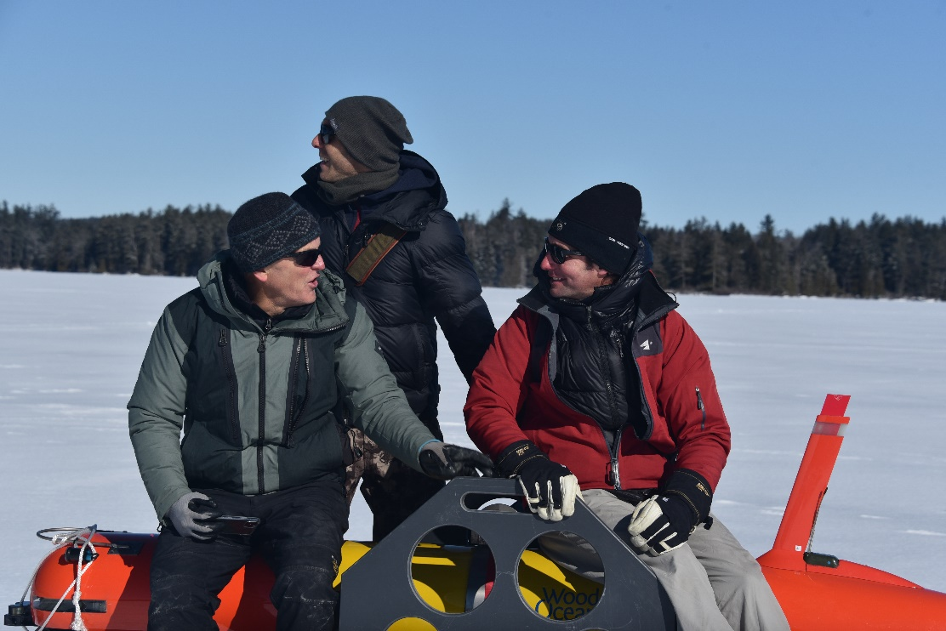
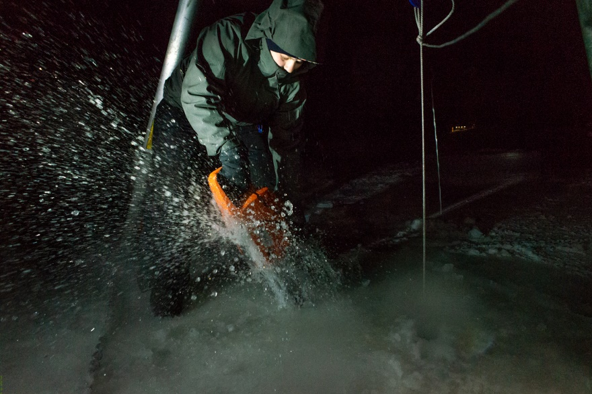
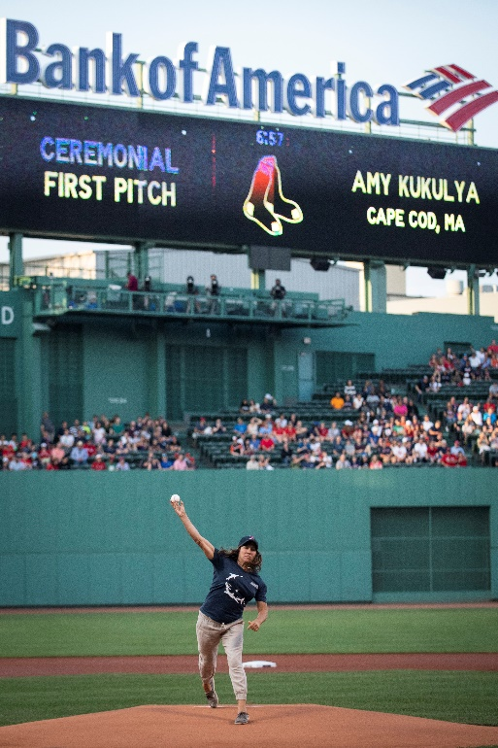
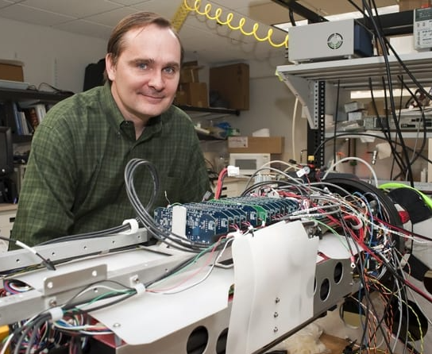
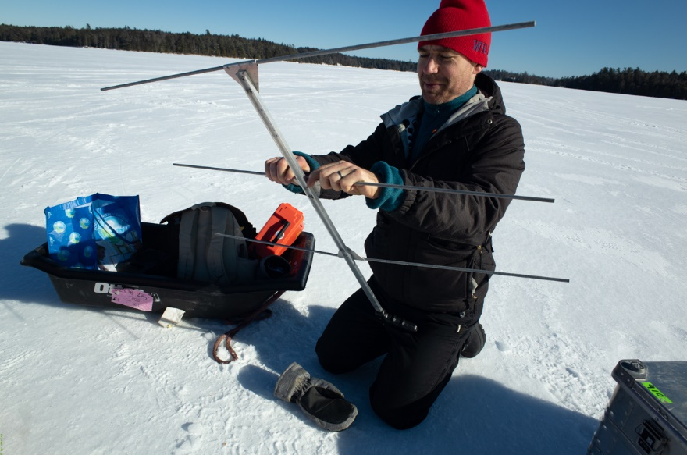
ADAC Program Year 7
The WHOI-MBARI Operations/Engineering Team
Sean Whelan
Noa Yoder, WHOI
Daniel Gomez-Ibanez
MBARI’s Brett Hobson, Ben Raanan, Brian Kieft
Amy Kukulya
Jim Bellingham
Not pictured: Amanda Besaw, Ryan Govostes

Slide 4
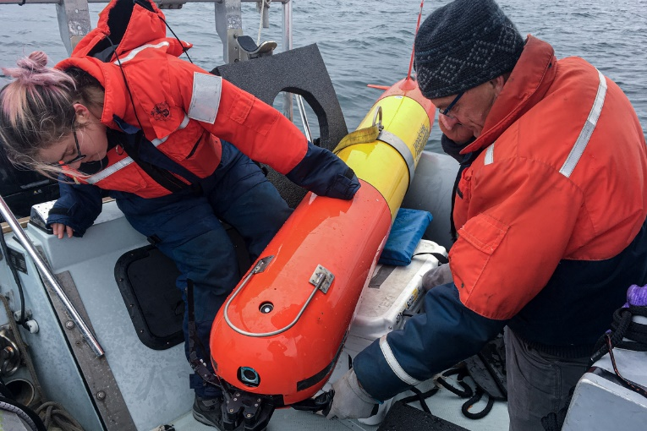
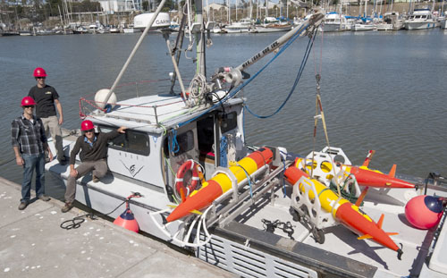
LRAUV: Description and Baseline
Baseline: Currently, there is no USCG baseline for an AUV to meet the unique demands of Arctic operations that requires a minimal logistical footprint, a small operational team and oil detection and mapping capability.
Project Description: To develop an Arctic-capable long-range Autonomous Underwater Vehicle (AUV) that is helicopter portable, carries an environmental mapping payload, allowing rapid response while providing situational awareness and damage mitigation for first responders/USCG.

Slide 5
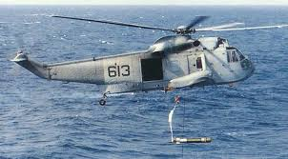
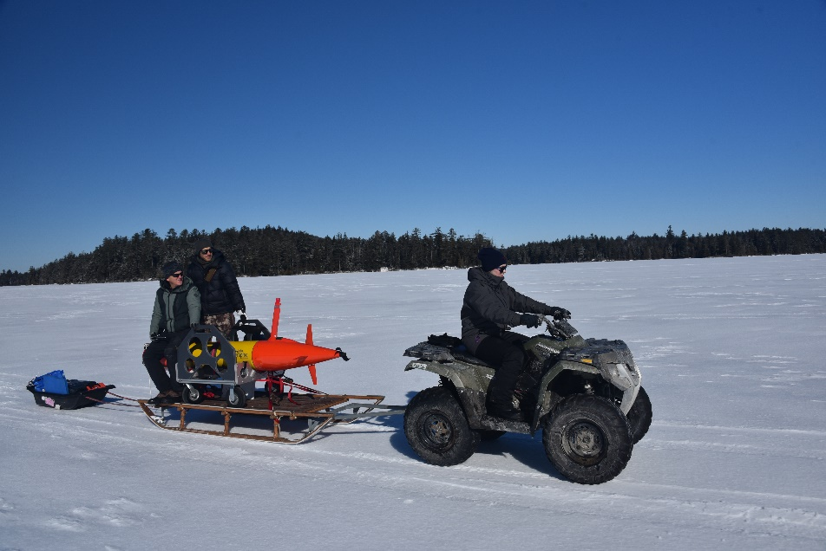
Project LRAUV: Relevance and Method
Relevance to DHS and USCG: We characterize the challenge as the ‘last seat in the helicopter’ problem: If first responders are operating at the far end of their logistical support capability, the system must be able to fill that void.
Research Method: Our approach is to leverage an existing Long-Range AUV developed at MBARI (LRAUV), and enhance the system to detect oil and operate under ice. LRAUV offers extended ranges (one to three weeks), and can be operated by a team remotely and monitored by anyone, anywhere.
We need an opportunity to deploy via a helo

Slide 6
The Vehicle: Tethys LRAUV
For under-ice dissolved hydrocarbon & environmental anomaly detection, mapping, and docking/undocking

Slide 7


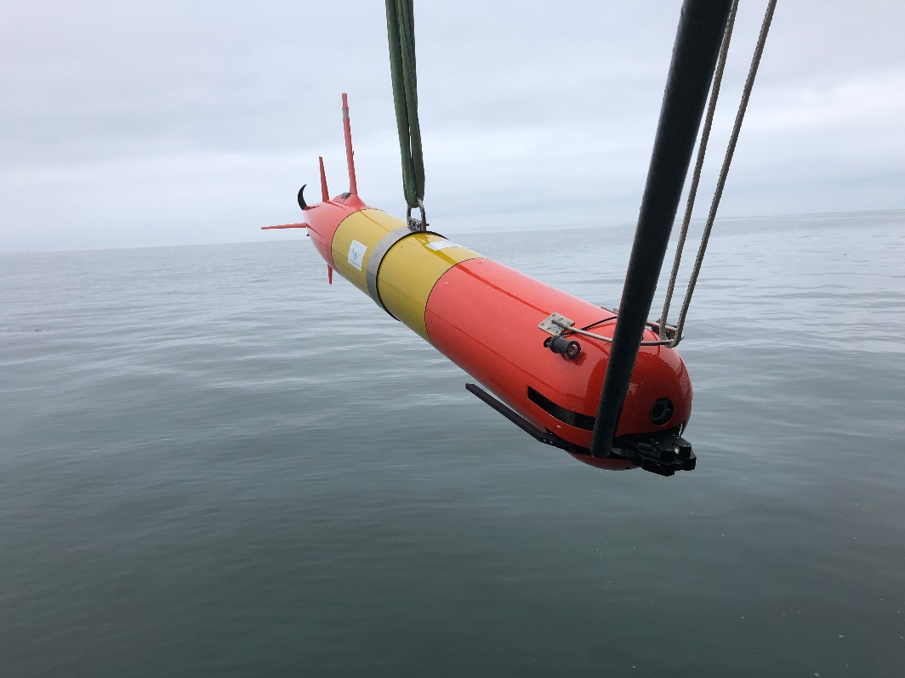
Long range autonomous capability: Tethys LRAUV
300-meter rated, 2.7 m long, 0.3 m (12’’) diameter, 110 kg dry weight.
Propeller-driven: 0.5~1.2 m/s speed. Buoyancy engine enables neutral buoyancy and drift mode.
Low-drag and low-power design: 15 day duration with 6 kWh rechargeable batteries, more than twice that with expendables.
Current Sensors: CTD, DO2, SeaOWL fluorescence/backscatter and hydrocarbon detection, Up/Down ADCP, umodem, USBL array, Docking nose, PAR
Multi-mission capability, mapping and inertial navigation payload
Notes:
2.3 standard to 2.7 docking

Slide 8
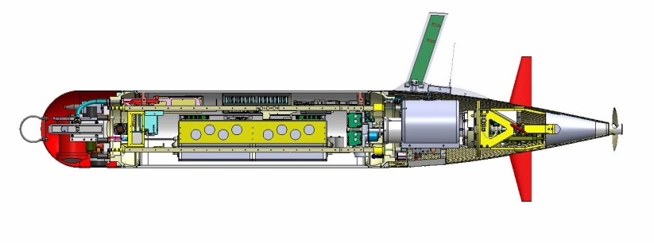
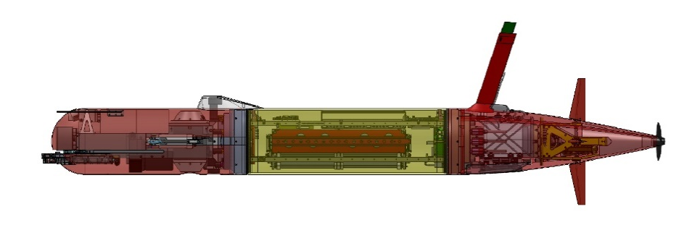
Tethys LRAUV Specifications
Core sensors: DVL/ADCP , Fluorometer/ Backscatter (WetLabs), CTD (Seabird), PAR, O2
Iridium, GPS, WiFi and Cellular in mast
Backup Argos and VHF
Load Control System
18 configurable channels
Isolates load, circuit breaker, ground fault detection
Buoyancy Engine allows neutral drift in water column - 1 Liter
Efficient low-speed propeller
------------------
Paired Rudder and Elevator Control Surfaces
Docking Module
6 kWh rechargeable,
11 kWh expendable
Shifting Mass allows controlled angle of attack during flight
INS Module
Short Nose
With Mapping Module
Mass: 110 kg ( 240lb) dry weight 118 kg (260 lbs)
Size: 0.3m (12”) diameter, 2.47m long 2.75 m long
Speed: 0.5 – 1.2 m/s plus hover 0.5 – 1.0 m/s plus hover
400 Ah energy, ~1.1 Ah/hr, 400 Ah energy, ~1.5 Ah/h ~3 km/hr .83 m/sec ~15 days, 1000 km See different modes below
Mode: 5 day RT transit out 120 km = 1800 W-hrs; 28 hours of survey= 2800 W-hrs;
13.5 days of slow science = 4600 W-hrs
300 A-hr useable at 15.3v=4600 W-hrs
Notes:
Need new power numbers

Slide 9
Sensors
Up/down 600 kHz ADCP (RDI Pathfinders)- water velocities, relative terrain navigation
Licor Par for measuring photosynthetic artificial radiation (important for biological measurements when using an ecopuck)
SeaOwl Ecopuck-provides dissolved and droplet signals
Seabird CTD with a dissolved oxygen probe
WHOI Whisker Box for line capture docking
WHOI DUSBL for homing/docking
WHOI umodem for subsurface communication replaces need for LRAUV to surface to send data back to command control

Slide 10
ADAC New Kit For Prgm YR7
Soundtrap self-contained soundscape sensor (can be strapped in nose)
Inertial navigation (integration inside housing)
Multibeam for mapping (varied tasks, some outside YR7)
Multi-channel low frequency diversity array (have hardware, for 400 km range receive only navigation pings, works with receiver)
Low-frequency receiver for long distance navigation (hundreds of kilometers)
Chelsea UviLux- has a lower excitation (SeaOWL) wavelength, it gives you a clearer dissolved oil signal that can be discerned from natural humic DOM. (have sensor, integration lower priority, but compliments SeaOWL)
Upgrade to CTD/DO: integrated system
Backseat computer for more versatile control of sensor integration/new behaviors. ROS development is scope creep and beyond YR7 objectives are needed
Notes:
UviLux sensors enable real-time, in situ detection of a wide variety of UV fluorescence parameters, including: Polycyclic Aromatic Hydrocarbons (PAH), BTEX, CDOM, Tryptophan-like fluorescence (TLF), BOD and Optical Brightening Agents (OBA). The compact and highly sensitive fluorometers have excellent turbidity rejection and high ambient light rejection, making them suitable for use in water and wastewater treatment works, as well as natural waters at the surface and to depths of up to 1000 m.
Find out more

Slide 11
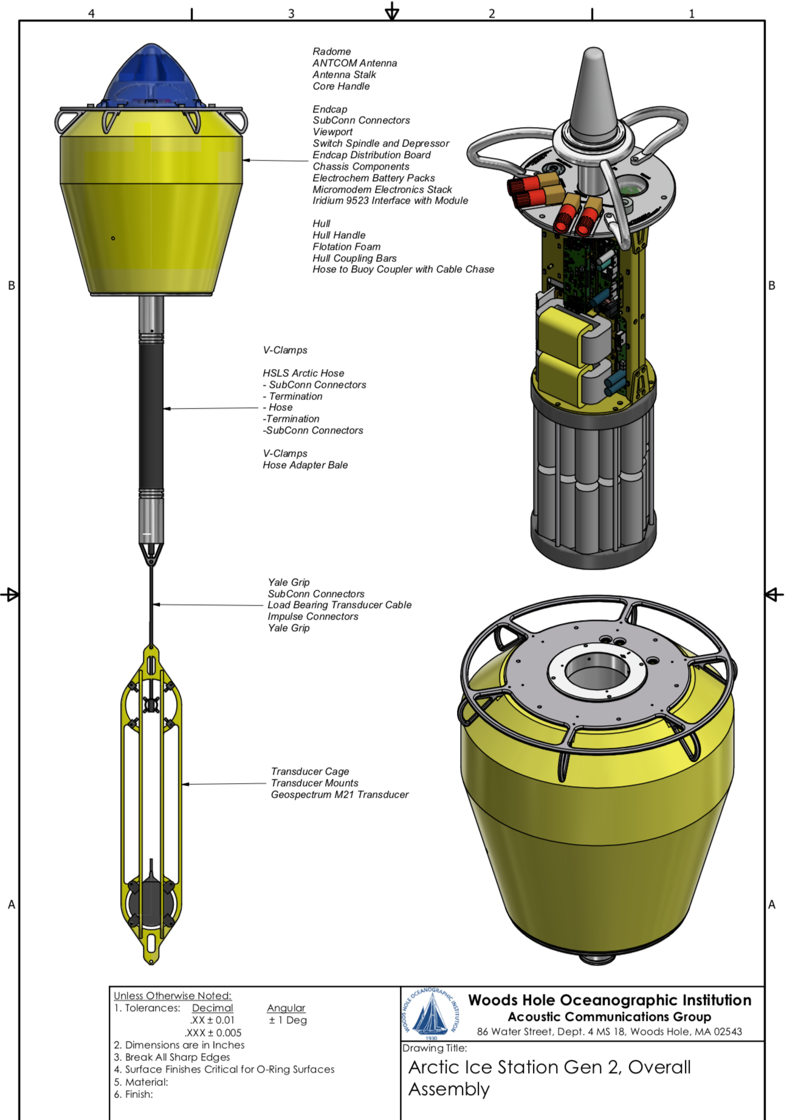
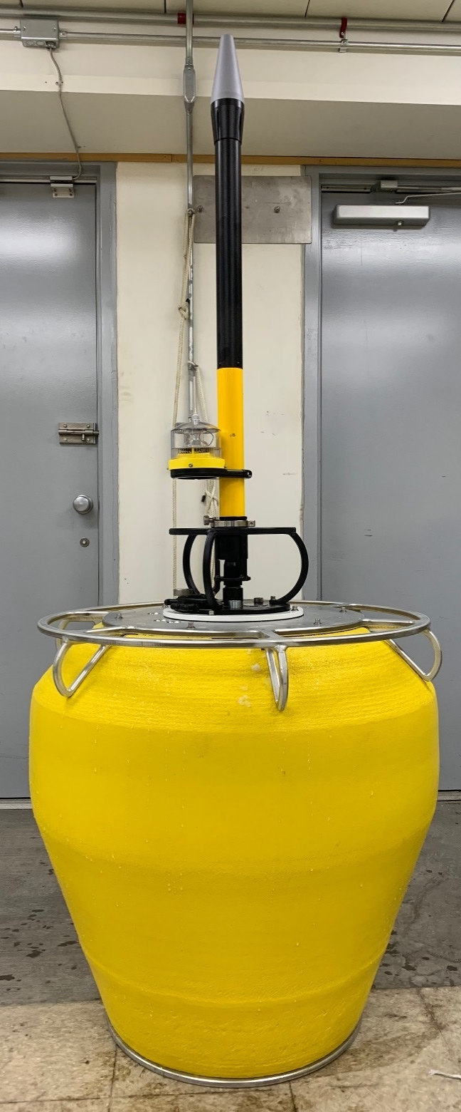
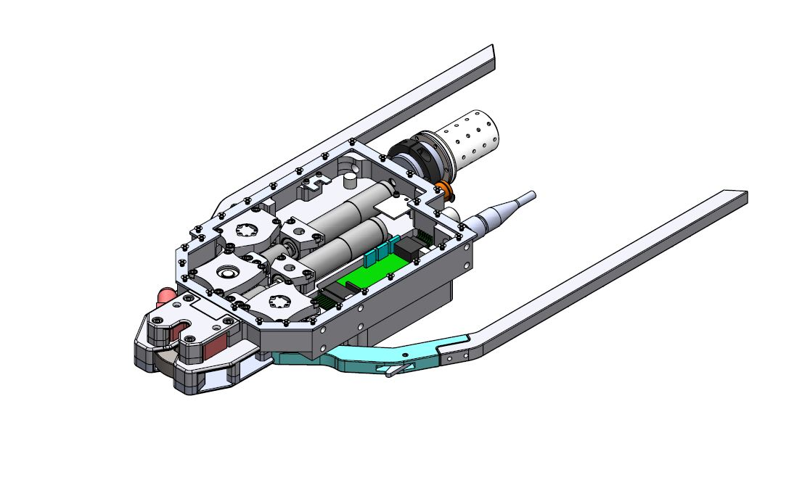
UPDATE Arctic Buoy’s can be configured to be HF or LF
Can be configured for 25 and 10 Khz. Testing still underway for CUSBL
Current testing is underway with a LF CUSBL array
Have disposable primary battery packs in had for 12-14 day duration. Bracketry in shop.

Slide 12
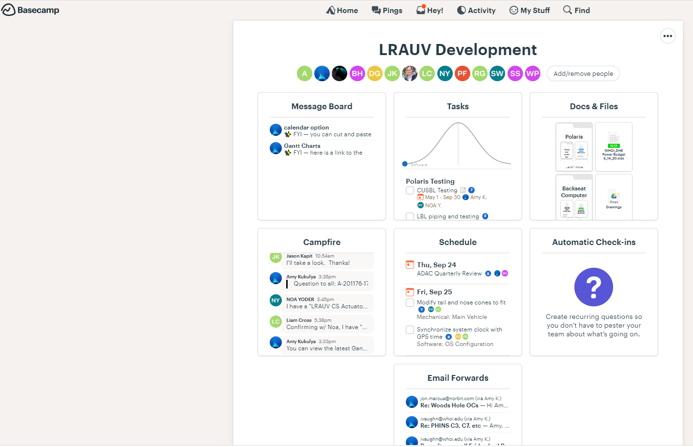
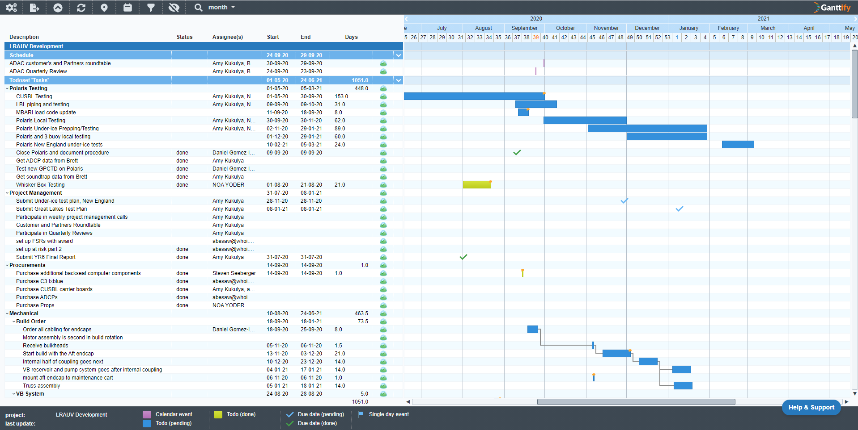
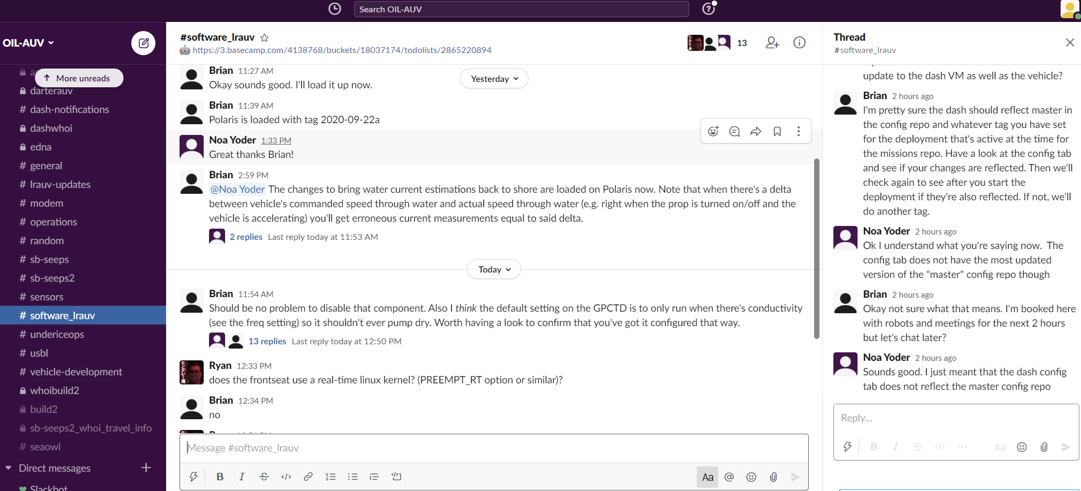
PM Tools for new vehicle build and task tracking/documentation across organizations
We also use Slack in place of email across teams and chatter/questions/updates daily

Slide 13
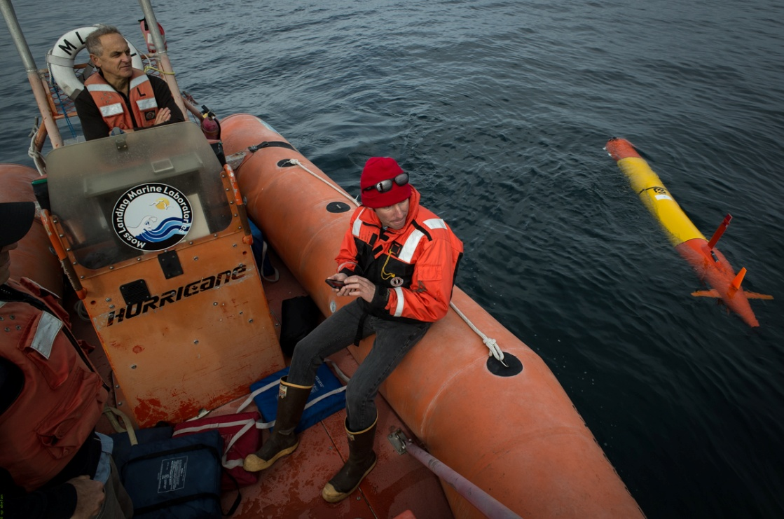
Remote Tracking and Testing
Notes:
Launched from a phone and operated from a phone from anywhere in the world.

Slide 14
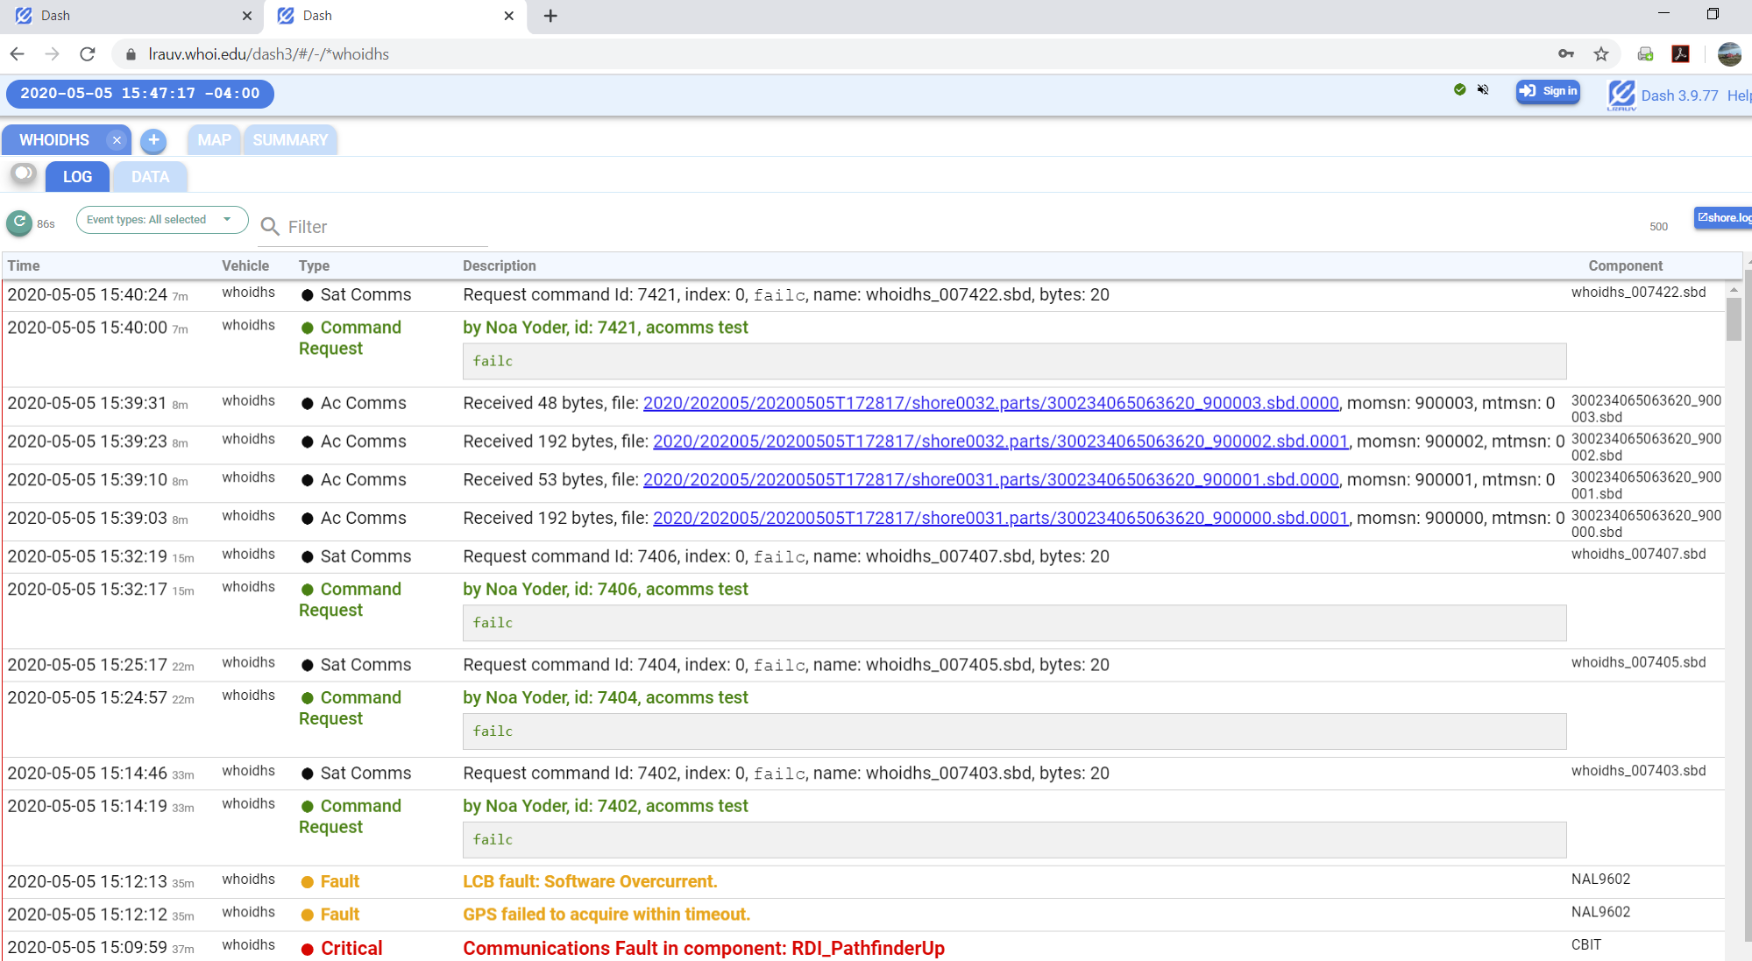
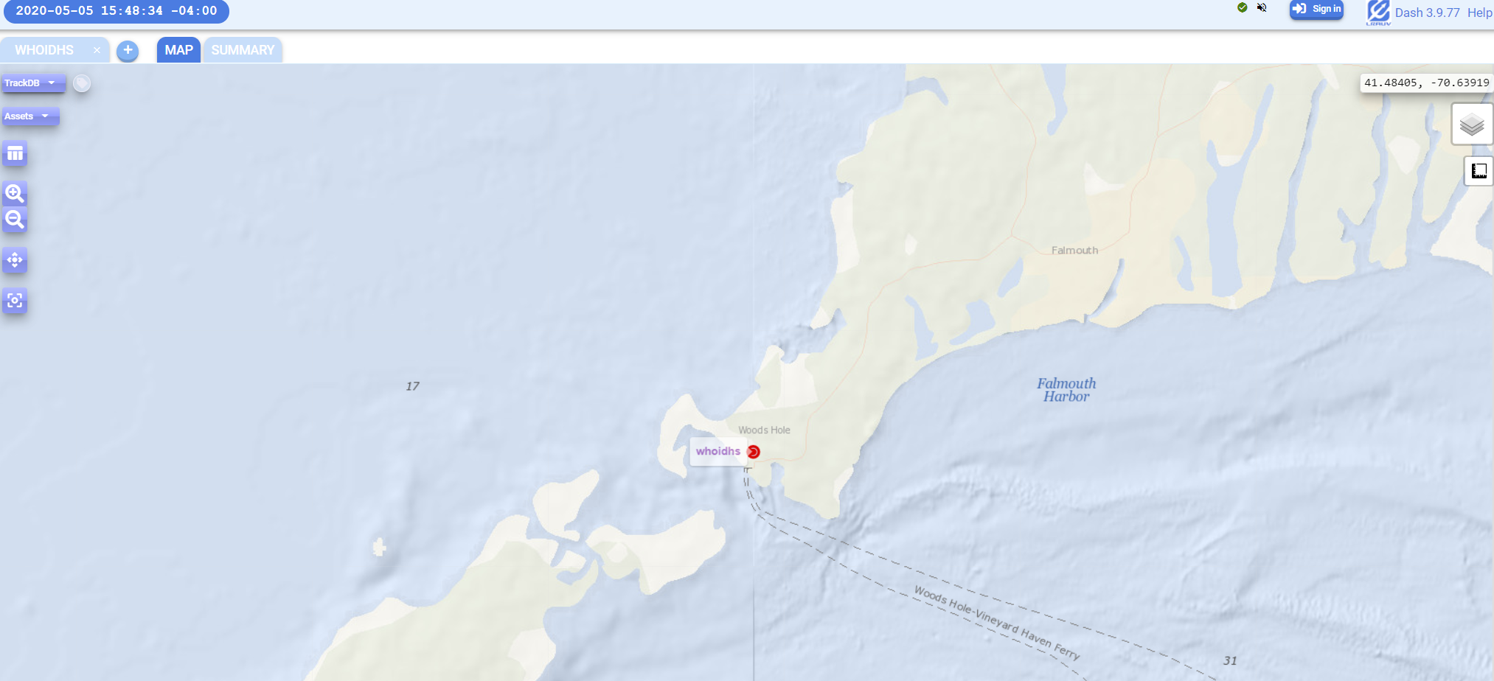
https://okeanids.mbari.org/dash3/#/-/whoidhs;Map
OR
https://lrauv.whoi.edu/dash3/#/-/whoidhs;Map
All LRAUV operations are conducted via remote communications
In YR6 WHOI installed a new Dash to host command and control on LRAUV platforms. This serves as a primary tracking system and/or complimentary Dash to MBARI’s tracking portal
Having 2 independent Dash setups allows for secure backup in case of technical difficulties inside WHOI or MBARI or for any reason operational control needs to be shifted from one institution to the next.
Typically operators use an Ipad to run the vehicle, but cell phone, etc. also work

Slide 15
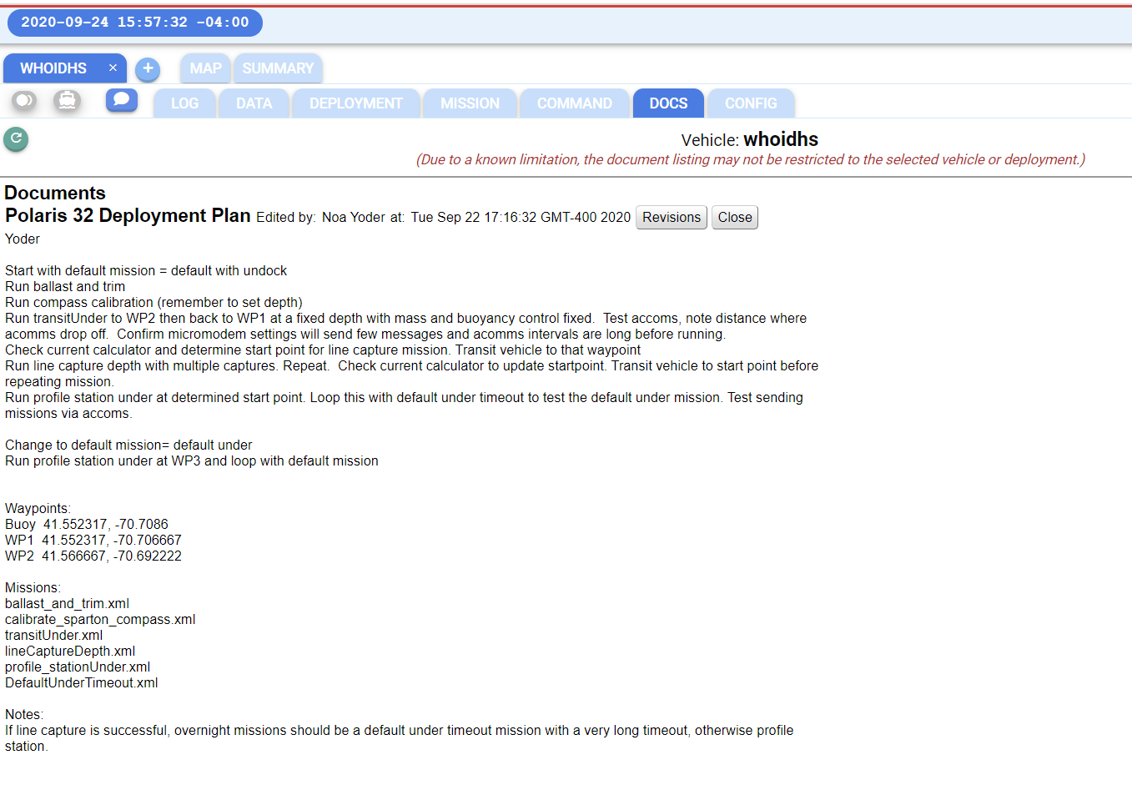
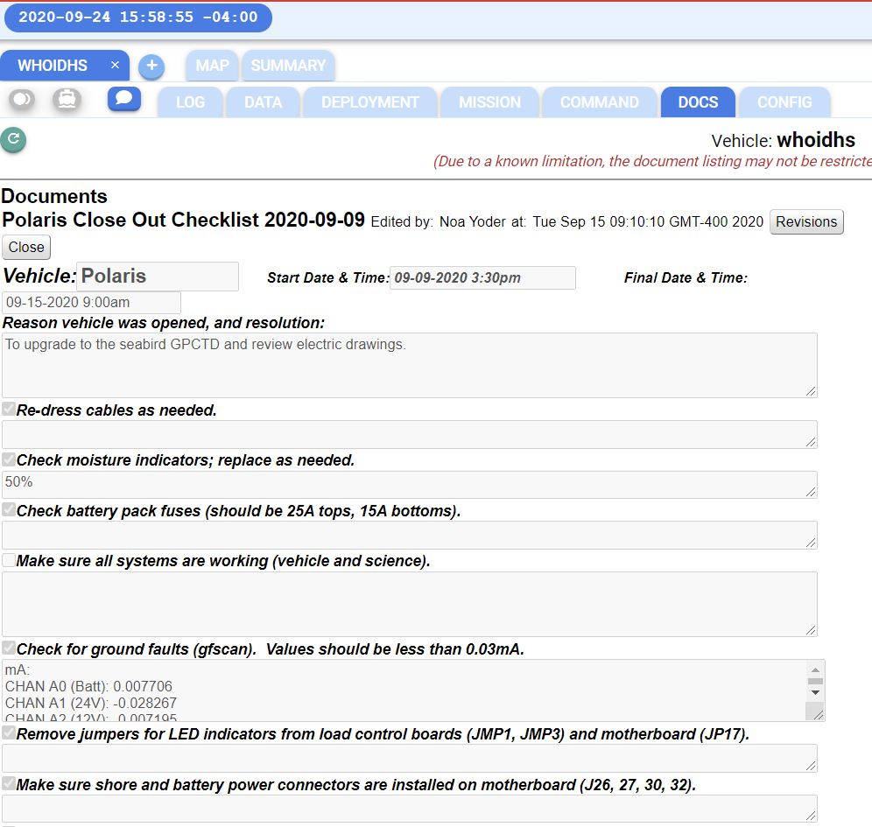
https://lrauv.whoi.edu/dash3/#/-/*whoidhs

Slide 16

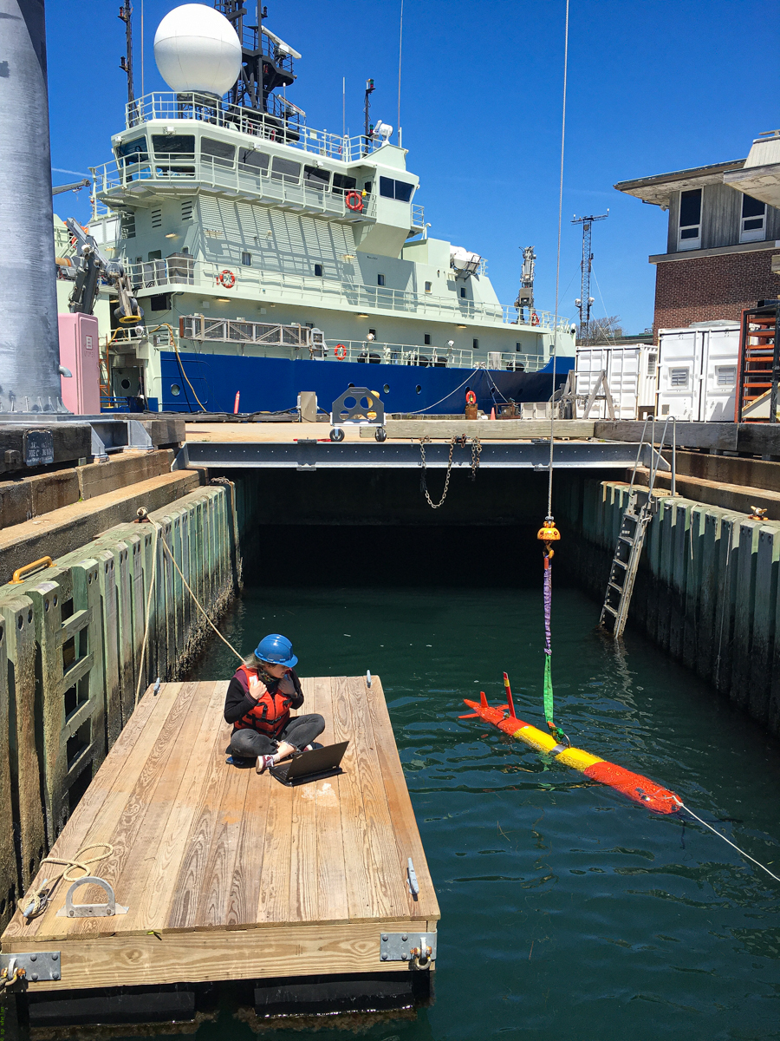
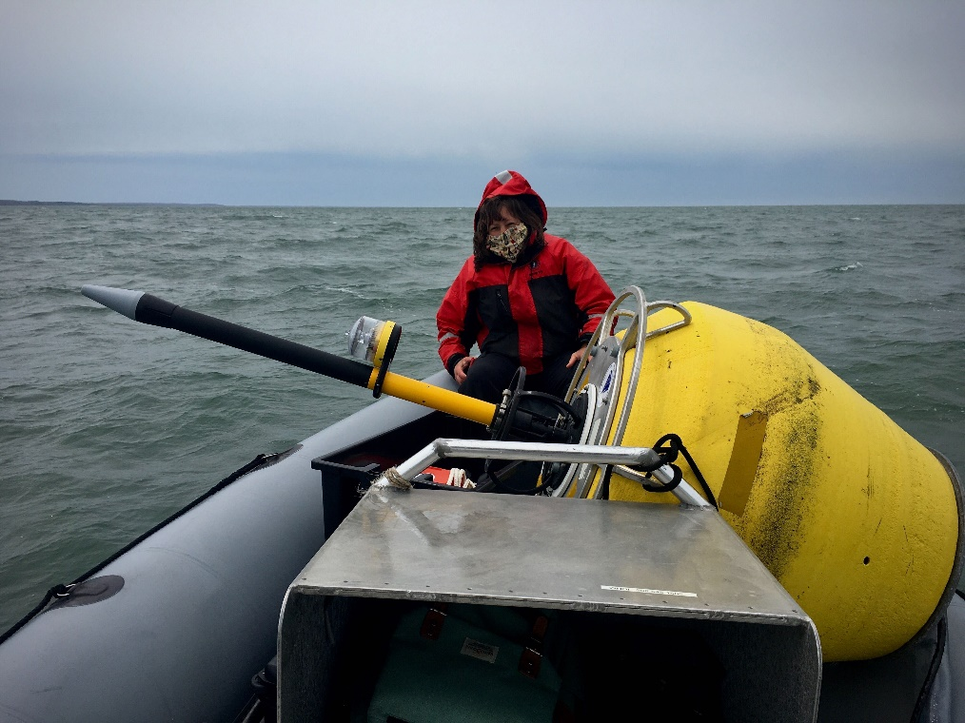
Woods Hole Testing
We are open for work and can splash assets quickly and easily

Slide 17

Problems or Challenges or Opportunities?

Slide 18
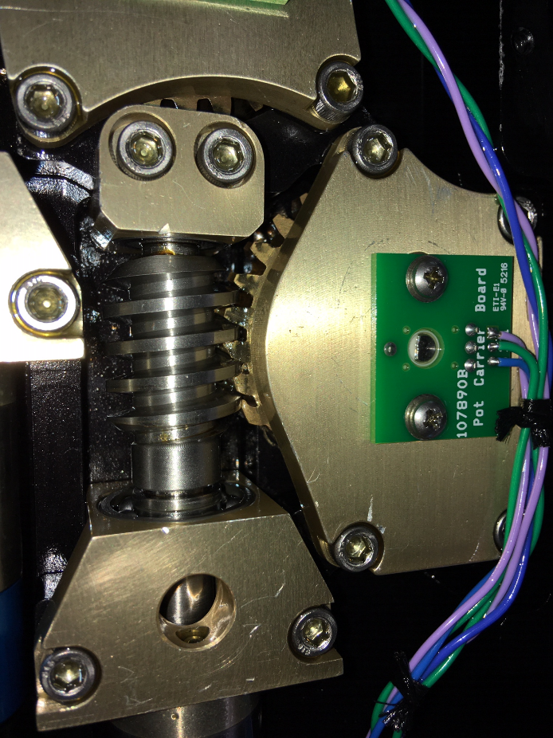

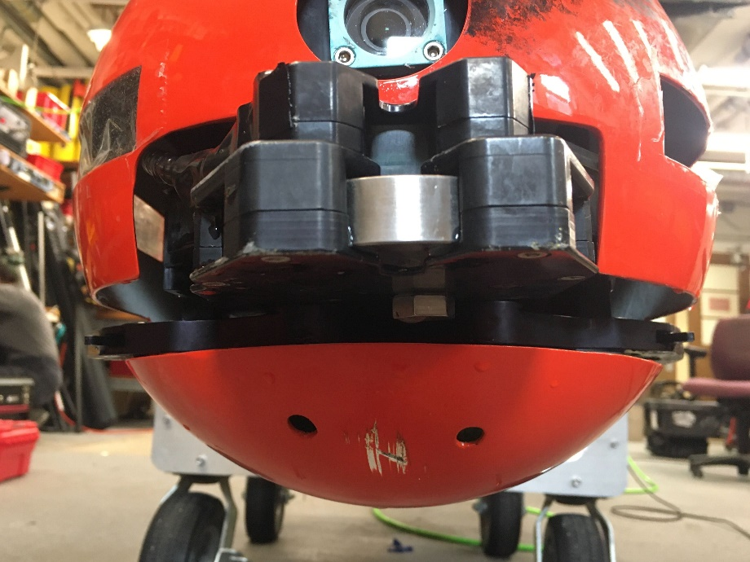
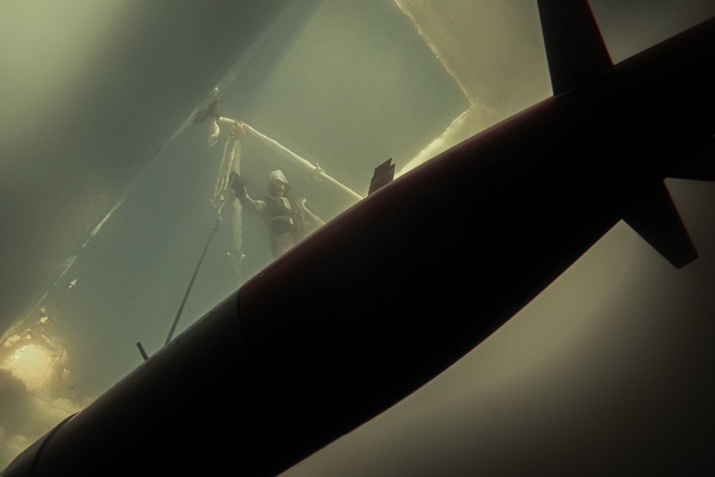




Definitely a combo of Challenges and Opportunities!
Oops, testing whiskers and gears in different scenarios
We are trying to break things
Gear mashup, software solved this one
Antenna needed to beefed up
Notes:
In the original software developed by MBARI, when the vehicle completes a mission or when it experiences a critical failure, it reverts to a “default mission” in which the vehicle returns to the surface. This allows for cellular or iridium communication to diagnose the problem, or simply command another mission. Naturally, in order to operate under the ice, where surfacing the vehicle is not an option, a new “default mission” needed to be put in place. In the under-ice default mission, the vehicle returns to the dock instead, so the vehicle will be in range for strong ACOMMS, and latched in a known location.

Slide 19
Current Year Schedule, Status and
Accomplishments

Slide 20
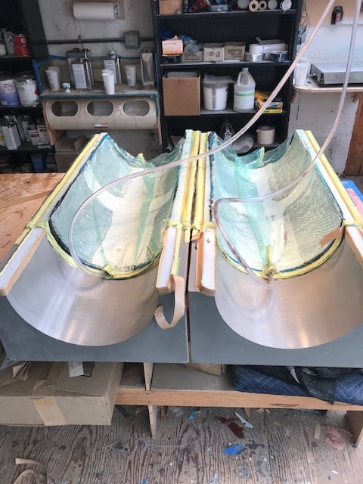
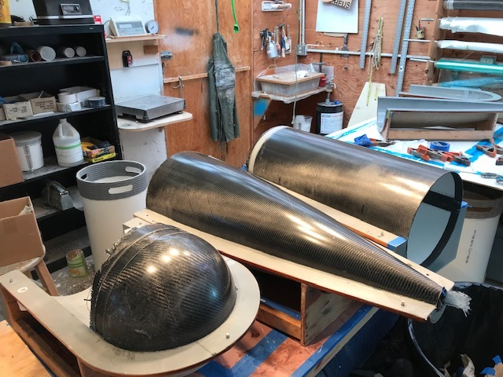
Project LRAUV Key Milestones, Underway or Achieved (1):
Fabrication of a second platform (Stella)
  Main system parts designed, ordered in YR6
  Most parts received by 30 July 2021
  All received parts have been kitted into assemblies and a second stage of checking for missing parts is underway
  Basecamp and a Gannt chart was created organize and track tasks/progress
  Procure auxiliary equipment
  Transition and training

Slide 21
Project LRAUV Key Milestones Underway or Achieved (2):
Conduct Arctic Readiness Test, most important and time consuming tasks, majority can be done in Woods Hole
  Three buoy system
  Docking/Undocking reliability
  Plume tracking algorithm further development
  Comms reliability (antenna/buoy/Dash)
Provide testing documentation and familiarization of LRAUV to USCG
  Includes collaborations with EPA, NOAA, etc. partners
Develop software for improved operator system interface
  Backseat
  Dash operator Portal

Slide 22
Project LRAUV Key Milestones underway or achieved (3):
Upgrade in progress WHOI operational DASH for operating LRAUV from inside WHOI https://lrauv.whoi.edu/
Provide Conops and final reports on field exercises
Participating in biweekly oil group calls for CRREL sensor testing and general technology discussions
Planning for 2021 under-ice testing
  Local, Woods Hole?
  New England, VT
  GLRC
Sonar payload purchase, integration
  Conduct Sonar test missions
Software pipeline for LBL navigation (underway with Mike Godin)
Software talent and development to further system readiness

Slide 23
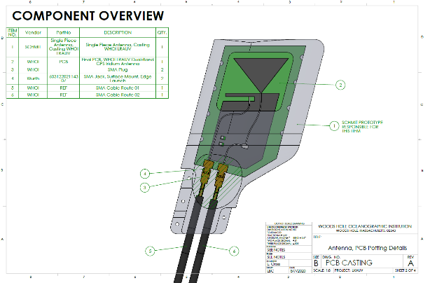
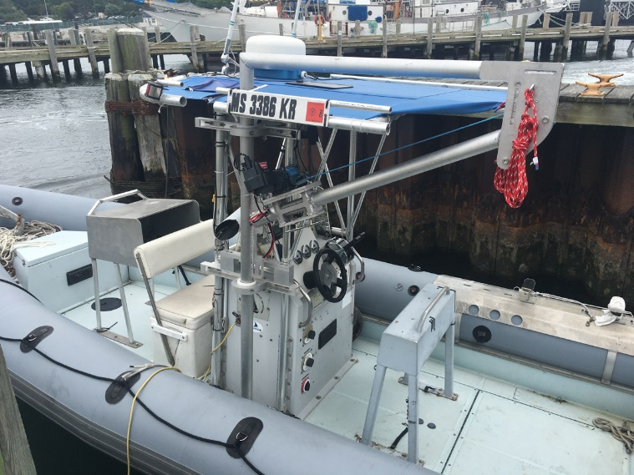
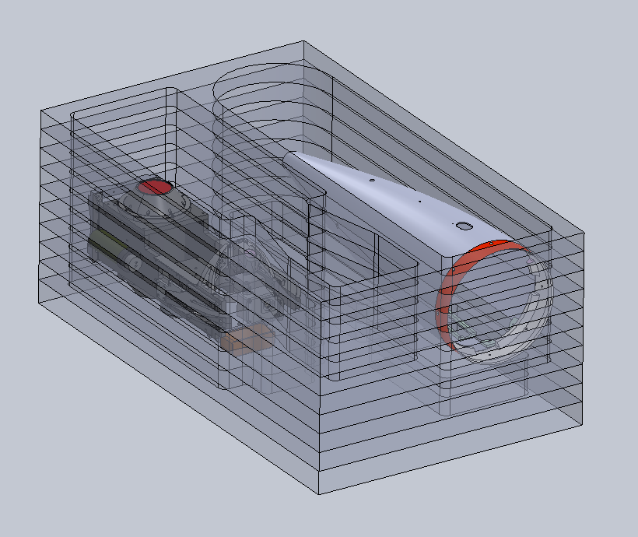
Project LRAUV Key Milestones Achieved (4):
Redesigned antenna for short and long versions. Design out to shops and boards in fabrication
Developed new software behavior missions for docking, undocking, no surfacing, new sensor configurations, refinement of plume tracking for oil mapping
Developed LARS capabilities
  Designed and implemented a davit on the WHOI R/V Hurricane
  Vehicle can be picked from the nose or with a center bail when installed
Designed and procured disposable primary Buoy batteries for 2 week missions
Procured shipping boxes and made custom foam
Build second docking nose
Evaluate alternate power sources (energy harvesting synergy with Darpa project)

Slide 24
Project LRAUV Key Milestones Achieved (5):
Conduct New England Ice tests
Conduct GLRS, Lake Superior or equivalent tests
Find a helicopter deployment opportunity
Build partnership with Woods Hole USCG to be a local operator, user, etc.
Conduct CRREL ice tank tests of sensors
Prepare for Barrow Summer 2021 Tests

Slide 25
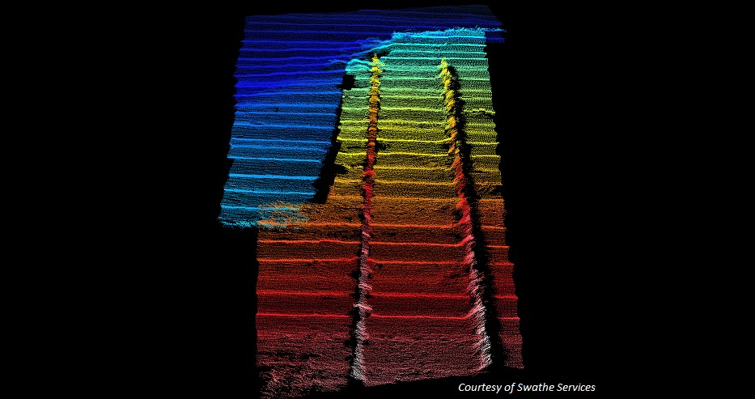
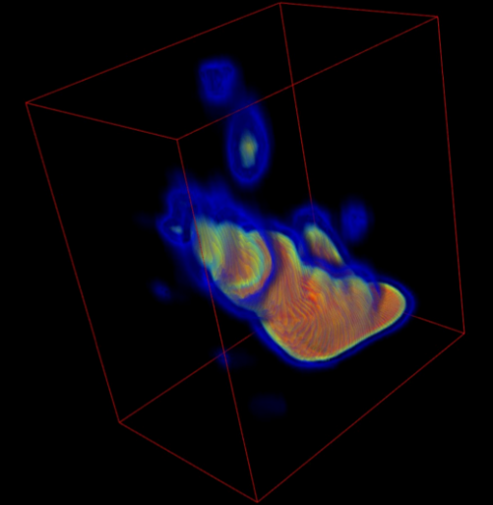
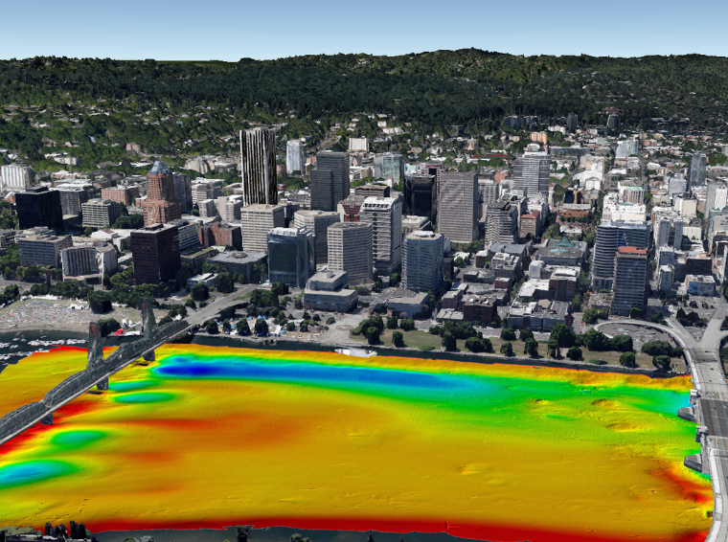
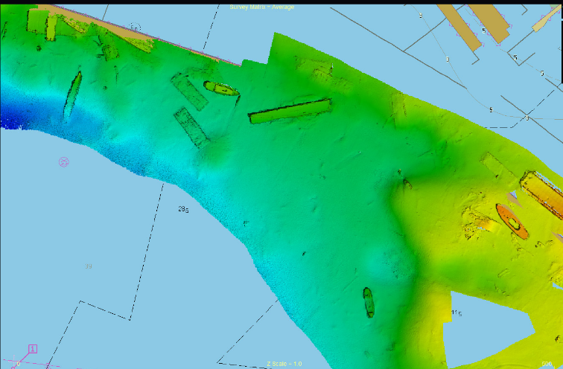
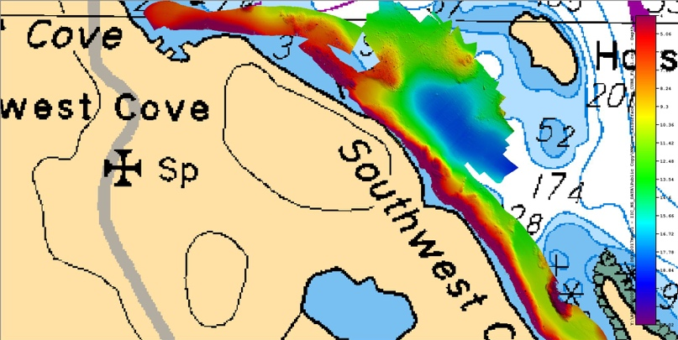
Multibeam & INS
Norbit WBMS (60W 10-28VDC, 110-240VAC)
Ixblue Phins C3 INS
We want our sonar to be:
Low power
Easy to digest data and evaluate
Be compact
Low cost
Be easy to flip up or down for bottom mapping or ice keel mapping
Imagery courtesy of Norbit
Notes:
Norbit 400kHz (Frequency Agility 200-700kHz) WBMS Bathymetric System
integrated with Real-time Sonar Head Sound Velocity Sensor. Includes
Snippets, Sidescan, Backscatter and Water Column Output. Includes Sonar
Interface Unit (SIU-I)
R2Sonic AUV-Sonic 2020 (4000 m rated) Wideband Multi Beam Echo-Sounder System incl:
• 1x Wideband Receiver/Projector, 200-450 kHz,
o 1.8° Beamwidth @ 450 kHz
o 4000 m Depth Rating Switchable Forward-Looking Sonar Imagery Output $ 8,900
1x MultiSpectral Snippets & TruePix™ Backscatter Output $ 6,675
1x Ultra High Resolution 700 kHz $ 6,675
1° x 1° Beamwidth over 70° swath
1x Raw Water Column Data Output

Slide 26
Summary
Planned outcomes of the research:
  A portable Long Range AUV, for under-ice anomaly and oil detection with deployable arctic buoys for aided navigation, remote communication and docking; around-the-clock expertise available and training with a TRL 7/8 system ready for low-rate manufacturing and payload capability expansion.
Additional research identification:
  Service for hire
  Interest in commercialization
  Interest in scientific community to use and develop tech (BSEE, EPA, NOAA, etc.)

Slide 27
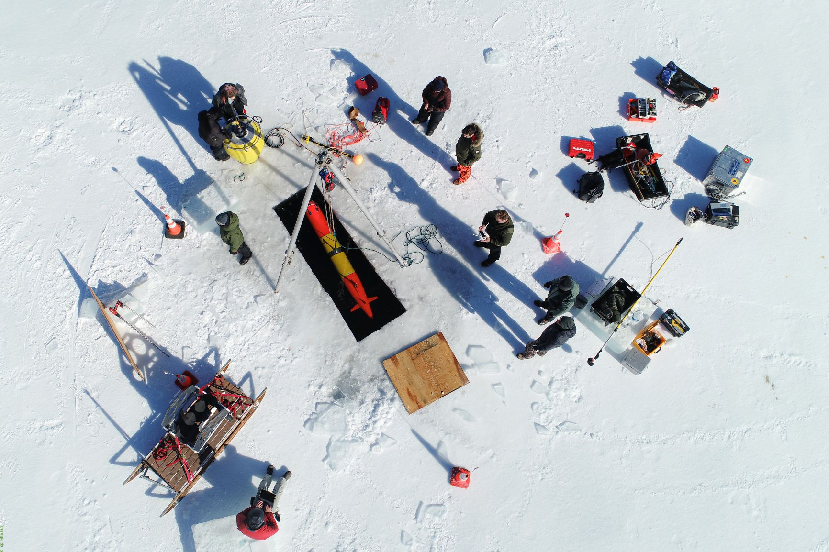
Thanks and
LRAUV Ready for questions

Slide 28
What needs improvement or is missing?
  Sensing of oil against the ice and seafloor
  More sensor payloads-Echosounders, Cameras, Water sampling, energy harvesting
  Lower vehicle costs, Design review?
  More operational time for shake-down and training
  Software development (behaviors) and backseat autonomy
Who should we connect with to improve odds of success?
  Engage with USCG operators early
  Broaden R&D support
  Need to coordinate field operations with first responders and fill technology gaps that are identified.
  Continue to connect with alternative funding sources like ONR, NOAA and BSEE to help fund operations and sensor development (methane, what else?)
  Need more vehicles?
Input on future from you: Do we need 2, 5, 10 vehicles?
Notes:
Thank you for the gift of your time and attention.

Slide 29
Extra Slides

Slide 30
Why is LRAUV a smart choice?
Has a proven variable ballast system and mass shifter making it the only propeller-driven AUV in the world that can drift, hover and accurately navigate to tell you exactly where an anomaly is. (speed variability)
Buoyancy change and mass shifter allows vehicle to dive while stuck under-ice
Has reliably operated remotely for weeks at a time for more than ten years and can be operated from a web browser

Slide 31
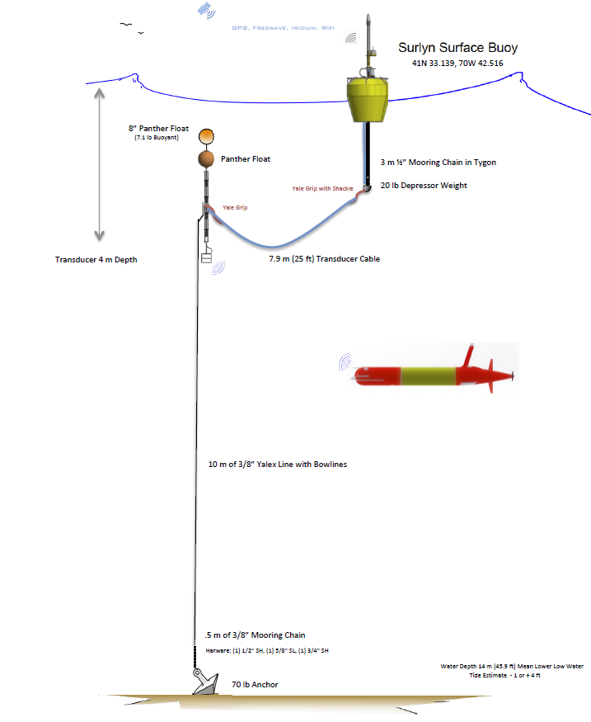

Slide 32
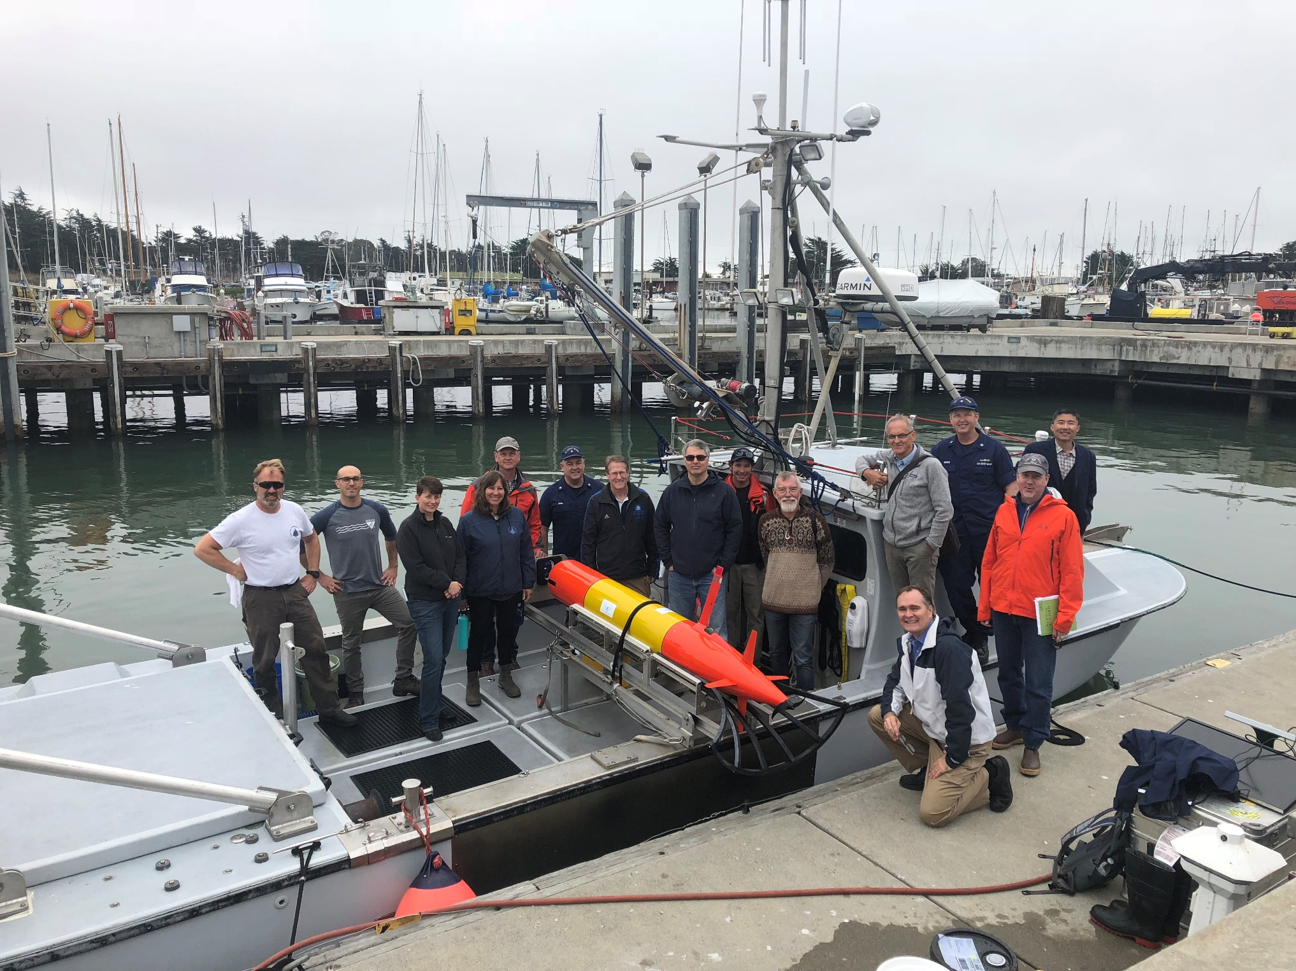
ADAC Program Year 6 Annual Meeting 14 May 2020

Slide 33
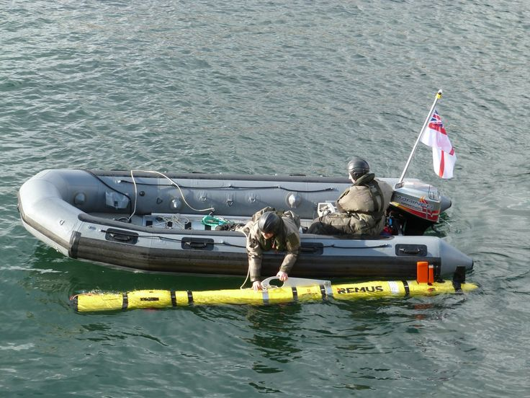
Project LRAUV: Transition Plans
ADAC Program Year 6 Annual Meeting 14 May 2020
Pathway to Transition:
Create an operational system that the USCG can use for characterizing spills in ice-covered ocean environments. Transition advantages of the LRAUV platform:
  Contains commercially available sensors
  Can be replicated for the USCG
  Has a proven vehicle design and proven reliability
  Sensor commonality

Slide 34
Project LRAUV: Transition Plans
ADAC Program Year 6 Annual Meeting 14 May 2020
Transition Plan includes the following:
  Facilities: WHOI operates facilities for fabrication, testing, logistics (on-ice support) and platforms such as ALVIN
  Service for-Hire: Operators and AUV’s such as the REMUS are available for hire and also have been transitioned into both the Navy and commercial sectors
  Hardware Builds: WHOI has a history of replicating systems and training end users
  Commercialization: Demand for WHOI built systems may occur through spin-off companies or through licensing the technology to a commercial entity. (example: Hydroid Kongsberg with REMUS and Bluefin from MIT, Bellingham)

Slide 35

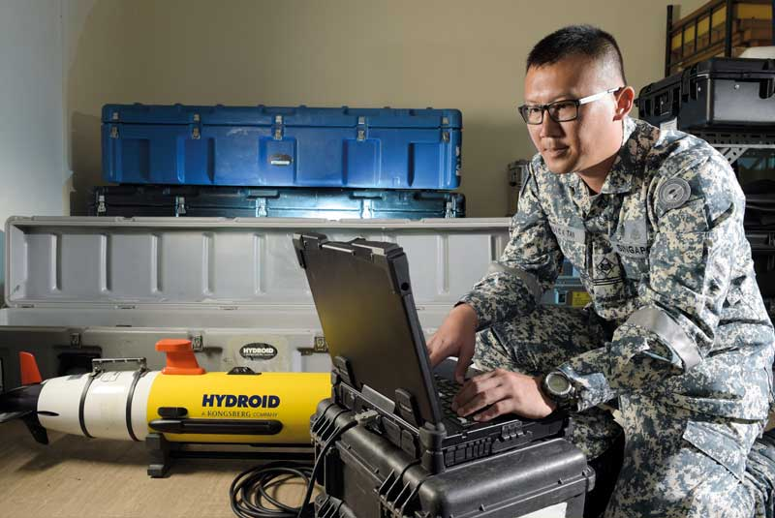
Project LRAUV: Transition Plans
ADAC Program Year 6 Annual Meeting 14 May 2020
Two-Stage Transition Plan:
  Build one or more systems to support USCG complete with successful open-water and under-ice demonstrations. WHOI trains USCG operators with support funding. WHOI can support USCG on site or remotely via iridium vehicle communications as needed. 24 hr support possible.
  Commercialize resulting platform: Based on lessons learned from (1), prepare the system for commercialization by accessing WHOI CMR fabrication resources. LRAUV was not designed for efficiency of manufacturing and rapid prototyping, therefore revisiting AUV design is a top priority.

Slide 36
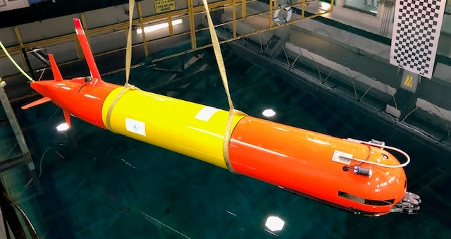
Polaris

Slide 37
Project LRAUV: Low Cost Vehicle
ADAC Program Year 6 Annual Meeting 14 May 2020
    Projected- Perform low cost vehicle study at DunkWorks
    Reduced Cost Vehicle Fabrication: Using WHOI's maker space known as Dunk Works, the WHOI LRAUV team along with designated student interns accomplished the following in order to reduce vehicle costs:
    Evaluate LRAUV BOMs and identify machined parts that can be 3D printed with less people labor and less expensive materials.
    Produce drawings and prototypes of vehicle components, such as chassis, end comes, end caps, vehicle shells, etc.
    Evaluate third party licensing of the LRAUV with MBARI approval.

Slide 38
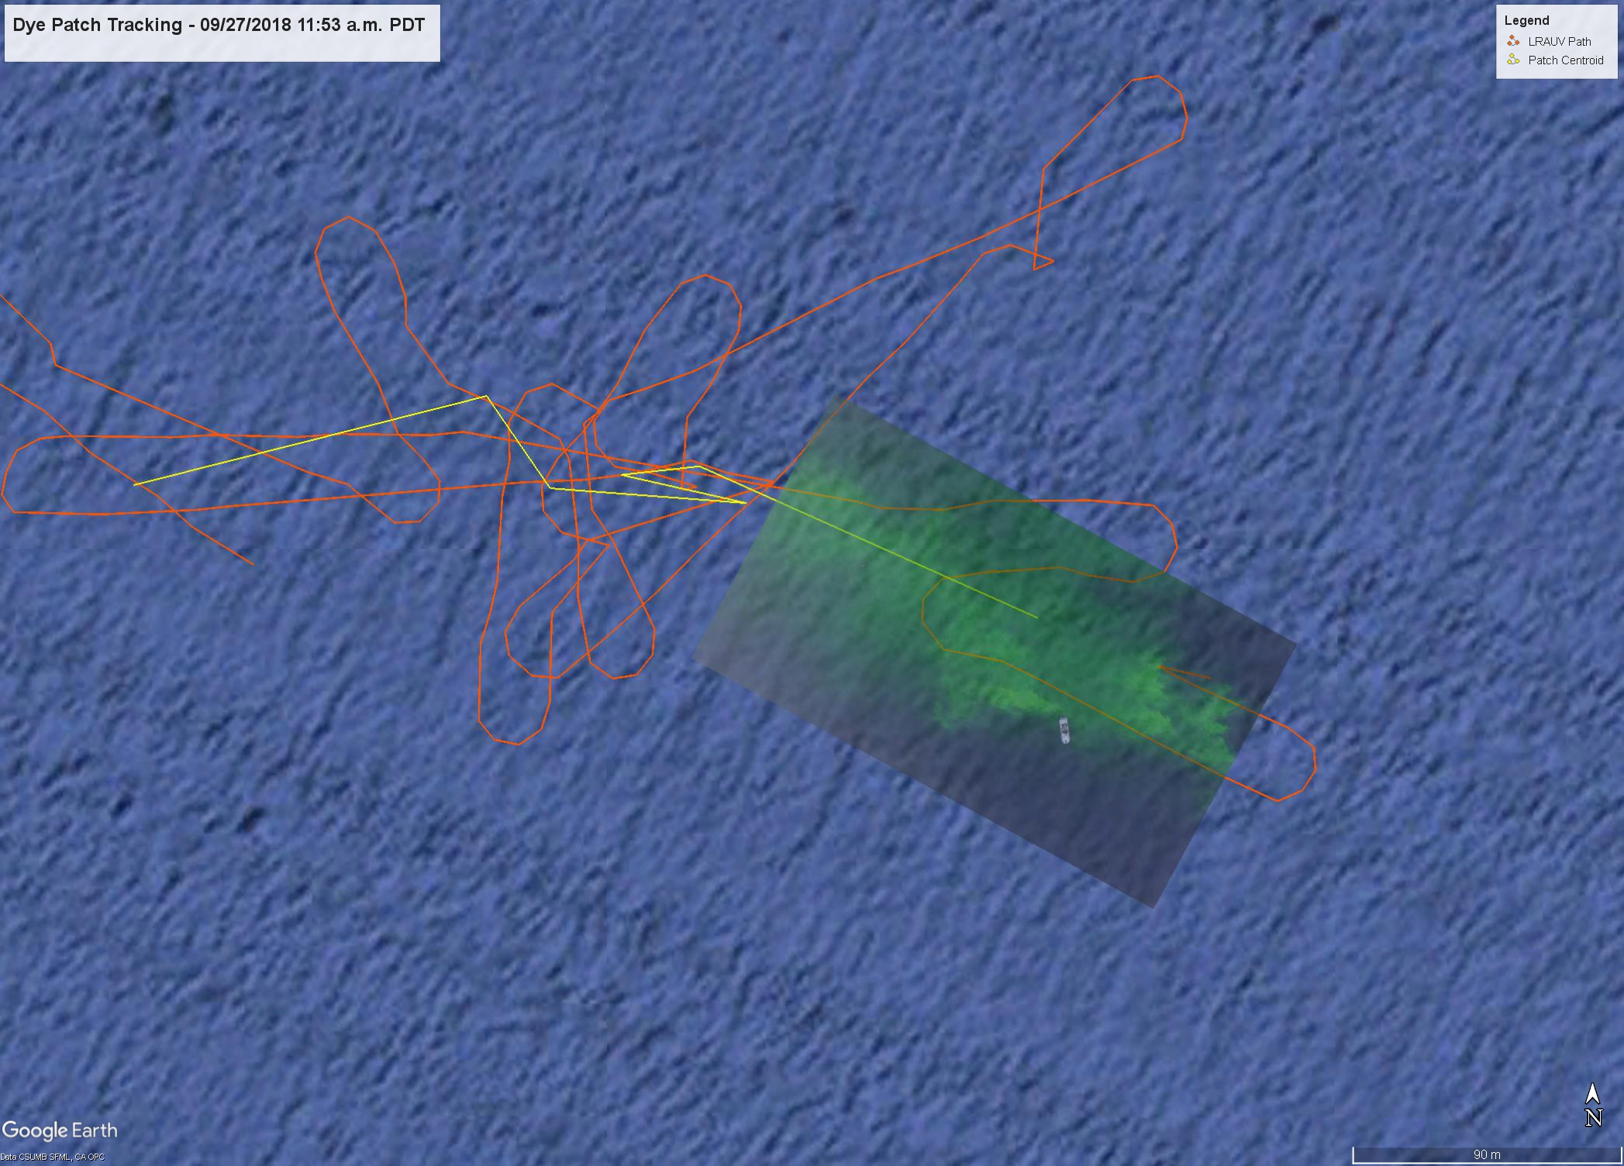
Project LRAUV: Metrics
ADAC Program Year 6 Annual Meeting 14 May 2020
  Original YR1 metrics:
    Performance-specific measures:
      Detection level of oil: measured in terms of minimum sensitivity Target: < 80 ppb.
      *Range and endurance: Target: 300 km on secondary (chargeable) batteries, >twice that on primary (disposable).
      Adaptive sampling performance- mapping of spill extent: Target: Area coverage 1000 km2 per vehicle deployment (lane spacing TBD, e.g. 30 km x 30 km, 1 km grid).
    Operator ease of use:
      Logistical footprint: number of operators required on site, number of kilograms to be transported. Target: 2-3 and < 600kg.
      Ease of mission configuration: time to specify grid survey: Target: < 1 hr.
      Ease of remote interaction: training time required for operators: Training: < 1 week.

