Slide 1
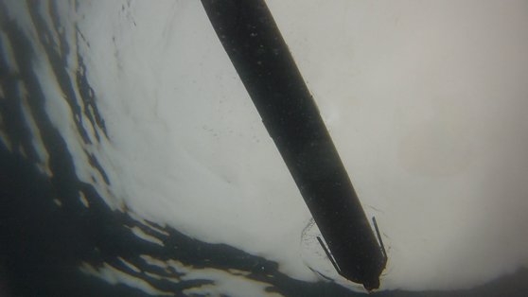
ADAC Year 5 Santa Barbara Seeps Field Work
ADAC Project Briefing-2
(LRAUV) for Under-Ice Mapping of Oil Spills and Environmental Hazards
PI Dr. Jim Bellingham, Co-PI/PM Amy Kukulya (WHOI), Co-PI Brett Hobson (MBARI)
Team: Sean Whelan (WHOI), Brian Kieft (MBARI)

Slide 2
Mission Objective
This expedition is designed to provide comprehensive open-water testing in a real-world oil spill environment with specially designed WHOI/MBARI technology.
Implement and Test under-ice and oil detection/tracking capabilities for LRAUV
The fieldwork will train personnel and exercise under-sea to air communications from the vehicle to command control via a buoy gateway.
Two stakeholder virtual meetings are also planned with DHS/USCG/ADAC partners.

Slide 3
Testing objectives & LRAUV Success
First time ever LRAUV has sent data without surfacing
First time ever LRAUV reset the navigation without surfacing (used buoy instead of GPS)
First time ever acoustic homing to a single beacon (back to the hole)
Multi-Vehicle operations designed for vehicles to more rapidly inform each other and operators for more informed decision making
Convinced Sea-owl sensor is reliable and can detect low signals and decipher against the environmental baseline

Slide 4
Under-ice Capable LRAUV Testing con’t
Homing to a beacon: Ice hole/buoy
  Dynamic Docking
Sending data remotely to command control Via Arctic Buoys
Patch tracking/anomaly detection algorithms
First Buoy deployment, needs low power mode Mode

Slide 5
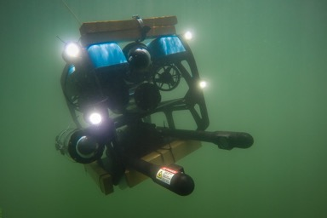
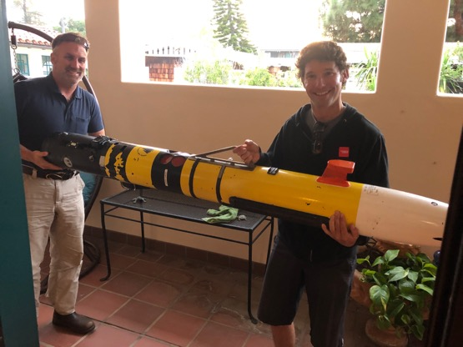
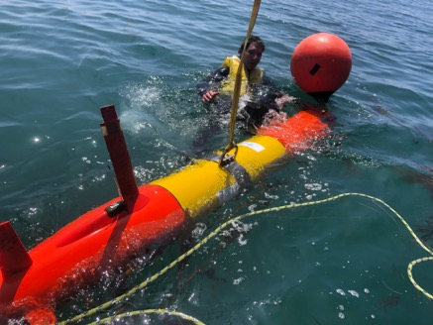
Multi-vehicle Assets

Slide 6
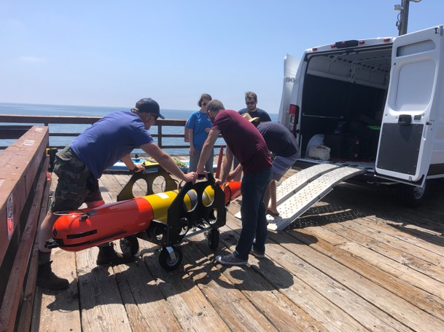
Helicopter portable

Slide 7
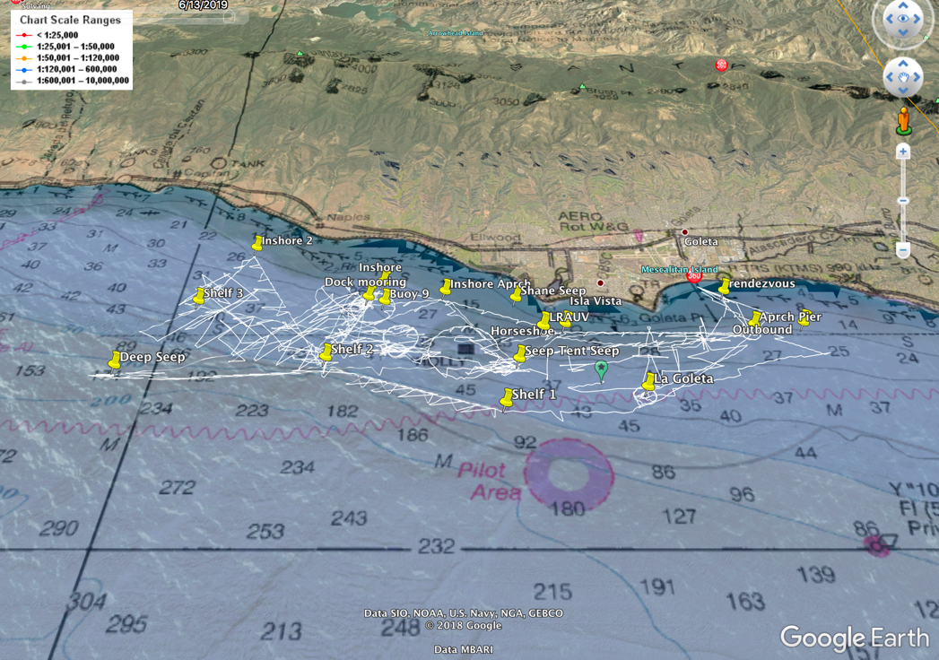
LRAUV Tracks:
-280 nautical miles
-10 Days

Slide 8
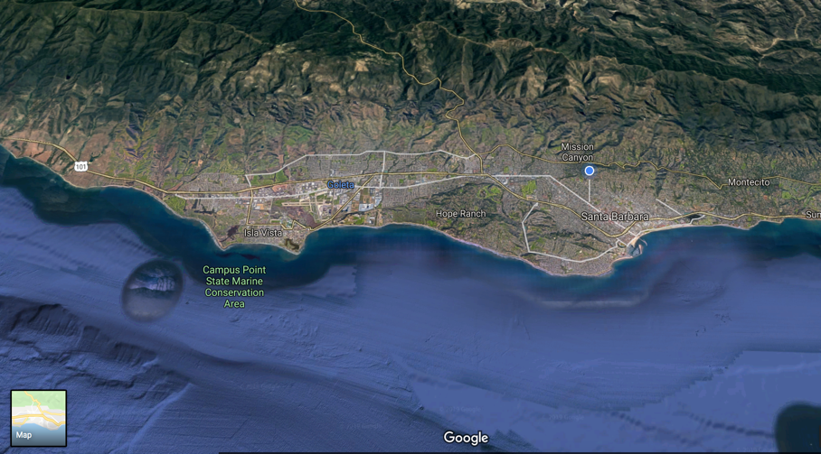

REMOTE COMMS Success with Buoy!
Same functionality for Arctic!
Message heard around the globe
LRAUV to
RF Antenna at UCSB
Laptop at house (blue dot) email server at MBARI
Sends email to WHOI
Forwards back to MBARI to display (decode) on Dash
30 second round trip
Reliable 5 km range
11 miles

Slide 9
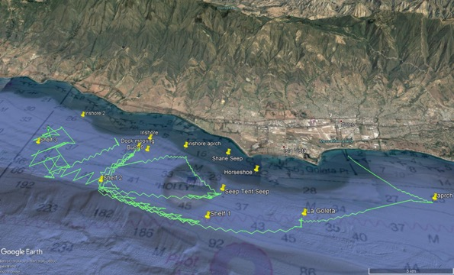
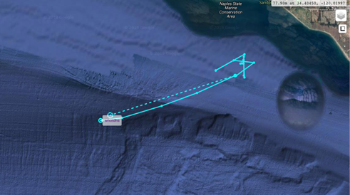
Expert Input
Local knowledge
Physical Oceanography
Received input from Dave Valentine UCSB about an unmapped seep off the shelf in 240 meters of water. Redirected LRAUV to sample hours later.
Deep Seep

Slide 10
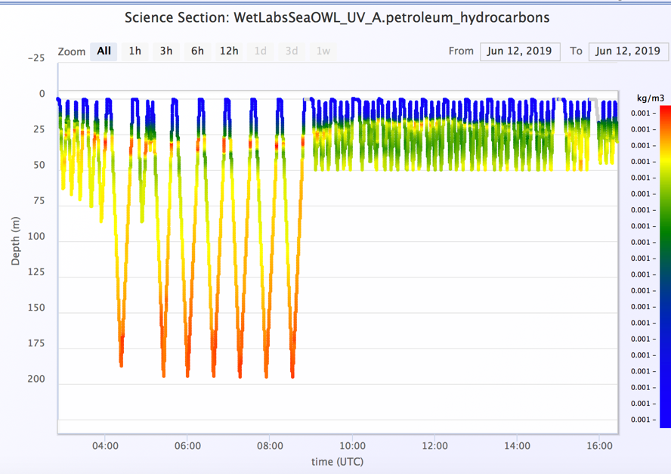
Surface oil does not correlate with subsurface detections

Slide 11
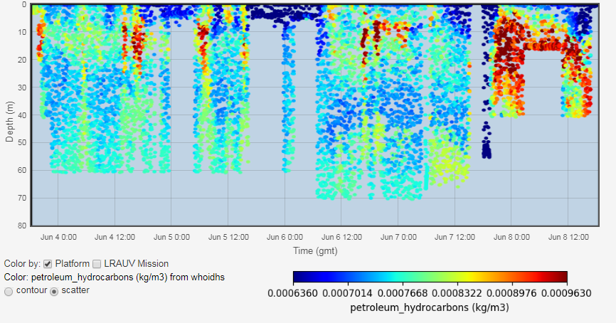
Today

Slide 12
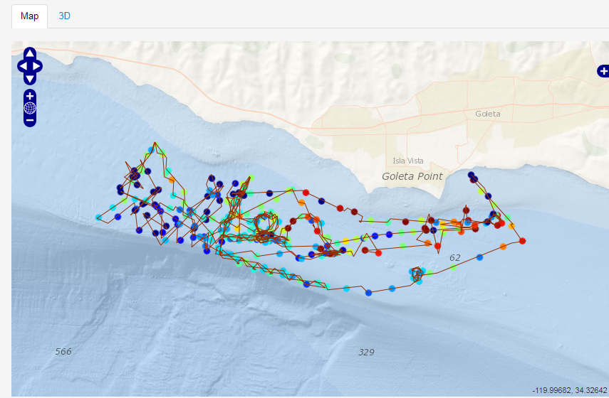
LRAUV tracks with hot spots

Slide 13
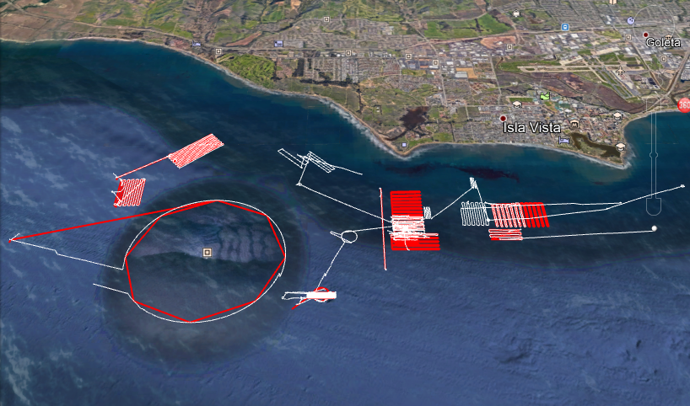
REMUS-100 Tracks

Slide 14
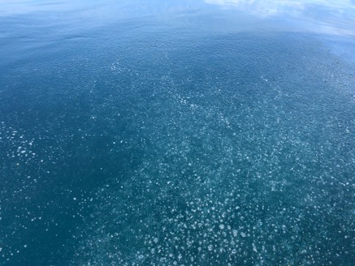
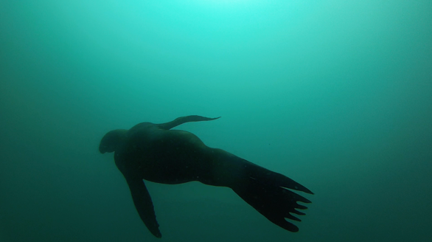

Environment

Slide 15
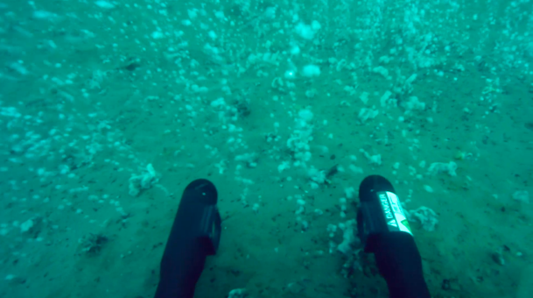
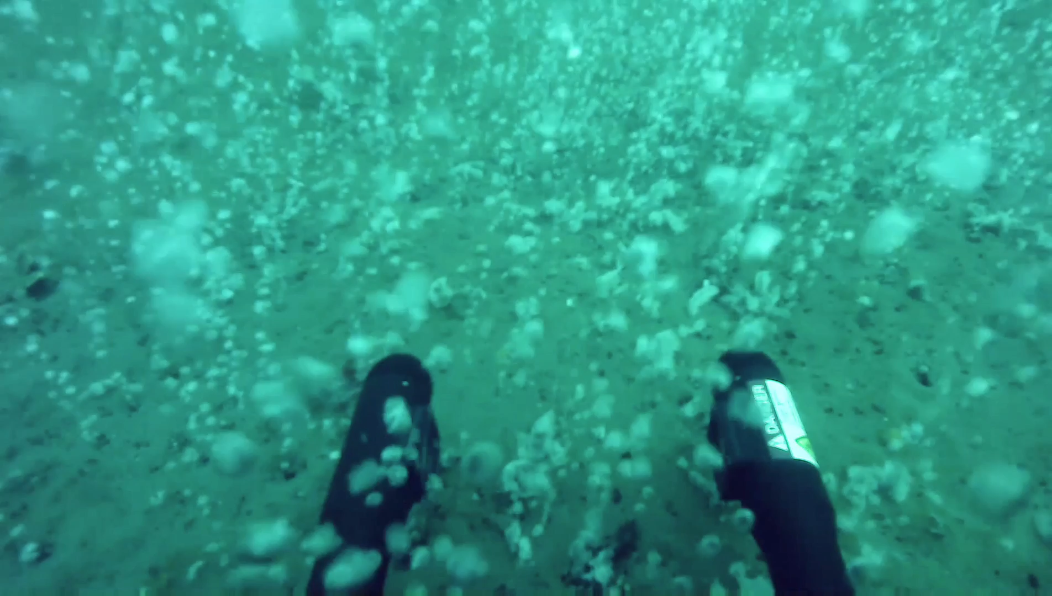
ROV

Slide 16
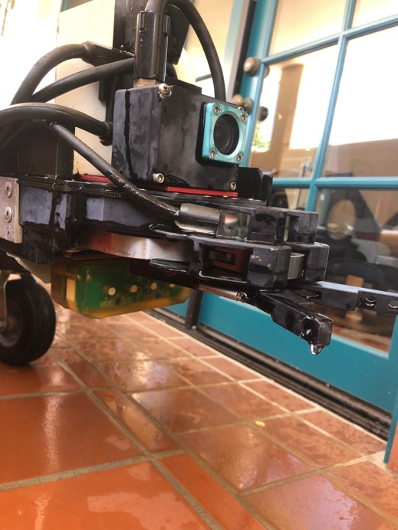
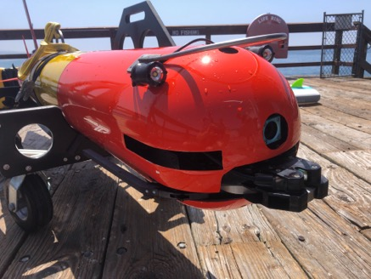
Docking Slide

Slide 17
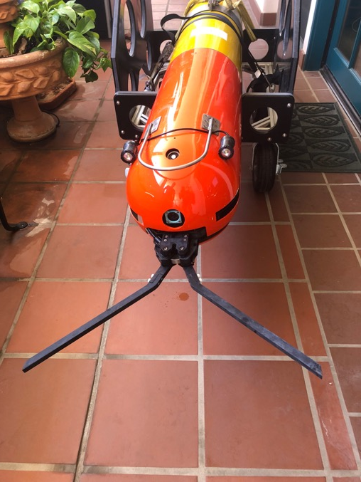
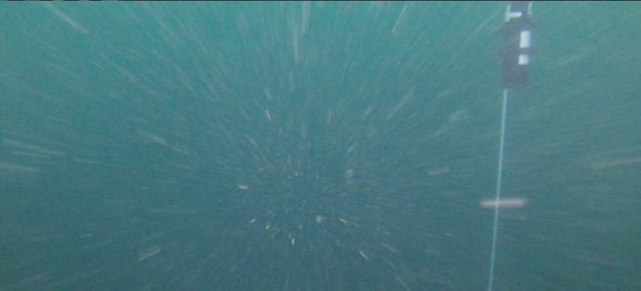
Docking Slide

Slide 18
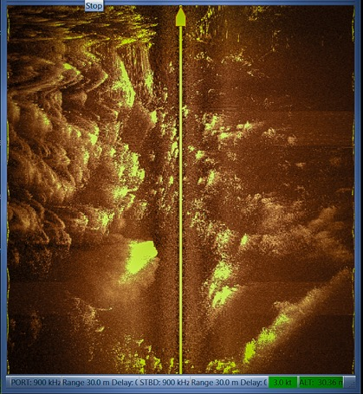
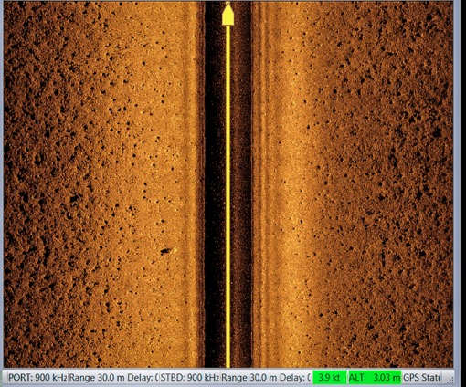
Sidescan Sonar (REMUS)

Slide 19
What’s Next
WE are still operating the vehicle as we speak!
Evaluate mission architecture for recovering from faults, so vehicle does not go to surface…build new default missions
More hours and confidence needed for nav reset and acoustic homing/docking
Did not dock to line (came within meters), need to evaluate mechanical and software (was lowest priority and not enough time with hardware)
Further develop patch tracking and mission behaviors
Return to Santa Barbara end of August for another round of tests to assess above items

