Slide 1
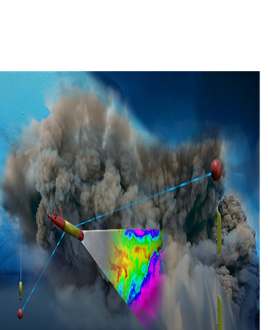
ADAC Year 5 Biannual Review
(LRAUV) for Under-Ice Mapping of Oil Spills and Environmental Hazards
Co-PI/PM Amy Kukulya (WHOI), PI Dr. Jim Bellingham (WHOI), Co-PI Brett Hobson (MBARI)

Slide 2
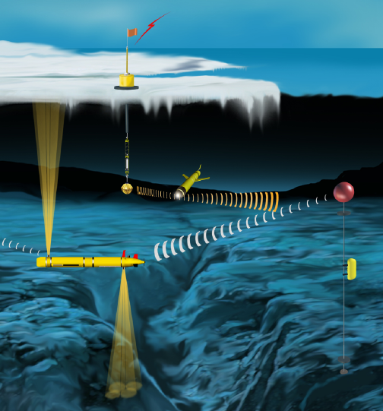
ADAC Project (Name): (LRAUV) for Under-Ice Mapping of Oil Spills and Environmental Hazards
ADAC YR5 Biennial Review
Project Principal Investigator(s): PI Dr. Jim Bellingham (WHOI), Co-PI/PM Amy Kukulya (WHOI), Co-PI Brett Hobson (MBARI)
Woods Hole Oceanographic Institution
Supporting Team: Dr. Chris Reddy, Daniel Gomez-Ibanez, Sean Whelan
Project Champion: Kirsten Trego, HQ USCG MER
Project Advocates: Dr. Robyn Conmy, EPA USEPA/NRMRL/RTEB, USCG Research and Development Center, Dr. Jay Choy BSEE/Oil Spill Preparedness Division, Dr. Lisa Dipinto, NOAA, Office of Restoration and Response

Slide 3
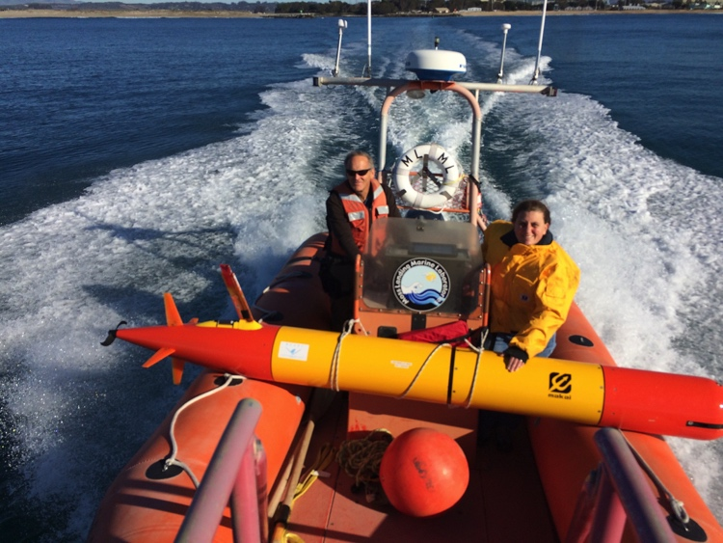
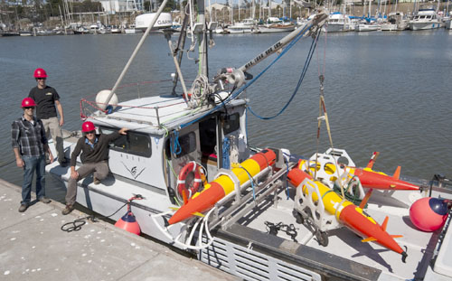
LRAUV: Description and Baseline
ADAC YR5 Biennial Review
Project Description: To develop an Autonomous Underwater Vehicle (AUV)-based approach leveraging a small, reliable COTS system, called the Tethys Long-Range AUV (LRAUV). The LRAUV is helicopter portable, carrying an environmental mapping payload, allowing rapid response to provide situational awareness and damage mitigation for first responders/USCG.
Baseline: Currently, there is no USCG baseline for an AUV to meet the unique demands of Arctic operations that requires a minimal logistical footprint, a small operational team and oil detection and mapping capability.

Slide 4
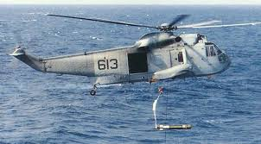
Project LRAUV: Relevance and Method
ADAC YR5 Biennial Review
Relevance to DHS and USCG: This project’s goal is to create a rapidly deployable platform for oil spill characterization in ice-covered oceans that has minimal logistical overhead. We characterize the challenge as the ‘last seat in the helicopter’ problem: If first responders are operating at the far end of their logistical support capability, the system must maximize operational capability, minimize logistical support and operate autonomously.
Research Method: Our approach is to leverage an existing Long-Range AUV developed at MBARI (LRAUV), and enhance the system to detect oil and operate under ice. LRAUV offers extended ranges (one to three weeks), comparatively small size and its ability to be operated by a remote support team via an Iridium communication link, all by using commercially available off-the-shelf sensors (COTS). By adding dynamic docking capability, LRAUV can stay tethered for weeks to months baring extreme weather events.

Slide 5
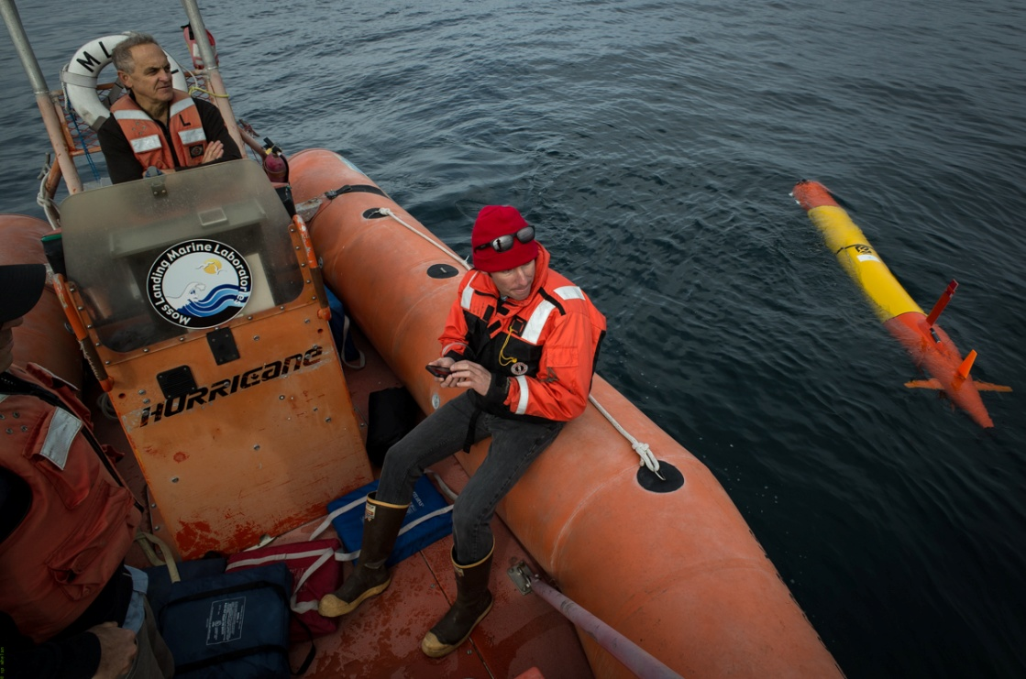
Project LRAUV: Relevance and Method
ADAC YR5 Biennial Review
    YR5 Prior:
      Integrated arctic/oil science payload on LRAUV;
      Conducted open water testing and plume mapping/training exercise at MBARI (September 27, 2018);
      Developed LRAUV mission simulations with Bulgar site current data
      Designed arctic buoys (LBL, USBL, ACOMMS, WiFi, RF, Iridium, thermistor)
    Current:
      MBARI is performing further offshore testing of vehicle;
      Implementation and testing umodem and USBL functionality (WHOI/MBARI/Intuaware);
      Implementing LBL navigation capability;
      Building three* arctic buoys;
      Developing firmware for buoys for three subsurface capabilities (LBL, USBL, ACOMMS)
      Planning under-ice testing (NH pond)
LRAUV can be launched from a cell phone

Slide 6
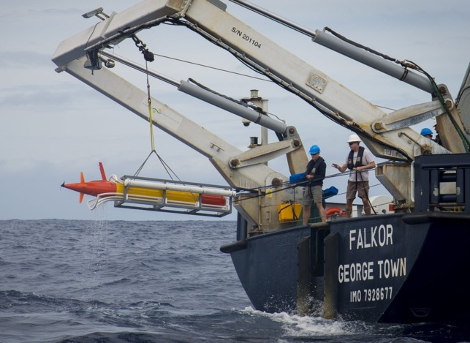
Project LRAUV: Relevance and Method
ADAC YR5 Biennial Review
*Field testing/water component
    Projected -Developing Arctic Capable Vehicle System:
      Buoy completion in late Feb (ahead of schedule)
      Under-ice test in pond in NH with either Arctic buoy or surrogate* transponder to test USBL and ACOMMS capability under-ice
      Planning for MC20 GoM survey
      Conduct extensive testing of LRAUV at WHOI in open water/ice
      Develop mission macros for plume mapping
      Build vehicle boat launcher*
      Conduct MC20 survey with anchored Arctic buoys
      Evaluate performance, further testing in Woods Hole
      Finish Capture Nose integration nose and testing, test line docking

Slide 7
Project LRAUV: Relevance and Method
ADAC YR5 Biennial Review
    Projected- Perform low cost vehicle study at DunkWorks
    Reduced Cost Vehicle Fabrication: Using WHOI's maker space known as Dunk Works, the WHOI LRAUV team along with designated student interns accomplished the following in order to reduce vehicle costs:
    Evaluate LRAUV BOMs and identify machined parts that can be 3D printed with less people labor and less expensive materials.
    Produce drawings and prototypes of vehicle components, such as chassis, end comes, end caps, vehicle shells, etc.
    Evaluate third party licensing of the LRAUV with MBARI approval.
        (Demo goes here)

Slide 8
Project LRAUV: Schedule and Metrics
ADAC YR5 Biennial Review
Current year research schedule and milestones:
  ML1-1: Test/Transition LRAUV to WHOI: Underway​
  ML1-2: Collect Navigation Performance Data: September 2018​
  ML1-3: Complete Delivery/MBARI transition to WHOI: November 2018​ (now Jan ‘19)
  ML1-4: Process data and further develop software behaviors: January 2019​
  ML2-1: Plan adaptive mission in GoM for oil mapping, February 2019​
  ML2-2: Perform low latitude oil mission GoM, May 2019​
  ML2-3: Complete software development for data visualization, June 2019
  ML3-1: Plan High latitude Mission: May, 2019 –Great Lakes and Frozen NH Lake for prelim tests​
  ML4-1: Complete fabrication of Arctic Buoys: May 2019​ (Feb 2019)
  ML4-2: Test Arctic Buoys in open water: June 2019​ (Now May 2019)
  ML5-1: Evaluate data, software enhancements, training: June 2019​
  ML6-1: Low cost vehicle evaluation: June 2019​
  ML7-1: Transition Plan: June 2019
ADD Under-ice test of LRAUV in NH for USBL/ACOMMS-March

Slide 9
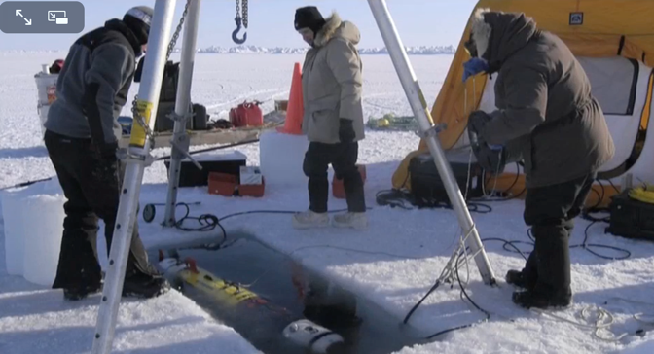
LRAUV: Key Accomplishments
ADAC YR5 Biennial Review
  The MBARI/WHOI team has combined the best AUV technologies from two successful AUV systems to make a custom Arctic capable platform;
  Designed custom LRAUV and vehicle agnostic arctic buoys;
  Built an operational LRAUV for oil detection;
  Developed Vehicle current modeling simulator;
  Evaluated COTS sensor packages (split beam, multibeam, methane, optics);
  Performed two vehicle demonstrations to stakeholders (WHOI, MBARI);
  Presented and published two IEEE papers on our research;
  Built collaborations with EPA, NOAA and BSEE;
Barrow Alaska WHOI REMUS Deployment
Sea Owl tests at MC20 site (REMUS)

Slide 10
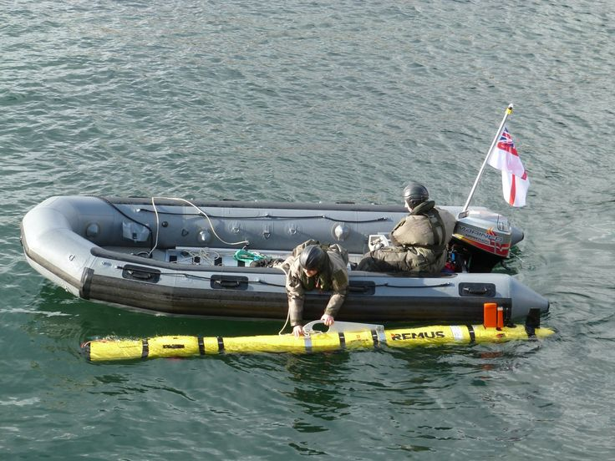
Project LRAUV: Transition Plans
ADAC YR5 Biennial Review
Pathway to Transition:
Create an operational system that the USCG can use for characterizing spills in ice-covered ocean environments. Transition advantages of the LRAUV platform:
  Contains commercially available sensors
  Can be replicated for the USCG
  Has a proven vehicle design and proven reliability

Slide 11
Project LRAUV: Transition Plans
ADAC YR5 Biennial Review
Transition Plan includes the following:
  Facilities: WHOI operates facilities for fabrication, testing, logistics (on-ice support) and platforms such as ALVIN
  Service for-Hire: Operators and AUV’s such as the REMUS are available for hire and also have been transitioned into both the Navy and commercial sectors
  Hardware Builds: WHOI has a history of replicating systems and training end users
  Commercialization: Demand for WHOI built systems may occur through spin-off companies or through licensing the technology to a commercial entity. (example: Hydroid Kongsberg with REMUS and Bluefin from MIT, Bellingham)

Slide 12
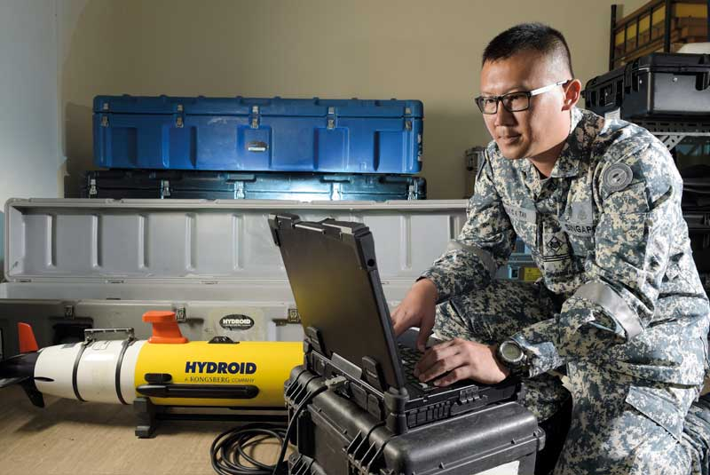
Project LRAUV: Transition Plans
ADAC YR5 Biennial Review
Two-Stage Transition Plan:
  Build one or more systems to support USCG complete with successful open-water and under-ice demonstrations. WHOI trains USCG operators with support funding. WHOI can support USCG on site or remotely via iridium vehicle communications as needed. 24 hr support possible.
  Commercialize resulting platform: Based on lessons learned from (1), prepare the system for commercialization by accessing WHOI CMR fabrication resources. LRAUV was not designed for efficiency of manufacturing and rapid prototyping, therefore revisiting AUV design is a top priority.

Slide 13
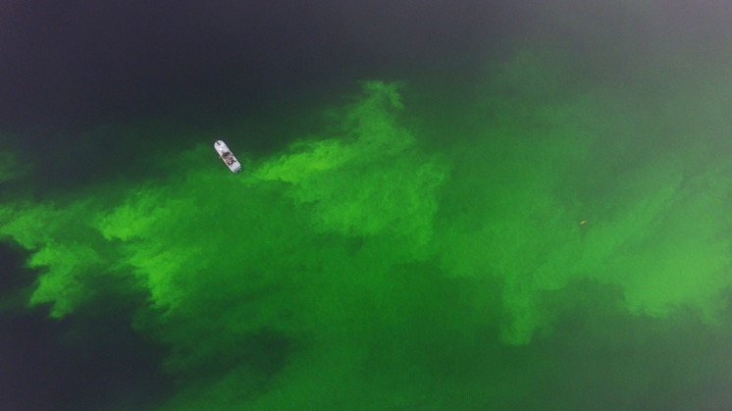
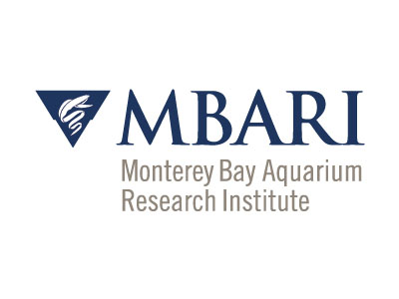

LRAUV Ready for questions
ADAC Program Year 5 Annual Meeting 5-6 December 2018
What needs improvement of is missing?
  Sensing of oil against the ice and seafloor
  More sensor payloads-Bathymetric sonar, Cameras, Water sampling
  Lower vehicle costs
  More operational time for shake-down and training
  Software development (behaviors)
Who should we connect with to improve odds of success?
  Engage with USCG operators early
  Broaden R&D support
  Need to coordinate field operations with first responders and fill technology gaps that are identified.
  Continue to connect with alternative funding sources like ONR, NOAA and BSEE to help fund operations and sensor development (methane, what else?)
  and need more vehicles
Input on future from you: Do we need 2, 5, 10 vehicles?
Notes:
Thank you for the gift of your time and attention.

