Slide 1
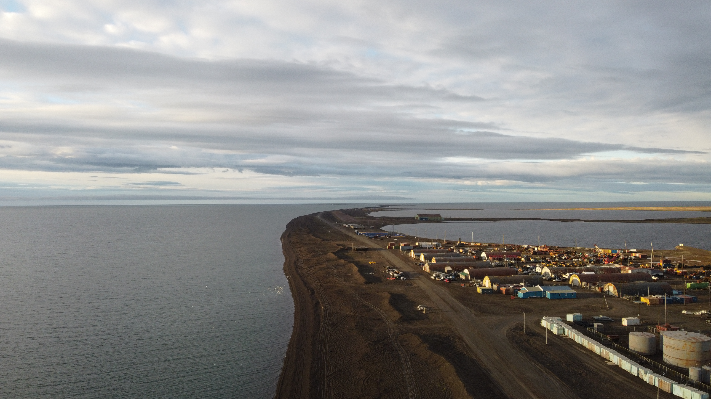
LRAUV in the Arctic
LRAUV Arctic Demonstration

Slide 2
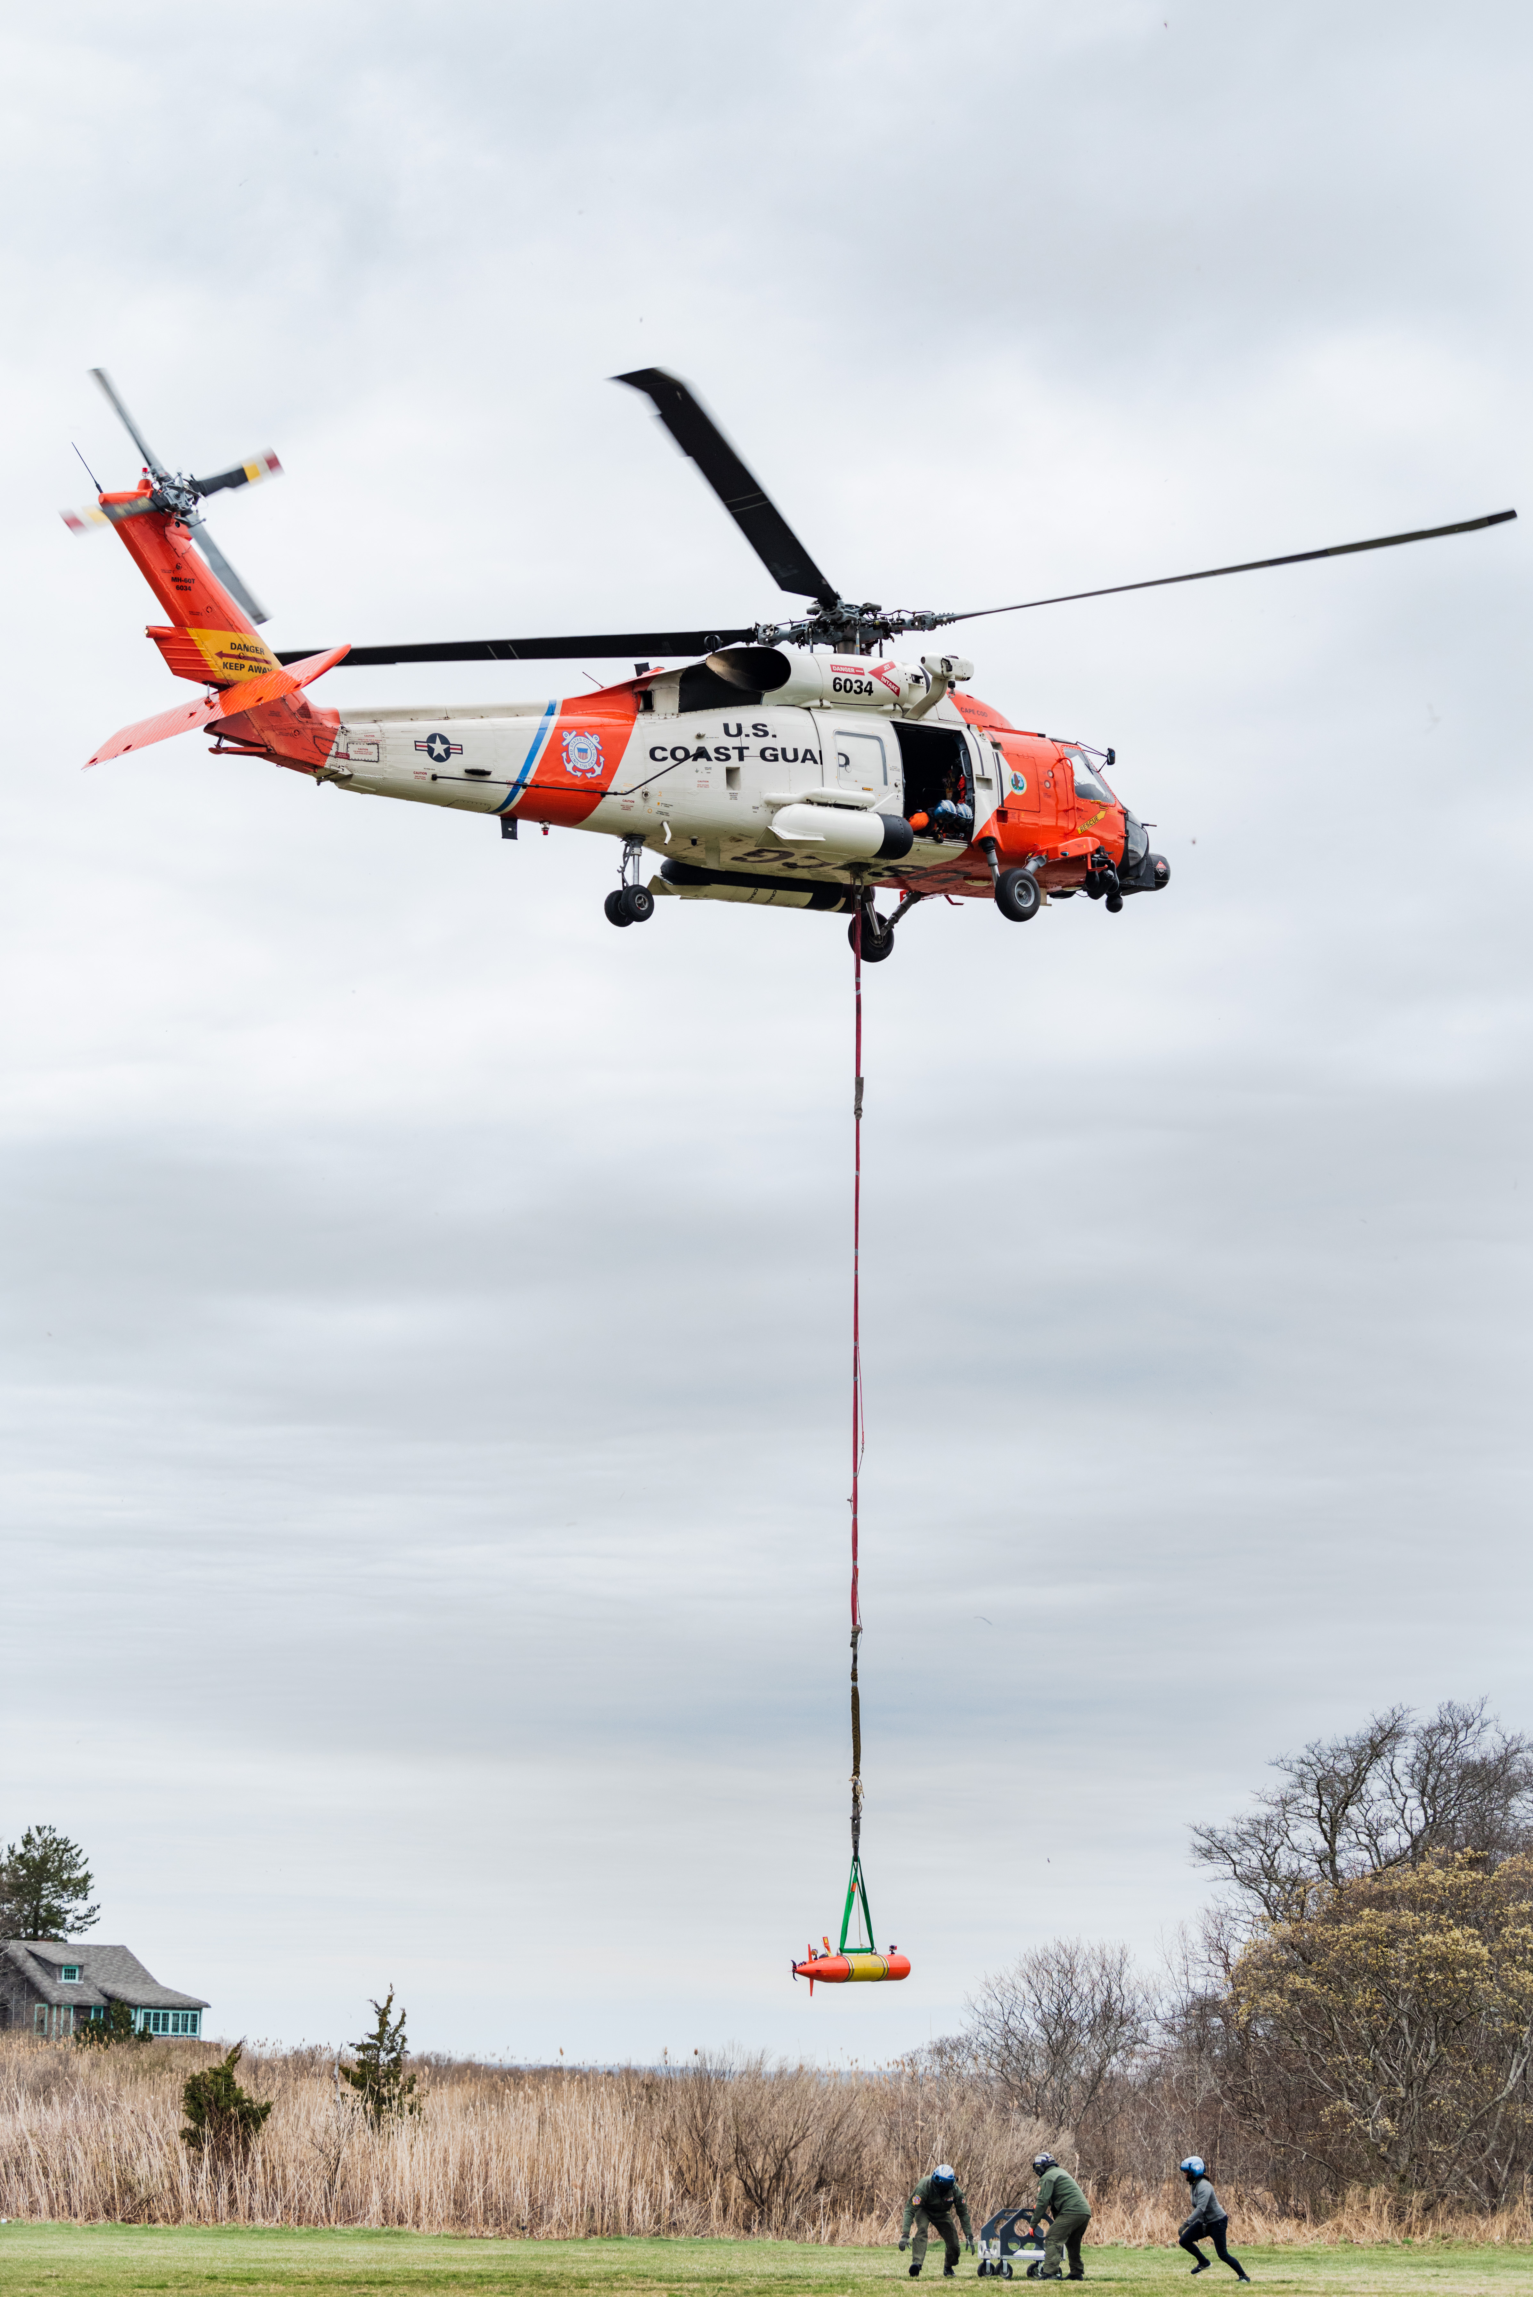
LRAUV
We are developing an AUV-based approach leveraging a small, long-range system- Tethys Long-Range AUV (LRAUV). The LRAUV is helicopter-portable, allowing rapid response to incidents to provide situational awareness for first responders carrying a COTS payload.
The Team:
WHOI- Amy Kukulya, Noa Yoder, Owen Cesarano
MBARI: Brett Hobson, Brian Kieft

Slide 3
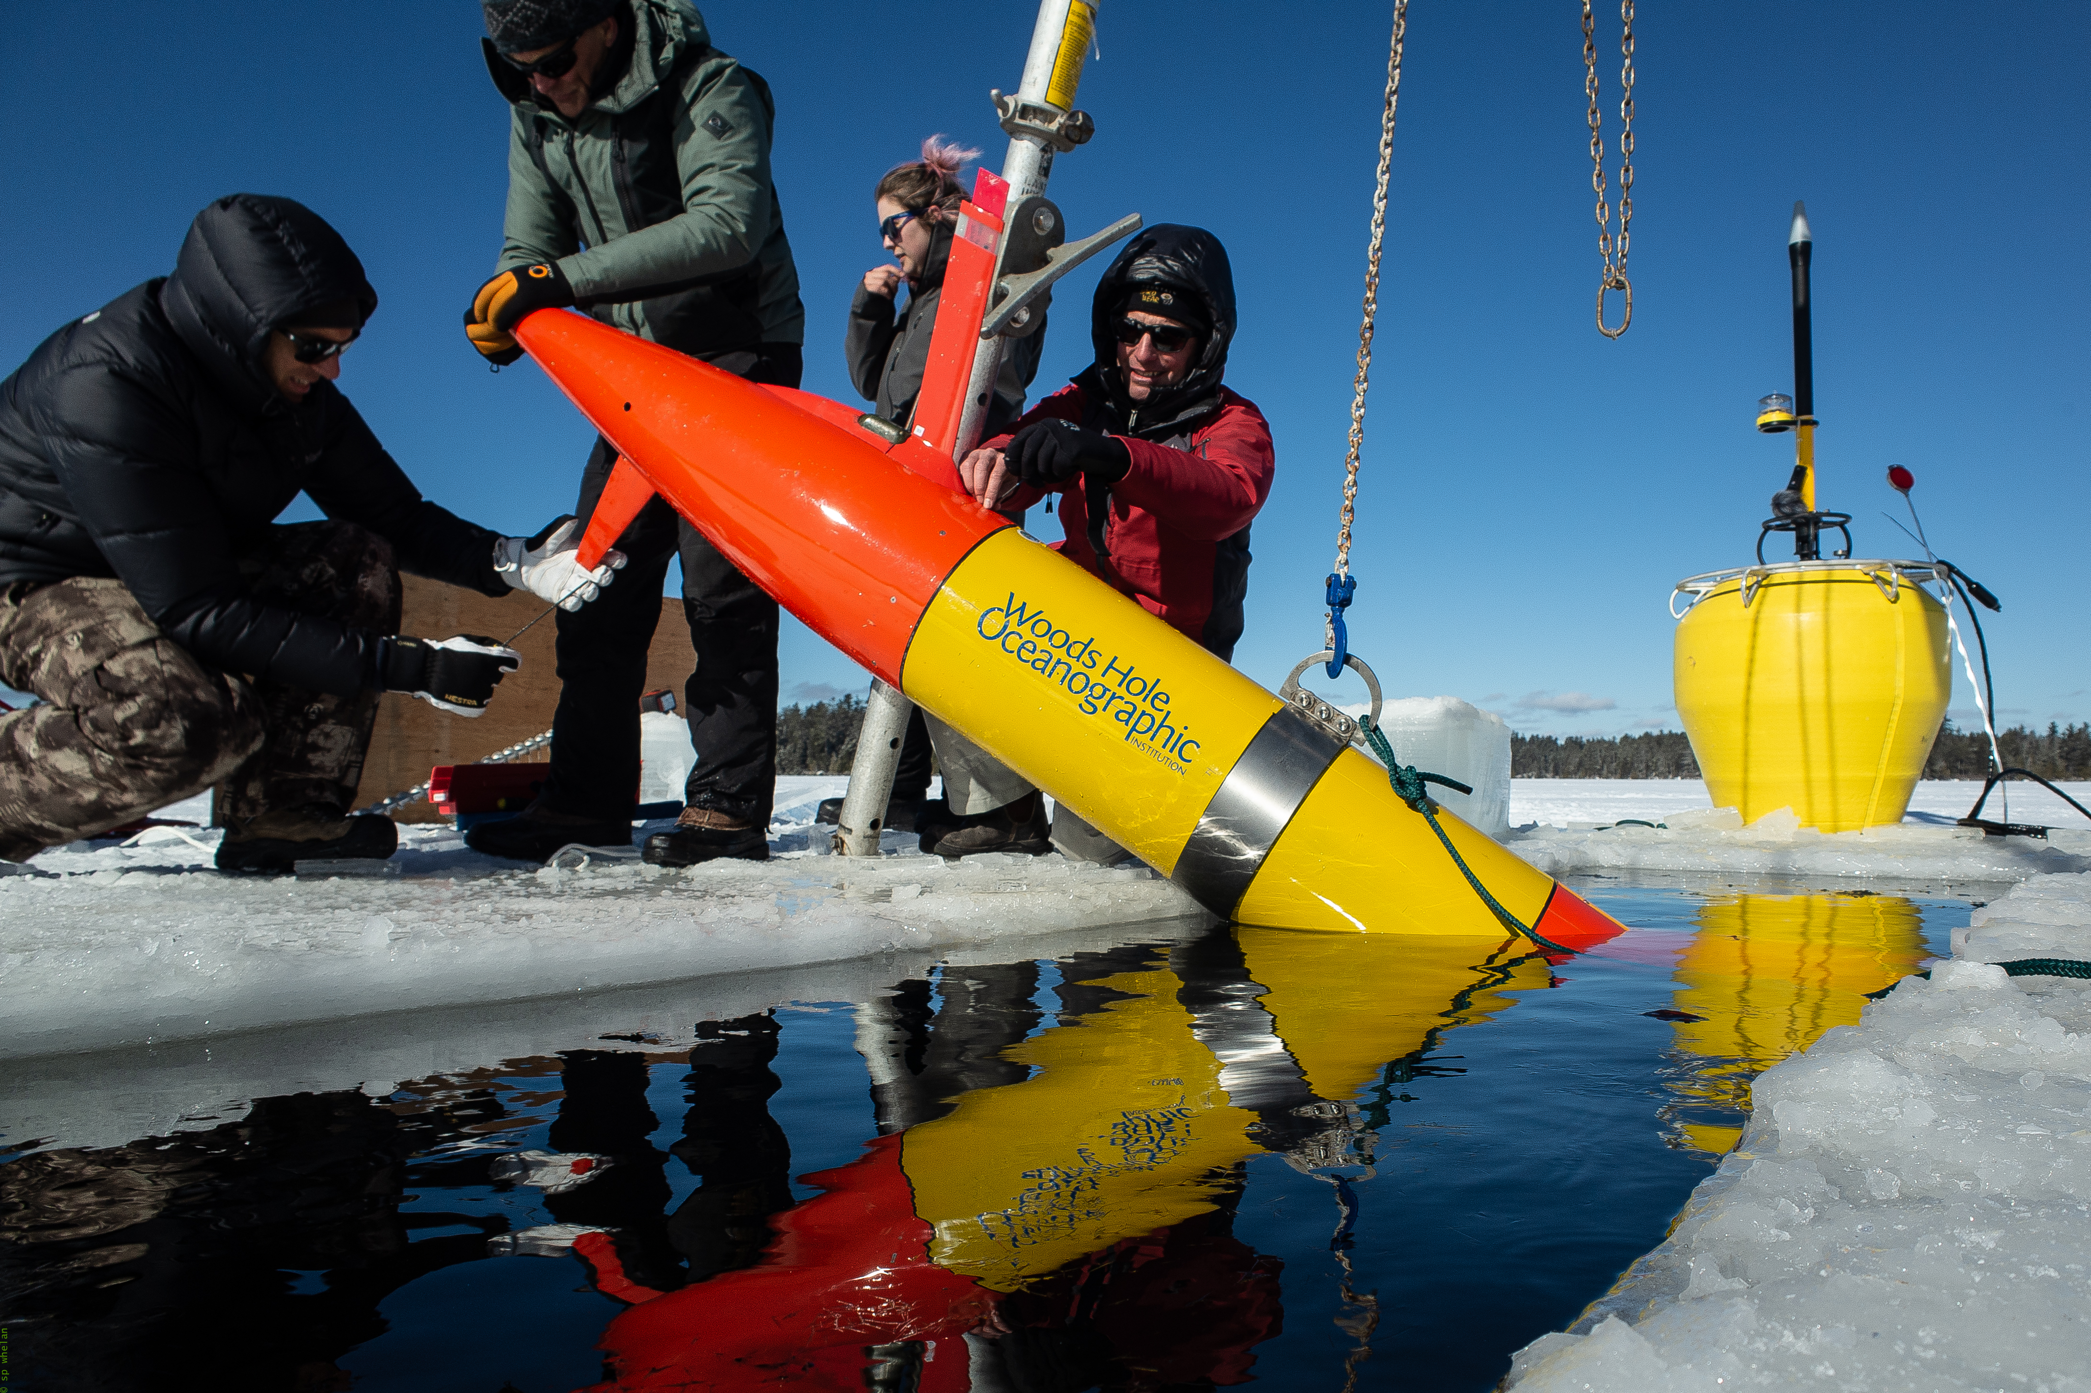
Long-Range Autonomous Underwater Vehicle (LRAUV)
#PolarisUnderice
Collaborative team to innovate new payloads and capabilities…Rapidly
Goal is to train many operators, no prior experience needed across departments/institutions
Interchangeable sensors payloads and/or multivehicle interaction
Boundless applications
Notes:
Traditional AUV Tech----then long-range which does not require a tending vessel

Slide 4
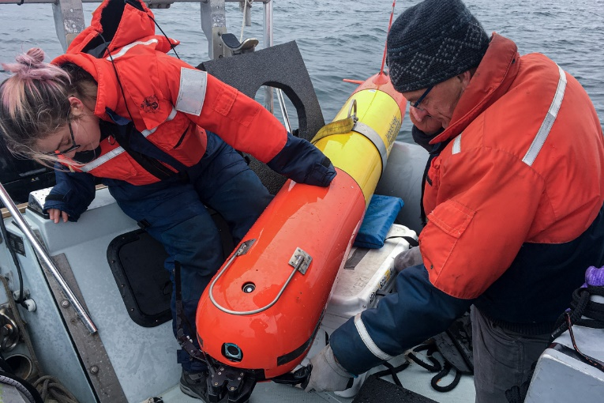
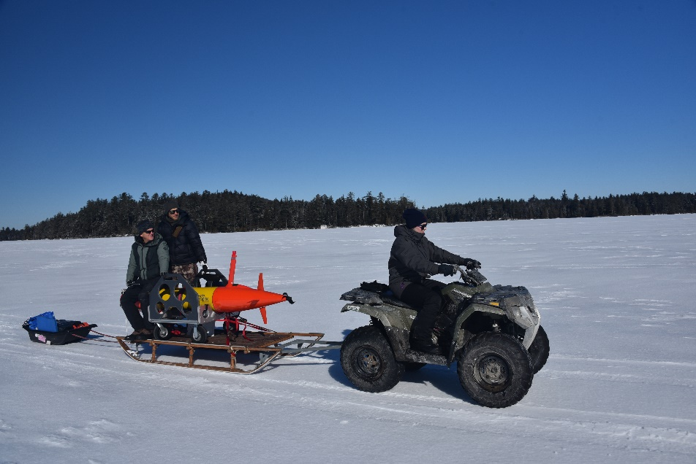
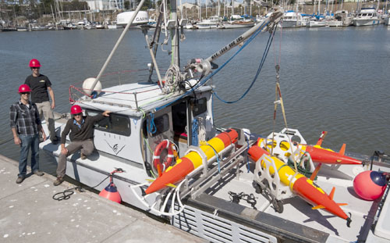
LRAUV: Description and Baseline
MBARI-Long-range AUV (LRAUV)
Baseline: Currently, there is no USCG baseline for an AUV to meet the unique demands of Arctic operations that requires a minimal logistical footprint, a small operational team and oil detection and mapping capability.
Project Description: To develop an Arctic-capable long-range Autonomous Underwater Vehicle (AUV) that is helicopter portable, carries an environmental mapping payload, allowing rapid response while providing situational awareness and damage mitigation for first responders/USCG.
Q’s
How much oil/gas?
Sampling the source
Mapping its extent
Searching three dimensionally for the plume
Tracking currents
Assessing the impacts
  Baseline studies???

Slide 5
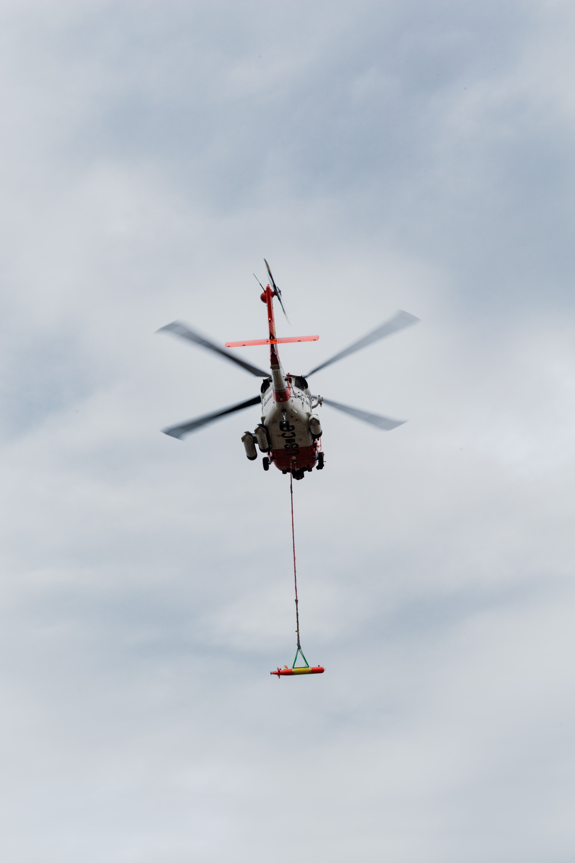
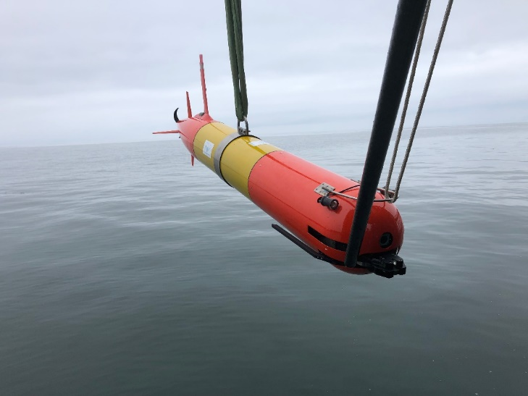
MBARI-Long-range AUV (LRAUV)
Why is LRAUV a smarter choice? (you can operate it from your sofa during a pandemic)
Has a proven variable ballast system and mass shifter making it the only propeller-driven AUV in the world that can drift, hover and accurately navigate to tell you exactly where an anomaly is. (speed variability)
Buoyancy change and mass shifter allows vehicle to dive while stuck under-ice
  Buoyancy engine enables neutral buoyancy and drift mode.
  Allows for fine-scale sampling, e.g. More accurate Gulper samples
  More versatility than other propeller driven vehicles
Has reliably operated remotely for weeks at a time for more than ten years and can be operated from a web browser
Notes:
At Woods Hole there are large group of technical staff challenged with building the next generation of underwater robots to service the science community. In parallel, and sometimes overlapping are efforts to feed the defense pipeline.

Slide 6
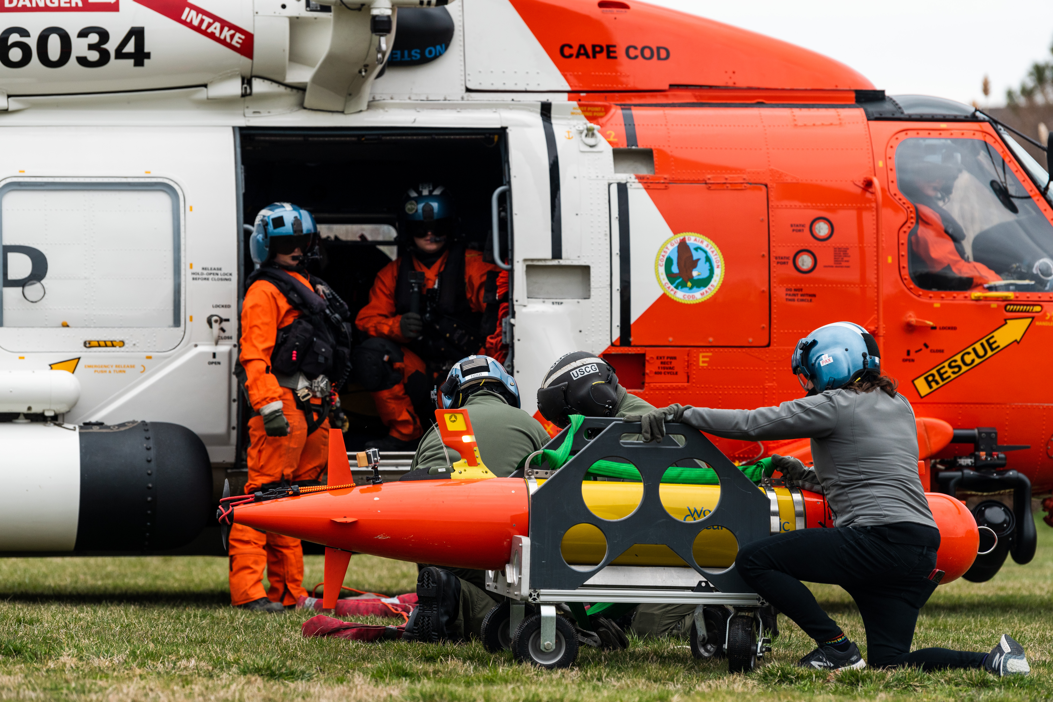
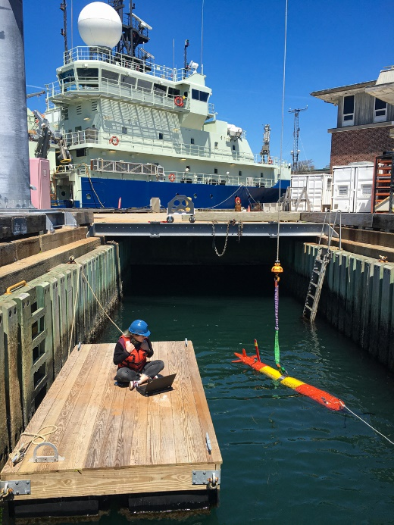
WHOI-MBARI LRAUV Details
Long range autonomous capability: Tethys LRAUV (MBARI, WHOI, DHS, ADAC)
300-meter rated, 2.7 m long, 0.3 m (12’’) diameter, 110 kg dry weight.
Propeller-driven: 0.5~1.25 m/s speed. Buoyancy engine enables neutral buoyancy and drift mode.
Low-drag and low-power design: 15 day duration with 6 kWh rechargeable batteries, more than twice that with expendables.
Current Sensors: CTD, DO2, SeaOWL fluorescence/backscatter and hydrocarbon detection, Up/Down ADCP, umodem, USBL array, Docking nose, PAR, Soundtrap, many more
Multi-mission capability, multibeam mapping and inertial navigation payload and backseat ROS
Notes:
Yellow highlights upgrades under ADAC

Slide 7
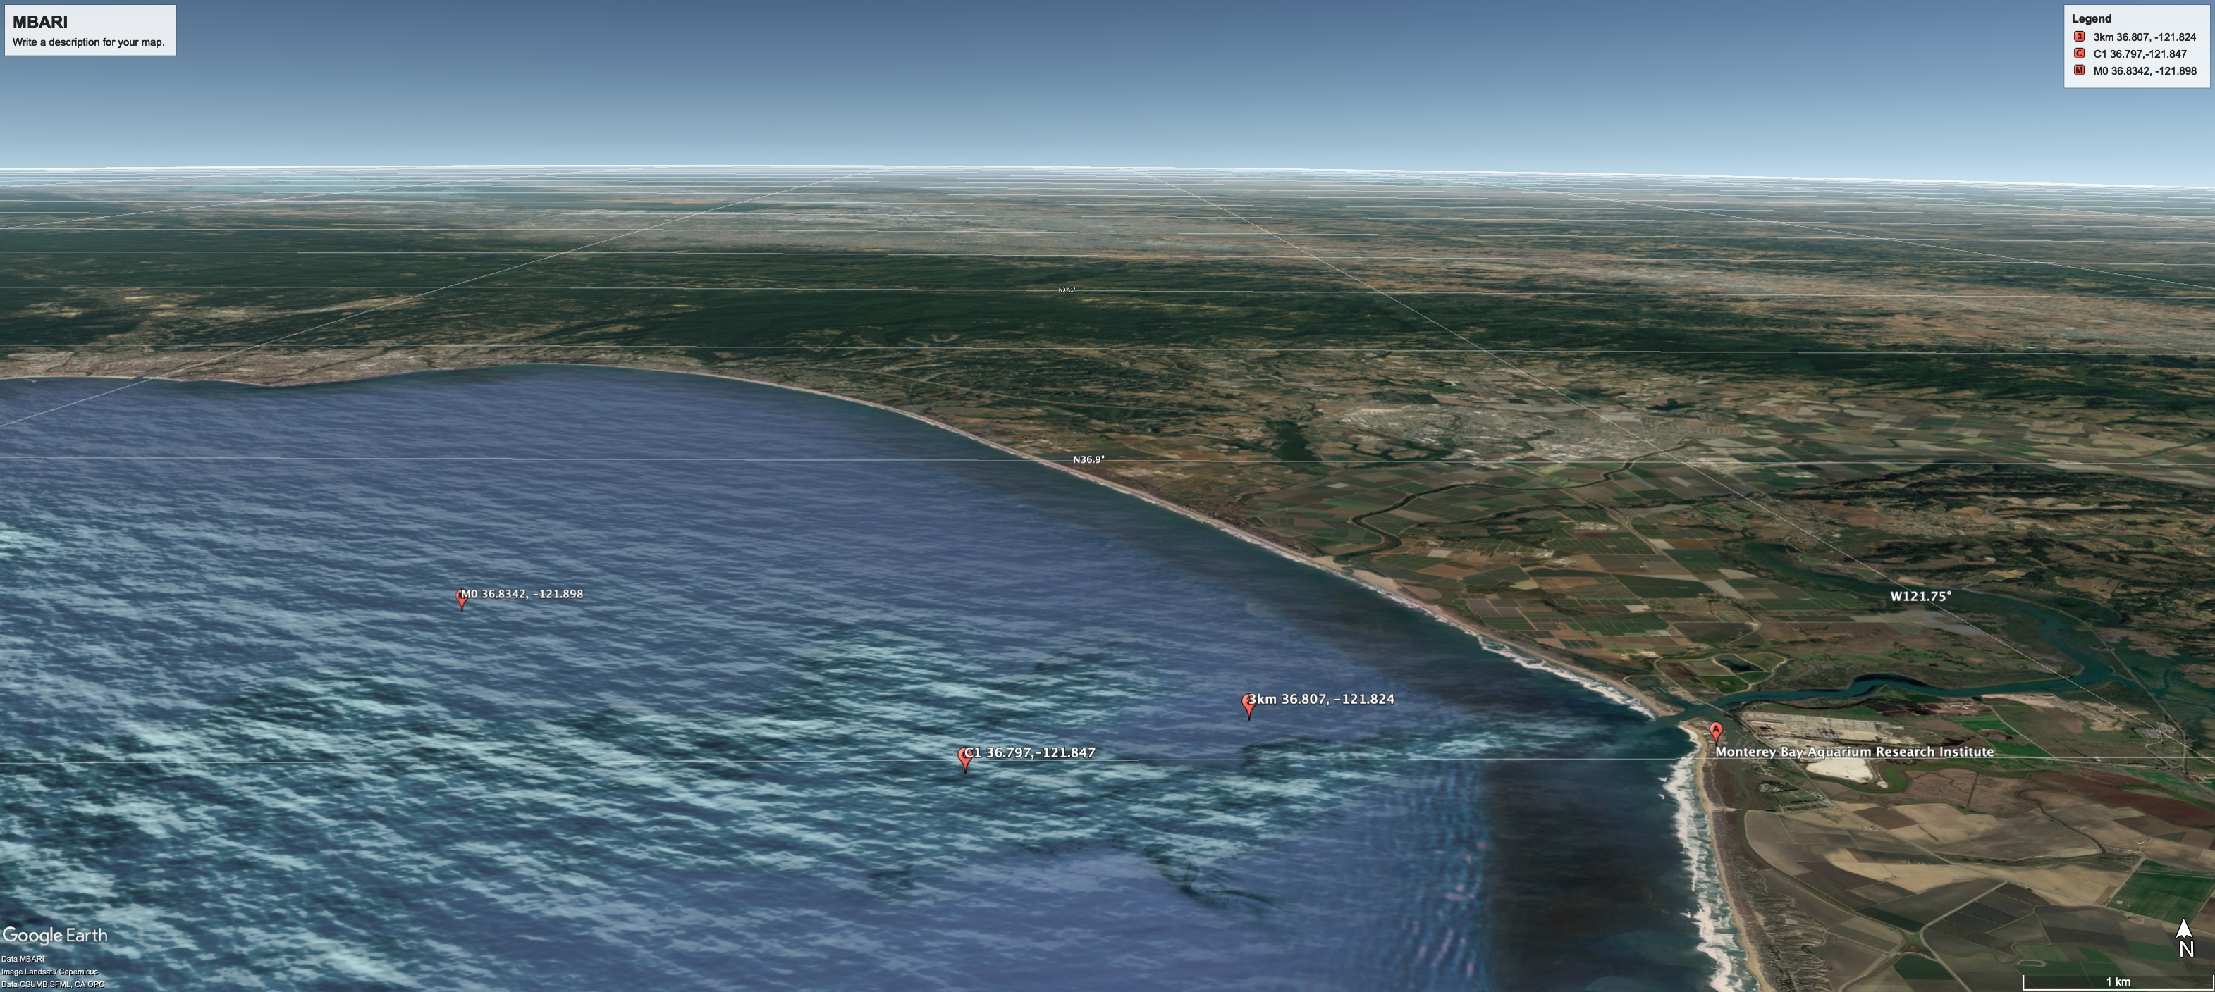
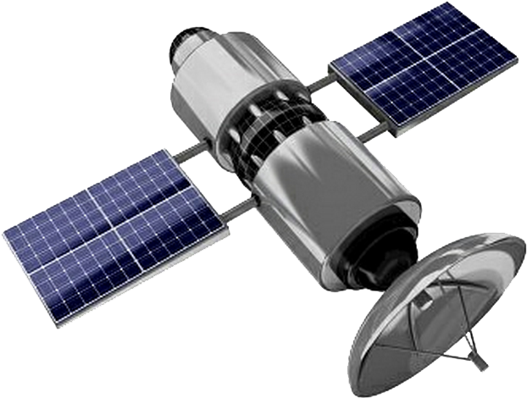
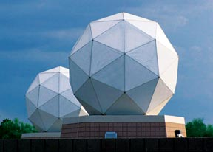
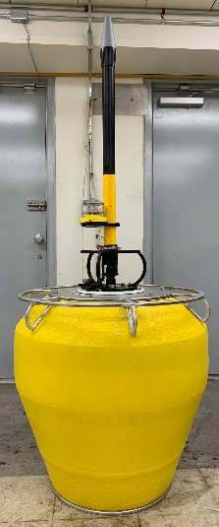
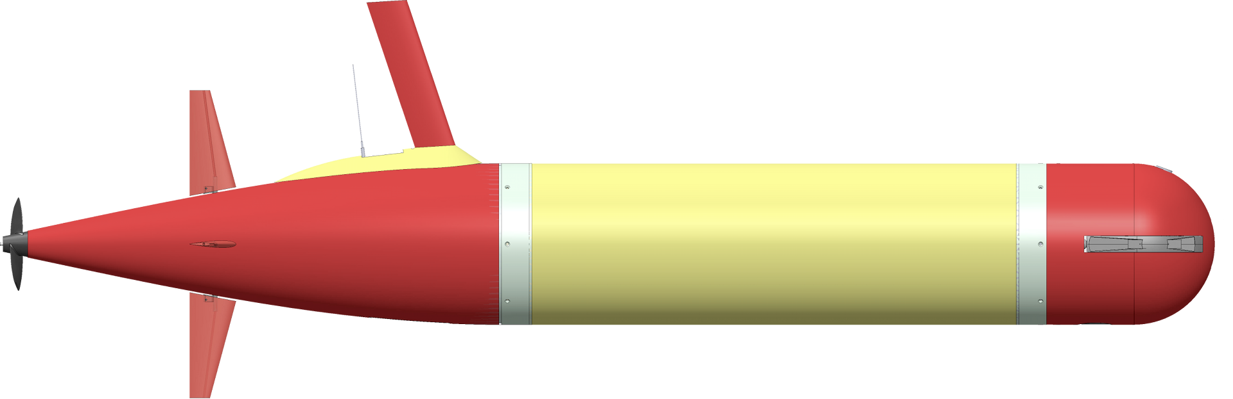
Tethys-class Long range AUV
iridium satellite
GPS/ARgos
Communications
SAT COMMS
iridium ground station
Short Burst Data (SBD)
340 bytes/packet
2-3 packets/minute
Acoustic Gateway Buoy
Direct COMMS (cellular)
Kilobytes/second
Acoustic COMMS
192 bytes/packet
Up to 7.5 km range
Notes:
SBD queue
Mobile Terminated Message Sequence Number (MTMSN)

Slide 8
LRAUV Capabilities in the Arctic
What we have
  Rapid Response – received the AUV and got it deployed in 19 hours
  Reliability (System failure recoveries)
  Accurate navigation (LBL, USBL, IMU, particle filtering, machine learning/terrain following, no surfacing)
  Long-range (from hours/days to weeks/months)
  Data Relay (no surfacing)- comms from AUV to buoy to shore/surface iridium
  Data Visualization (quick decision making)
  Unpredictable ice/weather- what happens with the LRAUV
  Use AUVs to predict/map ice- ADCP currents
  Launch & Recovery (tiny boats, hellos'/C-130’s, icebreakers, ice holes, etc.)
Notes:
The first AUV deployment was 47 years ago and looked a little different then the Curry illustration. But similar challenges remain

Slide 9
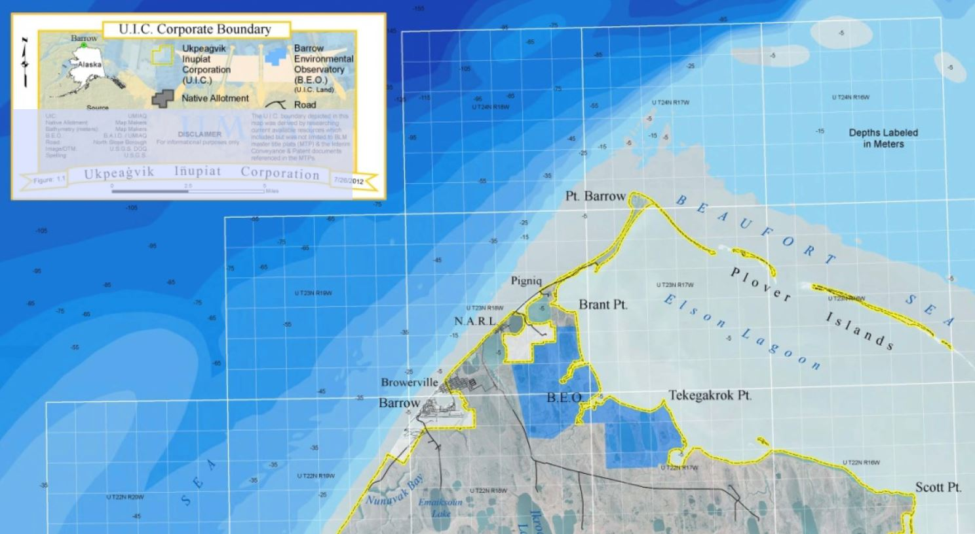

Slide 10
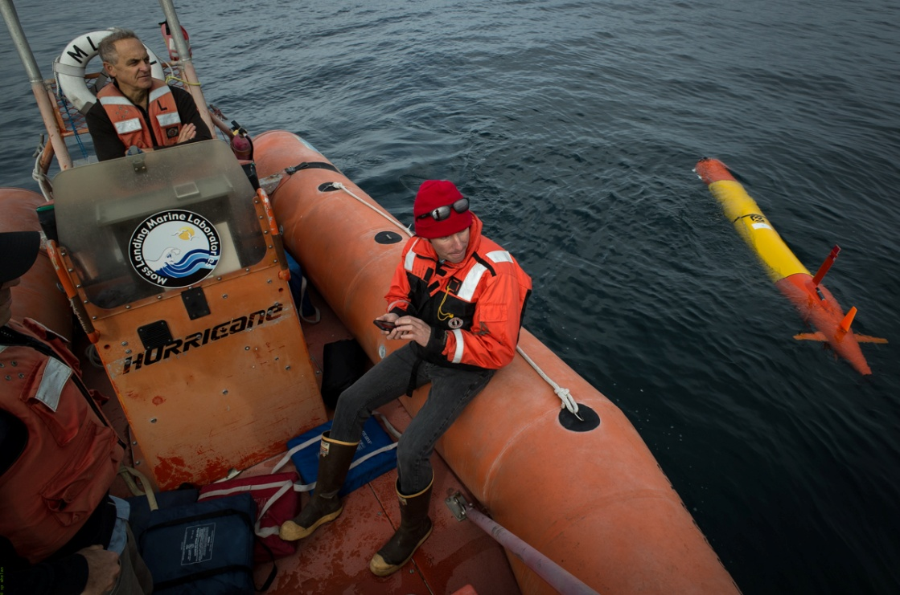
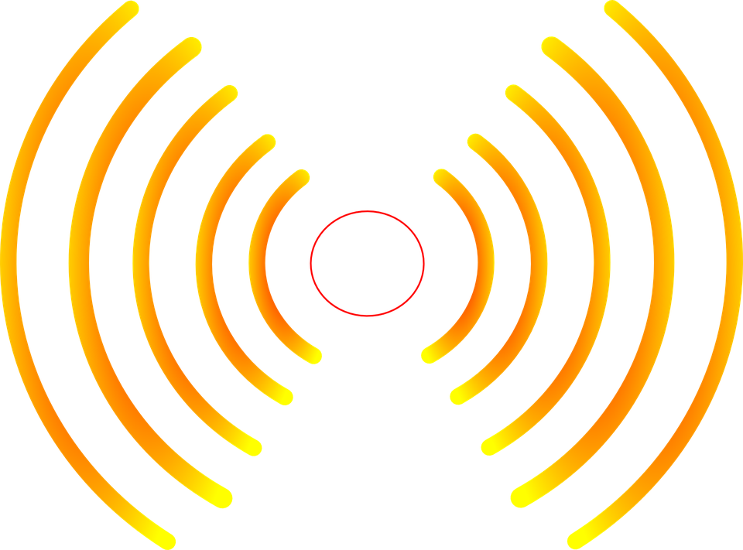
Remote Tracking from anywhere
Small operational footprint
Notes:
Launched from a phone and operated from a phone from anywhere in the world.

Slide 11
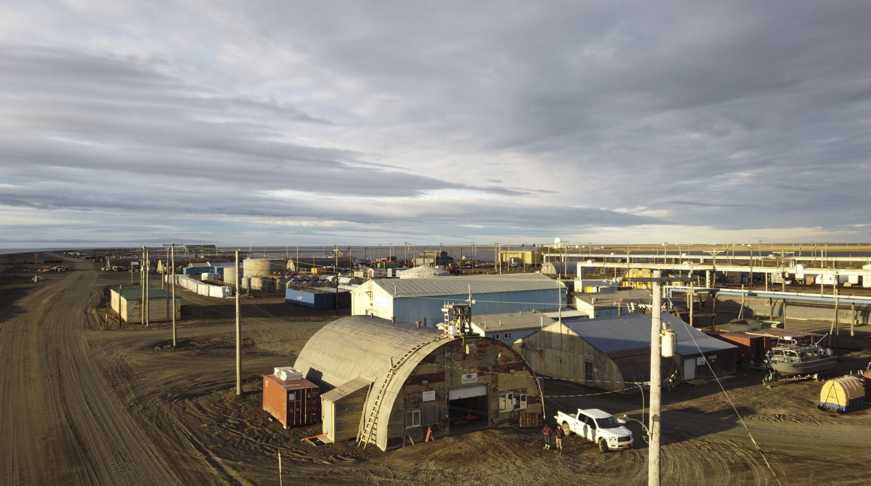
The Theater

Slide 12
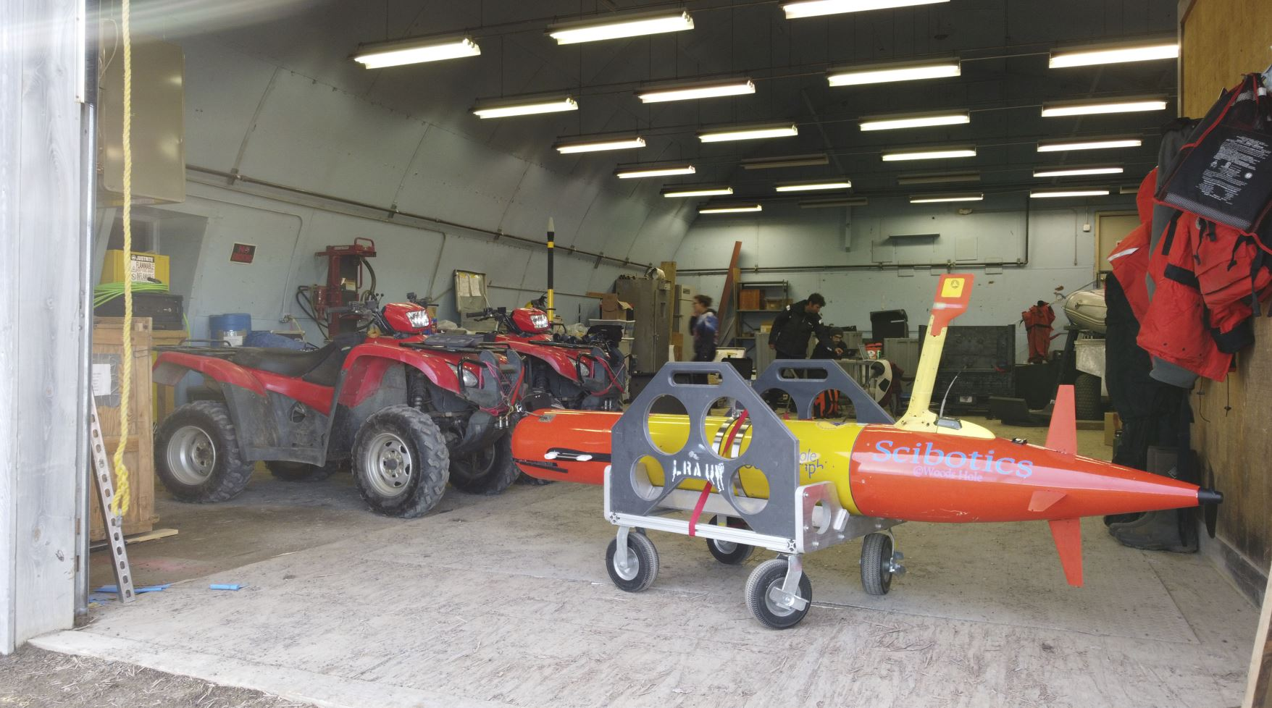

Slide 13
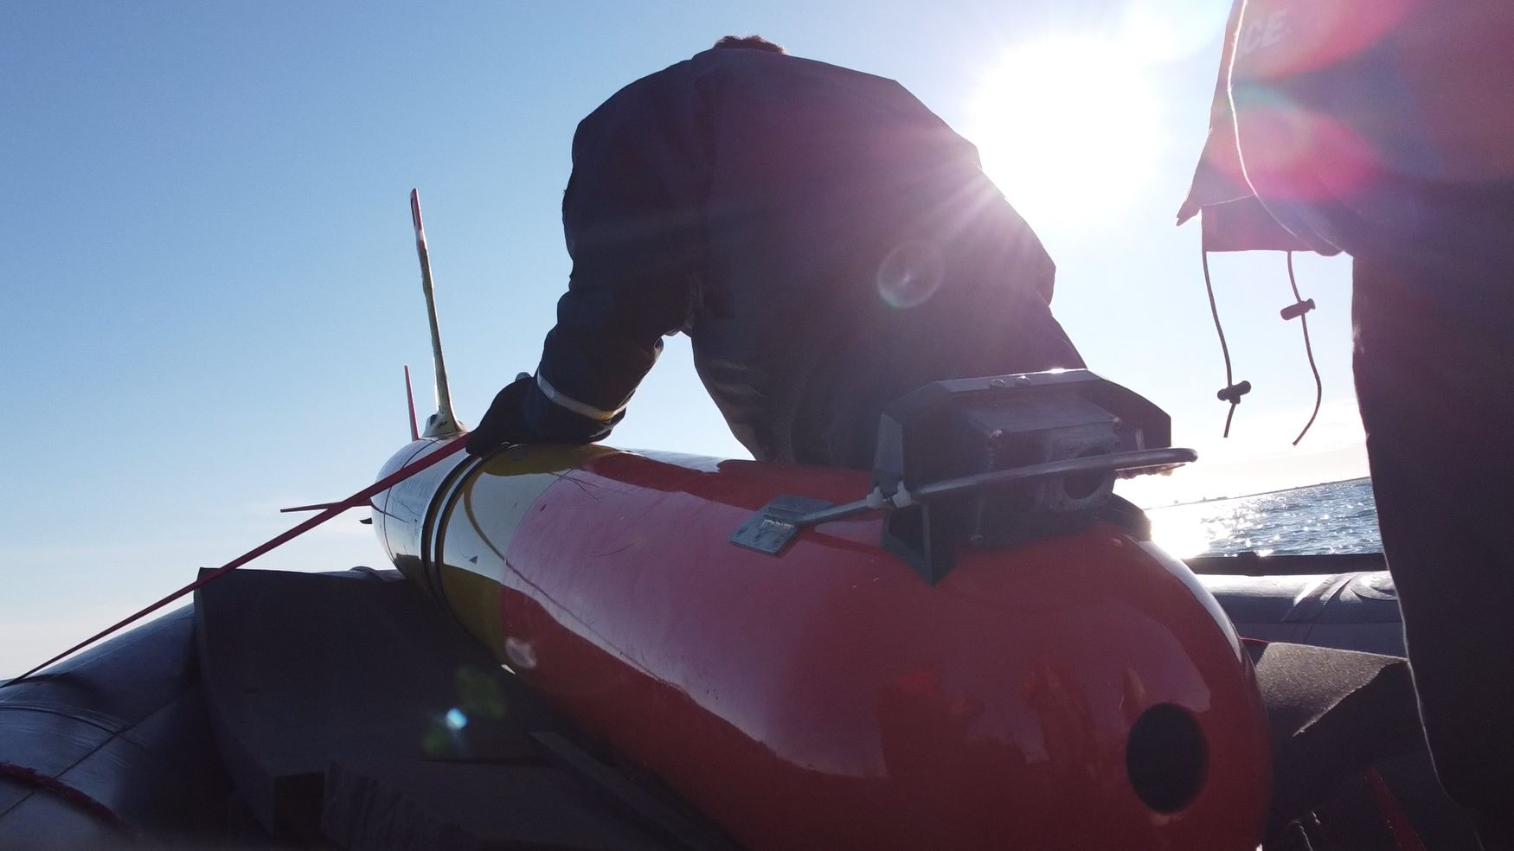

Slide 14
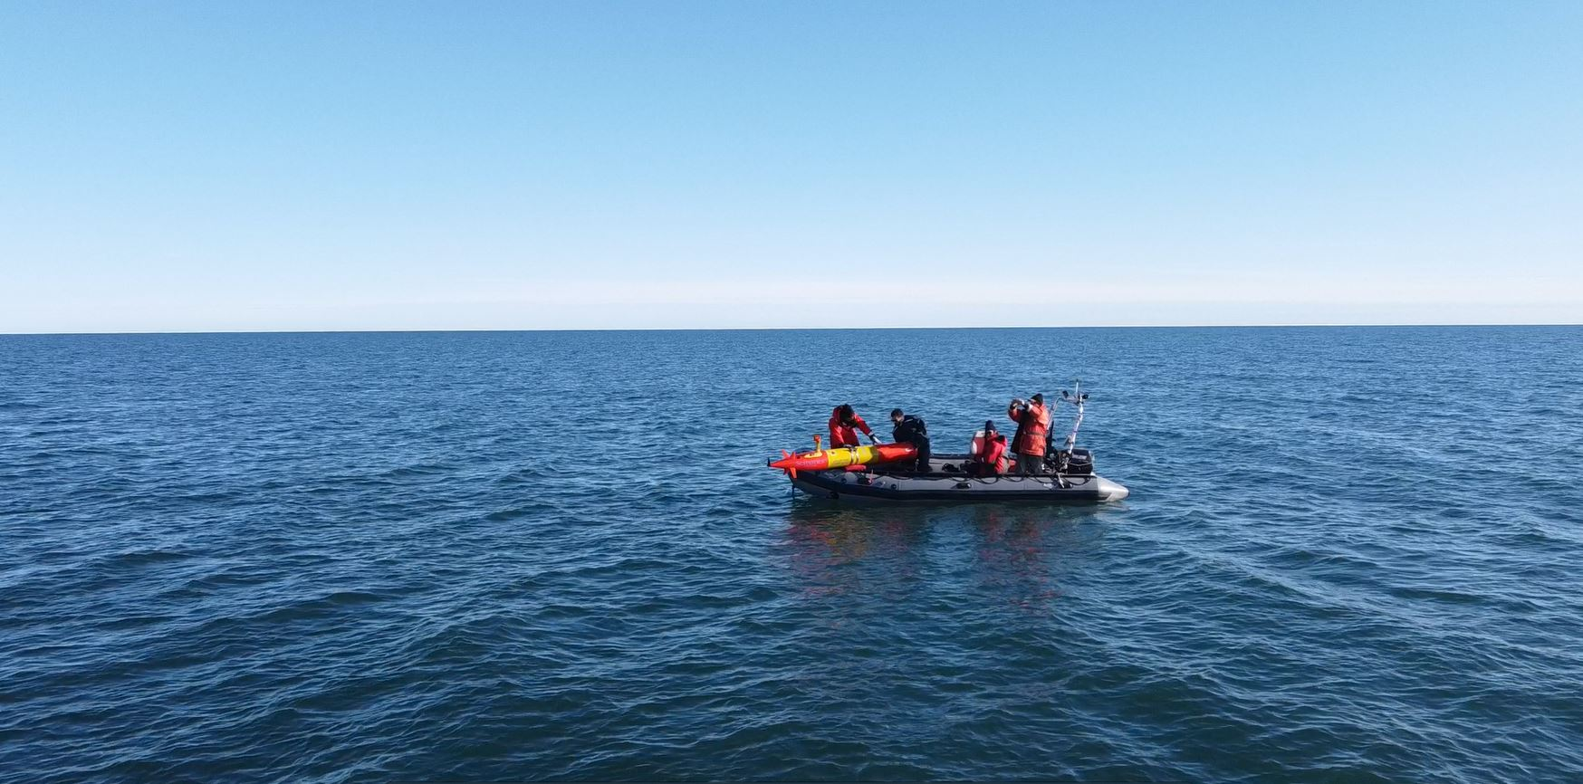
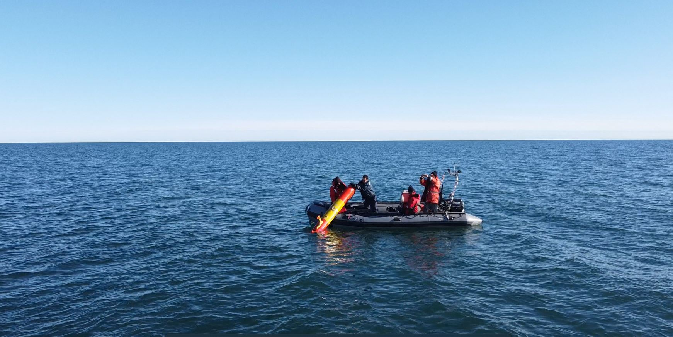
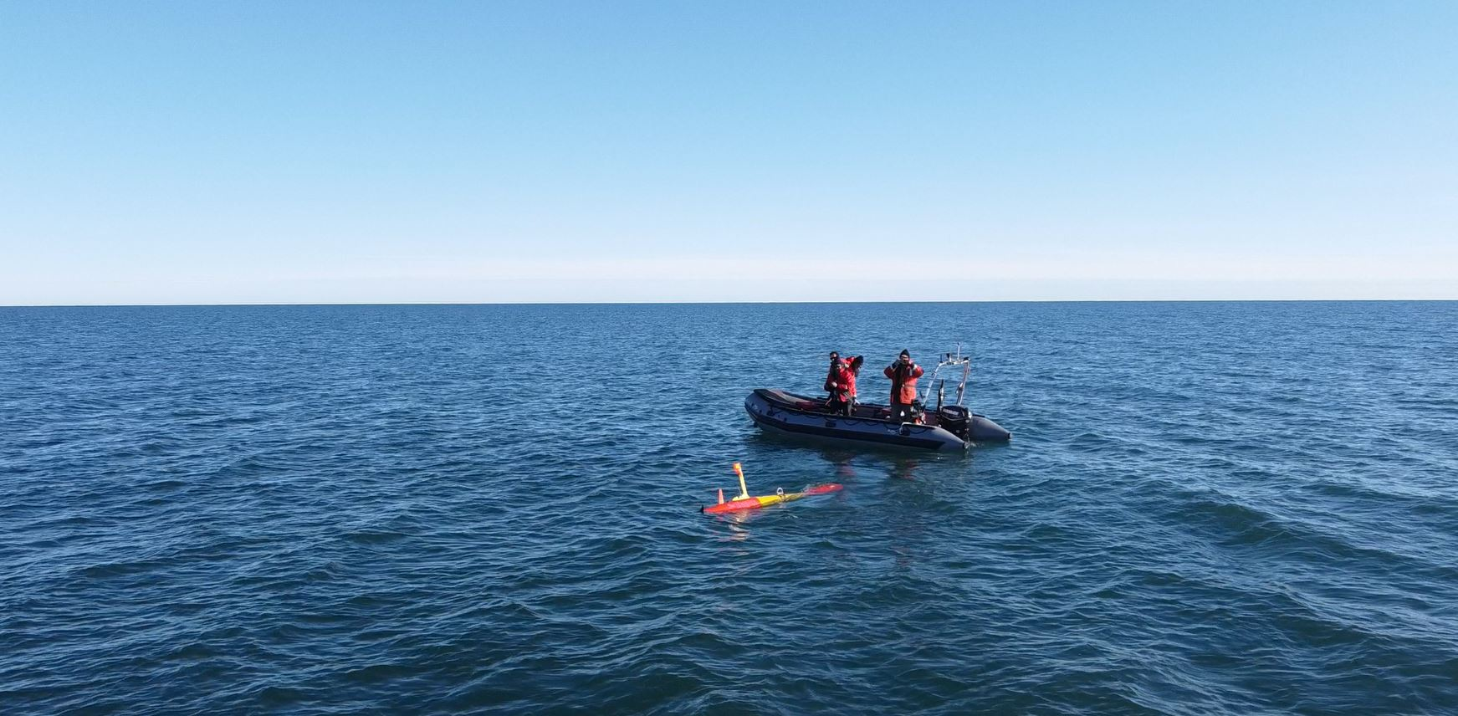

Slide 15
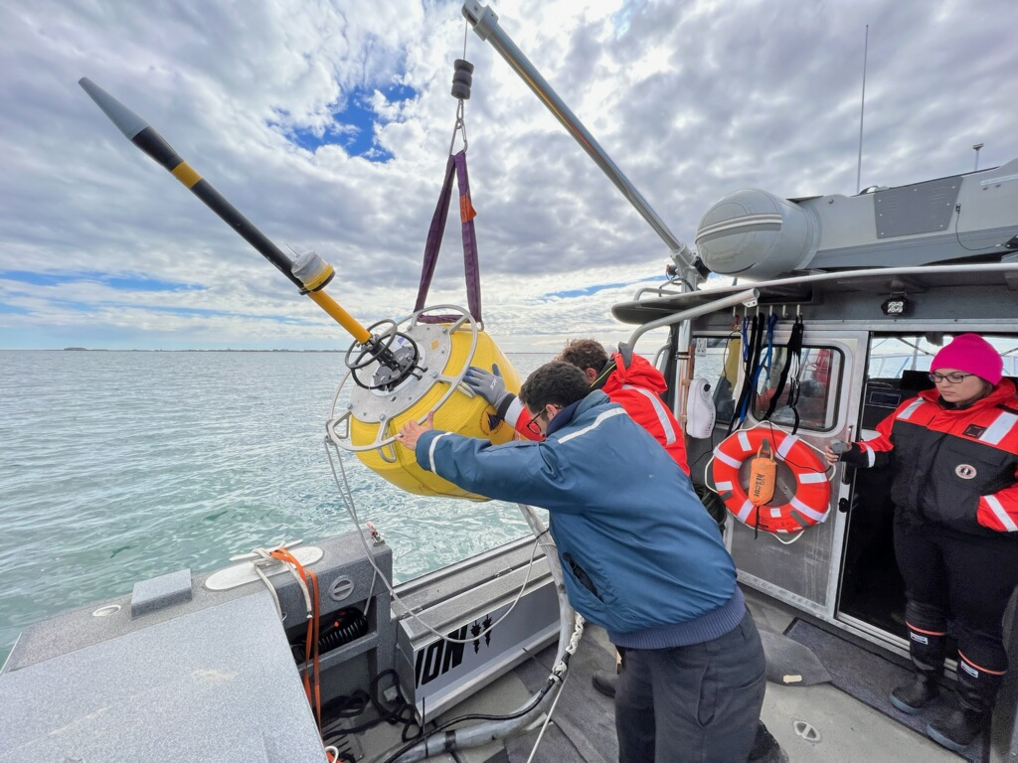

Slide 16
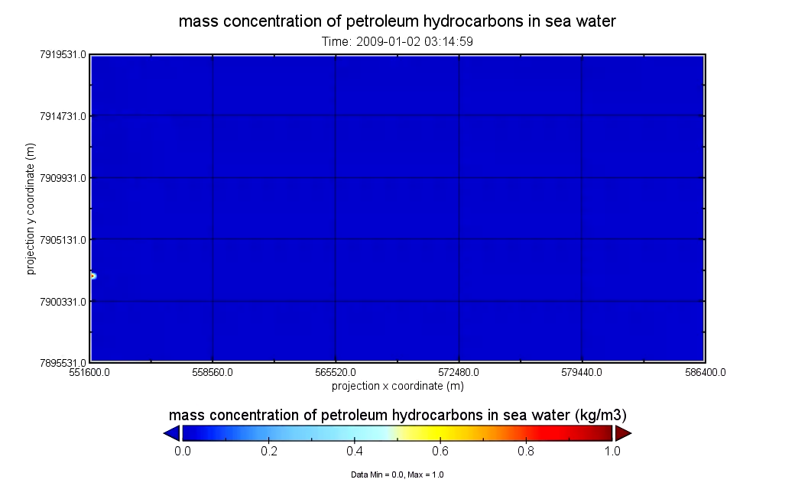
4-D Oil Spill Simulation
Berger Oil Spill - Five Days, 35km x 24 km, 3D + Time
Video above is compressed into 2-D
Runs on LRAUV Frontseat Computer in Realtime
Serves fake SeaOWL data to LRAUV based on Lat/Lon/Depth/Time

Slide 17
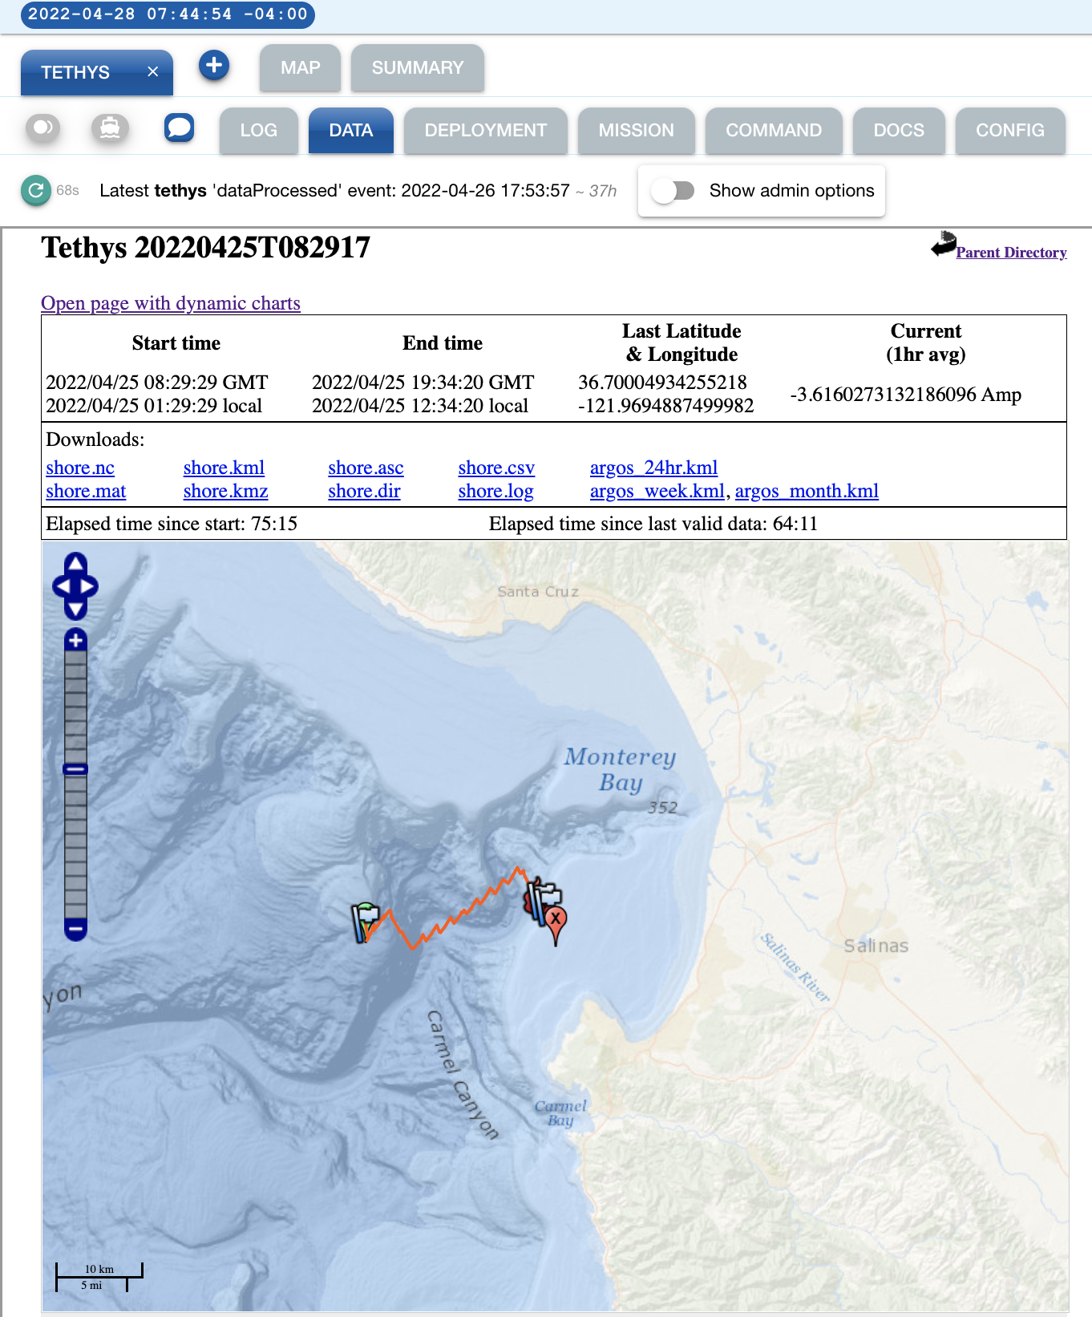
An oil spill in Monterey Bay
Sim in Monterey Bay
LRAUV Patch Track Mission

Slide 18
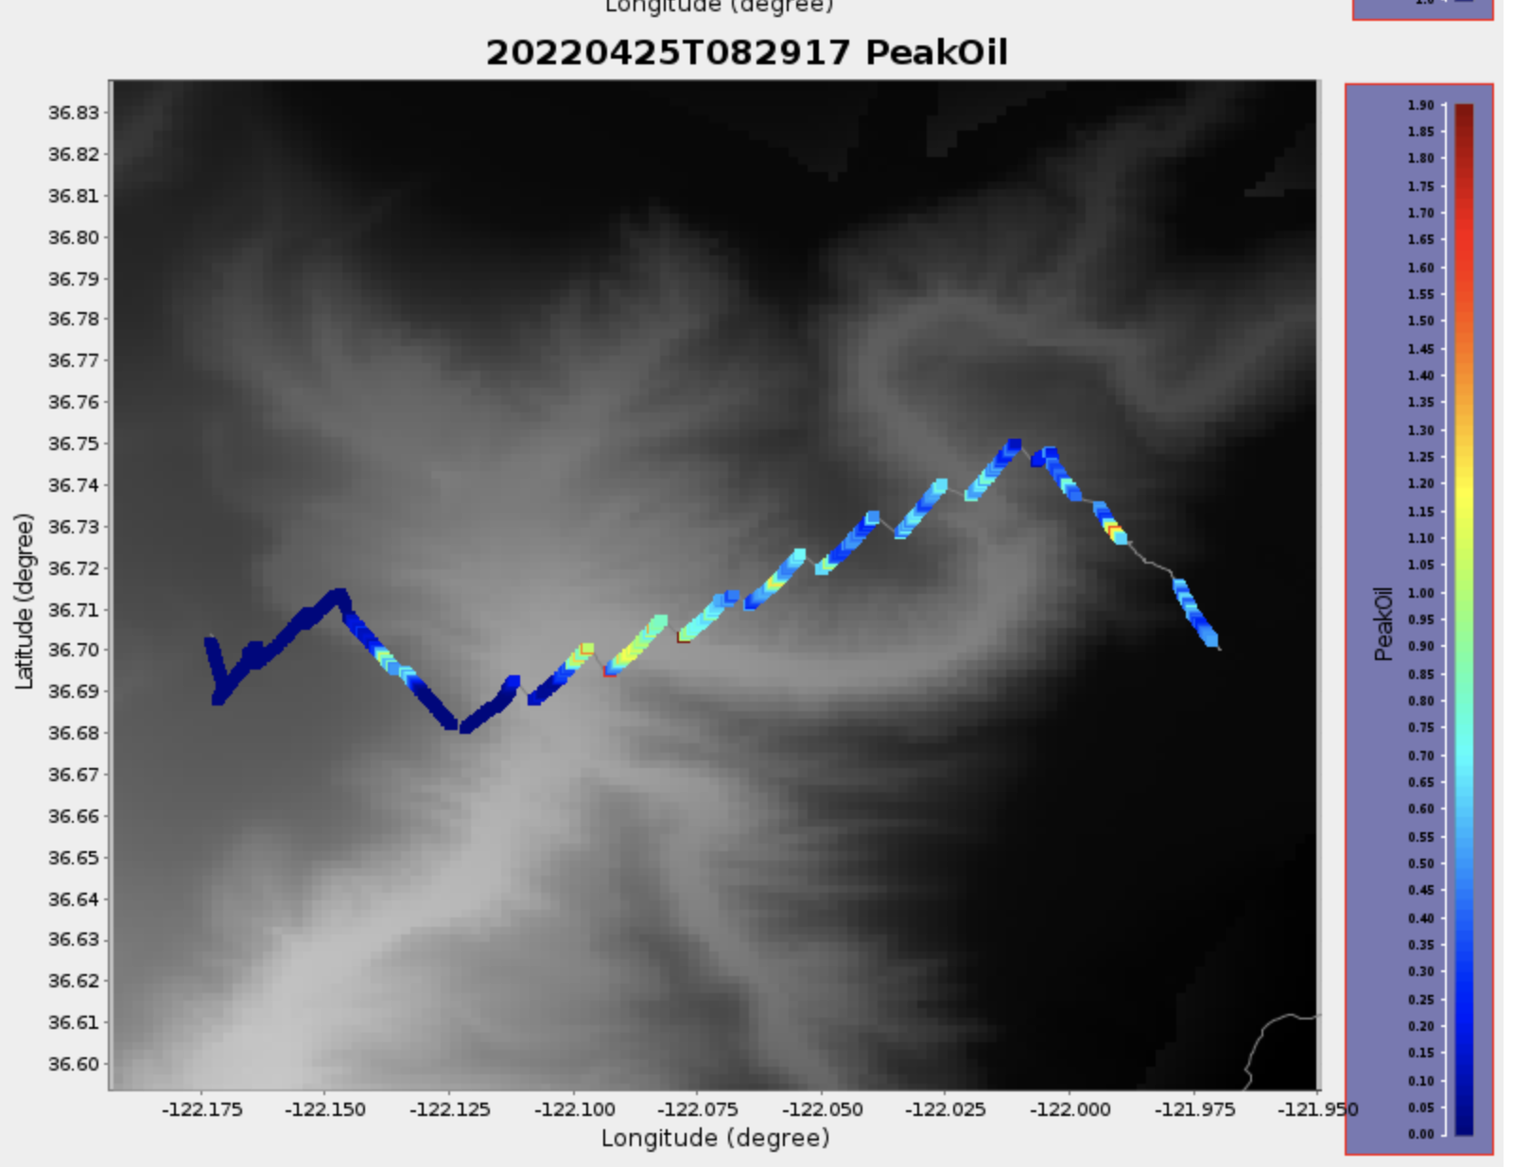
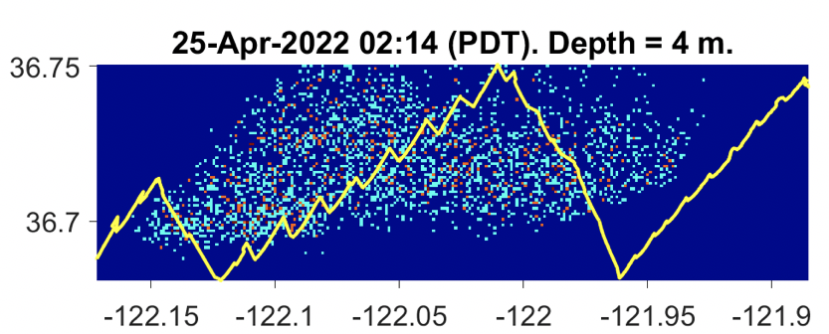
Oil distribution mapping
Post-mission Data, including actual oil plume
Near Real-time Data

Slide 19
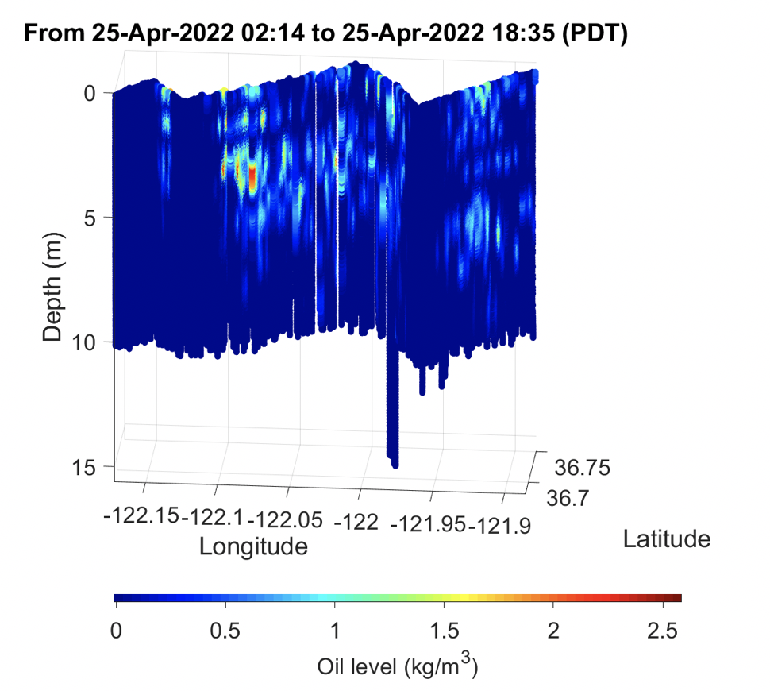
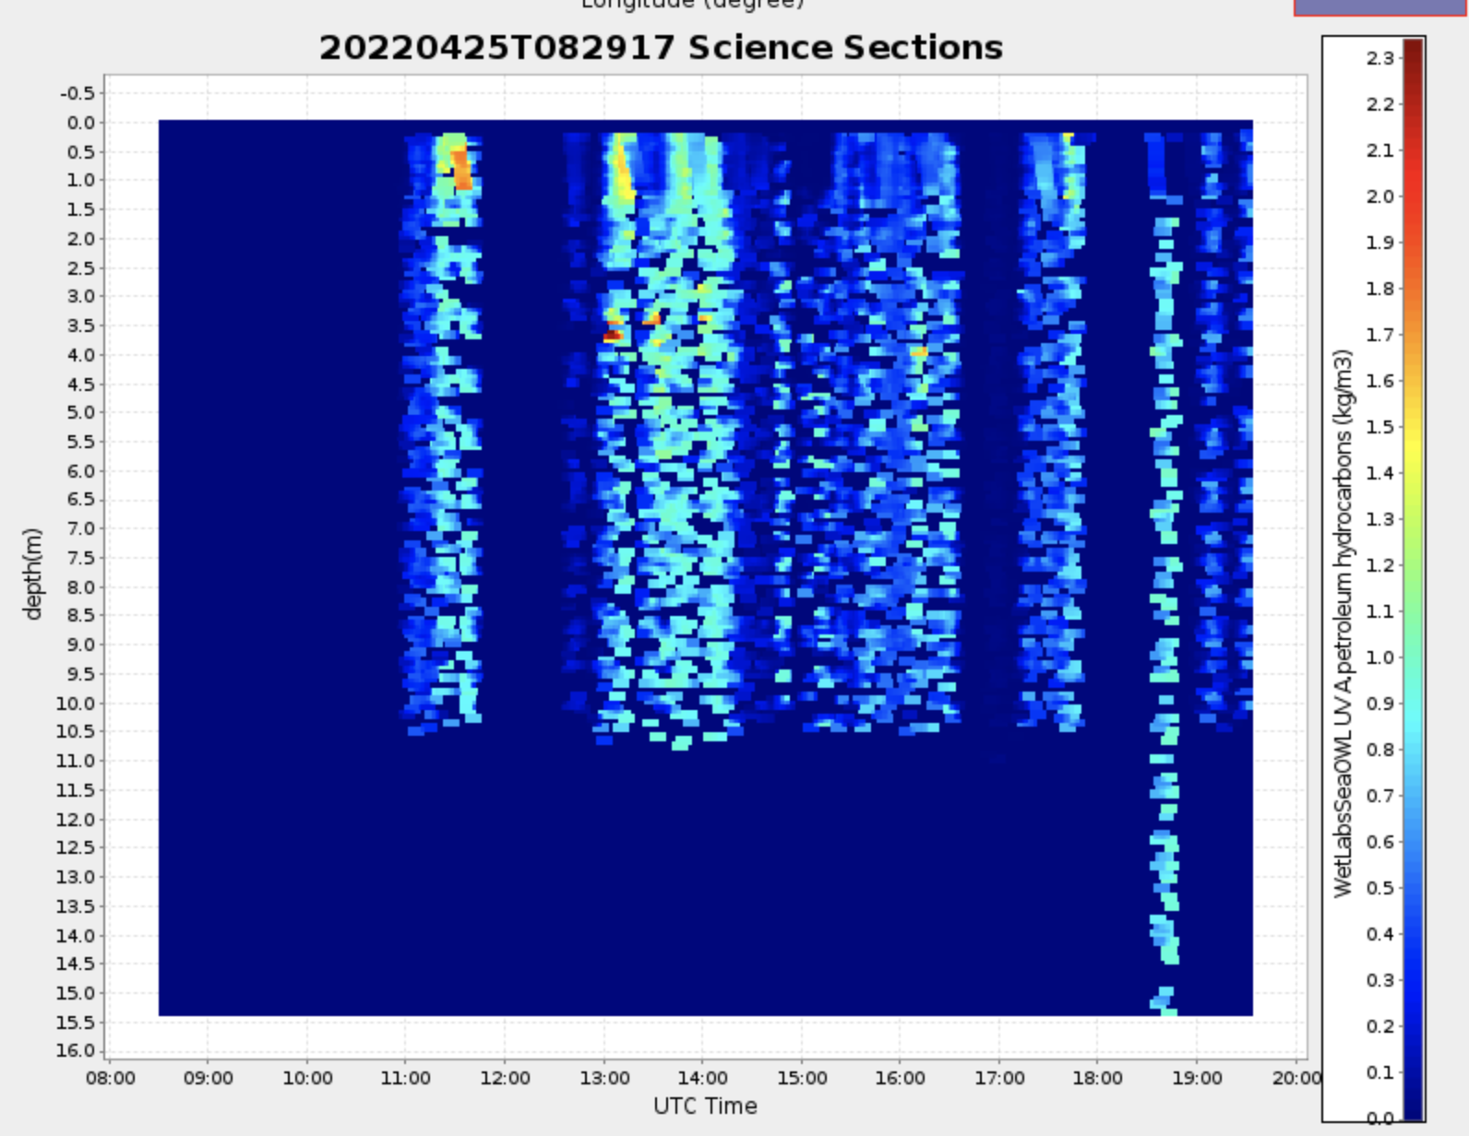
Oil distribution verses depth
Near Real-time Data
Post-mission Data

Slide 20
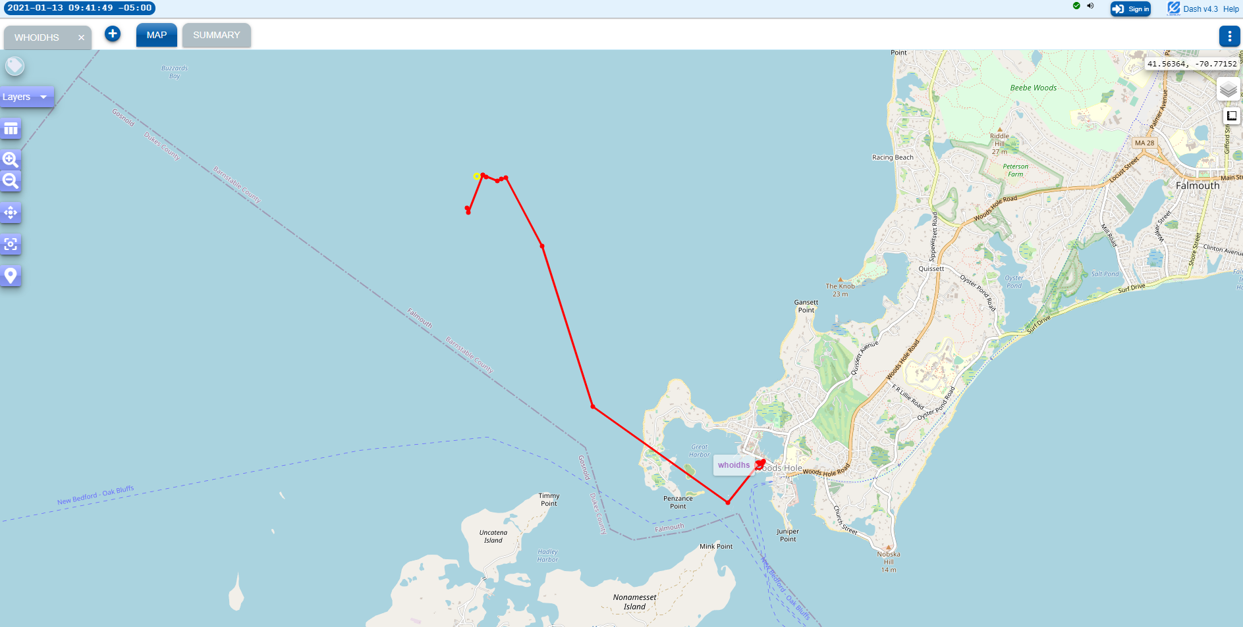
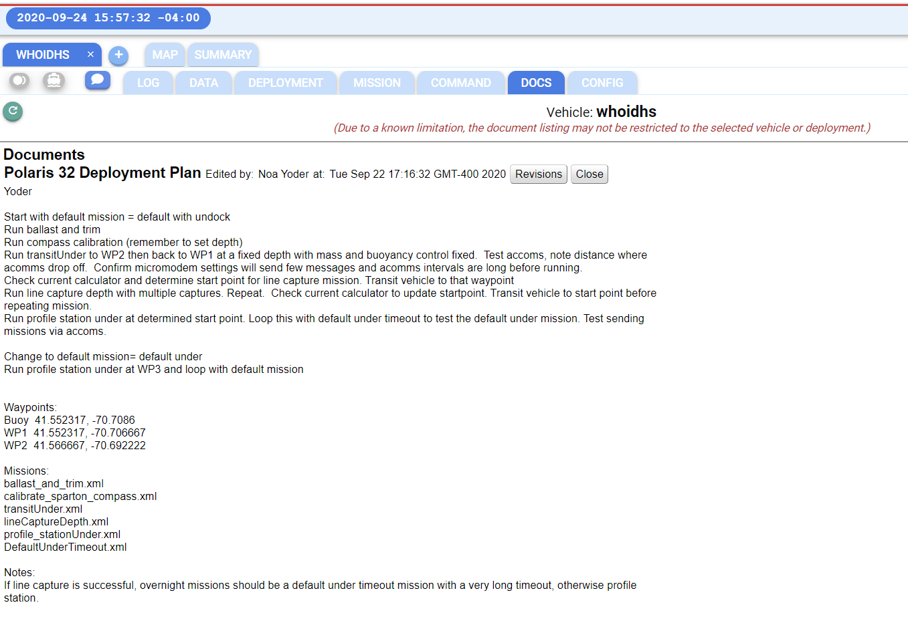
Remote Tracking
All LRAUV operations are conducted via remote communications
Command Control can be anywhere with Internet
Dash-Command Control:
LRAUV.WHOI.EDU
Typically operators use an iPad to run the vehicle, but cell phone, etc. also work
Notes:
Ryan Govostes

Slide 21
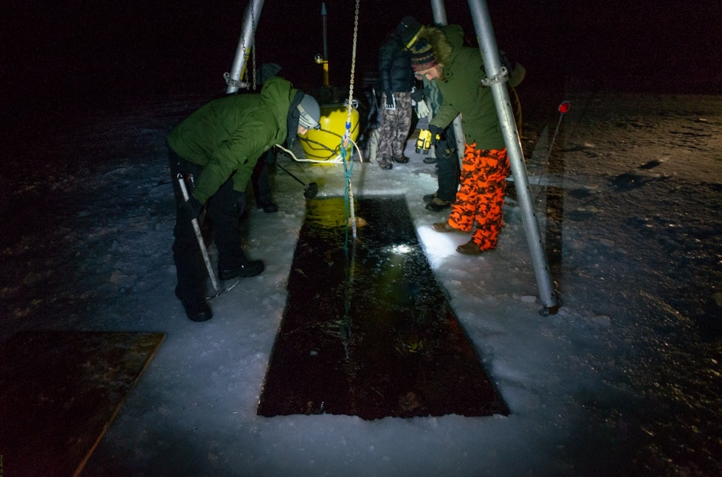
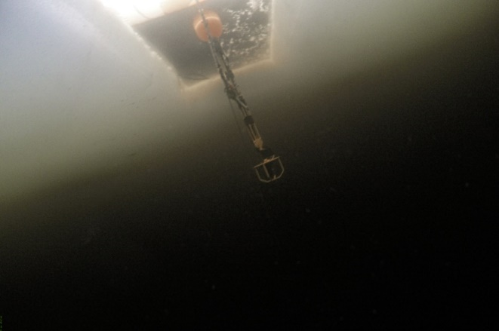

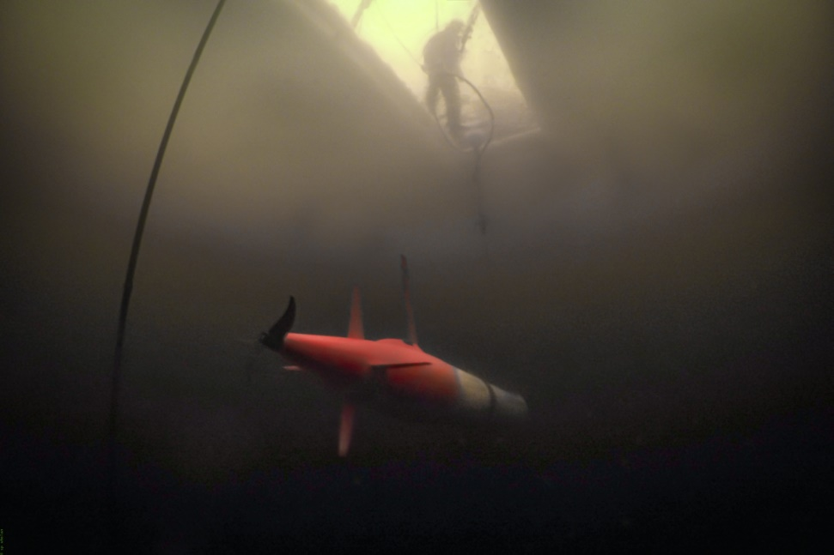
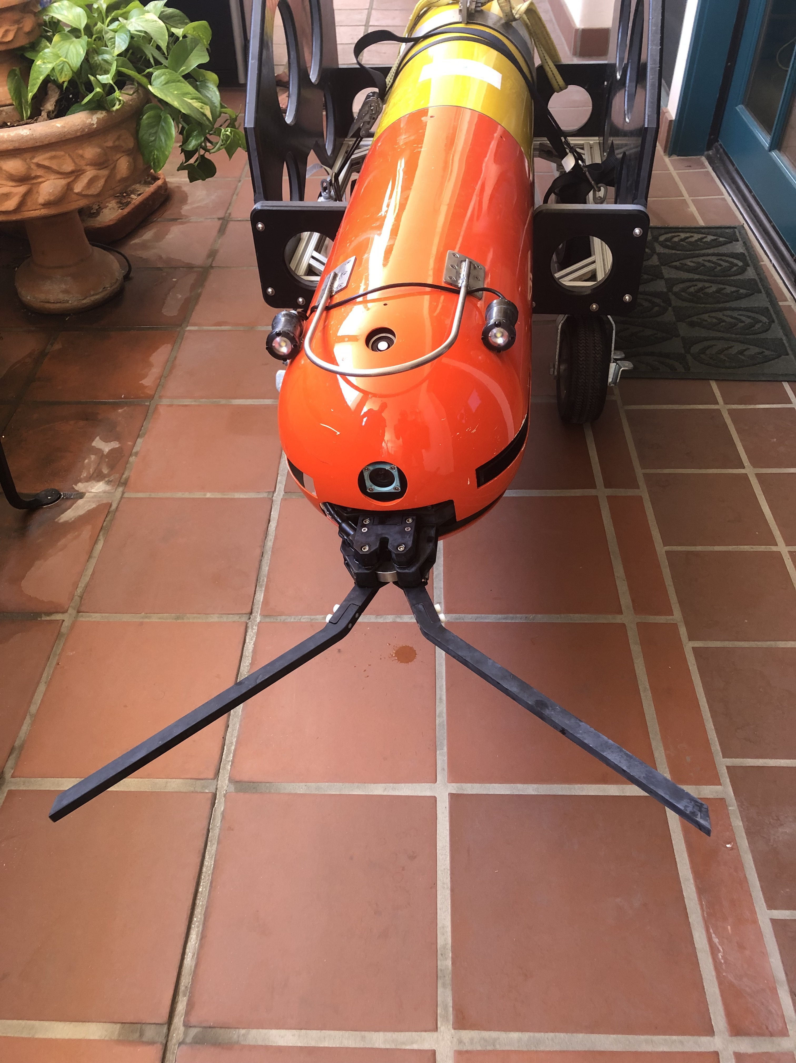
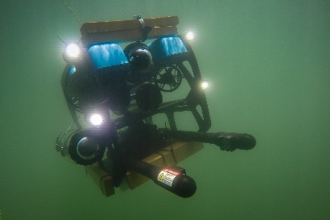
Docking:
Park, hang-out, wait, undock, recharge, recovery
Dynamic Docking for parking overnight
Notes:
Docking under-ice, use avalanche beacon, argos, wifi, iridium and acoustics and lights to find vehicle

Slide 22
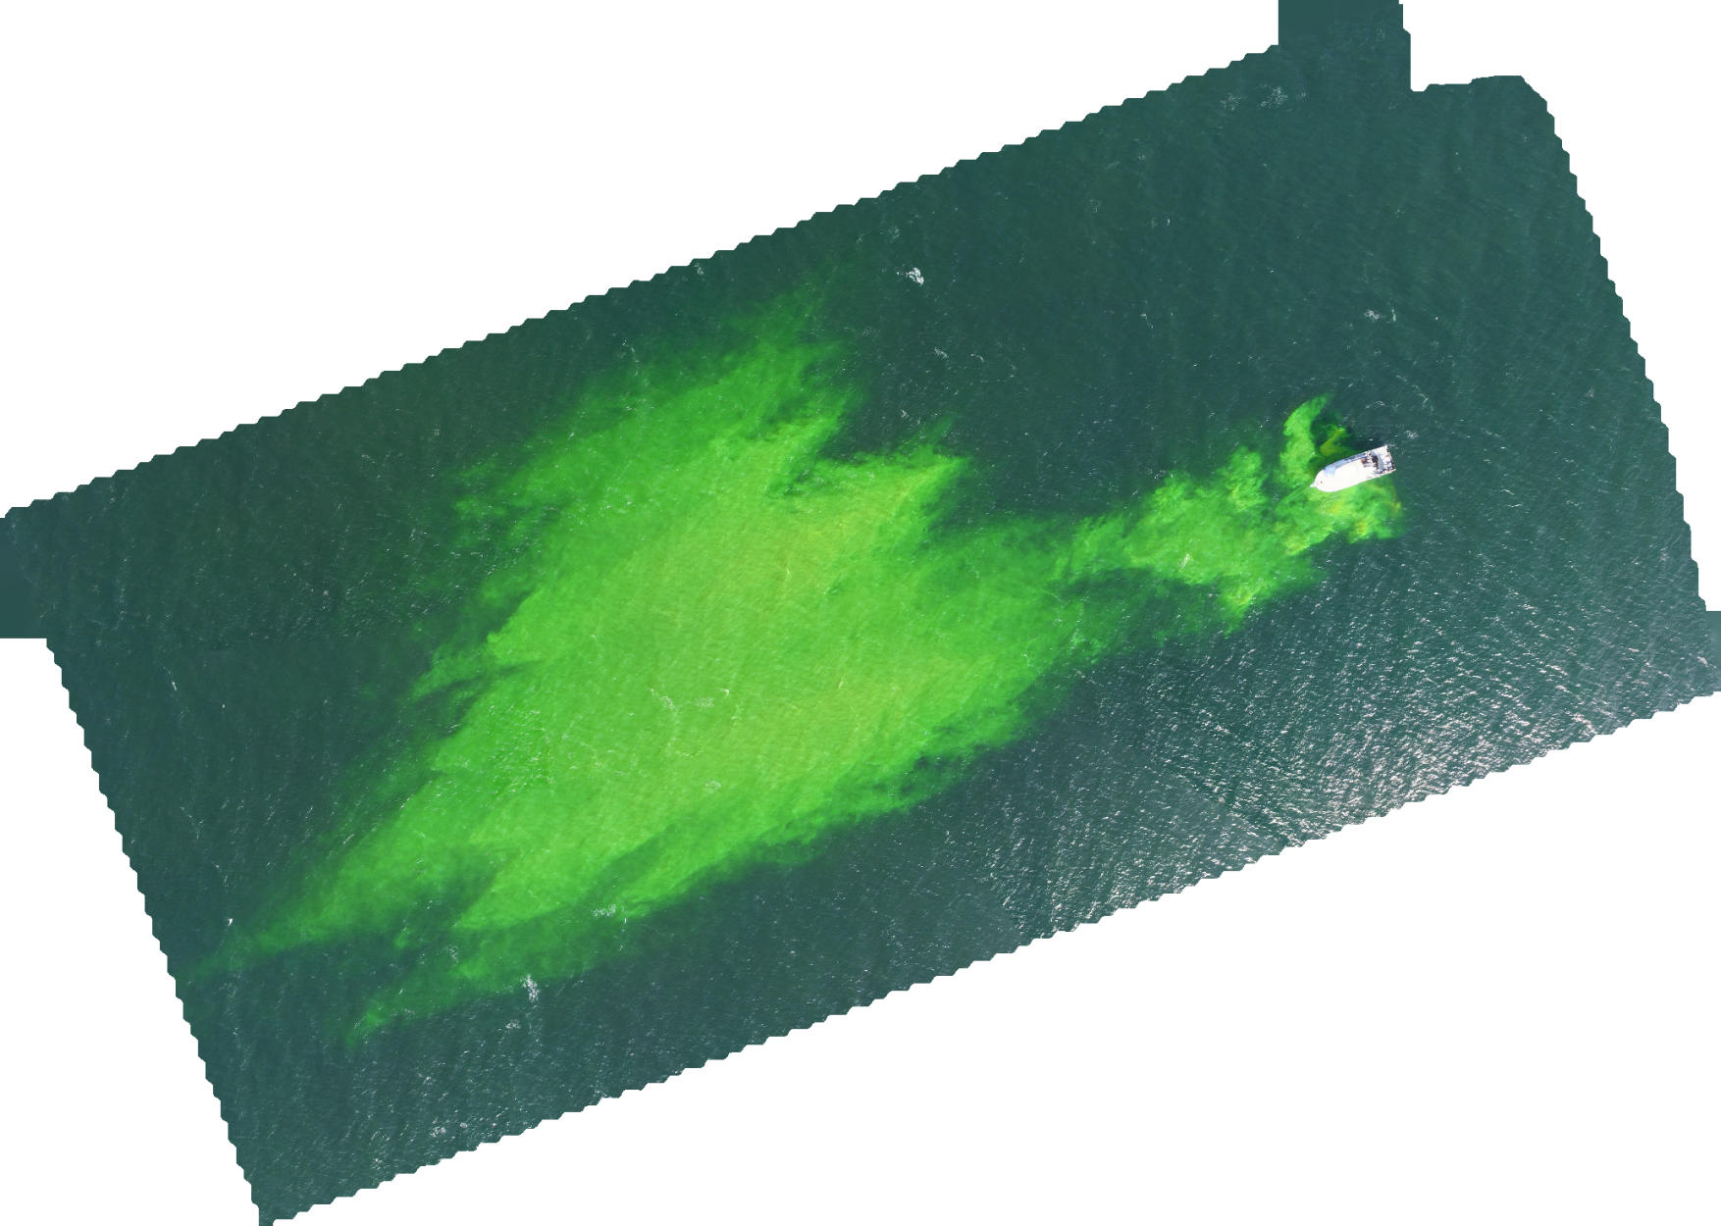
Finding oil in the Arctic
Highlight the capacity to search for “dissolved hydrocarbons” (using a fluorescein-dye release) as an analogue.
USE COTS- oil detection sensor on REMUS-100 AUV (SeaOwl)
Map “areas” where a chemical signal exists and doesn’t exist.
Adaptive search algorithm (Find Max, one of many options)
Real-time data via ACOMMS/Iridium back to Command Control Center, Where to put the boom? etc. Mitigate damages

Slide 23
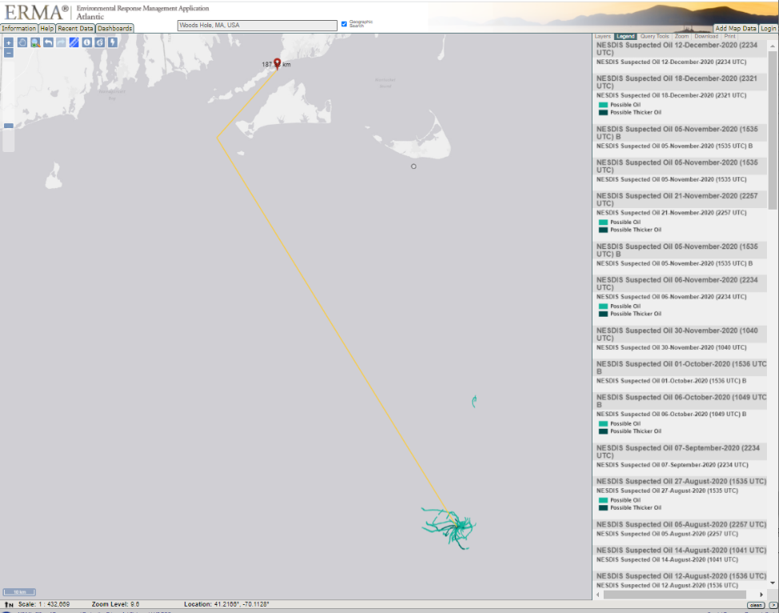
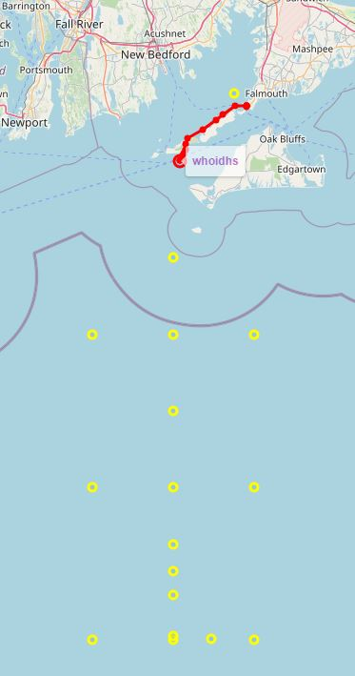
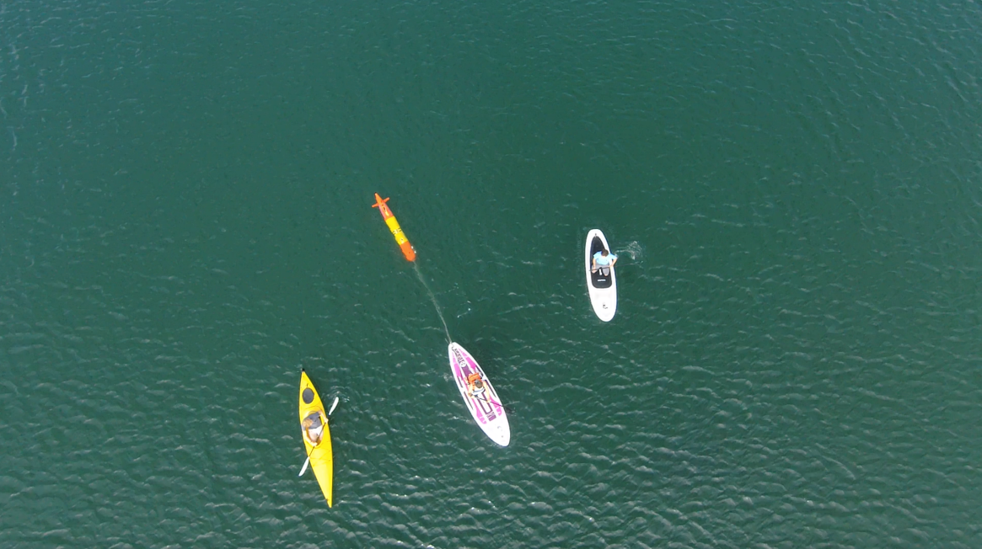
Long-range adds versatility: Wreck 1487
Overview of over-the-horizon mission – Shipless Operations
188 km from Woods Hole shipwreck actively leaking oil….in LRAUV wheelhouse (Scott Lungren (NOAA)

Slide 24
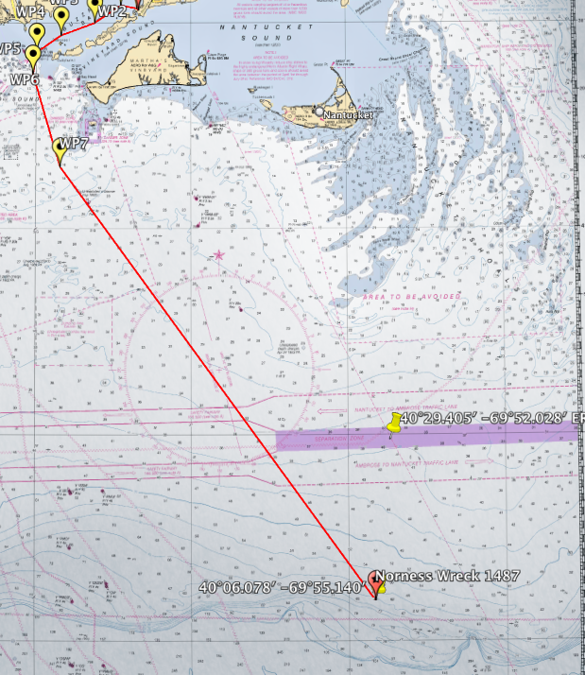
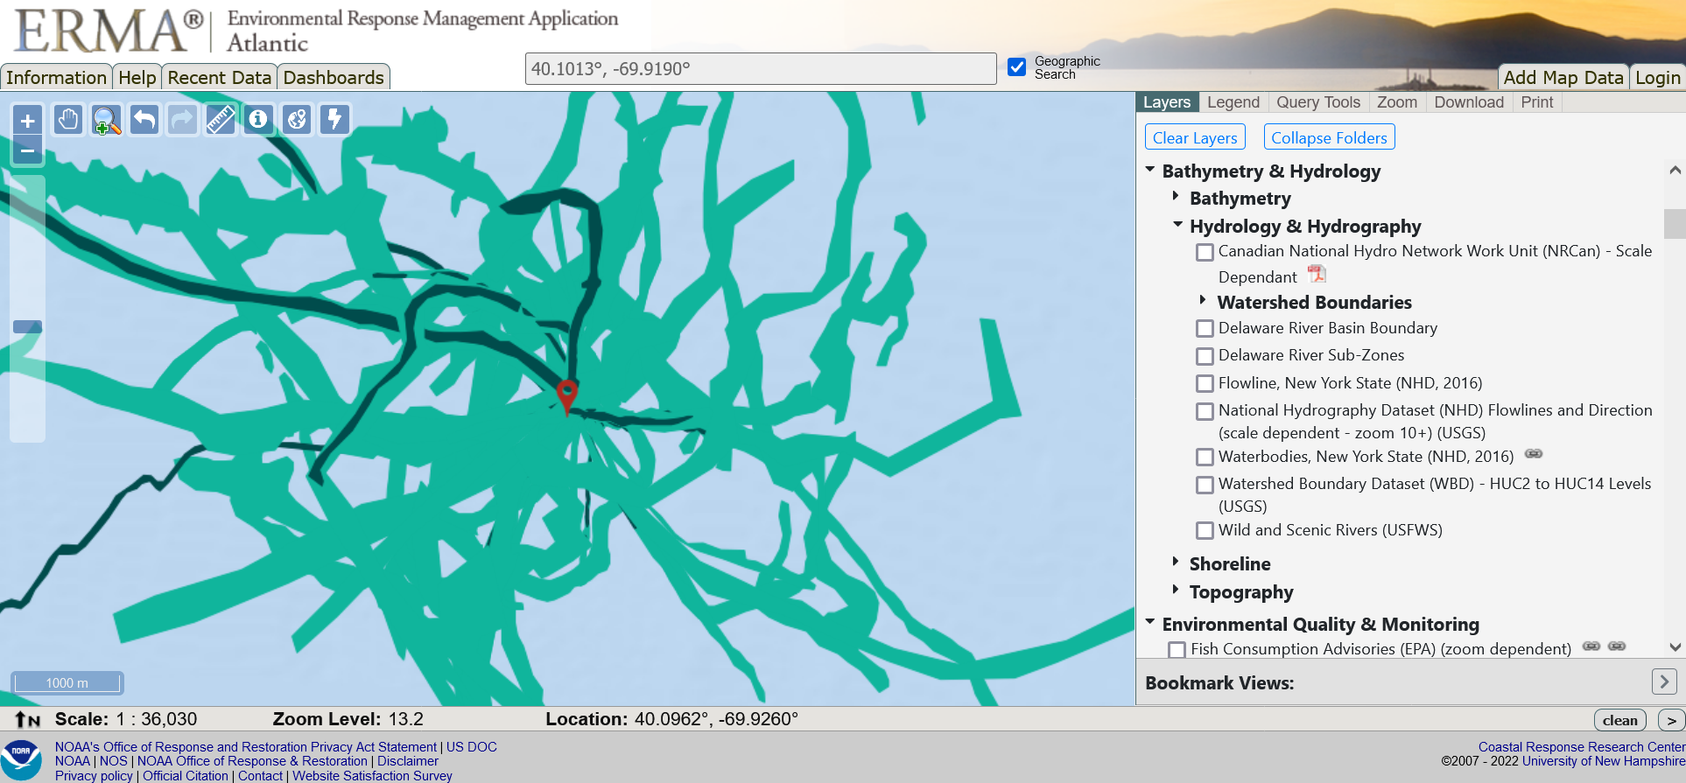
Long-range adds versatility: Wreck 1487
13 day mission out to the shelf break and back with LRAUV
Started out as a find-the-oil mission
A Nor’ester hit the area and we reprogrammed to yo-yo to collect storm impact data on T&S
Notes:
There are 7-8 other wrecks in the area they would love to be surveyed. 11 leaky wrecks in the NE (although the number is growing and now should include the ANDREA DORIA
Sometimes USCG training divers dive on these wrecks but priority is set based on Hurricane Ida impacts currently and unlikely NE wrecks will be practice dives.
On May 20th, 2013, NOAA presented the U.S. Coast Guard a national report that finds 36 sunken vessels scattered across the U.S. seafloor could pose an oil pollution threat to the nation's coastal and marine resources. Of those, 17 were recommended for further assessment and potential removal of both fuel oil and oil cargo.
EEZ wrecks

Slide 25
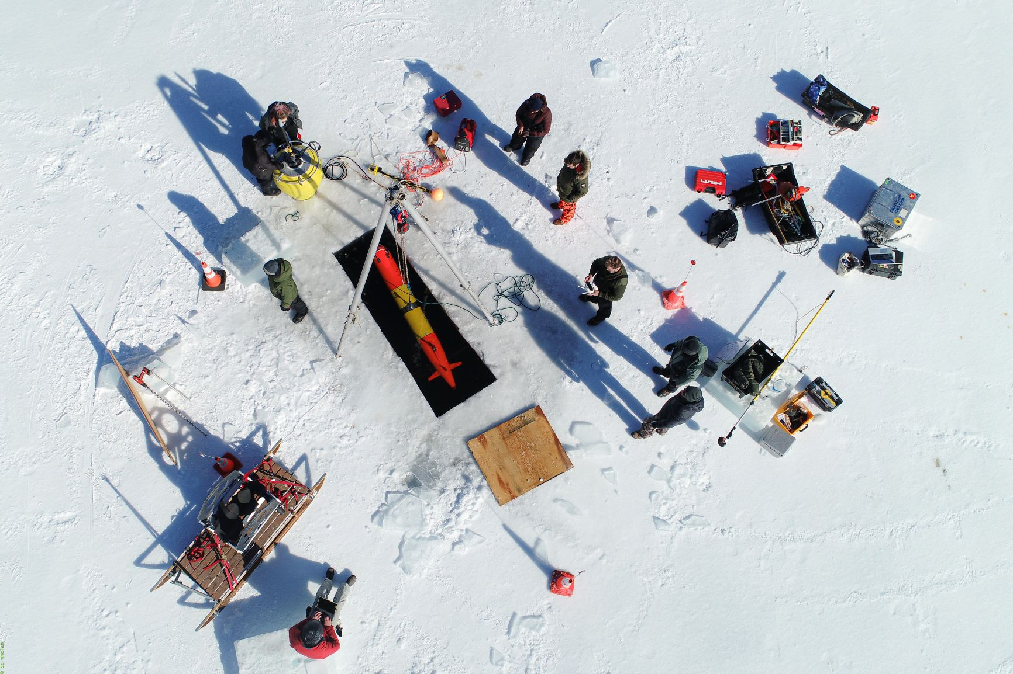
Thanks and
LRAUV Ready for questions
@sciboticslab

