Slide 1

Export options for
MBARI’s L-RAUV
12/14/21 IP Committee, by Brett Hobson

Slide 2
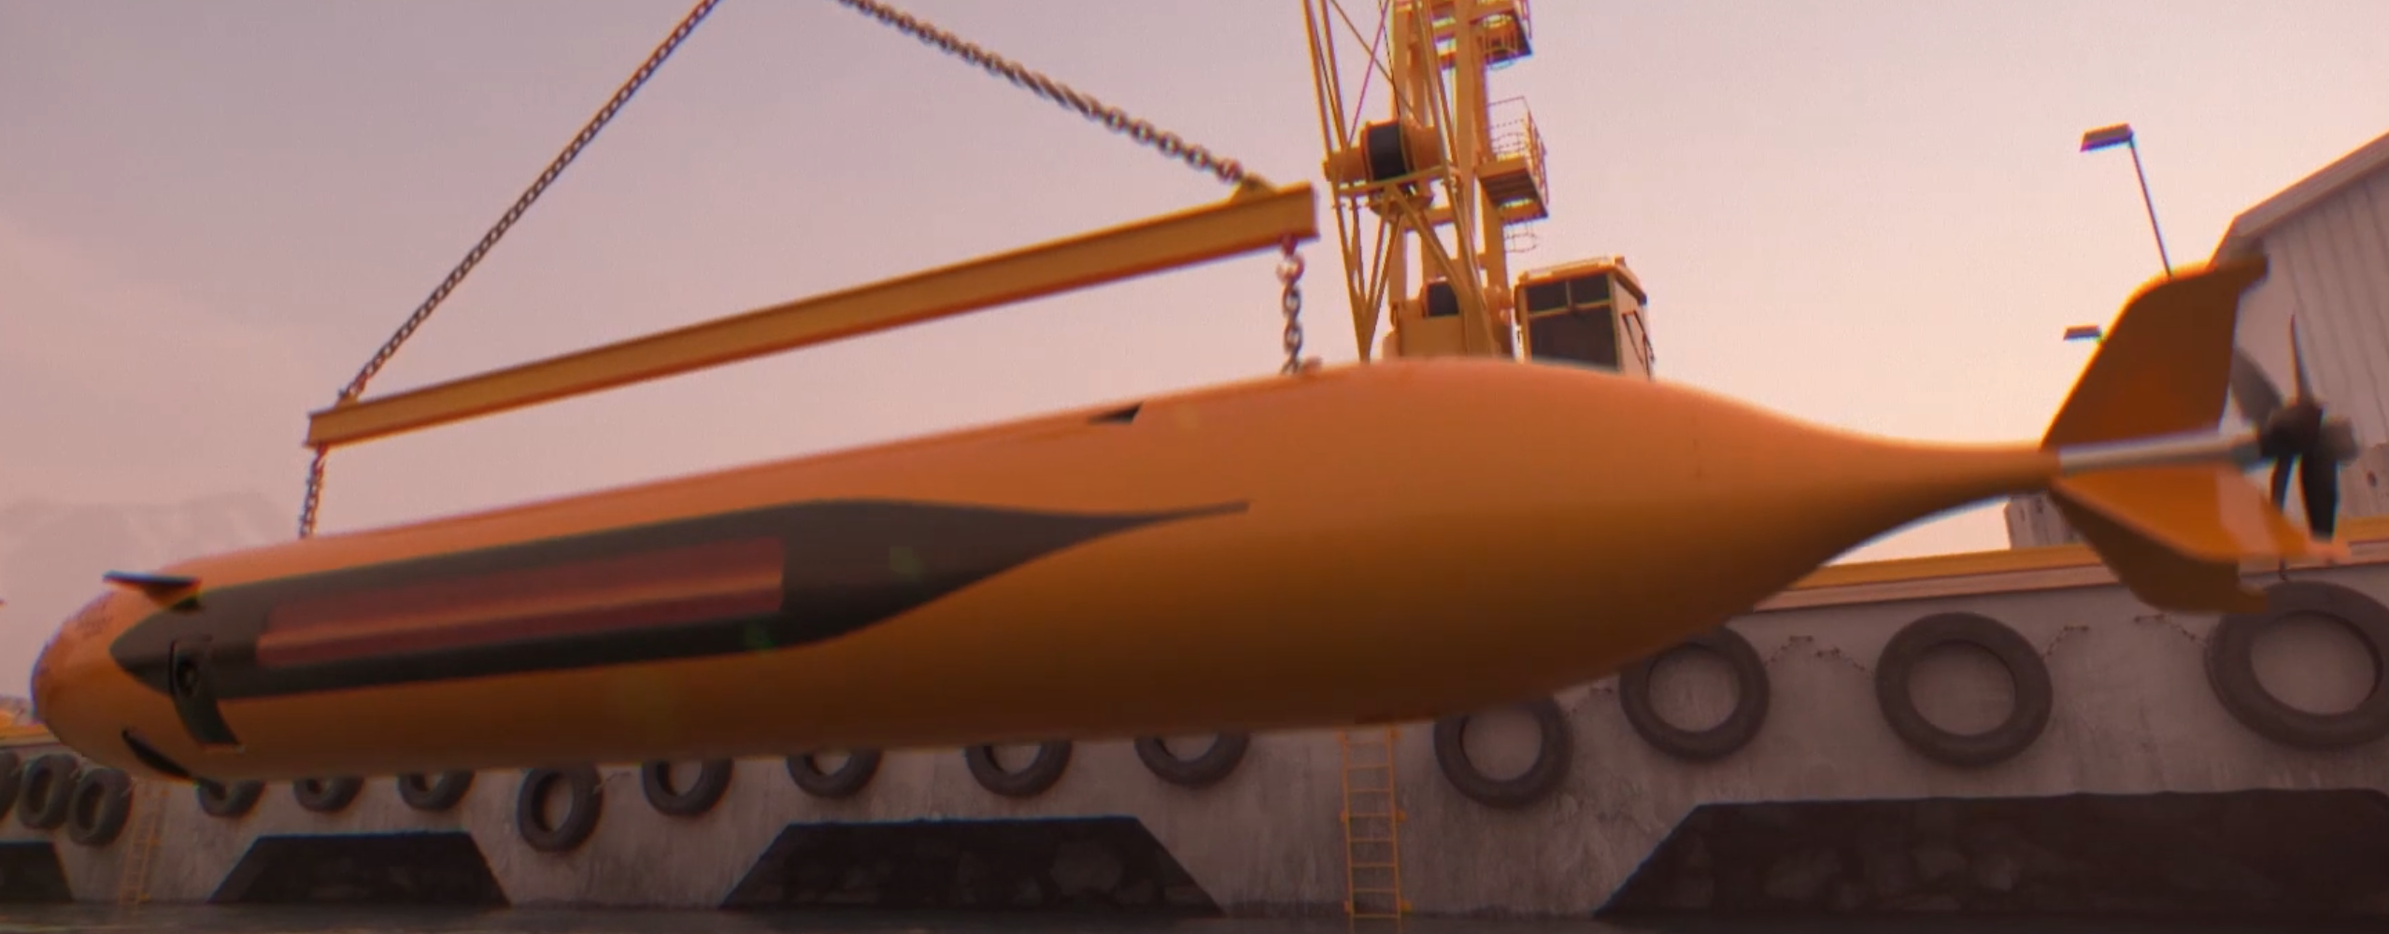
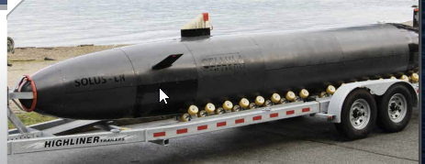
AUV Marketplace, ~ $500M
Commercial AUV Users
  Fugro – Hugins
  Oceaneering - Hugin
  Teradepth – Custom Cellula vehicle
  Ocean Infinitty – Hugins
  Ocean Floor Geophysics – Hugin, Explorer
  Modus – SAAB, Hydroid
Existing AUV builders
  Kongsberg – Hugin, including 2200 km range Endurance
  Hydroid/Huntington Ingalls
  Bluefin/General Dynamics
  Ocean Server/L3-Harris
  Teledyne – Gavia
  Cellula Robotics – Solus-lr, 2000 km range
  Eca Group
  ATLAS ELEKTRONIK
  Saab
  ISE
  Rip Tide/BAE systems
  OceanScan – LAUV in Portugal
10m Hugin Endurance, 6000 kg
Science Users of Commercial AUVs
  WHOI – Hydroid, L-RAUV
  Scripps - Hydroid
  NTNU/Univ Porto – Ocean Scan
  Marum - Explorer
8m Cellula Solus-LR, 3700 kg
~3 years ago, we reached out to Teledyne, Hydroid, OceanScan, ISE to gauge interest in them licensing the L-RAUV: no interest at that time. We weren’t a threat to their market share.

Slide 3
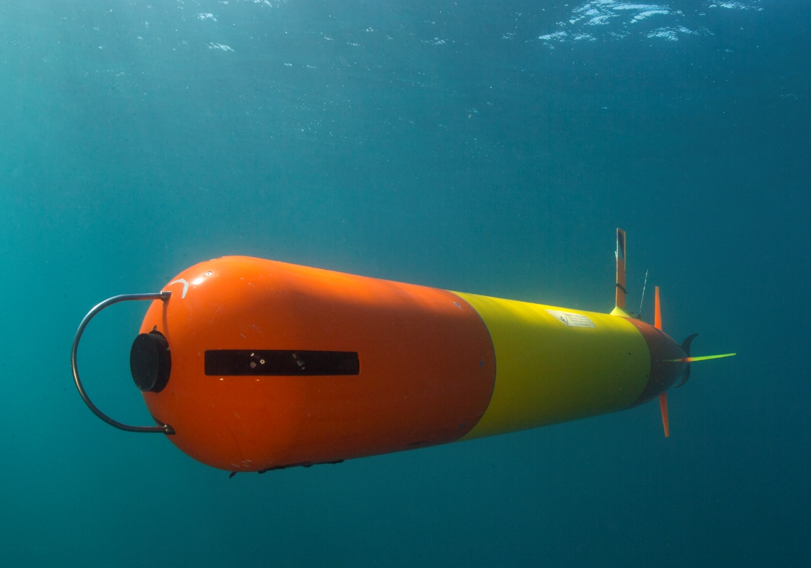
MBARI’s Tethys-class LRAUV
Propeller Driven Long-Range Autonomous Underwater Vehicle
Ship-less Operations, Port to Port
Wide Speed Range
  Slow effecient cruise, 1-2 knots
    Low power payloads
    >Mega-Meter Range
  Faster – 3 knots
    High Power Payloads
      Mapping, Imaging
  Neutrally Buoyant at Depth
  Zero speed Lagrangian Drift
Over-the-Horizon Command/Control
Easy Web-based Operator Interface
Smart: Autonomous Targeted Sampling
Optional Backseat Computer Control
Open-Source Simulator
Small-ish
  110 kg, 0.3 dia, 2-3m LOA
Reliable
  ~30,000 hours offshore so far
Image Credit: Kip Evans
Notes:
Still actively developing new capabilities, but MTBCF* over 140 hours when we stop fiddling and just let it work.
Iridium messages are 270 bytes. Typically we get a couple messages a minute. So how to we interact? How do we keep a common ops picture?

Slide 4
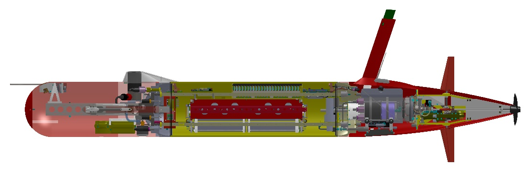
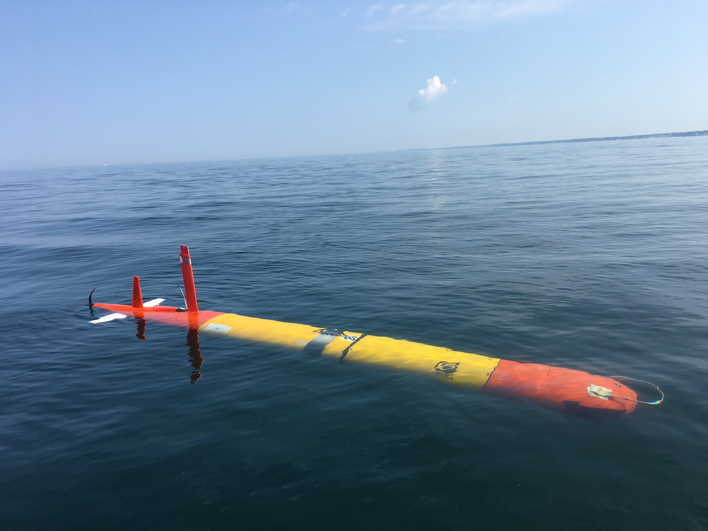
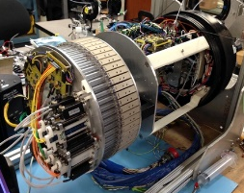
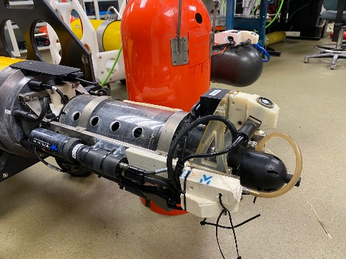
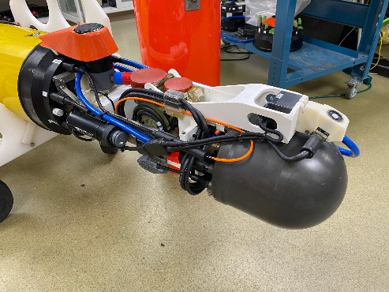
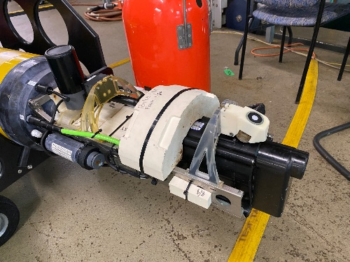
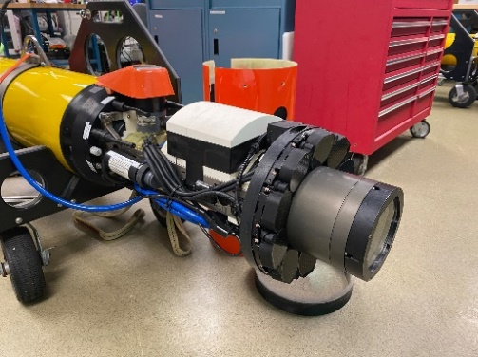
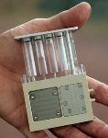
MBARI’s L-RAUV
Propeller Driven Long-Range Autonomous Underwater Vehicle
Core Science Payload: Seabird CTD+O2, Chl/OBS, PAR, Acoms+USBL, DVL/ADCP
24 Channel Configurable Load/Comms Control
Antenna Mast: Iridium, Cellular, WiFi, Argos, VHF
Backseat Computer: Nvidia Jetson
Ultra-Low-Power Main Vehicle Computer and Motherboard
High Efficiency and Quiet
Direct-Drive Thruster, 0.5-1.5 m/s
Open
Payload Bay
Paired Elevators and Rudders
Move-able Mass Battery Pack
5.7 kW-hr Rechargeable or 14 kW-hr Primary
1 L Variable Buoyancy System Plus Emergency Drop Weight
Microbial Sampler
60x Filtered and Preserved + Real-time
Water Sampler
15 x 100 ml Raw Water
Bio-Acoustic Imaging
EK-80 Gimbaled, Up/down
Biolumenescence
WetLabs UBAT
3D Plankton Imaging
7 Cameras, 350k Lumens

Slide 5
Who wants an L-RAUV today?
Almost zero marketing, just word of mouth
WHOI’s Scibotics lab – has 3 now, 1 more in 2022 for NOAA Scallop survey, potential for Another vehicle for Heidi Sosik who is developing a ISUS plankton imager for the L-RAUV
USGS GLSC – Existing funding for a pilot program using MBARI’s vehicles
NOAA GLERL lab – On-going Science collaboration using MBARI’s vehicles
NTNU, Martin Lugvigsen, ~ $1M for two L-RAUVs in 2022
University of Porto + EU Marine Robotics, Funding for one in 2022, two more in 2023
Scripps, Mathew Alford, physical oceanographer wants to write a DURIP proposal for one

Slide 6
Why do we want to license the L-RAUV?
Packard Foundation wants us to share the technology
Facilitate new ocean science discoveries
What do we want?
Somebody to build vehicles, stock and sell spare parts and answer the phone for support
Somebody who will invest to improve the vehicle and expand the market for L-RAUV
Somebody who won’t turn their back on ocean science
  focus on defense/energy like bluefin and hydroid
A self sustaining, critical mass of external users that requires minimal support from us
License fee, from commercial buyers, e.g. people making money with our tech

Slide 7
Candidate LICENSEEs
Generic Contract manufactures
  least Inexpensive way to build vehicles
  No ability to test and integrate payloads, No sales, marketing, product development
Ocean science Sector
  Prospective company shouldn’t compete with existing customer base
    E.g. Seabird wouldn’t want to sell auvs that competes with many of their customers
  USV, glider or Float builders could expand product line with swimming vehicle
    Seatrec, MRV, Seatrak, Liquid Robotics, Saildrone, Marine Advanced Robotics (WAM-V),
  Ocean Energy Harvesting company Might want to expand with a “turn-key” AUV docking system
    Ocean Power Tech (OPT), Columbia Power Technologies (CPT)
    SEATREC, Yi Chao
      Ocean thermal energy harvesting technology licensed from CalTech
      Modules added to Argo-type floats and gliders
      Drifter-based open ocean bathymetric mapping
General Ocean Equipment
  Ocean Instruments/Gravity Marine, Shawn Hinz
  McLane, etc.

Slide 8
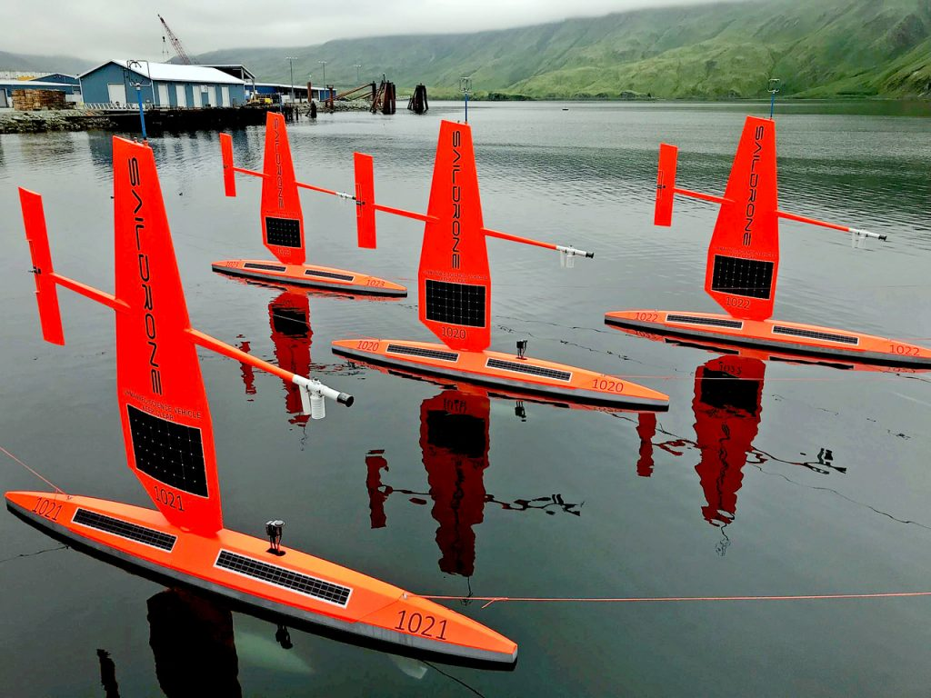
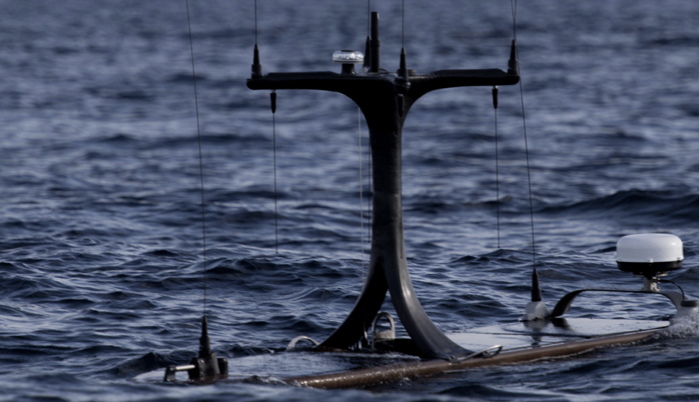
Owner/operator/manufacturer
Keep the technology Private and use it as a Competitive Advantage
  Good for environmental Survey in Energy Sector but Expensive for Ocean Science users, limited Defense
Saildrone
ThayerMahan, Richard Hine
Tetra Tech
Robotics as a Service (RaaS, coined by OPT/MAR)

Slide 9
Challenge 1: L-RAUVs are still a secret
    need high visibility Operations
      More Collaborators
    Need to write articles in trade journals, e.g. Sea Technology, Ocean News
    Display at large tech conferences, e.g. Oceanology, Ocean Business, Ocean Sciences

Slide 10
Challenge 2: How can we ensure Ocean science doesn’t get abandoned
  Hydroid, Bluefin, Ocean Server, Teledyne all have
    Not affordable, difficult to customize, don’t support older systems
  Carefully choose a privately owned company committed to ocean science
    Corporation is required to maximize profits
  Impose a cost+ manufacturing clause for non-profit/science

Slide 11
L-RAUV Ocean Science Users Consortium
    Increases exposure
    Develop new payloads, e.g. seafloor mapping & search, pipeline-following,
    Build out-of-house expertise
    Already have WHOI in this role
    Use a Contract Manufacturer to build vehicles w/o integration/test
    Open Source Development within Collective
    Self Supporting between Members
    Gift to the Ocean Sciences from the Packard Foundation

