Slide 1
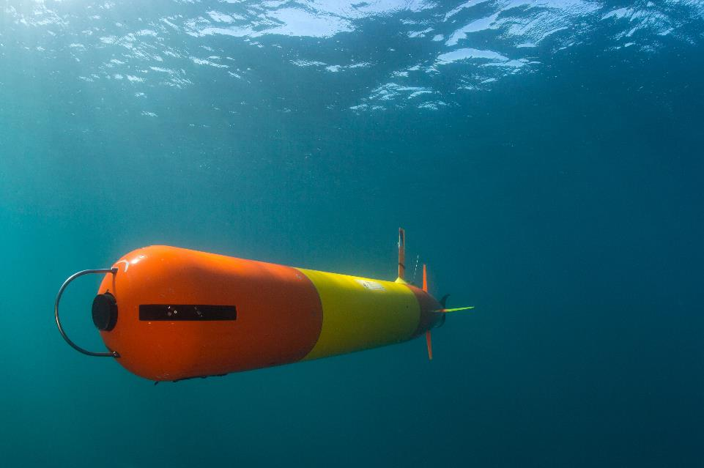
LRAUV 2020 Operations Planning Meeting

Slide 2
Outline
Transition to DMO
Current and Future Development – open discussion

Slide 3


LRAUV Lead Operations Engineers
Erik Trauschke
  etrauschke@mbari.org
  Ext. 2068
Chris Wahl
  cwahl@mbari.org
  Ext. 1746
Lab ext. 2061

Slide 4
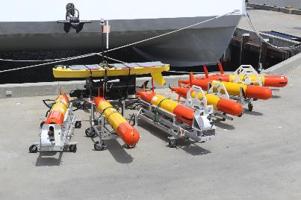
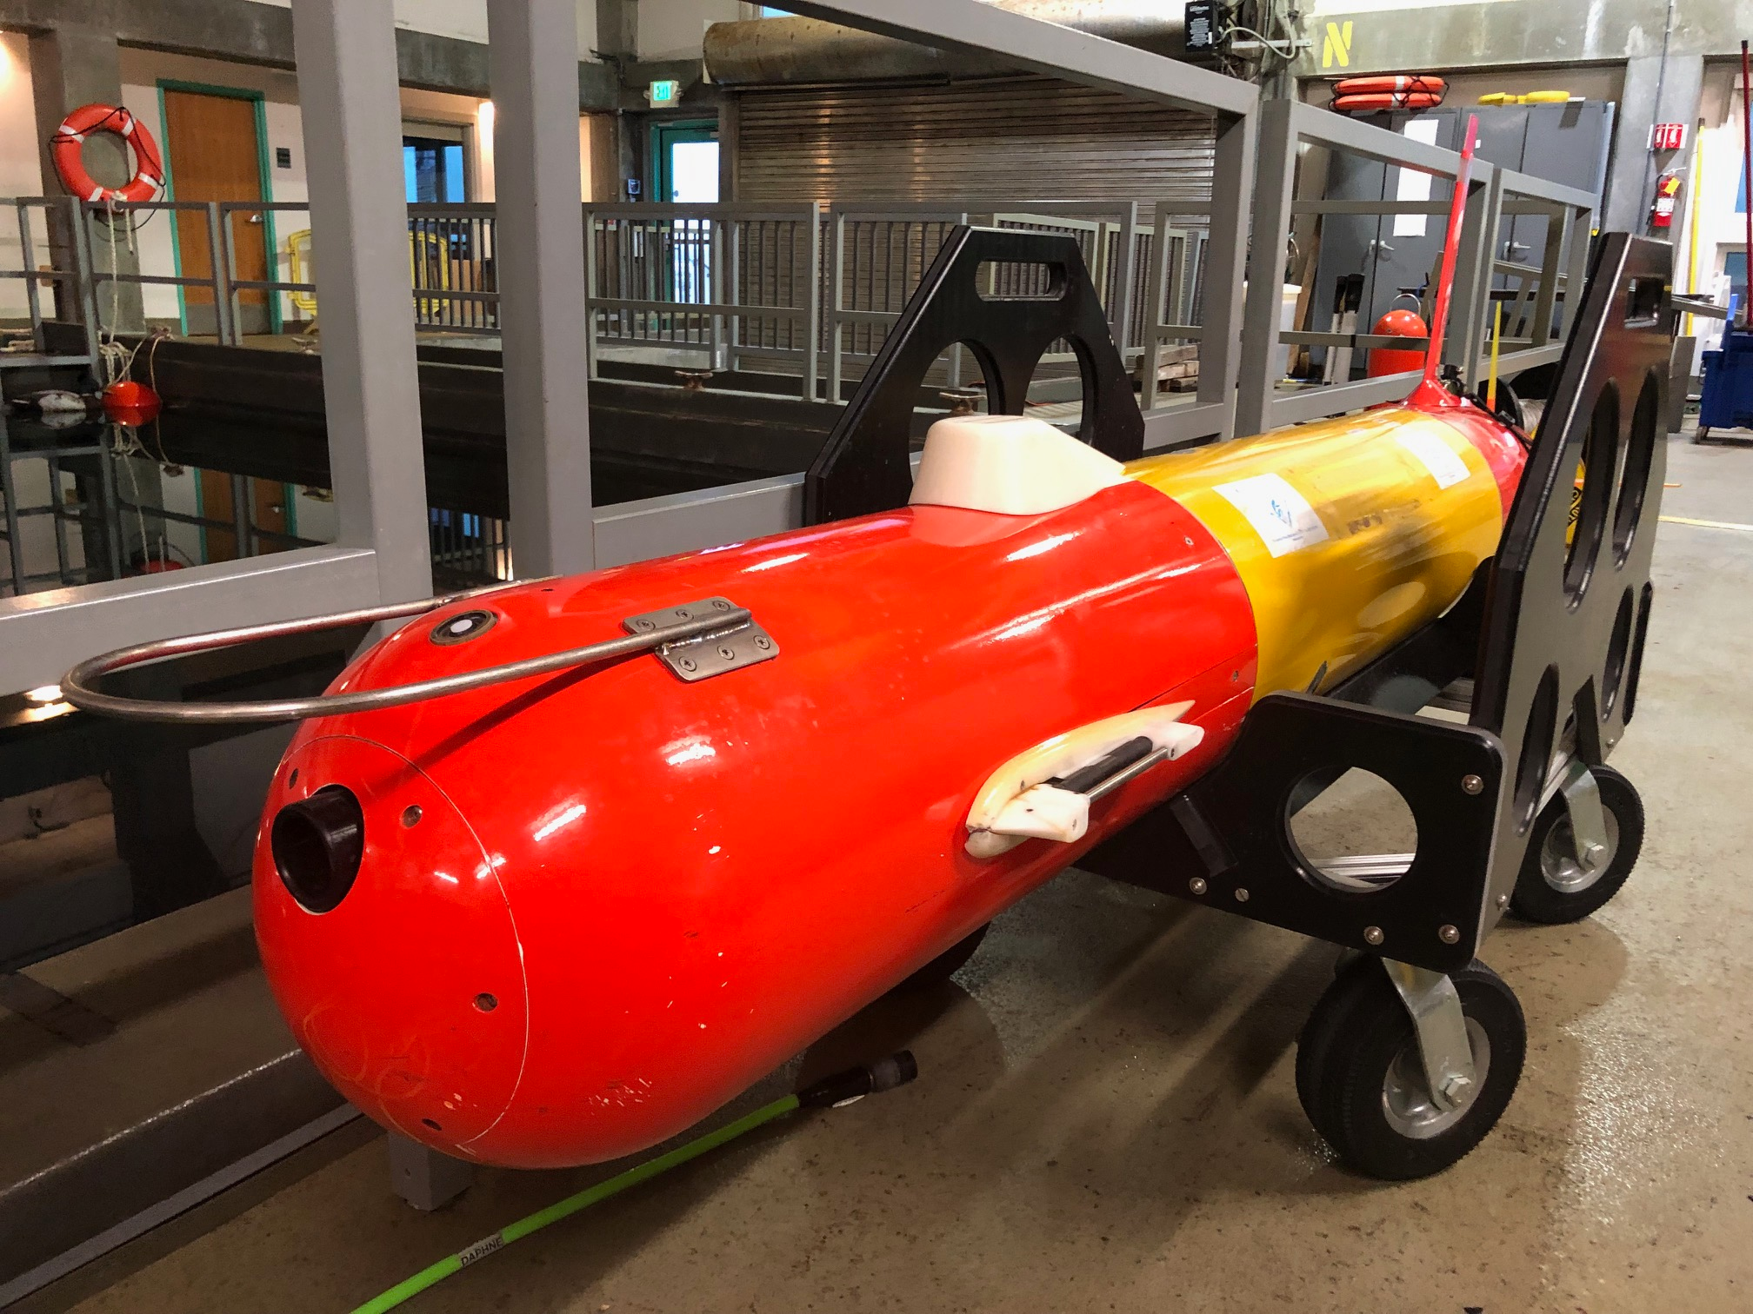
LRAUV Fleet
6 LRAUVs, 2 Wave Gliders, 2 LARS, 1 Paragon
6 Payloads:
  Sipper water sampler
  2 ESP samplers
  Biolumenesce
  Prognostication
  Bio-Accoustics

Slide 5
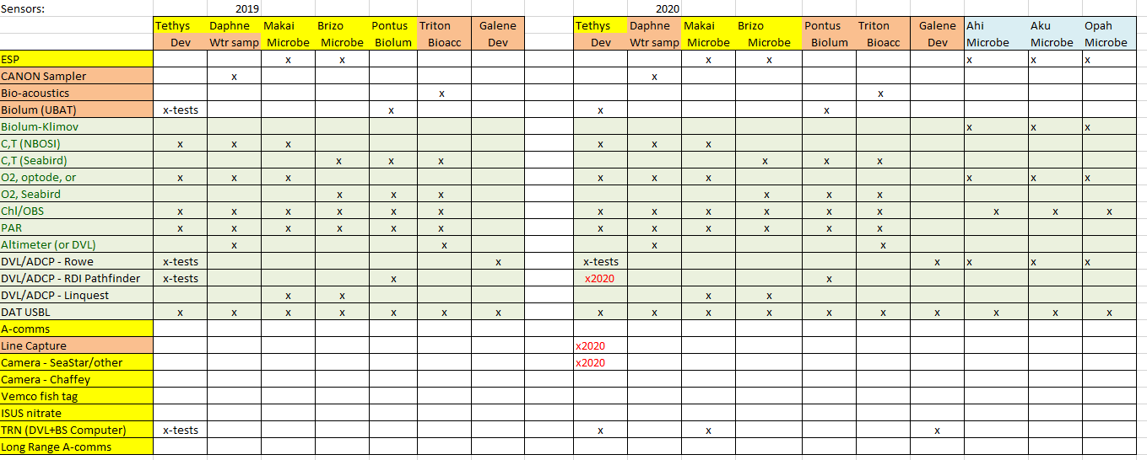
LRAUV Vehicle Configurations
MBTS and Biolum: Daphne and Pontus
ESP: Makai and Brizo
Prognostication: Galene
Bio-Acoustics: Triton

Slide 6
LRAUV Operations
Routine Operations – DMO run
  MBTS, Biolum, BioAcc, …
Advanced Operations – DMO and Engineering
  Most CANON and ESP experiments, development projects (Hobson, Zhang, Rock..)

Slide 7
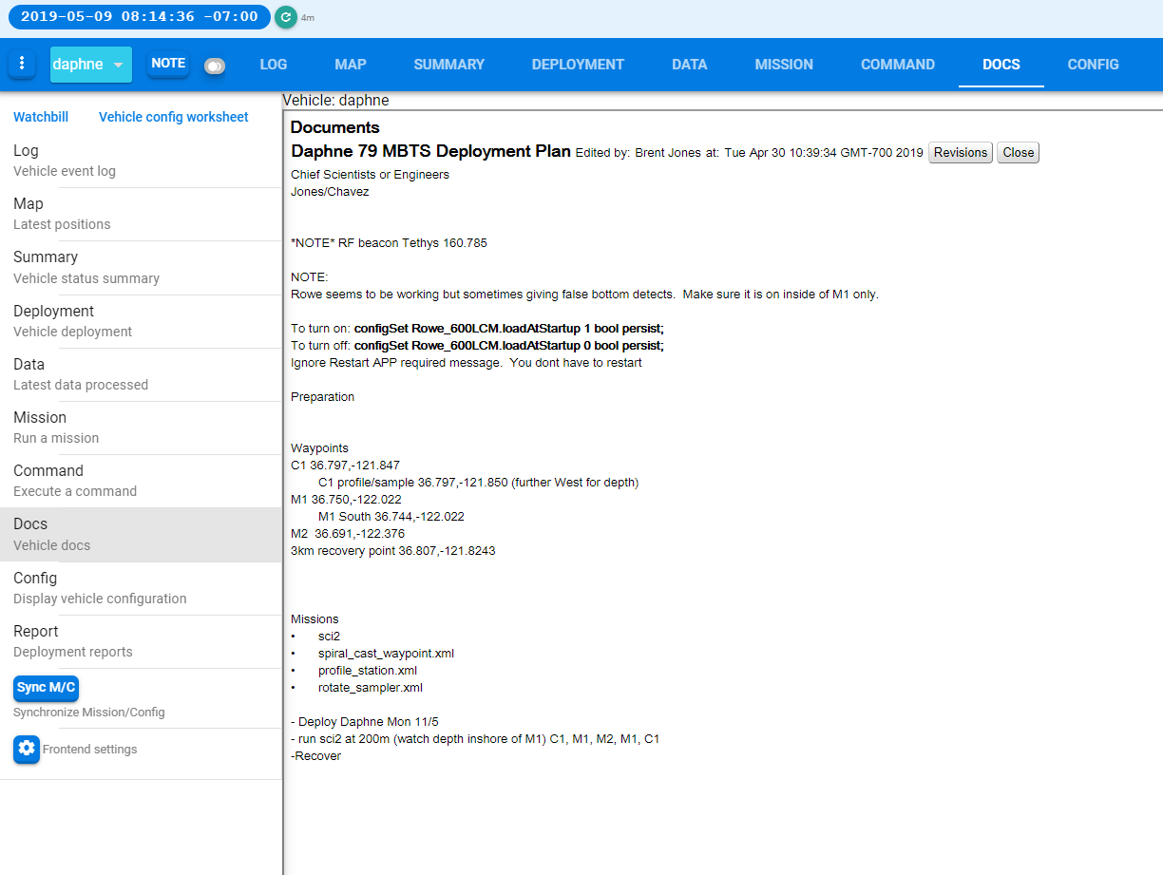
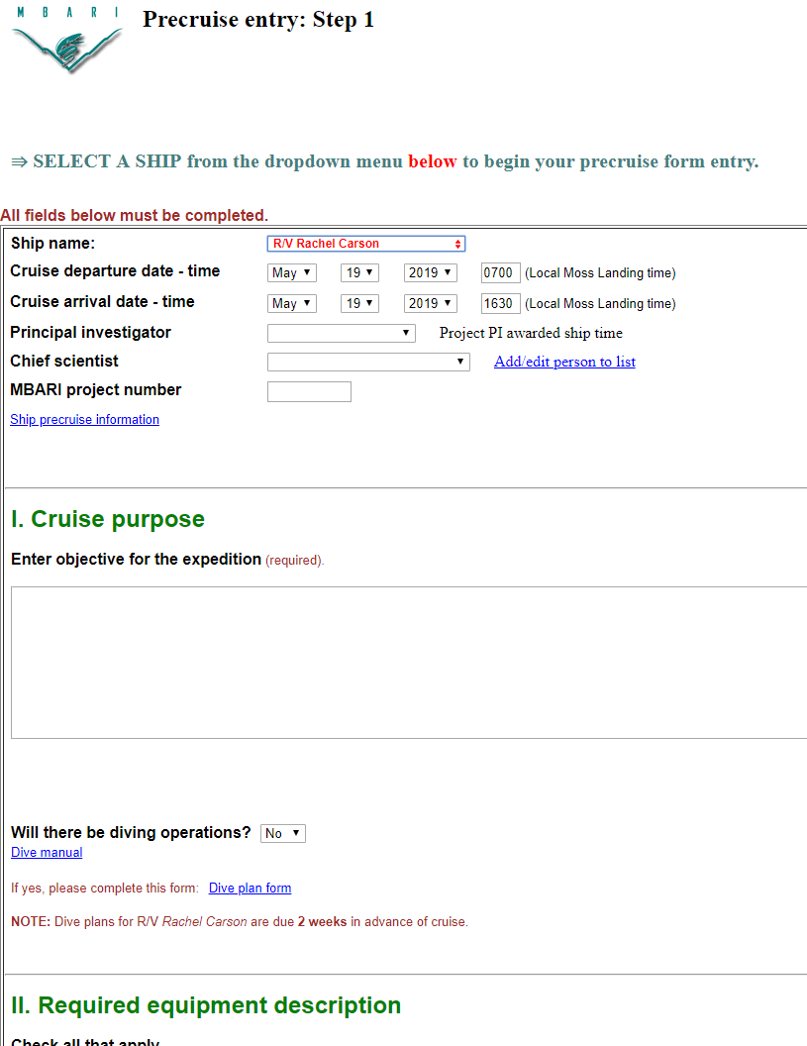
Deployment Plan
Required before vehicle launch
  Fill out doc on Tethys Dash, or send txt in email
  Could set up a new Pre-Cruise Form

Slide 8
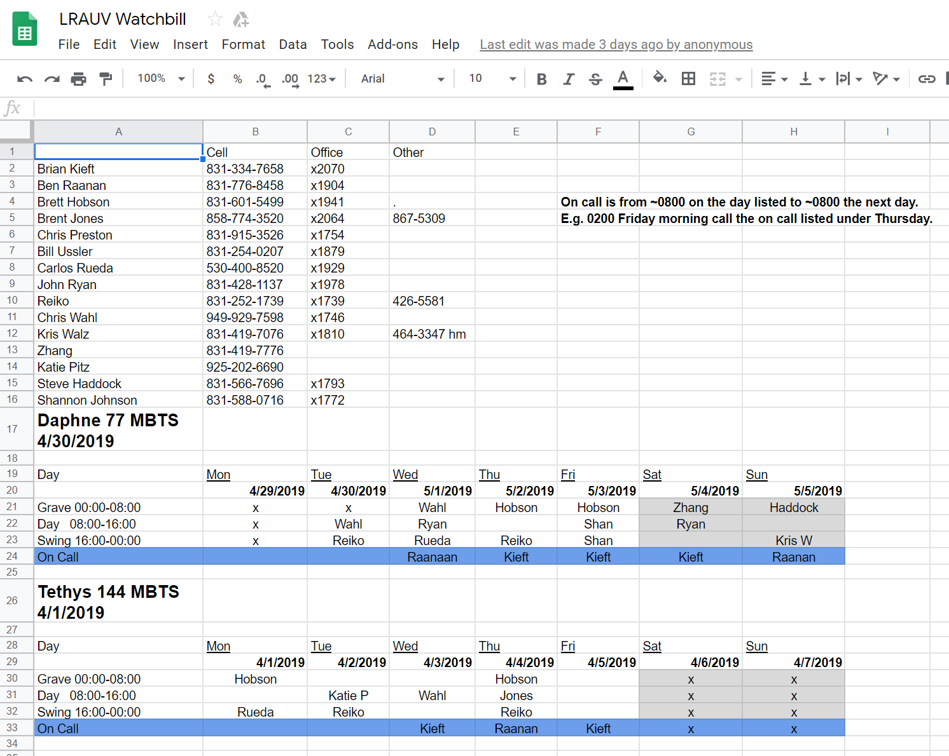
Watchstanding
Any operations after working hours requires a full staff of watchstanders signed up - Before launch
Currently 25 trained pilots with 2 experts on call
  Need more people, or people more often
  Recruit other MBARIans?
  Recruit outside?
  Automate?
  Make it trauma free and fun

Slide 9
Vehicle Reliability
20,000 hours of offshore operations (almost)
New Code Branching
  Fully tested Master Branch used for Routine Opps
  Independent Feature Branches for various development tracts – carefully merged when ready

Slide 10
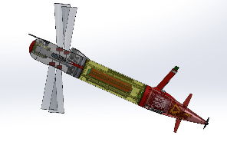
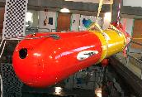
Planned LRAUV Work
Add Sipper water sampler to ESP
Add pH sensor to one of the vehicles
Externally funded
  Multi-beam sonar
  Under-ice operations
  Long-range acoustic comms
  Building a 2nd LRAUV for WHOI (at WHOI)

Slide 11
Possible new LRAUV work
2000m upgrade
  New pressure housing
  Same vehicle guts, mostly
    New VB pump motor
    New shells (13.5-14” diameter), New propeller
    New Sensors (depth rating)

Slide 12
LRAUV Persistence
2019
  Event response with anchor and wait
    Any vehicle can be anchored and remotely (or on a timer) enabled through a WaveGlider or RF gateway buoy. Sipper nose isn’t compatible
    Testing in June/July
  Park-n-Fly
    Homing and repeatable line capture
    Testing May-June
  Tow-out:
    Same nose anchor can be used to attach to the WaveGlider towbody.
    Testing in July Aug

Slide 13
LRAUV Persistence II
2020 +
Extend deployments to 3 months
  Hybernation (park-n-fly) to spread 12 days of opps over 3 months
    24 hour mission once/wk, or two 12 hr, or four 8….
Waveglider tow out and and back
Extended Lagrangian drift mission enabled though vehicle exchange

Slide 14
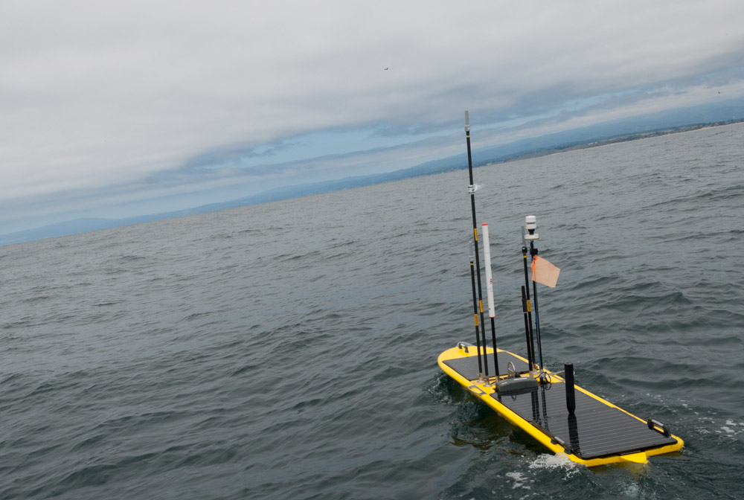
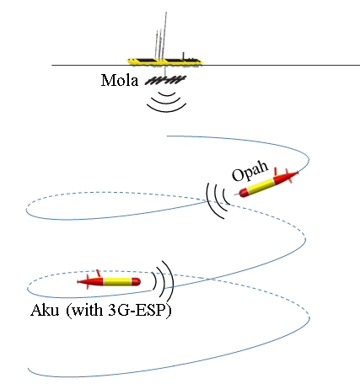
Multi-Vehicle Collaboration
Wave Glider SV-3 with MBARI Hotspot payload
  USBL tracking, autonomous following
  Acoustic/RF Gateway
2nd LRAUV (Opah) to collect contextual data around sampler
  USBL tracking, autonomous following: circle + YoYo

Slide 15
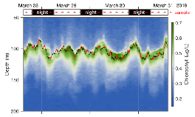
An Autonomous Vehicle Based Open Ocean Lagrangian Observatory
Produce 4-D 'motion pictures' of the genetic, taxonomic, transcriptional, metabolic, physical and chemical fields that drive the ecological dynamics of microbes, plankton, fish and marine mammals – in the Lagrangian Frame

Slide 16
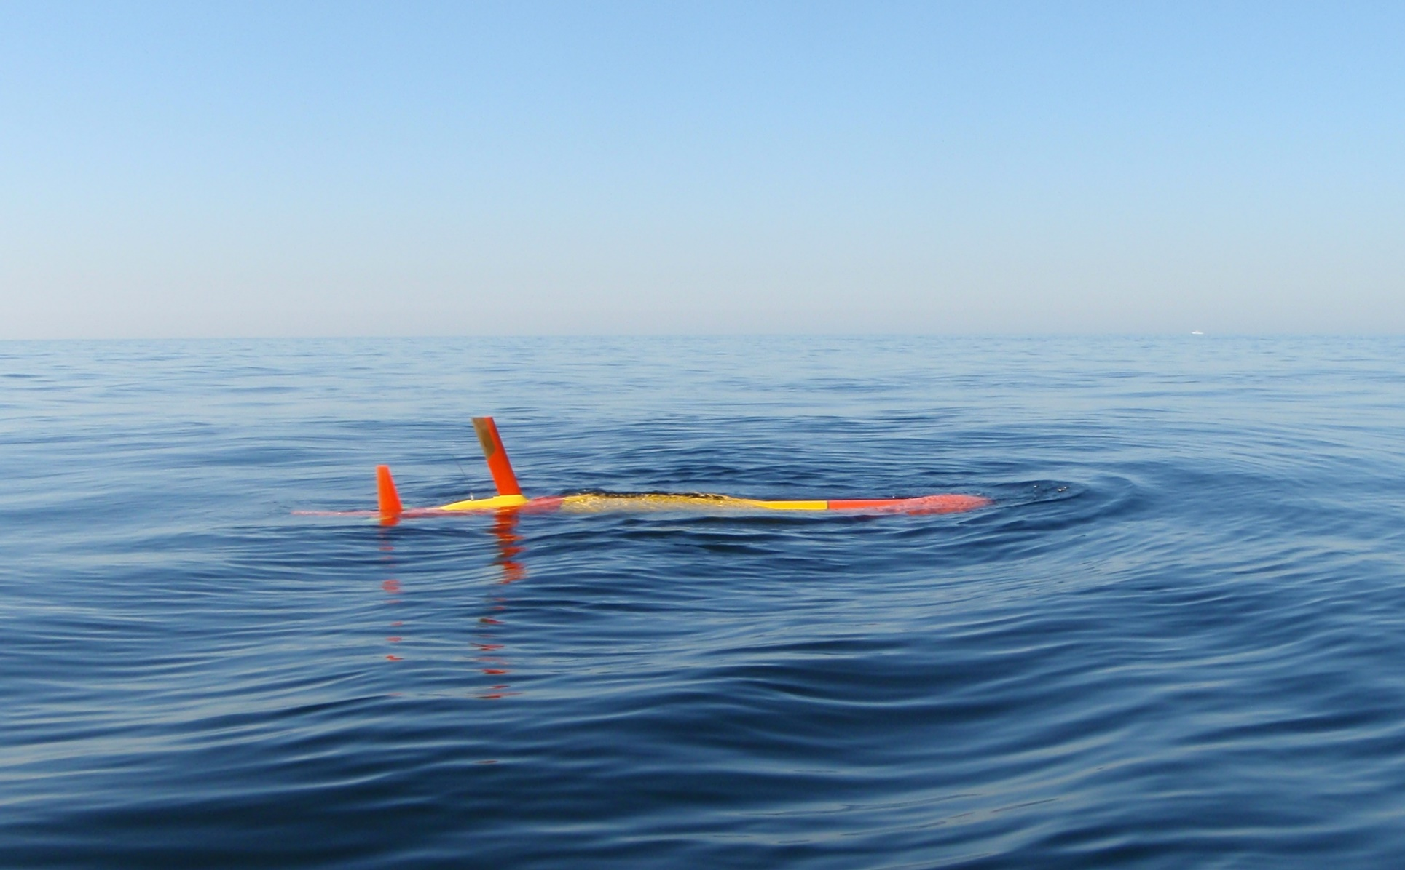
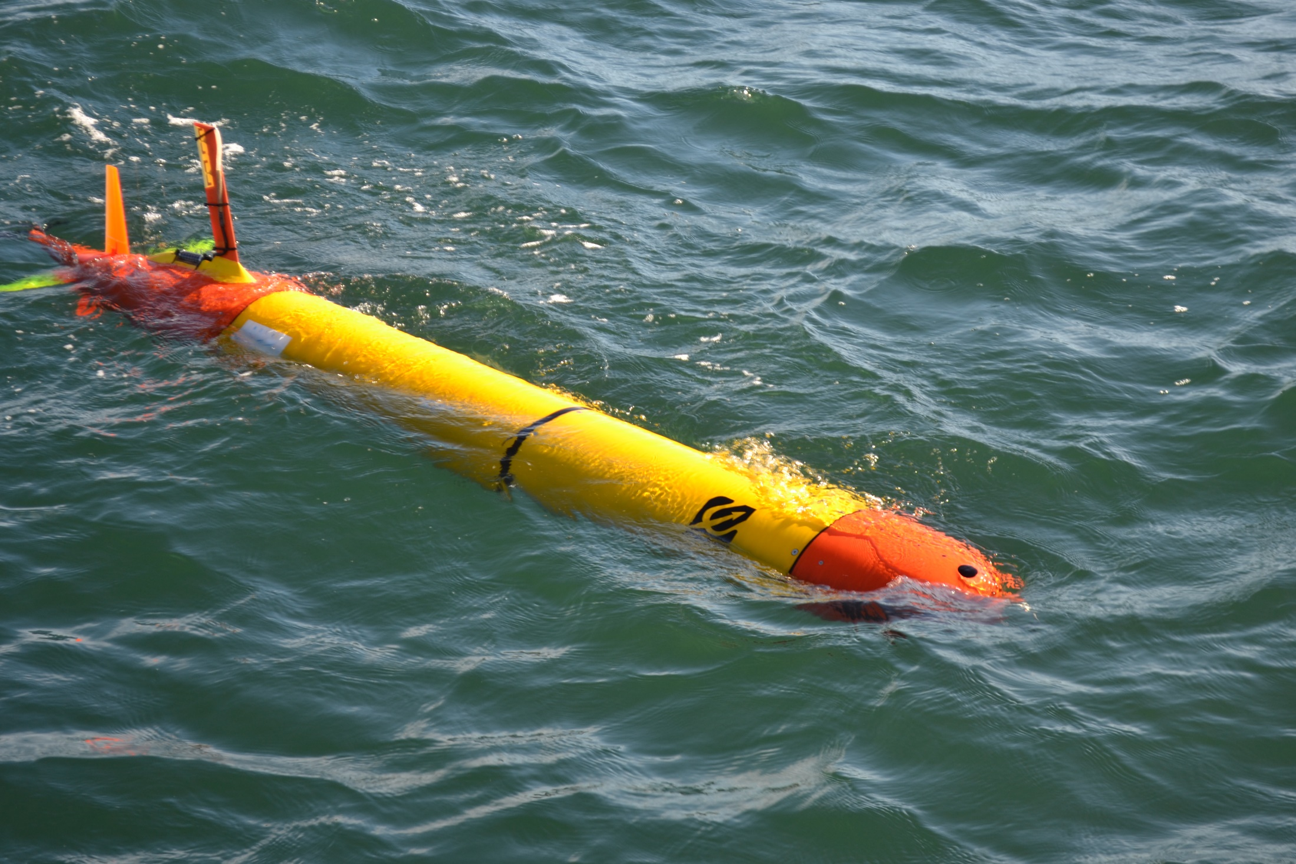

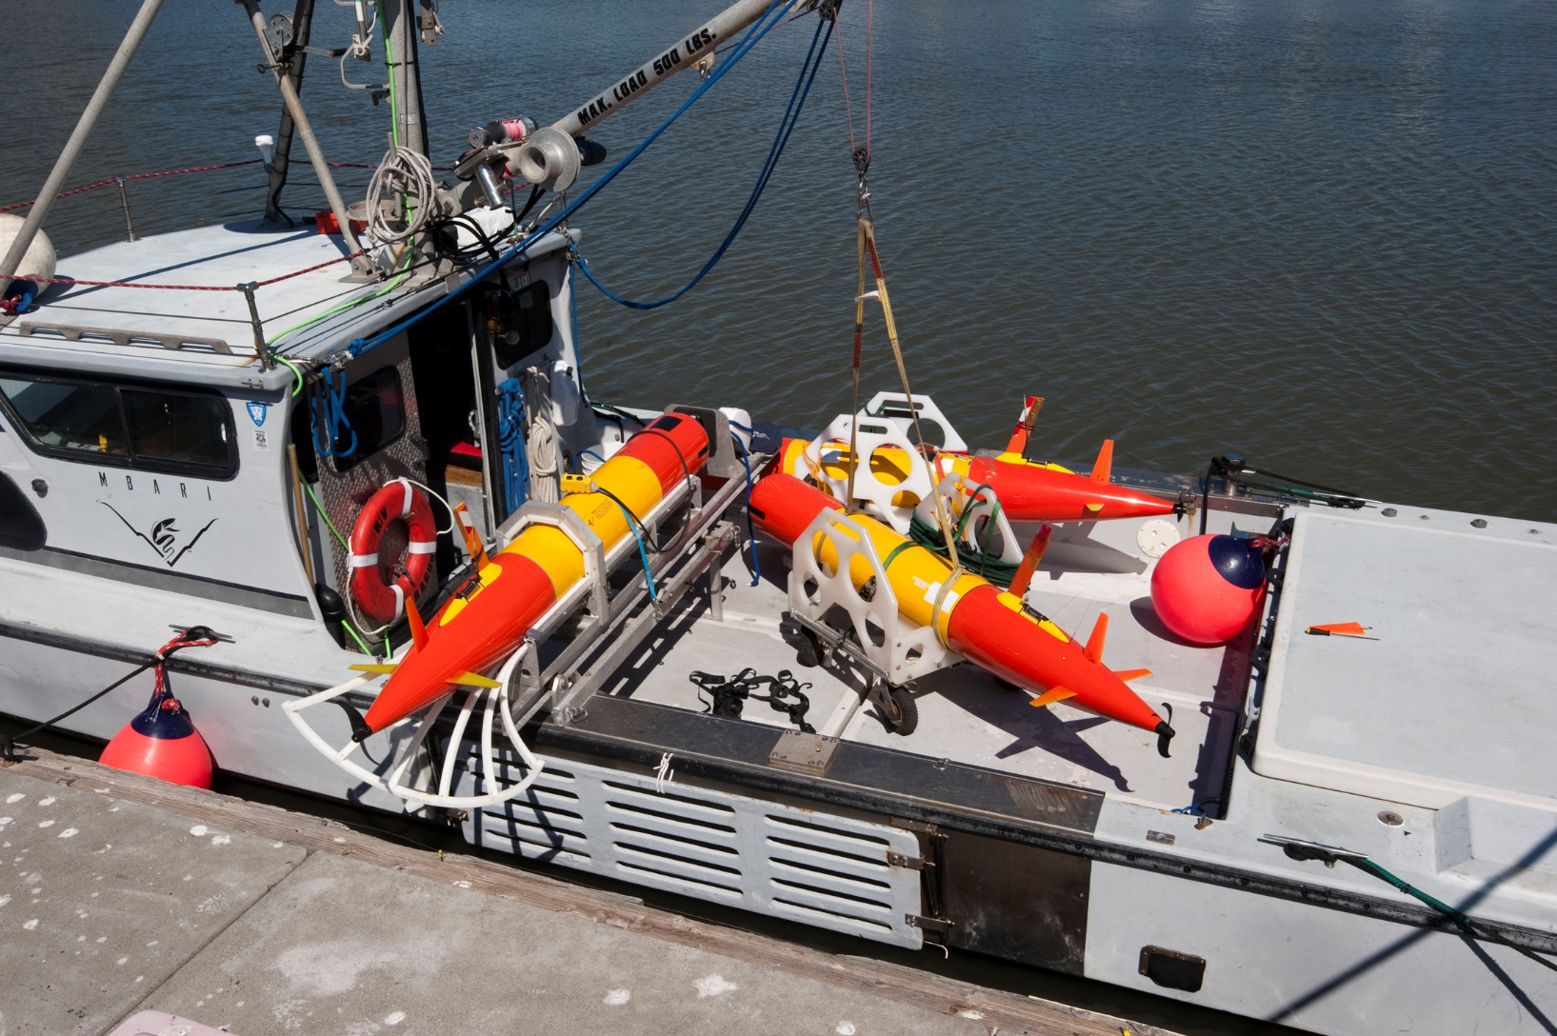
MBARI’s Tethys Long Range AUV
Multi-Mission Payloads
- Core science: CTD, DO, OBS/Chl, PAR
- Samplers: 3G ESP 60x 1 liter filtered/preserved, 15x 100 mL water
- Bathyphotometer + on-board processing for species detection
- EK-80 Mini Up/Down 120 kHz, 330 kHz bioacoustics echosounder (in Dev.)
- HD color camera and lights (in Dev.)
- Oil in water detection + line capture docking
Long Range/Endurance
- Mega-meter range with core science and 6 kW-hr rechargeable or 2x range with 12 kW-hr primary battery pack
- Low-power transit, switch to high power mission, then return
- Shore-based, ship-less operations from anywhere using web interface
Inter-vehicle acoustic positioning and communication for collaborative operations
Zero speed, active buoyancy for Lagrangian observation
Mature system with over 22,000 hours offshore across 12 vehicles
Collaborations and licensing with U-Hawaii and WHOI

Slide 17
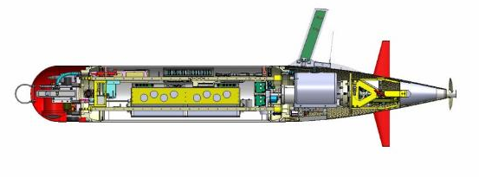
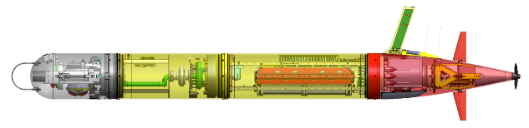
Tethys LRAUV Specifications
Iridium, GPS, WiFi and Cellular in mast
Backup argos and VHF
1 Liter buoyancy Engine allows neutral drift in water column
Core sensors: DVL/ADCP, Fluorometer/ Backscatter (WetLabs), CTD (Seabird), PAR, O2, ACOMs (Benthos DAT)
Efficient low-speed propeller
------------------
Paired Rudder and Elevator Control Surfaces
Load Control System
18 configurable channels
Isolates load, circuit breaker, ground fault detection
3G ESP Sampler Module
6 kWh rechargeable,
11 kWh expendable
Shifting Mass allows controlled angle of attack during flight
Short Nose
With 3G ESP Nose
Mass: 110 kg ( 240lb) dry weight 160 kg (354 lbs)
Size: 0.3m (12”) diameter, 2.47m long 3.18 m long
Speed: 0.5 – 1.2 m/s plus hover 0.5 – 1.0 m/s plus hover
6 kW-hr energy, 17.6 W/hr, ~ 6 kW-hr energy, ~24W/h 1 m/s, ~3 km/hr, ~15 days, 1000 km ~2.5km/ hr ~11 days, 670 km

Slide 18
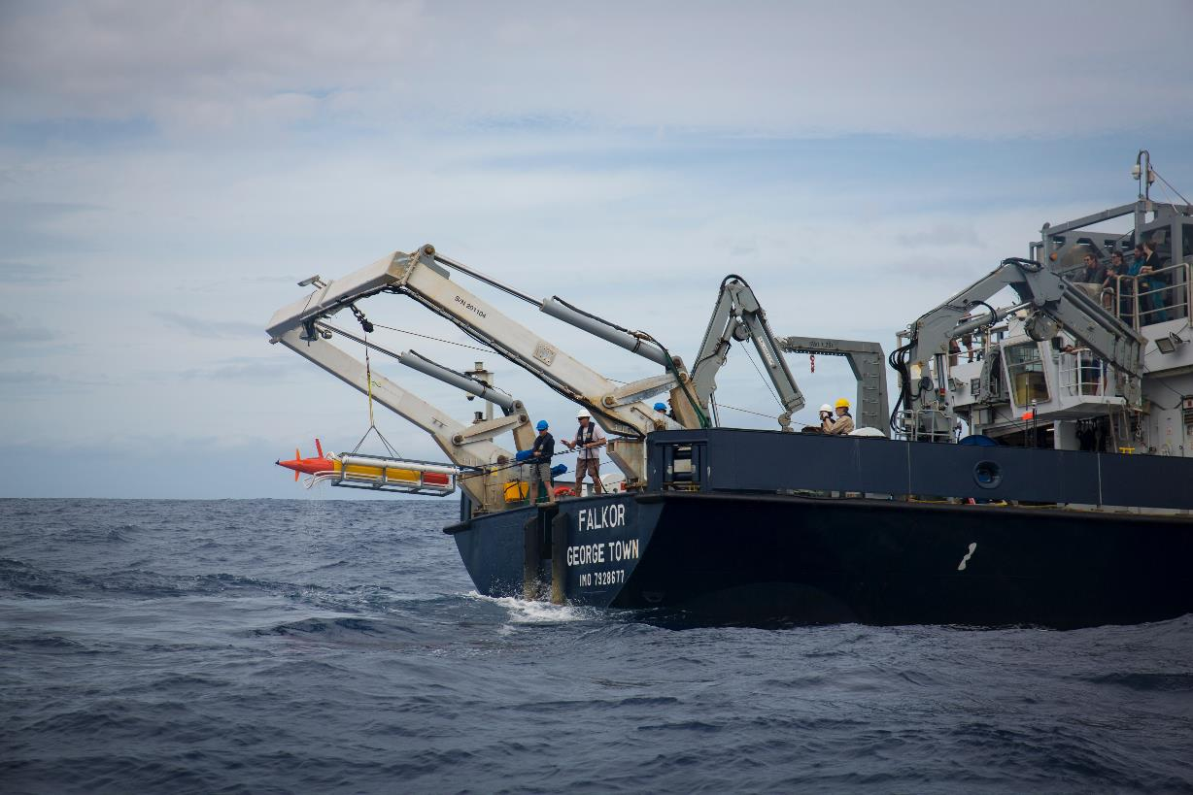
Image Credit Thom Hoffman, SIO

