Slide 1
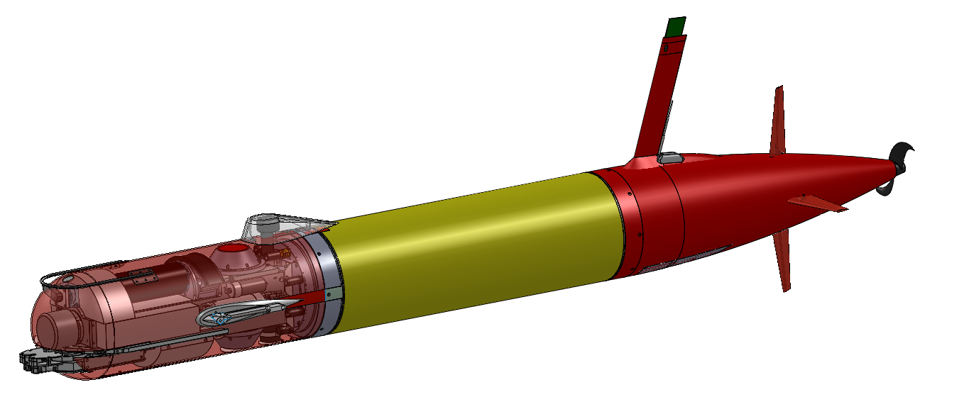
LRAUV Under-Ice Configuration
Up/Down DVL and ADCP
Upward-Looking Multibeam Sonar
Acoustic Homing Sensor
Long-Range Acoustic Communication Transducer
Long Range AUV: 300m Depth, 0-1.2 m/s Speed, 1000 km Range, Variable Buoyancy, Web-Based Over the Horizon Command and Control
Science Sensors: CTD, DO, Chl, OBS, PAR
Line-Capture Docking Device

