Slide 1
Goals/Requirements
Sampler system that can filter >1000 Liters of seawater across a 100 micron filter in less than 20 minutes.
Minimum contamination…
  Minimum Detectable Limit = 8 particles/1000L
ROV Independent. Operable from the Paragon or similar sized vessel.
800m depth rating.
One sample per cast, perhaps expandable to more.
Multiple samples per trip.
Measured sample volume and depth to 1% accuracy.

Slide 2
Contamination
Minimizing contamination of the samples is a very important requirement, but hard to quantify.
Sources of contamination:
  Bits of the sampler shedding into the filter, directly or recirculated out the exhaust.
  Contaminants adhering to the sampler and subsequently shedding onto the filter. i.e. Dock, ship or storage contamination.
  Pre and Post cast contamination of the filter during handling.

Slide 3
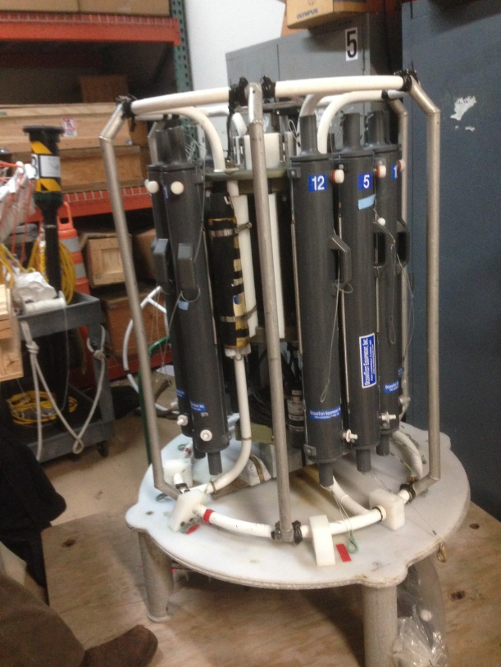
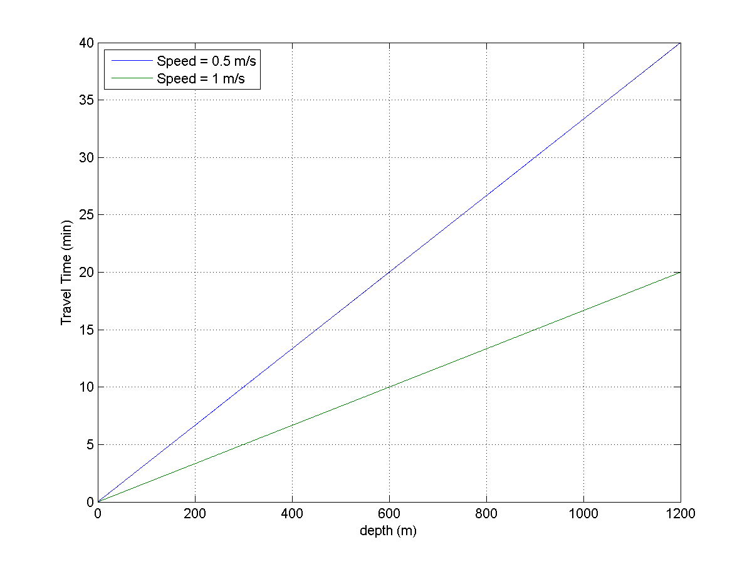
Approach
Develop a battery operated system with replaceable sample cartridges and battery packs as needed.
Approximate size/weight of existing paragon CTD Rosettes
Control/Monitoring over CTD wire conductors
Battery powered, swappable packs for multiple samples. Would need to charge on paragon, details TBD
Swappable sealed filter components
As cleanable as possible, details TBD.
~40” Tall
32” Diameter ->

Slide 4
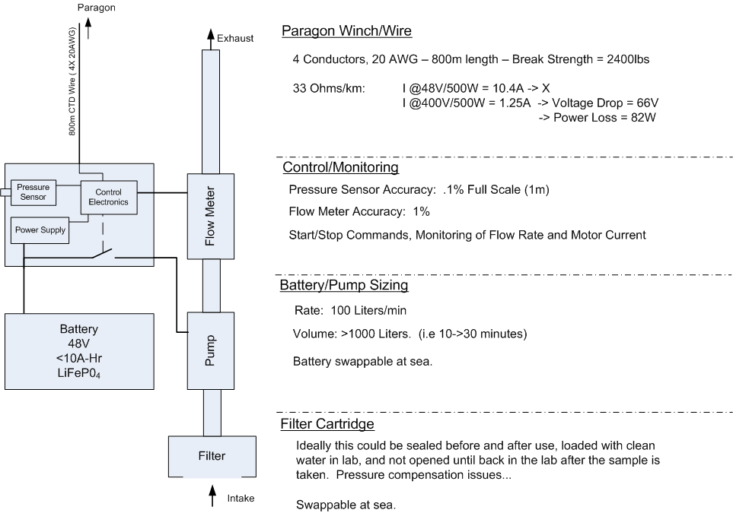
Block Diagram

Slide 5
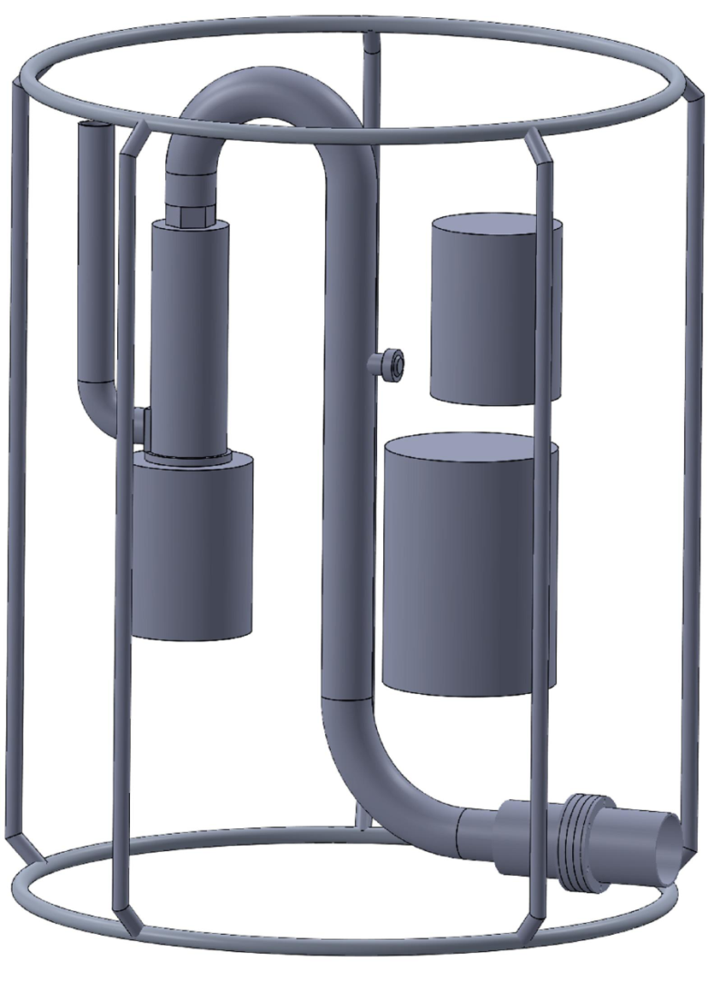
Motor/Pump
Flow Sensor
Controller
Batteries
Filter
Single Sampler Version

Slide 6
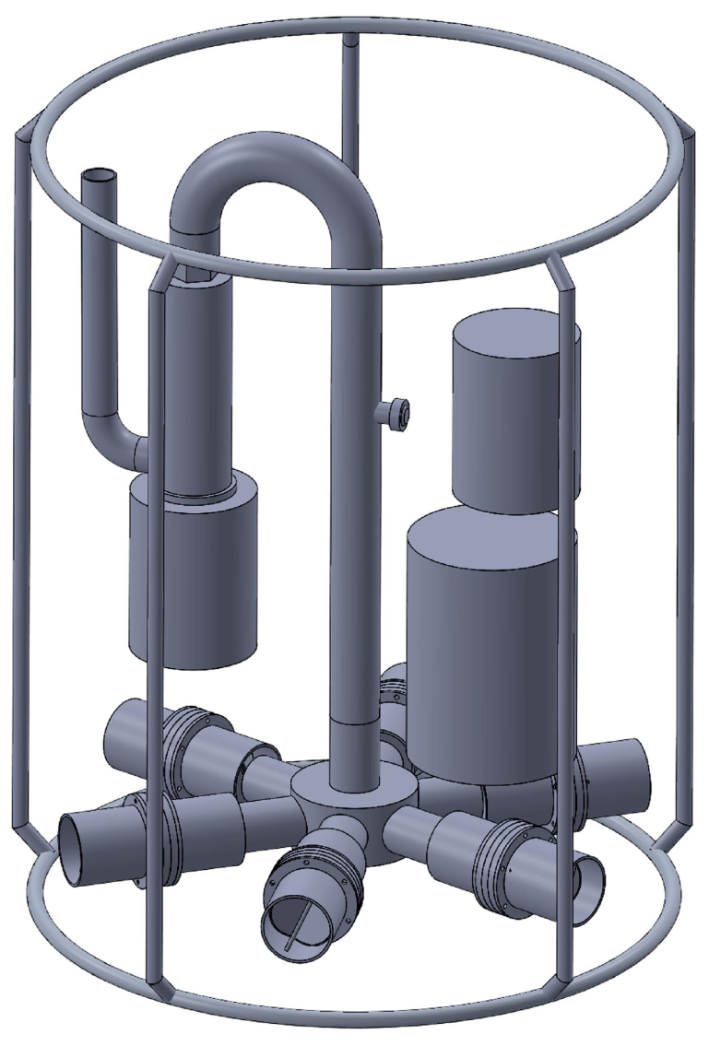
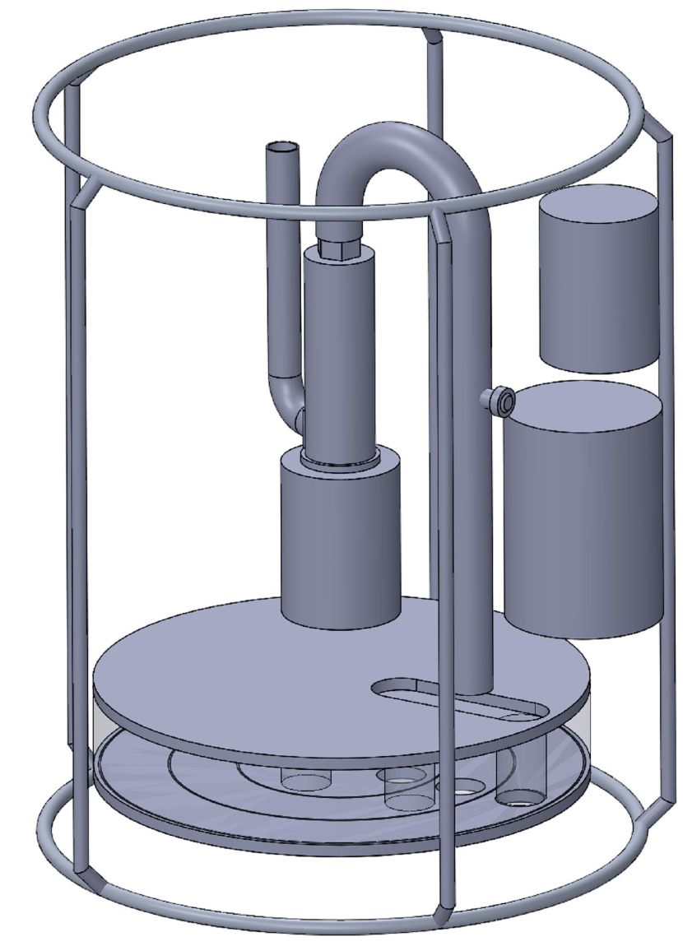
Motor/Pump
Flow Sensor
Controller
Batteries
Filter
Manifold
Multiple Sampler Version
Multiple Sampler Carousel

Slide 7
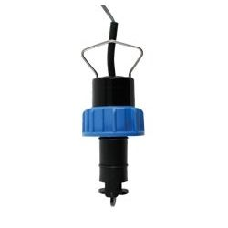
Flow Sensor
Signet paddlewheel sensor was modified for use at depth and tested in March ROV dives.
Digital interface that was integrated to dsPic board during March ROV dives.
~1% Accuracy
Flow-rate range in 2” Pipe:
      17.633 Pulses/Liter
    15->1000 Liters/Min
Requires 15 ID’s (30”) of straight pipe upstream, and 5 ID’s (10”) downstream.

Slide 8
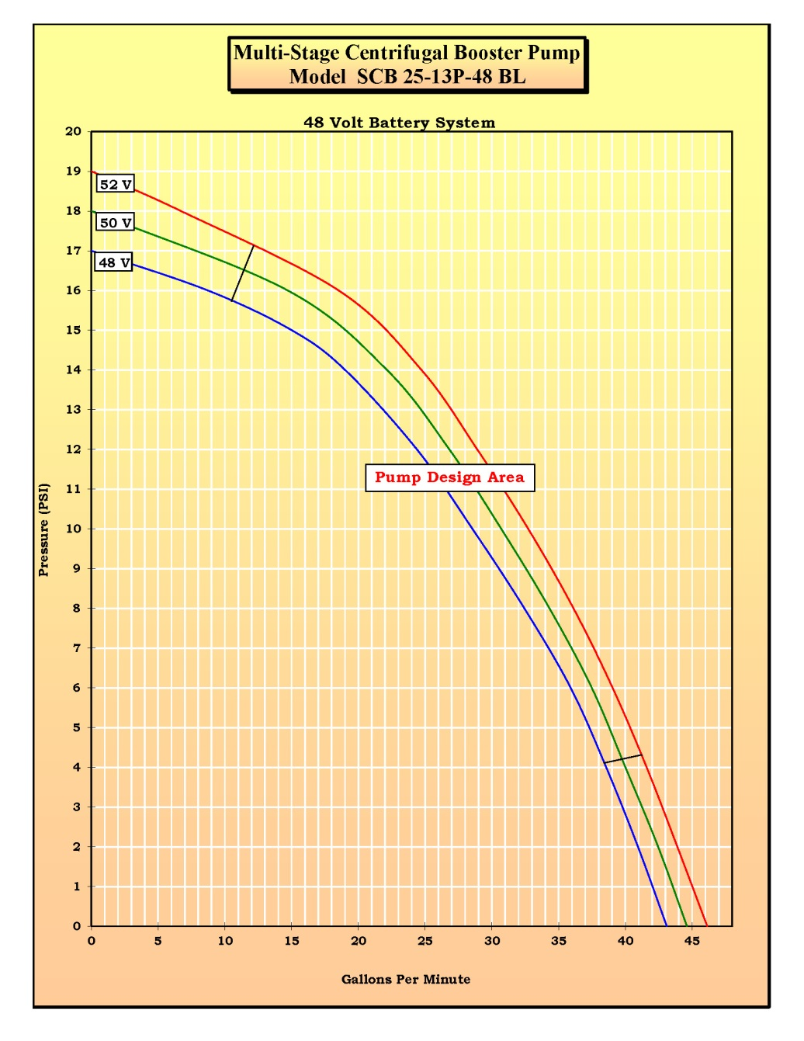
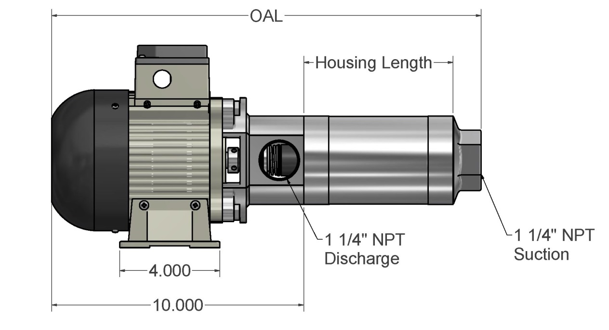
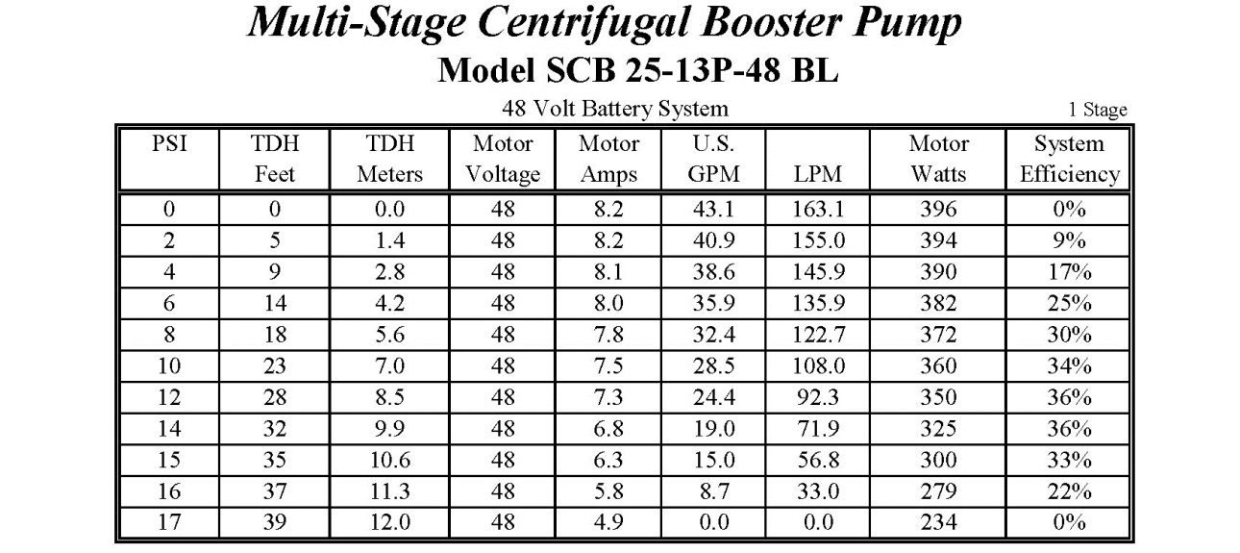
Pump

Slide 9
Energy Requirements
Pressure Drop
Main contributors are the filter, and any check-valves or other restrictions in flow path. 2” Piping over a few feet is negligible.
Testing required.
Electrical Power Requirements (example)
100 LPM @ 10psi draws ~360W
2000L/100LPM = 20 minutes = .33Hrs
Energy Requirement = 120W-Hrs = 2.5A-Hrs @ 48V

Slide 10
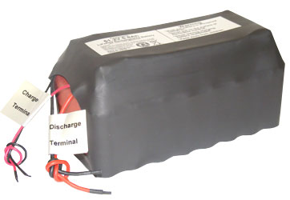
Batteries
Requirements
- 200 W-Hrs + Margin
- Light enough in housing to be managed and swapped
aboard Paragon
- Safely rechargeable on board the Paragon within the cast time.
LiFePO4 Examples
- 51V, 6.6AHr -> 7.6lbs - 330W-Hr (x3)
8.5”X4.2”X4.2” (~11”Long by 6” ID Housing, ~18lbs)
Total Weight = ~26 lbs
- 51V, 13.2AHr -> 15.3lbs - 660W-Hr (x5)
10.5”X6.0”X5.5” (~14”Long by 8.25” ID Housing, ~36lbs)
  Total Weight = ~51 lbs

Slide 11
Control Electronics
Re-use dsPic board design from wave-energy system.
RS-485 or CAN for communications
Laptop based user interface on Paragon
User Actions
  Pump on/off
  Sample selection (if needed)
Real-Time Feedback
  Pressure (depth)
  Flow Rate and Flow Total
  Pump Motor Current

Slide 12
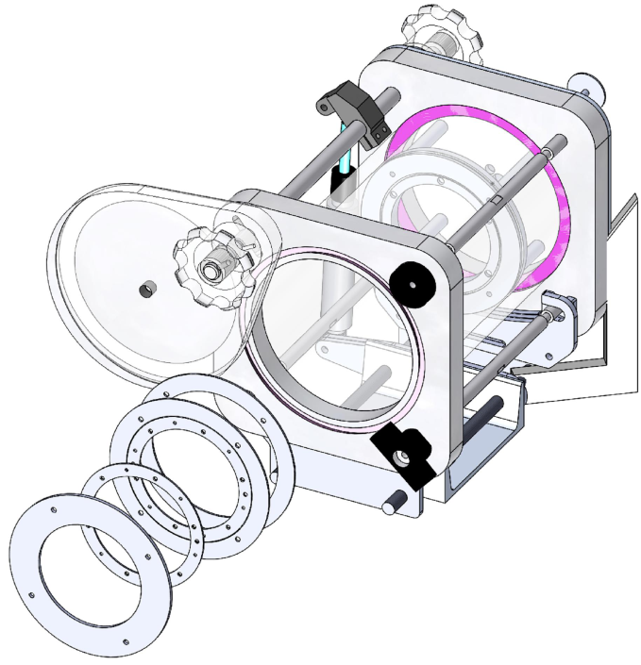
Filter Housing – Design TBD
Requirements
100 micron filter, 3” diameter. Size Fractionation desireable
Sealed before and after use to minimize contamination
Pressure compensated so there is no water exchange during cast, or at worst, inflow behind filter.
Minimum inflow restriction
Multiple instances, exchangeable on board the Paragon between casts
Imaging requirements?

Slide 13
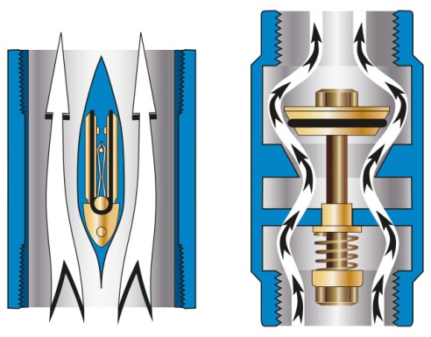
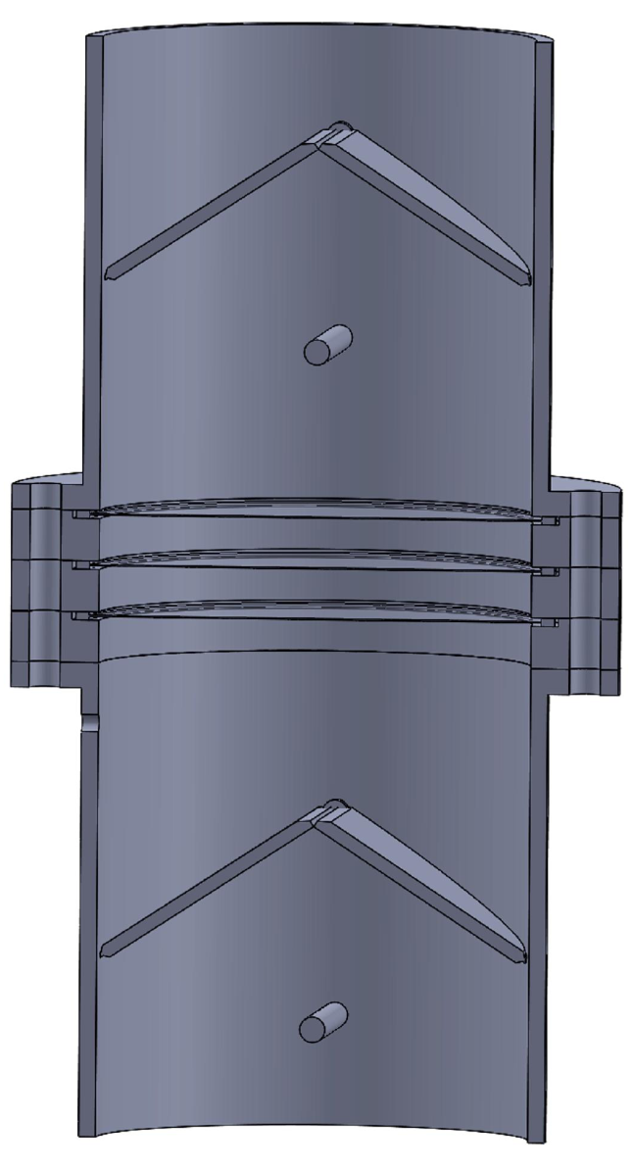
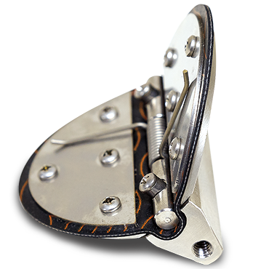
Filter Housing – Concept Design

Slide 14
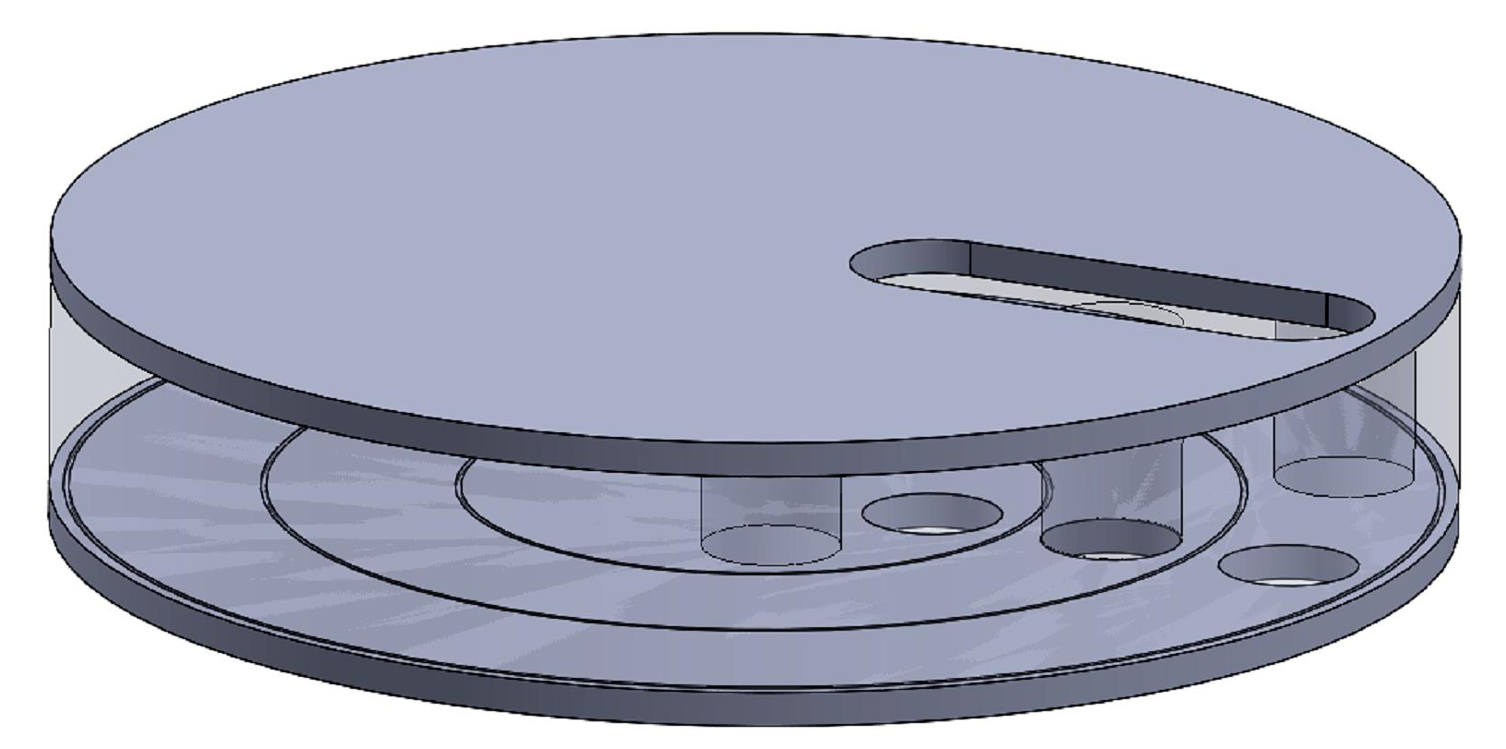
Filter Housing – Concept

Slide 15
2017 Activities
Outline plan in 2018 Proposal
Prototype Sampler and Test on ROV dive
Measure Pressure Drop versus Flow Rate for prototype sampler
Obtain Pump and test

