Slide 1
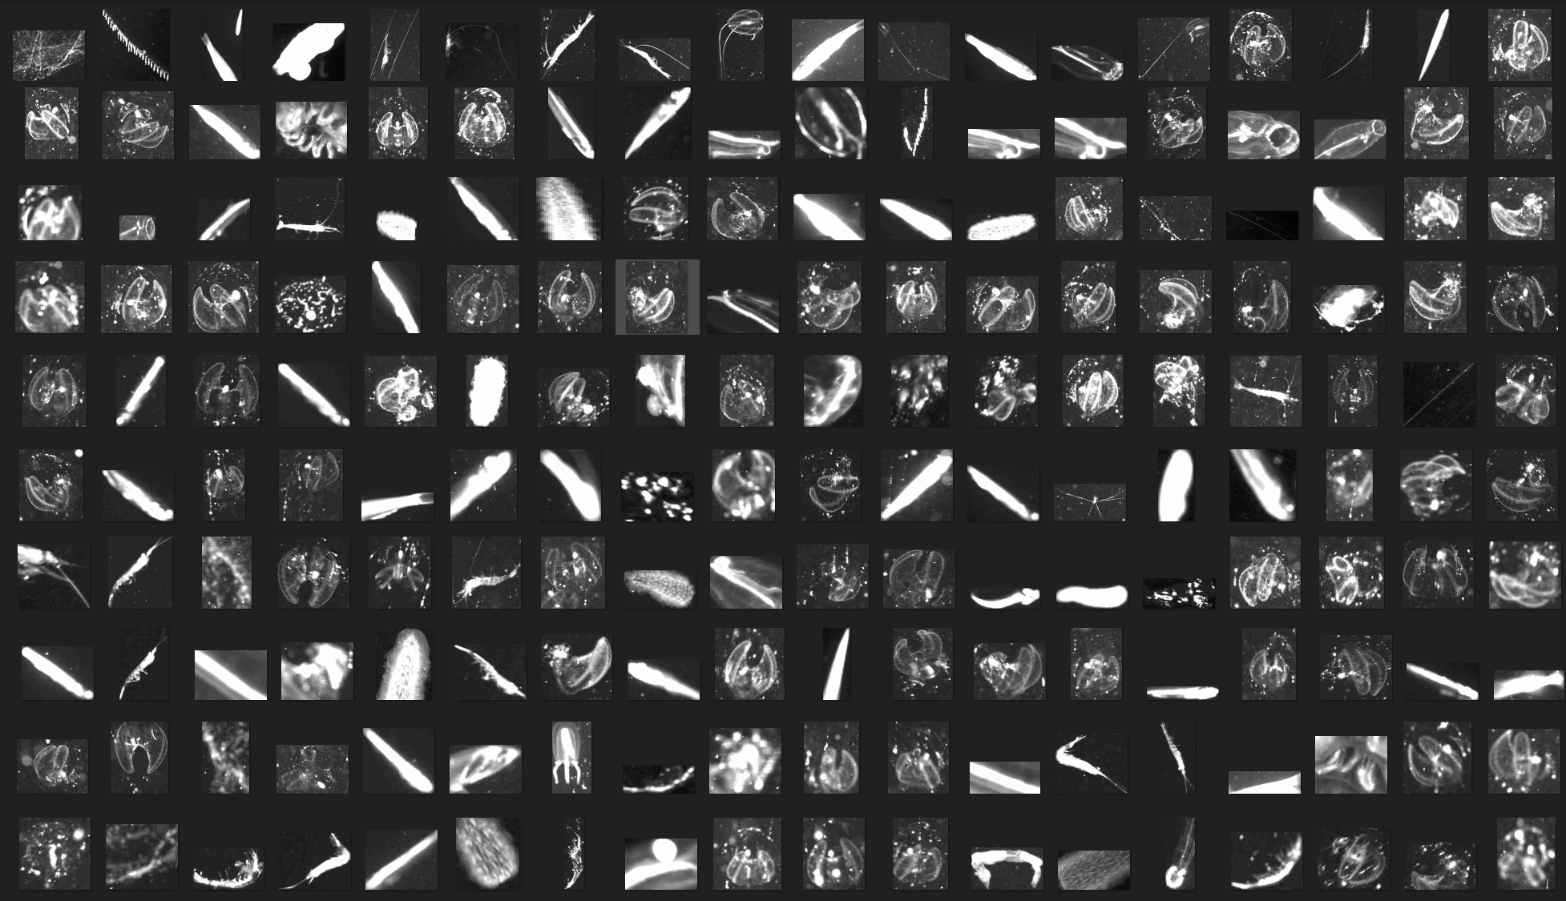



A high resolution camera array with integrated edge computing for three-dimensional, sub-millimeter-resolution imaging and real-time processing on autonomous vehicles
Paul Roberts*, Eric Orenstein, Kevin Barnard, Jon Erickson, Denis Klimov, Rich Henthorn, Ben Raanan, Brian Kieft, Brett Hobson, Erik Trauschke, Joost Daniels, Alana Sherman, Henry Ruhl, Kakani Katija
Grant #: 7583
Notes:
Shorten title: EyeRIS Remote Imaging System – Enabling 3D in situ
Moore foundation grant number
Thanks to Adam Jones

Slide 2
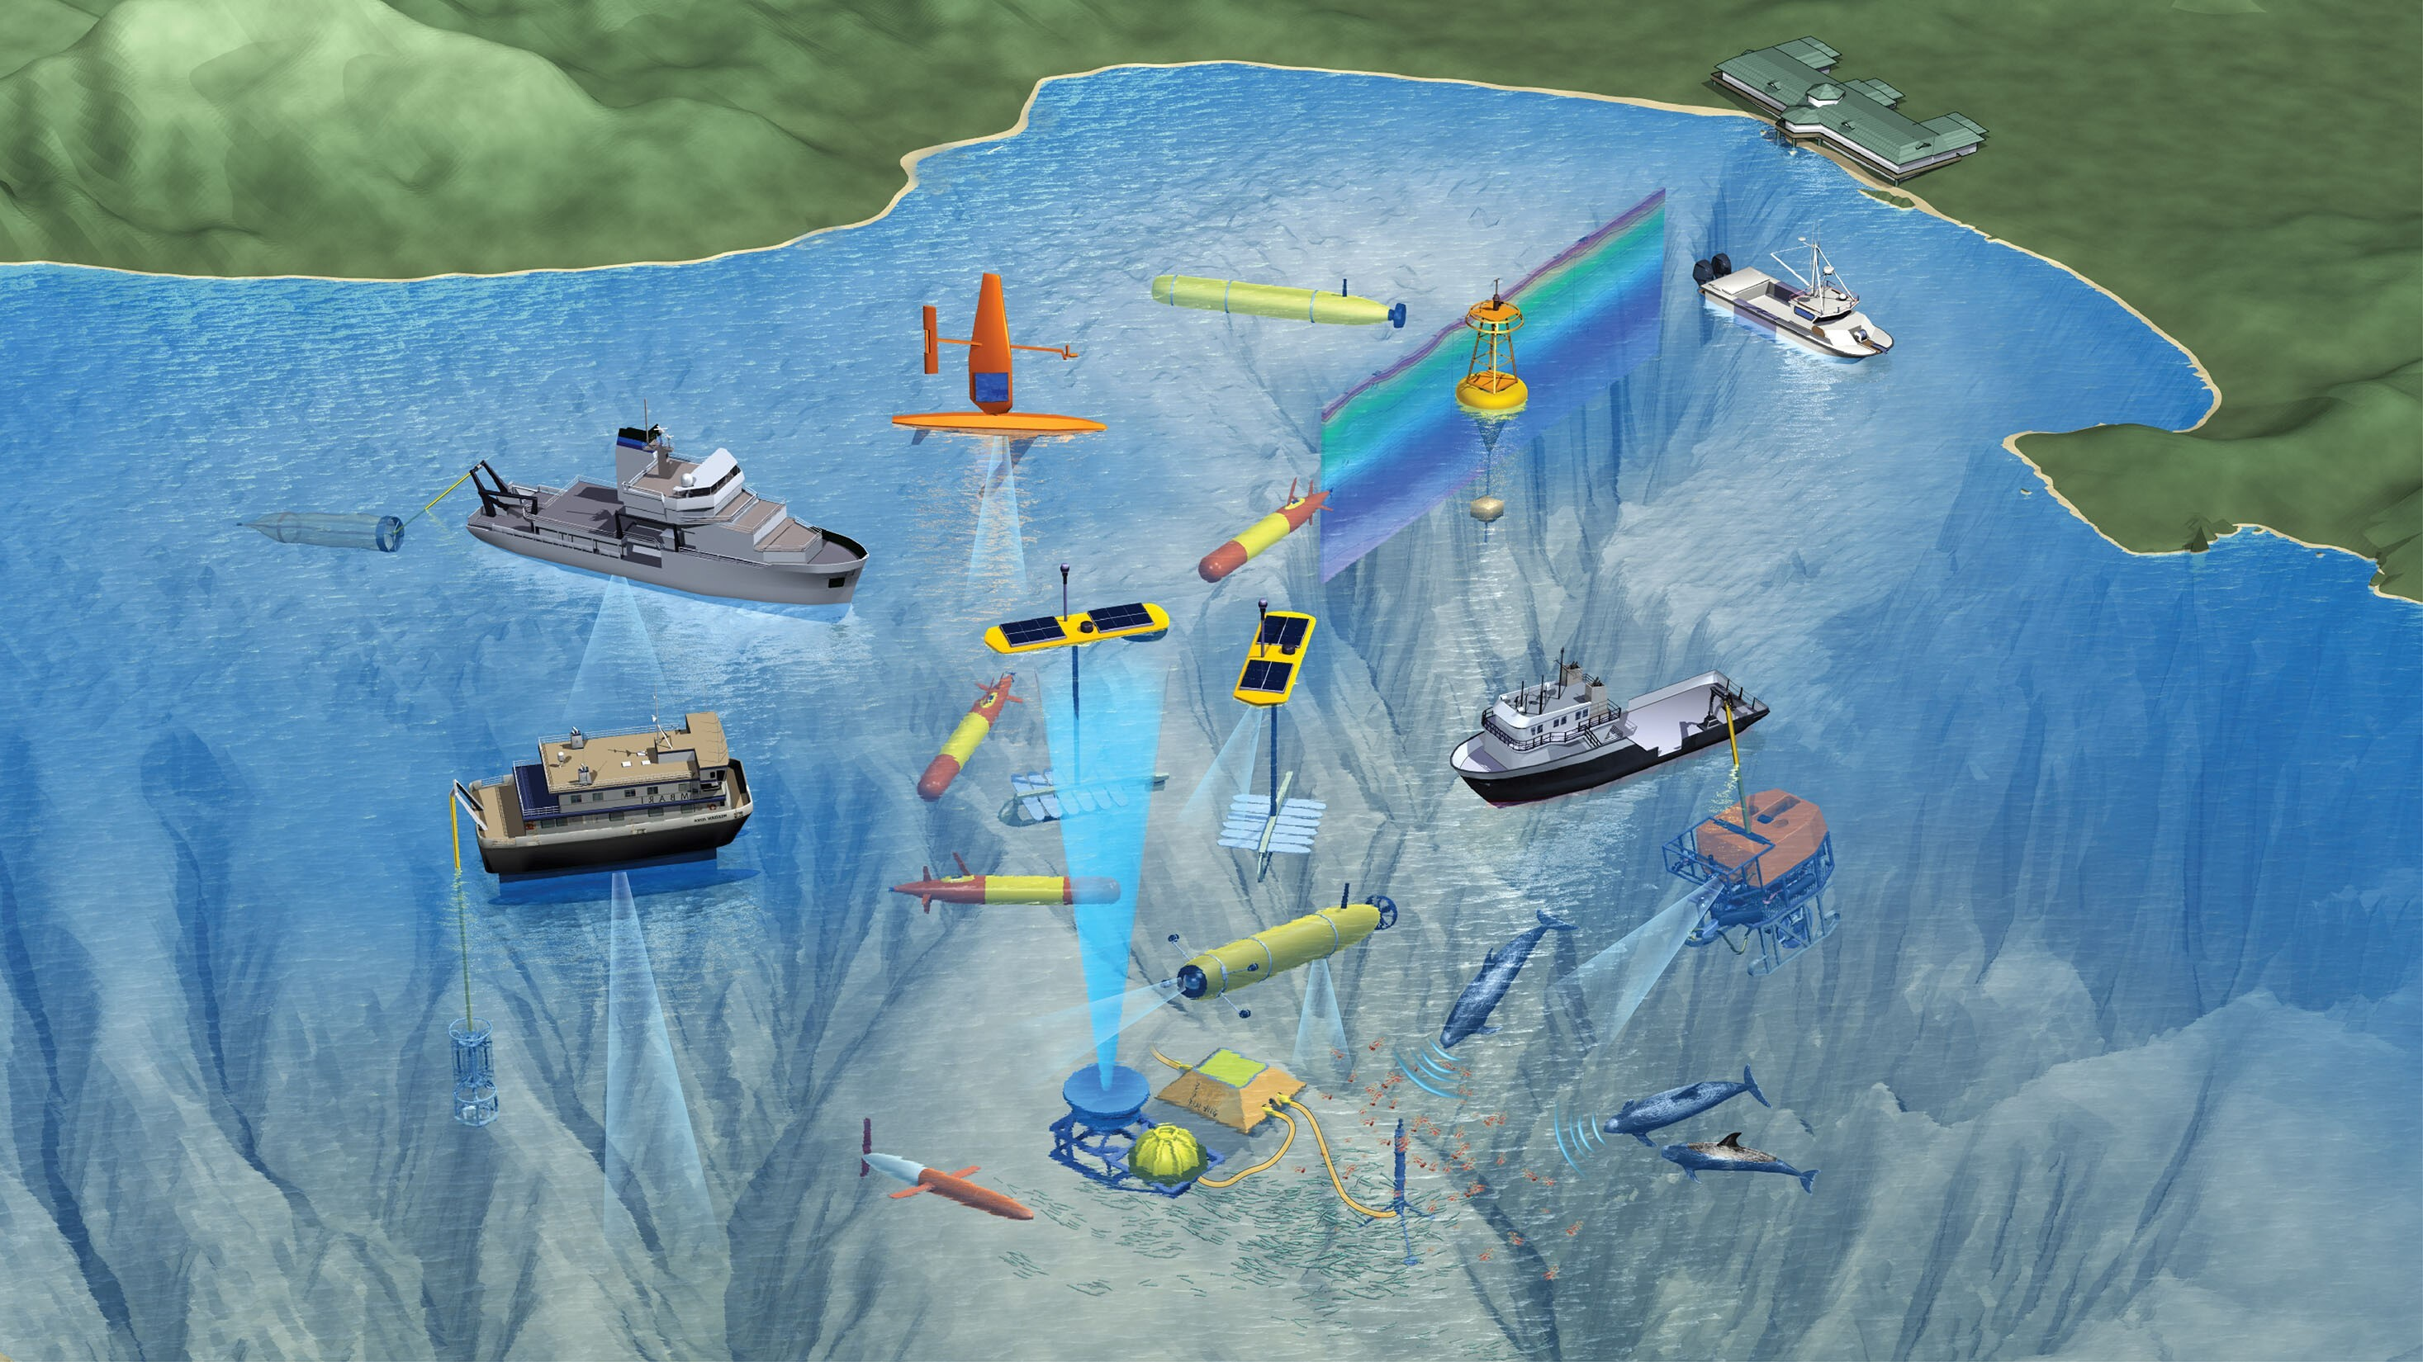
Monitoring a
Changing Ecosystem
Illustration: David Fierstein © MBARI 2019
Notes:
Motivate this work by considering the tools and vehicles needed to monitor an ecosystem
Here’s an example from a recent field program at MBARI to study vertical migration of plankton in 2019
The main point here is that it takes an ensemble of approaches to study these processes in a synoptic way
Despite the great diversity of platforms, aside from ships, only a few can carry imaging systems
Of these approaches consider how many are now taking shape as autonomous vehicles
I've highlighted five unique kinds of vehicles here
Dorado, fast short duration
Long range AUV fast and powerful
Spray glider longer endurance
Wave Glider
Sail drone
Key challenge is to design imaging systems that can integrate with these platforms without changing there capabilities.

Slide 3
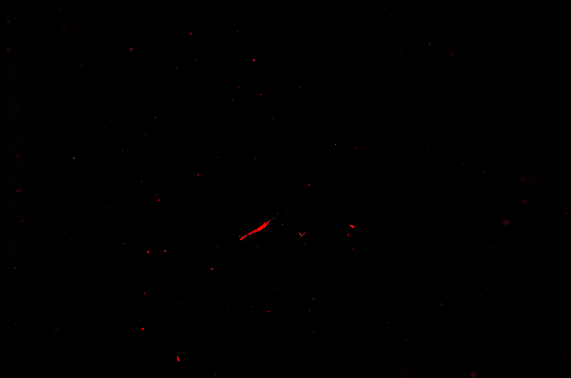
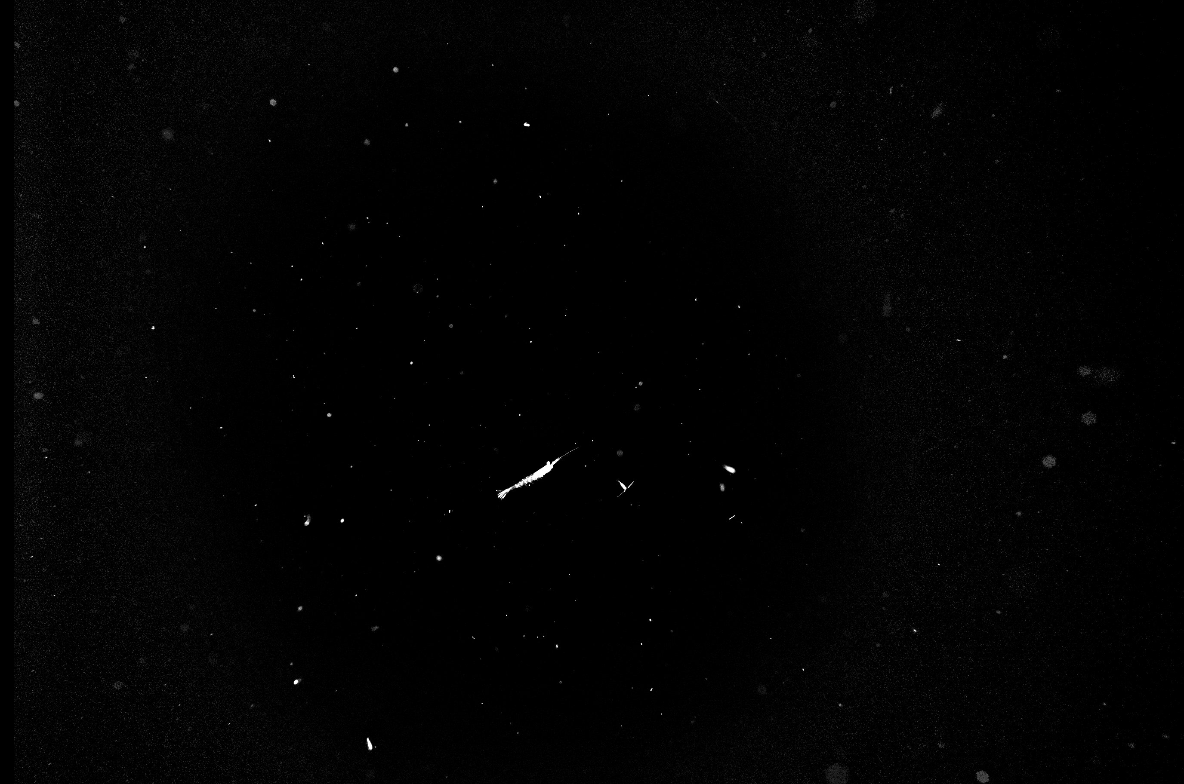
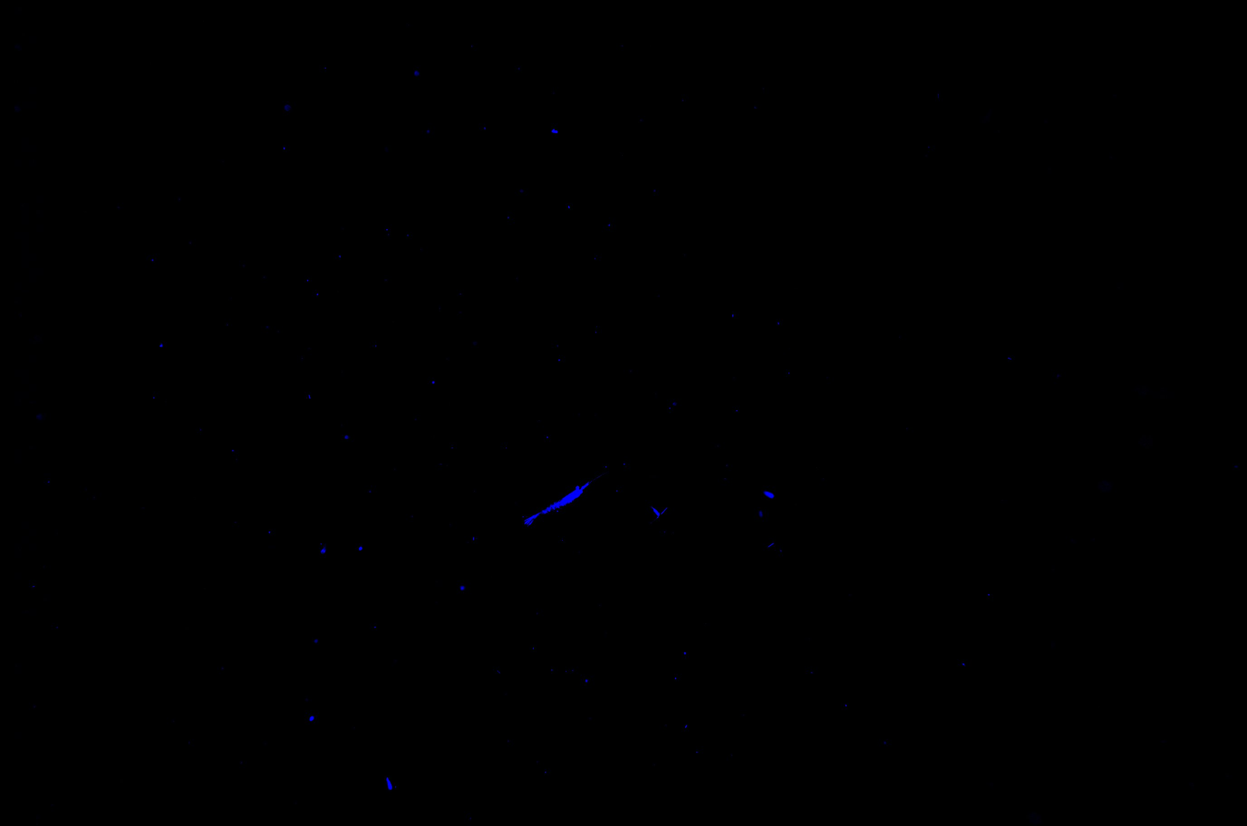
Benefits of Imaging Plankton
Who/what is there
Proximity to each other
How many
Size and orientation
Projected size
3D statistics
1 cm
Notes:
To motivate the use of imaging on autonomous vehicles, lets start with an in situ image of plankton. Without knowing anything more about the image we can say:
Who/what is there
How many of them are there
If we add scale then we can define:
Projected size
But there is a lot more to this scene, if we add 3D location and scale we can define:
Proximity to other particles / animals
True size and orientation
3D statistics
Many more things!

Slide 4
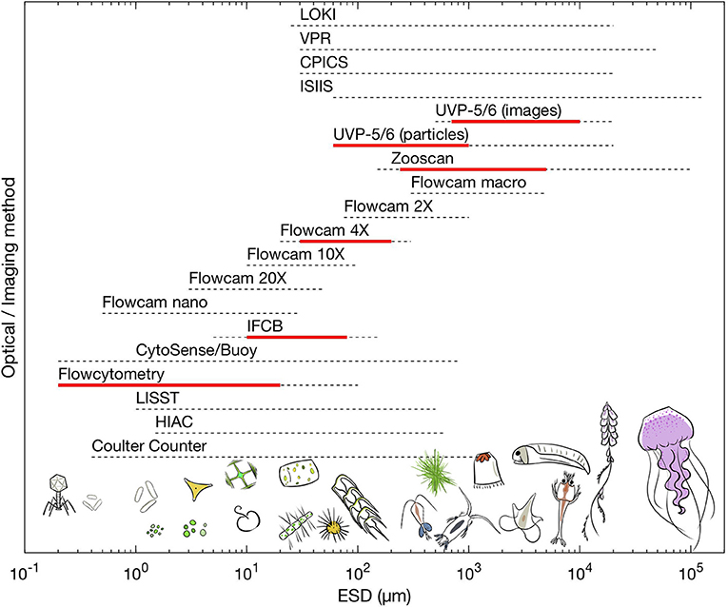
Plankton Imaging Tools
Flow cell, Free space, Telecentric, Light sheet, Holographic
In Situ
Camera array
Preserve 3D spatial relationships
Camera Arrays
Lombard et al. 2019

Slide 5
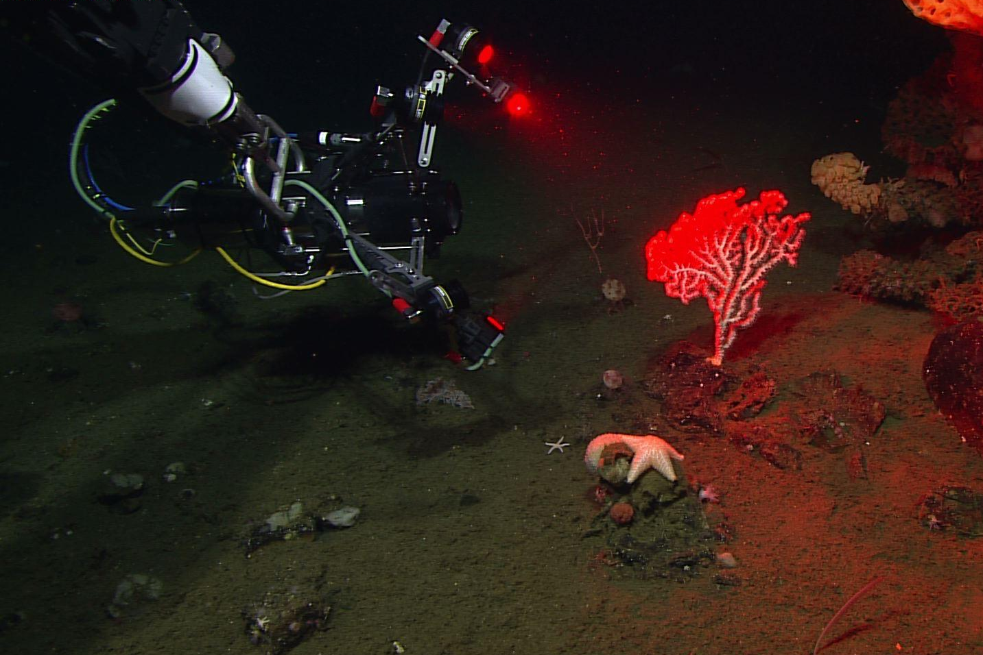
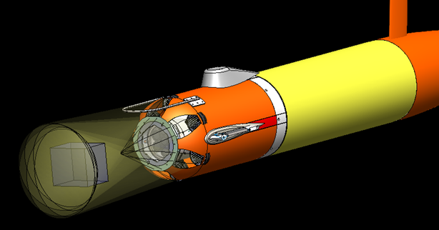
AyeRIS = Autonomous EyeRIS (Remote Imaging System)
Quantitative
Compact
Large imaged volume
Real-time
Joost Daniels: PI02 Studying flow inside and around deep-sea animals in 2D and 3D using novel imaging techniques
MBARI’s Long-Range AUV
Camera array and strobes integrated in AUV payload
~ 2 liter imaged volume with 50 um resolution

Slide 6
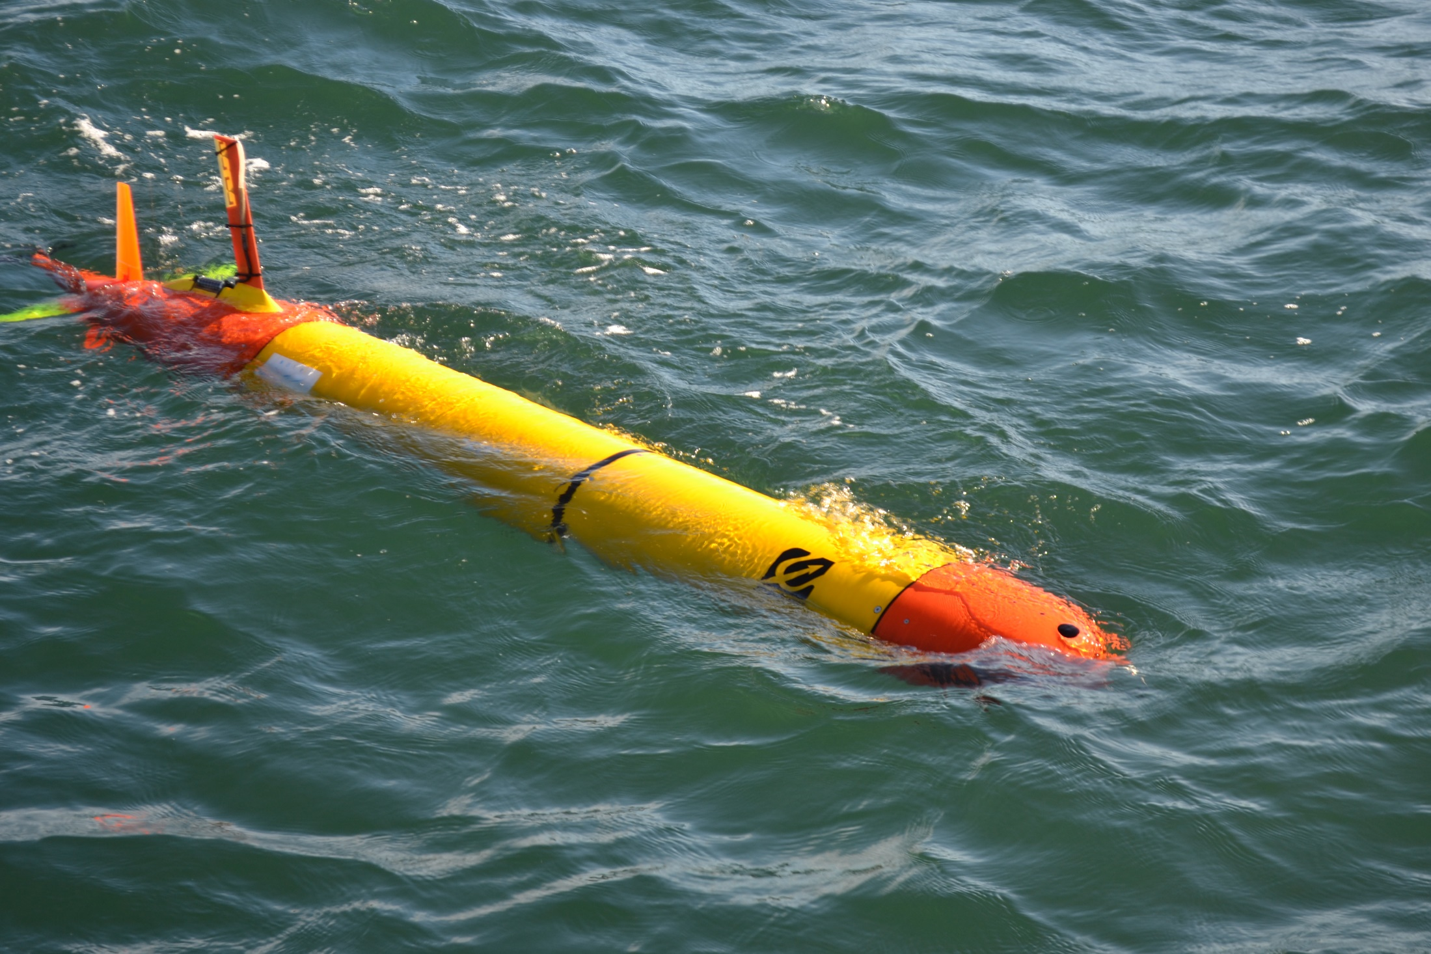
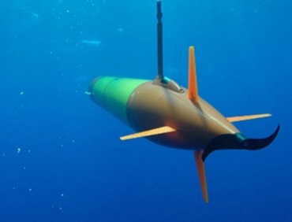
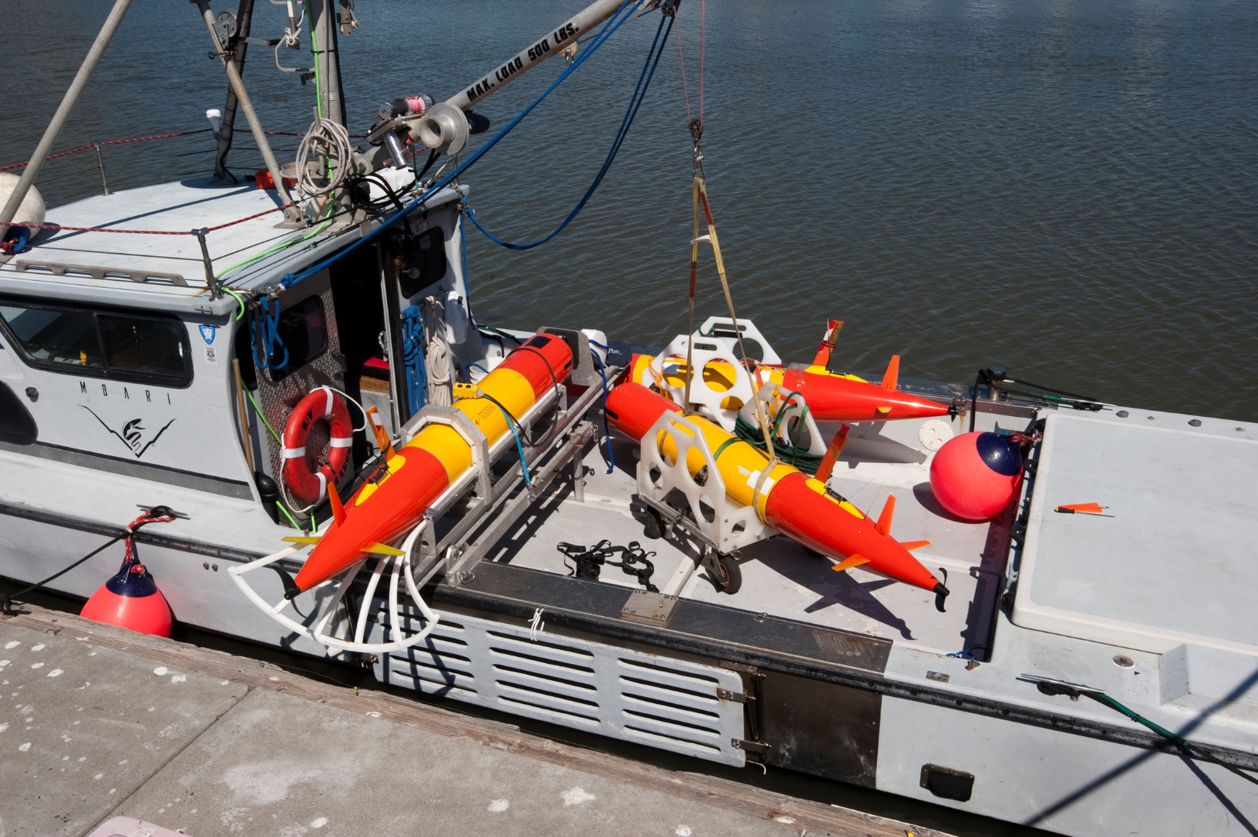
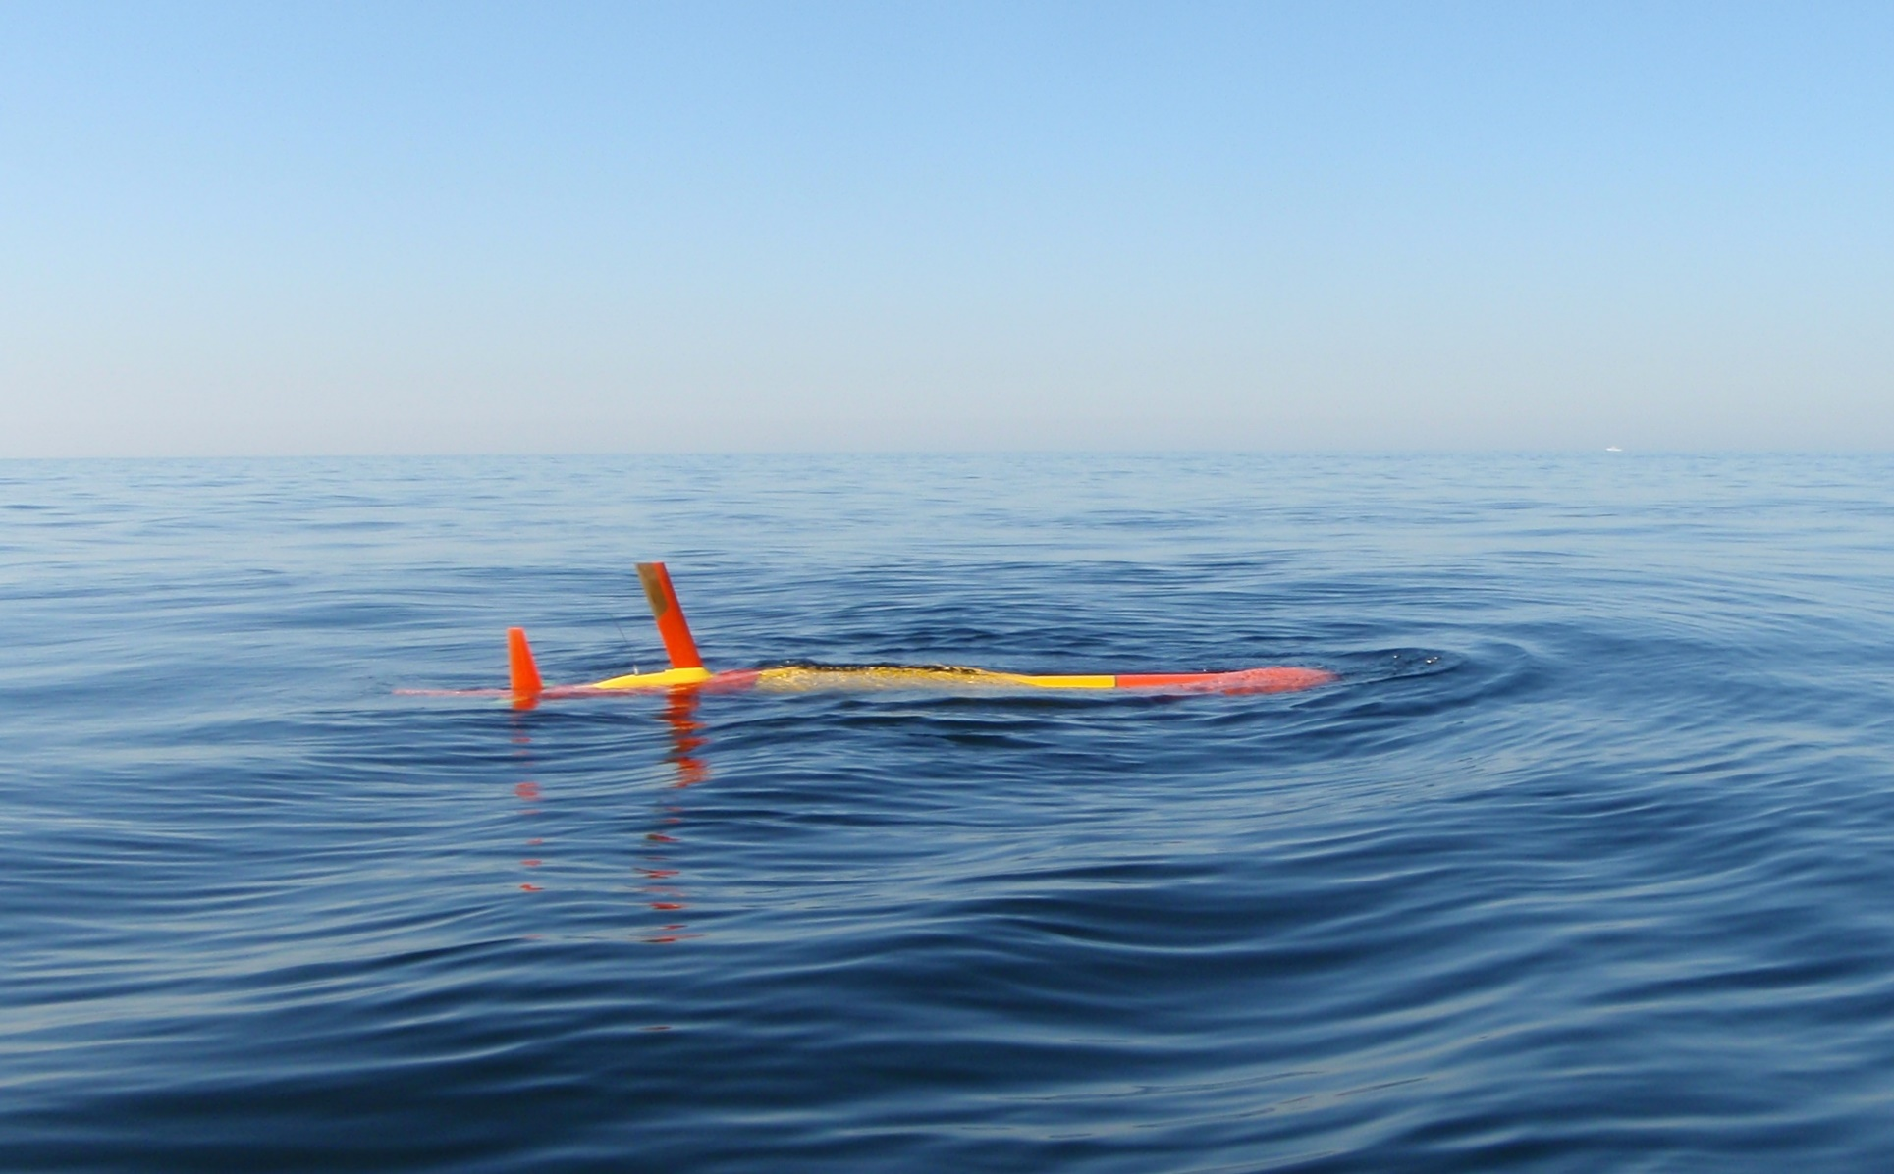
MBARI’s Tethys Long Range AUV
Mature system: 22,000 hours offshore across 12 vehicles
Long Range/Endurance (weeks)
Collaborative operations (inter-vehicle comms)
Lagrangian observation
Notes:
For this work we focused on designing a system to integrate with MBARI’s long range AUV, here’s why

Slide 7
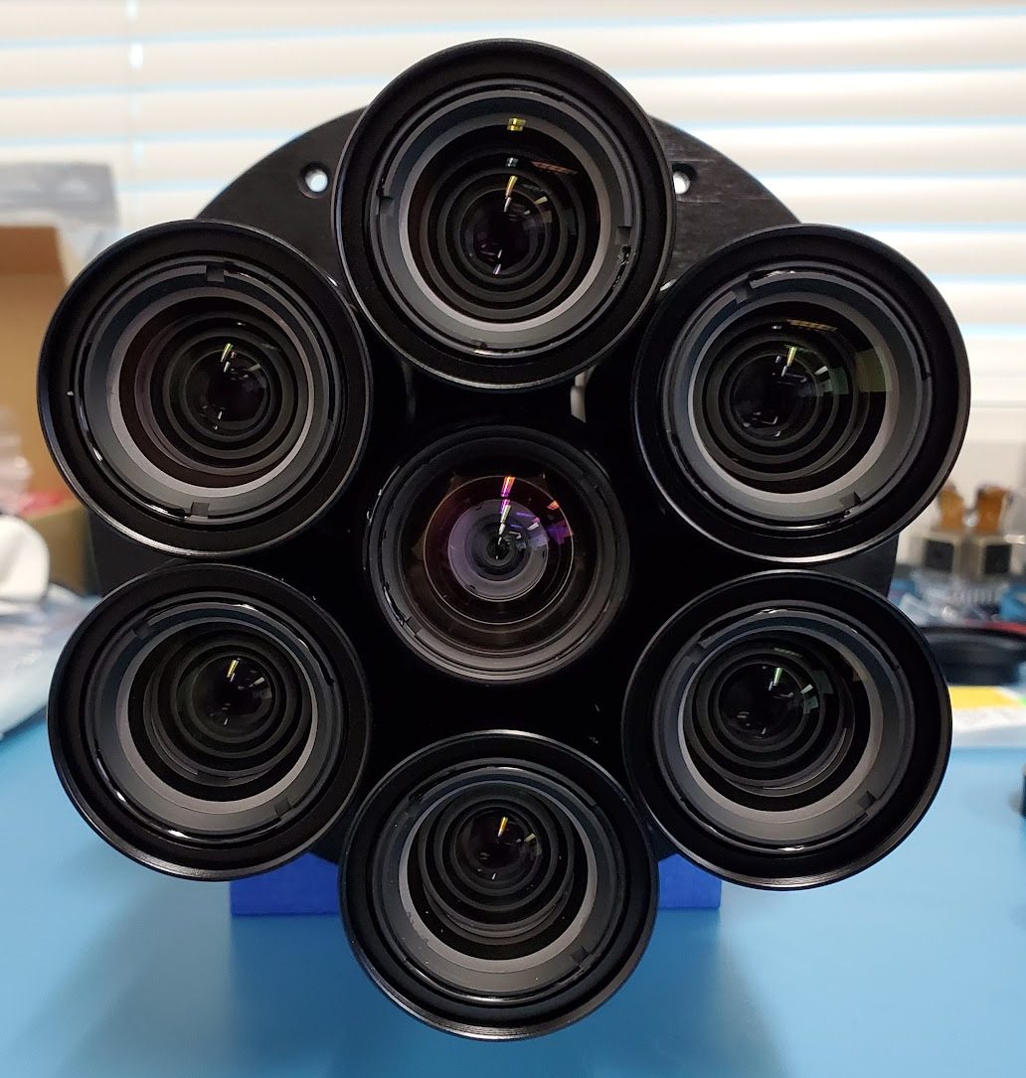
Camera Array Approach
Enable multiview image processing
Flexible
Cameras and lenses are readily available
Leverage advances in drones and self-driving-cars

Slide 8
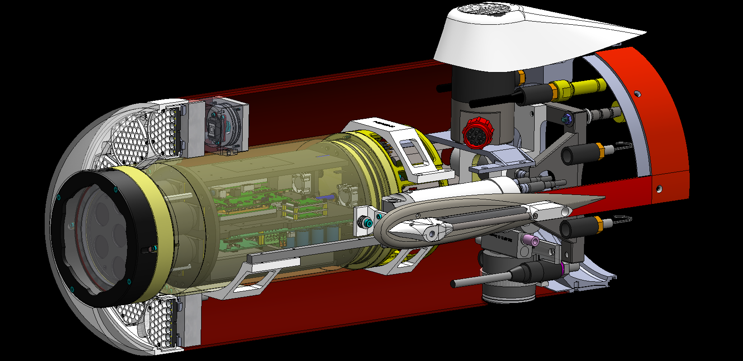
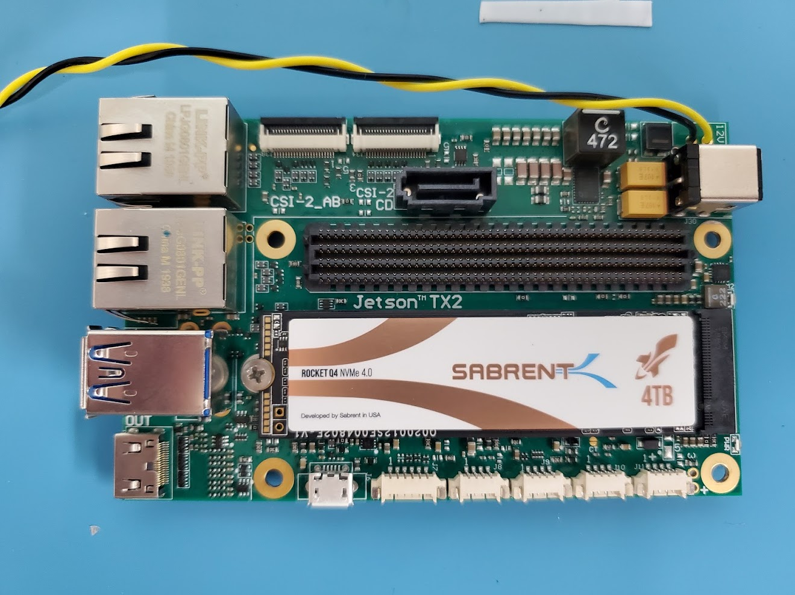
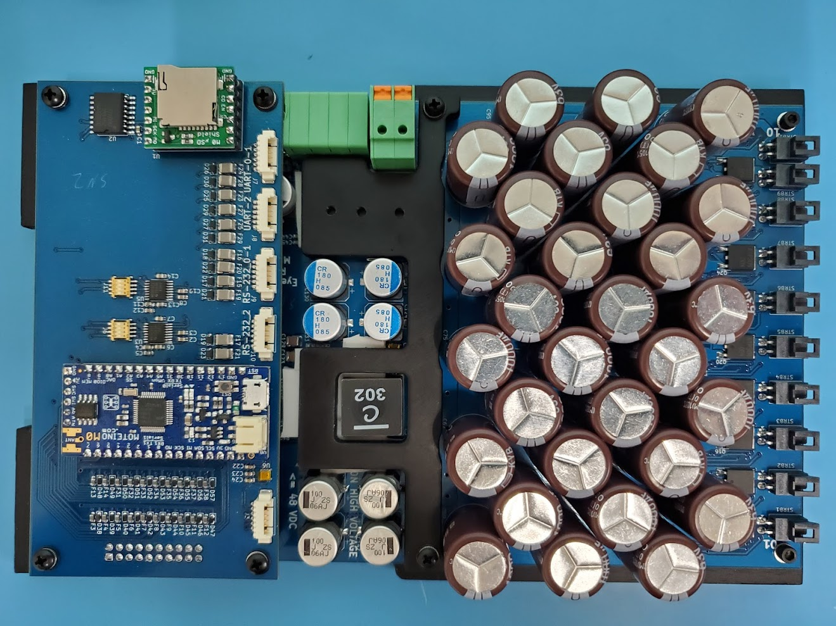
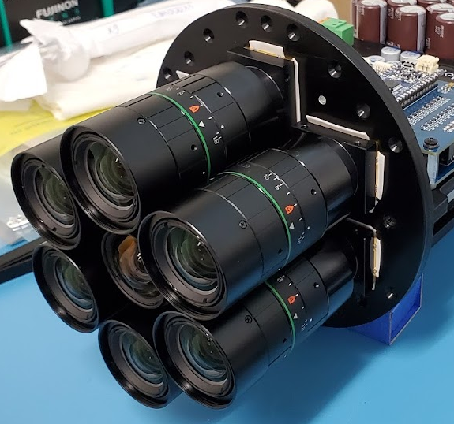
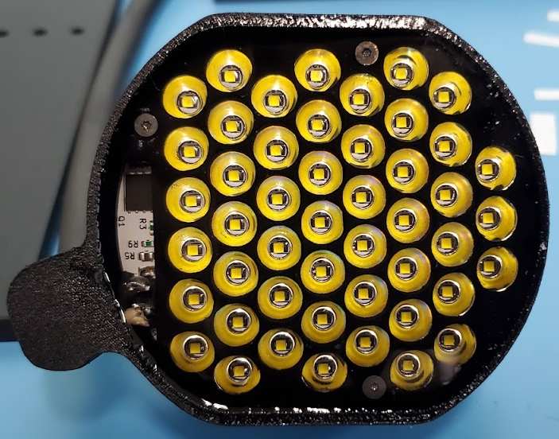
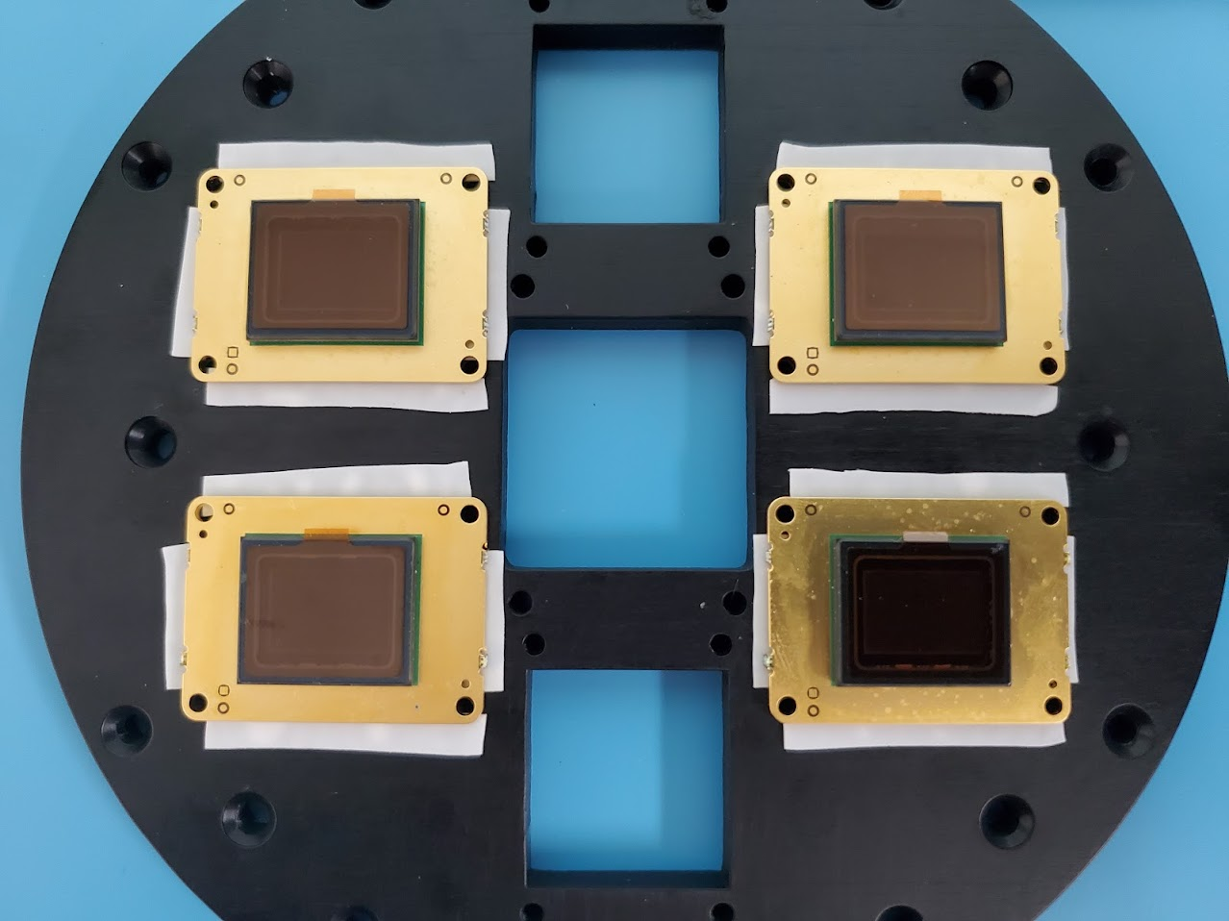
Integration on LRAUV
12 in
31 in
7x Sony IMX183
20 MP imagers
2x Nvidia Jetson TX2
Controller and strobe
ballast
Acrylic
View Port
10x 30,000 lumen
4000k LED strobes
7x Fujinon 23 MP Lenses
6x 16 mm, 1x 8 mm
2x 48 Whr Li-Ion

Slide 9
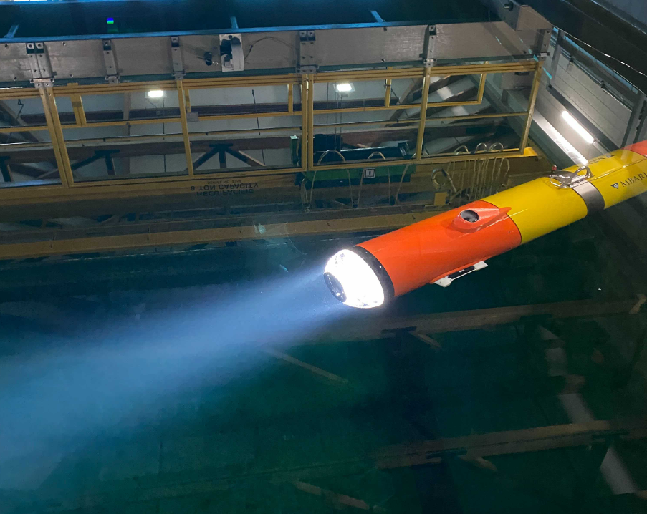
Tank Testing
Calibration
Confirm vehicle operations
Ballasting

Slide 10
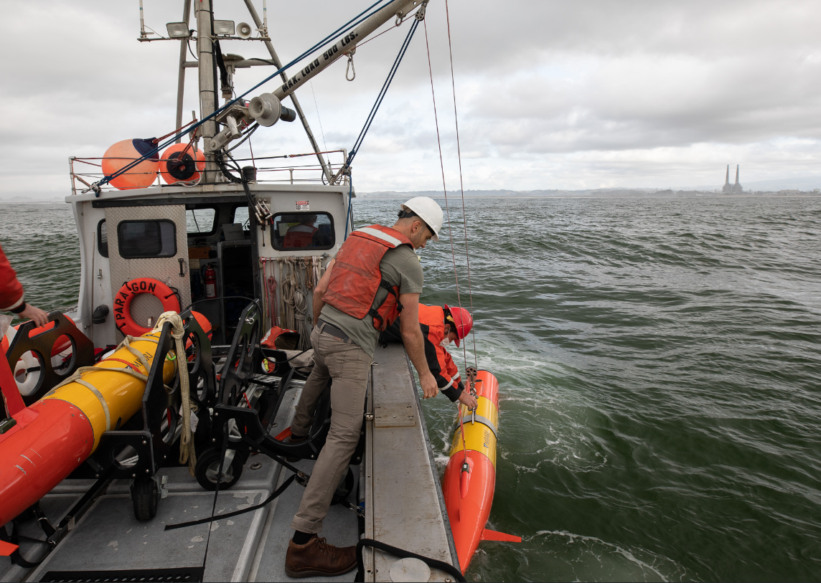
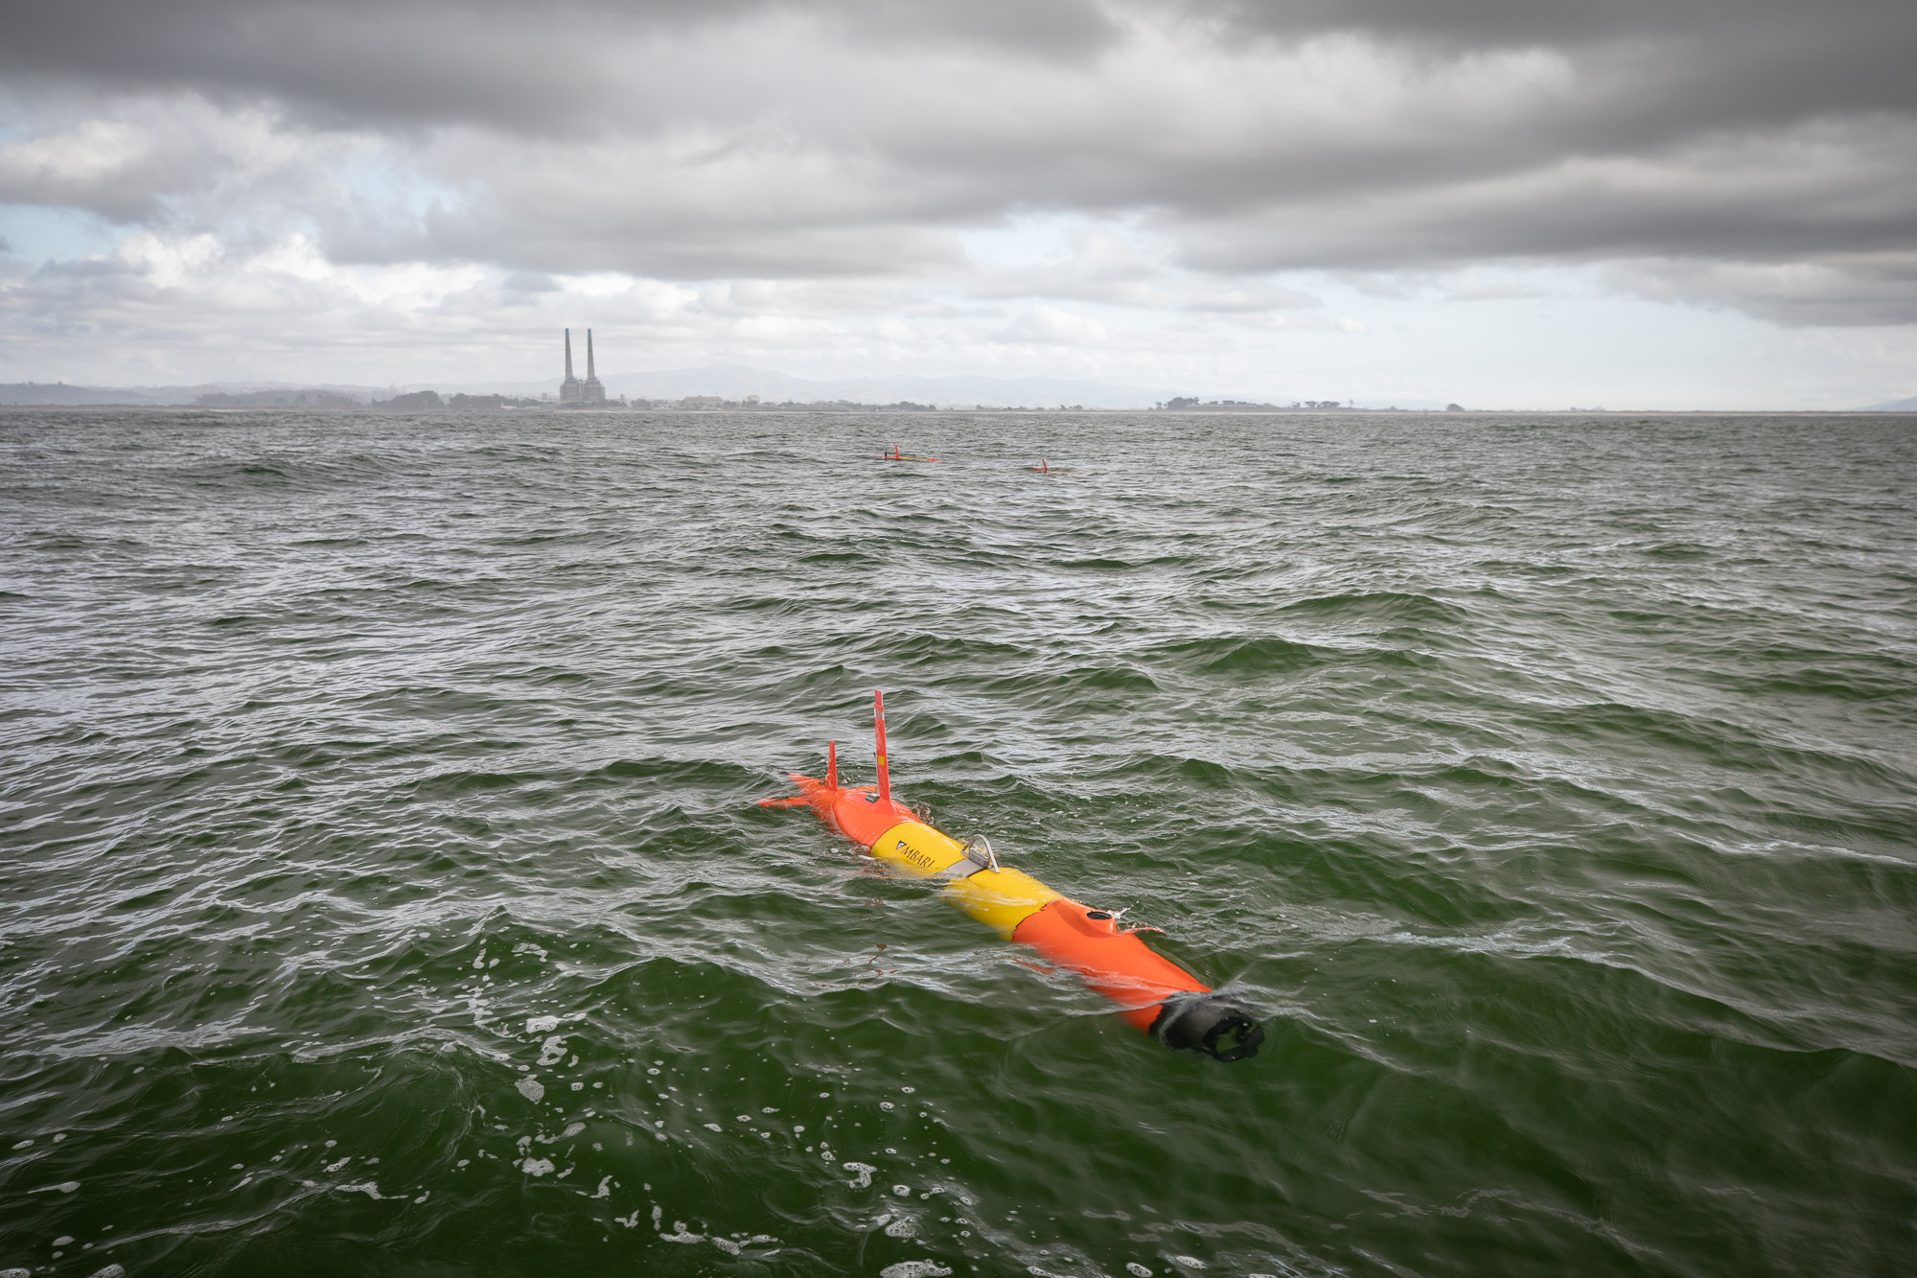
Deployment on LRAUV Galene
Over 60 hours in Monterey Bay
Vehicle behaviors
  Circular profiles
  Yoyo transect between waypoints
  Station keeping
  Drifting with the flow
Processing modes
  Local storage of up to 7 TB
  Real-time particle detection and publishing to shore
  Supervised autonomy: object detection and acoustic transmission during mission
Ivan Masmitja : OT05 A reinforcement learning approach for underwater target tracking optimization

Slide 11
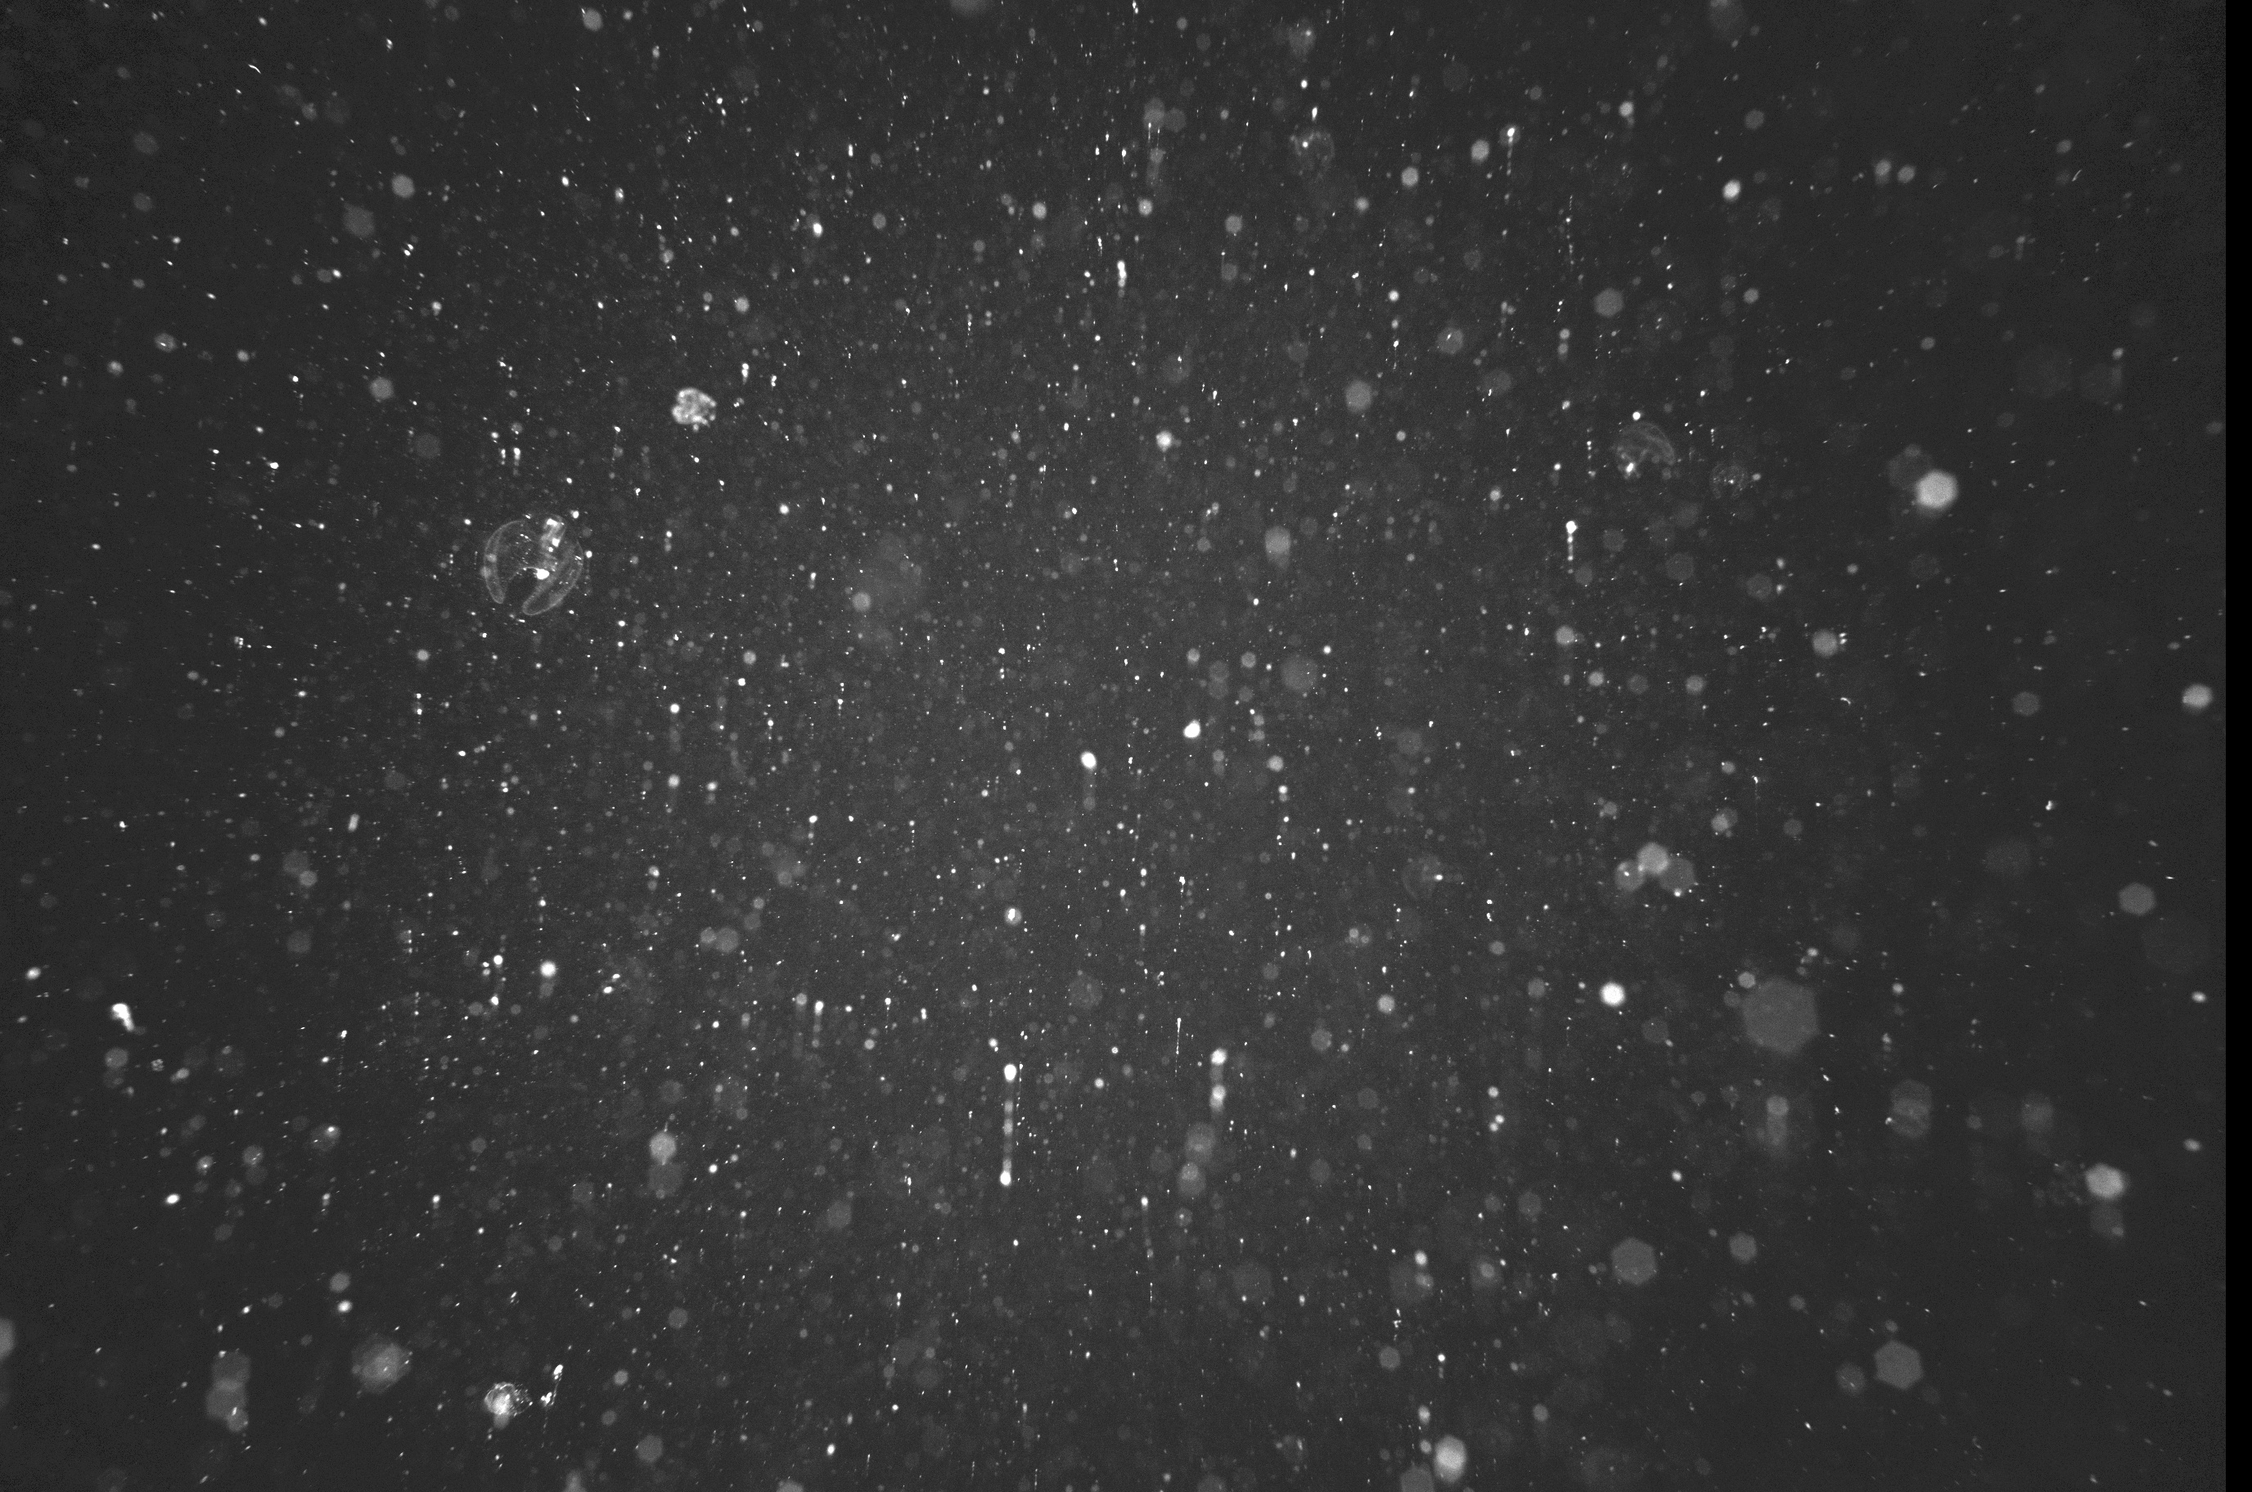
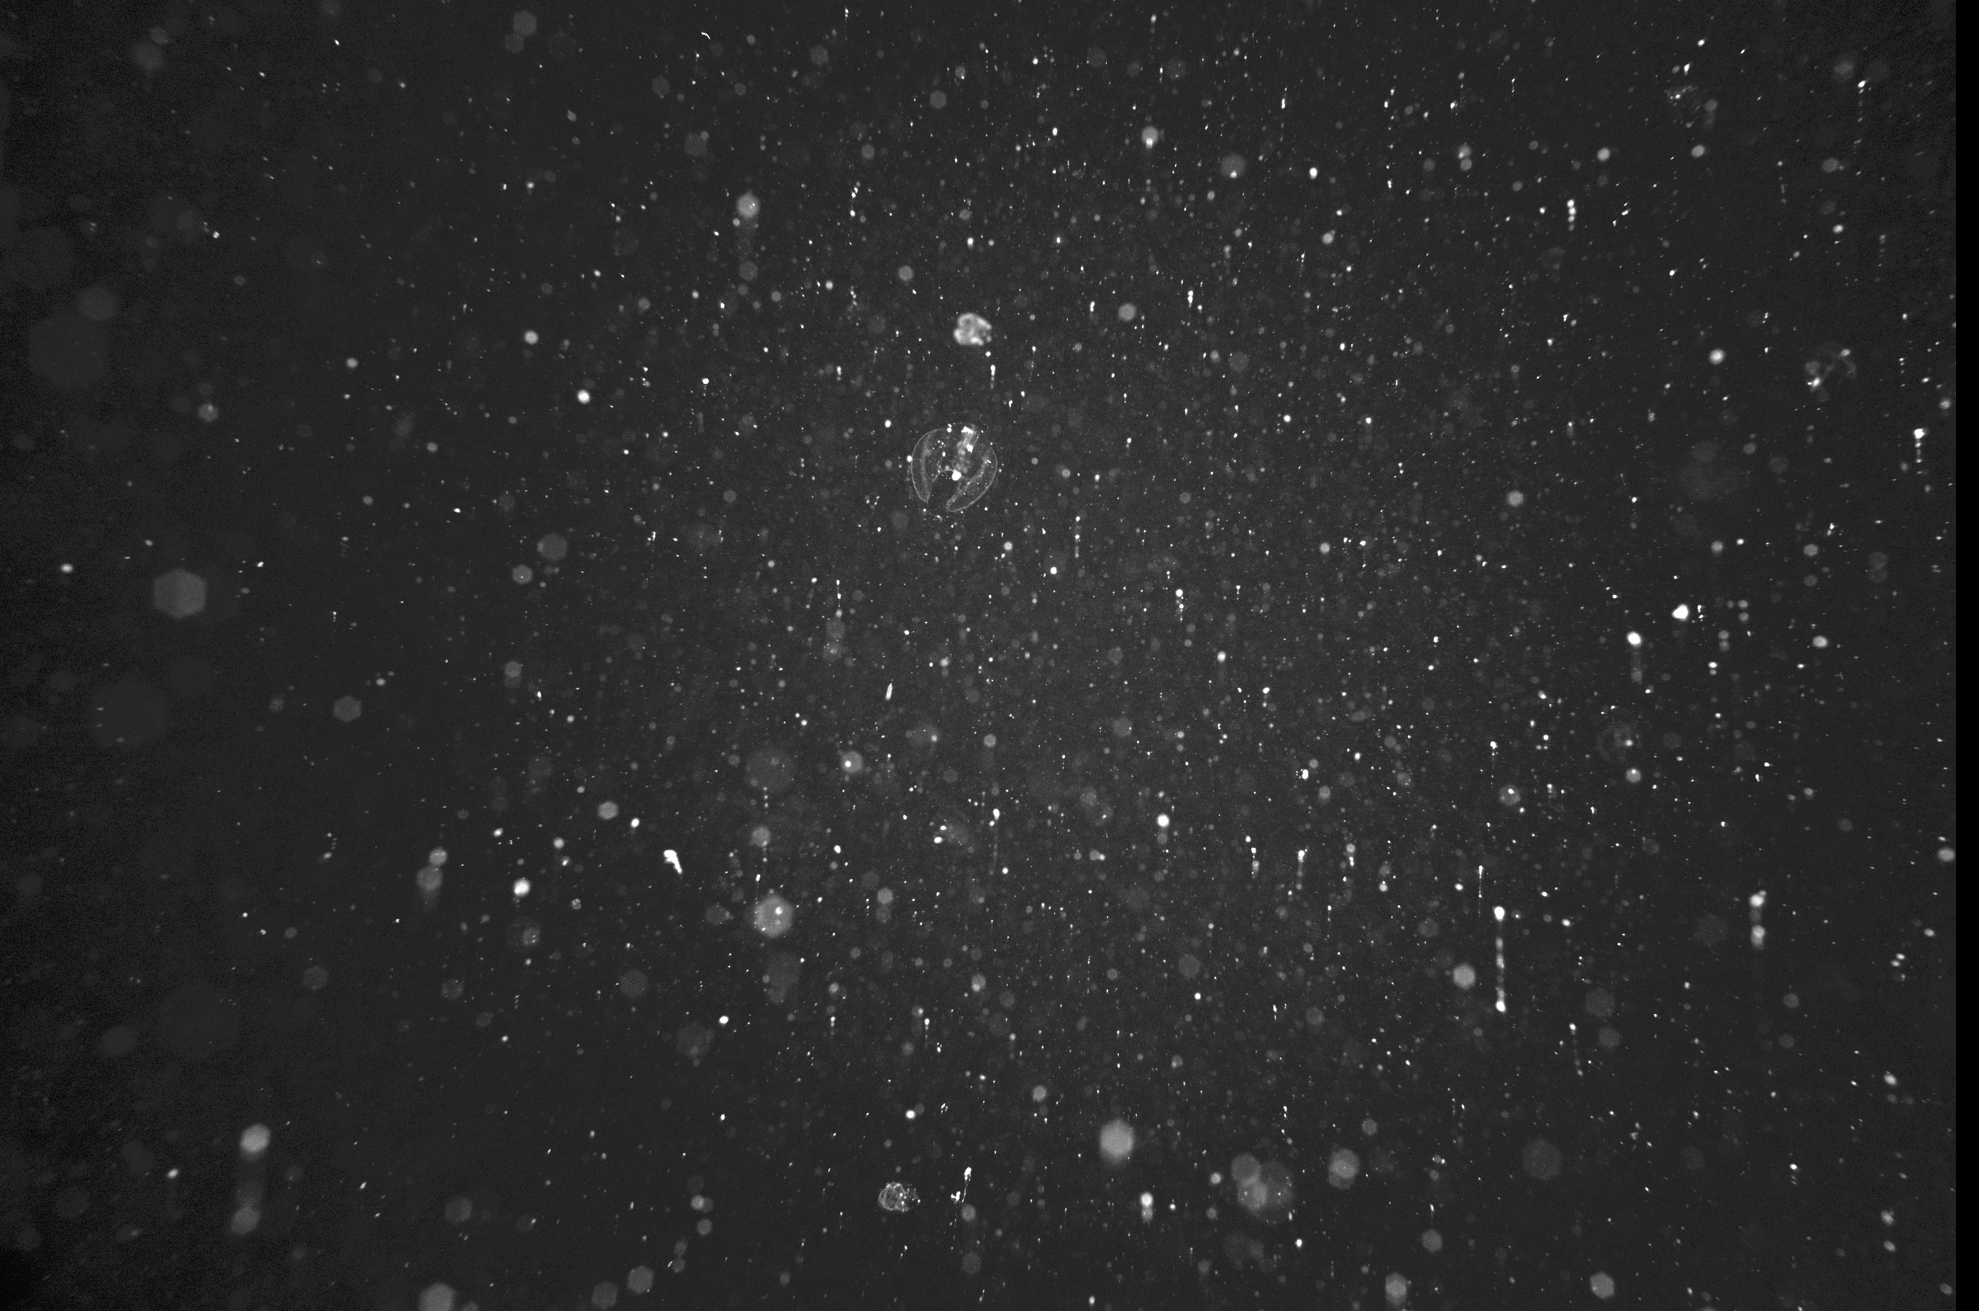
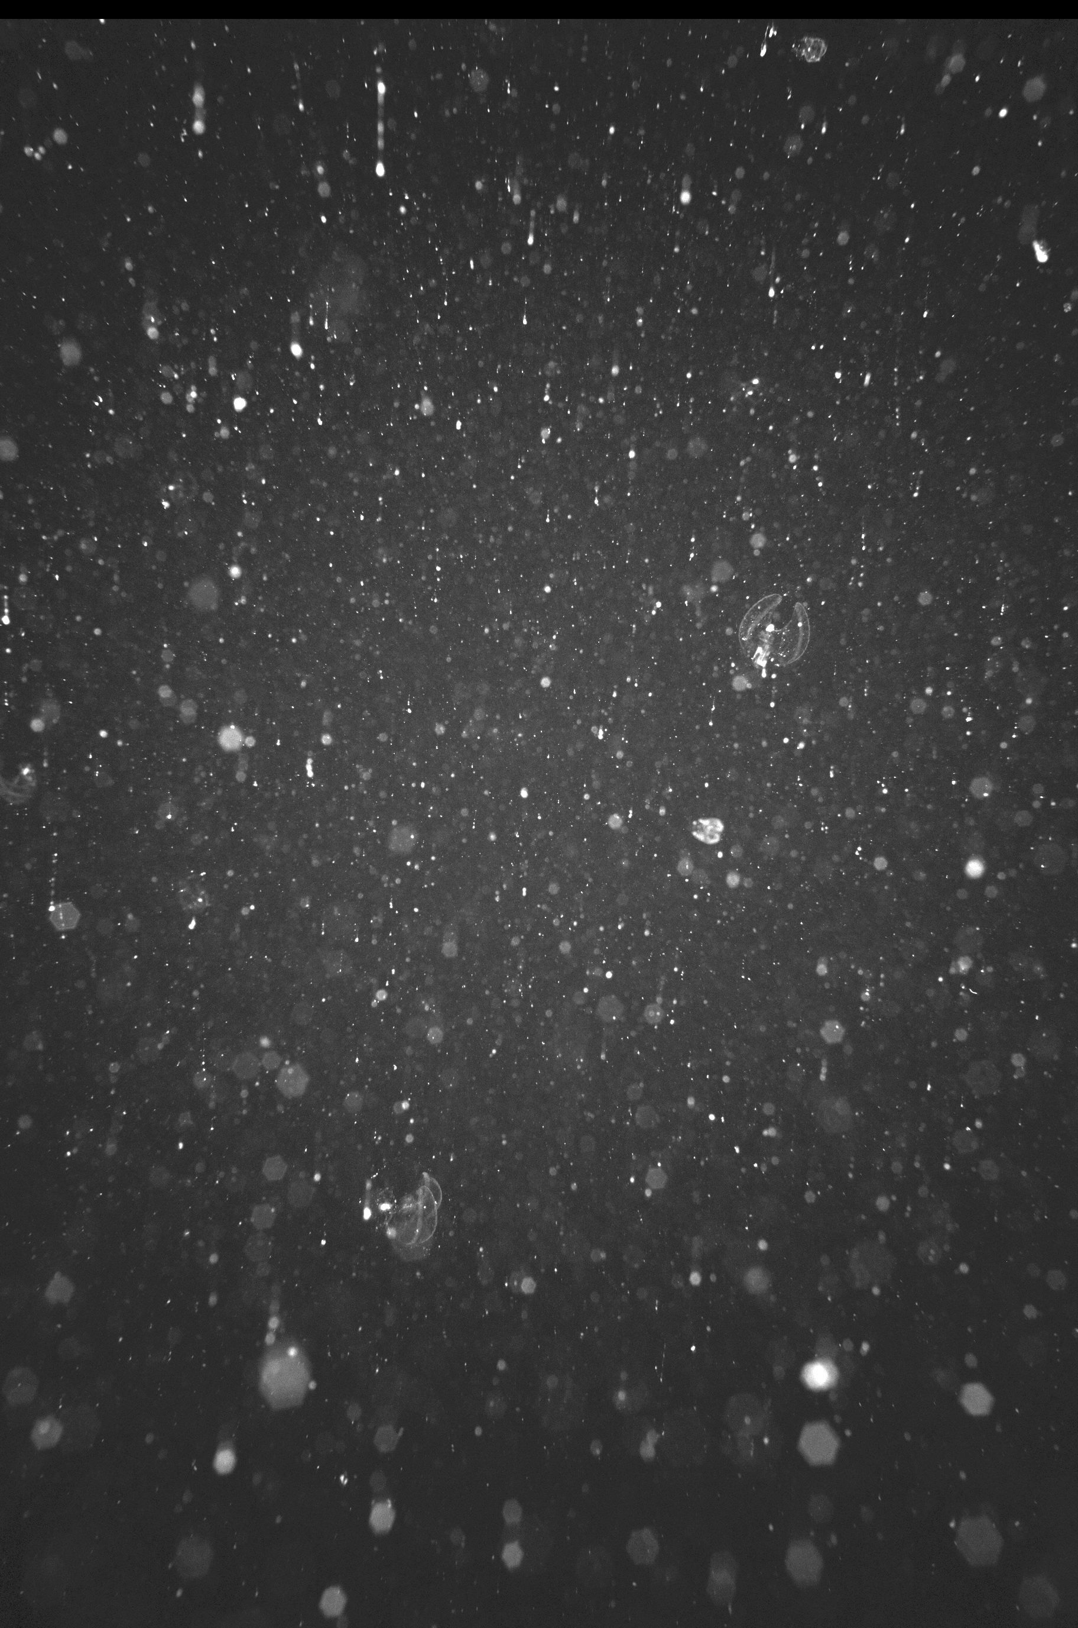
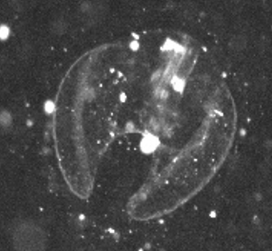
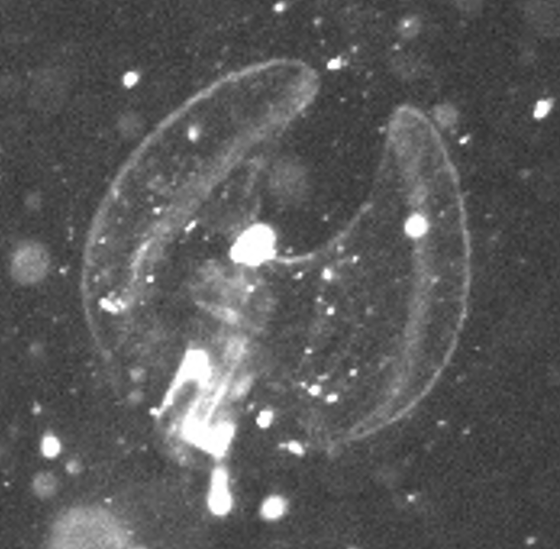
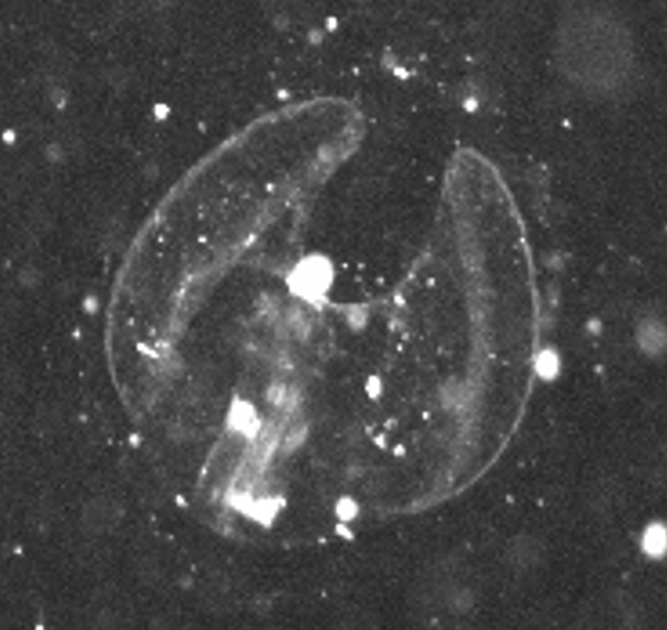
High Resolution Multiview Images
2 cm

Slide 12
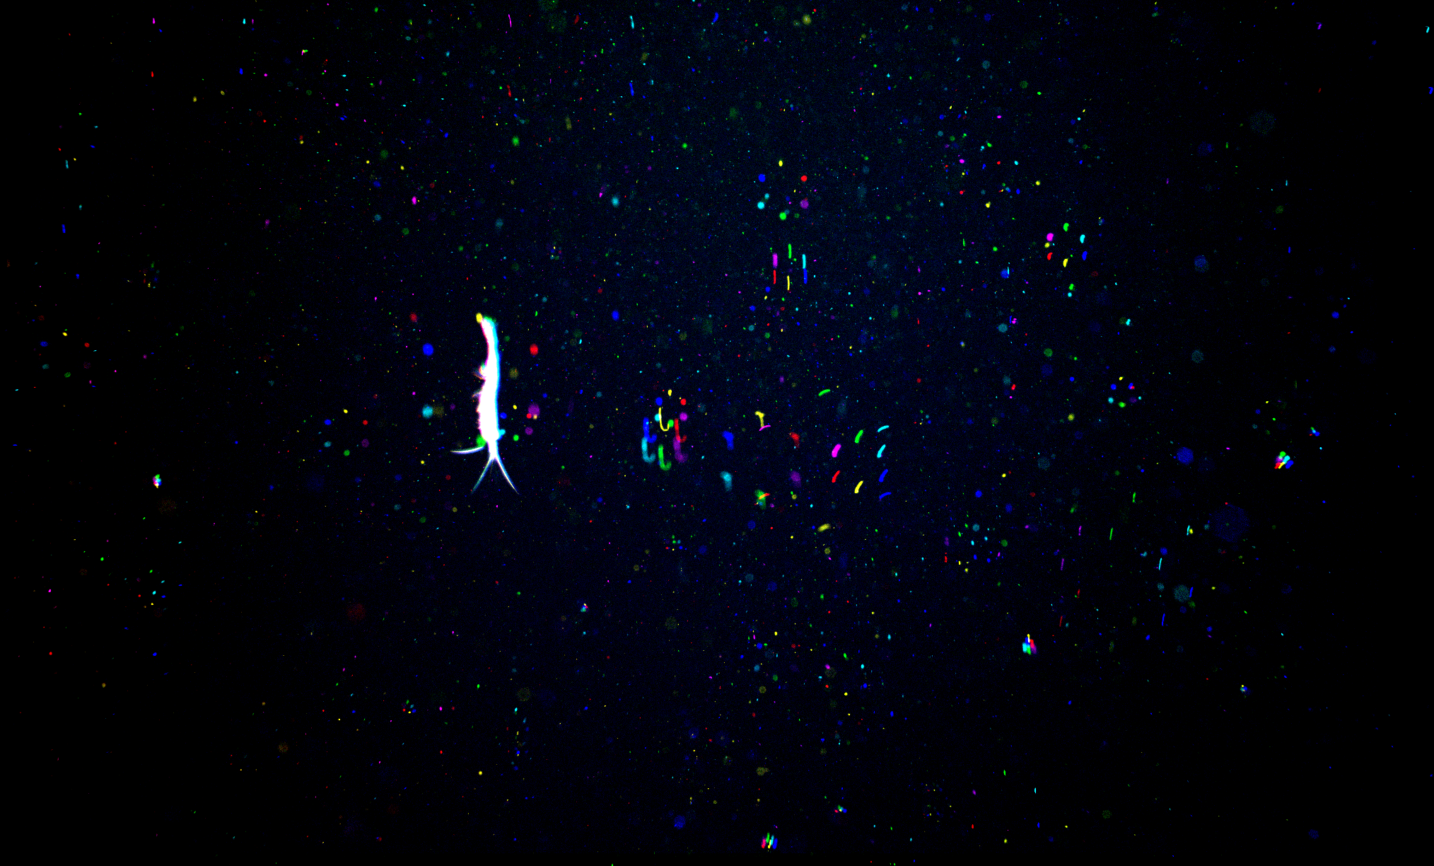
Realtime object detection and 3D Localization
{
bounding_box : [top, left, width, height],
timestamp: unixtime in microseconds,
camera_id: 0-6 number of camera
region_props: [eccentricity, angle, area]
}
Hexagonal geometry constrains
Epipolar search to equilateral triangles
LRAUV Data Slate
(Realtime)
{
bounding_box : [top, left, width, height],
3d_location: [x, y, z]
timestamp: unixtime in microseconds,
camera_id: 0-6 number of camera
region_props: [eccentricity, angle, area]
}
Particle Logs
(at surface)
Enumerate and Distribute
LRAUV Image transfer (at surface)

Slide 13


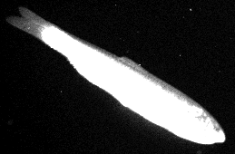
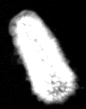

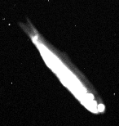




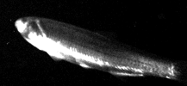














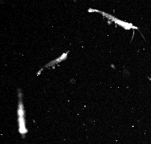


















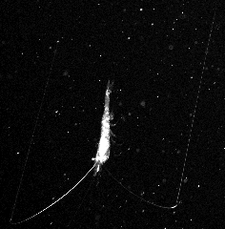


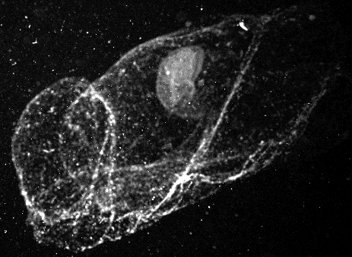






Example regions of interest from nighttime yoyo
0-5 m
10 cm
50-70 m
110-120 m

Slide 14
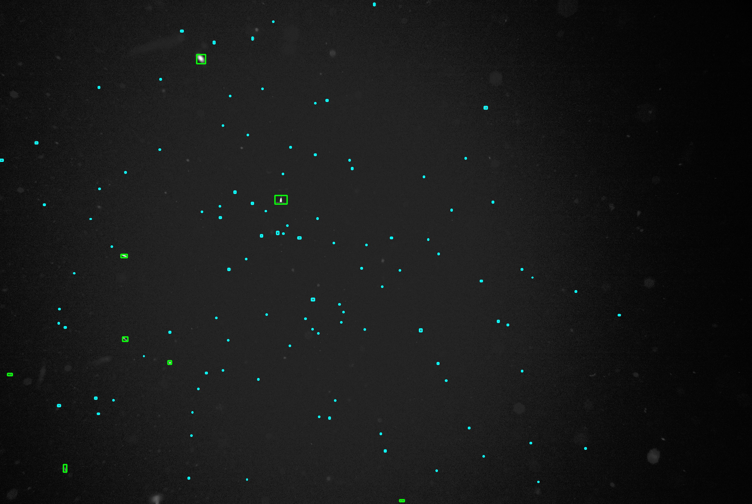
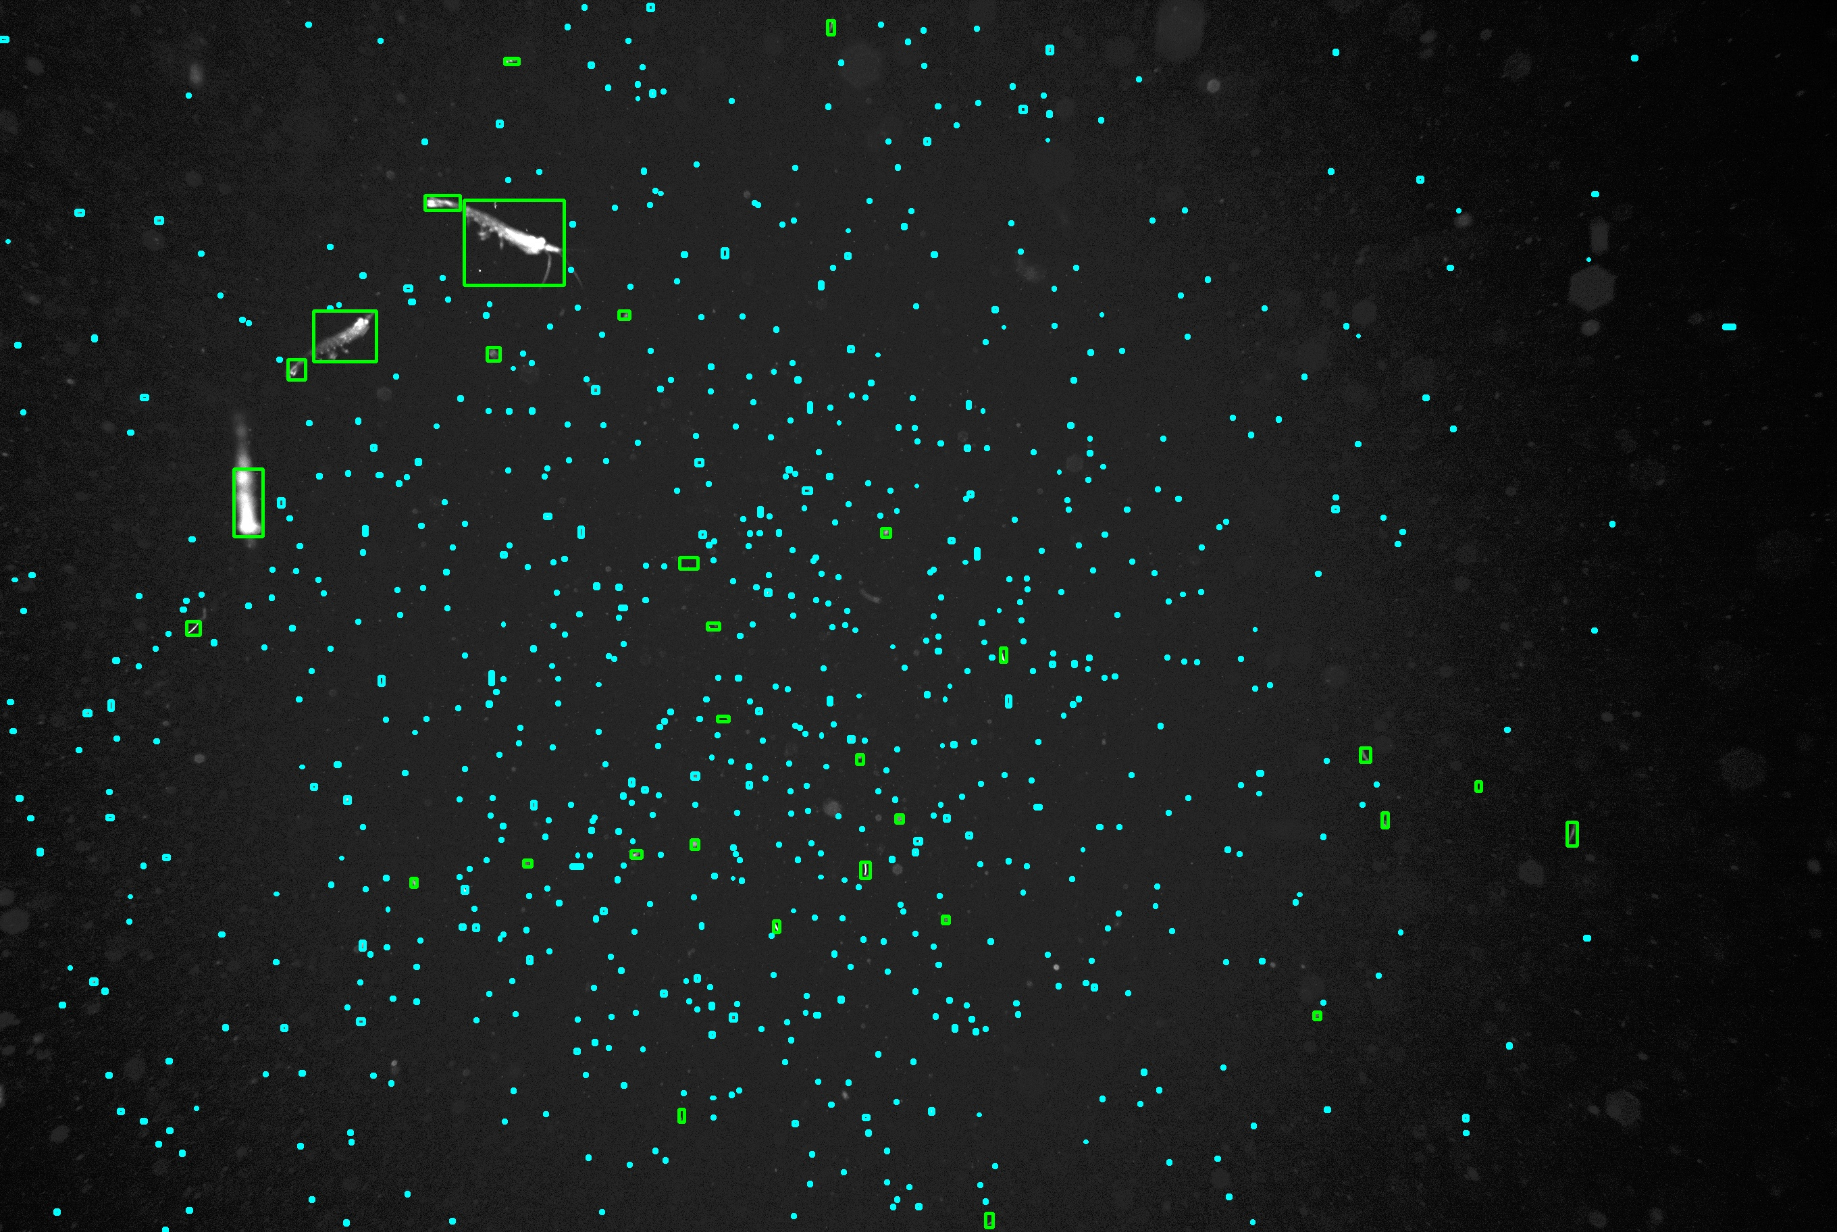
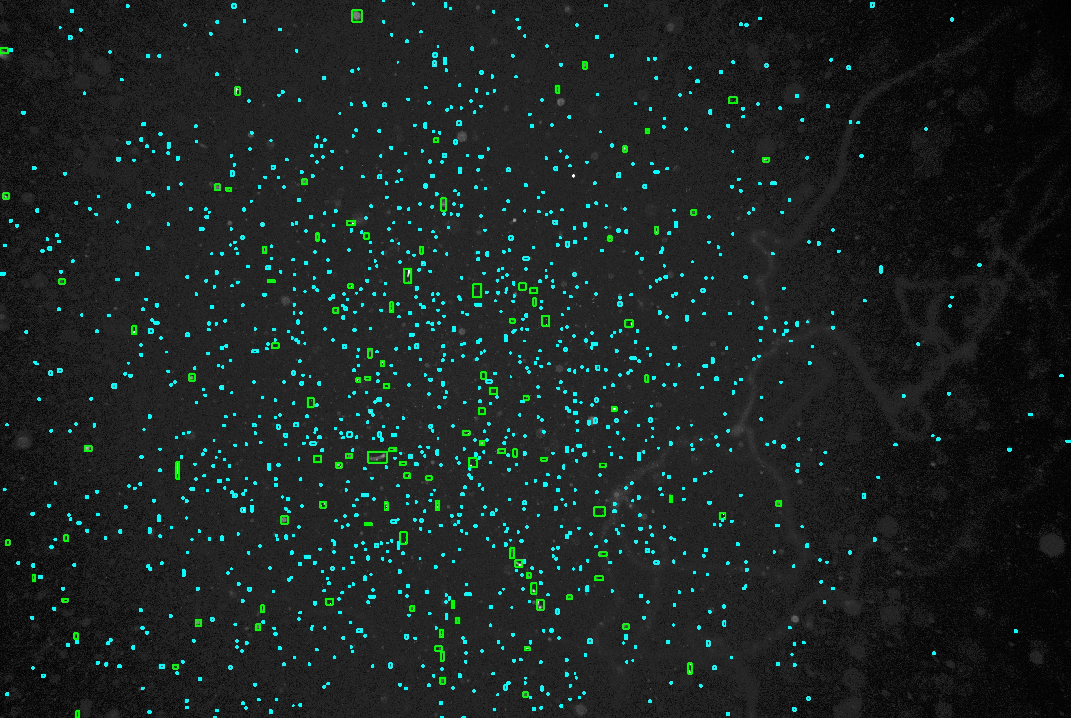
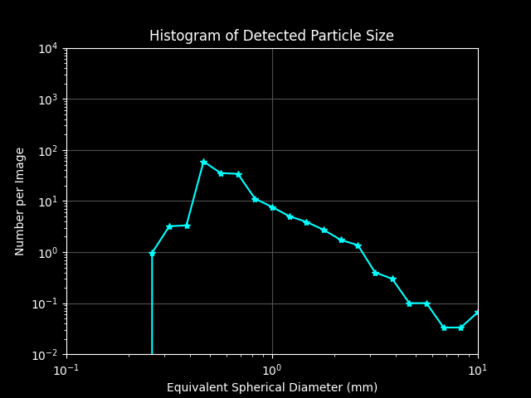
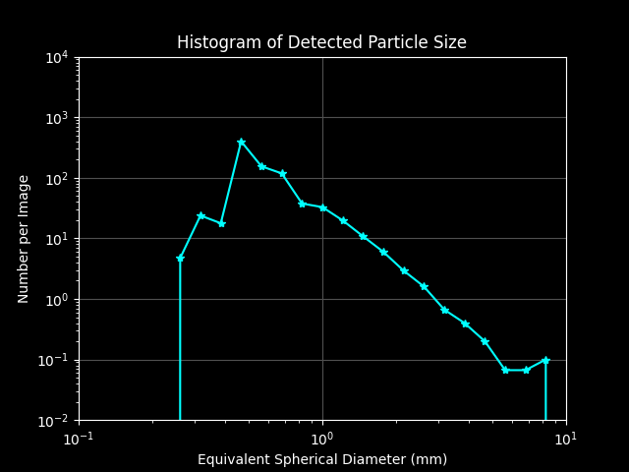
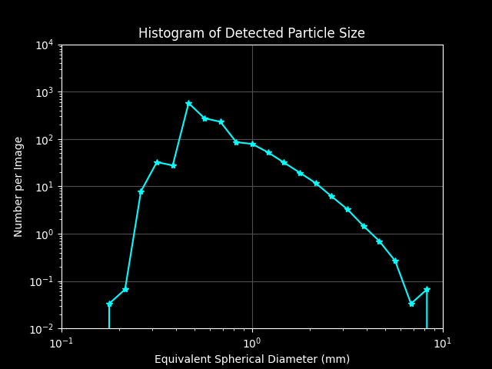
Example Particle Distributions
5 m
50 m
110 m

Slide 15
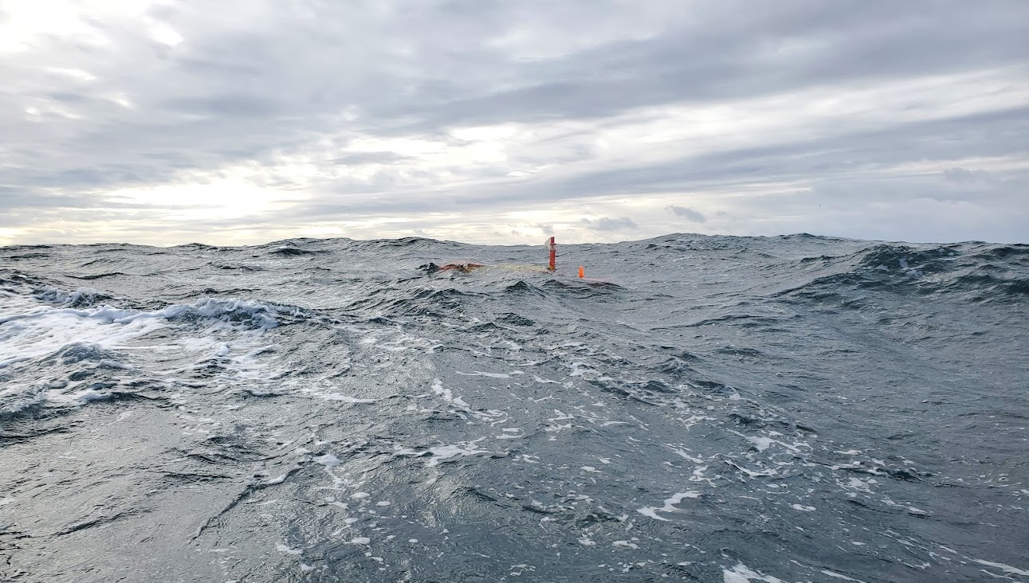
Future work
Training robust object detection models
  Kakani Katija : IN05 FathomNet: An open-source image database to train artificial intelligence algorithms that help us understand our ocean and its inhabitants
Targeting biological features
  Eric Orenstein : OD13 Autonomous detection and sampling of biological features with the AyeRIS imaging system on an AUV
Real-time 3D particle statistics
  Sending summary statistics of 3D particle distributions to shore within minutes of vehicle surfacing during extended missions
Deeper water versions down to 6000 m
Grant #: 7583

