Slide 2
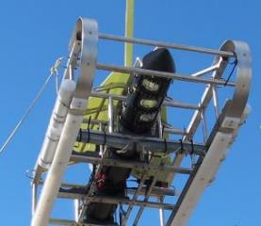
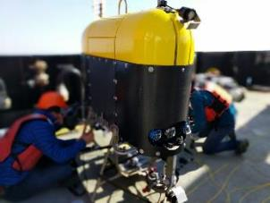
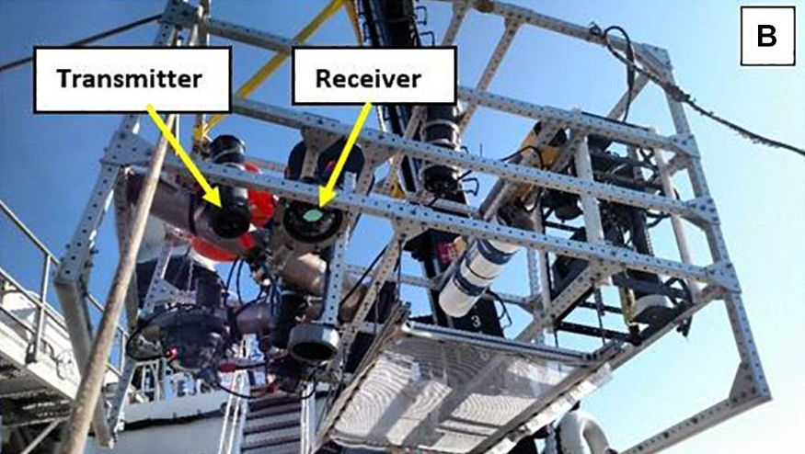
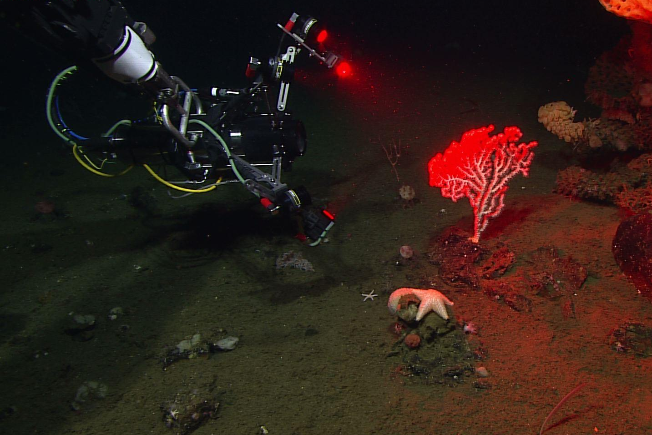
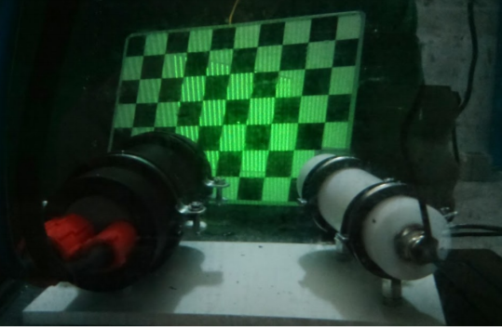
In Situ 3D methods
Stereo Cameras
Time of Flight /
Lidar
Harbor Branch: Unobtrusive Multi-Static Lidar Imager (2020)
WHOI / MBARI : Mesobot
Lightfield
Structured Light
MBARI EyeRIS Remote Imaging System (2021)
Massot-Campos et. al 2014

Slide 3
Room for One More?
Telecentric,
holographic
or free space
Quantitative
Compact
Large imaged volume
Instrument Size
Flow-through
Light sheet
Camera arrays
Object Size

Slide 4
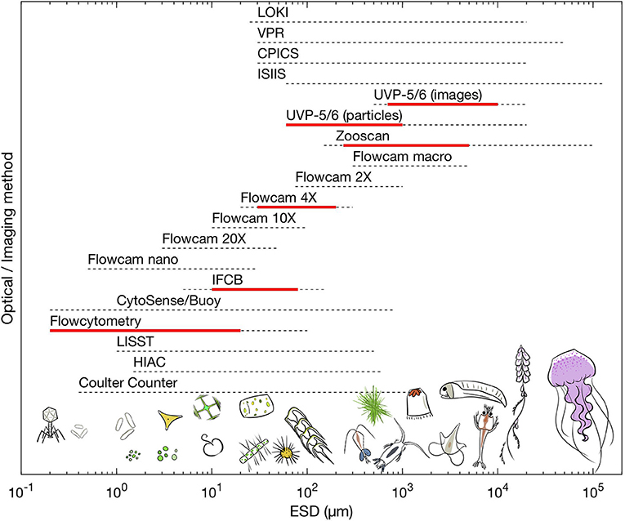
Many excellent tools for imaging plankton
Lombard et al. 2019

Slide 5
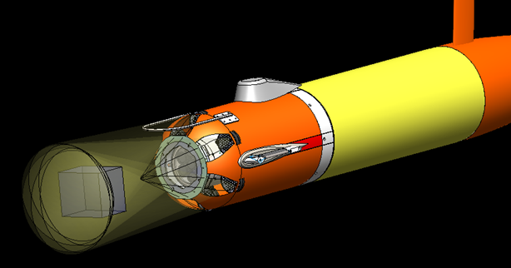
AyeRIS Autonomous Instrument
Camera array and strobes mounted in AUV payload
AyeRIS = Autonomous EyeRIS
7, Sony IMX183, 20 megapixel sensors in hexagonal array,
10, 33,000 lumen strobes in a ring around the cameras
Real-time particle detection and size spectra estimation
Deployed on MBARI’s Long-Range AUV
300 m depth rating version completed and demonstrated
~ 2 liter imaged volume

Slide 6
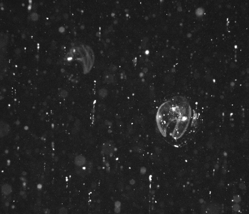
Realtime object detection and supervised autonomy
larvacean
Collate counts from images
Update vehicle behavior
{
larvacean : 2,
copepod: 0,
jelly: 0,
aggregate: 0,
}
if num_larv > threshold:
stop yoyo
signal partner LRAUV
larvacean
Run an on-board object detector
LRAUV Data Slate
(Realtime)
Enumerate and Distribute
Object Logs
(at surface)
Human operator confirms behavior change
LRAUV Image transfer (at surface)

