Slide 1



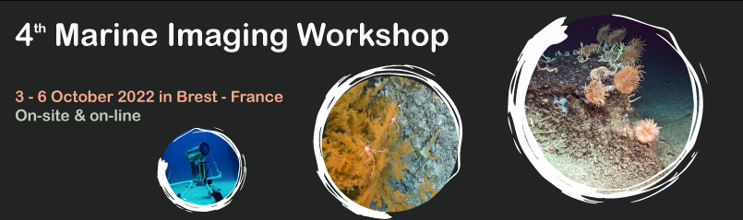
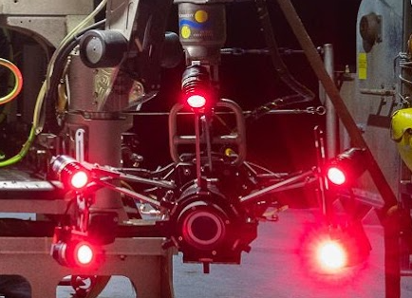
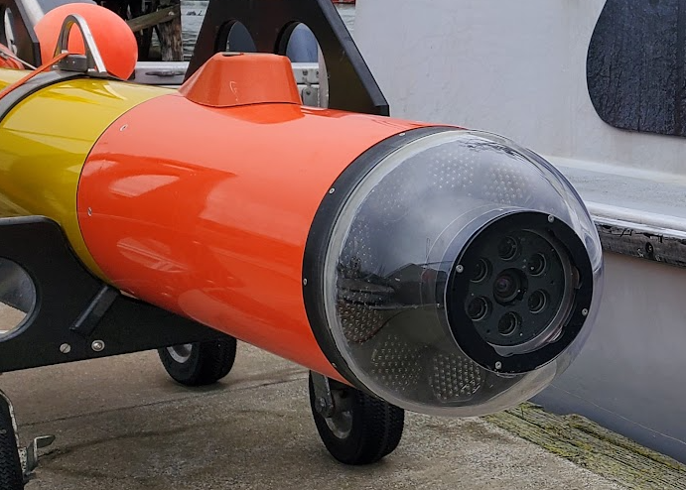
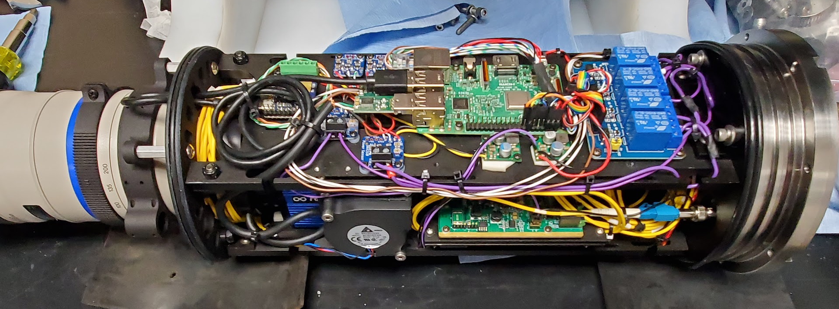
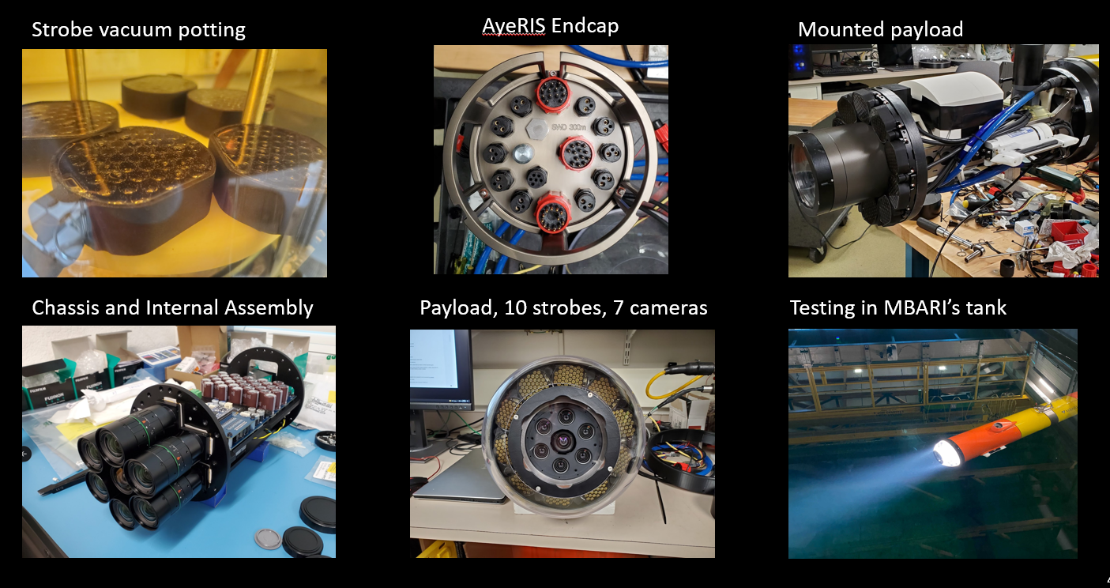
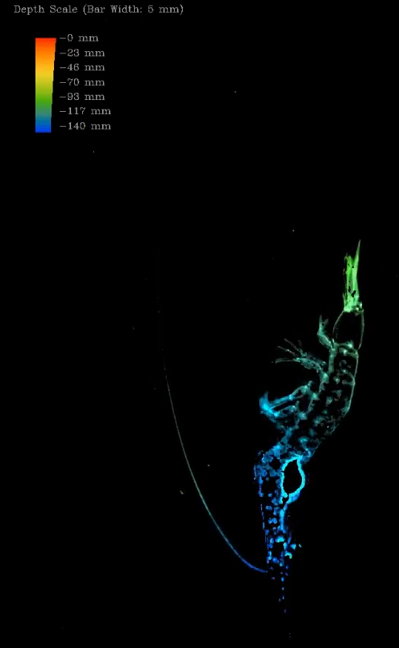
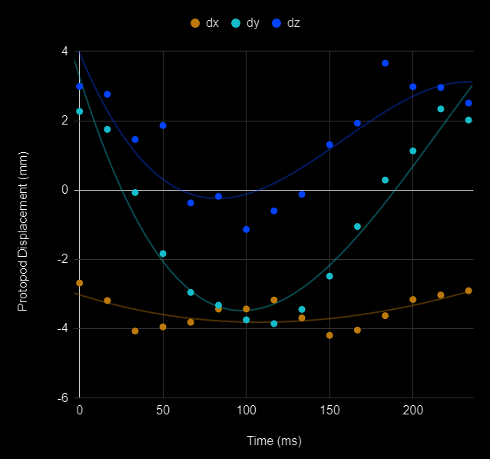
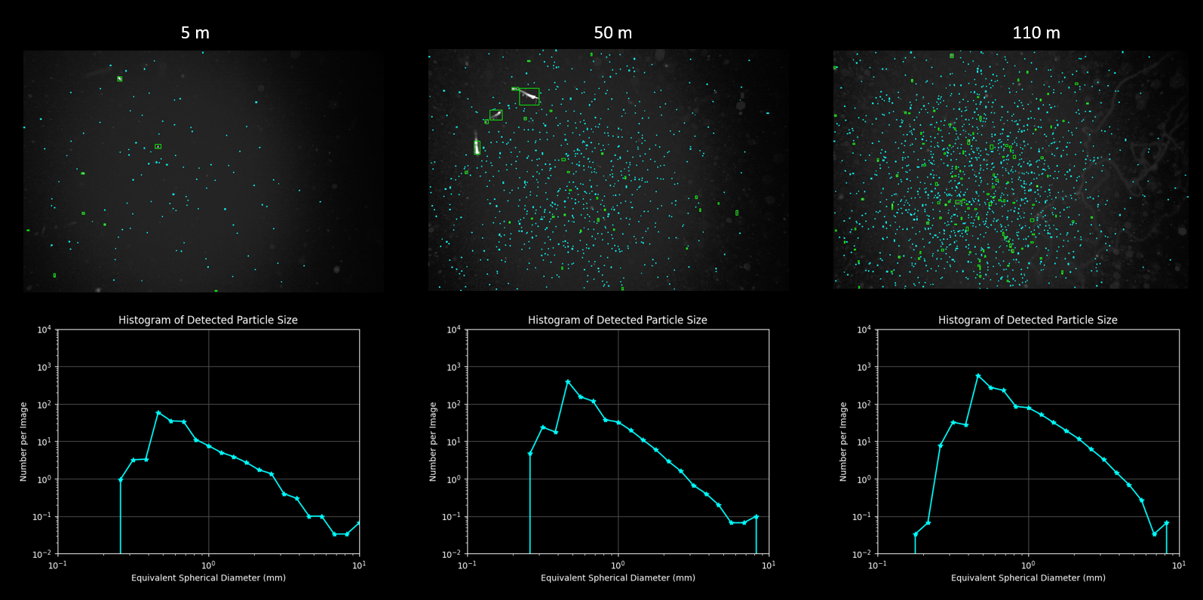

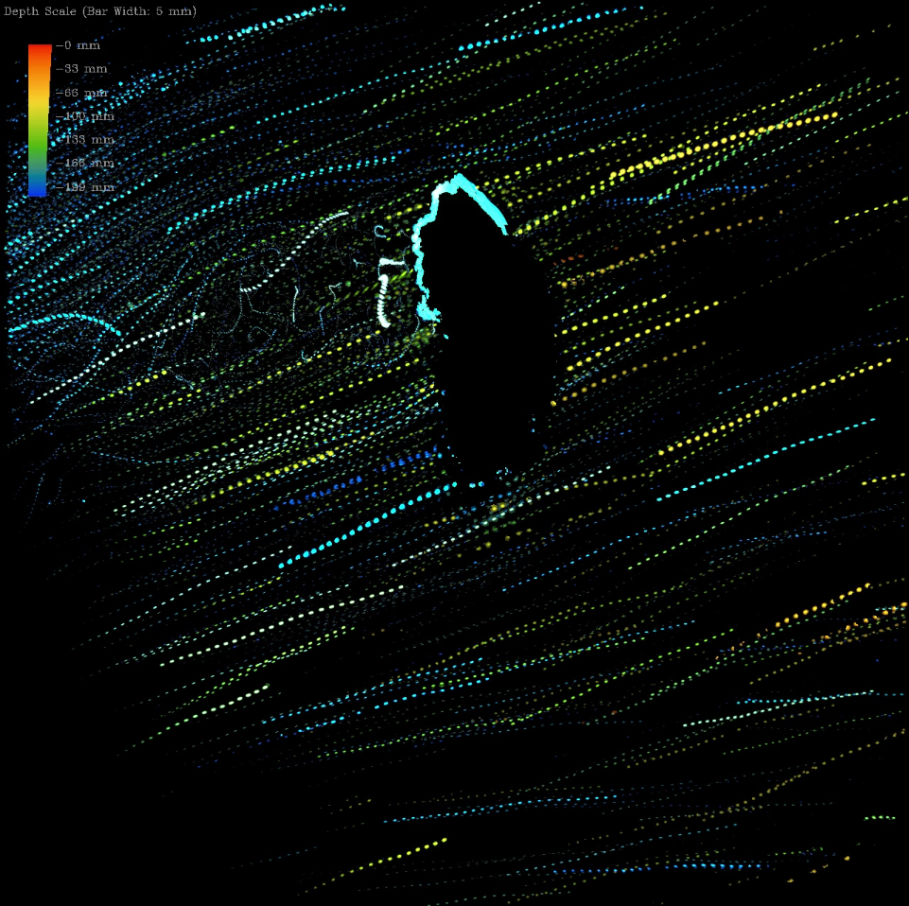
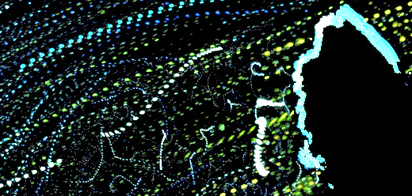
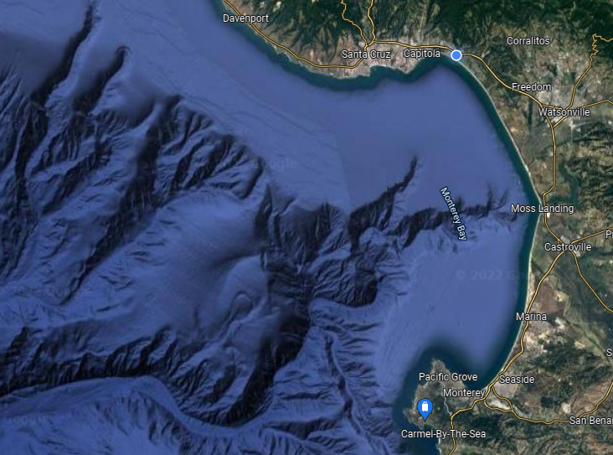

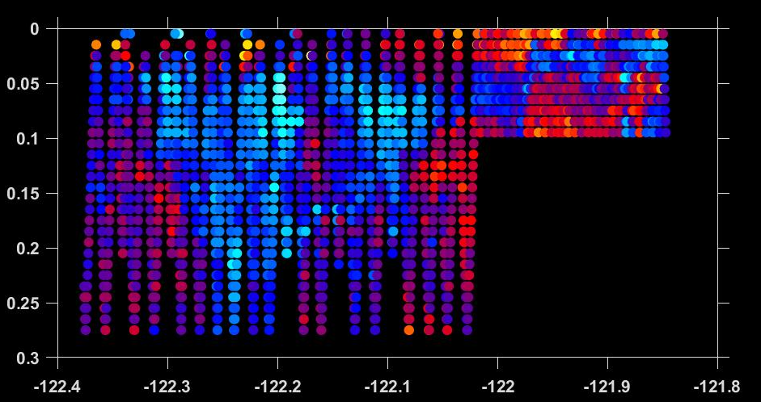

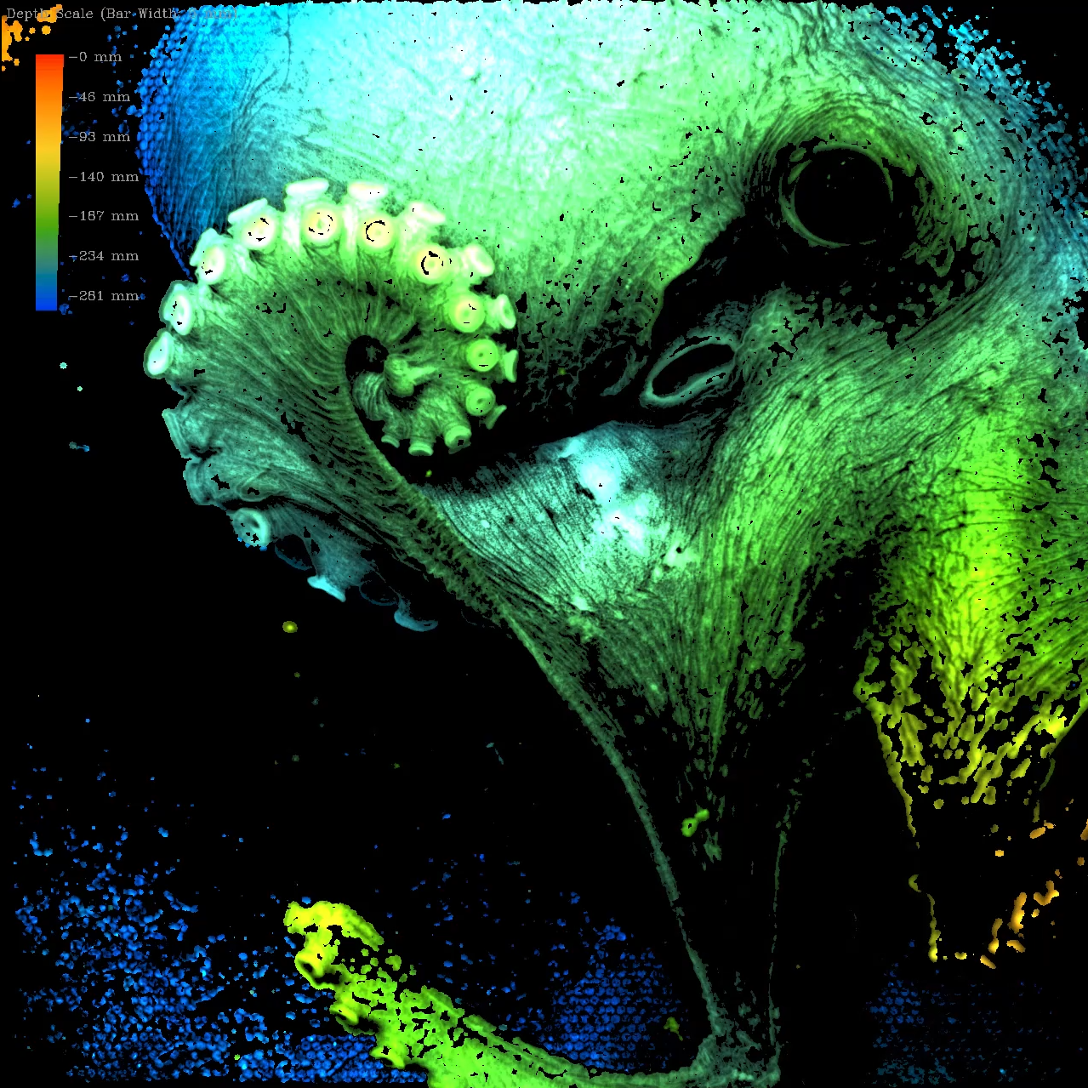
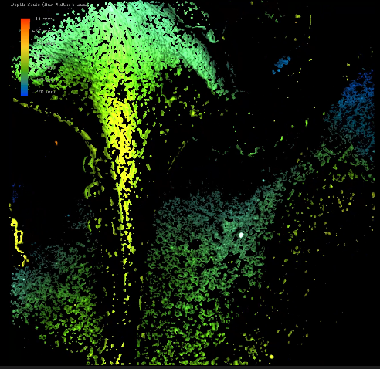
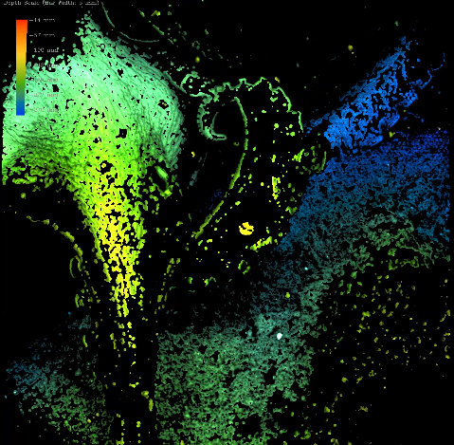
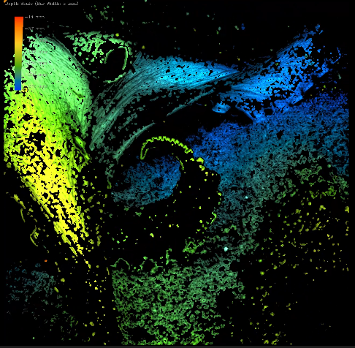
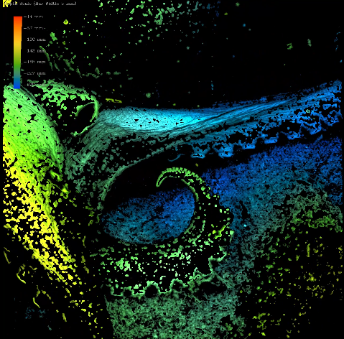
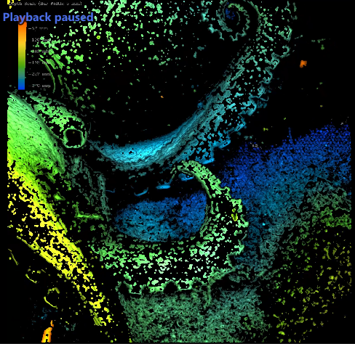
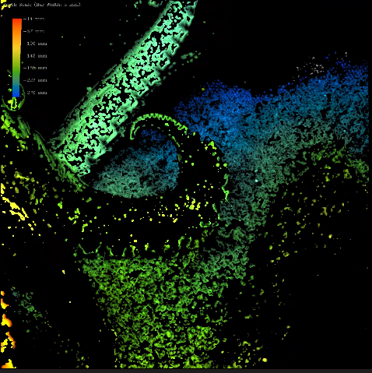
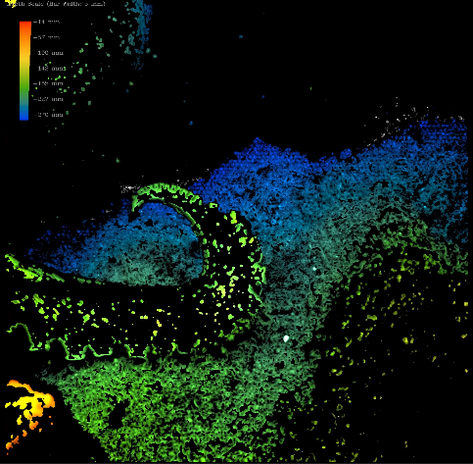
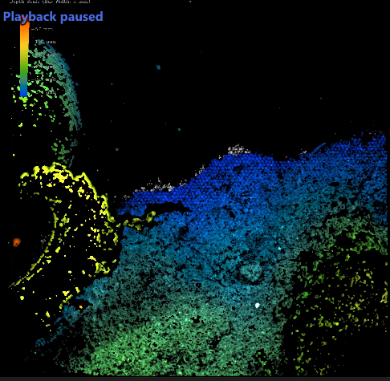

Plenoptic and multi-camera imaging on ROVs and AUVs
Paul Roberts, Joost Daniels, Eric Orenstein, Jon Erickson, Denis Klimov, Rich Henthorn, Alana Sherman, Henry Ruhl, Kakani Katija
Grant #: 7583
Enabling the quantitative study of time-resolved, small-scale (mm to cm) animal-fluid interactions, predator prey dynamics, particle distributions, and plankton abundance through the use of in situ 3D imaging
EyeRIS - Remotely Operated Vehicles
4000 m lightfield camera with real-time 3D visualization
AyeRIS - Autonomous Underwater Vehicles
300 m autonomous camera array with real-time processing
EyeRIS on SOI SuBastian Aug 2021
Key Features:
4000 m depth rating
Real-time 3D visualization
Imaged volume: 60 ml to 2 l
Resolution:
  x/y: 20 um to 60 um
  z: 200 um to 600 um
Interface:
  Wide range AC/DC
  < 300 W (with lights)
  Single-mode fiber
AyeRIS on MBARI’s
Long-Range AUV Nov 2021
Key Features:
300 m / 1500 m depth rating
Real-time object detection
Imaged volume: 2 l to 10 l
Resolution:
  x/y: 50 um
  z: 400 um
Interface:
  24 VDC
  < 25 W (at 1 FPS)
  Gigabit ethernet
3D printed zoom gear drive
Raspberry Pi Controller
Power Relays
Strobe ballast
Camera array
Internal batteries
Canon f2.8
70-200 zoom lens
Raytrix R26 lightfield camera
Phrontier CWDM CXP 1.0 extender
5-channel CWDM mux
Strobe firing in test tank
Midwater Kinematics
Particle Size Estimation
Examples of raw images from AyeRIS and estimated particle size spectrum averaged over 10 m depth depths at three distinct depths in one profile. An overall increase in particle abundance with depth and change in size spectrum slope can be seen.
Protopod Motion
Protopod Displacement (mm)
Scan for Video
Time(ms)
10⁴
Histogram of Detected Particle Size
10⁴
Histogram of Detected Particle Size
10⁴
Histogram of Detected Particle Size
(left) Focused depth map of a pasiphaeid shrimp as it swims downwards. (Right) Displacement of the tip of one of its protopods during a cycle. This shrimp swam over 90 meters downwards during the recording.
10³
10³
10³
10²
10²
10²
10¹
10¹
10¹
Number per Image
Benthic Flow Studies
Number per Image
Number per Image
10⁰
10⁰
10⁰
10⁰
10⁻¹
10⁻¹
10⁻¹
10⁻²
10⁻²
10⁻²
10⁻¹
10⁰
10¹
10⁻¹
10⁰
10¹
10⁻¹
10⁰
10¹
Equivalent Spherical Diameter (mm)
Equivalent Spherical Diameter (mm)
Equivalent Spherical Diameter (mm)
(Right) Map of Monterey Bay showing a transect line between waypoints in the Monterey Bay Time Series. ROIs and particle size data were recorded continuously during the transect and saved to local storage.
(Bottom) Visualization of particle size spectrum slope along the transect between (M2) to near-shore (C1). Size spectra are computed over 10 m depth bins and the slope is estimated for particle sizes in the range 0.8 mm to 8 mm. The plot shows a large patch of relatively flatter size spectrum that intrudes into the shallower water near-shore.
(Top) Zoomed in view showing particle trajectories meandering in the wake of the branch.
(Left) Pathline view of flow over an isidella coral branch at Sponge Ridge off Monterey. Lines show the bulk fluid motion and the downstream vortices to the left of the coral are clearly visualized.
C1
M2
An amphipod surfs in the wake of the coral branch
Scan for Video
Benthic Biomechanics
-1.0
Scan for Video
Depth (km)
-1.5
Size Spectrum Slope
(Left) Focused depth map of an octopus imaged at Octopus Garden on Davidson Seamount in August 2022. (Top) Sequential frames from video of an octopus moving. Video will be used to measure in situ gait dynamics of these deep-sea animals.
-2.0
Longitude (deg)

