Slide 1
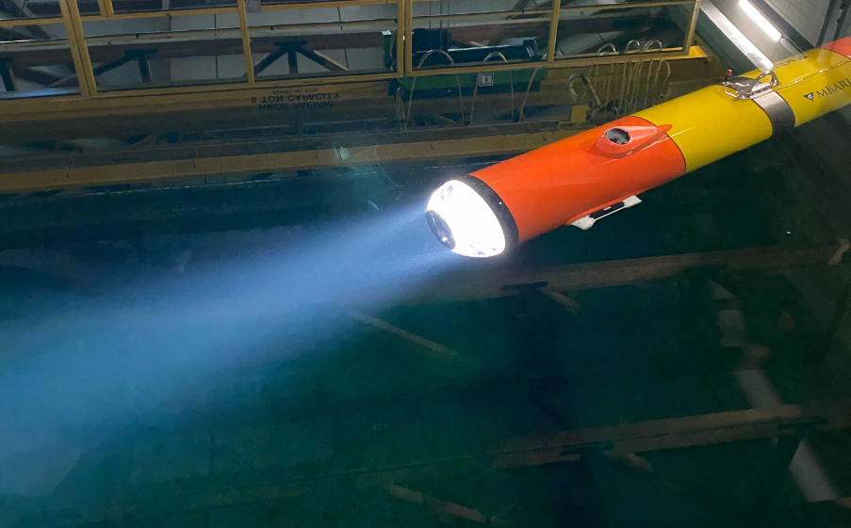
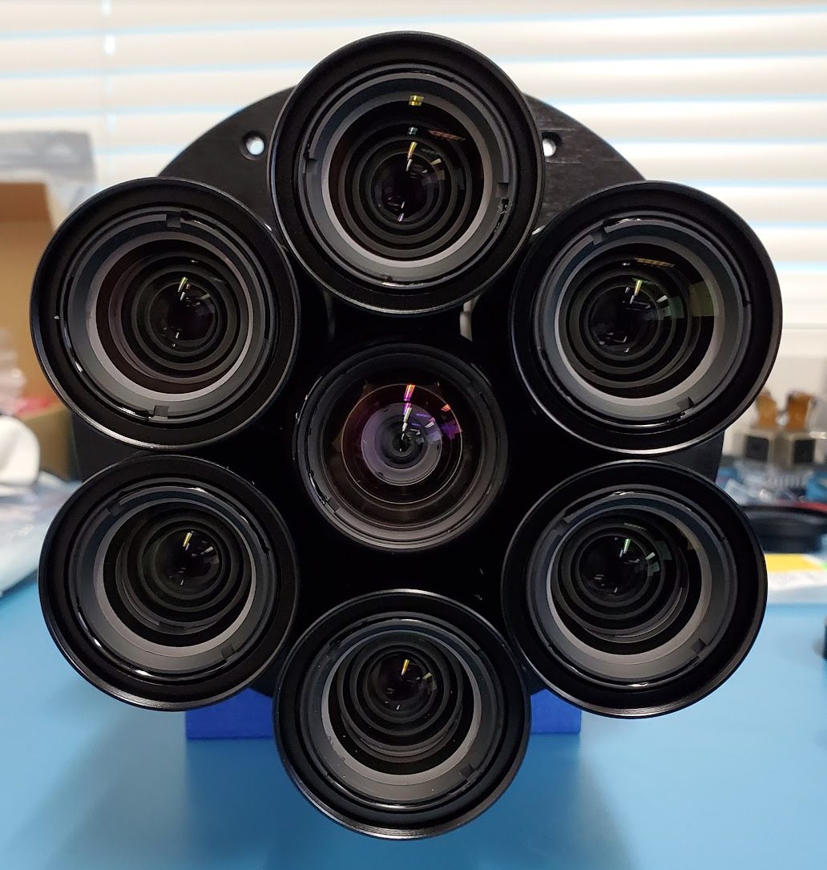
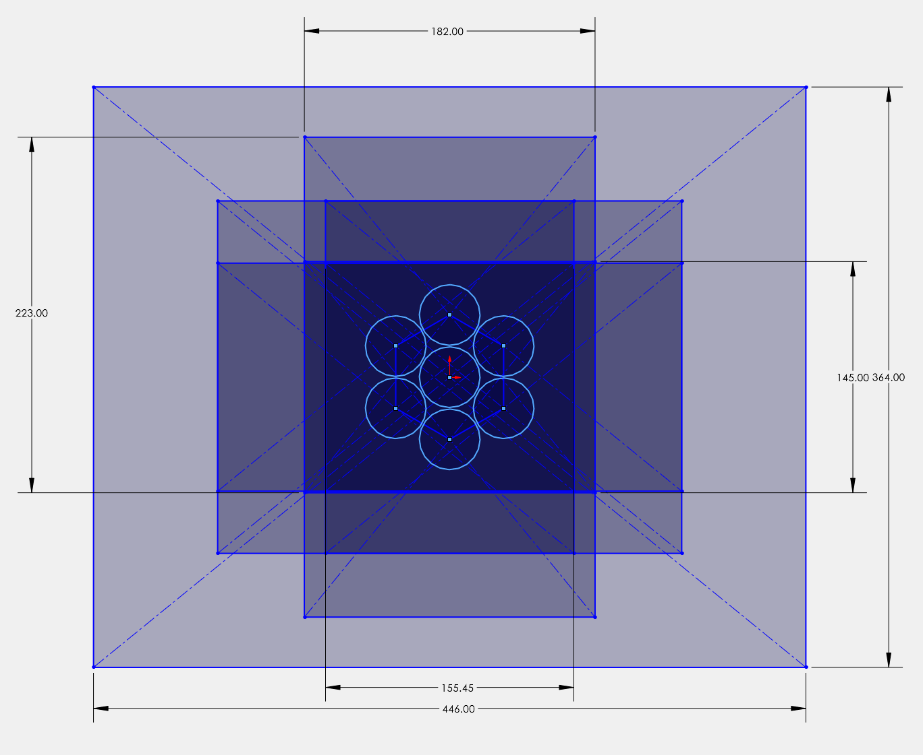
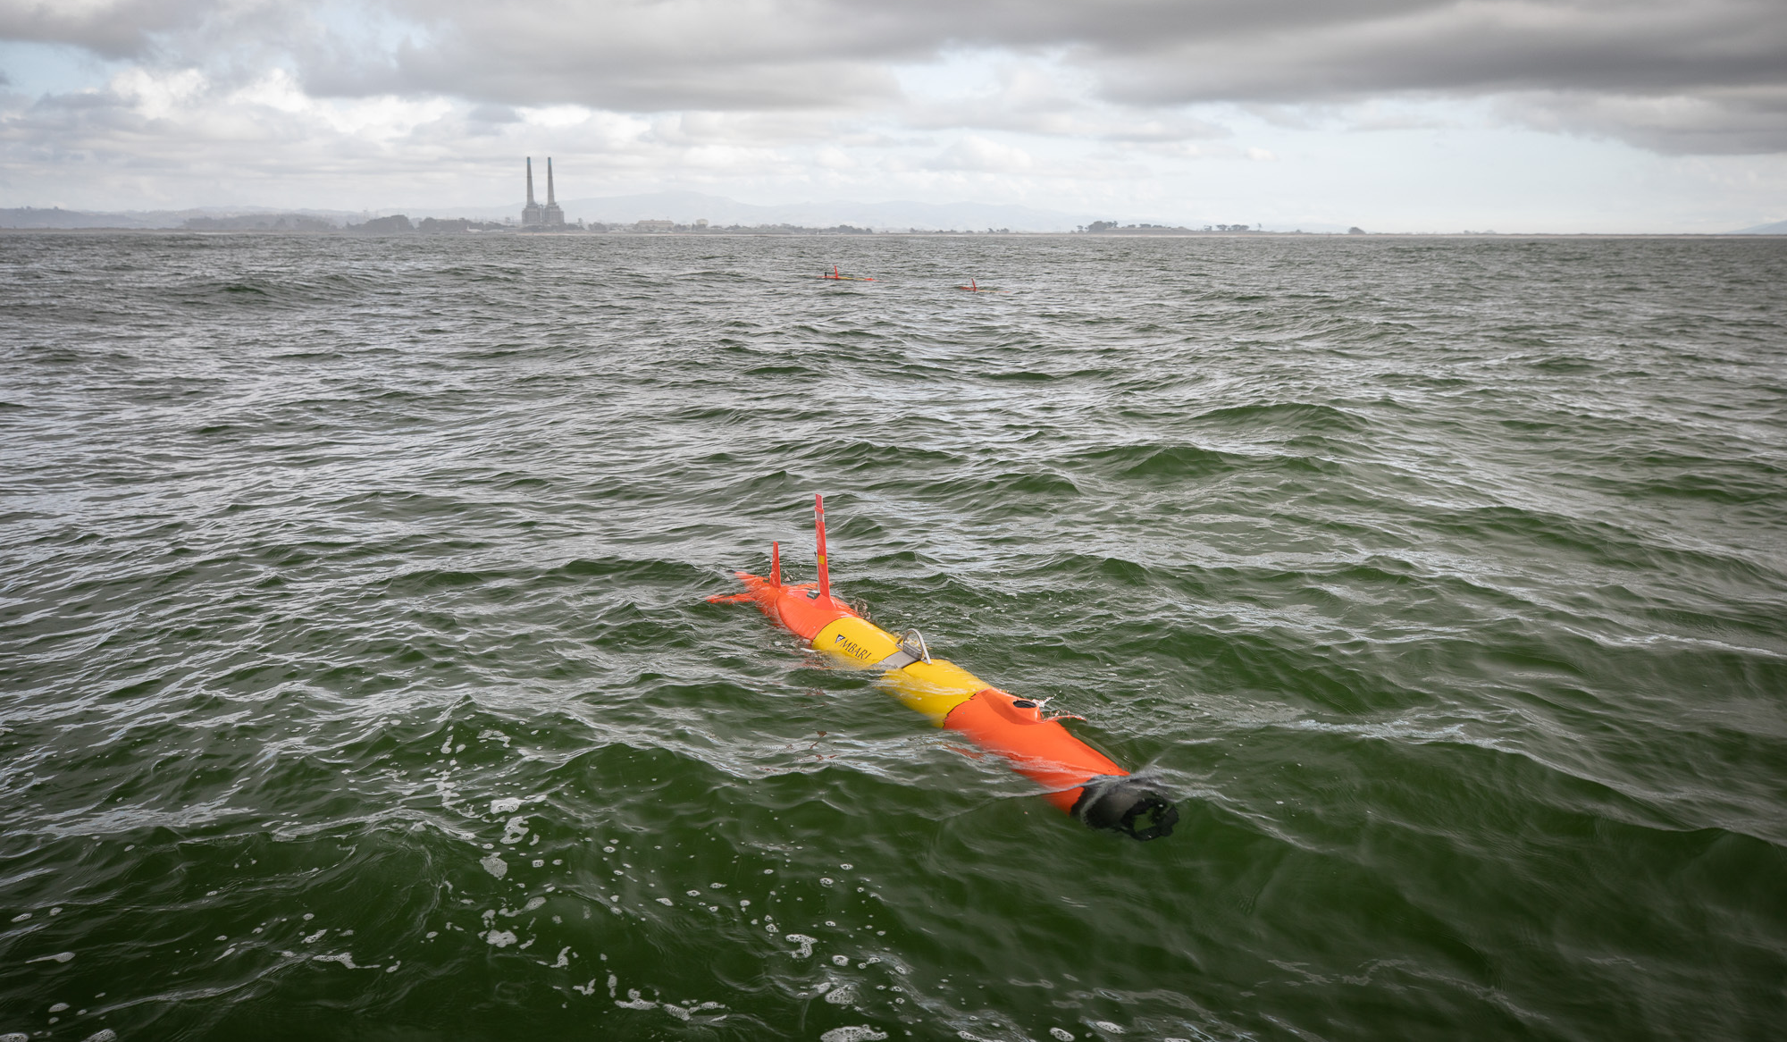
Chiton Imaging System
140 megapixels per “frame” at up to 10 frames per second (1.4 GB/s raw data rate)
50 um pixel size in object space
2-10 liter multiview imaged volume
Objects can be triangulated to obtain 3D position and size
18.2 cm
22.3 cm
14.5 cm
44.6 cm
Notes:
At MBARI with funding for the Moore foundation we have developed the Chiton imaging system
This system is made of of an array of high-resolution cameras (discuss specs). Details of the imaging geometry are shown in the schematic next to a closeup of the lens array
A key element of this system is a high-power array of LED strobes that are integrated into the nose of the AUV. These put about an equivalent of about 60 card headlights when flashing for 0.5 ms and an example of the flash is shown in the upper right
The system has been deployed many times in the Monterey bay as shown in the image on the bottom right

Slide 2
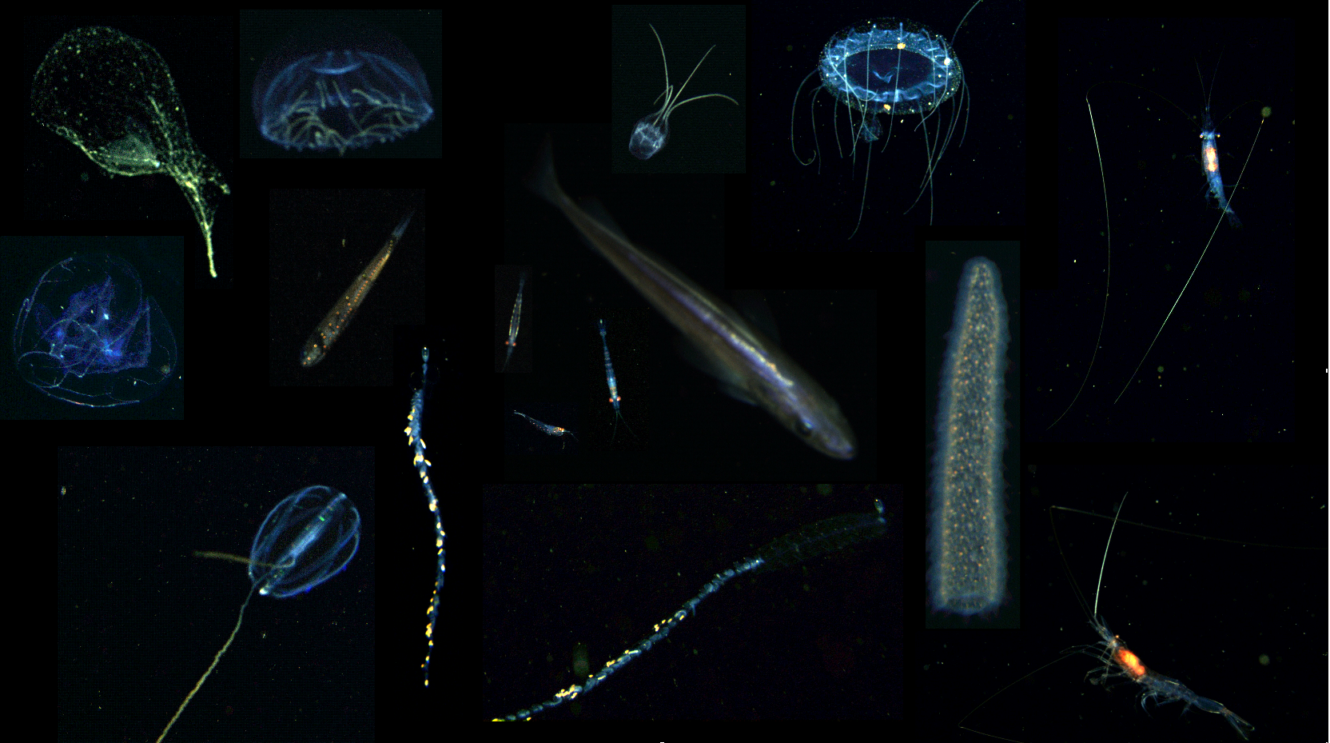
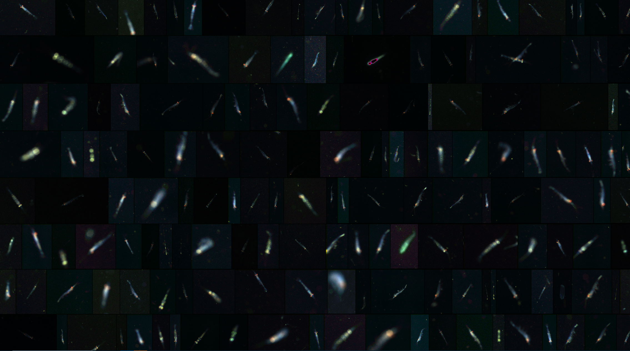
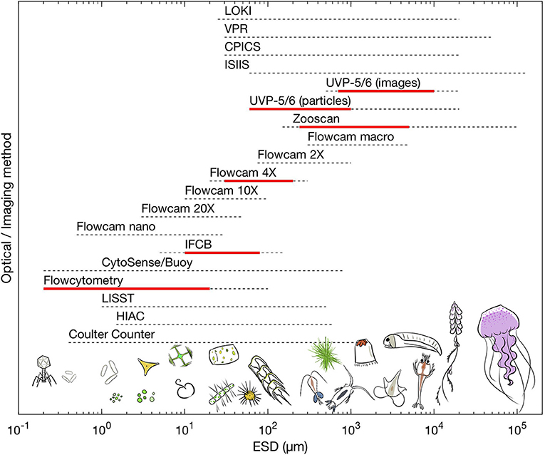
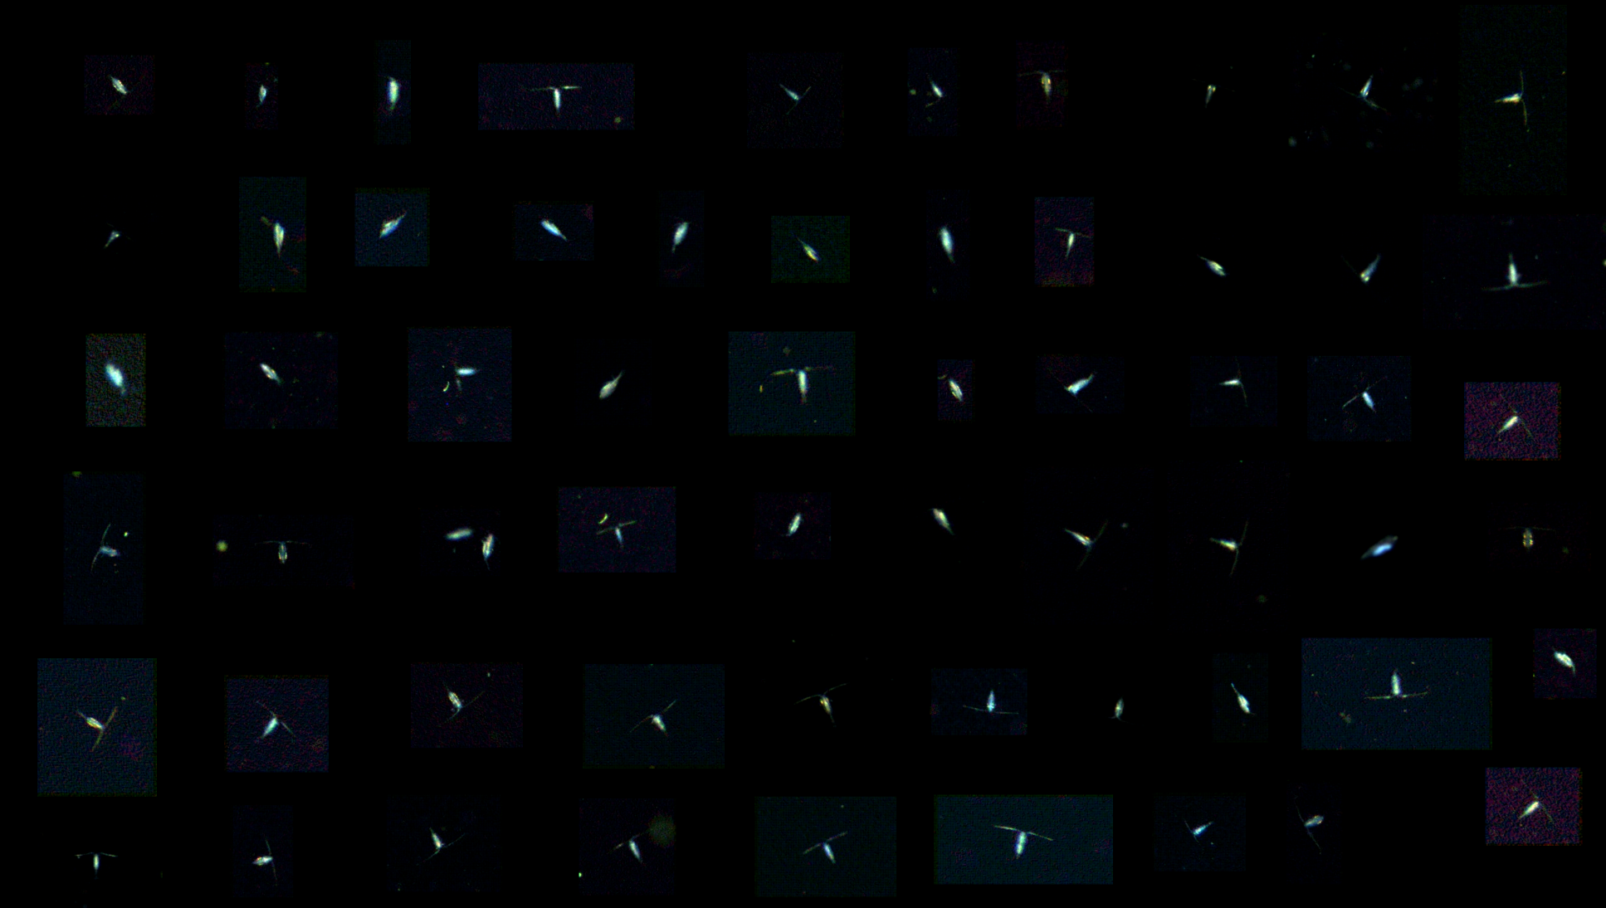
Imaging Capabilities
Detection of objects: 2 mm to 20 cm
Detection of particles: 0.4 mm to 20 cm
20 mm
10 mm
Chiton
Lombard et al. 2019
5 mm
Notes:
The resulting image data (after demosaicing the bayer pattern and enhancing contrast look like the examples to the right. Talk about size classes and object types, emphasize the large objects
On the left we show where Chiton images compare to a wide range of other imaging systems that were enumerated by Lombard et al. in 2019
Of special note is that Chiton covers a relatively wide size range biased to larger, less common objects with a considerably large imaged volume compared to other instrumets that can integrate on an AUV

